Slide 1













Thank you to our Sponsors
#EquallyWellAu22

Slide 2

Peer Interventions for Physical Health Outcomes in Schizophrenia
Centre for Complex Interventions, CAMH
March 2022

Slide 3
Background & Rationale
Issue to Address:
Individuals with schizophrenia spectrum disorders are disproportionately affected by chronic diseases and physical health problems due to a combination of lifestyle, physiological, and social factors
    E.g., Obesity, Diabetes, Hypertension
Some antipsychotics have a large metabolic footprint
Results in an increased risk for premature mortality: lifespan shortened by 15 to 20 years

Slide 4
Cardiometabolic profile by age and sex
Risk status threshold
General population
People with psychotic disorder
Waist circumference (b) and triglycerides (e) (below the risk threshold is better)
from Foley D et al. Cardiometabolic risk indicators that distinguish adults with psychosis from the general population PLoSONE, 2013, 8, e82606

Slide 5
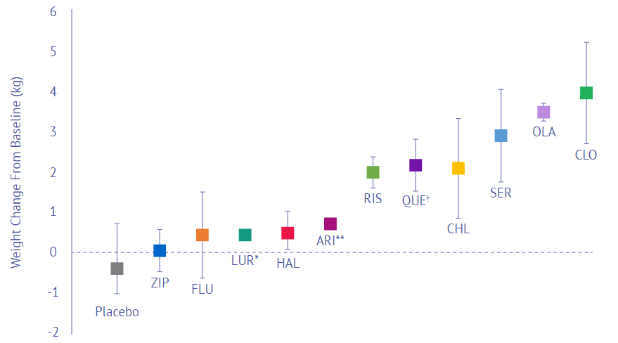
Mean change in weight after 10 weeks of antipsychotics
ZIP: Ziprasidone; FLU: Fluphenazine; LUR: Lurasidone; HAL: Haloperidol; ARI: Aripiprazole; RIS: Risperidone; QUE: Quetiapine; CHL: Chlorpromazine; SER: Sertindole; OLA: Olanzapine; CLO: Clozapine.
*Data pooled from short-term, placebo-controlled studies²; **4-6 week pooled data³;†6-week data.
Allison DB, et al. Am J Psychiatry. 1999;156(11):1686-1696. 2. LATUDA® (lurasidone HCl) Approved Product Information. 3. Marder SR, et al. Schizophr Res. 2003;61(2-3):123-136.

Slide 6
Peer interventions
Peer Interventions:
Peers, also called ‘Individuals with Lived Experiences’, use their experience with mental illness to empower and mentor individuals with similar conditions, in an effort to improve physical and psychological outcomes in serious mental illness.
Preliminary research suggests that peers may provide individual or group-based services for the purposes of:
      Psychoeducation
      Social support, encouragement and motivation
      Development of targeted interventions specific to various mental health disorders
      Facilitation of interventions

Slide 7
Evidence for Peer Facilitated Interventions in SMI
The inclusion of peer facilitators in interventions for serious mental illness and/ or chronic disease have been shown to improve the following outcomes:
Illness self- management
Medication adherence
Navigation of health care system
Patient-physician relationships
Quality of life
Self-efficacy
Hope, Recovery and Empowerment
Physical Activity
Pain severity
Glycemic control
Blood Pressure
Weight/BMI/Waist circumference
(Lloyd-Evans et al., 2014; Cabassa et al., 2016; Stubbs et al., 2016)

Slide 8
Peer Intervention Facilitators- Pros and Cons
Pros:
Aid in the development of interventions by peers may allow for more targeted and accessible interventions, potentially improving outcomes
More effective engagement with targeted populations due to shared experiences
May be cost-effective
Can facilitate equal and empathetic relationships between peers and participant
Expansion of individuals able to deliver interventions (not limited to clinicians)

Slide 9
Peer Intervention Facilitators- Pros and Cons
Cons:
Varying degrees of lived experience and recovery may affect consistency of delivered interventions
Varying degrees of experience in domains of coaching, motivational interviewing, previous experience in study settings, etc. may also affect outcomes
No consistent definition of peer across the literature
Training pre-study initiation also differed across literature

Slide 10
Systematic Review & Meta-Analysis
Coles et al., 2022 under review at MJA
Review of 12 RCTs of peer facilitated interventions for physical health outcomes in schizophrenia
Results Overview:
8 of 12 interventions showed improvement in at least one physical health domain at post-intervention, compared to TAU
The following outcomes saw most significant improvements:
  Physical Health
  Physical Activity
  Healthy Eating
  BMI
Interventions that targeted physical activity were the most consistently effective
    Most studies included weekly group aerobic exercise classes facilitated by peer facilitator
    Delayed onset of physical activity improvements (i.e., non-significant at study end, but significant at follow-up)
    May be greater benefit from the co-facilitation by both a peer specialist and mental health clinician, rather than peer-alone
Maintenance of effects at study follow-ups were inconsistent

Slide 11
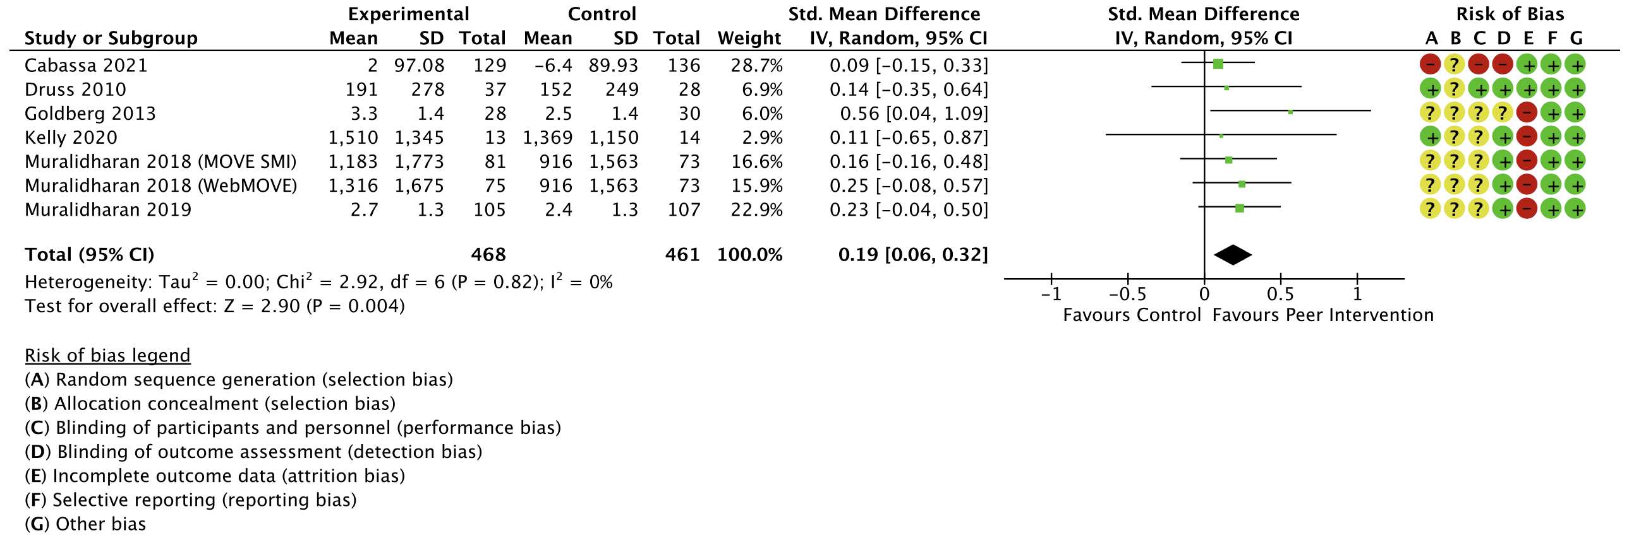
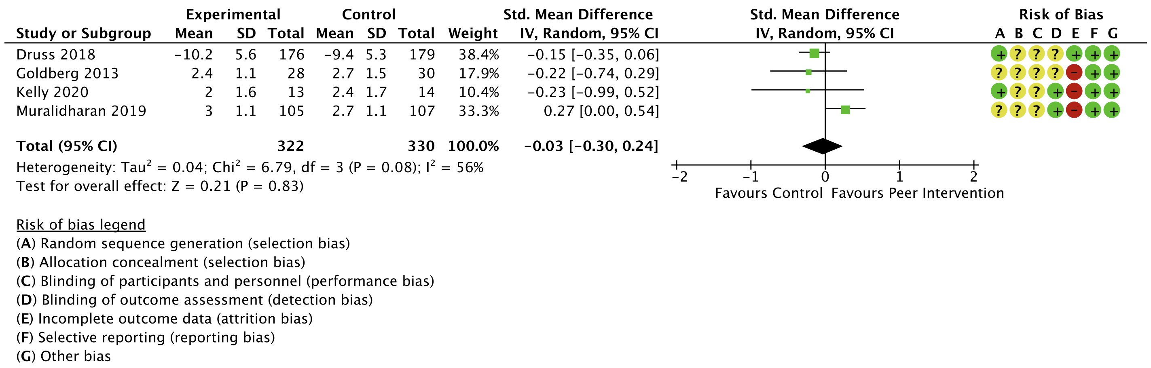
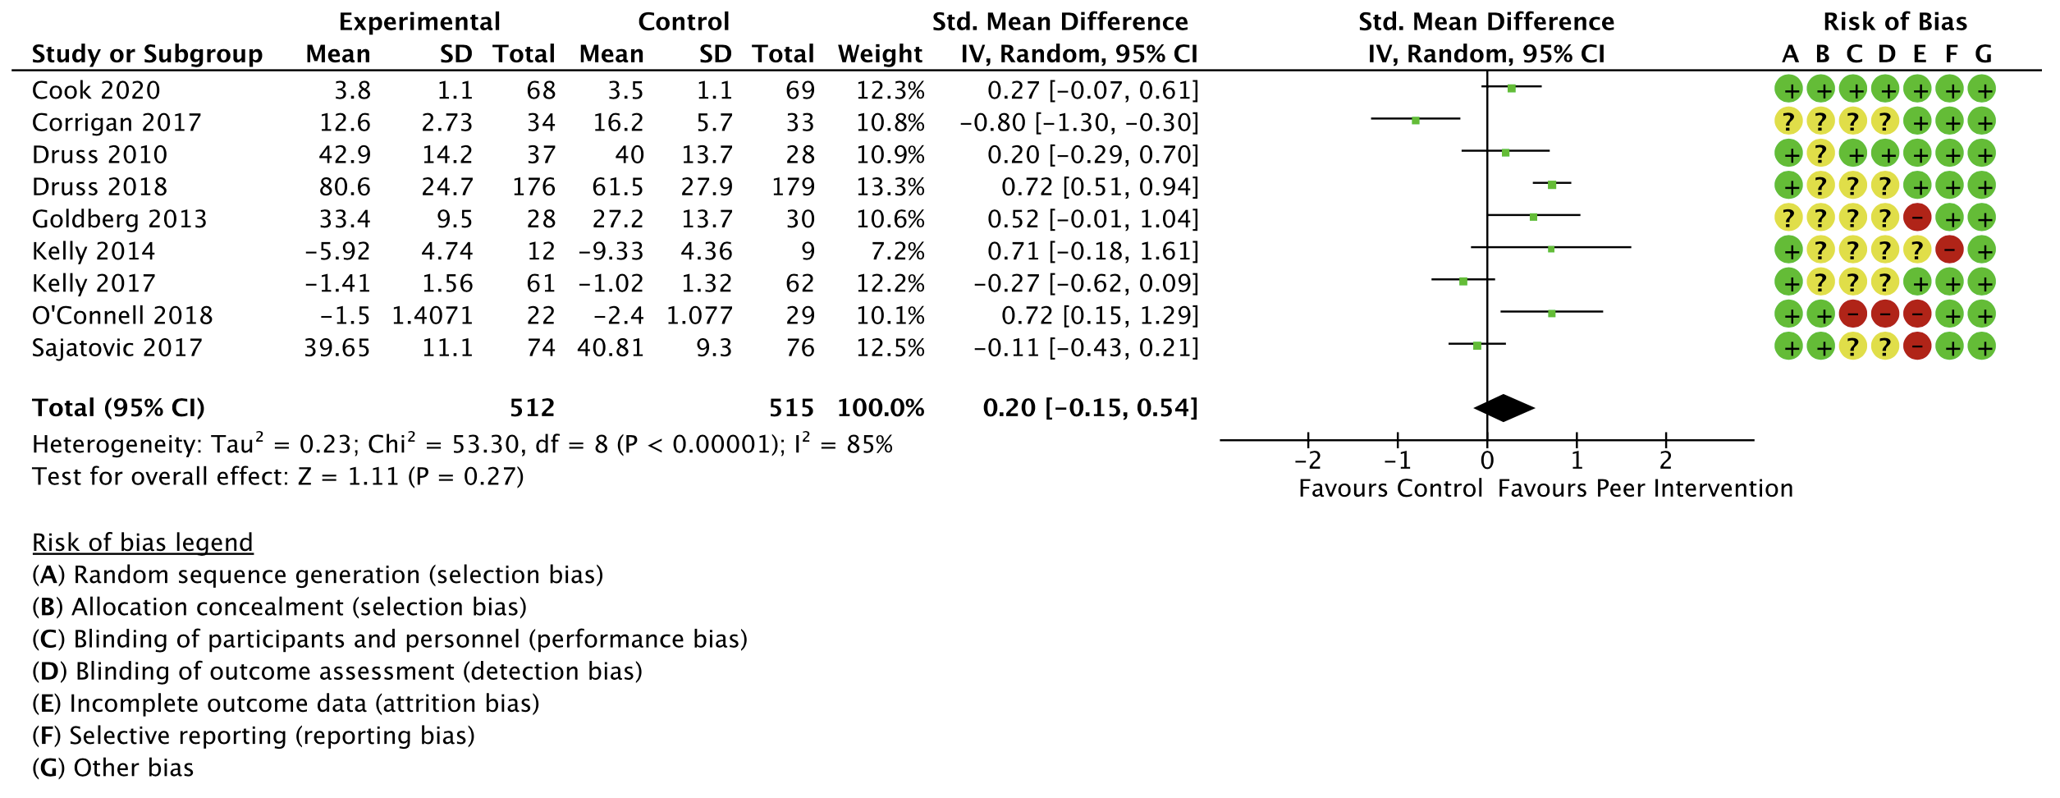
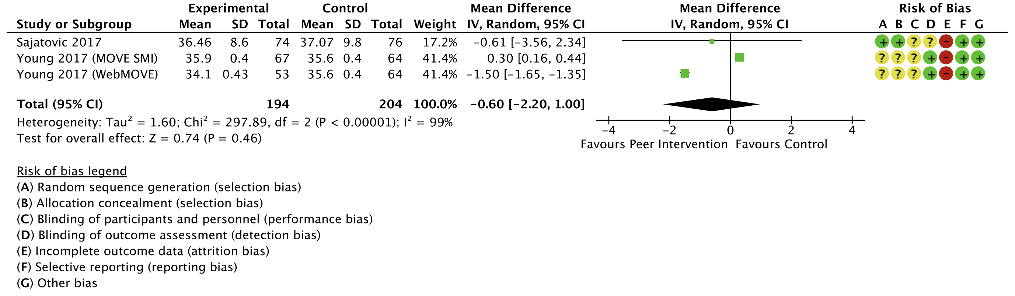
Systematic Review & Meta-Analysis- Forest Plots
(A) Physical Activity
(C) Healthy Eating
(B) Physical Health
(D) BMI

Slide 12
Peer Intervention Study at CAMH
Setting: The CAMH Metabolic Clinic
Design: Open-label, feasibility pilot trial (RCT to follow)
Sample: 5-8 outpatients with schizophrenia or schizoaffective disorders
Primary Objective: Feasibility and acceptability of peer facilitated intervention
Secondary Objectives: Measurable, long-term improvement in targeted physical health outcomes such as:
    Weight/ BMI
    Blood pressure
    Diet & nutrition
Inclusion Criteria:
18 years+ Ontario resident enrolled in the CAMH metabolic clinic
DSM-5 or ICD-10 diagnosis of schizophrenia or schizoaffective disorder
Internet access

Slide 13
Peer Intervention Study at CAMH-Outcomes & Assessments
PHYSICAL HEALTH OUTCOMES | MEASURE
Physical Activity Levels | SIMPAQ
 | Pedometer
Group Exercise | Number of weekly group exercise sessions attended
CVD Risk | PsyMetRic
Changes in weight/BMI | Change in lbs
Metabolic parameters: HBA1C Fasting Glucose Fasting Insulin | Blood sample collection
Diet & Nutrition Changes | Diet log (RedCap), Number of fruit and vegetable servings per day
CLINICAL OUTCOMES | MEASURE
Psychiatric Symptoms | BPRS
 | CGI
Group Exercise | HAM-D
Outcome measurement at 3 timepoints:
Baseline
3 months
6 months (Follow-up)

Slide 14
Peer Intervention Study at CAMH- Proposed Interventions
Weekly Psychoeducation Modules x 1 hour
  Co-facilitated by peer facilitator and clinician
  Virtual or in-person
Weekly optional aerobic exercise class
  Co-facilitated by peer facilitator and clinician
  Virtual or in-person
1:1 Peer coaching sessions x 1 hour weekly
  Virtual
  Purpose: support, goal discussion, progress tracking etc.
  Potential for adjunct weekly text message exchanges
RedCap Platform Use/ Access
  Complete assessments
  Goal setting and tracking
  Food log
  Access to resources

Slide 15
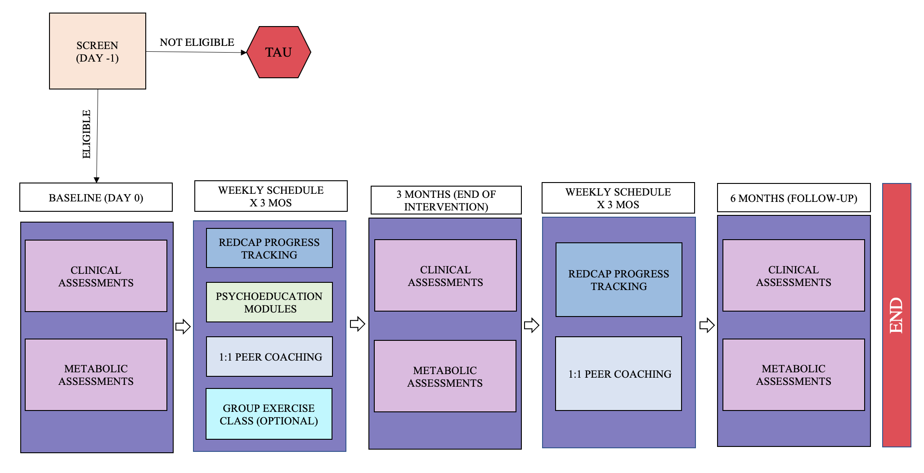
Peer Intervention Study at CAMH- Study Design

Slide 16
Peer Intervention Study at CAMH- Psychoeducation Modules
WEEK 9: SUPPORT SYSTEMS
Weekly goal discussion
Socializing importance
Reaching out to friends and family
Maintaining relationships
WEEK 10: SELF-CARE
Self-care habits
Hygiene practices
Self-care & mental wellness
WEEK 11: HEALTHCARE SYSTEM NAVIGATION
Making appointments
How to talk to you doctor and self-advocate
Available resources in Ontario and at CAMH
WEEK 12: GRADUATION
Session conclusion
Celebration of goals reached, and progress made
Key takeaways
WEEK 1: SESSION INTRODUCTION
Weekly goal discussion
Impact of lifestyle interventions on symptoms
and health
Setting realistic and achievable goals
RedCap navigation
Problem solving skills
WEEK 2: NUTRITION
Weekly goal discussion
Inflammatory foods to avoid
Whole food benefits
WEEK 3: DIET
Weekly goal discussion
Grocery shopping on a budget
Hydration
Easy meals/ recipes/ cooking class?
WEEK 4: PHYSICAL ACTIVITY
Weekly goal discussion
Types of physical activity
Low impact options
Cons of sedentary behaviour
Stretching
WEEK 5: SLEEP
Weekly goal discussion
Sleep importance for health
Consequences of reduced sleep
Sleep hygiene
Sleep strategies
WEEK 6: STRESS MANAGEMENT
Weekly goal discussion
Mindfulness & Meditation techniques
Stretching & Deep breathing
Exercise
List making of tasks to complete
Organize your space
Reduced screen time
WEEK 7: MEDICATION
Weekly goal discussion
What is available
Side effects
Importance of adherence and strategies to stay on track
WEEK 8: CHRONIC DISEASE SELF-MANAGEMENT
Weekly goal discussion
Specific strategies geared toward everyday management of chronic disease
Total number of modules= x 12 weeks
Sessions 2-12= weekly goal setting

Slide 17
Peer Intervention Study at CAMH- Peer Facilitator Roles
Two part-time individuals with lived experience to act as peer facilitators throughout study
Individuals with experience in health coaching, motivational interviewing, etc are preferred
Responsibilities:
Work closely with research team to create and plan intervention & related aspects
Complete TEACH course prior to study initiation to ensure adequate understanding of modifiable risk factors in patients with schizophrenia
  Course: Integrated Chronic Disease Management and Prevention Course
  A facilitator-led, online specialized course created by CAMH’s Peter Selby and group, which allows learners to increase their knowledge about modifiable risk factors (the six pack) and their relationship to health outcomes in mentally ill populations.
Co- facilitate weekly psychoeducation modules and weekly exercise class
1:1 coaching weekly & participant text messaging

Slide 18





Diet

Slide 19

Exercise (Falkai et al. 2013)

Slide 20
Thank you!
Questions & Comments?
Selected References:
Cabassa, L. J., Camacho, D., Vélez-Grau, C. M., & Stefancic, A. (2016). Peer-based health interventions for people with serious mental illness: A systematic literature review. Journal of Psychiatric Research, 84, 80–89. https://doi.org/10.1016/j.jpsychires.2016.09.021
Lloyd-Evans, B., Mayo-Wilson, E., Harrison, B. et al. (2014). A systematic review and meta-analysis of randomised controlled trials of peer support for people with severe mental illness. BMC Psychiatry, 14, 39.
Stubbs, B., Williams, J., Shannon, J., Gaughran, F., & Craig, T. (2016). Peer support interventions seeking to improve physical health and lifestyle behaviours among people with serious mental illness: A systematic review. International Journal of Mental Health Nursing, 25(6), 484–495. https://doi.org/10.1111/inm.12256

