Slide 1













Thank you to our Sponsors
#EquallyWellAu22
Notes:
Add your name and introduce yourself
Also let people know about following us on social media – all handles on last slide

Slide 2

Lifestyle and Cardiology for People with Mental Illness
12th April 2022 Version
Griffith University, Gold Coast Campus
A/Prof David Colquhoun
University of Queensland
Wesley & Greenslopes Hospitals
Brisbane, Australia
d.colquhoun@uq.edu.au

Slide 3
Patients with severe mental illness have high rates of vascular disease. (Poor assessment of CVD risk factor)
Patients with CVD have high rates of poor assessment depression anxiety and PTSD

Slide 4
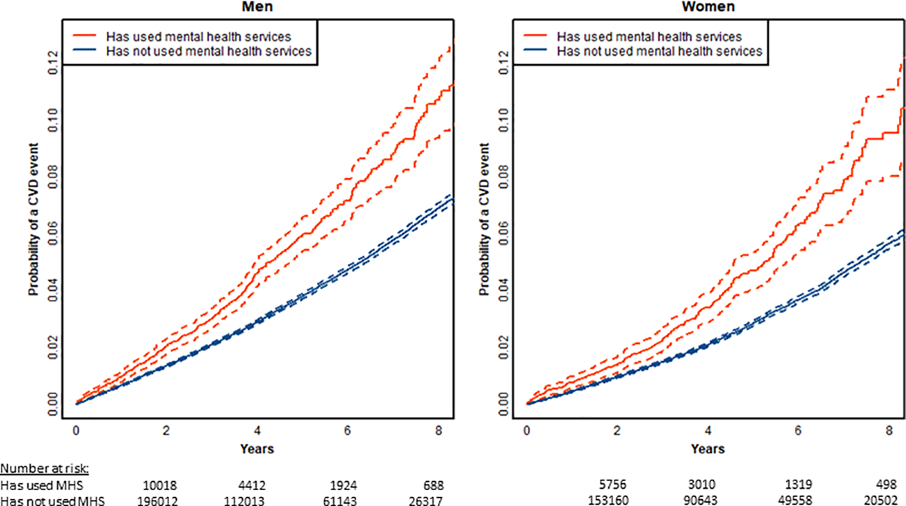
CVD risk in people with severe mental illness.
R.Cunningham… R.Jackson et al. Prediction of CVD risk… PLoS ONE 14(9): e0221521 ; Septermber 2019

Slide 5
SADHART
Sertraline Antidepressant Heart Attack Randomised Trial
- USA, Canada, Australia
369 Depressed pts with ACS
Depression on HAM-D, BDI-I, interview
Randomised during admission Sertraline or Placebo
24 week follow-up
Glassman JAMA 2002; 288:801-9

Slide 6
SADHART: Cardiovascular Event
Relative risk for sertraline vs. placebo
0 0.5 1 1.5 2 2.5
Event Relative risk (95% CI)
Death 0.39 (0.08 – 1.39)
Myocardial 0.70 (0.23 – 2.16)
infarction
Stroke 0.98 (0.14 – 6.93)
Worsened 0.85 (0.53 – 1.38)
Angina
Congestive 0.70 (0.23 – 2.16)
Heart failure
Composite* 0.77 (0.51 – 1.16)
0 0.5 1 1.5 2 2.5
* Composite consists of combination of 5 individual events
Relative risk for sertraline vs. placebo
Swenson JR (Colquhoun – Investigator) Am J Cardiol 2003 92;11:1271-76

Slide 7
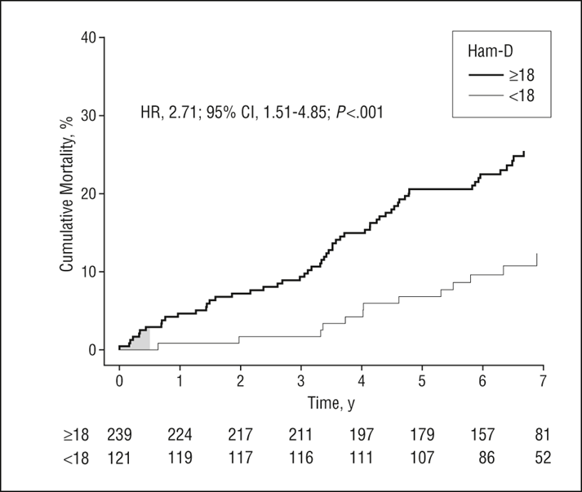
Long Term Mortality Among 361 Patients Having an Acute Coronary Syndrome and Major Depression
n= 361 of original 369 patients.
Randomised to sertraline or placebo for 6 months
“substantial mood improvement at 6/12 regardless of treatment had significant lower mortality (at 7 years).
16% vs 28% HR 2.4 (1.5-3.8)
Alexander H. Glassman, MD; J. Thomas Bigger Jr, MD; Michael Gaffney Arch Gen Psychiatry. 2009;66(9);1022-1029

Slide 8
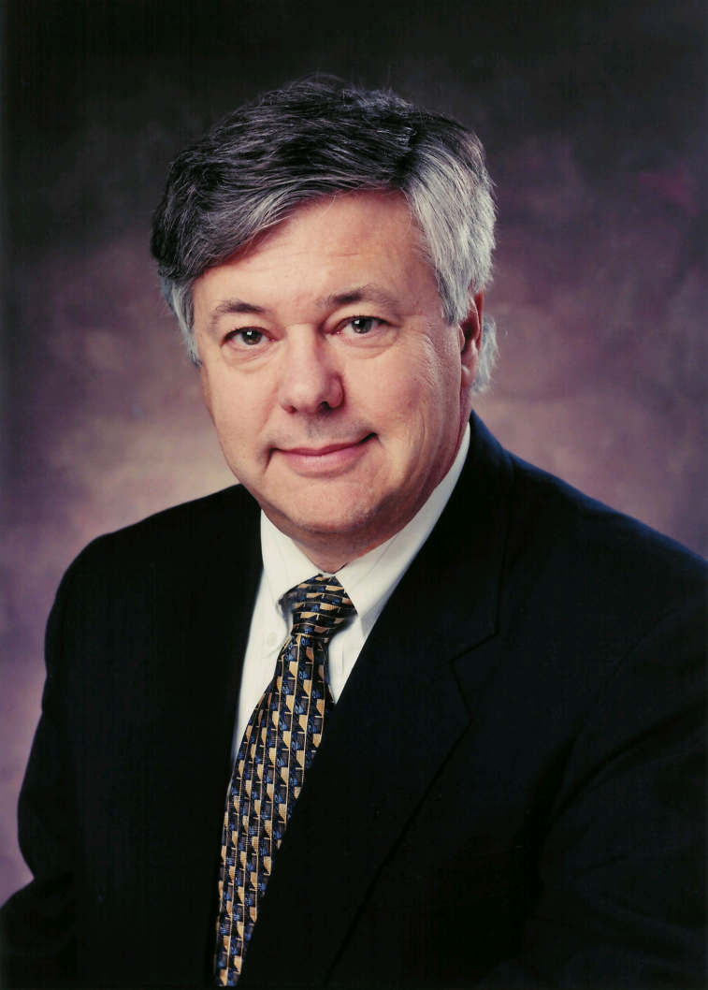
Professor Michael Brown Nobel Prize Winner for Medicine with Joseph Goldstein in 1984 “for their discoveries concerning the regulation of cholesterol metabolism including LDL Receptor”
“An elevated
Low Density Lipoprotein-cholesterol (LDL-C) is the primary risk factor (cause) of atherosclerosis”
Plenary Lecture
European Atherosclerosis Meeting
NICE France, May 1992

Slide 9
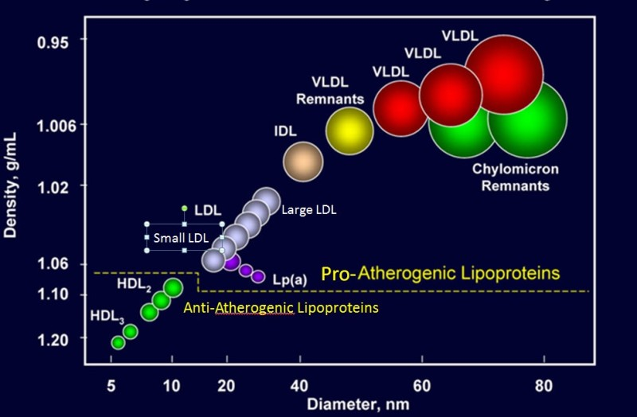
Goldstein JL & Brown MS. A century of cholesterol and coronaries: from plaques to genes to statins. Cell 2015; 161(1): 161-172

Slide 10
CHD Risk Factors are Universal
“force depends on culture, gender and time” ₆
Classic biological_{1&2} -Cholesterol, BP (>160/95mmhG), ECG-LVH (2-3times)
-Gender, Age, Educational status & Smoking
Other Biological - Lipids: LDL-C, Triglycerides, HDL-C, Lp(a), Omega-3 Index
Genetic Lipid Disorders : FH, Familial combined Hyperlipidemia, Type 3, Lp(a)
-Diabetes
-Renal impairment, inflammation, Omega 3, ethnicity, short stature, male pattern baldness & Frank’s sign.
Psychosocial_{3&4} - Mental illness – depression, PTSD, anxiety, schizophrenia.
-Social Isolation & Socioeconomic Status
Other Lifestyle₅ -Obesity, alcohol (+ /- dose), exercise, diet, pollution.
Combination of Chol, BP, LVH - Risk of CHD over 6years 3.6%→50%
At least 50 well defined risk factors/markers for CHD
₁Dawber TR, et al. Some Factors Associated with the Development of Coronary Heart Disease–Six Years’ Follow-Up Experience in the Framingham Study. Am J Public Health Nations Health 1959; 46(10): 1349-1356
₂Kannel WB, Dawber TR et al. Factors of risk in the development of Coronary Heart Disease – Six Year Follow-up Experience. The Framingham Study. Am Intern Med. 1461; 55: 33-50
₃Bunker SJ, Colquhoun DM, et al. NHFA. “Stress” and coronary heart disease: psychosocial risk factors. NHFA Position Statement Med J Aust 2003; 178: 272-276.
₄Colquhoun DM, Bunker SJ, Clarke DM, et al. NHFA. Screening, referral and treatment for depression in patients with coronary heart disease. Med J Aust 2013; 198: 483-484
5Glozier N, Tofler G, Colquhoun D Psychosocial risk factors for coronary heart disease. (NHFA) Med J Aust 2013; 199: 179-180 5Aug2013
₆Keys A. Coronary heart disease in seven countries. Summary.Circulation. 1970 Apr;41(4 Suppl):I186-95.

Slide 11

Psychosocial Factors in Vascular Disease
Acute and Chronic Stress
Mood Disorder
Depression and anxiety
Schizophrenia
Posttraumatic Stress Disorder
Social Isolation
Economic Status
Persistent moderate-sever distress 2x risk of total mortality over 12 years₍₁₎
₍₁₎BMJ Wednesday, 21st June 2017 @ 23:30 embargo lifted!

Slide 12
Interheart Myocardial Infarction Case-Control Study
In 52 Countries 15,152 cases and 14,820 controls.
9 RISK FACTORS account for 90% PAR in men 94% in women
Risk factors are universal - “relative importance …..largely related to its prevalence.
Raised LIPIDS, SMOKING, and PSYCHOSOCIAL factors were the most important risk factors in ALL REGIONS IN THE WORLD”.
Psychosocial factors were a composite of depression and perceived stress (marital, work, financial)
Yusef S et al. “Effect of potentially modifiable risk factors associated with myocardial infarction” Lancet 2004;364:937-52

Slide 13
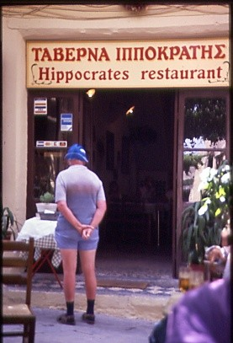

Slide 14
PREvencion con DIeta MEDiterranea (PREDIMED)
Men 55 – 80 years, women 60 – 80 years
Free of CVD at baseline
Diabetes or ≥3 risk factors:
smokers,
high BP ≥ 140mmHg,
LDL-C ≥4.1mMol/L or on lipid lowering drugs,
HDL ≤1.0mMol/L in men, in women <1.3mMol/L,
BMI ≥25,
Family history of premature CHD
Martinez-Gonzalez MA. Corella D. Salas-Salvado J. et al. Cohort Profile: Design and methods of the PREDIMED study. Int. J. Epidem 2012; 41:377 – 385.

Slide 15
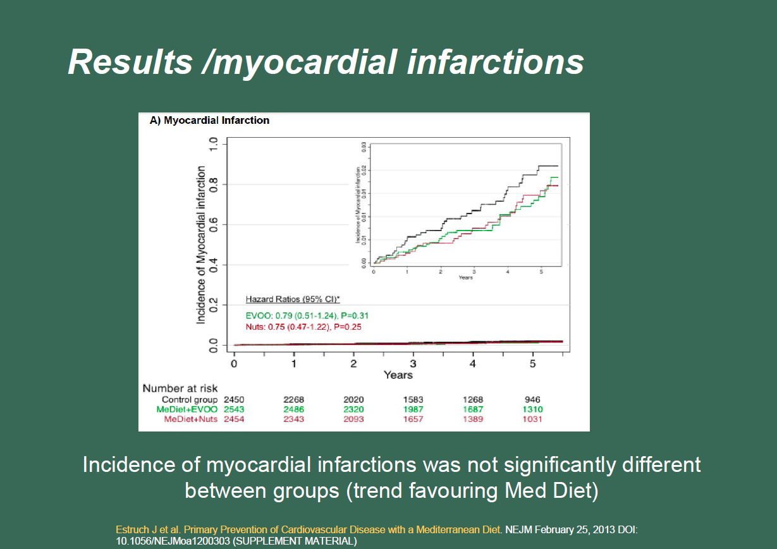

Slide 16
PREDIMED Trial New Onset Depression
Depression is a major risk factor for first and recurrent CHD
Patients included were:
not depressed at baseline
not on antidepressants
Greater than 3 year follow-up – n=3923 patients
New cases – n=224, reported by a physician or by use of an antidepressant drug
Inverse relationship between Med Diet and depression
HR 0.38 (0.6/0.8 – 1.1)
In diabetic HR 0.6 (0.4 – 0.96: n=0.04) for Nut Med Diet
Sanchez-Villegas A. Martinez-Gonzalez MA. Estruch R. et al. Mediterranean dietary pattern and depression: the PREDIMED randomized trial. BMC Medicine. 2013. 11:208

Slide 17
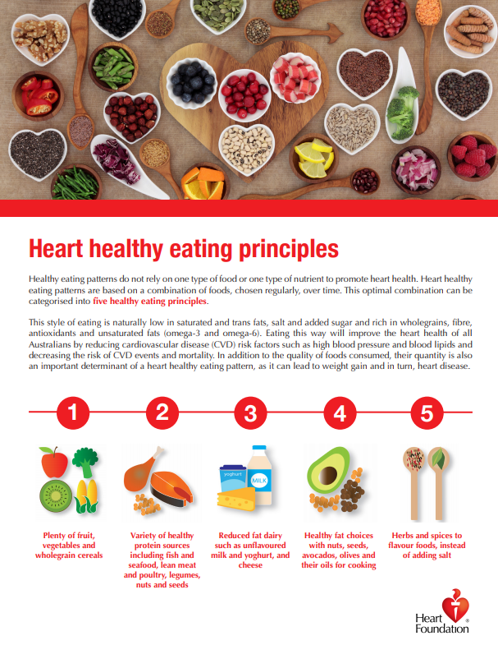

Slide 18
Omega-3 Quick Facts
EPA and DHA “essential fatty acids” and seafood the best source.
Origin is algae for almost all EPA/DHA in ecosystem.
In all cell membranes in all tissues and essential for life.
Omega-3 deficiency determined cause of vascular disease by Hugh Sinclair in 1956.
DHA dominant and very rich in neural tissue.
Omega-3 index reflects tissue levels throughout the body.
Browning L, Walker C, Mander A, et al. Incorporation of EPA and DHA into lipid pools… Am J Clin Nutr 2012;96:748-58
Arterburn L, Hall E, Oken H. Distribution, interconversion, and dose response of n-3… AM j Clin nutr 2006;83(suppl):1467S-76S
Sinclair H.M. Deficiency of essential fatty acids and artherosclerosis, etc. LANCET. 1456; 270 : 381-3

Slide 19
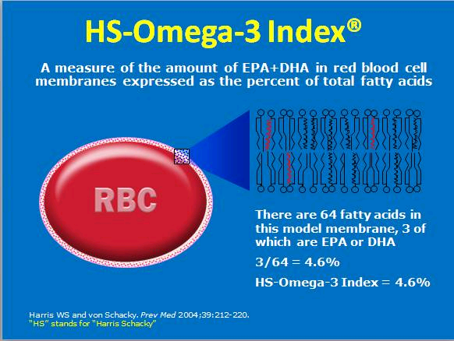

Slide 20
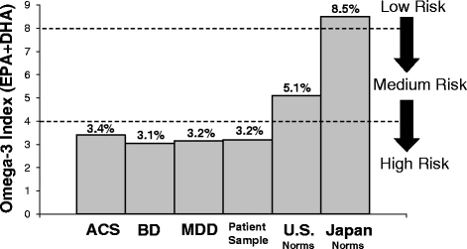
Omega-3 Index in Patient Groups
ACS = Acute Coronary Syndrome
BD = Bipolar Disorder
MDD = Adolescent Group
Messamore E, McNamara R Detection and treatment of omega-3 fatty acid
Psychiatric Practice: Rational and Implementation Lipids in Healthcare and Diease 2016; 15:25

Slide 21
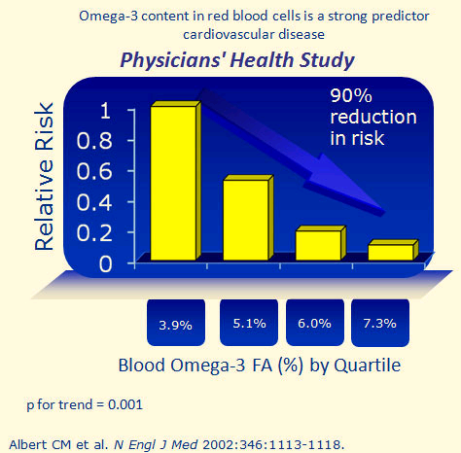

Slide 22
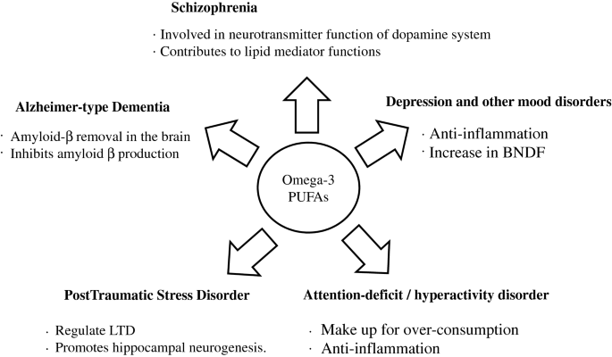
Mental Illness and Omega-3 fatty acids

Slide 23
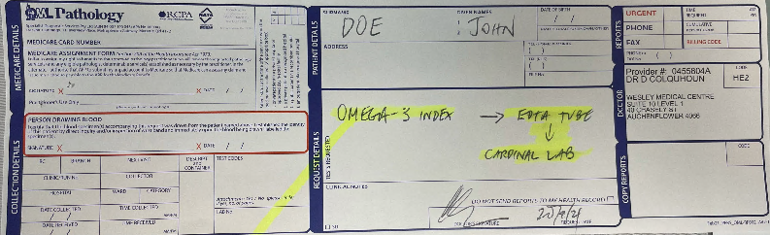
Blood Request Form

Slide 24
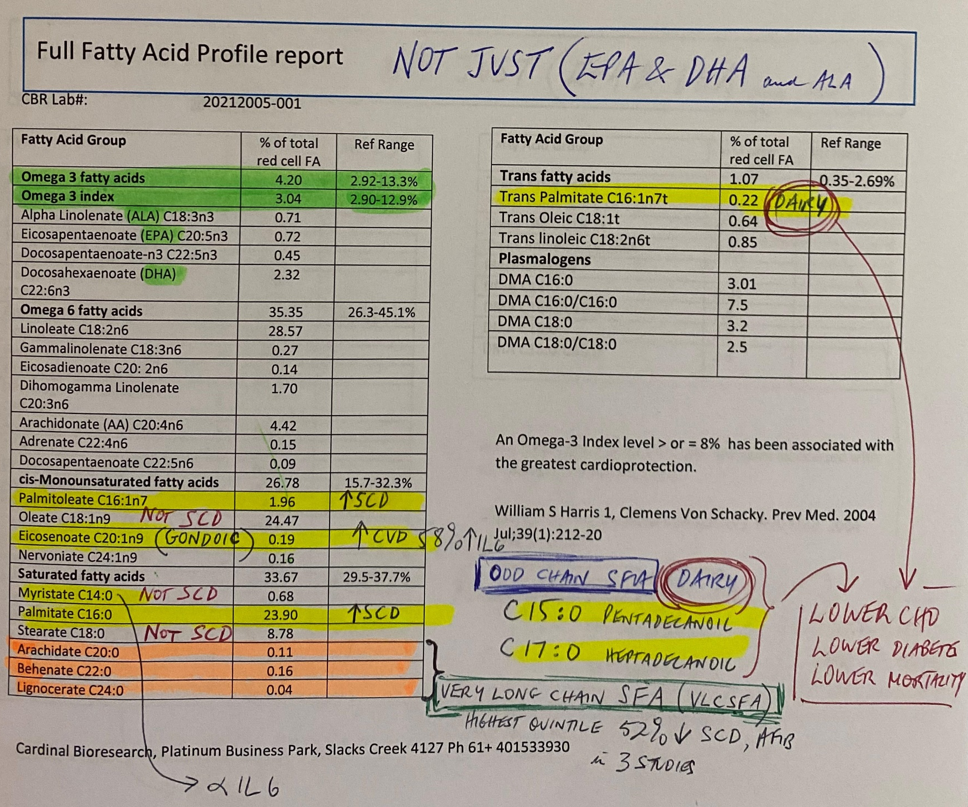

Slide 25
Primary Prevention 2021 Cardiac Investigations
Basic
Examination and history
Include PHQ 2 consider Mediterranean Diet Score
ECG
Bloods (E/LFTs + HDL, FBC, CRP, Iron Studies, Folate, B12, TSH)
Heart Age Calculator and Australian Risk Calculator
Advanced
Coronary Arterial Calcium (CAC)
NT-proBNP, Omega-3 index, Lp(a) & Apo E typing
Echo
+/- Stress Echo or Stress ECG
NHFA responsible for Heart Check MBS “interim” items (699 & 177)

Slide 26
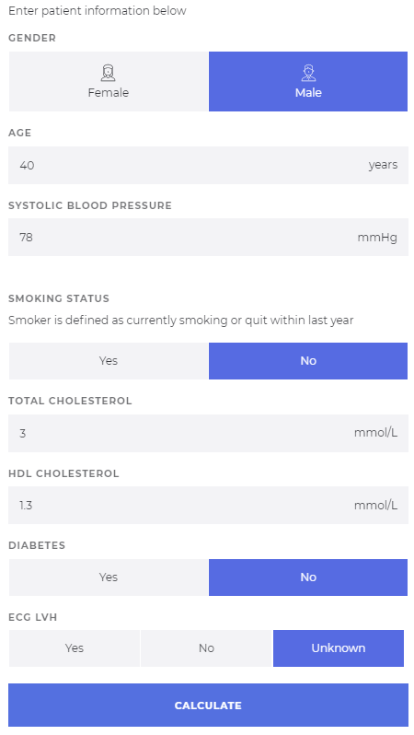
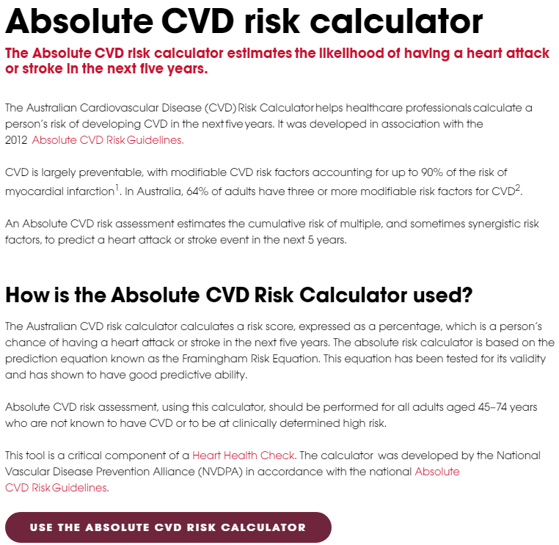

Australian
Risk Calculator

Slide 27
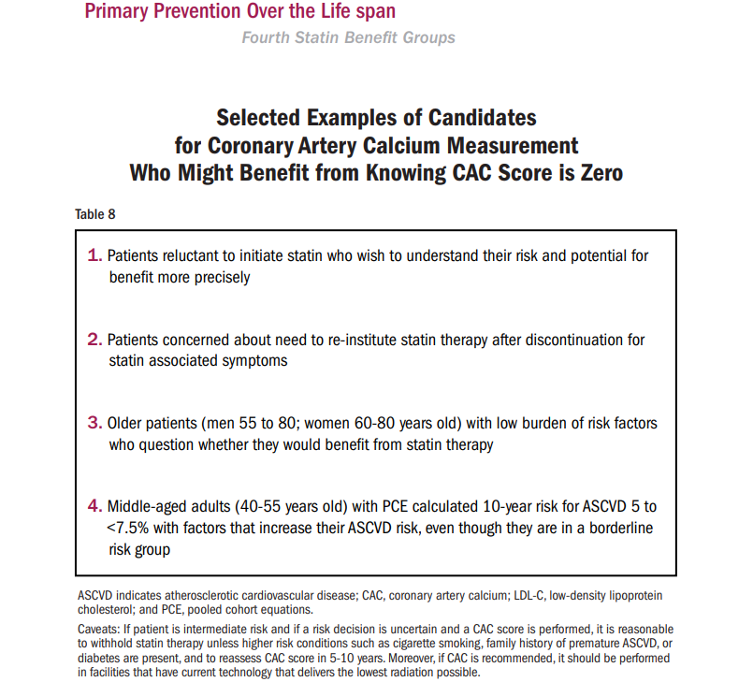
AHA/ ACC/ AACVPR Guideline on the management of blood cholesterol. Nov.2018

Slide 28
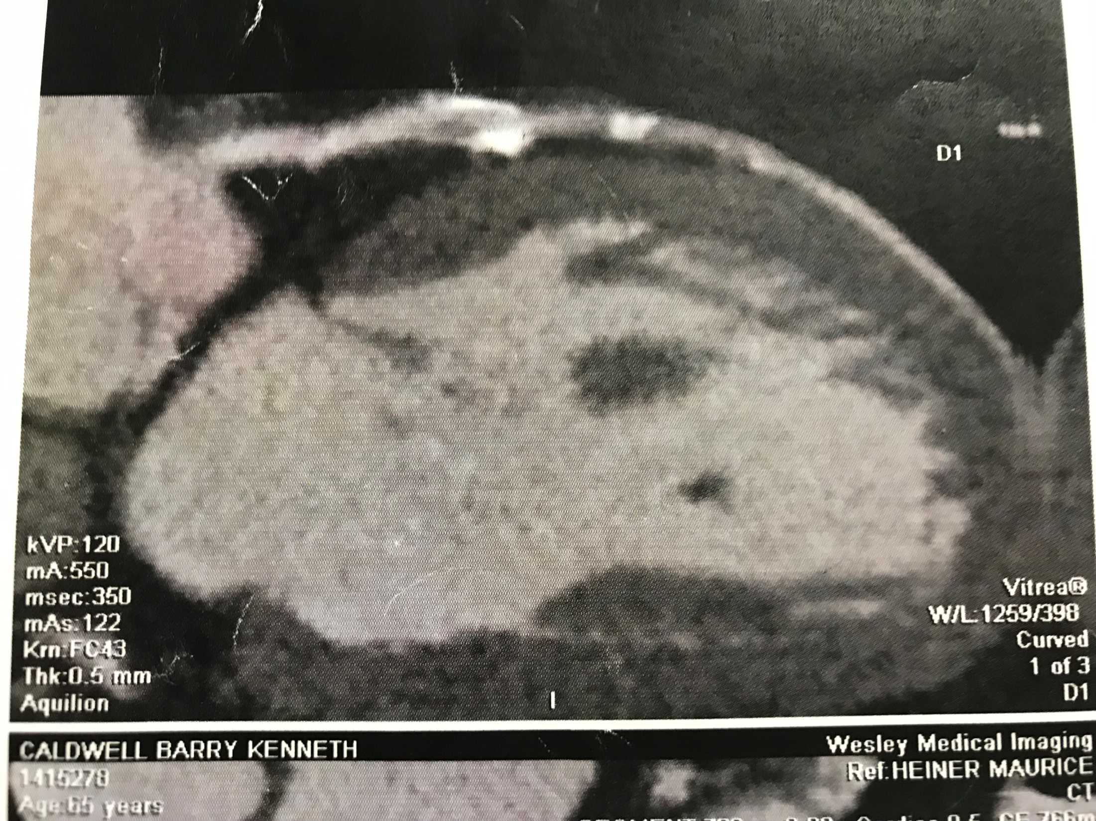

Slide 29
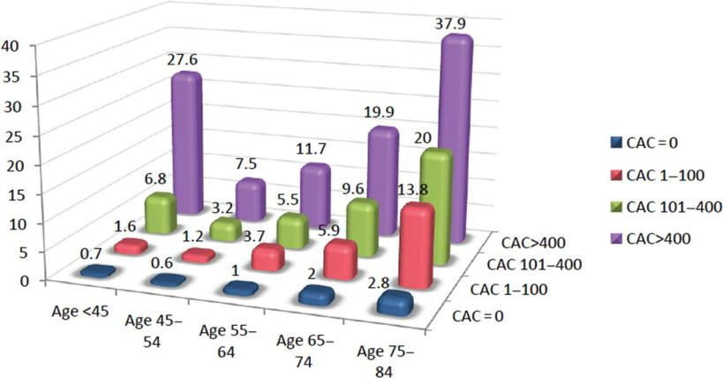
All-cause mortality per 1000 person-years,
for each coronary artery calcium category within each age group.
Rajesh Tota-Maharaj et al. Eur Heart J 2012;33:2955-2962
Published on behalf of the European Society of Cardiology. All rights reserved. © The Author 2012. For permissions please email: journals.permissions@oup.com
Notes:
All-cause mortality per 1000 person-years, for each coronary artery calcium category within each age group.

Slide 30
Lipid Targets
LDL-C <1.4mmol/L (primary or secondary)
For very high risk (subset)
<1.0mmol/L (2 or more CVD events within 2 years)
Triglycerides <2.0mmol/L
And <10mmol/L for prevention of pancreatitis
Lp(a) no targets
HDL-C no targets
Mach F. Baigent C. Catapano AL. 2019 ESC/EAS guidelines for the management of dyslipidaemias: lipid modification to recude cardiovascular risk. Atheresclerosis 2019; 290:140-205

Slide 31
Expected Treatment Benefit
CHOLESTEROL
For each 1mMol/L decrease of LDL-C 20-25% less CVD & 10% deaths
BLOOD PRESSURE
For each 10mmHg decrease Systolic BP 10-20% less CVD
DIET
1 point increase Med Diet 10-20% less CVD
OMEGA-3
2000mg EPA/DHA per day if Omega-3 Index >8% : 90% lower SCD, 30% lower mortality.
EXERCISE
Walking (moderate) 30 minutes daily 10-20% less CVD
DIABETES
Treatment with GPL-1 agonist or SGLT-2 inhibitor 20% less CVD and HF
WEIGHT LOSS
Unfortunately, treatment does not prevent CVD

Slide 32

The End

