Slide 1













Thank you to our Sponsors
#EquallyWellAu22
Notes:
Add your name and introduce yourself
Also let people know about following us on social media – all handles on last slide

Slide 2

The view from both sides
Notes:
2

Slide 3
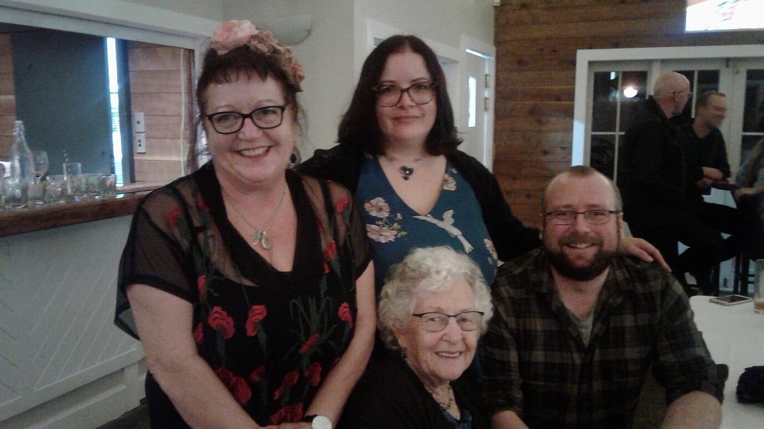
How did I get here?

Slide 4
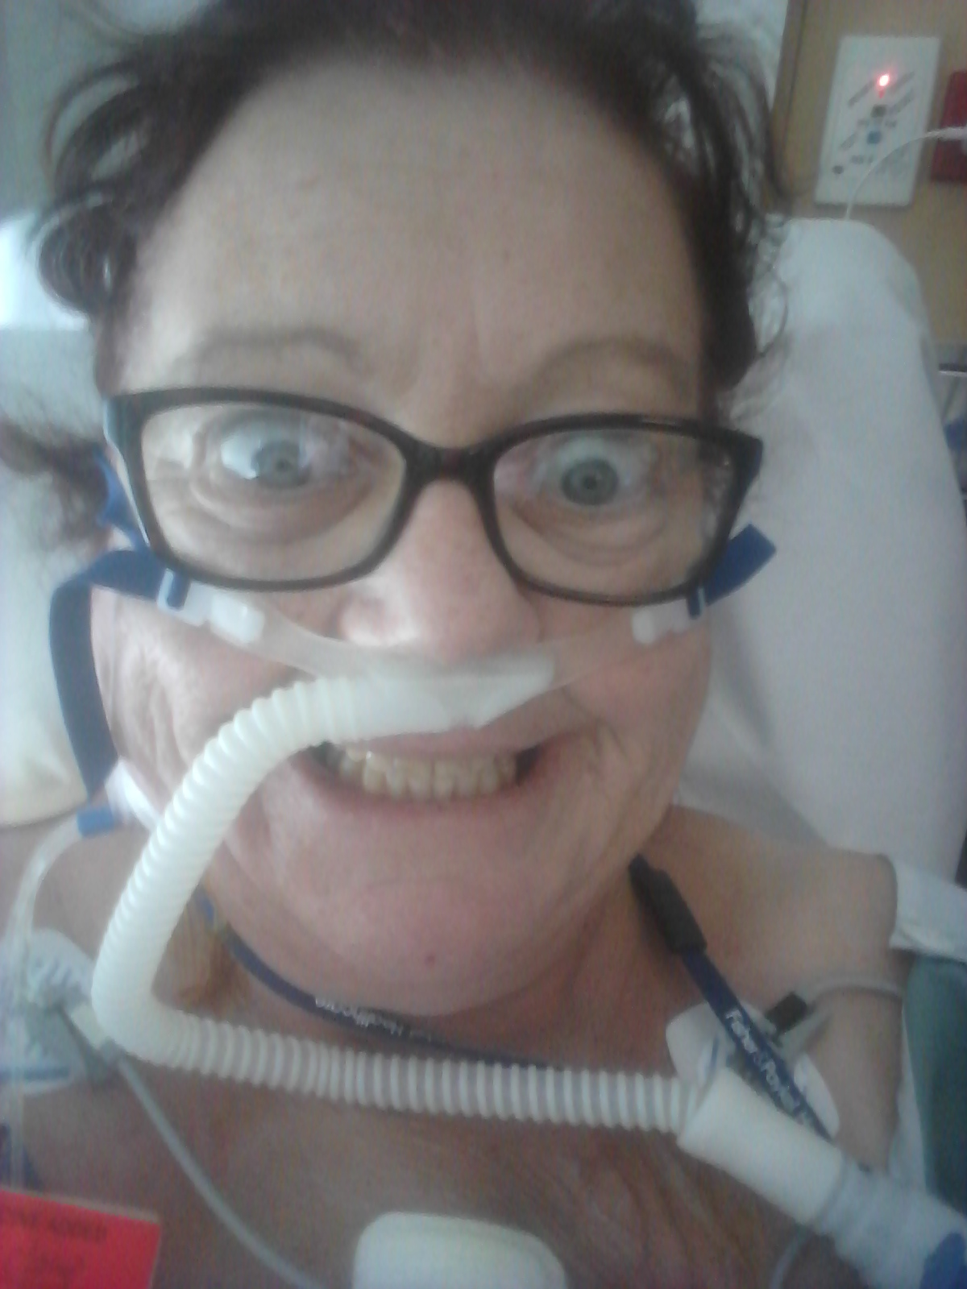
What survival looks like-

Slide 5


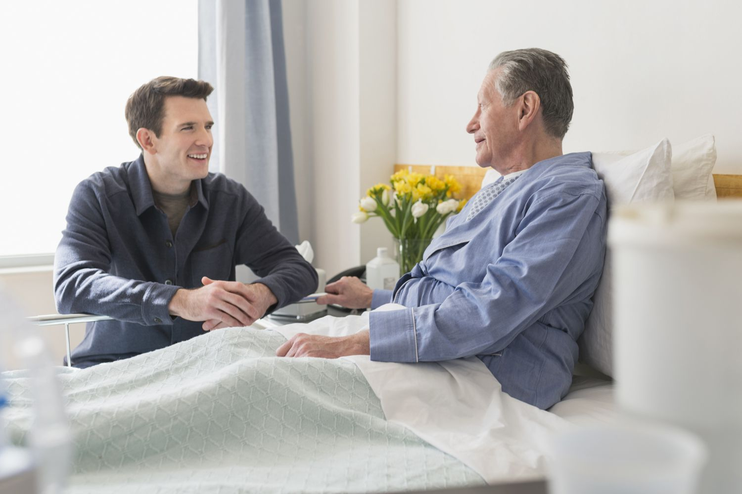
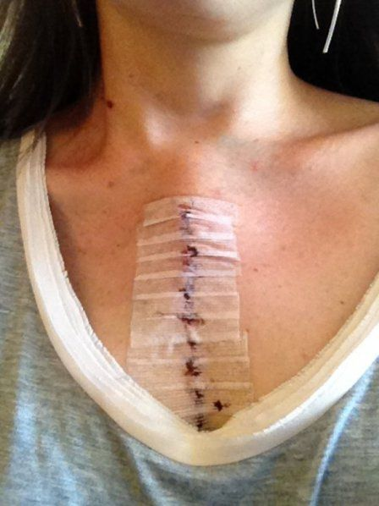
Wow, what a difference

Slide 6

That shadow thing, before and after

Slide 7
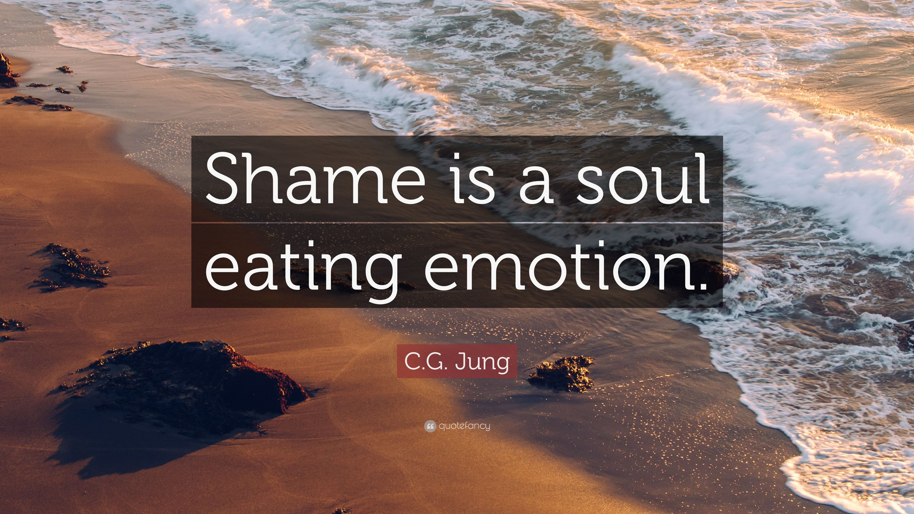
The role of shame

Slide 8
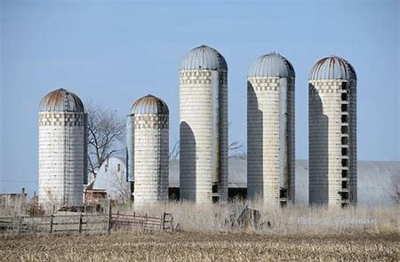
Silos work for storing grain, for people, not so much…..
Notes:
People are not silos. We are never one thing. You are not just MH and addiction nurses. You are parents, children, partners, leaders, colleagues. Every part of us impacts on other parts of us and those around us. Our identity is not one thing but many. Not static but an ever changing landscape. This is why silos don’t work for us, why treatment models don’t work all the time, for all the people. To truly support people in living with their mental health and addiction challenges, we need to understand every persons context. Pivotally what is it THEY feel they need help with, right now. The human thing- socks story

Slide 9
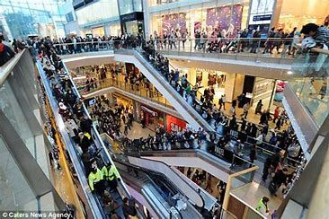
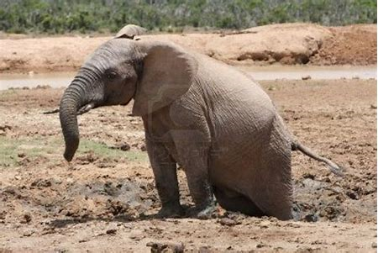
Accessing services
Notes:
But when you are managing challenges or crisis, just one of those things is unbelievably hard. Complicated, chaotic and overwhelming.

Slide 10
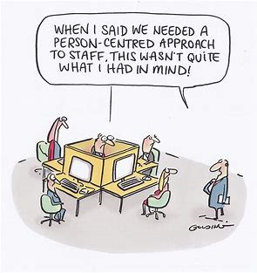
Notes:
Recovery?
Wellbeing, for all of us, is a team effort.
Participants come and go around the person and their family as needed
The missing part now, is the joined upness between mental health, addiction, physical health, family, communities and hopes for a better future.

Slide 11
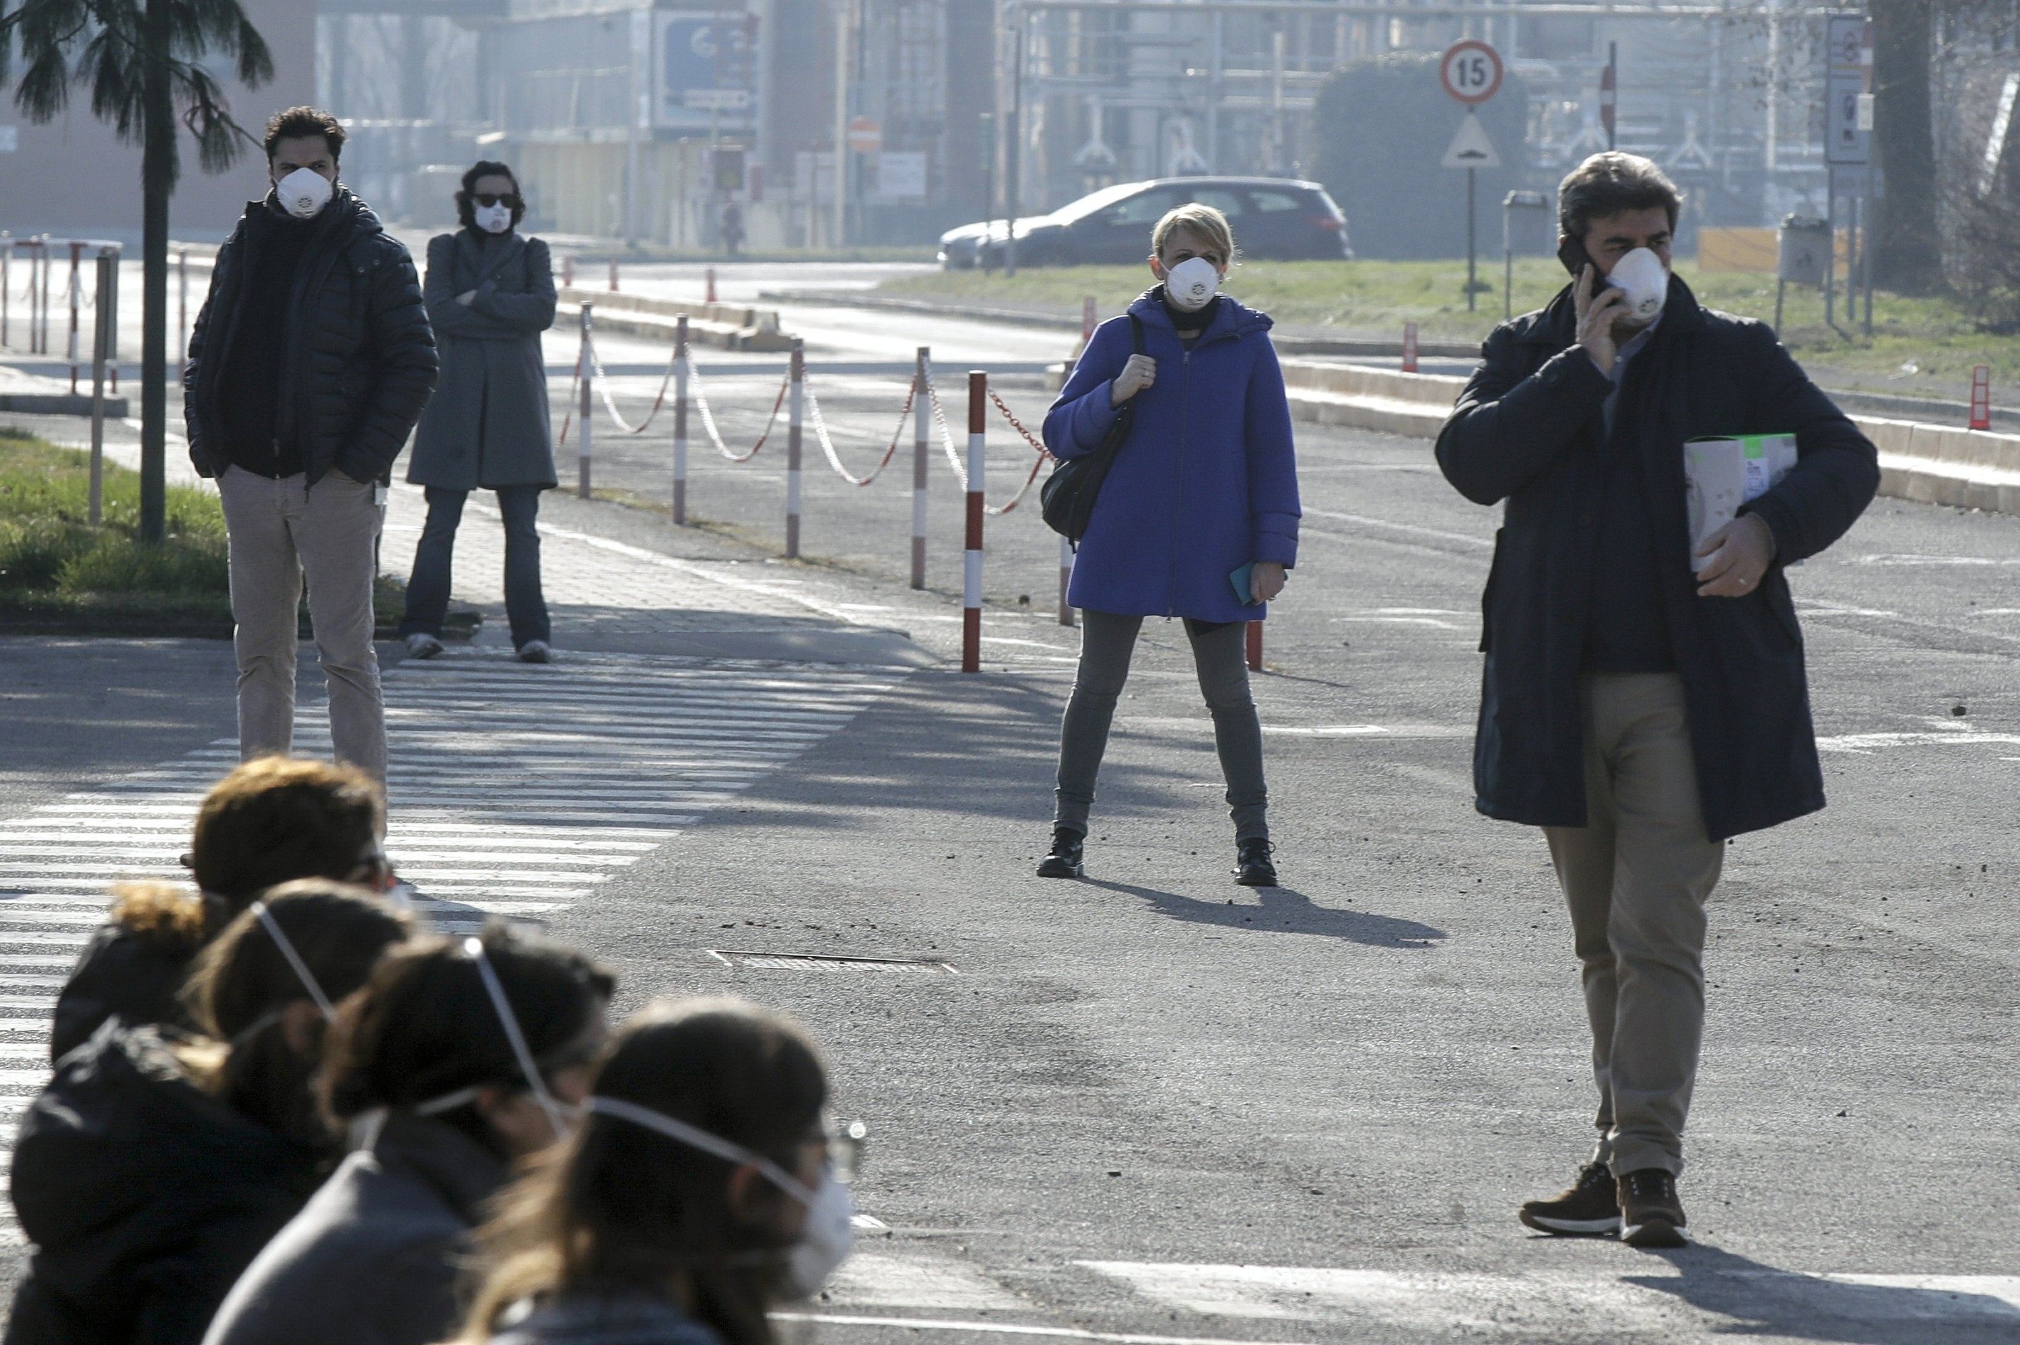
Covid 19- Raising our profile

Slide 12
LIFE ONE
Difficult childhood- Highly critical parents, some physical abuse
Feisty, sensitive and rebellious child
First episode bipolar at 18, psychosis at 21
Became a teenage unmarried mum with violent partner who had problematic alcohol use
Many job changes
Severe postnatal depression and psychosis
Marriage ended followed by several relationships
Multiple periods of serious mental health problems
Multiple access of mental health services spanning life
Major physical health problems- potentially life limiting
Single in middle age, no financial security
Notes:
Facilitators notes:
This is one of the tools we have found really effective in making people think about their own values and attitudes and also about seeing people in their ‘wholeness’ . This slide contains a description of someone’s life (life one) as does the following slide describing life two. It is suggested that you the facilitator complete life one and life two from your own life journey experience or create a fictional life situation.
Task-
Present Life One
Life One contains the challenges
Ask people for their initial thoughts on Life One
Go on to the following slide - Life Two

Slide 13
LIFE TWO
Close loving country childhood with siblings, many friends
Joyful, loving and imaginative child
Raised two independent confident children
Maintained committed relationships
Successful careers in the arts and health
Independent, resilient and resourceful
Continuous learning and development
Loved and respected by family, friends and colleagues
Secure, sociable and confident
Believes the best is yet to be
Notes:
Facilitators notes:
Present Life Two
Life Two contains the joys and successes
Ask people for their initial thoughts on Life Two

Slide 14
SHADOW AND LIGHT
Life one | Life two
Difficult childhood- Highly critical parents, some physical abuse Feisty, sensitive and rebellious child First episode bipolar at 18, psychosis at 21 Became a teenage unmarried mum with violent partner who had problematic alcohol use Many job changes Severe postnatal depression and psychosis Marriage ended followed by several relationships Multiple periods of serious mental health problems Multiple access of mental health services spanning life Major physical health problems- potentially life limiting Single in middle age, no financial security | Close loving country childhood with siblings, many friends Joyful, loving and imaginative child Raised two independent confident children Maintained committed relationships Successful careers in the arts and health Independent, resilient and resourceful Continuous learning and development Loved and respected by family, friends and colleagues Secure, sociable and confident Believes the best is yet to be
Notes:
Facilitators notes:
Explain they are both the SAME life seen from different perspectives- which glasses do you look through?
Its also REALLY important to explain you cant have one with out the other- the challenges in life one create the skills in life two, BOTH are IMPORTANT
This is EVERYPERSONS story in some way or another, we are ALL shadow and light, just as we should be ☺

Slide 15
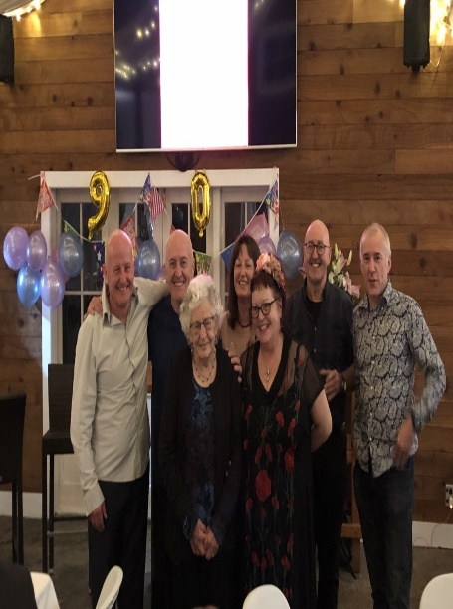
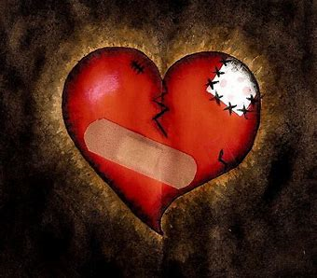
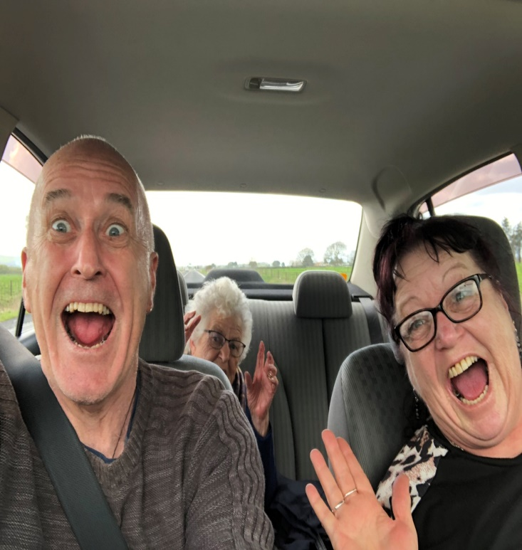
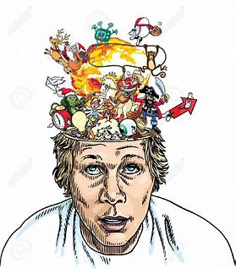
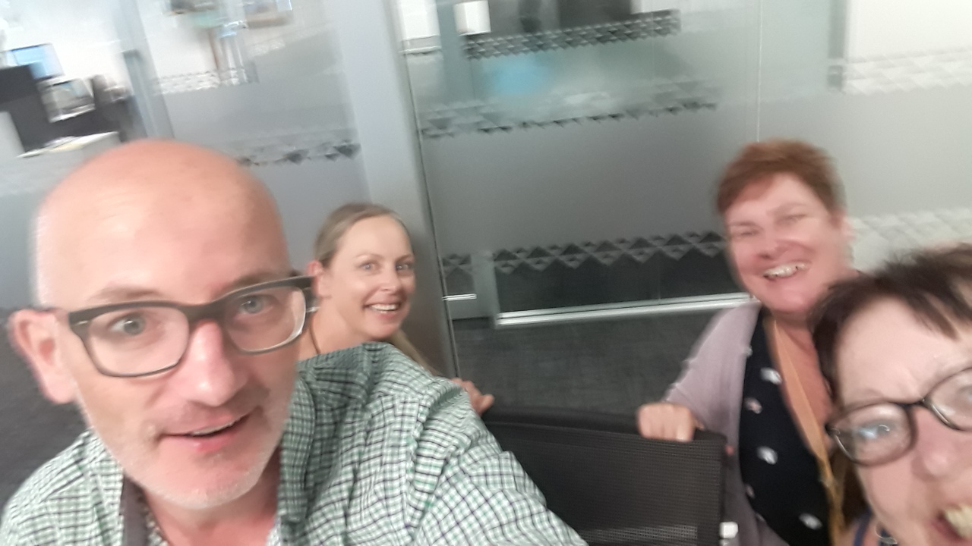
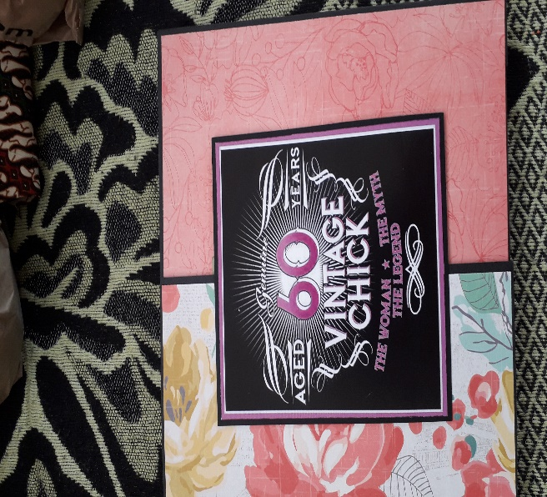
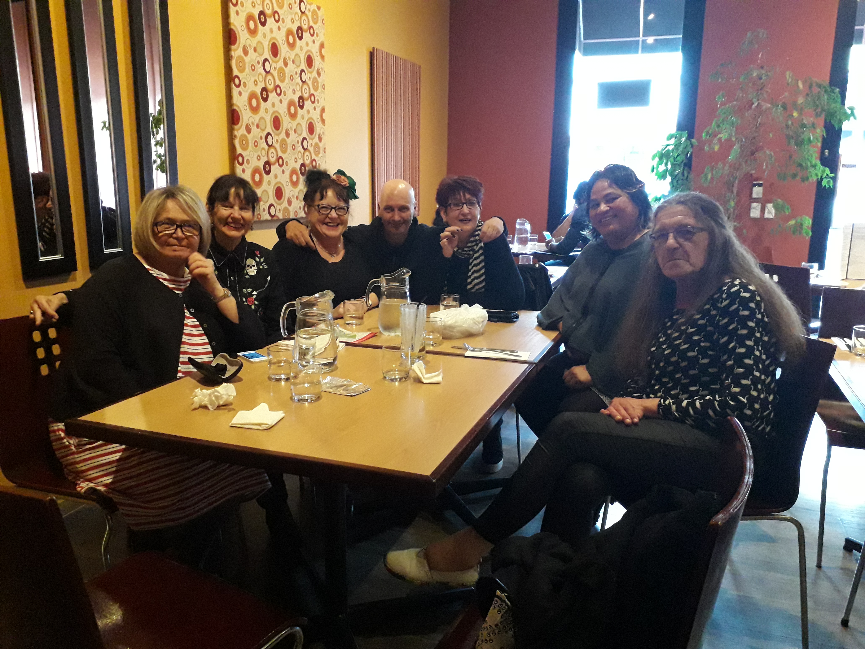
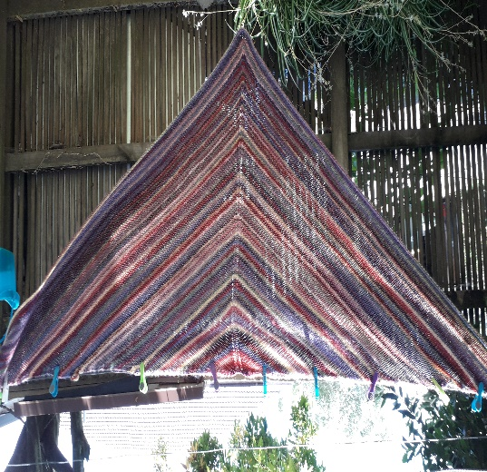
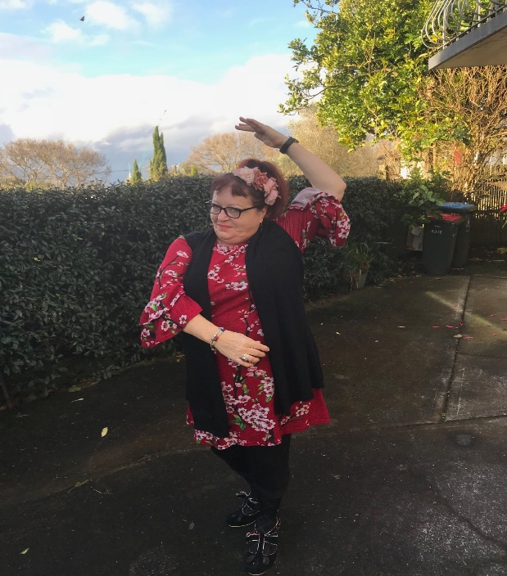
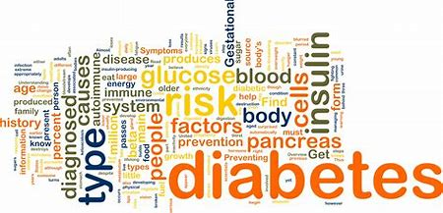
Notes:
Each integrated in our own ways to be uniquely ourselves
Who are you? And how do you bring that to your work?

Slide 16

THANK YOU
Notes:
16

