Slide 1













Thank you to our Sponsors
#EquallyWellAu22

Slide 2
Equally Well UK: what we have learned so far
Andy Bell, 12 April 2022
@Andy__Bell__ @CentreforMH @EquallyWellUK

Slide 3

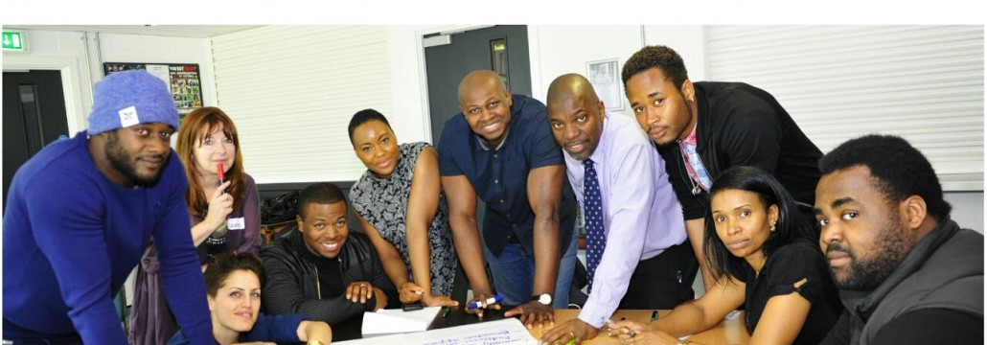

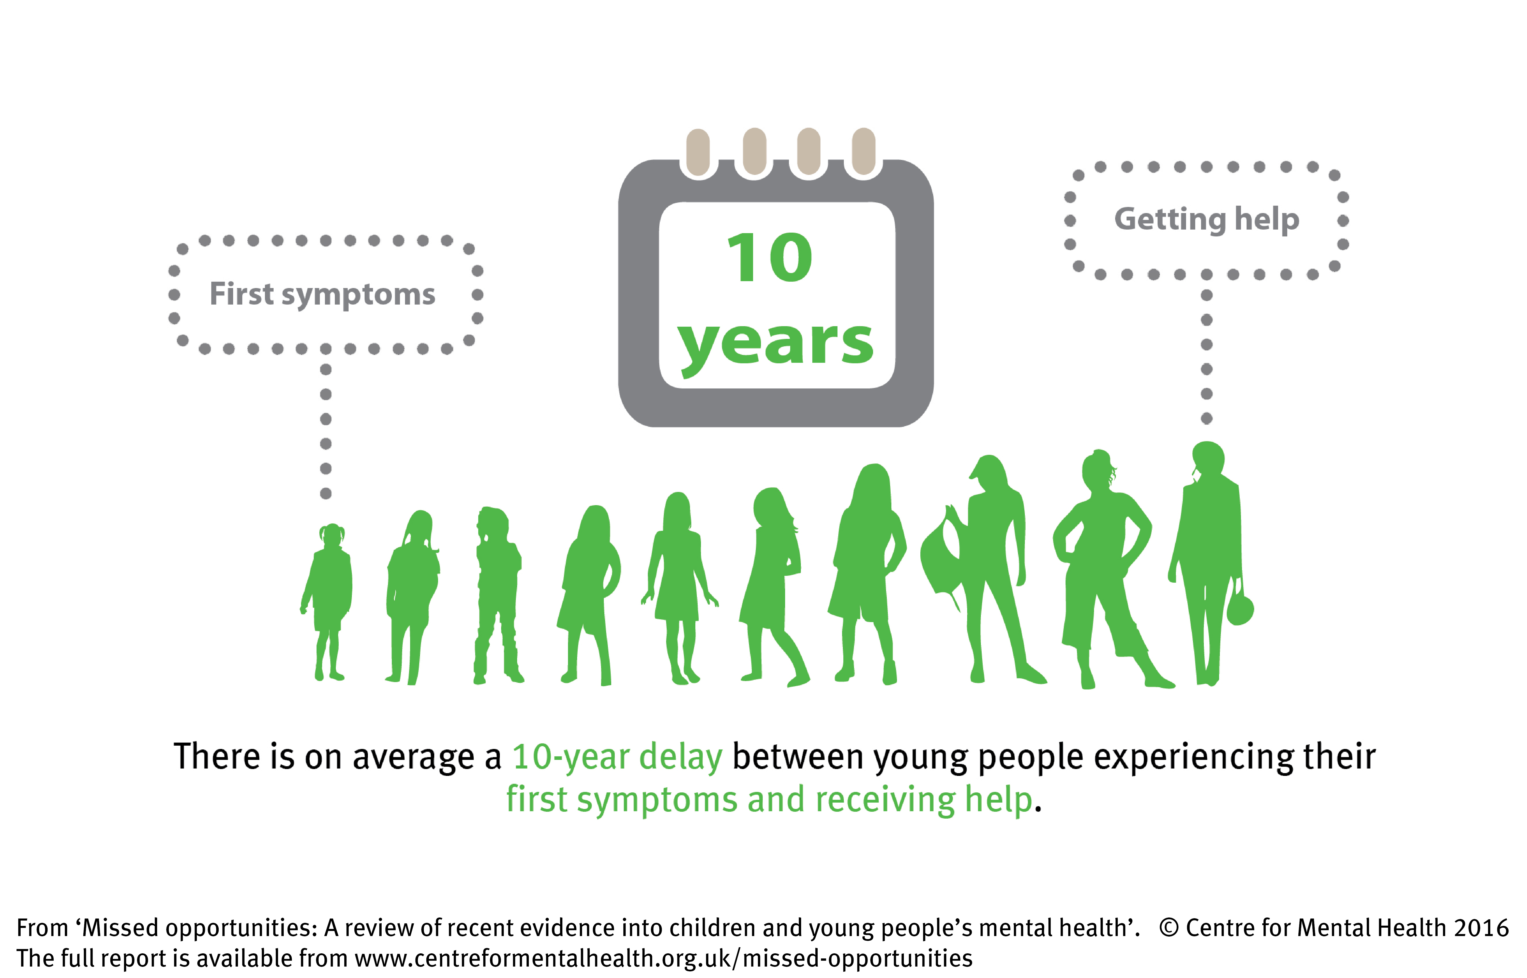

Tackling inequalities in mental health
P

Slide 4
Unequal health outcomes
15-20 year shorter life expectancy
3.7 times higher premature mortality
Three times risk of Covid mortality
Three times as likely to have diabetes
Twice as likely to have heart disease
More likely to die from cancer
More likely to have multiple physical health problems

Slide 5
Collaborative to spur collective action on physical health
Members from across UK including NHS, professional bodies, charities & universities
Three principles:
  We all have a right to good health
  No one organisation can do this alone
  The answers lie in collaboration and coproduction

Slide 6
Coproduction included from the outset
Hosted by Centre for Mental Health
Experts by experience group brought together by Rethink Mental Illness
Clinical group supported by clinical bodies including medical Royal Colleges, nursing, occupational therapists, dietitians, public health, etc

Slide 7
Major activities:
Sharing evidence, research and resources
Publishing blogs & podcasts on practice and experience
Organising learning events, webinars and other activities
Supporting system change and innovation
Campaigning for change
Website www.equallywell.co.uk

Slide 8
Key topics (so far):
Healthy weight management
Tobacco smoking
Covid19 (including vaccinations)
Poverty and racial injustice
Health checks and screening
Early intervention

Slide 9
Healthy weight management
Weight management is complex, and no one size of support fits all
People need long-term support to maintain a healthy lifestyle
Look beyond the numbers (weight, BMI etc)
Emotional aspects of food and eating
Interventions delivered by staff trained in helping people with severe mental illness to manage their weight

Slide 10
Support with smoking
Smoking rate 3x average and gap growing
Personalised approach: asking at the right time, not through shame & stigma
Access to full range of interventions (SCIMITAR+ approach)
Support and reward
Opportunity through Long Term Plan to extend support nationwide

Slide 11
The importance of coproduction
Understanding what helps (and what doesn’t)
Redesigning services as equal partners
Peer-led services and peer support (including families/carers)
Effective communication (both medium and message)

Slide 12
Holistic approach
Importance of housing, work, education and money
Covid and flu vaccination
Oral health and dentistry
Sexual and reproductive health
Trauma-informed approach

Slide 13
Covid-19 vaccination resources
Supporting NHS and partners to reach out to people with mental illness and carers
Guide for ‘what to expect’ from the vaccination process
https://equallywell.co.uk/resources/a-guide-for-people-with-severe-mental-illness-and-their-carers-on-what-to-expect-from-the-covid-19-vaccination-programme/

Slide 14
Flu vaccination resources
Guides for:
  People living with mental illness and their families
  GPs and pharmacists
  Mental health teams
https://equallywell.co.uk/resources/flu-vaccination-and-mental-illness-resources/
Concern that not everyone with a mental illness if eligible for this still

Slide 15
Keys to engagement
Coproduction works – at every level
Words matter
Use multimedia communication to reach people
Community organisations can connect where statutory organisations can’t
Trauma informed approaches work
Support staff to ‘own’ it

Slide 16
Positives so far
Growing interest in physical health equality across the NHS
Funding for full six-point health check in primary care
Commitment to extend smoking cessation treatment to mental health services
Covid vaccination prioritisation and coverage

Slide 17
Shortcomings
Limited implementation of agreed priorities
Resource constraints
Workforce enthusiasm, knowledge and skill
Lack of holistic or equalities approaches in policy and practice

Slide 18
A few insights
Changing practices takes (a lot) longer than changing policies
Discrimination and stigma are still pervasive in our health care system
Coproduction gets markedly better results than any other approach we know of
We’re getting there piece by piece, with a long way to go

Slide 19
Thank you
For more information:
andy.bell@centreformentalhealth.org.uk
@CentreforMH @EquallyWellUK @Andy__Bell__
www.centreformentalhealth.org.uk

