Slide 1













Thank you to our Sponsors
#EquallyWellAu22

Slide 2

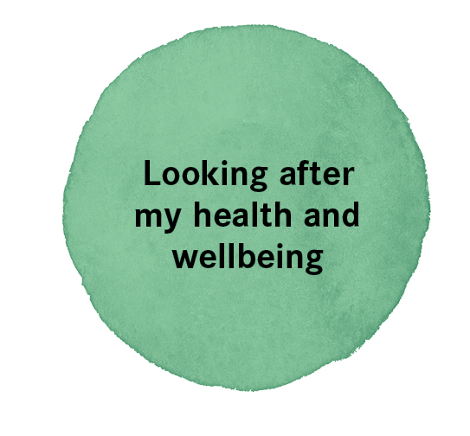

Re-viewing physical health guidelines through a mental health lens
Dr. Carolynne White and Elise Whatley
Notes:
Abstract:
Introduction
Growing recognition of the physical health inequities faced by people living with mental ill-health prompted a review of the Physical Health Guidelines at Mind Australia. The review aimed to ensure that the guidelines were fit for purpose, within staff members’ scope of practice, and aligned with recovery-oriented and trauma-informed approaches to care.
Method
The guidelines were reviewed by advisors from the Practice development and Participation teams over a six-month period, using an iterative and collaborative process. We began with a workshop with Mind’s Lived Experience Advisory Team (LEAT) to understand their experiences and preferences followed by an audit of current policy and practice, and a workshop with Mind staff from across Australia. The findings from the workshops were collated and used to revise the Physical Health checklist and guidelines, with further input from the LEAT and staff to develop practice resources.
Results
The initial workshop with LEAT members highlighted that physical health is important for clients and challenged assumptions that people with mental ill-health lack motivation or knowledge to act on their health. Instead, clients reported numerous barriers including living costs, medication side effects, and difficulties accessing health professionals with appropriate training. In general, staff felt comfortable talking about physical health with clients but were mindful of sensitivities related to age, gender, culture and health conditions such as eating disorders. Staff felt it was important to normalise conversations about physical health but wanted further training to contextualise the relevance of physical health for clients as well as support to integrate physical health guidelines within existing systems and models of practice.
Conclusion
The revised Physical Health Guidelines include resources to start conversations and help with goal setting. Input from people with lived experience and staff was essential to creating guidelines and tools that promote physical health, give hope, and address relevant social determinants of health.

Slide 3

Acknowledgement of Country
Mind acknowledges that Aboriginal and Torres Strait Islander peoples are the Traditional Custodians of the lands on which we work and we pay our respects to Elders past and present.
We recognise the intergenerational impact of the history of invasion, dispossession and colonisation and are committed to the recognition, respect, inclusion and wellbeing of Australia’s First Peoples.

Slide 4
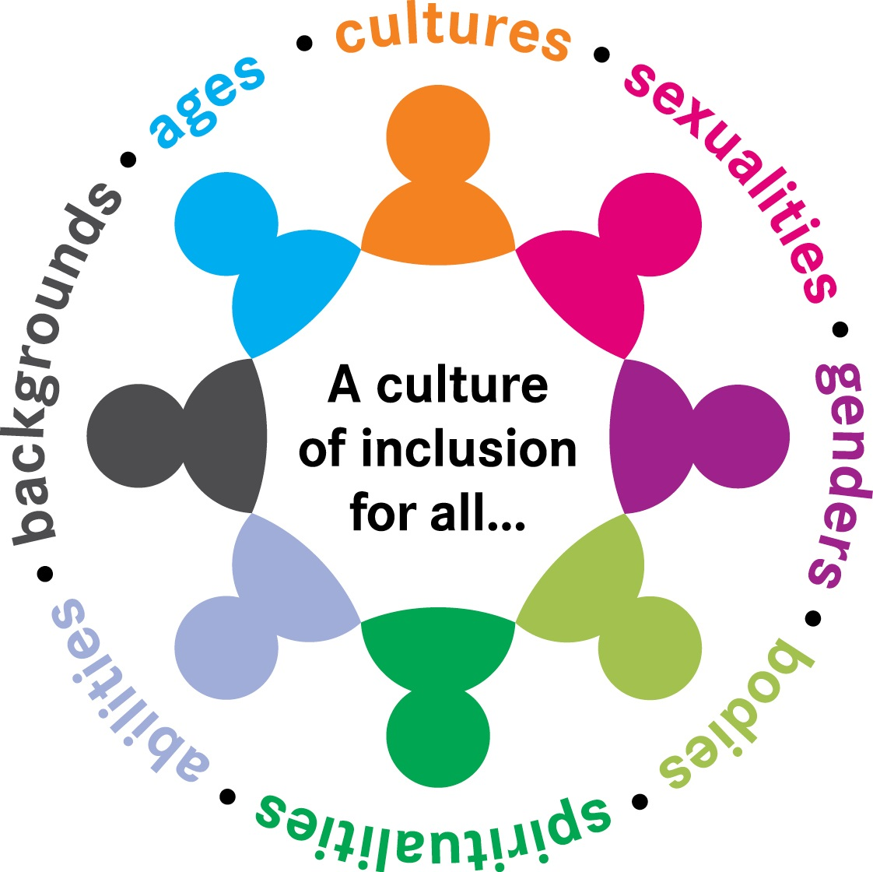
Inclusion statement
Mind values the experience and contribution of people from all cultures, genders, sexualities, bodies, abilities, spiritualities, ages and backgrounds.
We are committed to inclusion for all our clients, families and carers, employees and volunteers.

Slide 5
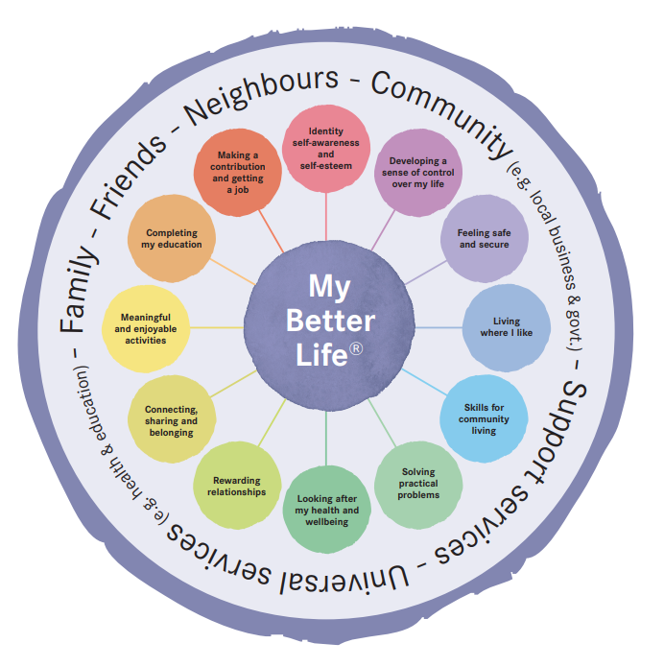
About Mind Australia
Mind supports people experiencing mental health and wellbeing concerns to find help, hope and purpose in their lives.
We provide individualised, evidence-based and recovery focussed support to more than 11,000 people in Australia every year.
We are committed to lived experience approaches in mental ill-health services and a culture of continuous improvement in practice.
We strive for meaningful participation with clients, carers and families to co-design processes and challenge biases.
Notes:
Mind supports people experiencing mental health and wellbeing concerns to find help, hope and purpose in their lives.
We provide individualised, evidence-based and recovery focussed support to more than 11,000 people in Australia every year.
Residential, mobile outreach, centre-based and online services
We are committed to lived experience approaches in mental ill-health services and a culture of continuous improvement in practice.
We strive for meaningful participation with clients, carers and families to co-design processes and challenge biases.
My Better Life – is one example of a model co-designed with people with lived experience used to guide practice. My Better Life is an assessment and planning tool that supports clients to articulate their recovery goals, design their recovery journey and manage their own wellbeing in partnership with their family, carers and Mind’s practitioners. The tool is built around 12 key life domains fundamental to wellbeing and is also informed by international evidence and Mind’s own service data and evaluation studies.
Looking after my health and wellbeing is one area where clients can choose to explore and set goals to address their physical health. Today, I will share with you a continuous improvement project undertaken at Mind over the past 18 months to revise Mind’s Physical Health Guidelines and Checklist using a co-design approach. I’ll begin with some background information to set the scene, before describing the co-design process, showing what we produced and explaining how we are rolling out the tools across Mind’s services.

Slide 6
What’s the problem?
People with severe mental illness are likely to die 20 years earlier than the general population.
People with an eating disorder have 5 x increased risk of early death.
People with severe mental illness are no more likely to get cancer but are more likely to die from cancer due to barriers to screening and early treatment.
(Roberts, 2019)
(Roberts , 2019)
Notes:
There is growing awareness that people who experience mental ill-health and distress experience a gap in life expectancy and quality of life due to physical health conditions.
People with severe mental illness are likely to die 20 years earlier than the general population
People with an eating disorder have 5 x increased risk of early death. (and rates of eating disorders and disordered eating increased during the COVID-19 pandemic).
People with severe mental illness are no more likely to get cancer but are more likely to die from cancer due to barriers to screening and early treatment. (with one of the barriers being stigma and discrimination, which I’ll come back to in the next slide)
The statistics remain shocking and too close to home.
The findings from Mind’s internal service evaluations show similar findings to the statistics reported in the literature with a significant number of premature deaths, which refers to deaths before age 70). The graph on the right is from a snapshot of outcome measures from clients in Mind’s Adult Housing and Support stream that showed Residents at Mind’s Supported Independent Living services and lower physical health related quality of life, when compared to the Australian population and Australians living with psychosis.
Roberts, R. The physical health of people living with mental illness: A narrative literature review. NSW: Charles Sturt University; 2019. ISBN: 978-1-86-467344-9.

Slide 7
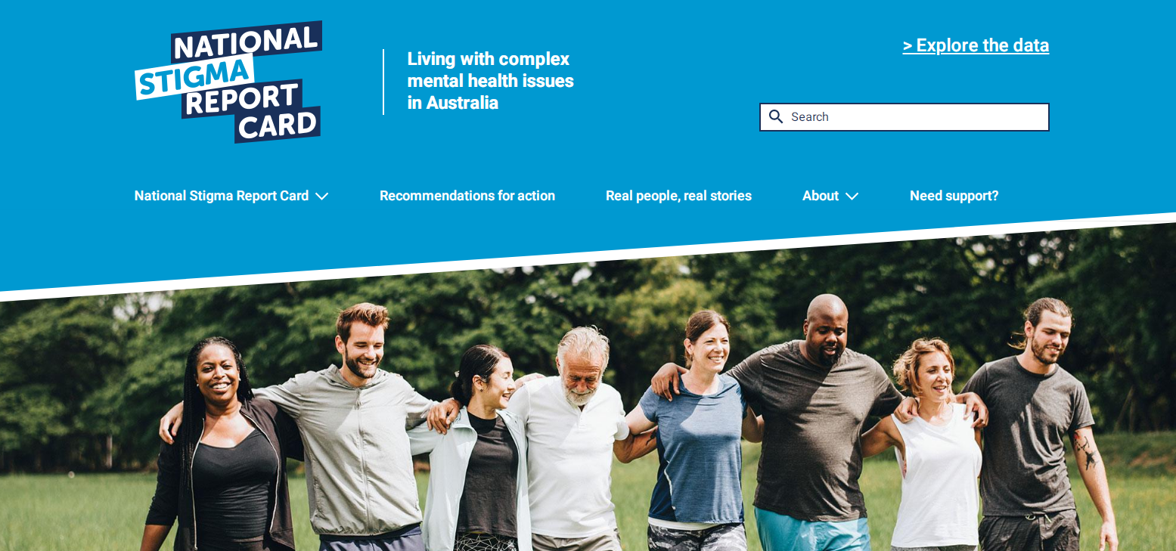
“Our Turn to Speak”
In the past 12 months...
83.9% (n=1605) participants experienced some level of stigma and discrimination in healthcare services
60% of participants also anticipated future stigma and had withdrawn from health care opportunities
Participants reported unfair treatment when trying to get help and unfair treatment by physical healthcare professionals:
  Needs not taken seriously
  Mental health issues inappropriately became a focus.
  (Groot, et al., 2020)
Notes:
In 2019-2020, Dr Sarah Pollock and Katie Larsen from Mind served on the National Stigma Report Card steering committee.
They developed a survey, called Our Turn to Speak, that explored how stigma and discrimination affects people with complex mental health issues across many aspects of their lives including when accessing health care services.
The survey ran between October 2019 and March 2020, during which period 1,912 people from across Australia took part online, over the phone, or in person.
The survey highlights stigma and discrimination as a social determinant that contributes to the higher rates of physical health conditions among people with complex mental health issues. 83% of people with complex mental health issues experienced some level of stigma and discrimination in healthcare services, and of these 60% anticipated future stigma and had withdrawn from health care opportunities.
Unfair treatment when trying to get or receiving help was reported by participants, where their
Needs were not taken seriously and
Mental health issues inappropriately became a focus.
Groot, C, Rehm, I, Andrews, C, Hobern, B, Morgan, R, Green, H, Sweeney, L, and Blanchard, M (2020). Report on Findings from the Our Turn to Speak Survey: Understanding the impact of stigma and discrimination on people living with complex mental health issues. Anne Deveson Research Centre, SANE Australia. Melbourne.

Slide 8
Addressing physical health at Mind
Notes:
To address the physical health needs of clients, Mind developed a Physical Health Guideline and Checklist in 2014, that was updated in 2018. In 2020, the guidelines and were due for a review to align with Mind’s My Better Life model.
The practice development team had also received feedback from Community mental health practitioners about difficulties using the checklist and concerns about it’s suitability for younger and gender diverse clients. The practice development team also were keen to make sure that the Guidelines and Checklist were within the scope of practice of our workforce. Although we often work in partnership, we are not medical practitioners or a clinical service.
Mind’s physical health guidelines and checklist were based on best practice guidelines that were developed for the general population.

Slide 9
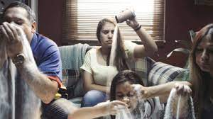
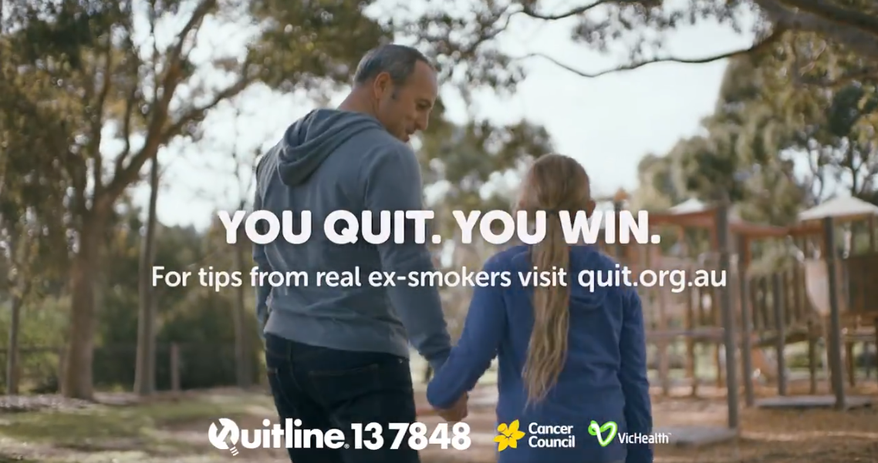
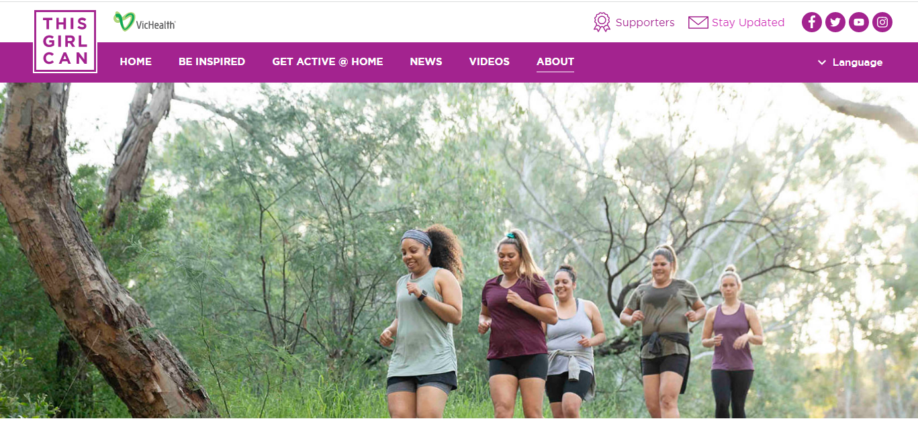
Taking time to listen
“[Advertisements] reflect our societies attitudes that generate stigma - ignorance to mental health’s existence.”
Highlights the gaps between the “haves and the have nots”
“I know if I watched the “This Girl Can” ad when I have been unwell that would make me feel worse about not being able to feel like I could access these activities. Like I was being left behind when others are able to.”
“A very black and white approach to "just stop" rather than providing supports or understanding.”
“The idea of smoking shouldn’t be met with shame. This is a terrible way to encourage people to quit.”
Notes:
But when we took time to listen to our clients and peer practitioners, we realised that guidelines and public health messages developed for the general population do not necessarily consider their impact on people’s mental health.
In a recent Peer Practitioner Community of Practice, Elise and I invited peer practitioners to watch three public health advertisements address through a lived experience lens. The ads addressed consumption of sugary drinks, quitting smoking and physical activity.
The peer practitioners shared that the advertisements were ignorant to mental health, reflect attitudes that generate stigma, and emphasise the gaps between the “haves and the have nots”.
Black and white messages and those that invoke shame were seen as particularly problematic.

Slide 10
What could we do differently?
Design
Think
Make
Break
We started here
Repeat
(Tomitsch et al., 2021)
Notes:
So – what could we do differently? How can we support people’s physical health, while protecting and promoting their mental health?
In 2020-2021, the Practice Development and Participation teams worked together with the Lived Experience Advisory Team and Mind practitioners to revise the Physical Health Guidelines and Checklist.
Because of time and resource constraints, we couldn’t design something new from scratch. So instead we used Tomisch and colleagues model, “Design, Think, Make, Break, Repeat”. We began with Break, which aims to find better solutions to complex problems.
The principles that guided this co-design project were:
Elevating the voice and contribution of lived experience
Working from strengths
True collaboration between people with lived experience and staff.
Tomitsch, M., Borthwick, M., Ahmadpour, N., Cooper, C., Frawley, J., Hepburn, L.A., Kocaballi, A.B., Loke, L., Núñez-Pacheco, C., ‎ Straker, K., ‎Wrigley, C. (2021). Design. Think. Make. Break. Repeat. A Handbook of Methods (revised edition). BIS Publishers, Amsterdam, The Netherlands.

Slide 11

How might we support client’s physical health using a
recovery-oriented and trauma-informed lens?
Safety
  Choice
  Collaboration
  Trustworthiness
  Empowerment
  Support personal recovery and promote well-being
  Person-centred approach
  Services informed by evidence and consistent with a social model of health
  Trusting relationships
  Sensitive to the needs of families and carers
  Work in partnership and collaborate
(Mind, n.d.; Kezelman & Stavropoulos, 2012)
Notes:
The guiding question for the co-design project was… “How might we support client’s physical health using a recovery-oriented and trauma-informed lens?

Slide 12









Co-design of My Physical Health
Lived Experience Advisory Team Survey and Workshop
Lived Experience Advisory Team Workshop
Review of Physical Health Guidelines and Checklist
+
Practice audit
Community Mental Health Practitioner
Survey and Workshop
+
Review of practice guidelines and literature
Community Mental Health Practitioner
Workshop
+
Input and feedback from subject matter experts
Notes:
This diagram shows the co-design process.
As I mentioned, we began by reviewing Mind’s Physical Health Guidelines and Checklist and did a practice audit where we learned that our services were already doing many things to support physical health. We also heard that there were areas where we could improve the guidelines and checklist and do even better.
2 workshops with Mind’s Lived Experience Advisory Team
2 workshops with Mind practitioners from across Australia
Survey of LEAT and Mind practitioner workshop participants
Feedback from subject matter experts in areas like nutrition and eating disorders.
Review of health guidelines and relevant literature
Benchmarking – how our sector partners address physical health
The name My Physical Health was suggested by a Mind community mental health practitioner, to link it in with My Better Life.
We hope that My Physical Health will make it easier to have conversations about physical health.

Slide 13
Through co-design
We heard…
“It’s hard to have 8 hours sleep if you don’t have a safe and secure place to sleep.”
“Getting enough food is important - if you can’t buy it, you can’t eat it.”
“You might not want to call an ambulance …because of bad experiences with hospital so you put off getting treatment for important health issues, like an asthma attack.”
CMHPs should not start a conversation with, ‘I’ve noticed you’ve put on a bit of weight lately.’
“Counting calories can send people with eating disorders down a wrong path again.”
“We want to be treated as whole individuals.”
Our conversations about physical health will be…
Person-centred and non-judgemental
Recognise people’s context
Trauma informed
Weight-inclusive
Notes:
The initial workshop with LEAT members highlighted that physical health is important for clients and challenged assumptions that people with mental ill-health lack motivation or knowledge to act on their health.
Instead, clients reported numerous barriers including living costs, medication side effects, and difficulties accessing health professionals with appropriate training.

Slide 14
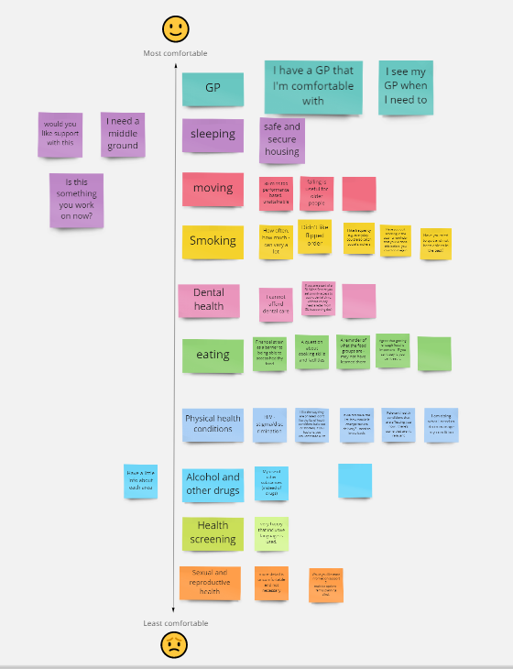
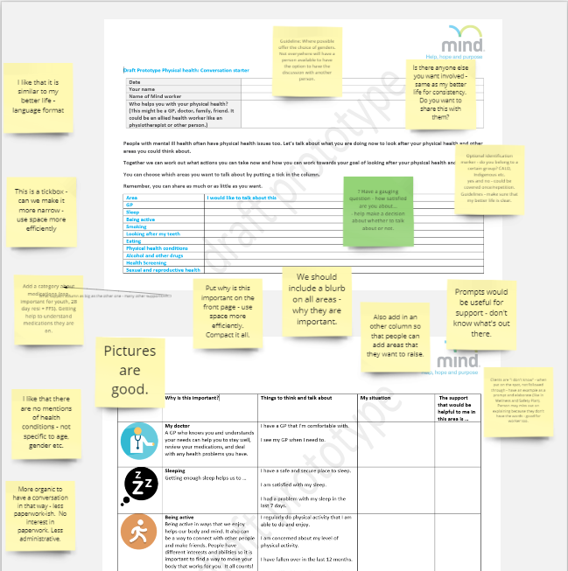
Making a new conversation tool
Lived Experience Advisory Team workshop
Staff workshop

Slide 15
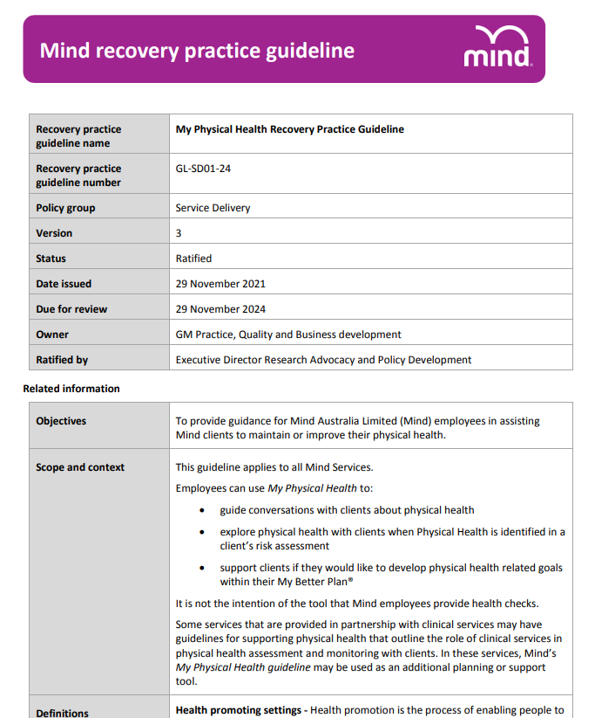
My Physical Health recovery practice guideline
How to approach a conversation about physical health
How to start a conversation
What can get in the way of a supportive conversation
How to link in to My Better Life plans ®
Supporting clients with their physical health (what’s next)
How do we know our support is making a difference?
Notes:
My Physical Health Recovery Practice Guideline
The guideline includes all the important practice tips that we learned through the co-design. It gives staff pointers for how to approach and start a conversation about physical health and ideas for how teams can support people to self-manage their physical health and links to other resources.

Slide 16
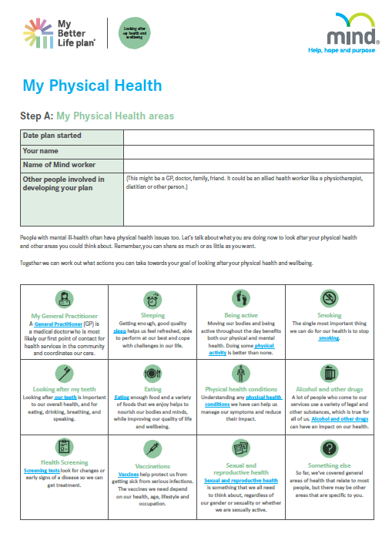
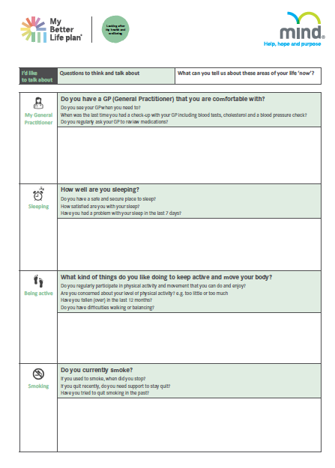
My Physical Health – conversation tool
Notes:
My Physical Health is a conversation starter to explore physical health and what is most important to the client. Staff can use it to help clients choose which areas of their physical health they want to address, if any.
If staff offer My Physical Health and a client decides that they do not want to have a conversation about their physical health, they do not have to as they may have other priorities. They can always ask them about My Physical Health at another time.
My Physical Health covers key areas identified in practice guidelines and space to explore other areas that are specific to the client.
Peer Practitioners told us that it is helpful to give an explanation of why an area might be important to look at to give it some context and to help people make an informed choice.
The areas are ordered from most comfortable to least comfortable to talk about. The LEAT told us that it feels more comfortable to talk about a GP but might feel more uncomfortable to talk about alcohol use or whether they know where to access support for sexual or reproductive health. It is very individual though! What one person will find comfortable someone else might not.
Once staff have explored the areas that are important to the person, they can check if the person would like to talk about any of the other areas.

Slide 17
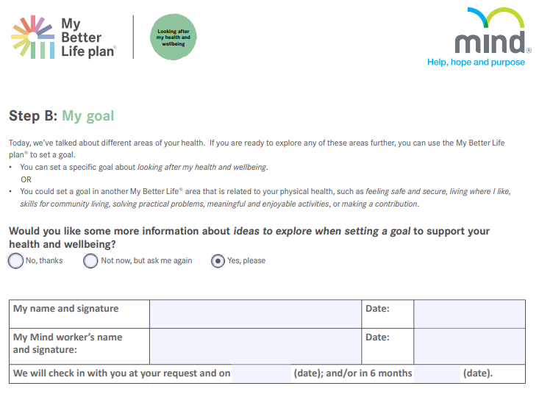
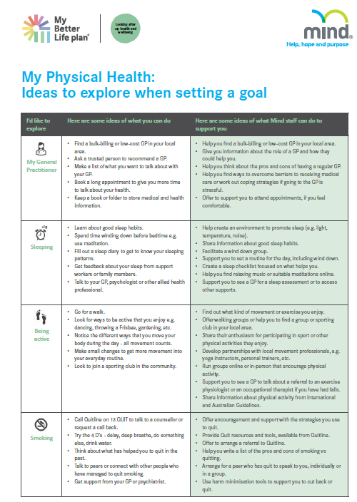
My Physical Health – goal setting tools
Notes:
You’ve talked about the areas – then what! Well, sometimes we ask people ask about their health but may be unsure about how to support them to take the next steps themselves or where to refer them for more specific help.
Our role is to encourage and inspire people to do what they can to support their physical health (this is known as self-management) AND also to link people with health services and practitioners that can help (this is known as self-management support).
If the client has identified physical health areas they want to address, then together you can use the My Better Life plan® to set a goal(s) - so that any steps are linked with My Better Life®
Note:
If a client chooses to set a goal about looking after their health and wellbeing or a related area, they can add or review their goal using the My Better Life forms or app.

Slide 18
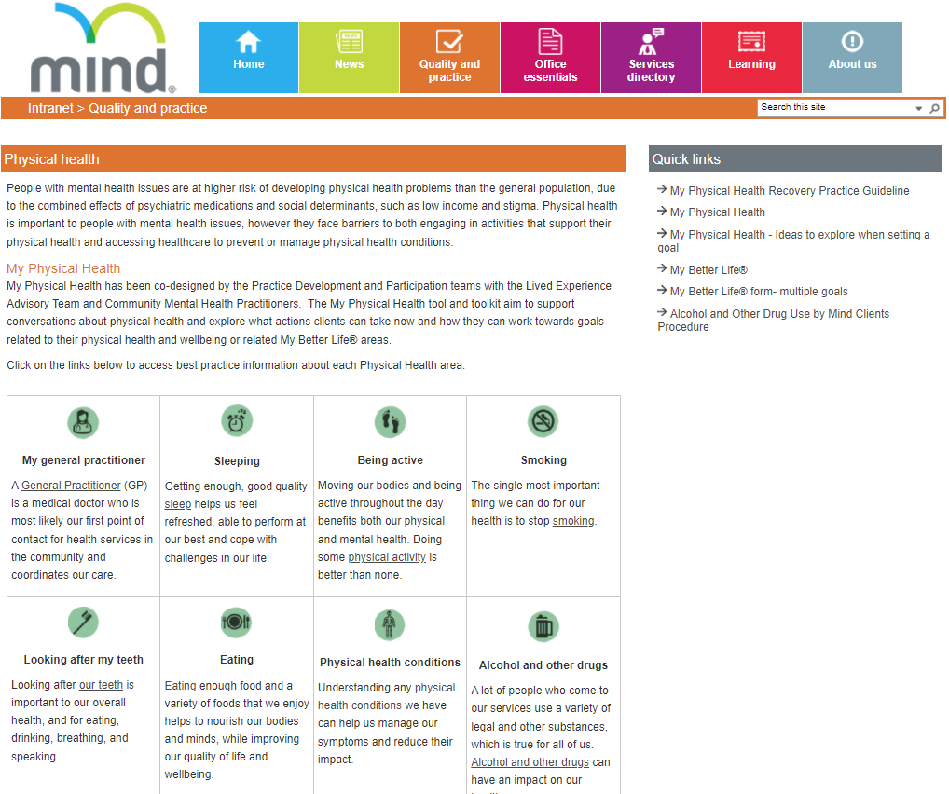

My Physical Health – resources
Notes:
Intranet has links to best practice guidelines and case studies of innovative practice at Mind.

Slide 19
Rolling out the toolkit in practice
Resources for Service Managers and Team Leaders to introduce My Physical Health to staff
Tailored presentations at Mind’s Communities of Practice e.g. Peer Practitioners, Youth, Complex Disability,
Run webinars to support the launch in 2022
Measure progress using data from My Better Life plans® and Outcome Measures that include General Health items
Encourage Quality Improvement Activities to share examples of good practice
Notes:
There’s no point in having a shiny new toolkit if people aren’t using them. Since creating the My Physical health Tool and Toolkit, we’ve been busy rolling it out in practice.
Resources for Service Managers and Team Leaders to introduce My Physical Health to staff
Tailored presentations at Mind’s Communities of Practice e.g. Peer Practitioners, Youth, Complex Disability,
Run webinars to support the launch in 2022
Measure progress using data from My Better Life plans® and Outcome Measures that include General Health items to tell if it is making a difference.
Encourage Quality Improvement Activities to share examples of good practice

Slide 20
Feedback so far
“This is an amazing tool and great resources, I think it gives a lot more substance to conversation around physical health than the old tick box physical health checklist.”
(Service Manager)
Following the Community of Practice, Peer practitioners said they will:
Stop: “Avoiding it and leaving it so long to review physical health goals/conversations”
Start: “Looking for more opportunities to have these conversations earlier”
Continue: “To be open and hold space for those that would like to discuss their physical health; conversations with a caring, compassionate and authentic approach.”
“I think it will be really valuable for all the participants of our programs.”
(Service Manager)
Notes:
Preliminary feedback has been really positive.
“I think it will be really valuable for all the participants of our programs.” (Service Manager)
“This is an amazing tool and great resources, I think it gives a lot more substance to conversation around physical health than the old tick box physical health checklist.” (Service Manager)
After the peer practitioner community of practice we had feedback from Peer practitioners that they were more confident to have conversations with clients about physical health when invited. Peer practitioners said they will:
Stop: Avoiding it and leaving it so long to review physical health goals/conversations
Start: Looking for more opportunities to have these conversations earlier
Continue: to be open and hold space for those that would like to discuss their physical health; conversations with a caring, compassionate and authentic approach
Our hope that My Physical Health would make it easier to have conversations about physical health is beginning to be realised.

Slide 21
We would like to thank
The Lived Experience Advisory Team
The Mind practitioners who participated in our workshops and also suggested the name for My Physical Health.
Jessica Kearney and Maggie Wong, Master of Occupational Therapy students from Swinburne University of Technology (Placement 2020)
Content experts:
Dr. Lauren Bruce, Eating Disorders Victoria
Mandy Lee Noble, Accredited Practising Dietitian
Prof. Russell Roberts, Equally Well

Slide 22
References
Groot, C, Rehm, I, Andrews, C, Hobern, B, Morgan, R, Green, H, Sweeney, L, & Blanchard, M. (2020). Report on Findings from the Our Turn to Speak Survey: Understanding the impact of stigma and discrimination on people living with complex mental health issues. Anne Deveson Research Centre, SANE Australia.
Kezelman C. & Stavropoulos P. (2012). The last frontier: Practice guidelines for the treatment of complex trauma and trauma informed care and service delivery. Blue Knot Foundation.
Mind Australia. (n.d.). Mind’s approach to recovery oriented practice. Author.
Roberts, R. (2019). The physical health of people living with mental illness: A narrative literature review. Charles Sturt University.
Tomitsch, M., Borthwick, M., Ahmadpour, N., Cooper, C., Frawley, J., Hepburn, L.A., Kocaballi, A.B., Loke, L., Núñez-Pacheco, C., ‎ Straker, K., ‎Wrigley, C. (2021). Design. Think. Make. Break. Repeat. A Handbook of Methods (revised edition). BIS Publishers.
Notes:
Read: Slide content

Slide 23
mindaustralia.org.au
Mind Connect 1300 286 463
Carer Helpline 1300 554 660

