Slide 1













Thank you to our Sponsors
#EquallyWellAu22

Slide 2
Co-designing a Physical Health Conversation Guide: Working together for hope and health
Shifra Waks & Kath Thorburn
Bani Aadam, Professor Mark Harris, Dr Catherine Spooner, Professor Karen Fisher
Centre for Primary Health Care & Equity, UNSW
Social Policy Research Centre, UNSW

Slide 3
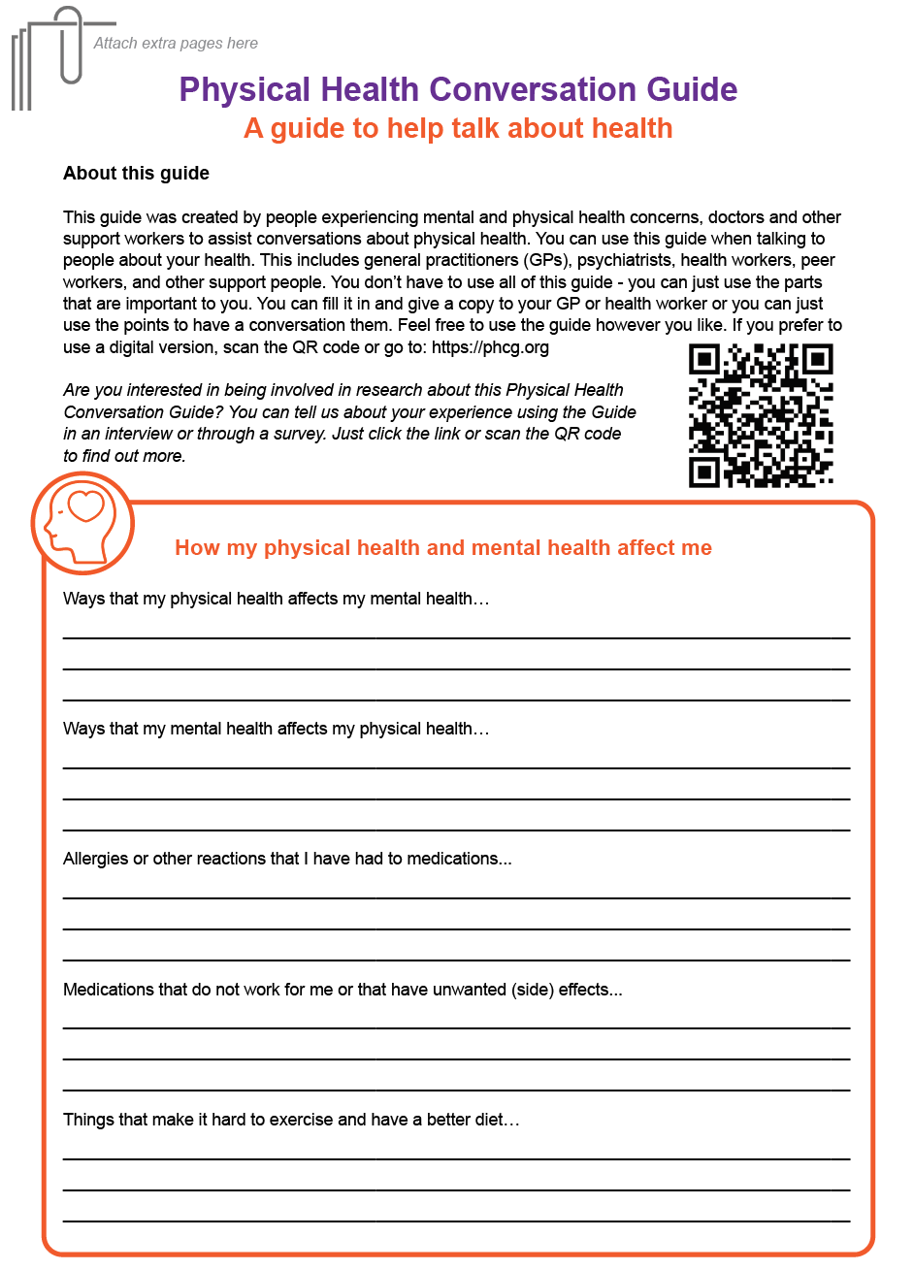
Background:
Improving physical health care of mental health service users in primary care settings
Stage 1: Co-design
Stage 2: Testing
This research (Stage 1) explored the co-design process, how outcomes were achieved and the co-designers’ experiences

Slide 4
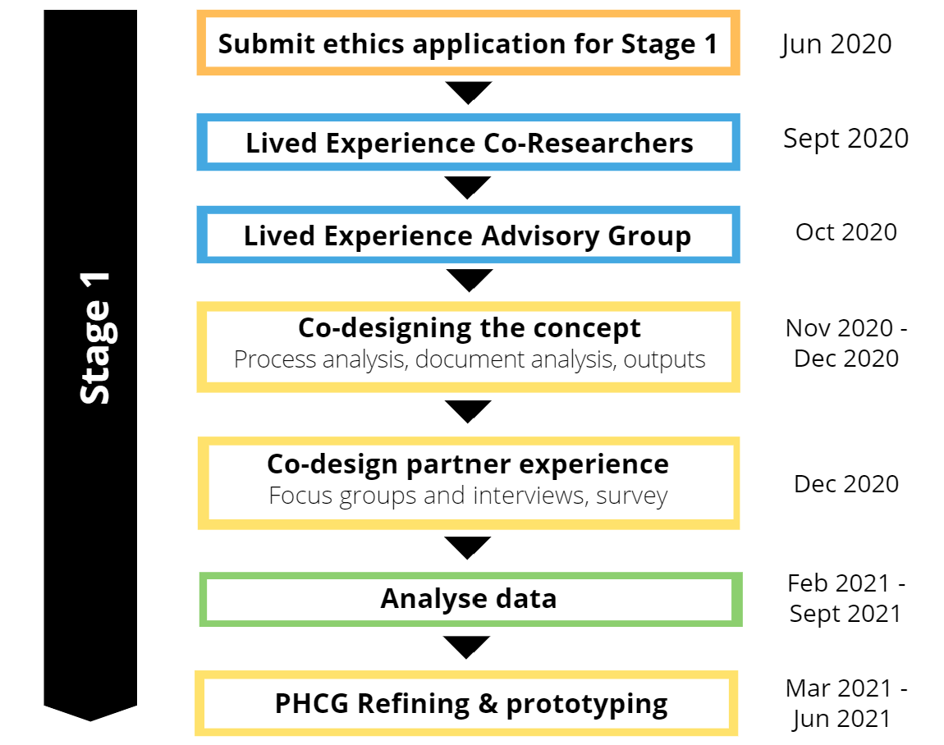
Research design & methods - 1
What were the key characteristics of the co-design process and the methods by which it achieved the outcomes?
What were the co-design partners’ experience of the co-design activities undertaken to achieve the outputs and the co-design process as a whole?

Slide 5
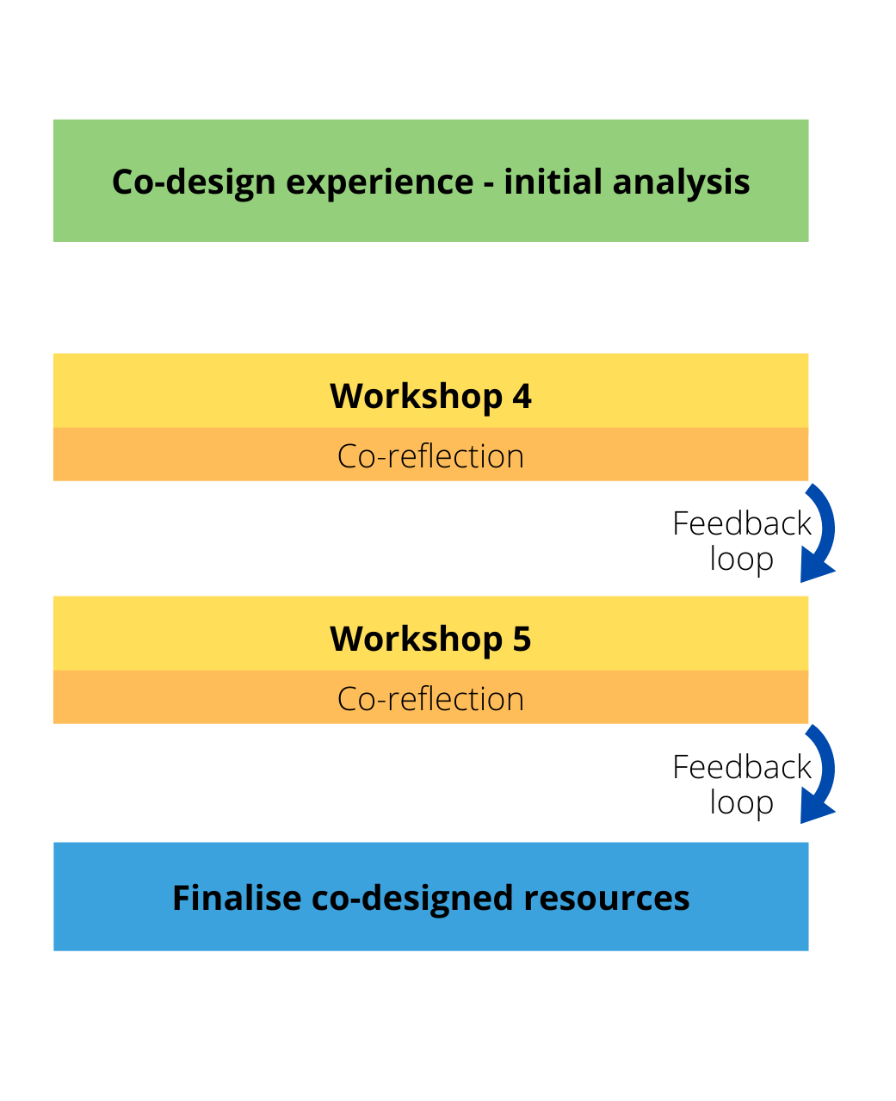
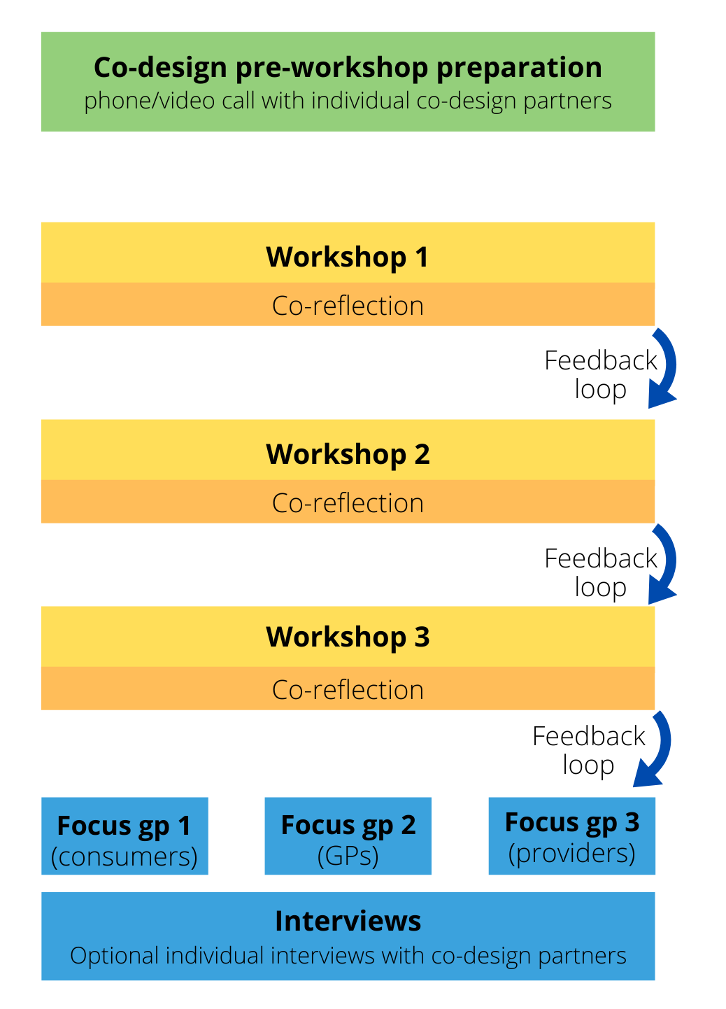
CO-DESIGN
1. Define the problem
2. Develop solutions together
3. Test solutions
(Roper, Grey & Cadogan, 2018)
Co-designing the concept
Refining & prototyping

Slide 6
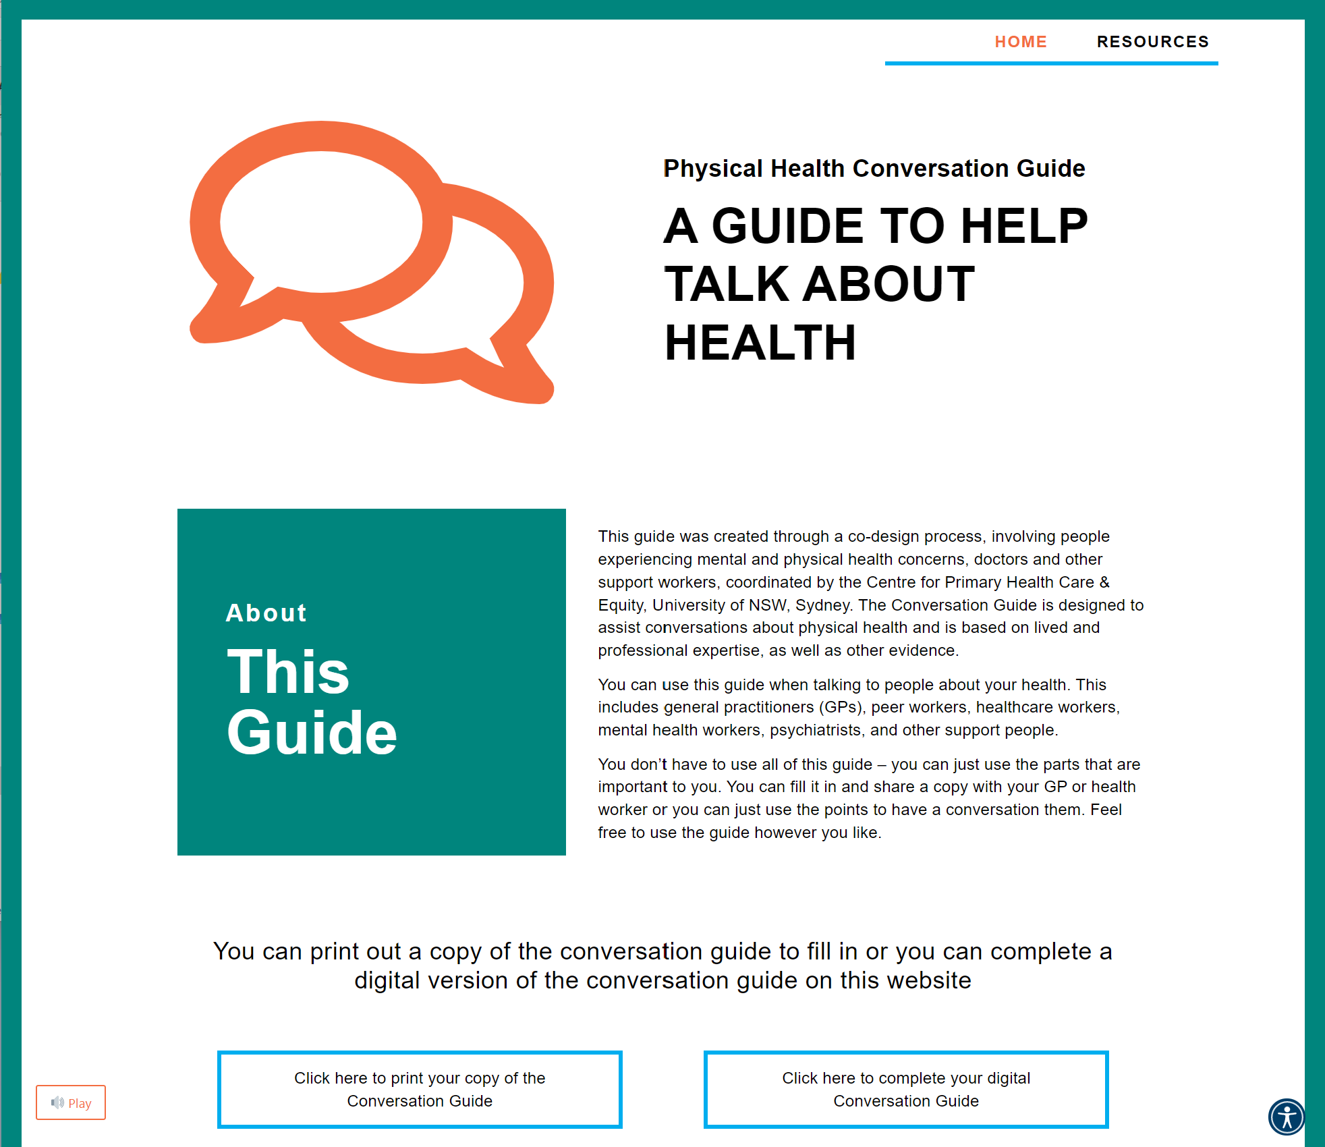

Slide 7
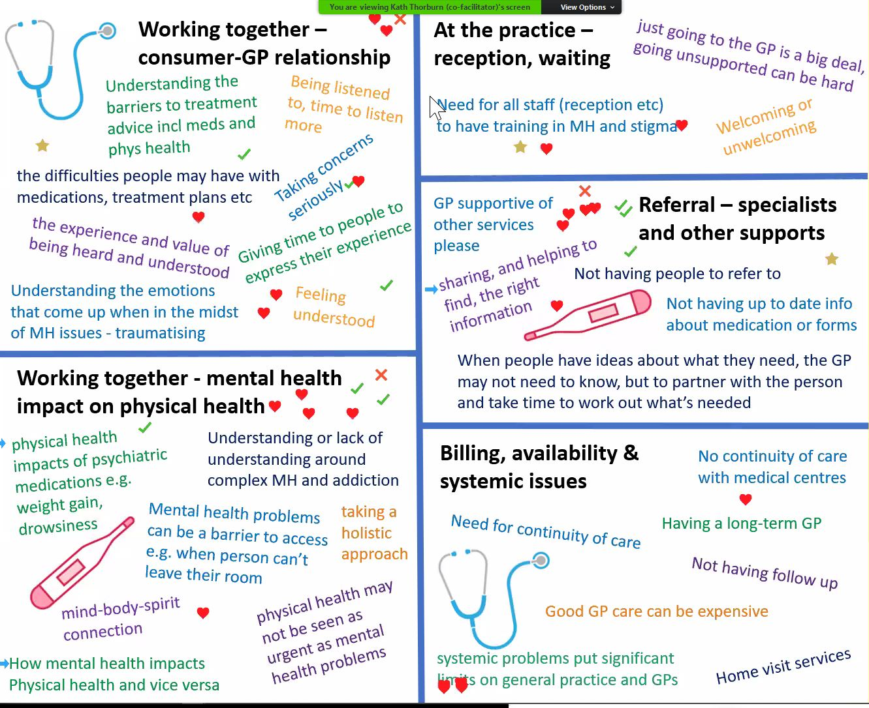
Co-design
No preconceptions regarding what was needed.
30 barriers to physical healthcare identified
12 potential solutions were identified
2 preferred solutions taken to the PHN (selection based on availability of funding and existing projects)
Refining and prototyping of preferred solution
Co-designing the research design for Stage 2: Testing

Slide 8
Analysis
Data:
Co-design documentation - text, diagrams and images
Co-design participants’ experiences – interviews and focus groups
Workshop interactions were not analysed
Co-design project inputs and outputs reported but not analysed
Analysis:
Coded using NVivo 12
Iterative categorization (Neale)
Reflexive Thematic Analysis (Braun & Clarke)
Reviewed by lived experience co-researchers and PhD supervisors
Eight Mechanisms of Change (Palmer et al 2019)

Slide 9
Findings
Sharing
& Generating Knowledge
(Individual)
Creating
&
Holding Space
(Transforming)
Experiencing
&
Influencing Change
(Internal)
Dual processes
(Collective)
(Stabilising)
(External)
Time
for
Dialogue & Meaning
Relations & Power
Recognition & Action
Relationships between themes, processes and practices

Slide 10
Implications
Co-design processes that support knowledge co-creation and collaborative decision-making
Underlying dual processes interact to support complex processes and dynamics
Time is a mediating factor across all themes and a valuable resource for engaging and supporting these processes
Attention and time given to co-design processes for the collaborative benefits of co-design to be realised
I felt like we were valued. And we kind of led the conversations rather than the clinicians...that was good.
Person with lived experience
I think the outcomes are probably different to what I would have chosen. That’s the whole point, isn’t it?
Service provider

Slide 11

With sincere thanks to the co-designers:
Asma Yusra
Glen Armener
Grahame Richards
Jasmine Yee
Josh Peachy
Julie Chalker
Marion
Nada Andric
Priscilla Wong
Sean Fitzgerald
Trysh Hart
and also
Mahlie Jewell (Graphics for Good)
Contact:
k.thorburn@unsw.edu.au
Website:
www.phcg.org

