Slide 1













Thank you to our Sponsors
#EquallyWellAu22

Slide 2

Older Person’s Physical Health Prompt
I’m NEVER too old to be Asked - Physical and Mental Wellbeing
Vicki Langan and Whitney Lee

Slide 3
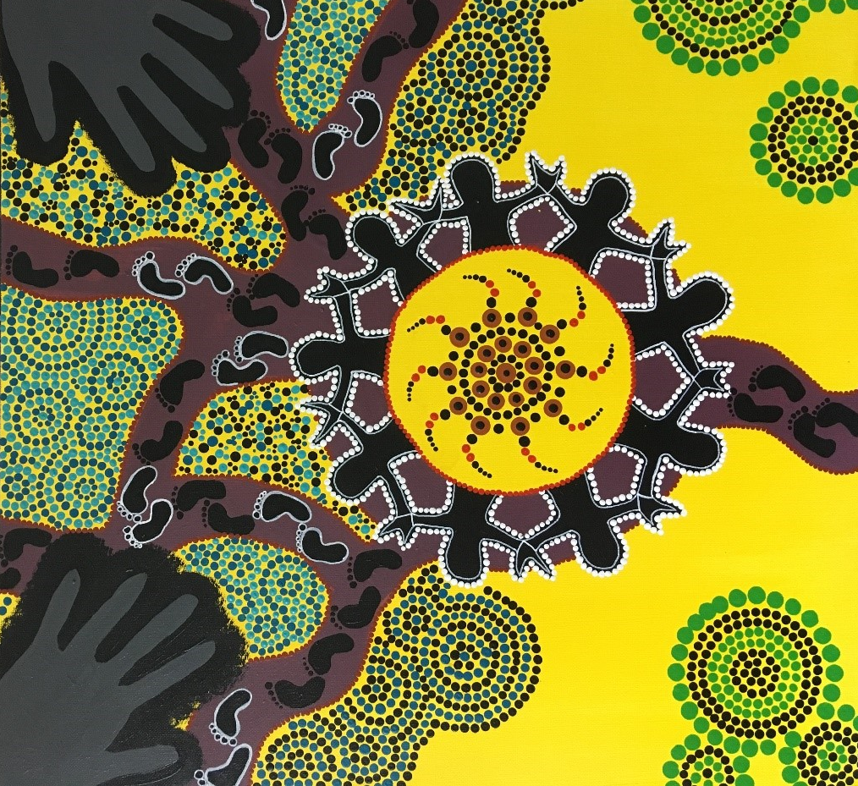


Acknowledgement of Country

Slide 4
Service improvement project: state-wide physical health practice for older people living with a mental illness
NSW Health
Implement pilot project of OPPHP across NSW in:
Residential care
Sub acute units
Community Mental Health
Charles Sturt University
Ethics approval, literature review and CSU research group
Neami National
Support with co-design of OPPHP, instructional video, and data monitoring.
Consumers and staff
Co-design the OPPHP
Notes:
Service improvement project: state-wide physical health practice for older people living with a mental illness
Delivered presentation to:
Physical health and social isolation have been identified by older people as two important areas of wellbeing that require intervention to improve their quality of life. There can be confusion around who is responsible for assessing and monitoring the physical health of older people accessing mental health services.
Work conducted by Neami’s NSW Health and Wellbeing Team in addressing the physical health of individuals living with a mental illness gained interest across the mental health sector, resulting in a request by NSW Health, Older Person Mental Health Services for Neami to partner with them and support implementation of the Physical Health Care Practice Improvement Project.
There were several projects identified to pilot across NSW involving Lhds, one such project was that of the Neami physical health prompt which is a screening tool to promote conversation in community practise using a recovery approach. This lead to the co- design of an older persons specific physical health prompt to be piloted in 5 lhds providing services to older persons in various mental health settings.
The project is still ongoing.

Slide 5
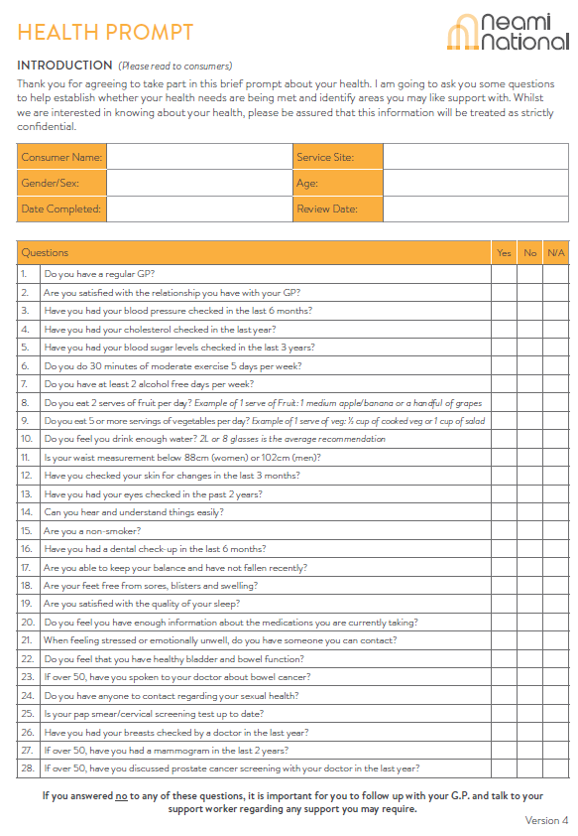
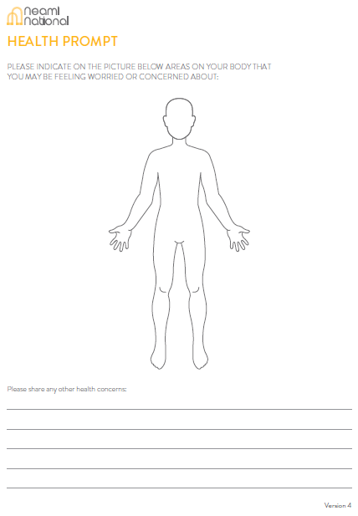
Neami National Physical Health Prompt

Slide 6
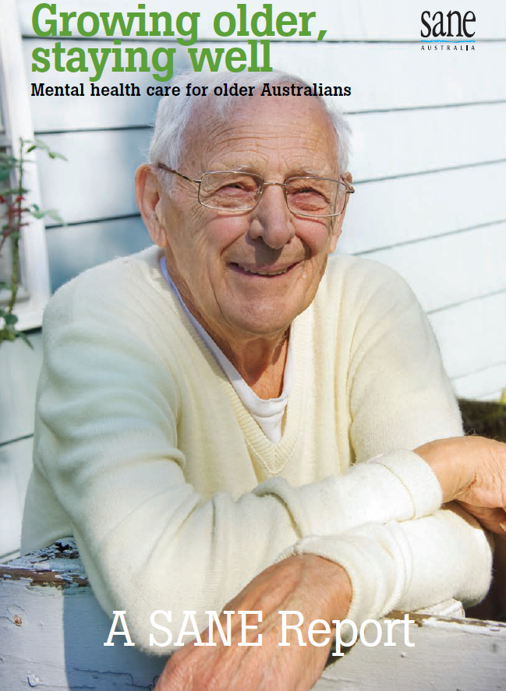


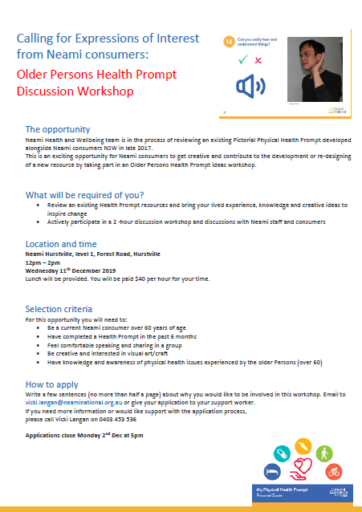
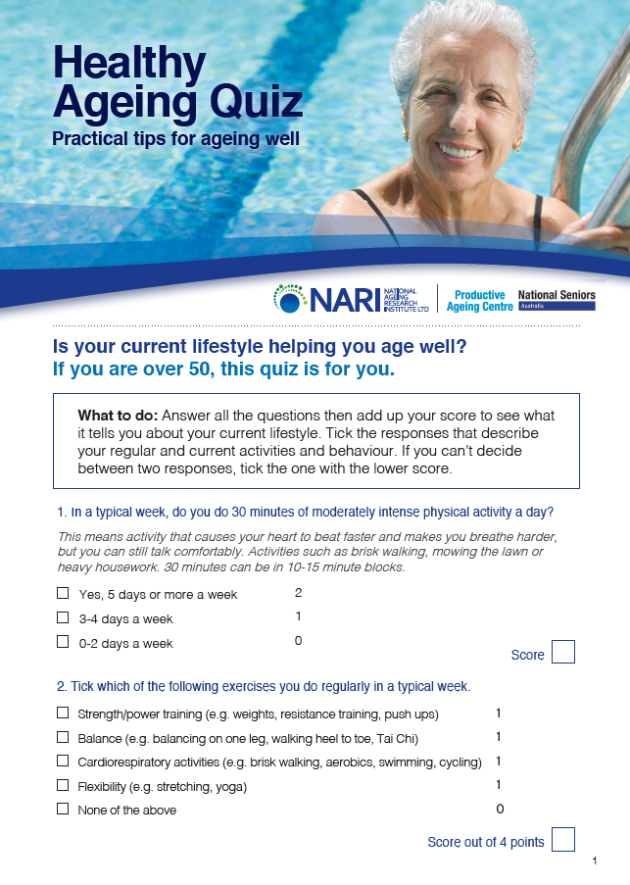
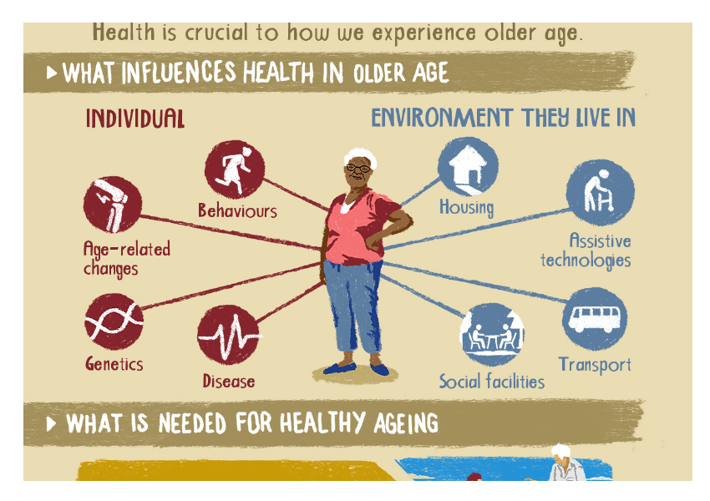
Older Person’s Physical Health Prompt
Notes:
Committee meetings
EOI

Slide 7
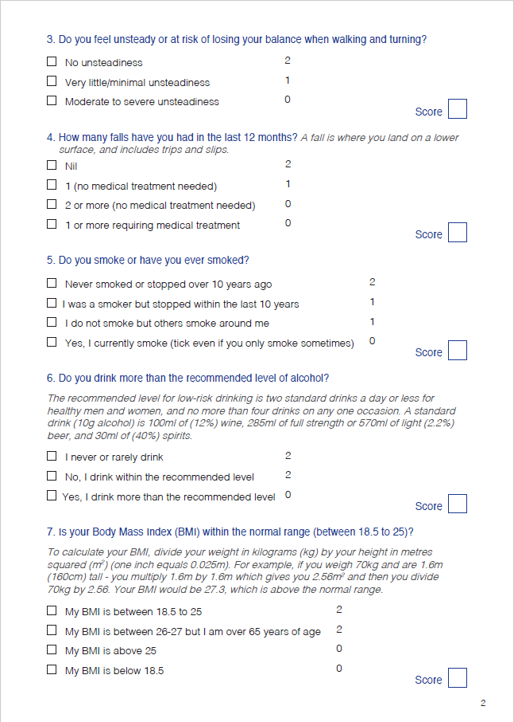
Notes:
Pre-reading
Looked for existing resources
What was found was that resources did not empower consumers to take ownership of their own health.
There was little opportunity for conversation and scoring system was very clinical.

Slide 8


Older Person’s Physical Health Prompt
Notes:
Online focus group
3X face to face focus groups

Slide 9
Co-design Feedback
Older Persons vs Seniors
Pain
National Recommendations
Accessibility
Wording
Physical Activity
Falls and balancing
Vaccinations
Nutrition
Medication
Sexual Health
Notes:
National recommendations
Needed to clarify many questions based on the national recommendations for the age group
“older persons vs seniors?”
What ages are older persons?
Accessiblity
Costs/ accessibility/ transport
GP so busy, that patient can’t be seen for 2 or 3 weeks, and no longer sick anymore.
Specialists
Fees for specialists
People cancel a lot because they can’t afford it
Can afford or access healthcare
Physical activity-
question needs to be there but need to add weight bearing/ strength exercise
More clarity needed around physical activity
Wording
Can you hear and understand things clearly
change wording- “do you think I’m stupid?
Nutrition
Access to food can be difficult:
if no transport- carrying fruits and veges can be painful
Buying fresh food but it goes off before being able to eat it
Cook big portions- but eat it all instead of saving it
Microwave meals- but have a lot of salt
Not being bothered to cook if alone
Emphasis on keeping balance and falling
A lot of discussion about this and the need to clarify this, including being able to navigate through small spaces.
Medication
a lot of discussion about drs not explaining it well/ not being told about side effects/ longterm efficacy
Sexual health
- this is an important question, but don’t get that this question also includes sexuality, intimacy and relationships, so an additional question about intimacy was added.
Vaccinations
It was noted that there wasn’t a question about vaccinations and the importance of this for the age group
Pain
A lot of discussion about pain, and needing to ask about this
Body chart as pain chart

Slide 10
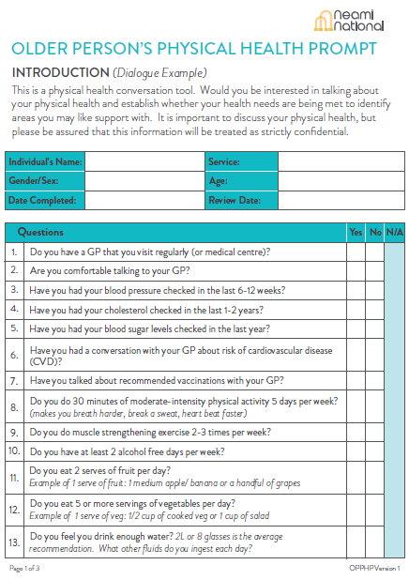
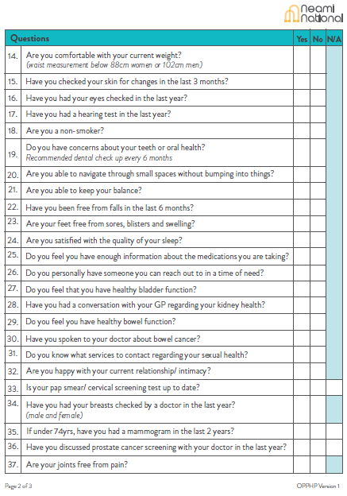
Notes:
Change colour
Larger font
-Some wording changes
E.g.
Are you satisfied with the relationship you have with your GP
Vs
Are you comfortable talking with your GP
1. Changed introduction message
2. Added questions
3. separated some questions into two

Slide 11
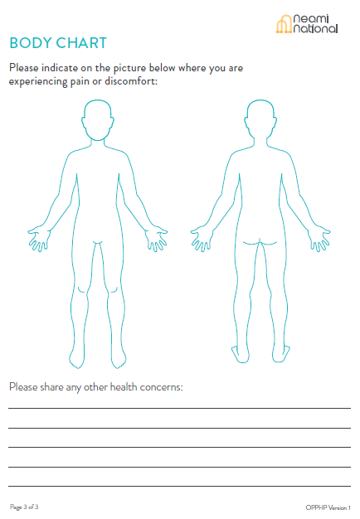
Notes:
Back of person

Slide 12

Instructional Video

Slide 13

Data Collection and Monitoring
Notes:
Have received completed health prompts from 3 of the 5 lhds and just onboarded two new lhds.
Here are some of the data

Slide 14
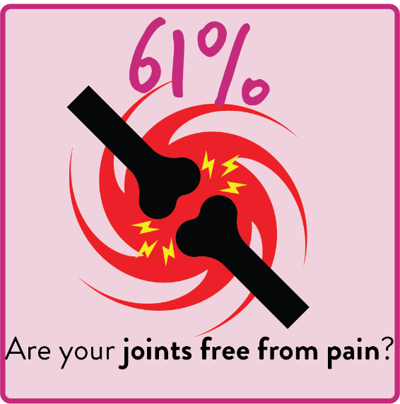
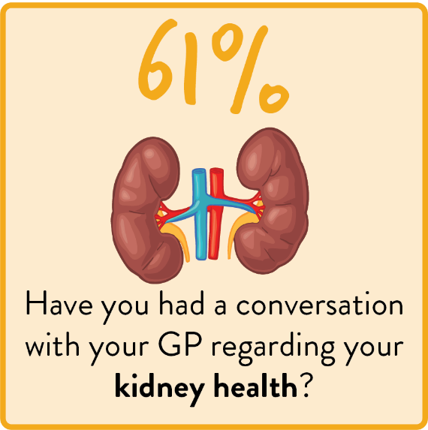
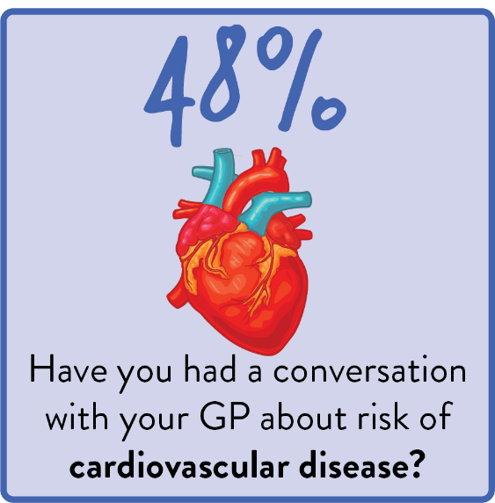
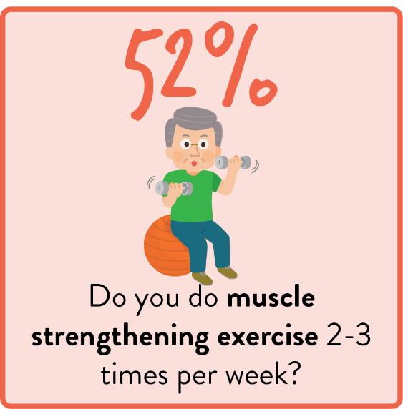

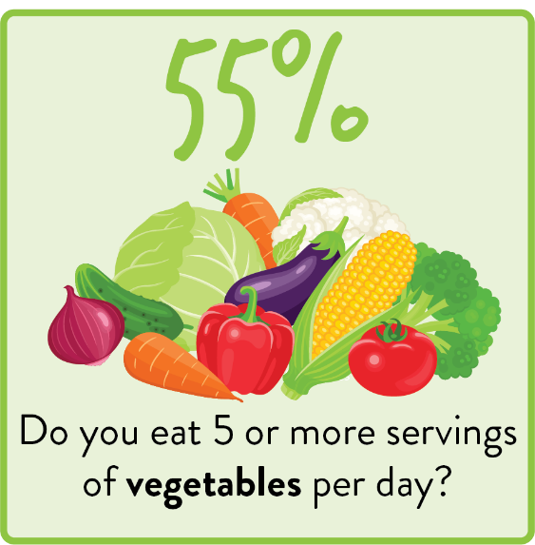
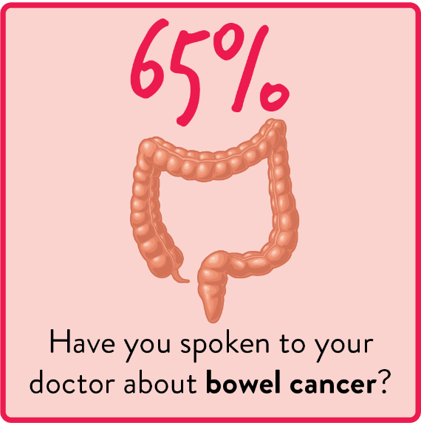
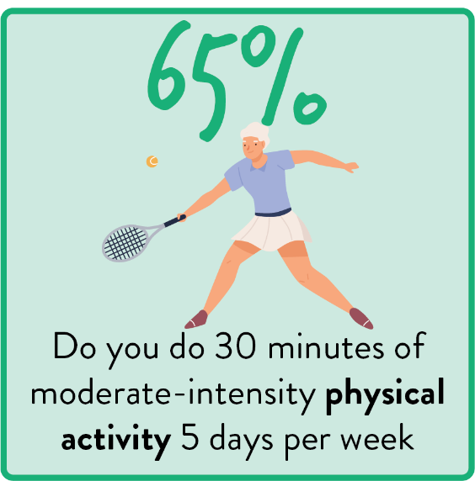
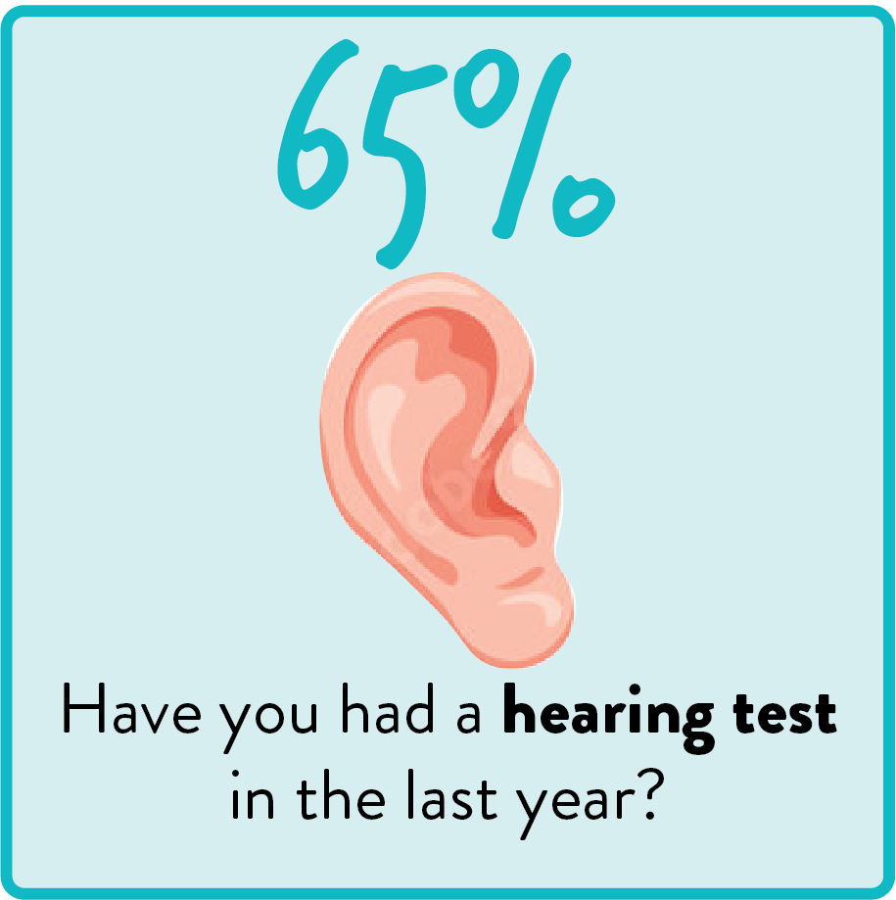
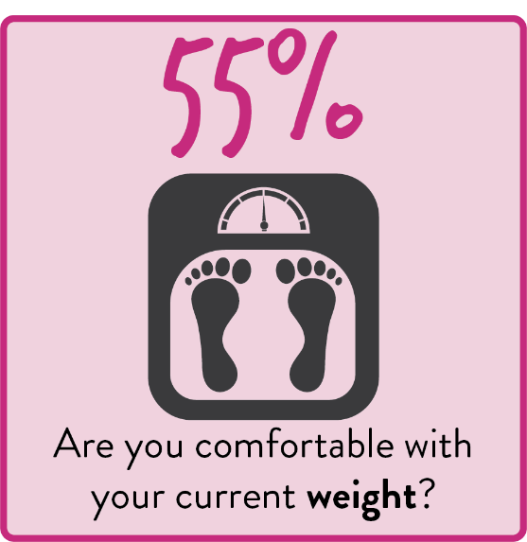
Top NO responses
Notes:
65-75, 4th highest cause of death is colorectal cancer and 65% haven’t spoken about bowel cancer
Coronary heart disease is 1st or 2nd cause of death 65-85+

Slide 15
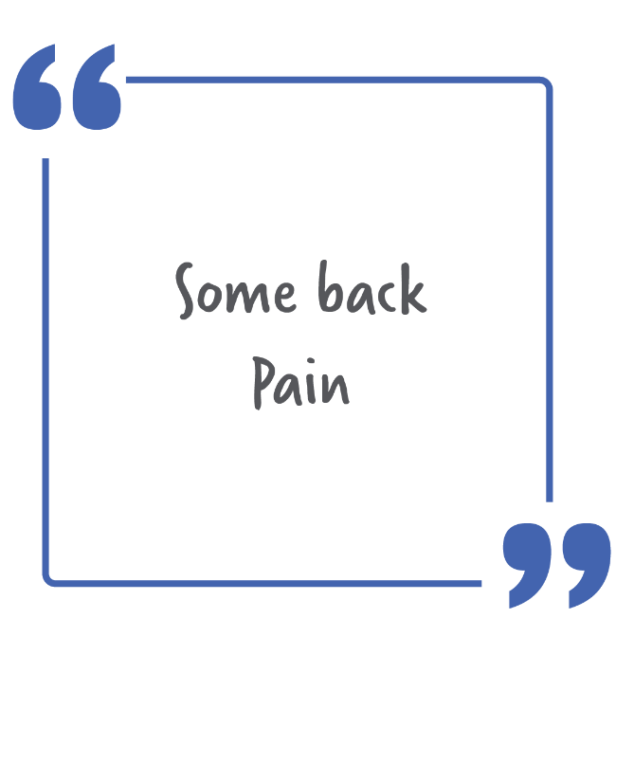
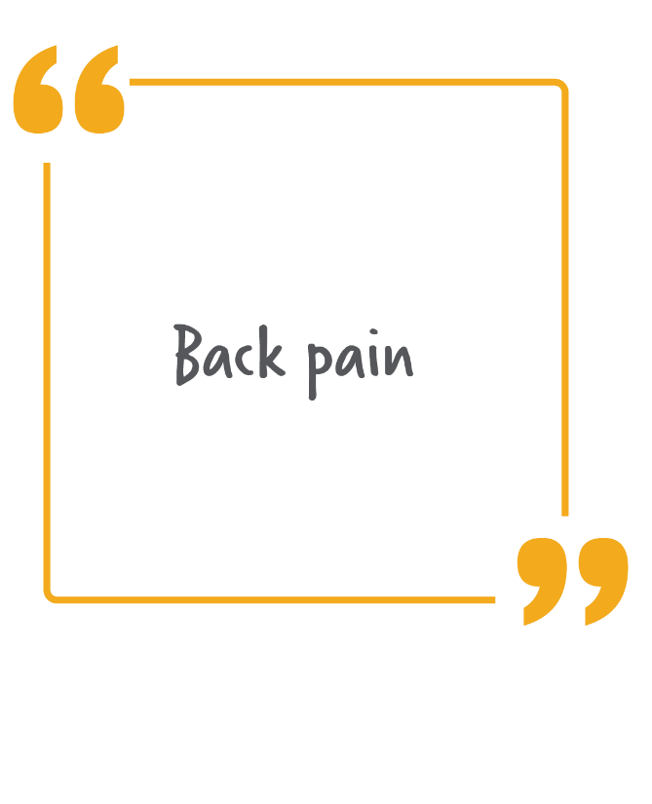
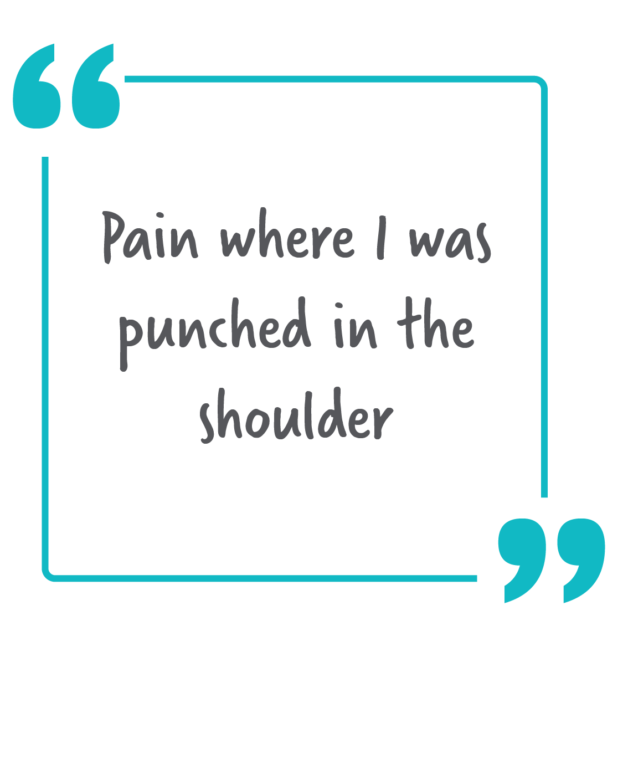
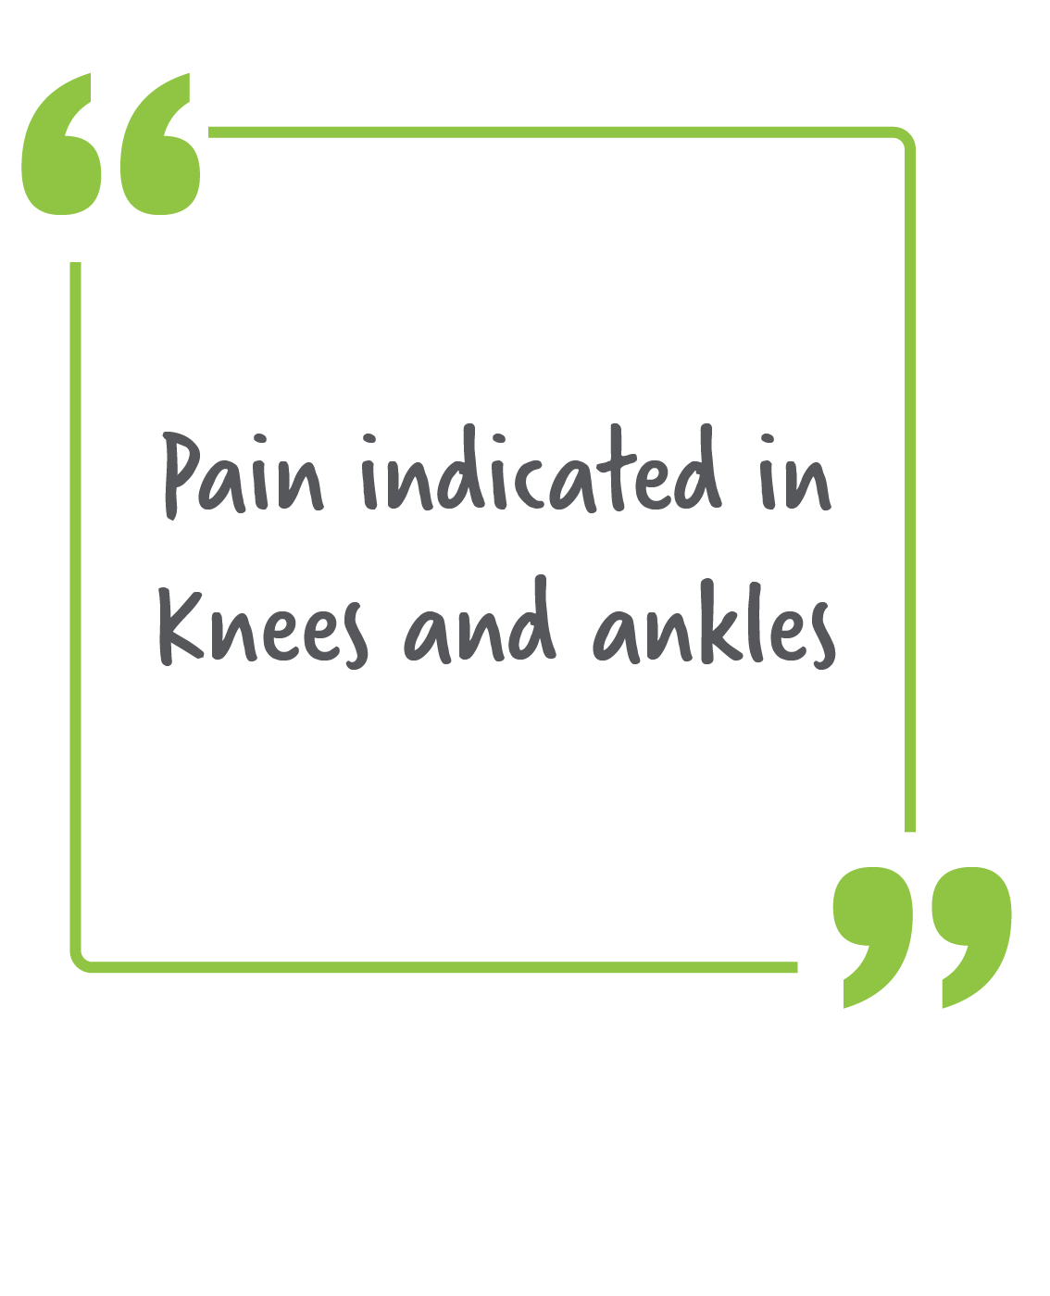
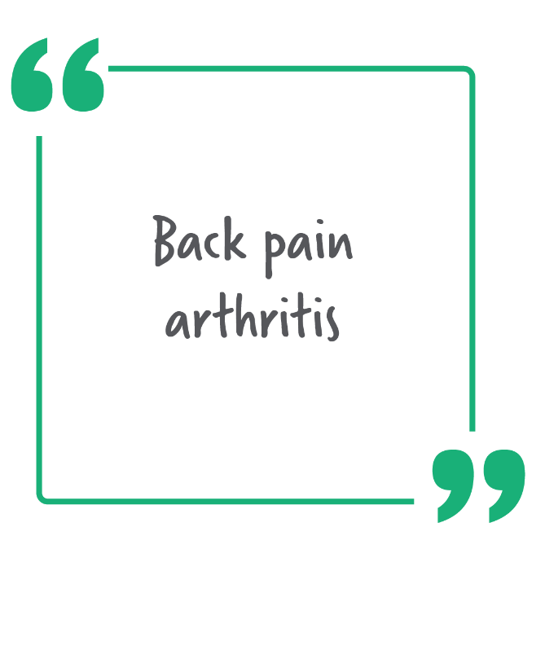
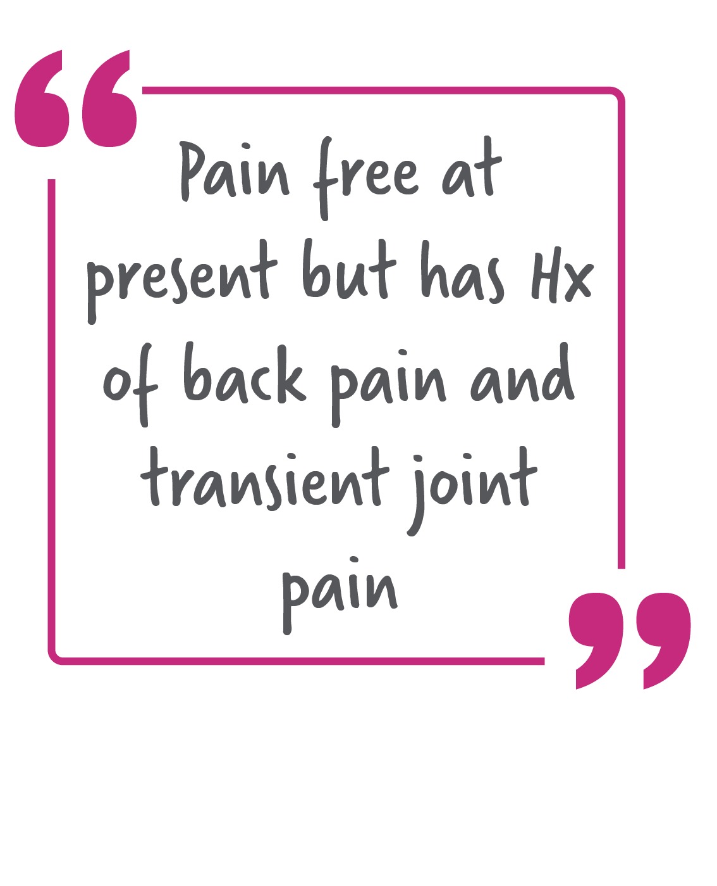
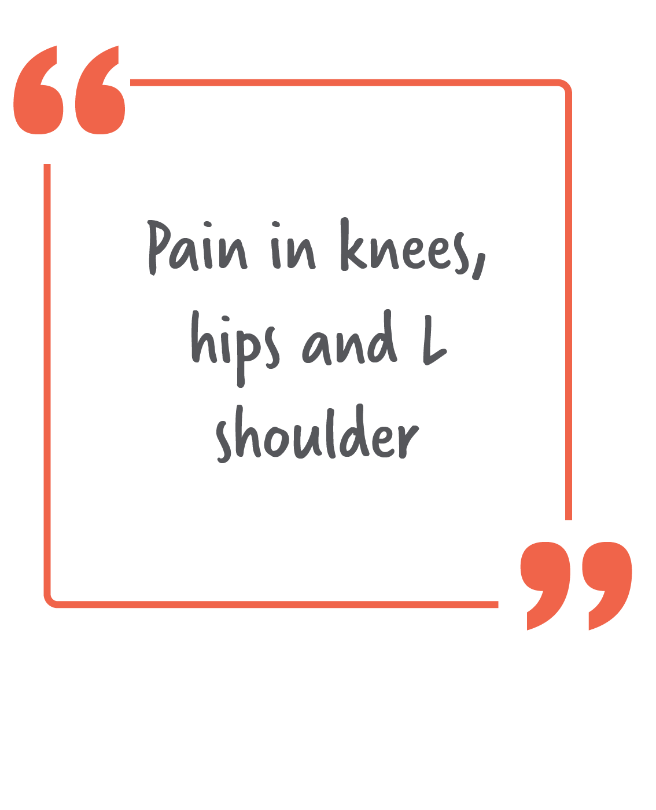
Notes:
Seven consumers reported pain related concerns

Slide 16
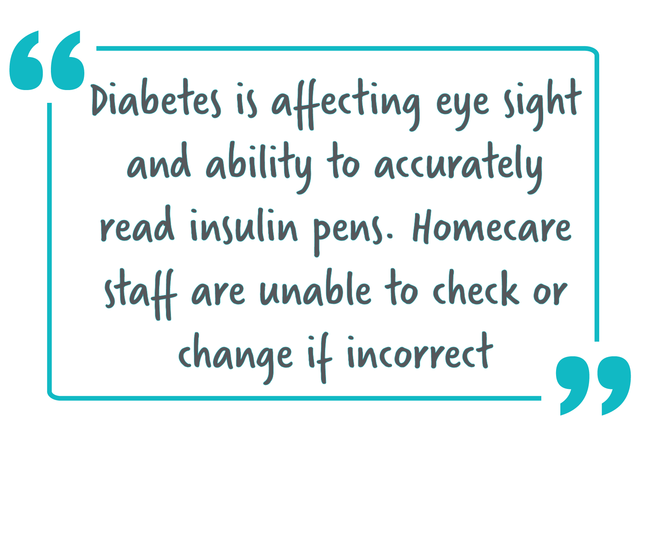
Notes:
Diabetes is effecting eye sight and ability to accurately read insulin pens. Homecare staff are unable to check or change if incorrect . Mood has been low

Slide 17
Falls/ mobility
Incontinence
Hearing
Weight concerns
Medication
Mood
Respiratory issues
Sleep
Notes:
Other notable concerns:
Falls/ mobility: 3
One person in a wheelchair
Has fractures to L foot and R ribs following recent fall
Dx Parkinson's diseaseMobility / stability varies daily
Hearing
Sleep
Weight: 2
Trying to lose weight, lost 5kg
Weight loss being investigated by GP
Mood
Respiratory (
Have problems with breathing end stage lung disease was never a smoker)
Lung cancer is leading cause of death in aged 65-75 and 4th cause of death in aged
Incontinence
medication

Slide 18
Never too old to be asked
Assumed sensitive topic
Staff comfort
Recovery conversation
Notes:
Staff feel uncomfortable asking questions that they don’t know the answers of/ they don’t know the topic well enough.
Actually have a conversation, not just a check list. Need to change from clinical assessment to a strength based conversations that empowers consumers to take ownership of their physical health/ recovery journey.
Assumed to be sensitive questions: weight/ sexual health/ mammogram/ prostate/ intimacy
Older persons identified that they need to be asked these questions
It’s dangerous to make assumptions in this context, but it’s something that we have identified throughout this process from CMH workers to GPs to primary health care workers. AS CMH workers we have an obligation to ensure the health and wellbeing of our consumers. Seeing that this resource is part of a larger initiative, the Physical Health Care Practice Improvement Project, and I would like to emphasise practise improvement, outcomes of this project need to be taken on board by service providers, even if it means changing current practise.

Slide 19
Leading causes of death, by age group, 2017–2019
 | 1st | 2nd | 3rd | 4th | 5th
65-75 | Lung cancer | Coronary heart disease | Chronic obstructive pulmonary disease | Colorectal cancer | Cerebrovascular disease
75-84 | Coronary heart disease | Dementia including Alzheimer disease | Cerebrovascular disease | Lung cancer | Chronic obstructive pulmonary disease
85 and over | Dementia including Alzheimer disease | Coronary heart disease | Cerebrovascular disease | Chronic obstructive pulmonary disease | Influenza and pneumonia
AIHW 2021

Slide 20

For more information, contact:
Vicki Langan
Vicki.langan@neaminational.org.au
0403 453 536
Or
Whitney Lee
Whitney.lee@neaminational.org.au
0423 780 250

