Slide 1
Vaccine preventable hospitalizations in mental health service users: a booster is needed
Grant Sara, Michael Lau, Wendy Chen, Myu Arumuganathan, Fred Wu
InforMH, System Information and Analytics Branch, NSW Ministry of Health
Northern Clinical School, Faculty of Medicine and Health, University of Sydney

Slide 2
Acknowledgement
The Yugambeh/Kombumerri people on whose lands we meet
People who have used NSW hospital or community mental health services, whose data we use with gratitude and respect

Slide 3
Context
Vaccine-preventable illnesses remain an important cause of illness and premature death
Evidence of impact on people living with Mental Health conditions is limited
Hepatitis: high prevalence
Respiratory illness: handful of studies showing lower vax rate, increased hospitalisation.
Recent NSW study found unexpectedly high rates of vaccine preventable hospitalisation
This study extends previous NSW study: larger data set (5 years), focus on adults
What is the rate of vaccine preventable hospitalisation for NSW adults who have had recent contact with MH services?
How does rate differ for different types of VPH?

Slide 4
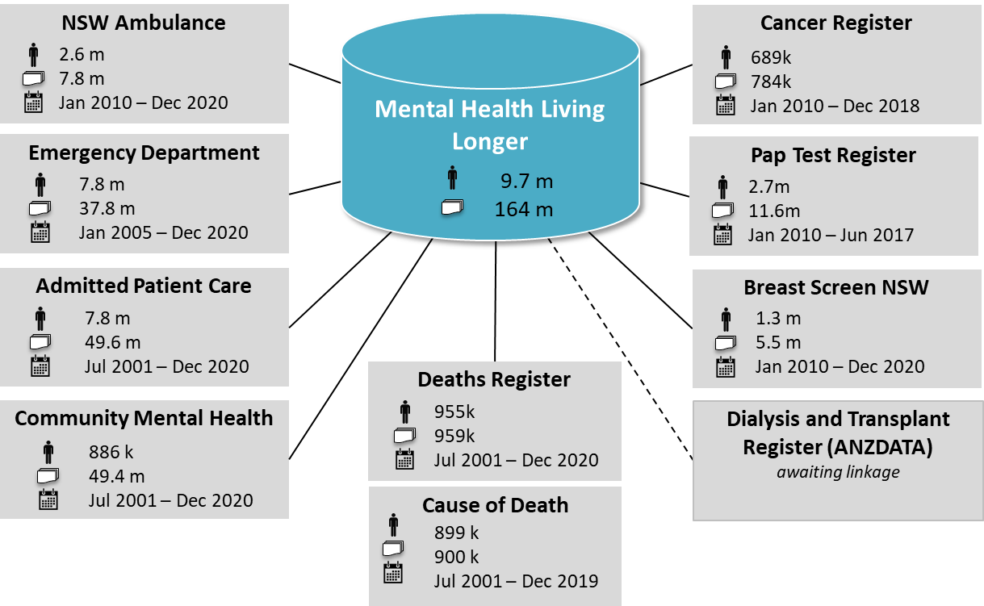
NSW Health Mental Health Living Longer data linkage
Supporting policy and system improvement to reduce premature mortality in people using mental health services
6 monthly linkage of:
Hospital (public and private)
ED and Ambulance
Cancer screening and care
Community MH
Dialysis and Transplant
Deaths
This study

Slide 5
Methods
Defining Mental Health care
2 year look back period and 5 year study period
MH Care = any MH service contact in look back or study periods
MH Care status is time-dependent:
MH person-years = time from first MH contact to end of study period (or death if sooner)
VPH before first MH contact are included in “No MH Care” rate
NSW hospitalisations
Jul15 – Jun20, Private and Public
People aged 20 - 100
Vaccine Preventable (VPH)
AIHW/ACQSHC PPH definitions
N = 100,290
Jul13
Jul15
Jun20
Look-back
Study
MH Care
VPH per 100k person yrs
No MH care
VPH per 100k person yrs
No MH Care
Public or private hospital, public community MH
308k unique persons
(187k persons pa)
Balance of NSW population aged 20-100
5.9 m
Index MH contact
MH Care
No MH
MH Care
Vaccine preventable hospitalisations
Adjusted IRR
(Age and Sex)
Statistical analysis
IRR standardised for sex, age-group
Age in 4 groups: 20-39,40-64,65-84,85+
Ages and NSW population centred at study midpoint (Dec 2017)
Include: Acute public and private hospital admissions
Exclude: non-NSW residents, non-acute admissions, mental health admissions, long stay admissions (>120 days)

Slide 6
Vaccine preventable hospitalisations (per 100k population)
MH Care
Respiratory infections
4.4
(4.2 – 4.5)
Hepatitis B
5.6
(5.4-5.7)
No MH Care
Respiratory spread
IRR 4.1
Adjusting for age and sex
aIRR 4.8
(95% CI 4.7 – 4.9)
3.5
(2.8-4.3)
Other
4.4
(3.3-5.8)
Admissions per 100k
aIRR
aIRR not calculated where MH n < 20

Slide 7
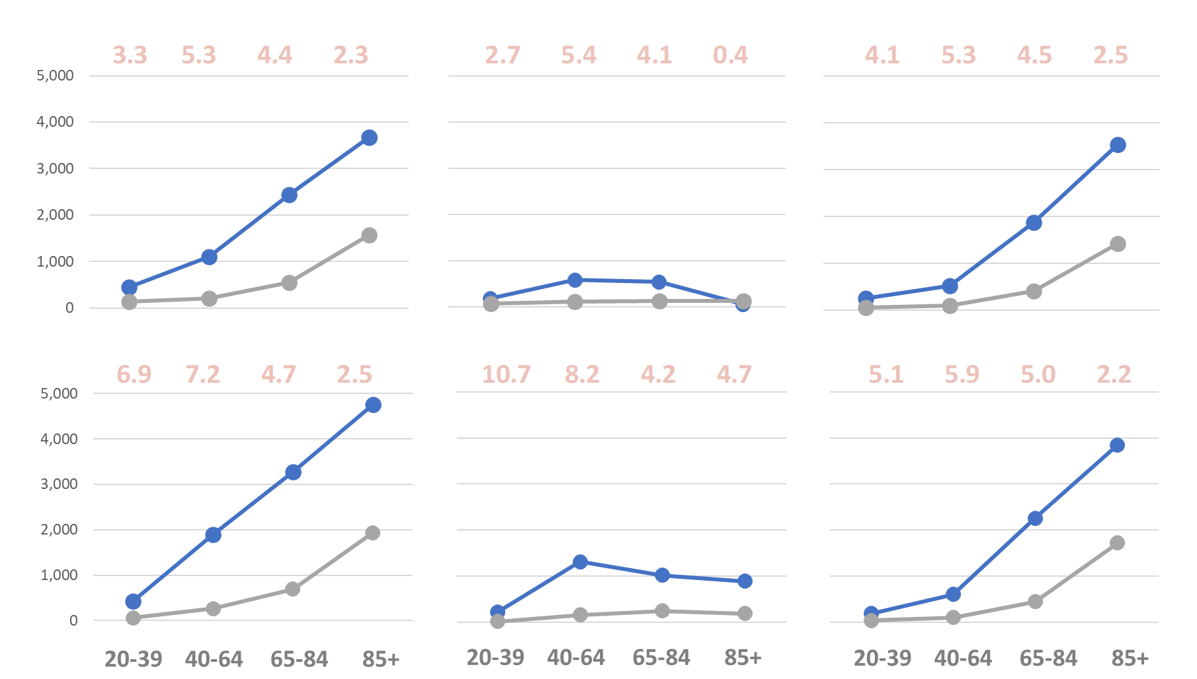
Absolute and relative risk differ by age, sex and VPH type
All PPH
Hepatitis
Respiratory
aIRR
VPH per 100k person years
Female
aIRR
Male
VPH per 100k person years

Slide 8
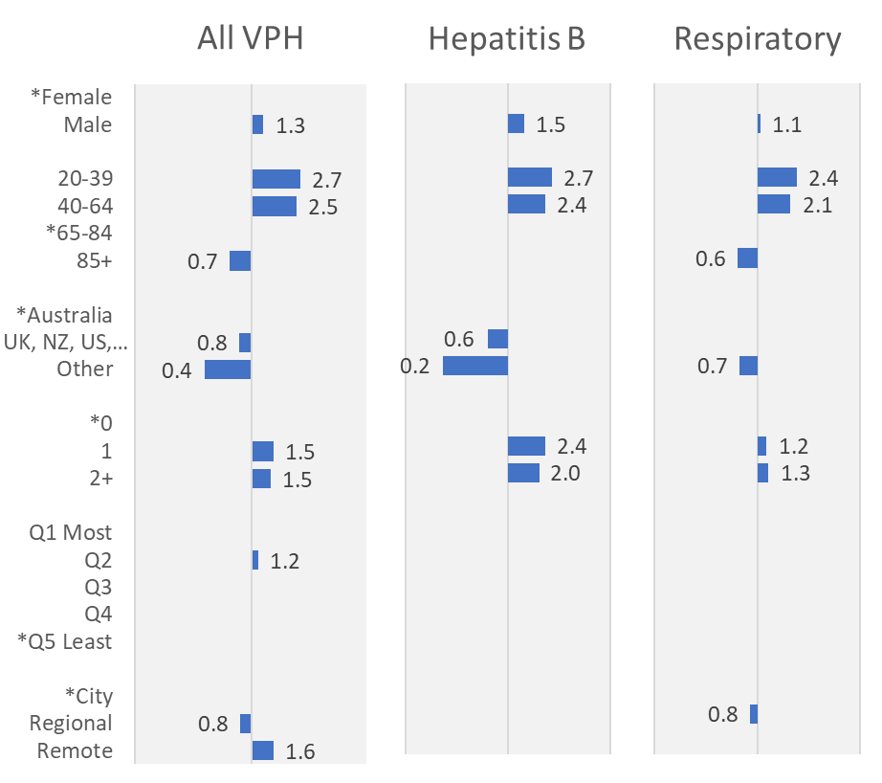
Compared to other people admitted for vaccine preventable illness, mental health service users are more likely to be:
Less likely
More likely
Sex
Male, younger (under 65), with comorbid medical conditions, born in Australia
Age group
Country of birth
Other medical illness (CCI)
These differences are not just due to living in more disadvantaged or rural areas
Disadvantage
Rurality
Multivariate odds ratios (OR) using binary logistic regression
Only significant odds ratios are shown
* = Reference category in each group
CCI = Charlson Comorbiity Index

Slide 9
Personal and system impacts are considerable
MH care
No MH Care
People with recent MH care make up…
6.0%
1.5%
3 % of NSW population
Chance of at least one VPH admission
1.7
1.4
12% of VPH admissions
VPH episodes per person
8.2
7.0
13 % of VPH bed days
Average days per VPH episode
Excludes admissions to MH units, non-acute admissions and long stay outliers (>120 days)
Pattern similar for all VPH types
17% of Hepatitis bed days
11% of Influenza bed days

Slide 10
Why do MH service users have more vaccine preventable hospitalisations?
Possible links …
Shared risk factors
Lower Vaccination rates
More exposure to illness
More severe illness
More severe symptoms
Hospitalisation
ICU Admission
Death
Disadvantage or rural location don’t appear to be the major drivers
Likely, but no direct evidence in this data
Home, work or study environments ?
(Flu, COVID)
IV drug use or unsafe sex ?
(Hepatitis)
Medical comorbidities lead to more severe illness and greater risk of hospitalisation

Slide 11
Action is needed. Action is possible.
Hepatitis B
Routine vaccine history and serology in younger people, risk groups
Promote vaccination, catch-up doses
Respiratory illness: Influenza, pneumococcus (and COVID)
Monitor and promote vaccination in all older or at-risk MH consumers
Consider all MH consumers > 40 or with medical comorbidity as at risk
Monitor and promote pneumococcal vax in MH consumers > 70
Health system barriers
Relational: trust, stigma, cultural safety
Structural: access, cost, regulations, integration, roles/responsibilities
Technical: location, data, KPIs and accountability
General health and risk factors
Support better overall health to reduce the impact and severity of vaccine-preventable conditions
Notes:
1. This is supported by previous research showing greater emergency department admissions for people with a mental illness (Ronaldson et al., 2020

Slide 12
Next steps for this work
People receiving mental health care are diverse: Further subgroup analysis planned
No data (yet) on COVID-related admissions
Limited or no data available on some important covariates
Smoking status
Vaccination status
Primary care access
…
Working towards routine linkage, reporting and KPI development

Slide 13
Thankyou
Mental Health Living Longer project team and collaborators
Steering Committee (Chair: Sharon Smith)
Aboriginal Sovereign Steering Committee (Co-chairs: Ashley Brown, Pauline Ferkula)
Academic Advisory Group: David Currow (Cancer NSW), Philip Burgess (UQ), Matthew Large, Jackie Curtis, Faye McMillan (UNSW), Parashar Ramanuj (National Orthopaedic Hospital, London), Niels Mulder (Erasmus U)
InforMH: Myu Arumuganathan, Wendy Chen, Fred Wu
Chris Lambeth: NSW Biostatistics Trainee Program
Grant.Sara@health.nsw.gov.au

