Slide 1
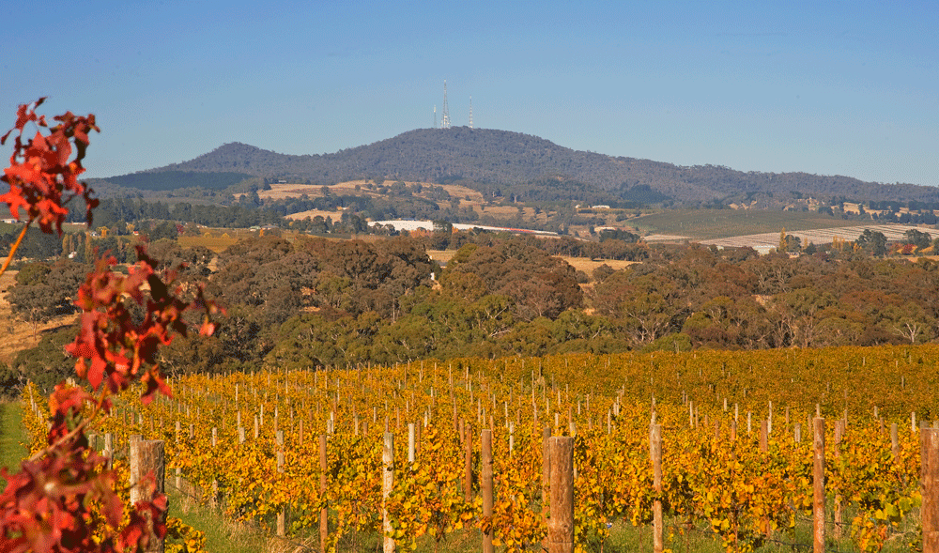

An effective partnership is key to a successful ‘physically active’ bush program
Gabrielle McNamara Caroline Robertson Tegan Hartmann Rachel Rossiter
District Coordinator OPMH Service Adjunct Research Fellow Lecturer Associate Professor

Slide 2
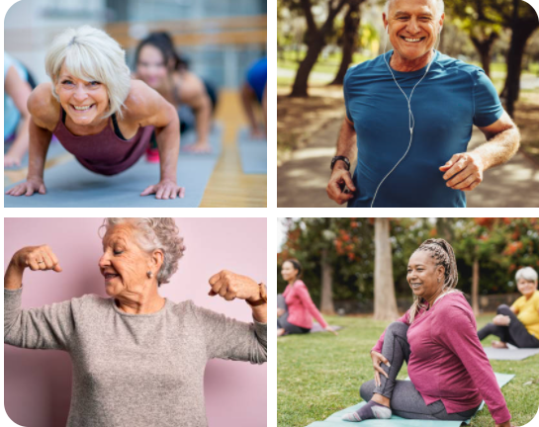
Overview
Implementing a community-based exercise program into an Older Persons Mental Health (OPMH) service in Orange, NSW
Why did we do it?
Who did we partner with?
What were the outcomes?
What were the strengths and challenges?

Slide 3
Mental Health and Exercise in older people
Exercise has been shown to be effective in improving both physical and mental health outcomes for older people living with a mental illness
Physical health
Weight management (Curtis et al. 2016)
Reduce the risk of chronic disease (Vancampfort et al. 2015)
Improved psychosocial function i.e. activities of daily living (Domenech-Abella et al. 2021)
Reduced risk of falls (Clemson et al. 2010)
Cognitive function (Langoni et al. 2019)
Mental health
Decrease symptoms of depression, (Bridle et al 2012) anxiety, stress and schizophrenia (Stanton et al. 2014)
Reduced social isolation (Domenech-Abella et al. 2021, Sen & Prybutik 2021)
Improved quality of life (Oliveira et al. 2019)
Notes:
Weight management (weight loss, maintenance and prevention of weight gain)
Reduce the risk of chronic disease (i.e. cardiovascular disease, metabolic syndrome & T2DM)
Older adults are well known to be at risk of falls leading to debilitation, social isolation and reduced confidence (Clemson et al., 2010).

Slide 4
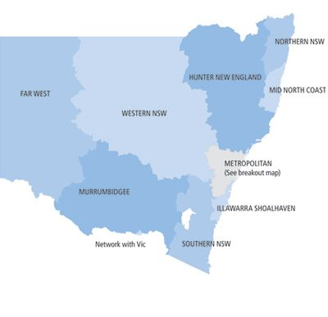
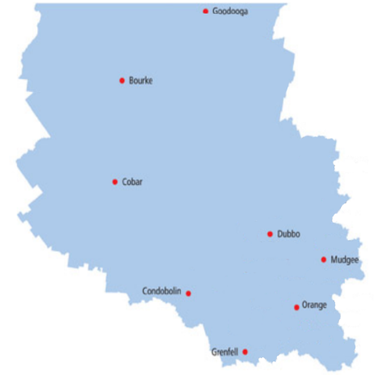
The Orange Older People’s Mental Health Service
Orange is a regional town, WNSW
Popn 40,000
4-hours drive from Sydney
Community based
Multi-disciplinary healthcare team
OT, social work, clinical nurse,
clinical psychologist and old age psychiatry
Provide case management to consumers
Notes:
Support and education to carers also
Older People’s Mental Health Service

Slide 5


Why a physical activity program?
Increased physical health needs
Nothing existing locally
Staff interest
Fit For Your Life
High proportion of older people live with complex health needs
“Having a place [for physical activity] that is easy to get to”
My experience would have been better if…
“I had physical activity
as part of my care”
“Gyms scare me and it’s expensive”
Notes:
Why did WNSWLHD decide to develop a physical activity project?
Older people experiencing mental illness have complex care needs.
Orange OPMHS recognised the physical health difficulties that their clients were experiencing with older age.
Nothing existing locally that met their consumer needs – easily accessible, suitable for those with mental illness. no/low cost; ease of access (regional areas - transport); tailored to mental health needs (existing gym spaces less likely to be accessed by a person unfamiliar with the space or large group sizes not conducive); currently no group program offered within existing OPMH service model (OT commenced and opportunity available).
Staff attended a FFYL workshop in Sydney – run by MFS. Falls risk and cognitive decline.
However clinicians did not identify having all the skills to meet the needs
Role of other service providers and opportunities to strengthen partnerships
Developed from perceived needs of the service and by feedback from consumers

Slide 6

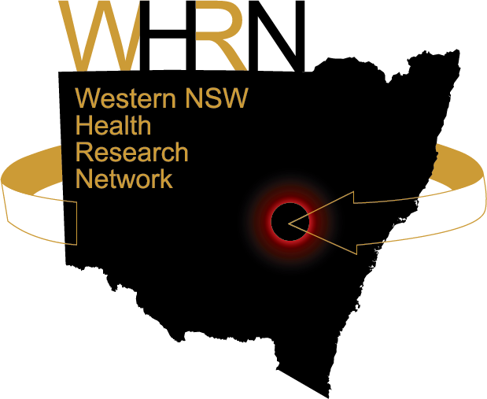

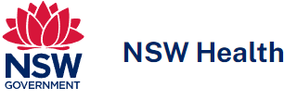
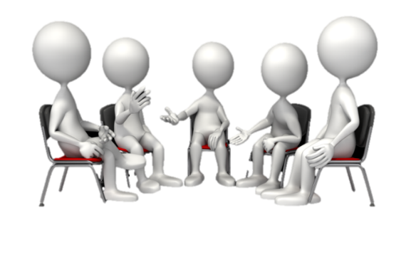

Building partnerships
OPMH policy unit
WNSW LHD Research directorate
RPT Health group (AEP)*
Charles Sturt University
Orange
OPMHS
Quantitative project Mixed methods project
*Accredited exercise physiologist
Notes:
The original team identified a gap in care and recognised that they couldn’t achieve this work in silo and reached out to the Local Health District (LHD), Director of Research and through this, sought connections and networks extending to external organisations including academic researchers and AEPs.
The OPMH Policy Unit of the Mental Health Branch of the NSW Ministry of Health works closely with state-wide OPMH services to provide strategic guidance and in 2019 had identified physical health care in OPMH as a key priority – this was very timely.
The key aspects of this were used to provide local leverage to advance the project; enhance the skills of the clinicians in development and design of the program
Essentially, the project design was based on partnerships incorporating clinicians from a public mental health service, AEPs from a private business and university based academic researchers and expertise from different fields and skill sets.

Slide 7
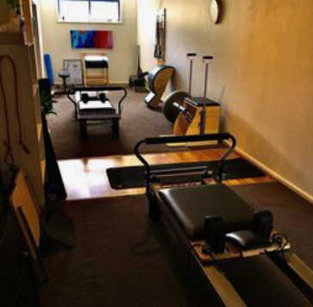
Adapting the Fit For Your Life program
Self determined exercise intensity
A 9 week exercise program
Self determined exercise intensity
A 9 week exercise program, three 60-minute sessions
Three 60-minute sessions weekly
Focus on fall prevention
Delivered by an AEP & with an OPMH clinician
Accessible to the community
Notes:
This brings us to the exercise program layout
The program was in line with key research about frequency, intensity, time and type
Recognised local adaption of these to meet regional community needs
Built with local community in mind
Acknowledged workforce, skills and environments required
Delivery of a 9-week exercise program consisting of three 60-minute weekly sessions to participants already engaged with case managers from the local Older Persons Mental Health Service (OPMHS). The program was delivered by an AEP in a fully equipped environment accessible to community members with a design informed by research and consisting of a combination of cardio, balance, and resistance training tailored to the identified needs of each participant.

Slide 8
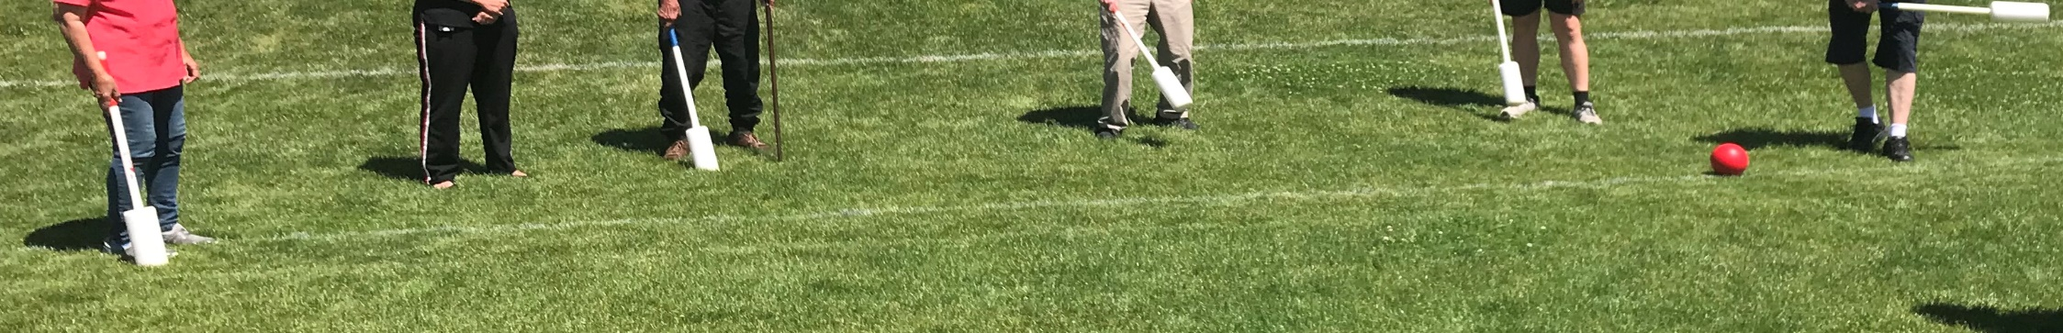
Program outcomes
Physical health
Timed up and go
Berg balance test
30s sit to stand *
10m walk test (normal) *
10m walk test (fast) *
(clinically meaningful change, Perera et al. 2006)
Mental Health
* K10
29
13
DASS
  * Depression and anxiety scores
  Severe
  Normal
Two participants scores decreased from severe mental disorder to within normal range
* P < 0.05
Notes:
Our key driver was to improve physical health, and the project demonstrated that.
Participants described improvements in fitness, balance and more awareness of falls related risks, which converged with improvements in their physical test scores.
*significant improvements from pre to post test data (p<0.05) for the 30s STS test and for both the 10mNORM and the 10mFAST tests (see table 3). Both the BBT and the TUG showed improvements, TUG showed a trend to be significantly faster (p = 0.06) but the BBT was not significantly different.
They also reported feeling improvements in mood such as feeling brighter, having a more positive outlook and increased motivation and this was reflected in both the K-10 and the DASS-21 scores.
* significant improvements from pre to post test data (p<0.05) in both the K10 and DASS responses

Slide 9
Program outcomes
“I guess it is like anything, the more you do, you get better” (Jack)
“I am feeling much safer on my feet and we have been taught how to walk which is important” (Helen).
“gave me a purpose” and “I don’t come home and go back to bed” (Jack).
“It just didn’t help your physical self … it helped you mentally as well” (Helen).
Notes:
Our key driver was to improve physical health, and the project demonstrated that.
1) that older adults in this setting actively engaged in a program that was led by an experienced professional and tailored to their needs
2) exercise supported an improvement in depressive and other mood related symptoms
3) exercise improved physical function outcomes
4) exercising as a group provided a sense of belonging and important social interactions.
Qual data showed that ppts engaged in the program, found both mental and physical health benefit s and wanted to do more!

Slide 10
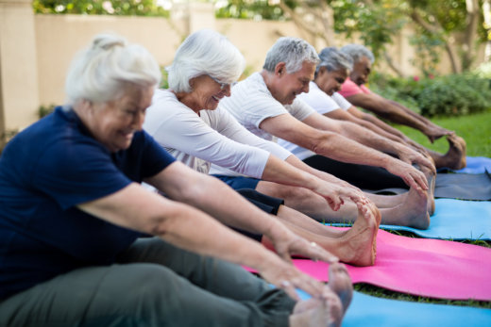
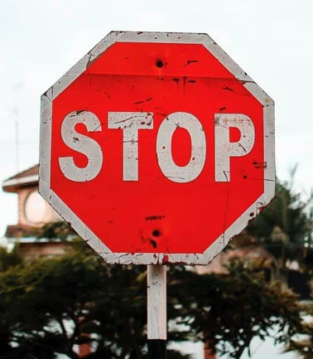
Challenges
Changing workforce & leadership
Limitations to resources
Shift in partnerships
Difference in “how we worked”
+
Covid restrictions
(Ocloo, et al, 2021; Henderson, et al, 2018).
Notes:
Adaptation became key to this project with changing workforce, resources, partnerships with AEPs and processes of how we worked. These factors are well known barriers to partnership success (Ocloo, et al, 2021; Henderson, et al, 2018). One study argued that incentives for individuals to adapt and collaborate is crucial for innovation (Kippin & Fulford 2016).
As alluded to earlier,
Covid restrictions in particular meant a stop to in-person meetings delaying project implementation however a unique advantage of working in a rural/regional setting had already meant that infrastructure related to virtual platforms were available and partnerships could be maintained through these systems. Equipment resources and processes for the project needed to be adapted in line with covid restrictions highlighting challenges in applying research to practice including processes for supporting participants without independent transport. The OPMHS ensured personal barriers to accessing the program were minimised and this included inclusion of transport.

Slide 11
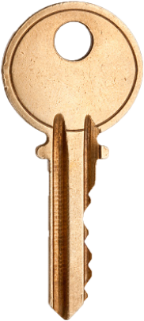
Keys to success
Partnerships & collaboration
Leadership
Adaptability
Flexibility
Trust
Notes:
Adaptation became key to this project with changing workforce, resources, partnerships with AEPs and processes of how we worked. These factors are well known barriers to partnership success (Ocloo, et al, 2021; Henderson, et al, 2018). One study argued that incentives for individuals to adapt and collaborate is crucial for innovation (Kippin & Fulford 2016).
As alluded to earlier,
Covid restrictions in particular meant a stop to in-person meetings delaying project implementation however a unique advantage of working in a rural/regional setting had already meant that infrastructure related to virtual platforms were available and partnerships could be maintained through these systems. Equipment resources and processes for the project needed to be adapted in line with covid restrictions highlighting challenges in applying research to practice including processes for supporting participants without independent transport. The OPMHS ensured personal barriers to accessing the program were minimised and this included inclusion of transport.

Slide 12
Partnership strengths
Accredited Exercise Physiologist
Catered the program to the needs of the consumers
Researchers
Lived experience
Person centered approach
Ecologically valid program
Exercise physiology and mental health backgrounds
Engaged early on
Comfortable with no set exercise program (type or intensity)
Reaching a wide audience - influence
(Witteman, et al, 2018; Kerkhoff, et al, 2022; Fields, et al, 2021).
Notes:
Research shows value in cross-sector partnerships, incorporating academic knowledge of research design with clinician skill and knowledge of interventions and then implemented in real-life (Witteman, et al, 2018; Kerkhoff, et al, 2022; Fields, et al, 2021).

Slide 13
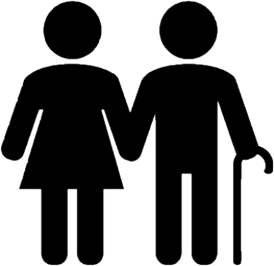
Leadership from the ground
Collaboration
Commitment
Responsibility
Passionate clinician!
Accountability
Perseverance
Motivation
(Bonawitz, et al, 2020; Demes, et al, 2020; Naylor, et al, 2016)
Notes:
Needed leadership from the ground up
From our experience, leadership was from two key members from clinical and academic backgrounds who were committed and persevered.
It was these attributes that were influential in promoting the project at all levels and maintain stakeholder engagement and project kept moving forward.
A few studies describe these key people as ‘champions’ (Bonawitz, et al, 2020; Demes, et al, 2020; Naylor, et al, 2016) and a number outline attributes for successful change in healthcare that are similar to attributes of our leads: responsibility, persuasiveness, tenacity, accountability, dedication and motivation (Bonawitz, et al, 2020; Demes, et al, 2020; The Kings Fund, 2016; Henderson, et al, 2018).
“We were just doing our job” and keeping the people we work with at the heart

Slide 14
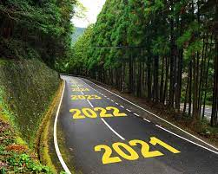
Next steps
“I am planning on continuing on, I don’t want to just stop now” (Sue)
AEP now works for LHD in mental health
Submitted a research article for publication
Presented findings to the OPMH policy unit
How do we keep this going?
Notes:
What we created:
An exercise program that older people of the mental health service were engaged in and were positive about! -
We have a key group who remain passionate about positively impacting physical health in mental health in regional NSW
One key partner has moved beyond working in the private community setting and into working directly within a mental health setting providing AEP
OPMH are continuing to consider how to re-establish the program in an endemic
We have submitted a paper for publication on the “Effectiveness and benefits of exercise on older mental health consumers’ physical and psychological outcomes in regional Australia – a mixed methods study”
And have presented findings to the OPMH Policy Unit of the Mental Health Branch of the NSW Ministry of Health (Steering group) and to Equally Well evaluators
We wish to build the knowledge and research in a regional setting for OPMH and physical health – if you would like more information on our process, design, implementation, please reach out

Slide 15
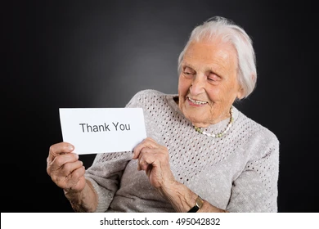
Thank You
For more information, please contact:
Gabrielle McNamara
Gabrielle.mcnamara@health.nsw.gov.au
Dr Caroline Robertson
carobertson@csu.edu.au

Slide 16
Recommendations
Carers
Larger participant cohort
Other resources
Research design
CV and metabolic health
Partnership with GP or physical health nurse
Exercise and the MBS

Slide 17
NSW Agency for Clinical Innovation Framework
VISION
Easily accessible physical activity program
Suitable to the needs and wants of the older persons being cared for by the OPMHS team
System design principles
Shared vision for older persons services in local communities
Involve older people and value their experiences as much as clinical effectiveness
Making integration happen
Empower participation
Co-developed
Shifting clinical team behaviours
Components of the ACI “Framework for Integrating Care for Older People with Complex Health Needs” were adapted and applied

Slide 18
More than expected
Clinicians
Academics
AEP
State leadership
Managers
Notes:
However, we achieved more than we expected with the connections that developed across participants, clinicians, academics and AEP stakeholders adding value to positively impacting physical health in mental health in regional NSW.

