Slide 1
BreastScreen participation rates in mental health consumers
Chris Lambeth¹, Grant Sara^{1,2}, Wendy Chen¹, Myu Arumuganathan¹, Fred Wu¹, David Currow³
1: InforMH, System Information and Analytics Branch, NSW Ministry of Health
2: Northern Clinical School, Faculty of Medicine and Health, University of Sydney
3: Cancer Institute NSW

Slide 2
Acknowledgement
The Yugambeh/Kombumerri people on whose lands we meet
People who have used NSW Breastscreen, hospital or community mental health services, whose data we use with gratitude and respect

Slide 3
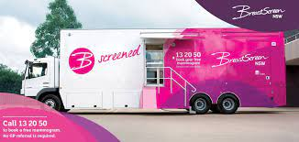
Breast cancer is the most common cancer in Australian women
28% of reported cancers
14% of cancer deaths
More than 3,200 deaths per year in Australia
Breastscreen Australia has offered free biennial screening for women aged 50-74 since mid 1990s
Advances in screening and care have reduced mortality
Screening halves mortality in participants
1 death averted for each 500 persons screened

Slide 4
BreastScreen participation in women living with mental health conditions ?
US and European clinical studies find 20-50% lower screening rates
Evidence is limited
  Few large population studies
  Few studies adjust for possible confounders
  No data from Australasia
We know that
  Health system factors influence screening rates
  In NSW screening rates are lower for Aboriginal and Torres Strait Islander women, women from non-English speaking background or living in disadvantaged areas
We need Australian data on breast screening participation in women who use mental health services
Screening study aims
Describe BreastScreen participation in NSW mental health service users aged 50-74
Compare to population rate after adjusting for other factors which may influence screening rates

Slide 5
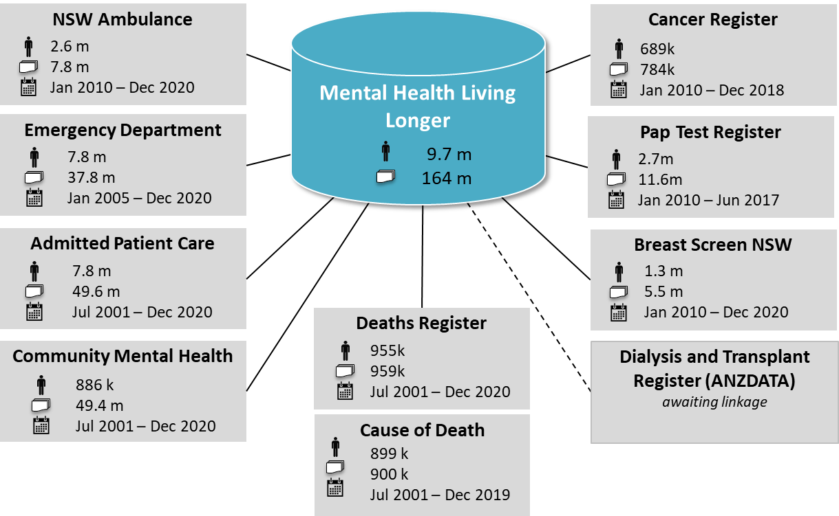
NSW Health Mental Health Living Longer data linkage
Supporting policy and system improvement to reduce premature mortality in people using mental health services
6 monthly linkage of:
Hospital (public and private)
ED and Ambulance
Cancer screening and care
Community MH
Dialysis and Transplant
Deaths
This study

Slide 6
Method
NSW BreastScreen data
NSW women aged 50-74 with at least one screening mammogram
(small number of private screening mammograms not included)
Jan 2017 – Dec 2018.
n = 564,688
NSW Mental Health service data
Women aged 50-74 with any NSW mental health service contact
Public or private hospital admission, public community mental health teams.
(No data from private or NGO community services)
Jan 2015 – Dec 2018. n = 33,591
Split by mental health service user status
Mental health service users with at least one mammogram
n = 10,177
Other NSW residents with at least one mammogram
n = 554,511
Calculate crude and standardised population rates
Mental health service users
n = 33,591
Other NSW women aged 50-74
n = 1,051,495

Slide 7
2 year BreastScreen Participation rate
Incidence Rate Ratio (IRR) 0.57
Women aged 50-74 who have recently used NSW Mental health services were 43% less likely to have had a screening mammogram than other NSW women of the same age.
Mental health service users
(33,591)
However, mental health service users were
Younger
More likely to live in rural or disadvantaged areas
Could that explain these differences ?

Slide 8
Screening gaps were large in all subgroups
In the NSW population, screening rates were lowest in younger women and more disadvantaged areas.
Women who used mental health services had much lower screening rates for all age groups and regions
Mental Health service users

Slide 9
Adjusting for age, disadvantage or region does not change the gap
Rate | MH service users (%) | Other NSW residents (%) | IRR (95% CI)
Crude rate | 30.3 | 52.7 | 0.57 (0.56-0.59)
+ Age | 30.6 | 52.7 | 0.58 (0.57-0.59)
+ Age, disadvantage | 31.0 | 52.9 | 0.59 (0.57-0.60)
+ Age, remoteness | 30.8 | 52.9 | 0.58 (0.57-0.59)
(Rates adjusted by direct standardisation to the NSW 2018 population)

Slide 10
Does reduced screening lead to more advanced cancer?
Current study
  NSW Cancer Register, 10 years (2008-2017)
  NSW residents aged 50-74 with invasive breast cancer
  Degree of spread
    Local
    Regional (surrounding organs or lymph nodes)
    Metastatic
  29,966 women
    686 (2.4%) had recent MH service contact
  At cancer diagnosis MH service users were
    Younger
    More likely to live in disadvantaged areas
Preliminary findings
Screening is critical: for the NSW population, women with no past screening had higher risk of regional (1.8x) or metastatic (4.8x) spread at diagnosis
Mental health service users diagnosed with cancer were
Less likely to have had recent breast screening
More likely to have regional or metastatic spread
BREAST SCREENING
DEGREE OF SPREAD
Past
Recent
Regional
Metastatic
Other NSW women
MH service users
Other NSW women
MH service users

Slide 11
Reduced screening contributes but is not the whole explanation
64%
Predictors of | Regional spread | Metastatic spread
Age | Younger age | Older age
Socioeconomic status | More disadvantaged
Region | Urban location
After adjusting for age, disadvantage and rural location
MH service use | 1.6 (1.4 - 1.8)
+ adjusting for BreastScreen participation
Never screened | 2.1 (1.9-2.2) | 3.8 (3.4-4.2)
Past screen | 1.6 (1.5-1.7) | 2.2 (1.9-2.6)
MH service use | 1.5 (1.3 - 1.8)
53%
53%
46%
Regional or metastatic
46%
35%
Regional
Metastatic
Partial proportional odds regression, Odds Ratios for age, disadvantage and region not shown
Even among women with recent screening, mental health service users were more likely to have advanced disease at diagnosis
After adjusting for age and demographics, mental health service users were 60% more likely to have advanced disease at diagnosis.
BUT also adjusting for BreastScreen participation only slightly reduced this risk (to 50%).
This suggests other factors also contribute.

Slide 12
Summary
Study 1: Using Breastscreen data for all NSW women aged 50-74 over 2 years
  Only 30% of mental health service users had a recent screening mammogram
  This compares to 53% of other NSW women of the same age
  Younger age, greater disadvantage or rural location do not explain these differences
  Adjusted rate ratio 0.58
Study 2: Using NSW Cancer Register for women diagnosed with breast cancer over 10 years
  Mental health service users were less likely to have had a recent screening mammogram before cancer diagnosis
  After adjusting for age and demographics they were 60% more likely to have advanced disease at diagnosis
  However lower screening participation only explained a small part of that risk

Slide 13
Action is possible
Build data and understanding
  Develop ongoing data and reporting on screening rates
  Understand barriers: personal, cultural, health system (stigma, acceptance, trust) …
  Explore factors contributing to more advanced disease
  Explore Breast Cancer care and outcomes
Increase BreastScreen participation
  Develop flexible, locally appropriate models to support choice
  Address the barriers
  Monitor what works
Build alliances and partnerships
  Closing gaps and addressing disadvantage is a priority for cancer strategies
  Coordinate efforts : lived experience, screening services, primary care, community organisations, cancer treatment services, mental health services
Notes:
1. This is supported by previous research showing greater emergency department admissions for people with a mental illness (Ronaldson et al., 2020

Slide 14
Thankyou
Mental Health Living Longer project team and collaborators
  Steering Committee (Chair: Sharon Smith)
  Aboriginal Sovereign Steering Committee (Co-chairs: Ashley Brown, Pauline Ferkula)
  Academic Advisory Group: David Currow (Cancer Institute NSW), Philip Burgess (UQ), Matthew Large, Jackie Curtis, Faye McMillan (UNSW), Parashar Ramanuj (National Orthopaedic Hospital, London), Niels Mulder (Erasmus U)
  InforMH: Myu Arumuganathan, Wendy Chen, Fred Wu
  Chris Lambeth: NSW Biostatistics Trainee Program
  Grant.Sara@health.nsw.gov.au

