Slide 1


Endocrinologist-led Multidisciplinary Metabolic Clinic: Service Implementation Dr. Mridula Kayal

Slide 2
About me
Consultant Psychiatrist @ Cairns Hospital
Rehabilitation Psychiatry
Cairns Community Care Unit

Slide 3
Talk overview
Model of care
Service implementation of Cairns MMC: Preliminary data
Barriers encountered and modifications made

Slide 4
Background
2019
Talks with Endocrinologists
2021
Involvement of State-wide Diabetes Network
Working group was formed
Meeting fortnightly from Feb 2021
First clinic MDT on 20th August
Apr. 2022
Omicron: Clinic closed (Jan – Apr), no group activities allowed
First group completed treatment phase
Good flow of referrals
First group Sep 2021

Slide 5

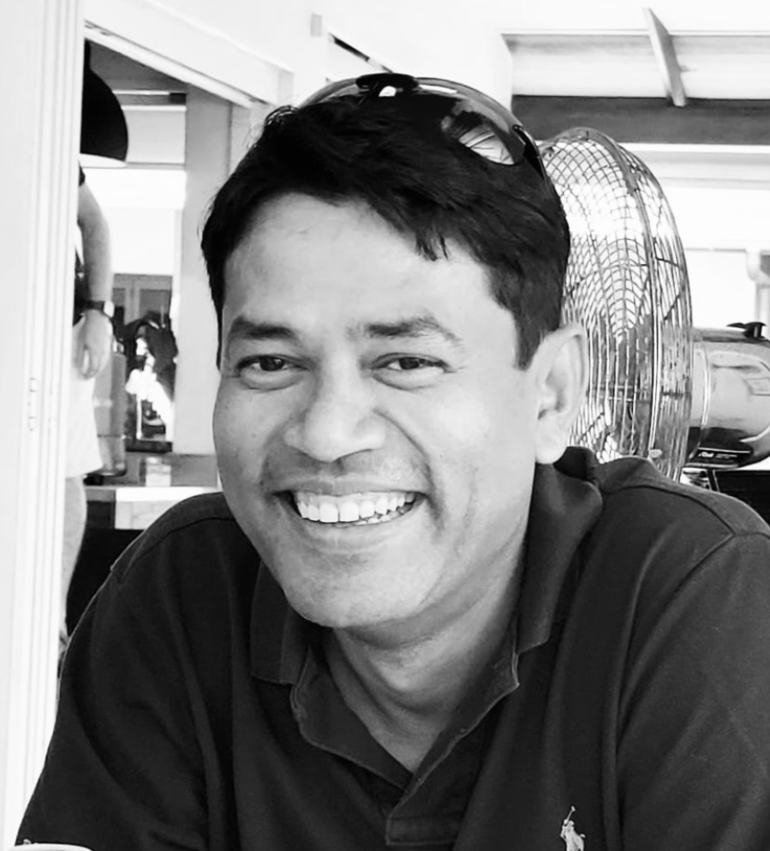
Working group
Michael Tervit: Clinical Director, Mental Health
Nirjhar Nandi: Divisional Director of Medicine
Gaurav Puri: Endocrinologist and Head for State Diabetes Network
Lauren Caruana: Director of Dietetics
Pauline Walter: Director, Psychology
Bernadette Sellwood: Team leader at Cairns Diabetes Centre
Kere Donald: A/Director of Physiotherapy
Nicola Roberts: Smoking Cessation Therapist
Yvette Haselden: Proxy for Director of Pharmacy
Justin Chapman: Research Officer
Sourav Das: Statistician, Lecturer JCU
Jane Kugelman: Exercise physiologist, PCYC
Mridula Kayal: Project Lead
Consumer representatives

Slide 6


Literature that guided the development of MOC
This Photo by Unknown author is licensed under CC BY.

Slide 7
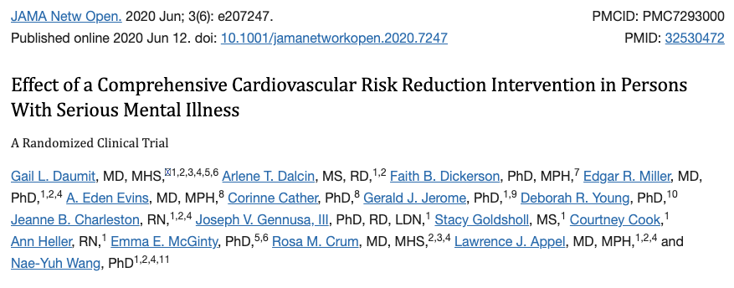
Effectiveness of current models of care…
Studies of interventions in which specialty mental health organizations are responsible for physical health care coordination and management have shown either no or minimal improvements in cardiovascular risk factors.
In contrast, care management and care coordination interventions have shown efficacy in improving cardiovascular risk factors in the overall population.
Notes:
Haskell WL, Berra K, Arias E, et al. Multifactor cardiovascular disease risk reduction in medically underserved, high-risk patients. Am J Cardiol. 2006;98(11):1472-1479. doi:10.1016/j.amjcard.2006.06.049 29. Ma J, Berra K, Haskell WL, et al. Case management to reduce risk of cardiovascular disease in a county health care system. Arch Intern Med. 2009;169(21):1988-1995. doi:10.1001/archinternmed.2009.381

Slide 8

Dalcin, A. T., et al. (2019) Need for Cardiovascular Risk Reduction in Persons with Serious Mental Illness: Design of a Comprehnsive Intervention. Frontiers in Psychiatry
John Hopkins University

Slide 9

The Psychiatry Lancet Commission: A Blueprint for Protecting Physical Health in People with Mental Illness 2019
Petra C. Gronholm et al, FPetra C. Gronholm et al, February 2021
ebPetra C. Gronholm et al, February 2021
rPetra C. Gronholm et al, February 2021
uary 2021

Slide 10
The blueprint
Part 1: “It’s more than premature mortality”
Part 2:Key Modifiable Factors in Health Behaviours and Health Services
Part 3: The interplay between psychiatric medications and physical health
Part 4: Multi-Disciplinary approaches to Multi-Morbidity
Part 5: Innovations in Integration for Physical-Mental Healthcare

Slide 11
The blueprint: Multidisciplinary approach
"Priorities for future initiatives and research include:
(i) Translating Diabetes Prevention Program-based interventions for people with mental illness -across primary care, secondary services
(ii) Using implementation science and cost-effectiveness evaluations to develop a business-case for integrating DPP-based interventions as standard in mental healthcare. "

Slide 12


Slide 13

Pharmacological interventions in SMI with weight gain

Slide 14
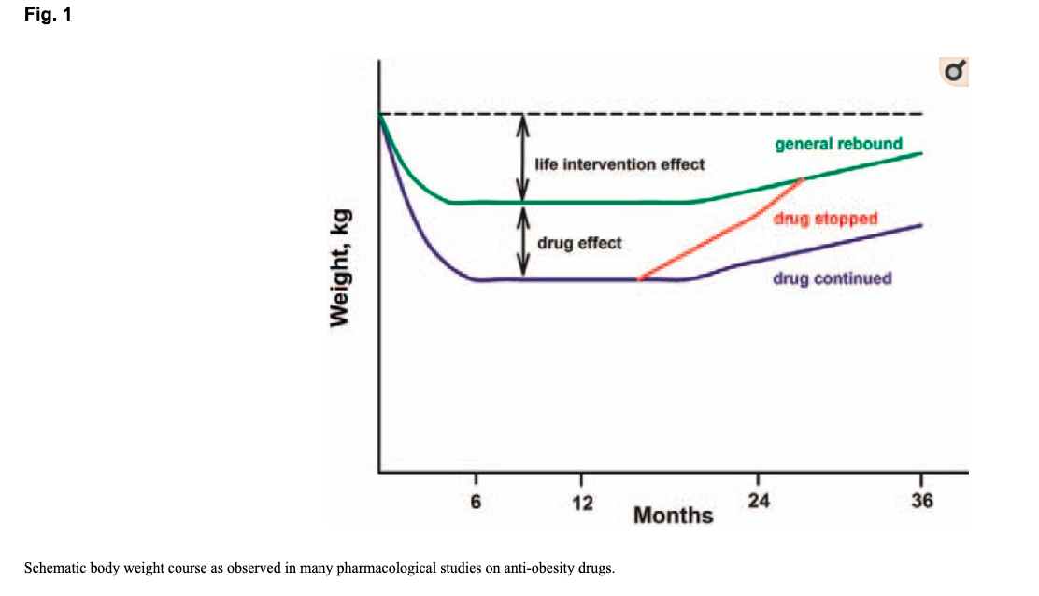

Slide 15

Model of Care for Endocrinologist-led Multidisciplinary Metabolic Clinic in Cairns

Slide 16
Who does the service support?
Inclusion | Exclusion
Case managed clients Age at or > 18-year-old Diagnosis of mental illness High risk for metabolic syndrome (1 out of 5 criteria) Lives locally | Pregnancy Cardiovascular event in last 6 months

Slide 17
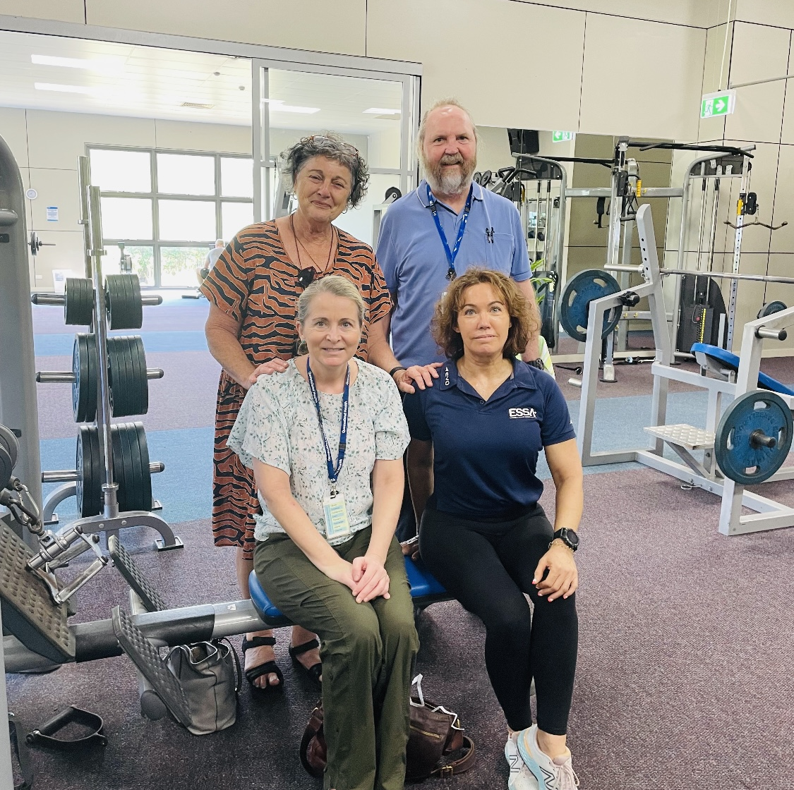
Who provides the service?
Endocrinology (0.1 FTE)
Dietician (0.2 FTE)
Psychologist (0.2 FTE)
Exercise physiologist (3 sessions)
Smoking cessation clinician (0.1 FTE)
Admin officer (0.2)
Care coordinator (RTW)

Slide 18

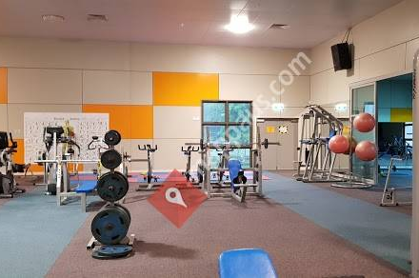

Where is the service provided ?
Cairns Diabetes Centre and Cairns North Community Health Facility
PCYC

Slide 19
How is the service provided?

Slide 20
Multi-Disciplinary Metabolic Clinic
Cairns and Hinterland Hospital and Health Service
Receive referral
(from Case Manager or Treating Team)
Inclusion Criteria
Meets ALL criteria:
Case managed consumer
Age 18 years or older
High risk for metabolic syndrome
Review Referral / Assess Motivation for Group Program
(Care Coordinator)
Exclusion Criteria
If meets ANY criteria:
Pregnant
Cardiovascular event in last 6 months
Add to Agenda
for Next Weekly Intake Meeting
(Administration Officer)
Determine Motivation
for Group Program
(Multi-Disciplinary Intake Team)
Motivation in Action Phase
Motivation in Contemplation or Precontemplation
Setup Endocrinologist Appointment
Setup Individual Psychologist Appointments (Motivational Interviewing)
Multi-Disciplinary
Metabolic Clinic
Willing to Participate
Yes
Intervention Phase
Endocrinologist Appointment
12 Week Group Program
Optional: “Kick Butts” Program
Maintenance Phase
Monthly group and Contact with Care Coordinator
3 Monthly Endocrinology Review
3 Monthly MDT Care Review
No
Refer Back to Treating Team
with Treatment Recommendations
(cc Administration Officer)
Community Integration Phase
Supported Transition to Community Lifestyle Program
Record Treating Recommendations
(Administration Officer)
Discharge from
Multi-Disciplinary Metabolic Clinic
(12 months)

Slide 21

Consumer Journey
Assessment phase
1-2 weeks
Assessment by dietician and exercise physiologist
Treatment phase
12 weeks
Maintenance phase
5-12 months
Monthly GLB group sessions
Assessment by Endocrinologist
Assessment by smoking cessation nurse ( if applicable)
12-week weekly Group Lifestyle Balance program
Kick Butts program
Phone contact in between the F2F contacts
Access to other PCYC programs
Individual motivational interviewing by psychologist if necessary
Individual dietician sessions if applicable
Endocrinology appointments as clinically indicated

Slide 22
Capacity of the clinic
Pilot project
Groups likely to have 16 consumers at a time
4 groups of 12 week each/ 60 participants a year
Endocrinologist: 4 appointments per fortnight

Slide 23
Example of weekly schedule for the model
 | Week 1 |  | Week 2
 | AM | PM | AM | PM
Monday | Group exercise and education component of the GLP + Kick butts |  | Group exercise and education component of the GLP + Kick butts
Tuesday
Wednesday
Thursday
Friday | Assessments Endo appointments | Group Therapy | MDT Assessments Endocrine appointments | Group Therapy
One hour: delivery of core curriculum from DPP, recap
Another hour of supervised exercise

Slide 24
Group Lifestyle Balance: Core curriculum
Healthy Eating Dietician Be a calorie detective Healthy eating Move those muscles Tip the calorie balance Four keys to healthy eating out More volume, fewer calories | Activity level Exercise physiologist Move those muscles Step Up Your Physical Plan Strengthen your physical activity plan Sit less for your health Stay active Heart health | Motivation and lifestyle Psychologist Take charge of What's Around You Problem Solving Manage slips and self-defeating thoughts Make social cues work for you Ways to stay motivated Take charge of your lifestyle Mindful eating, mindful movement Manage your stress Balance your thoughts Look back and look forward

Slide 25
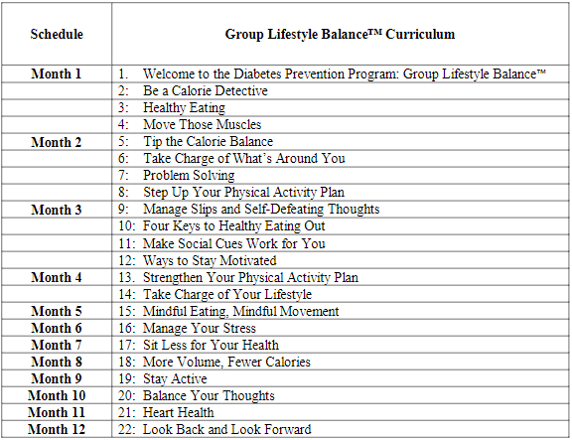
Recommended sequence for GLB program

Slide 26
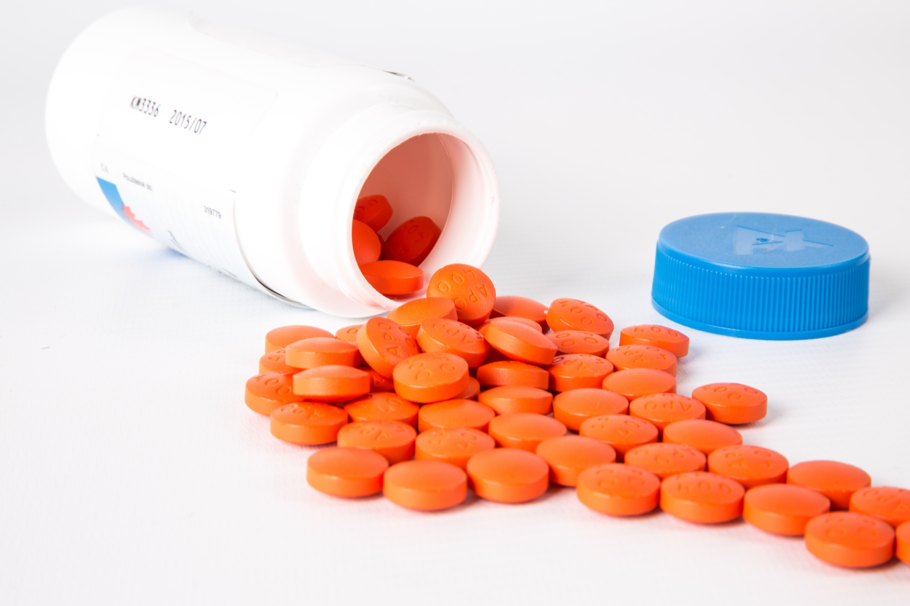
Weight lowering medication Funding approved for one off $30,000 (12m)

Slide 27
Role of the PSP
Bring consumer to Endocrinology appointments (3 monthly)
No obligations to bring them to attend group programs
Support and motivate consumer to participate and problem-solve barriers when possible

Slide 28
Role of treating psychiatrist
To attend MDT once in 3 months ( 15-20 min) via Teams
When possible (if clinically safe), to implement recommendations by Endocrinologist

Slide 29

Research opportunities
Open label prospective pre-post design
Cost effectiveness analysis
Ethics approved
JCU and UQ involvement
Successful in getting funding for CEA
This Photo by Unknown author is licensed under CC BY.

Slide 30
Data collection
Assessments are to be done at the beginning- prior to intervention, at the end of 16 weeks, 6 month and 12 months.
Assessments will collect the following.
Metabolic parameters: collected by Endocrinologist:
Blood pressure
FBS
TG level
HDL level
Central girth and weight
HbA1c
Diet information: collected by dietitian.
Measures around physical fitness: collected by Exercise physiologist
Level of smoking: collected by smoking cessation clinician (smoke analyser)
Acceptability of the program through a feedback form: collected by care coordinator

Slide 31
How did we go?

Slide 32
First set of referrals and first group program (September 2021- ongoing)
18 referrals:
all accepted to encourage clinicians
13 started group program
2 dropped out
(1 physically sick, one low motivation)
4 declined service
(had poor understanding of the expectations)
1 consumer with ED: discharged after initial assessment (added as exclusion criteria)
11 people stayed with the program (61%)

Slide 33

Let’s take a closer look!

Slide 34
 | Medication | Attendance | Weight | WC | Fitness: Sit to stand in 30 sec: change in 6 m | Comment
AP | yes | 75% | - 10 kg | - 5 cm | 14 > 22
PT | yes | 100% | - 13 kg | - 6 cm
MN | yes | 50% | - 7 kg | - 5 cm | 14 > 18
KT | DNA | 58% | + 3 kg | - 2 cm | 21 > 18 | New Clozapine + sedation
MM | Yes | 54% | - 8 kg | - 6 cm | 13 > 21 | 3 m data
TA | Yes | 42% | - 12 kg | - 14 cm | -
BJ | Declined | 52% | - 3 kg | - 9 cm | 24 > 30 | 3 m data
TX | Declined | 96% | - 20 kg | - 16 cm | 20 >31
TR | yes | 16% | - 1 kg | - 6 cm | - | 3 m data
JC | yes | 57% | - 1 kg | - 6 cm | 12 > 15 | 3 m data
HM | yes | 20% | - 3 kg | - 14 cm | - | Stopped Ozempic

Slide 35
In summary
61% retention at the end of 6 month
72% attended more than half of the group sessions
72% accepted to take weight loss medication
63% achieved weight loss more than 5 kg (Avg 7kg)
81% achieved reduction in WC by more than 5 cm
Most had improved their fitness level

Slide 36

Semaglutide (Ozempic)
GLP1 analogue, antidiabetic medication, used for weight loss under MPA
Up titrating dosing via weekly subcutaneous injections on abdomen
0.25 mg X 4 weeks then
0.5 mg X 4 weeks then
1 mg X continue
Takes 6-8 weeks to reach therapeutic level

Slide 37
Barriers and learnings
High proportions of consumers with serious cognitive deficits: DPP material not suitable for them
Developed simplified material (pictorial, slide shows, cooking classes)
Next group will have two subgroups: low and high functioning (capacity to receive and retain information)
High functioning: 1 hr education, low: 30 min

Slide 38
Barriers and learnings
Non-attendance at 3 monthly care review meeting
Scrap this

Slide 39
Barriers and learnings
Poor attendance in monthly group sessions after the 12 week (twice weekly sessions)
We are evaluating relevance of this in our consumer populations

Slide 40
Barriers and learnings
Completion of pathology tests prior to appointments : poor adherence

Slide 41
In summary
High uptake among clinicians. Increased numbers of referrals over time
Good level of acceptance among consumers
Material for education needs tailoring for MH consumers
Key aspects in running the clinic: Care coordination: Funding should be made available
Preliminary results are encouraging
The medication aspects needs advocacy: PBS approval

Slide 42
Thank you
mridula.kayal@health.qld.gov.au

