Slide 1

Notes:
Add your name and introduce yourself
Also let people know about following us on social media – all handles on last slide

Slide 2



Improving access to quality shared care for people with severe mental illness
Presenters: Catherine Spooner, Peri O’Shea
Coinvestigators:
  Centre for Primary Health Care and Equity:
  Ben Harris-Roxas, Jane Taggart, Patrick Bolton, Mark Harris
  Social Policy Research Centre:
  Karen R Fisher
Equally Well Symposium
12 April 2022
Notes:
Acknowledgement of country and lived experience
Notes re the multidisciplinary team:
comes from two research centres,
Patrick and Mark are GPs – Patrick provides physical care to clients of the Eastern Suburbs Mental Health Service with significant mental illness in both the community and inpatient settingsis from SESLHD
Peri is a lived experience researcher
Karen is a professor of inclusive disability research

Slide 3
Overview
Background:
  What is the problem?
  Study aim
  Access model
Methods
Results
Discussion:
Implications
What we have done since
Notes:
1. Introduction — People with severe mental illness (PWSMI) have a life expectancy that is 13 to 30 years shorter than the general population. This mortality gap has been increasing. The majority of deaths are due to preventable conditions such as cardiovascular disease and diabetes. There is a need to improve the accessibility and quality of preventive health care for PWSMI to improve their physical health outcomes. Aims: 1. To identify what helps PWSMI establish and maintain a positive relationship with their GP to prevent, detect and manage long-term physical conditions. 2. Trial an intervention based upon the findings.
2. Method — Semi-structured qualitative interviews and focus group with PWSMI; knowledge exchange workshop with PWSMI, service providers and other stakeholders. A lived experience researcher (PO) was involved in planning and conducting the research.
3. Results — Participants and stakeholders identified a need for navigation support, GP capacity building to be more accommodating and appropriate for patients with SMI, and improved shared care between the GP and mental health service, with the GP coordinating comprehensive care.
4. Discussion — Multiple interventions are needed to improve access to good shared health care for PWSMI. We have partnered with two local health districts to obtain funding to trial new web-based systems to facilitate shared care, coordinated by the GP. Working with consumers and health service partners has been essential for us to progress this agenda.

Slide 4
The problem
People with severe mental illness:
have substantially diminished functioning
die about 20 years earlier than the general population
The majority of deaths are due to preventable diseases e.g. cardiovascular diseases
People with severe mental illness experience issues accessing primary health care and preventive care
Some evidence…..
Notes:
People with lived experience of severe mental illnesses (PWSMI) have substantially diminished functioning and live around 20 years less than the general population. Most deaths are due to preventable. Improved access to high-quality preventive health care can reduce this health inequity.

Slide 5
Relative to general population, people with severe mental illness are x times more likely to….
Die from preventable conditions
cardiovascular disease (x6)
respiratory disease (x4)
infectious diseases (x3)
Have modifiable risk factors
cholesterol (x5)
diabetes (x2)
obesity (x2)
high blood pressure (x2)
smoking (x2)
Roberts et al. Improving the physical health of people living with mental illness in Australia and New Zealand. 2018 doi:10.1111/ajr.12457
De Hert , et al. Physical illness in patients with severe mental disorders. I. 2011. doi: 10.1002/j.2051-5545.2011.tb00014.x
Notes:
People with severe mental illness (PWSMI) have poorer physical health and a shorter life expectancy than the general population. The size of the gap varies with different studies but is around 20 years and there is evidence that this gap is increasing (De Hert et al., 2011; Walker et al., 2015)
Most deaths among people with severe mental illness are due to preventable diseases such as obesity, cardiovascular disease and diabetes, which are more prevalent among this group than in the general population.(De Hert et al., 2011; B. G. Druss et al., 2011; Morgan et al., 2011)
Major contributors to poorer physical health include lifestyle, the side effects of psychotropic medications and reduced access to quality health care. (De Hert et al., 2011; Moore et al., 2015)
1.
De Hert M, Correll CU, Bobes J, et al. Physical illness in patients with severe mental disorders. I. Prevalence, impact of medications and disparities in health care. World Psychiatry. 2011;10(1):52-77.
2.
Morgan VA, Waterreus A, Jablensky A, et al. People Living with Psychotic Illness 2010. Report on the Second Australian National Survey. Commonwealth of Australia; 2011. https://www.health.gov.au/internet/main/publishing.nsf/Content/717137A2F9B9FCC2CA257BF0001C118F/$File/psych10.pdf
3.
Roberts R, Lockett H, Bagnall C, Maylea C, Hopwood M. Improving the physical health of people living with mental illness in Australia and New Zealand. Australian Journal of Rural Health. 2018;26(5):354-362. doi:https://doi.org/10.1111/ajr.12457
4.
Walker ER, McGee RE, Druss BG. Mortality in mental disorders and global disease burden implications: a systematic review and meta-analysis. JAMA Psychiatry. 2015;72(4):334-341. doi:10.1001/jamapsychiatry.2014.2502

Slide 6
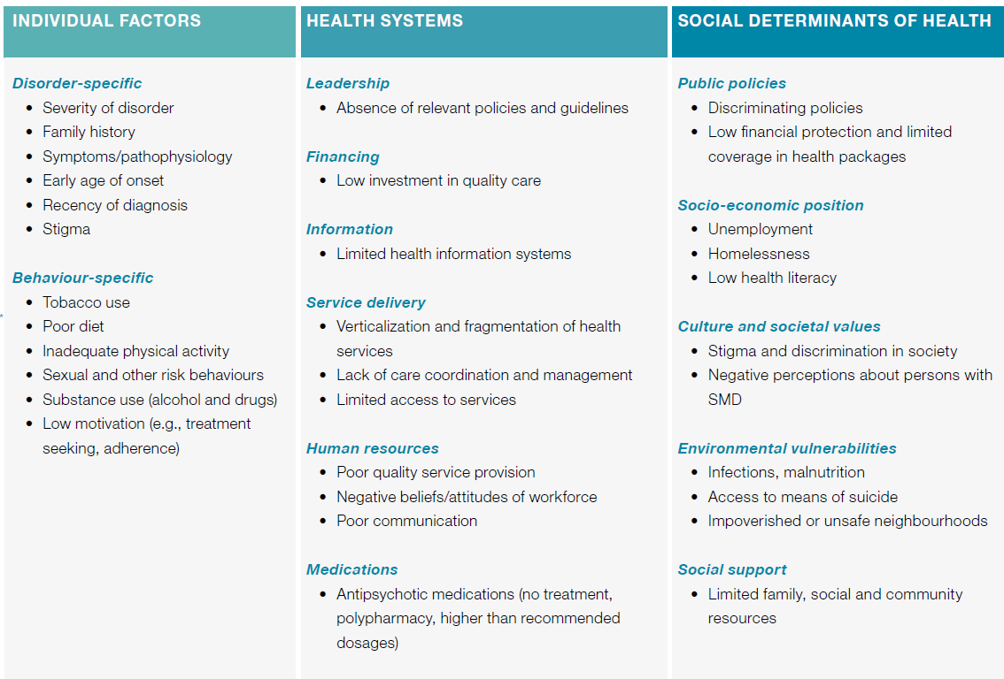
WHO model
WHO. Meeting Report Excess Mortality in Persons with Severe Mental Disorders; 2015.
Notes:
Of all the things that contribute to the gap, service delivery is one and GPs play a major role in this, particularly in the provision of preventive health care and the coordination of care
MULTILEVEL MODEL OF RISK FOR EXCESS MORTALITY IN PERSONS WITH SEVERE MENTAL DISORDERS (SMD)
World Health Organization. Meeting Report Excess Mortality in Persons with Severe Mental Disorders. WHO Headquarters, Geneva, 18-20 November 2015. WHO; 2015. https://www.who.int/mental_health/evidence/excess_mortality_meeting_report.pdf

Slide 7
Barriers to access to primary health care for people with SMI: Previous knowledge
Provider factors
Stigma e.g. lacking respect, compassion
Poor communication e.g. not listening
Diagnostic overshadowing
Consumer factors
Cognitive difficulties
Low health literacy
Mental health e.g. anxiety about leaving the house
Black & Held, 2017; Corrigan et al., 2014, Happell et al, 2012
Notes:
We already knew there are barriers to access to PHC for PWSMI. The barriers on the slide show provider factors and consumer factors
Barriers to people with severe mental illness attending primary-health services include both provider and consumer factors.
Provider issues include problems related to stigma and poor communication.
Consumer issues include cognitive difficulties, low health literacy and competing social demands.(Black & Held, 2017; Corrigan et al., 2014)
People with severe mental illness experience the “inverse care law”, which was first described by Julian Tudor Hart in 1971. The “inverse care law” is the principle that “the availability of good medical care tends to vary inversely with the need of the population served”. (Benjamin G. Druss et al., 2002; Hart, 1971; Lord et al., 2010)
There is a need to improve access to, and the quality of, preventive health care for people with severe mental illness to improve their physical health outcomes. This includes screening and management of risk behaviours (such as smoking and poor diet), physiological risk factors (such as blood pressure) and chronic diseases (such as diabetes). (Royal Australian College of General Practitioners, 2017)
1.
Black DR, Held ML. Cardiovascular risk screening for individuals with serious mental illness. Soc Work Health Care. 2017;56(9):809-821.
2.
Corrigan PW, Druss BG, Perlick DA. The impact of mental illness stigma on seeking and participating in mental health care. Psychol Sci Public Interest. 2014;15(2):37-70.
3.
Happell B, Scott D, Platania-Phung C. Perceptions of Barriers to Physical Health Care for People with Serious Mental Illness: A Review of the International Literature. Issues in Mental Health Nursing. 2012;33(11):752-761. doi:10.3109/01612840.2012.708099

Slide 8
Our aims
Study aim:
To identify what helps people with severe mental illness to access a GP and to establish and maintain a positive relationship with their GP in order to prevent, detect and manage long-term physical health conditions
Ongoing aim:
To work with other stakeholders to design, test and implement interventions that improve access to preventative care for people with severe mental illness
Notes:
This study aimed to identify what helps people with severe mental illness to access general practices – particularly for preventive care - and to establish and maintain a positive relationship with their general practitioner.
The project focussed on the experiences and perspectives of people with severe mental illness and their carers . This information was used to commence work on the codesign of an intervention to improve access to preventive health care for people with severe mental illness.

Slide 9
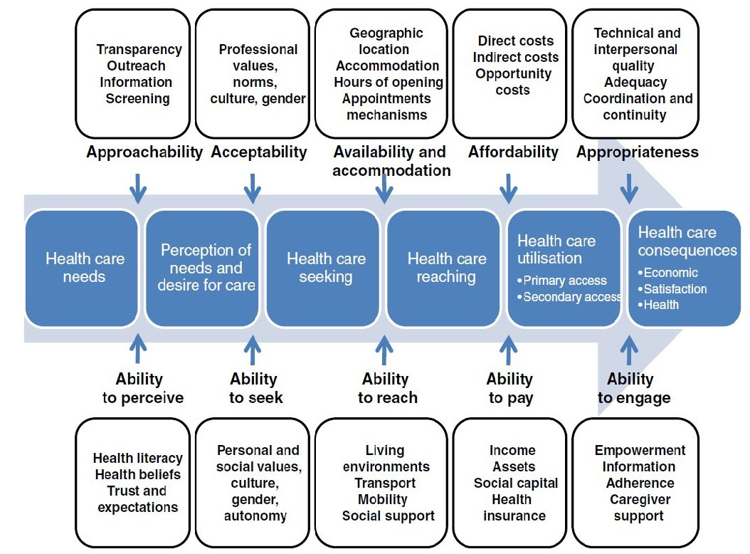
Levesque, Harris & Russell. doi:10.1186/1475-9276-12-18
Notes:
The Levesque model breaks down access to care by:
Steps in the process from identifying the need for health care to receiving and benefiting from health care
Provider and consumer factors that influence the achievement of each step
We used this because it helped us to differentiate the barriers and facilitators at different points of access and considering both provider and consumer factors.

Slide 10
Research method & findings
Peri O’Shea

Slide 11
Methods
Study population
Adults with severe mental illness in south-eastern Sydney
Recruitment
Via an LHD mental health service and a community organisation
Mixed method design
Discussions with consumers and carers
  Semi-structured qualitative interviews:
      10 consumers - Face 2 Face
      5 carers - via phone
  Focus group discussion with 10 consumers
Knowledge exchange workshop
Included consumers, service providers and other stakeholders
Notes:
The study population was adults with severe mental illness in south-eastern Sydney. We use the term “consumers” here to emphasise the active role of people in the study population in decision making about their health and health care.
The geographic location was south-eastern Sydney, which has a complex mix of highly urbanised areas, industrialised areas and low density suburbs, and a wide range of socio-economic backgrounds.
Recruitment of consumers and their family carers was organised through a government-run community mental health centre and a community-managed organisation that provided support workers for consumers.
We used a mixed-method design that included individual interviews, a focus group and a knowledge exchange workshop.
10 consumers and 5 family carers participated in an interview. Three of the consumers had support workers who also contributed data.
Consumer interviews were conducted at the community mental health service or at another place of the consumer’s choice. generally their home with a support worker present or nearby e.g. a park or cafe.
The family carer interviews were conducted via telephone.
An additional 10 consumers participated in a focus group discussion facilitated by two of the research team at the mental health service.
The knowledge exchange workshop included the research team in dialogue with (about) 20 consumers, service providers and other stakeholders.

Slide 12
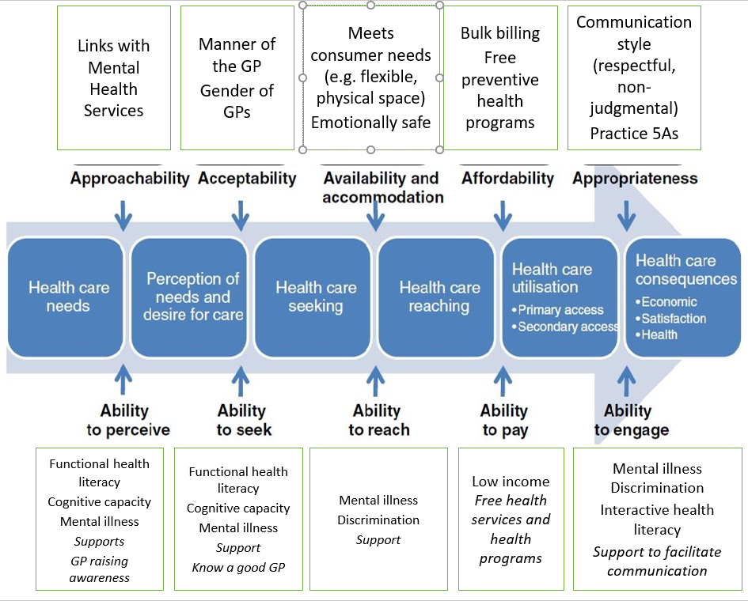
GPs
Consumers
Notes:
This is a summary of all findings across the access model for consumer abilities and provider dimensions of accessibility to generate access.
First, I will talk about the consumer abilities to perceive, seek, reach, pay and engage because this describes where people with SMI are at and will help us to understand what the providers need to do to facilitate access for this group. Then I will talk about the provider dimensions of accessibility and how they do and can generate access for people with SMI.

Slide 13
What people with SMI said influences their access to preventive care
Sometimes it’s hard to get to places and sometimes it’s hard to be organised enough or to know enough time when things are on and when you’ve got to book in for things. (Consumer 10)
I said, “You’ve got to see the doctor about this.” … So it was actually really tricky for [the consumer] to come to that awareness herself about ringing the doctor because of her [MH] conditions being bad. (Support Worker)
Well, because I suffer from anxiety as well, they come and just came with me to the doctor and it kind of broke that anxiety that I had someone with me. (consumer)
I’ve ﬁnished seeing the dentist….: Well, they charge for it and that’s why (Consumer).
And I think people with mental illnesses, we overthink everything as it is, so it doesn’t help when you’re catching on to the way someone’s treating you, like you pick up every little detail. (Consumer)
Notes:
To perceive :
Generally participants had a good understanding of need for health care. – Dr google
Perception was sometimes impeded when unwell – acute MH symptoms prevented people from noticing physical ailments (self overshadowing)
Acute MH symptoms and previous negative experiences can make it difficult to seek help
Sometimes people needed support to perceive they needed healthcare
[clk] I said, “You’ve got to see the doctor about this.” … So it was actually really tricky for [the consumer] to come to that awareness herself about ringing the doctor because of her [MH] conditions being bad. (Support Worker)
To seek:
Most could make an appointment.
But it could be impeded by the mental illness or concerns about discrimination - sometimes due to mental illness and often due to previous negative experience.
Unexpected changes of personnel or processes or possibility of failure (eg not available appts) thwarted some people’s ability to seek Healthcare.
Some told us that support was really helpful to make the appointment
To reach:
Some PWSMI could make their own way to the doctor.
Sometimes mental illness impeded reaching health care – e.g., organizing and remembering appointment times, concerns about using Public transport, leaving home, being in a public place stopped people from reaching their GP.
[clk} Sometimes it’s hard to get to places and sometimes it’s hard to be organised enough or to know enough time when things are on and when you’ve got to book in for things. (Consumer 10)
Most consumers told us that support workers or a family carer assisted them to reach their GP
To pay:
People told us they had a low ability to pay (GP out-of-pocket or specialists)– most were on disability pension.
Medicare bulk billing and other Government health services and programs essential.
Precludes people from getting necessary health care that isn’t supported. Eg dental:
[clk] I’ve ﬁnished seeing the dentist….: Well, they charge for it and that’s why (Con).
To engage:
Can be affected by mental illness or concerns about discrimination (real and perceived).
[clk] And I think people with mental illnesses, we overthink everything as it is, so it doesn’t help when you’re catching on to the way someone’s treating you, like you pick up every little detail. (Consumer 3)
Support person/carer can help with engagement
[clk] Well, because I suffer from anxiety as well, they come and just came with me to the doctor and it kind of broke that anxiety that I had someone with me. (consumer)

Slide 14
What people with SMI said GPs are doing to facilitate access
… you can’t get an emergency appointment and stuﬀ, or if you’re late, or if you miss your appointment, they’re not very ﬂexible or understanding (consumer)
I just worry about the other people in the [waiting] room. Well, because I get anxious. … A quiet space would be good. (consumer)
… they don’t mind spending five minutes explaining something. Some doctors say, “look no look I’m busy” and fair enough … but if they give five minutes of their time sometimes, I really appreciate that, it’s helpful (Consumer)
She listens a little bit more, and she’s open to talking about medications, stuﬀ like that. Well, just that she’s more personable than a lot of the other doctors that I’ve seen. (Consumer 1)
Notes:
Approachability
Consumers told us that they would change to a doctor who “got it” if they knew where to find one
No reports of GPs promoting they are mental health friendly or initiating outreach with MHS
Example: MHS initiated links with a Medical practice and built some capacity at the medical centre
Acceptability:
No evidence of people choosing GPs because of their MH expertise – perhaps due to there not being easy ways to identify doctors who ‘get it’.
Availability and accommodation:
Things that people told us helped:
Flexible appointment systems
Timely appointments
Public transport close by
Appropriate waiting area
Minimised wait time
Longer appointment times
[clk] I just worry about the other people in the [waiting] room. Well, because I get anxious. … A quiet space would be good. (consumer)
Clk]… the way they run the clinic, I’m not impressed. How you can’t get an emergency appointment and stuﬀ, or if you’re late, or if you miss your appointment, they’re not very ﬂexible or understanding to a sick person (consumer)
Affordability:
GPs bulk bill and free programs MHS provide free preventive programs e.g. KBIM,
Private services can be expensive
Appropriateness: Interpersonal qualities:
Most consumers had had an experience with a good GP, many had also had not so good experiences.
Many talked about the importance of a GP that ‘got it’.
E.g. being Respectful, non-judgmental, engaging in effective communication: e.g. asking questions, listening to consumer, knowing how to relate to PWSMI, taking time to relate
[clk] She listens a little bit more, and she’s open to talking about medications, stuﬀ like that. Well, just that she’s more personable than a lot of the other doctors that I’ve seen. (Consumer 1)
[Clk]… they don’t mind spending five minutes explaining something. Some doctors say, look no look I’m busy and fair enough, they’ve got the privilege to do that … but if they give five minutes of their time sometimes, I really appreciate that, it’s helpful (Consumer 4)
Receptionist interpersonal skills and waiting environments and procedures are important to PWSMI. Need for understanding and flexibility and all service staff need to take care to be respectful.
[clk] [The reception staff] are pretty good to me because, sometimes, they will let me wait, just come in and wait until they have a space open - - - (co 3)
[clk] Sometimes, [the reception staff] can be rude … Like, you can hear them when they’re talking – everybody gets stressed out. You can hear them when they’ve got somebody on the phone, and then they put them on pause and they’re talking about them. (co 3)

Slide 15
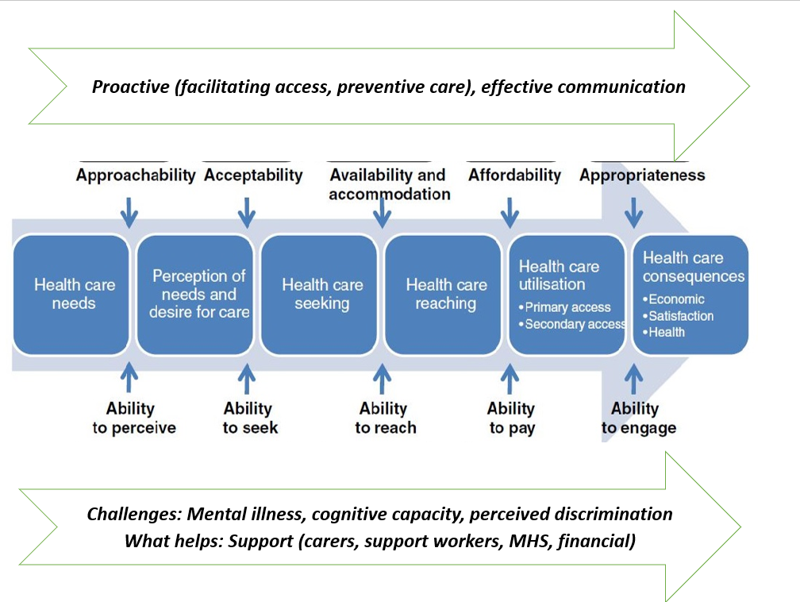
Notes:
Looking across all the stages of access model
Looking from the bottom again
The challenges for access from the focus of the ability or capacity of PWSMI include:
Effects of mental illness, diminished functioning and cognitive capacity – especially when people are acutely unwell
Perceived and real fear of discrimination – usually due to previous experience
Looking to what GPs are and can do to facilitate access (at the top now)
PWSMI told us GPs that ‘get it’ can help them to seek, reach and engage with primary health care
This requires more Proactive approaches at all stages and also more effective, respectful and engaging communication.
What works:
In addition to proactive GPs that ‘get it’
Support for consumers to access

Slide 16

Knowledge exchange workshop
Consumers and stakeholders identified a need for:
Navigation support
GP capacity building
A mechanism to enable shared care with the GP as the central point of care.
Notes:
When our interviews and focus group with consumers were completed and we had analysed the data, we conducted a knowledge exchange workshop with consumers, service providers and other stakeholders.
At this workshop, we presented the results of the consultations with consumers and carers. We then had a number of small group and larger group discussions about what the results meant and what could be done to improve access to preventive health care in South Eastern Sydney. There were many ideas, but three stood out: navigation support, GP capacity building and GP-coordinated shared care.
Navigation support was proposed to support consumers to access and engage with a GP and to follow up on referrals. This could involve, for example, training and coaching existing peer workers and support workers; or resources to assist consumers and carers in accessing and communicating with primary health services.
One specific idea was to identify and list mental health friendly general practices, thus avoiding the negative impacts of experiencing stigma or inappropriate care.
GP capacity building was proposed to assist GPs and the practice staff to be more mental-health friendly. This would of course include reducing stigma and judgement of mental health consumers.
Mechanisms to support care coordination and shared care were proposed to improve coordination and communication between general practices and other services and supports. The proposal was to enable the GP to be the central point of holistic care. Such a system would provide active recall so consumers know when and where they need to go – whether it be the GP, allied health or any other service.

Slide 17
Implications and next steps
Catherine Spooner

Slide 18
Implications
For general practitioners – what works
Proactive practices to improve access
Respectful communication
Work in partnership with support people (paid & unpaid) and MHS
For primary health networks (PHNs) – what’s needed
Capacity building to support GPs to achieve the above
Help health services to recognise and address discrimination
Provision of support people to assist people with SMI to access preventive care
For policy makers
This is a complex field requiring a long-term and a coordinated approach between MHS, PHC and other relevant services.
Notes:
There are many implications of this research for the people and organisations with a role in supporting people with severe mental illness. Here are just a few.
For general practitioners: Consumers have identified that some GPs ‘get it’ and are responsive to their needs Those who ‘got it’ demonstrated proactive practices and respectful communication.
Primary health networks (or PHNs) have a role in capacity building of GPs. They do this via training workshops as well as visiting individual general practices. This research supports the need for training and resources to help general practices to be more responsive to the needs of people with SMI, particularly in how to proactively support access and communicate effectively.
Also, some consumers reported experiencing discrimination. We would all agree there is no place for stigma and discrimination in our health services – even if this is unintended. Long-held assumptions and stereotypes can be difficult to shift, but we know from other campaigns in the area of HIV, LGBTQI and mental health more generally that stigma can be reduce. Some educational interventions with healthcare providers have demonstrated some effectiveness, although larger multi-level interventions are also required.
Knaak S, Mantler E, Szeto A. Mental illness-related stigma in healthcare: Barriers to access and care and evidence-based solutions. Healthcare Management Forum. 2017;30(2):111-116. doi:10.1177/0840470416679413
https://journals.sagepub.com/doi/full/10.1177/0840470416679413
Gronholm, P.C., Henderson, C., Deb, T. et al. https://link.springer.com/article/10.1007/s00127-017-1341-9. Soc Psychiatry Psychiatr Epidemiol 52, 249–258 (2017).
https://doi.org/10.1007/s00127-017-1341-9 https://link.springer.com/article/10.1007/s00127-017-1341-9
PHNs also commission services. Our research underscores the importance of support people to assist people with SMI to navigate to and interact with community-managed organisations. PHNs
PHNs explanation if needed in Australia are organisations funded by the Australian government with a brief to increase the efficiency and effectiveness of medical services for patients, particularly those at risk of poor health outcomes, and improving coordination of care to ensure patients receive the right care in the right place at the right time. PHNs support GPs and fund some community-managed organisations to provide mental health and support services.
For policy makers: This is a complex field. It does not just need a new program and some more short-term funding. It needs a coordinated approach that addresses navigation, GP quality improvement and the systems to support shared care

Slide 19
What have we done since?
New projects at CPHCE:
  Electronic shared care trials in SLHD and SESLHD
  Mental Health Literacy project commissioned by Mental Health Commission NSW: New resources for PHNs and GPs https://www.nswmentalhealthcommission.com.au/content/resources-action
  Scientia PhD student: codesign project with people with SMI to address access to GP for preventive health care
  GP training in working with people with SMI
Notes:
As result of this small study we have engaged in new partnerships to address the mortality gap for people with severe mental illness . This was a new area for some of us and this study helped us to develop new networks In the health sector, the community-service sector and with consumer organisations.
Subsequently we have been successful in obtaining funding for a number of studies - one of which is to develop and trial software to enable GP-led shared care with consumers at a government-run mental health service.
Another is working with PHNs and consumers to co-design resources to help health services to be more responsive to the needs of people with lived experience of mental health issues.
And we have a new PhD student who is investigating the role of codesign in developing an intervention with people with severe mental illness to access preventive health care.
And we still spend our nights and weekends writing grant applications to implement and evaluate our findings. ☺

Slide 20
SHAReD project in SLHD
Pragmatic controlled trial with 500 consumers from 4 adult mental health services in Sydney LHD and their GPs
Exploring if an online shared care plan improves the frequency and quality of primary and preventive care for people with a lived experience of severe mental illness.
Aim: to improve the health of people living with mental illness by facilitating their engagement with primary care.
Notes:
This trial is exploring if an online shared care plan and telehealth improve the frequency and quality of primary and preventive care for people with a lived experience of severe mental illness.
It aims to improve the health of people living with mental illness by facilitating their engagement with primary care. It also aims identify more effective and time efficient shared care processes, which are essential given the multiple competing demands on primary care and mental health clinicians.
The online shared care plan outlines the preventive care tasks that GPs and SLHD Mental Health Care Coordinators will share. This includes, for example, physical health checks, metabolic blood tests, lifestyle assessment and advice, preventive screening, medication management and referrals to allied health.
This pragmatic trial will invite clients of the Sydney Local Health District Community Mental Health Teams and their usual GPs to participate. Participants will be followed for 12 months.

Slide 21

Questions
Notes:
Pre-prepared questions
How well do GPs and mental health services work together to ensure the mental health service consumers preventive health needs are met?
You mentioned MHS doing preventive health assessments.
Do GPs and MHS share assessment data?
Is there a possibility of people being assessed by both and the GP/MHS not sharing the information?
Why does the MHS do physical health assessments – isn’t this the role of the GP?

Slide 22
Thank you
Dr Peri O’Shea
    peri@xperienhance.com
    0418 455 562
Dr Catherine Spooner
    c.spooner@unsw.edu.au
    (02) 9385 1505
P

