Slide 1













Thank you to our Sponsors
#EquallyWellAu22
Notes:
Add your name and introduce yourself
Also let people know about following us on social media – all handles on last slide

Slide 2
Local Partnership Pilot- a General Practitioner co-located at Community Mental Health Service
Dr Nada Andric
General Practitioner
Dr Samir Heble
Consultant Psychiatrist and Medical Co - Director North Metropolitan Health Service - Mental Health , Public Health and Dental Services - Adult Mental Health inpatients
Notes:
The local partnership project was undertaken to help address the primary care needs of people living with severe mental illness who attended the mental health outpatient unit of the area health service.
It was thought that though the mental health care needs of the patients were being met, there were health needs that were not being met and were unable to be met in their community mental health services.

Slide 3
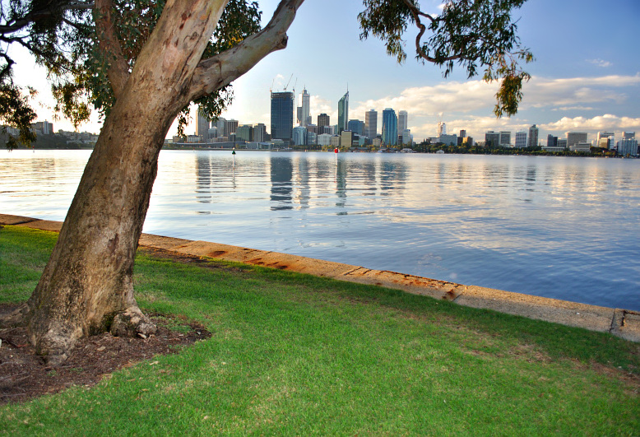
Notes:
Whadjuk Nyoongar people
Yugambeh language region
People w lived experience
Tireless dedicated staff in mental health units and community across Perth, WA.

Slide 4
GP at a Community Mental Health Service
Background
Design
Attendance
Types of presentations
Feedback
Advantages and disadvantages of co location
Future
Notes:
This talk will go through a pilot project to address these. This talk is not a clinical audit and is a very general overview of what we encountered in developing a primary care co-location model in the year it was launched through the lens of a GP.

Slide 5

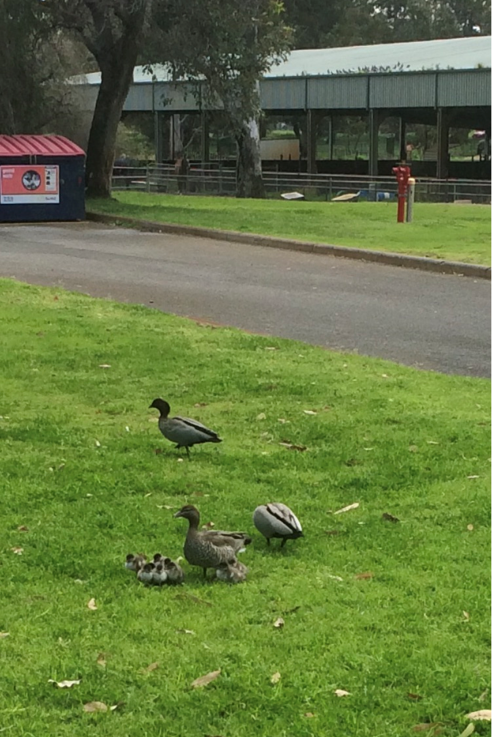
-Wholistic patient care and definition of “health”
-High rates of co-morbidity
-Proactive approach to engagement needed
Notes:
Why did we pilot this ?
Barriers like stigma/ judgement/ location and affordability exist for people who are marginalised and affect their attendance in mainstream GP services.
Multiple services may be attended to get needs met, perpetuating the barriers to care with ongoing worsening health!
Apparent gaps in physical healthcare in people who are admitted to mental health services. 3 reasons behind MetSyndrome- Drugs/ illness/ (motivation and initiation and capacity/ Epigenetics
These are backed by research- 6x likely to die CVS death, earlier deaths by 14-23 years, inc smoking and resp disease. What about other health needs?
Our local Mental Health service tried to address these with an onsite PHN pilot GP practice, location was issue- very wealthy area, patients didn’t live there, catchment of community mental health was further north.
A stem from this pilot was an in-reach GP funded by the PHN which became a successful model and was then funded by the mental health service for a year.
Ideally, people living in the community would be able to access general practice clinics for their primary care needs and there would be great communication between consumers and clinicians. However work from GP onsite service at the psychiatric hospital indicated that many very unwell patients had complex medical needs that were continually underprioritised due to their mental illness, and these needs existed in the community and needed attention. But on discharge, many had no nominated GP and often unstable housing.
We know stigma and marginalisation are barriers to appropriate healthcare access- could locating a service in a building already visited by patients be of use?

Slide 6
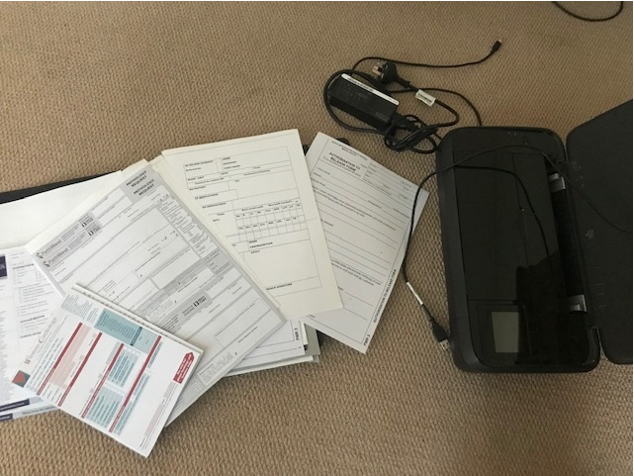
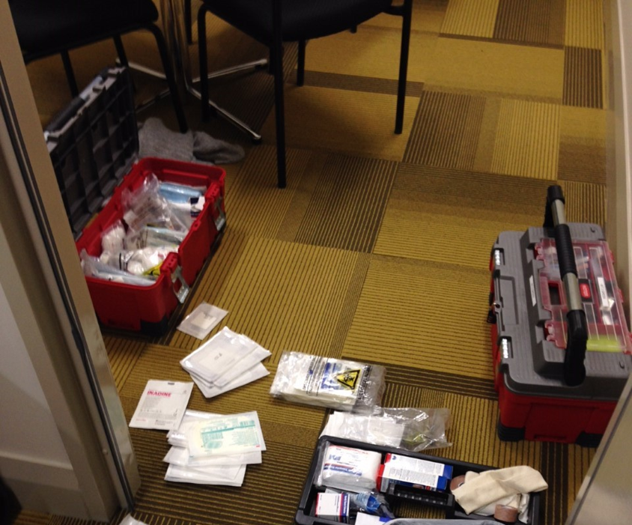
Notes:
The GP had 2 years experience in Mental Health, 5 years in homeless marginalised primary care in Perth and special interest in HCV
Current in CPD, registration, indemnity and started their own business to service this site.
The clinic was mobile- IT/ clinical notes/ paperwork and equipment (BP/ spirometry dressings) were transported to a room onsite at the MHS
The Service collocated with the hospital where pathology and XR could be accessed by patients at no charge.
The GP rooms were alongside offices used by acute crisis teams, psychologists and psychiatrists, and in the same building as group sessions.
Guidelines for pathology and clinical review were modelled on Lambert et al physical health guidelines in RANZCP as well as red book guidelines of the RCAGP.
The agreement was a fortnightly 4 hour commitment for 1 year to provide bulk billed services to clients attending CMHS in exchange for use of the room at not charge, some clinic admin and proactive case management support of the service

Slide 7
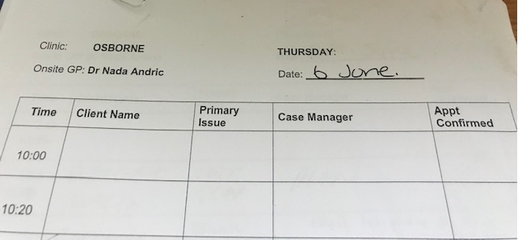
Notes:
2 community sites were piloted
The community Mental health services were based in a metro area- one was an annexe to a district hospital, accessible to trains with a 20 minute walk or by bus. The hospital site was handy to access other hospital services (bloods/ xr / podiatry/ physio)
The other was a community site with adjacent to a large medical centre and an aboriginal medical service, with a GP liaison officer based in the clinic
Appointments were made by clinicians, and some triage was completed to assist with formulating reasons for visit.
On arrival , GP would complete patient file admin, Medicare detail and populate practice software, alongside performing the consult
Patients were rebooked for follow-up n leaving either through the appointment system or contact would be made through their case worker to ensure review was done

Slide 8
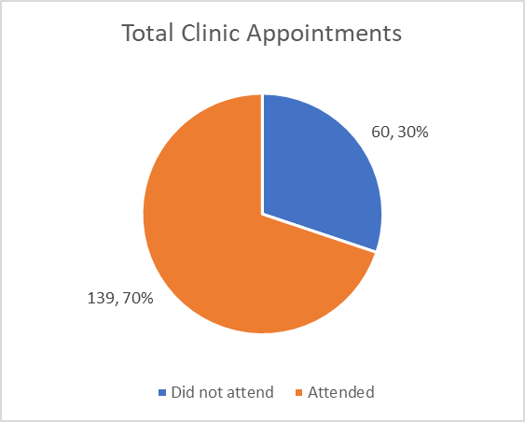
Attendance 2018/19
Notes:
In preparing this talk, I audited the case notes and written appointment sheets from the clinics run at the community MH services
Postulated a lower attendance rate but the intensive outreach team had very strong relationships and advocacy (and transport!)
From Carmen- the attendance rate is impressive, considering the majority of these clients had 0% attendance to a GP prior which is the reason they accessed you.
Also – many of the clients had legal guardians who were very keen for their clients to access GPs when the client refused. Being in the room next door to the depot/treatment room or psychiatrist assisted the process of gently and covertly linking them in a non threatening and seamless transition with the case manager. Once they had met you the engagement improved quickly with increased consent and follow up on issues of concern.
The flexibility of the appointment times and setting i.e. in the courtyard, in the corridor (of course conserving confidentiality), HVs, or assessing them in the carpark! It was very consumer centred and adaptable.
Most of the clients we see in ICOT (Intensive Clinical Outreach Team) have passed away or at risk of passing away due to physical health conditions

Slide 9
From 27 fortnightly clinics
199 appointments, attended in 139 cases
70% attendance rate
Just over 5 patients per 4 hour clinic
Initially 2 sites, dropped to 1 due to physical location
Notes:
27 clinics were completed across 2 sites, 22 at the main site. The site that was discontinued was already well serviced in community with proximity to a large medical centre as well as a GP liaison and an aboriginal medical service
The clinicians in the intensive case outreach were based on the main site and were able to book/ discuss/ advocate for patients who needed more intense case work

Slide 10
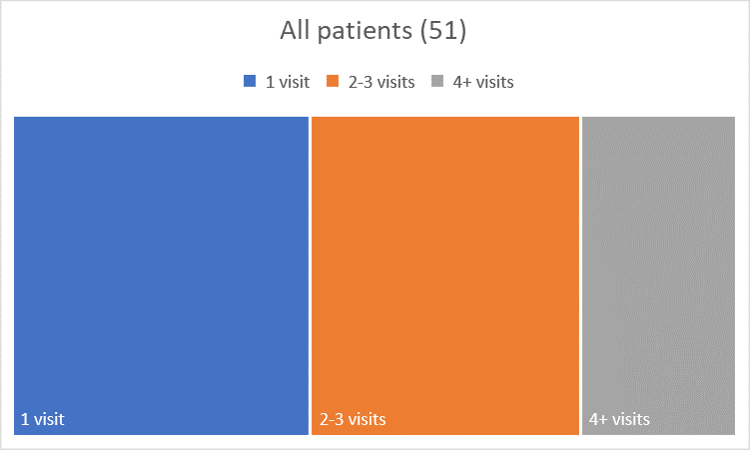
1 visit | 21
2-3 visits | 19
4+ visits | 11
Notes:
Single visits- 40% one off - home visits, specific things (cyst removal, ear syringe, referrals for ophthal, dermatology, walking aids) 10 measurements for metabolic screens., post hospi follow up

Slide 11
27 fortnightly clinics
74 people who were booked in for an appointment, 51 people had a GP consultation
14 known to GP from inpatient unit
19 attended initially w case manager/ ICOT worker
3 home visits attended with ICOT clinician

Slide 12
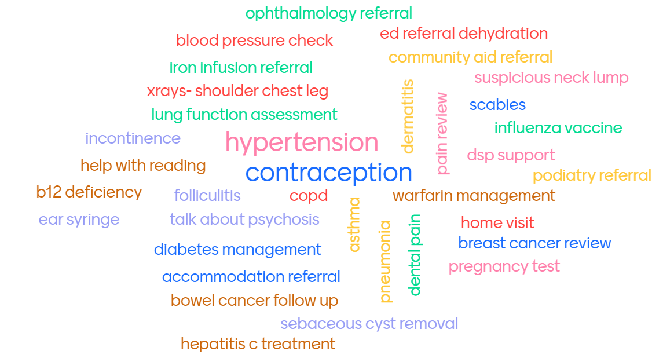
Notes:
What kinds of presentations?
STI screen, reassurance re: medication and effects
Commencing metformin on occasion for people on clozapine
Offering screening/ reoffering/ relationship establishment
These are GP bread and butter presentations. These cannot be addressed by the endocrinologist in a metabolic clinic, or a cardiologist. The benefits f having someone look after the whole of person, develop a relationship and help navigate them through the healthcare they need is a privilege that really only primary care can provide. GPs are mazing.

Slide 13
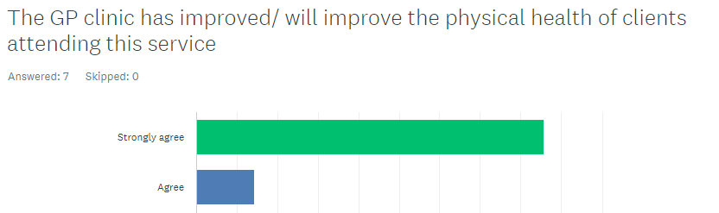
GP service feedback from clinicians
7 responders – 3 case managers, 3 clinical, 1 admin

Slide 14
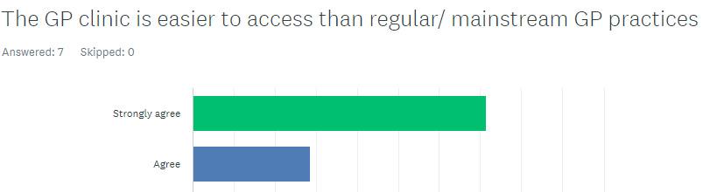

Slide 15

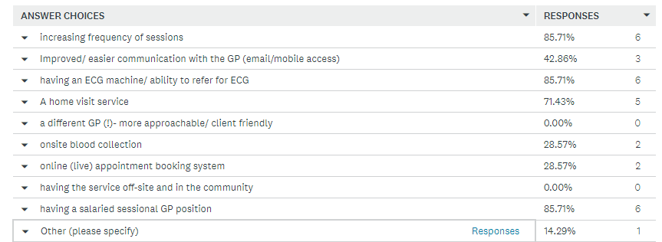


Notes:
Salary is always a discussion- esp. due to the fact that the remit of outpatient primary care being federally funded

Slide 16
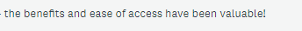


Slide 17
Advantages of co location
Patients
Familiarity of site, staff at reception etc
One stop shop
No obligation to see the GP
May know the GP, and get to know what to expect with other GP practices
Capacity for single scripts to complex attendances
Notes:
Smoking courtyard
Waiting for depot anyway
Seen in the car, seen

Slide 18
Advantages of co location
Clinicians
GP service an option for practical solutions to some patient queries
Can coordinate in advance to connect to primary care
Address their concerns directly w GP and advocate in person if needed
Work during appointment
Notes:
Situations in my past work where case managers had very sick clients who coped for years then suddenly died

Slide 19
Advantages for the GP
Patients all have good engagement in the local MHS
No “diagnostic overshadowing”
Familiarity of conditions/ situations
Excellent staff at the MHS/ capacity for direct communication
Good medicine

Slide 20
How did the model work for the GP?
Medicare “pays”
Any work done by a GP without a patient present is essentially volunteer work (so attendance is important)
Financial unsustainability changes the model- GP not there all the time, harder to book in to , not for crisis presentations
Notes:
Bulk billing means the GP accepts the Medicare benefit as full payment for the service
Average billings per 4 hour session approximately $410 if 5 patients seen for over 20 minutes and have a healthcare card Medicare ($230 if less than 20 min)
Similar models look like they have been piloted across rural NSW connected to a practice rather than an individual GP

Slide 21
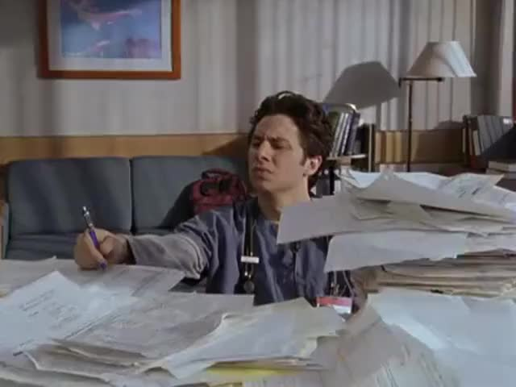
Notes:
Admin costs – first time solo GP that mobile equipment purchase, spiro, BP, diabetes, dressings, printer, software, security, email cloud,
Creating paper consent letterheads
Scanning, pathology, entering patient details
Chasing path chasing XR chasing pharmacy casewkers families
lack of consent form signing by clients(and signing of any forms- including request for information and simple patient information forms)
lack of availability of medication lists/ blood results/ mental health letters- patients usually don't know what they are on
lack of clear reasons for referral (people do forget why they are there- but I am usually filled in by your wonderful case managers)
no Medicare/ healthcare card details

Slide 22

Challenge: Designing a sustainable primary care service for people living with mental illness who regularly attend an outpatient setting within confines of Medicare
Notes:
Salary vs Private
Access to notes and consent
Access to Medicare benefits and community based allied health and mental health services through Medicare
vouchers for medication for people with severe mental illness who also have hypertension/diabetes/COPD
onsite visiting physio/podiatry (if they can be engaged)
salaried GP that can actually access results/letters etc (or physical health nurse/ or nurse practitioner)
using best practice software to monitor physical health care ? Separate system but there is already a separate MH system…

Slide 23
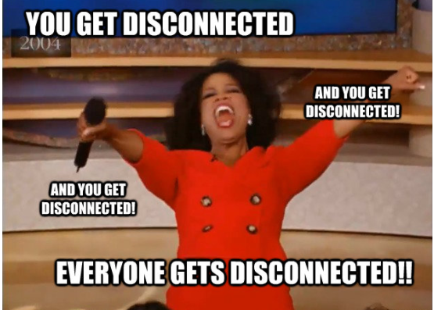
Connecting consumers to GPs is a system issue
Funding streams are not flexible and are a barrier to that connection
Notes:
It’s the GPs that are hard to reach- we know where the patients are =)

Slide 24
Future is bright
Models of care are being funded (tele-health etc)
Honorary GP appointments to hospitals?
Newer formulations are on the horizon to simplify things (weekly injectables for diabetes and weight control)
Co design and collaboration are occurring
Many of these will be well suited to general practice and community settings- avoiding hospital services

Slide 25
In Summary
Co-locating a GP to an existing community MH service is a successful model to offer people with enduring mental illness
Patients who do not have a GP/ do not attend any other health service
Clinicians with good relationships w clients
Patients attend with a variety of unmet needs, not just for a metabolic screen
Funding models need to be explored to make this sustainable
Different care models are needed to meet the broad needs of our clients
Notes:
GP training and advocacy for better benefits for this work

Slide 26
Acknowledgements
Dr Samir Heble, Carmen Stobie and team at Community Mental Health
Wonderful ICOT teams
Inpatient mental health nursing, allied health and pharmacy staff
Patients
Notes:
Osborne Park and Mirrabooka at North Metro Mental Health Services

