Slide 1













Thank you to our Sponsors
#EquallyWellAu22
Notes:
Add your name and introduce yourself
Also let people know about following us on social media – all handles on last slide

Slide 2



Embedding ‘lived experience’ engagement within PHNs
Paula Arro – Lived Experience Engagement Coordinator, Brisbane North PHN
Tim Heffernan – Mental Health Peer Coordinator, COORDINARE - South Eastern NSW PHN

Slide 3
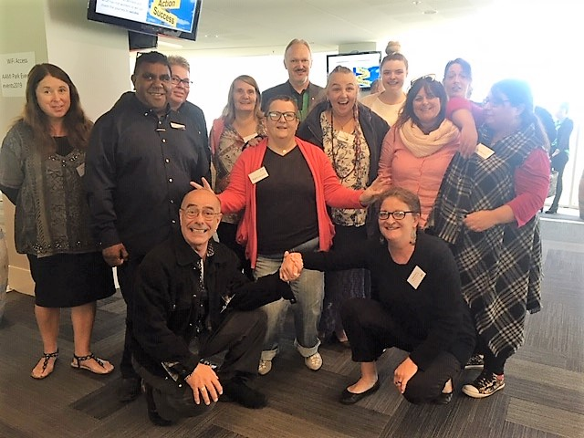
Understanding the context & the system
Regional
State
National
#EquallyWellAu22

Slide 4
Notes:
Lots of plans at the national and state level
Role of PHN is to bring this together at the regional level

Slide 5
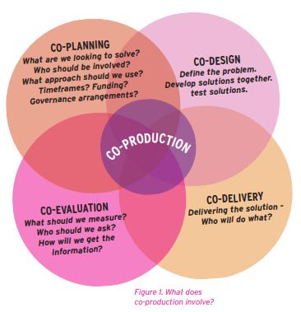
Co-production - Putting principles into practice in mental health contexts, Cath Roper, Flick Grey & Emma Cadogan. 2018

Slide 6
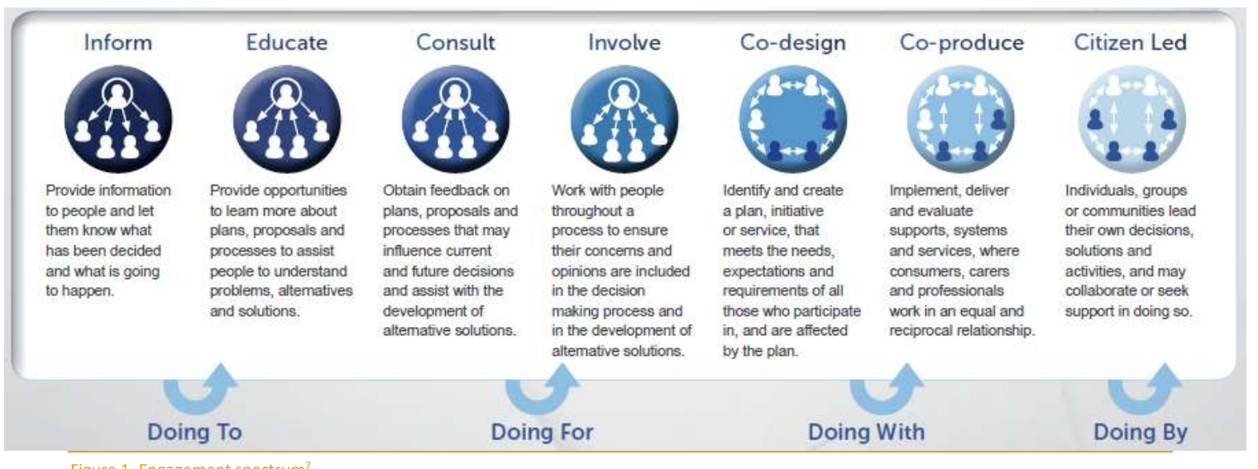

Slide 7
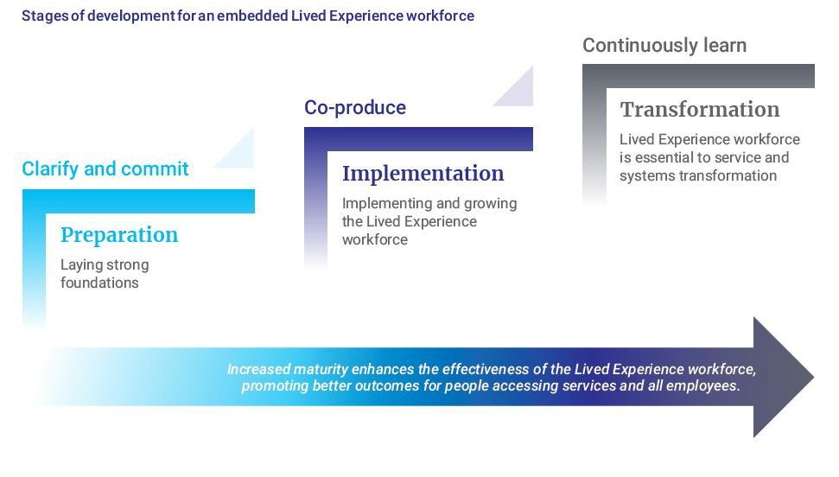
Byrne, L., Wang, L., Roennfeldt, H., Chapman, M., Darwin, L., Castles, C., Craze, L., Saunders, M. National Lived Experience Workforce Guidelines . 2021, National Mental Health Commission.

Slide 8
Foundation Resources
Engagement
Co-production - Putting principles into practice in mental health contexts, Cath Roper, Flick Grey & Emma Cadogan. 2018
Participation ladder - consumer survivor lens, Indigo Daya. 2020
NMHC Consumer and Carer Engagement: A practical guide
NMHC Mental Health Safety and Quality Engagement Guide
Lived Experience Workforce
National Lived Experience Workforce Guidelines, Byrne et.al 2021
QLD Framework for Lived Experience Workforce, Byrne et.al 2019
Framework for Mental Health Lived Experience (Peer) Work in South Eastern NSW, Craze 2021

Slide 9
6 practice principles
Conceptualising Participation and Engagement as routine practice
Skills and knowledge are recognised and developed (capacity building)
Leadership culture
Dedicated resourcing
Respect, safety and support
Evaluation and quality improvement
NMHC Consumer and Carer-engagement a practical guide
#EquallyWellAu22

Slide 10
Case Study: Regional
Peer Participation in Mental Health Services

Slide 11
Peer Participation In Mental Health Service (PPIMS)
Aim and Purpose
‘work collaboratively to actively participate in mental health systems and reforms in Brisbane North’.
Specifically, the functions of the Network include:
a) Collaborative development of a regional network of peers to provide ‘a voice’ for people with a lived experience as either a consumer or carer to the mental health sector in Brisbane North.
b) Support to other people with a lived experience who want to actively participate in the mental health system reform process and/or are accessing mental health services.
c) An opportunity to have regular updates and input around services, policy, program and system developments.
d) An opportunity to have regular updates and identify strategies to improve engagement, participation, training and employment opportunities.
e) Advice regarding emerging issues faced by consumers and carers in the mental health sector.
f) Participate in the co-design opportunities that evolve either through the PHN or other government and non-government services.
#EquallyWellAu22

Slide 12

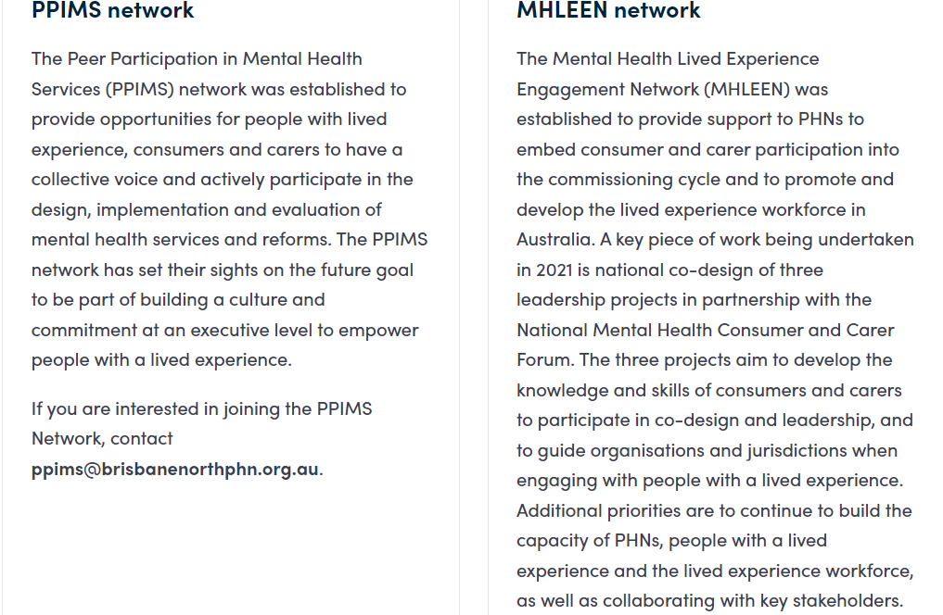
#EquallyWellAu22

Slide 13
Case Study: National
National PHN Mental Health Lived Experience Engagement Network
(MHLEEN)

Slide 14
MHLEEN Aims and objectives
PHNs engage people with a lived experience (i.e consumers and carers) in the co-design of systems and processes in line with the maxim ‘nothing about us – without us’
PHNs to embed consumer and carer engagement in the co-design throughout the commissioning cycle
PHNs to support better outcomes in mental health by promoting and supporting the employment of peer workers as part of multi-disciplinary teams providing person centred support and recovery-oriented and trauma informed care and
Maintain a National Network of PHN’s and other key stakeholders to support, coordinate and collaborate on continuous improvement of person centred, recovery focused planning, implementation and review of primary mental health care.
Notes:
Conversation Paula and Tim
How we met at Nov 2017 conference …. Paula first time sharing my story in a public forum … Tim and Paula had connected by phone previous to this but was first time meeting each other
Following recommendations from the November 2017 Stepped Care Workshop, in June 2018, the Department executed a contract for services with Brisbane North PHN to chair and project manage the newly formed National PHN Mental Health Lived Experience Engagement Network (MHLEEN). Due to its work, the Network received a commitment from the Department for a further three years.
Overall the main aims and objectives of MHLEEN align with the Departments Guidelines for Consumer and Carer Engagement (2016) and Peer Workforce Development (2019) and the Fifth National Plan.
Upon reflection of the 2020 year and work of MHLEEN, outcomes and achievements that are linked to the guidance materials has been undertaken. See below.
Lived Experience Engagement
embed consumer and carer co-design throughout the commissioning cycle, including in needs assessment; policy development; strategic planning; prioritisation; procurement of services; and monitoring and evaluation;
Outcome and Achievements
MHLEEN members were asked to provide a link to their regional plans and excerpts that refer to consumer and carer or lived experience engagement and peer workforce development. Other PHN’s who were still developing their plans were able to see what and how other PHN’s were embedding co-design activities
establish collaborative partnership arrangements with Aboriginal and Torres Strait Islander communities and their health and mental health services;
Outcomes and Achievements
The Aboriginal and Torres Strait Islander Lived Experience Centre at Blackdog Institute was invited and now attends MHLEEN meetings and provides advice.
establish collaborative partnership arrangements with transcultural mental health services, or the alternatives in states and territories where such services do not exist;
Outcome and Achievements
The Framework for Mental Health in Multicultural Australia (the Framework) is a free, nationally available online resource which allows organisations and individual practitioners to evaluate and enhance their cultural responsiveness. It has been promoted through the MHLEEN as a resource available to them. Some PHNs have established CALD implementation groups with their state peak body and other relevant services.
move to contractual arrangements with service providers which require them to demonstrate a rights based approach to consumers and carers
Outcomes and Achievements
Compared to the 2018, there has been an increase in PHNs recruiting people with a lived experience to be a part of the development of tender assessment process and monitoring of commissioned services (see Stocktake Report)
Peer Workforce Development
develop an understanding of peer work policies and programs, employment conditions (including salaries and wages), and models of practice and standards relevant to their respective state/territory government agency and/or community mental health organisation
Outcome and Achievements
There has been the development of Peer Workforce Frameworks at a regional (eg., Coordinare NSW), state (QLD Lived Experience Workforce Network and at the National level (eg., National Mental Health Commission). PHNs and MHLEEN members have actively promoted, supported and in some cases hosted focus groups involving both peer workers and service providers.
provide input to the development of the peer workforce and the equitable employment of peer workers in the region.
Outcome and Achievements
Further work needs to be undertaken in this space due to different state/territory industrial relations and award structures. PHNs have however allocated budgets specifically for peer worker roles (eg. service hubs, safe spaces)
In the longer term, PHNs will be expected to:
support models of practice that incorporate peer workers as specialised members of multidisciplinary teams providing person-centred, recovery-oriented and trauma-informed stepped care in mental health and suicide prevention services
Outcome and Achievement
PHN Members have presented at a number of conferences on the topic of support models through case studies (eg., LETS Peer Support Telephone – S.A.; Peachtree Perinatal Peer Program – QLD)
promote training, peer supervision and career development for peer workers in partnership with relevant community mental health organisations, state/territory government agencies, and local consumer and carer networks
Outcomes and Achievements
Monthly updates are provided to MHLEEN members with a range of resources and capacity building opportunities. Some organisational readiness training has also been available and attended (eg., SHARC – Vic; SHARE – International Conference on Peer Supervision - USA where webinars are available online). The Peer Hub (NSW) has proved to be a valuable site for all things peer work.
promote the development of standards of practice and a code of ethics for peer work in partnership with relevant community mental health organisations, state/territory government agencies and local consumer and carer networks
Outcomes and Achievements
most recently the Australian government has developed digital health standards. Also during the year there was opportunity to work with Darthmouth University on piloting of their ‘Digital Peer Support’ accredited training – USA. Standards development is also being undertaken involving a number of countries, MHLEEN represented on this group.
support the development and implementation of models of professional peer supervision by experienced peer workers to promote best practice in peer work in partnership with community mental health organisations and state/territory government agencies
Outcome and Achievements
While a number of ‘models’ of professional peer supervision have been developed in Australia and overseas, most commissioned services (including PHNs) do not have a dedicated budget for this. However a number of PHNs have facilitated the development of Communities of Practice where peer workers can meet, provide support and co-reflection and have access to mentoring opportunities. An additional issue is agreement of what requirements a peer supervisor needs. Anecdotally we hear that there is a lot of informal unpaid support and supervision and access to general supervision by their manager (who does not identify as having a lived experience of recovery and supervisory skills).
support the development, promotion and equitable distribution of appropriate supports for peer workers with lived experience of disability and co-occurring mental health issues, or who come from vulnerable community groups, in partnership with culturally appropriate services for peoples who identify as culturally and linguistically diverse (CALD), Aboriginal and Torres Strait Islander, and Lesbian, Gay, Bisexual, Transgender, Intersex or Queer (LGBTIQ).
There is a need to scope out the existing workforce who have specialist skills to work with these vulnerable community groups.
In summary, MHLEEN and PHNs have demonstrated a growing awareness, commitment and prioritising of lived experience engagement and peer workforce development. The recent Stocktake Report provides evidence of this and in particular having a central coordinated network which enables a strong collective voice, sharing of resources and support.

Slide 15
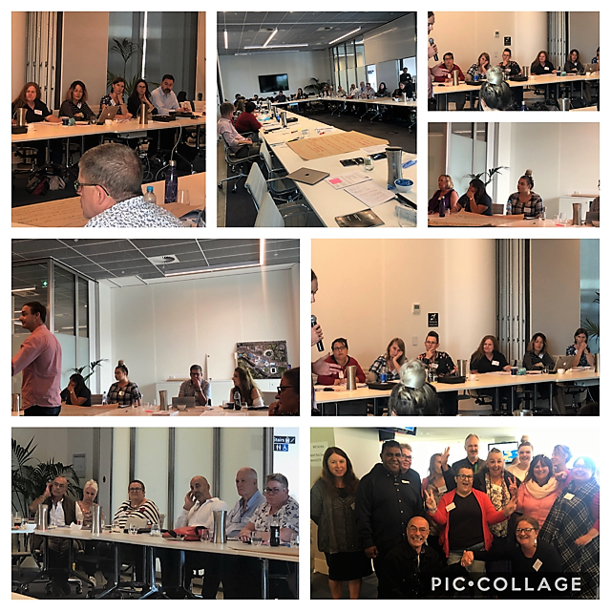
MHLEEN activities
Membership
Network Meetings
Stepped Care Workshops
Stakeholder forums
Lived Experience Engagement
Training/Capacity Building
#EquallyWellAu22

Slide 16
Lived Experience
Advocacy Delegates (LEAD)
LEAD has met bi-monthly since April 2021 and has worked on co-designing Terms of Reference for the group. Included in the Terms of Reference are LEAD’s key functions to:
Build a collective and independent voice and advisory group to support the work of MHLEEN.
Provide support to people with a lived experience to actively participate in mental health reforms.
Provide an opportunity to have regular updates on state/territory and national work underway.
Provide advice on emerging issues faced by people with a lived experience (consumers and/or carers).
Have opportunities to advocate on primary mental health issues.
Disseminate information and updates to local networks and groups.

Slide 17
“The main value of being a member of LEAD is that it has brought home to me (on reflection) a new awareness of the role my PHN has in embedding lived experience in the commissioning process with various projects ( I’ve only been on the PHN for a year, so relatively new to this) co-design process, and driving the peer workforce albeit MHLEEN objectives) I think I’ve become aware of gaps in how my PHN operates in this regard. I try to bring this more into focus when our group meets, because of my privileged position of being informed, by being a member of LEAD.” Jennie Sommerville – Lived Experience Representative, Nepean Blue Mountains PHN

Slide 18
Annual Stocktake
Involvement of People with a Lived Experience (PLE) with their PHN including employed by or a representative or consultancy and the type of roles
PHNs internal policies, procedures and supports for engaging with PLE
Using the IAP2 Spectrum, what engagement
Questions around PHN commissioning and co-design including tendering and reporting
Engagement activities with other stakeholders
Case Studies and
Areas of focus and priorities for PHN’s moving forward.
Notes:
A survey was developed in 2018 by MHLEEN members and approved by the Department. This current report has replicated the original survey and is being compared to the 2018 benchmark of activity being undertaken by PHNs.
The survey included the collection of both quantitative and qualitative data. For the 2020 survey case studies on engagement and peer workforce development were also requested from each PHN.
Survey questions included
(see slide)
Reminders and follow-up contact was made to encourage as many PHN’s to participate as possible. This included the Department writing to all PHN CEOs inviting their participation, support and assistance to those completing the survey and discussion at MHLEEN meetings.
25/31 response rate (81%)

Slide 19
Lived Experience Involvement in Governance
Notes:
Lived Experience Involvement in Governance
The majority of PHNs responded that their PHN have governance and management structures that include people with a lived experience (see Table 2). This was an increase compared to 2018 responses (80%).
MHLEEN has actively promoted and circulated resources, tools and online training opportunities to new members along with providing one to one induction. MHLEEN members are also responsible for sharing this information with their MHAOD teams.
Types of Committee/Representative Roles
Table 3
PHNs were asked what types of committees or representative groups included people with a lived experience (see Table 3). PHNs are required to have an overall Community Advisory Committee as a part of their contractual arrangements with the Department. Around 80% of PHNs reported that they have representation on the Community Advisory a broad MHAOD committee. Over 50% of PHNs had people with a lived experience on a Mental Health specific advisory committee. Other committees included child and youth, severe and complex, Aboriginal and Torres Strait Islander, Low intensity/brief therapies, psychological therapies and alcohol and other drugs. Add table number and title to all

Slide 20
Peer Work in Commissioned Services
PHNs were asked whether the services they commissioned had lived experience or peer workers.
Compared to 2018 there was more awareness and action relating to creating peer work positions in commissioned services.
In 2021, 100% of PHNs who responded to the survey said some Commissioned Service Providers employ lived experience or peer workers

Slide 21
Barriers to Establishing LE Roles within PHN
PHNs were asked what would be required to establish a lived experience identified role within their PHN.
68% of PHNs who responded to the survey indicated that they would require specific Lived Experience funding for the role.
63% of PHNs who responded said they would need to identify a suitable role, develop a position description and receive commitment at the Executive level (see Table 15).

Slide 22
Recommendations from the Stocktake
Requirements to establish lived experience identified roles within PHNs
The Department and PHNs commit to resourcing and creating LE positions. This would require quarantined budge allocations in the Departments funding requirements of PHN’s and the PHNs MHAOD budget.
Tendering and reporting of lived experience engagement and lived experience workforce
The Department and PHNs to include KPIs around lived experience engagement and lived experience workforce.
Peer work in commissioned services
MHLEEN to undertake a survey of commissioned services to gather more detailed data on how commissioned services are embedding lived experience engagement and lived experience workforce.
Collaborative engagement with other stakeholders
PHNs and MHLEEN to formalise partnership agreements with state/territory and national lived experience peak bodies
#EquallyWellAu22

Slide 23

The National Mental Health Consumer & Carer Forum (NMHCCF) and MHLEEN partnership
to co-produce
Lived Experience Leadership in Australia
The three projects have NMHCCF and MHLEEN members on project steering groups. The projects are:
  The establishment a central national repository of mental health consumer and carer leadership-related knowledge and initiatives to be included on the NMHCCF website
  The co-design of a mental health lived experience governance framework and toolkit to guide identified priority organisations and jurisdictions when engaging with people with lived experience, and
  Review and scoping of formal lived experience leadership education and training.
  LET(s)Lead AUS 2022 – Yale University
Notes:
Conversation Paula and Tim
How we met at Nov 2017 conference …. Paula first time sharing my story in a public forum … Tim and Paula had connected by phone previous to this but was first time meeting each other
Following recommendations from the November 2017 Stepped Care Workshop, in June 2018, the Department executed a contract for services with Brisbane North PHN to chair and project manage the newly formed National PHN Mental Health Lived Experience Engagement Network (MHLEEN). Due to its work, the Network received a commitment from the Department for a further three years.
Overall the main aims and objectives of MHLEEN align with the Departments Guidelines for Consumer and Carer Engagement (2016) and Peer Workforce Development (2019) and the Fifth National Plan.
Upon reflection of the 2020 year and work of MHLEEN, outcomes and achievements that are linked to the guidance materials has been undertaken. See below.
Lived Experience Engagement
embed consumer and carer co-design throughout the commissioning cycle, including in needs assessment; policy development; strategic planning; prioritisation; procurement of services; and monitoring and evaluation;
Outcome and Achievements
MHLEEN members were asked to provide a link to their regional plans and excerpts that refer to consumer and carer or lived experience engagement and peer workforce development. Other PHN’s who were still developing their plans were able to see what and how other PHN’s were embedding co-design activities
establish collaborative partnership arrangements with Aboriginal and Torres Strait Islander communities and their health and mental health services;
Outcomes and Achievements
The Aboriginal and Torres Strait Islander Lived Experience Centre at Blackdog Institute was invited and now attends MHLEEN meetings and provides advice.
establish collaborative partnership arrangements with transcultural mental health services, or the alternatives in states and territories where such services do not exist;
Outcome and Achievements
The Framework for Mental Health in Multicultural Australia (the Framework) is a free, nationally available online resource which allows organisations and individual practitioners to evaluate and enhance their cultural responsiveness. It has been promoted through the MHLEEN as a resource available to them. Some PHNs have established CALD implementation groups with their state peak body and other relevant services.
move to contractual arrangements with service providers which require them to demonstrate a rights based approach to consumers and carers
Outcomes and Achievements
Compared to the 2018, there has been an increase in PHNs recruiting people with a lived experience to be a part of the development of tender assessment process and monitoring of commissioned services (see Stocktake Report)
Peer Workforce Development
develop an understanding of peer work policies and programs, employment conditions (including salaries and wages), and models of practice and standards relevant to their respective state/territory government agency and/or community mental health organisation
Outcome and Achievements
There has been the development of Peer Workforce Frameworks at a regional (eg., Coordinare NSW), state (QLD Lived Experience Workforce Network and at the National level (eg., National Mental Health Commission). PHNs and MHLEEN members have actively promoted, supported and in some cases hosted focus groups involving both peer workers and service providers.
provide input to the development of the peer workforce and the equitable employment of peer workers in the region.
Outcome and Achievements
Further work needs to be undertaken in this space due to different state/territory industrial relations and award structures. PHNs have however allocated budgets specifically for peer worker roles (eg. service hubs, safe spaces)
In the longer term, PHNs will be expected to:
support models of practice that incorporate peer workers as specialised members of multidisciplinary teams providing person-centred, recovery-oriented and trauma-informed stepped care in mental health and suicide prevention services
Outcome and Achievement
PHN Members have presented at a number of conferences on the topic of support models through case studies (eg., LETS Peer Support Telephone – S.A.; Peachtree Perinatal Peer Program – QLD)
promote training, peer supervision and career development for peer workers in partnership with relevant community mental health organisations, state/territory government agencies, and local consumer and carer networks
Outcomes and Achievements
Monthly updates are provided to MHLEEN members with a range of resources and capacity building opportunities. Some organisational readiness training has also been available and attended (eg., SHARC – Vic; SHARE – International Conference on Peer Supervision - USA where webinars are available online). The Peer Hub (NSW) has proved to be a valuable site for all things peer work.
promote the development of standards of practice and a code of ethics for peer work in partnership with relevant community mental health organisations, state/territory government agencies and local consumer and carer networks
Outcomes and Achievements
most recently the Australian government has developed digital health standards. Also during the year there was opportunity to work with Darthmouth University on piloting of their ‘Digital Peer Support’ accredited training – USA. Standards development is also being undertaken involving a number of countries, MHLEEN represented on this group.
support the development and implementation of models of professional peer supervision by experienced peer workers to promote best practice in peer work in partnership with community mental health organisations and state/territory government agencies
Outcome and Achievements
While a number of ‘models’ of professional peer supervision have been developed in Australia and overseas, most commissioned services (including PHNs) do not have a dedicated budget for this. However a number of PHNs have facilitated the development of Communities of Practice where peer workers can meet, provide support and co-reflection and have access to mentoring opportunities. An additional issue is agreement of what requirements a peer supervisor needs. Anecdotally we hear that there is a lot of informal unpaid support and supervision and access to general supervision by their manager (who does not identify as having a lived experience of recovery and supervisory skills).
support the development, promotion and equitable distribution of appropriate supports for peer workers with lived experience of disability and co-occurring mental health issues, or who come from vulnerable community groups, in partnership with culturally appropriate services for peoples who identify as culturally and linguistically diverse (CALD), Aboriginal and Torres Strait Islander, and Lesbian, Gay, Bisexual, Transgender, Intersex or Queer (LGBTIQ).
There is a need to scope out the existing workforce who have specialist skills to work with these vulnerable community groups.
In summary, MHLEEN and PHNs have demonstrated a growing awareness, commitment and prioritising of lived experience engagement and peer workforce development. The recent Stocktake Report provides evidence of this and in particular having a central coordinated network which enables a strong collective voice, sharing of resources and support.

Slide 24
Contact
National PHN - Mental Health Lived Experience Engagement Network (MHLEEN)
Paula Arro
mhleen@brisbanenorthphn.org.au
Tim Heffernan
theffernan@coordinare.org.au

