Slide 1
Leading with power and influence
Professor Russell Roberts, CSU
Dr Kate Jackson, NSW Health
12 April, 2022.

Slide 2
Welcome
Overview - Introductions
Leadership theory and concepts
Personal power
Powerful implementation
Planning and strategy
Conclusion - evaluation

Slide 3
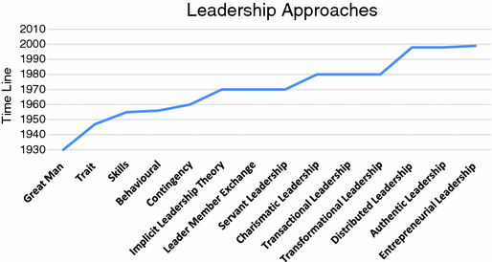

www.equallywell.org.au
twitter: equallywell_au

Slide 4



“Humility with fierce resolve”
Level 5 Leadership (Caldwell, 2017)
“
Level 5 leaders show
  Compelling modesty
  Quiet determination
  Company focus
  Responsibility for failure
  Acknowledgement of others
12 Dimensions of the humble leader (p 727)
“Those who seek to lead must…thoughtfully assess…their weaknesses”

Slide 5
A comprehensive view of power and leadership
Personal
Interpersonal
Positional
Intrapersonal
Collective
The physics of power

Slide 6

Sources of personal power in leadership
Rate level of power 1-10 | How can I access this power and influence?
Expert
Referent
Reward
Coercive
Information
Legitimate
Charismatic
Connection
1 = “I know nothing”. 10 = “I am the biggest dog in the room”

Slide 7
Leadership and Collaboration:
NSW Older People’s Mental Health (OPMH) Physical Health Practice improvement Project
Dr Rod McKay, OPMH Clinical Adviser
Dr Kate Jackson, Director, OPMH Policy
John Stevens, Policy Officer
Mental Health Branch, NSW Ministry of Health
April 2022
Notes:
Note that we have presented on this project at various stages in this journey:
2019 Equally Well Symposium in Melbourne, as we were embarking on the project, with a focus on project context and design
2020 Equally Well webinar series, reflecting on the project approach of ‘building on what we know and what we have’
In this presentation we will focus on the themes of leadership and collaboration, reflecting on:
project design/approach
project implementation
reflections on the journey so far, where we are now and next steps
Note that:
NEAMI and some of our LHD partners are presenting on other aspects of the project today.
Our presentation also includes recorded reflections from Rod McKay (clinical lead), Marcelle Droullers (a CSU project partner) and Michelle XX (an LHD project lead)

Slide 8
Background – what we had
Strong evidence to support need to act, but ‘implementation gap’
Building on approach for previous statewide practice improvement project
Policy priority and commitment to Equally Well
Supported by statewide OPMH clinical benchmarking
Strong support from local OPMH service leaders across NSW
“Overall, the number and scope of truly
tested interventions remain limited, and
strategies for implementation and scaling up
of programmes with a strong evidence
base are scarce. ”
Liu et al (2017)
Notes:
2019 reflections at commencement of project were that we need to:
Have specific actions to improve the physical health outcomes of older people with mental illness
Improve the evidence base regarding what works to improve the physical health outcomes of older people with mental illness
Work collaboratively and continually to build trust between partners
Focussed statewide practice improvement work addresses these points
The project recognized that there was strong evidence about the need to improve the physical health of older people with mental illness, but noted the key theme of the 2019 Equally Well symposium about the so-called ‘implementation gap’ in terms of evidence about ‘what works’ to address this (as per quote from Liu)
Other key context was:
Recognition of improving the physical health of people with mental illness as a policy priority (both in NSW and nationally), and NSW Health’s commitment to Equally Well
Identification of physical health assessment and care as a practice improvement priority within statewide OPMH benchmarking processes
Support for a statewide OPMH physical health practice improvement from LHD OPMH service leaders across NSW
Opportunity to build on project approach from a previous statewide OPMH practice improvement project, focused on promoting recovery-oriented practice in NSW OPMH services
There is substantial evidence in Australia and internationally that the risk factors for chronic physical disease are higher among people living with severe and persistent mental illness than in the general population. Older people with mental illness experience disadvantage in accessing appropriate physical health assessment and care, and experience poorer physical health and earlier mortality than the general population. This is particularly so for people who grow older with a continuing experience of severe and persistent mental illness, compared with older people who have developed mental illness in later life and generally have a history of better health care management.
The project supports state and national policy, population health and practice improvement priorities including NSW OPMH Service Plan 2017-2027 , Fifth National Mental Health and Suicide Prevention Plan, the National Mental Health Commission’s Equally Well Consensus Statement, and the NSW Mental Health Strategic Framework and Workforce Plan and the recently published NSW health guideline Physical Health Care for People Living with Mental Health Issues.
The project supports NSW Health's commitment to Equally Well
The OPMH physical health care practice improvement project has developed from OPMH benchmarking discussions and policy work indicating the need for new strategies to improve physical health assessment and care for consumers of OPMH services. NSW OPMH annual benchmarking self-audit findings indicate that OPMH services are challenged by a number of standards relating to physical health care including the involvement of GPs, physical examination of older consumers in the community and action about falls prevention (especially in the community). The NSW OPMH Community Model of Care Evaluation confirms that OPMH community services are experiencing challenges related to physical health assessment and accessing skilled staff for assessment and management (physios, dieticians, GPs).
The project was endorsed by the OPMH Services Advisory Group, which has representation from all LHD OPMH services. There is strong interest in membership of the project steering group. This interest ensured buy in from local health districts before any major planning for the project took place

Slide 9
Project approach – what we did
Builds on previous work using a similar approach
Aims to promote practice improvement within OPMH services and through OPMH service collaboration with consumers, carers and service partners
Undertaken within existing resources using an opt-in, ‘start where you can’ approach
State-level leadership from project team and steering group to guide and support projects across NSW
Local leadership from project champions and supporting managers, and CMO project leads
Collaboration at state and local levels, leveraging strengths of consumers, carers, key stakeholders and project partners
Encourages consumer consultation and collaboration, and ideally co-design
Encourages evaluation through research collaboration
McKay Roderick, Jackson Kate, Stevens John (2021) Implementing recovery-oriented practice in older people’s mental health services: the NSW experience. Australian Health Review. https://doi.org/10.1071/AH21155
Notes:
The project was build on a previously successful model used to improve recovery oriented care in NSW OPMH services, see McKay Roderick, Jackson Kate, Stevens John (2021) Implementing recovery-oriented practice in older people’s mental health services: the NSW experience. Australian Health Review and the related project report that can be found on the NSW Health website
The project was undertaken with no additional resources, leveraging on the passion and commitment for change by our key stakeholders.
We acknowledged early on that different LHD services were at different stages of readiness, and so a ‘start where you can’ approach was adopted, with the scope and scale of projects being undertaken were dictated by each LHDs readiness and resources to commit to the project
The project brought together partners from the academic, NGO and government sectors, seeking to leverage each's strengths to help drive projects towards success
Following endorsement of the project by both LHD coordinators and with the ministry executive, a recruitment drive took place to recruit LHD project champions to develop and initiate local projects that would bring about practice improvement
To support the LHD champions and their projects a state level project team was formed that was an intermediary between a state level expert reference group and the local projects, bringing a panel of experts together to provide support and advice to each of the LHD projects.

Slide 10
How it worked: statewide project manager perspective
Communicating progress and celebrating successes
Having the project being ‘start where you can’ allows it to be adaptive if there is a crisis
You can bring about quality improvement during a pandemic
Team building approach across sectors requires commitment
More complexity results in better work but needs persistence, time and support
Establish and manage timeframes
Sustainable change with long term improvements for OPMH
Governance structures
Design project to operate utilizing existing resources
Maintianing momentum
Establish cross sector partnerships
Notes:
From the perspective of the statewide project manager for the project, some key reflections I would emphasize is that:
Communicating progress and celebrating successes helps maintain momentum, engagement and motivation
Having the project design adopt a ‘start where you can’ approach allows it to be adaptive if there is a crisis and ensures that your partners are taking on something manageable and impactful to where they are at as a service
You can bring about quality improvement during a pandemic, but it does take patience and persistence.
Engaging in Team building across sectors requires commitment and time, getting to know each other sessions and building professional relationship by getting to know your colleagues personally can break down some of the sector barriers when you are needing to bridge that gap.
More complexity results in better work but needs persistence, time and support so be prepared to have everyone involved allocate more time to the project as you increase its design in complexity.

Slide 11

How it worked: statewide policy lead perspective
Creating the right environment for collaboration
Leadership and collaboration are mutually supportive
Policy commitment helps
A distributive leadership approach can be effective in a complex system
Persistence and adaptability are essential
A ‘start where you can’ approach can be adaptable to change
Building strong collaborative initiatives can help with scaling up to other sites
Research partnerships have added complexity, but should lead to publication and help generate further implementation and action
Notes:
Creating the right environment and processes to support statewide practice improvement - established mechanisms encouraging statewide cooperation between OPMH clinicians, service managers, policy makers and key stakeholders/partners have been significant facilitators of engagement in practice change (as per OPMH recovery project).
Leadership is partly about communicating an aim and vision, and engaging people in working together to achieve that aim and vision. Leadership has can’t achieve anything without collaboration. This project confirms that.
Policy commitment was important in establishing initial support for the project, and in maintaining support amidst many challenges to progressing the project.
A distributive leadership approach, involving both state-level and local level/service partner leadership, has kept the project on track (as per OPMH recovery project) in the context of a complex adaptive system of health and mental health care.
This project is ambitious in the number of leaders it has involved and the extent/scope of collaboration (statewide, LHD and CMO, research partners etc), and the pandemic has added further complexity. Persistence and adaptability have been essential.
The ‘start where you can’ approach meant that local projects were more adaptable to change as the pandemic altered the personnel, workforce and resources to progress the project changed in the context of the pandemic. With staffing changes and limitations and project delays, some projects have had to ‘restart where they could’ at various points in time.
Leveraging the leadership, investment and collaborative design of one project (NEAMI physical health prompt) to offer LHDs with limited local capacity the opportunity to participate in a multi-site trial has helped maintain statewide participation.
Adding the research partnership and collaboration to the project approach (building further on the OPMH recovery project and noting the need to address the gap in the implementation literature) added to the complexity of the project, but should/will ultimately lead to greater publication. This may in turn build further implementation and action.

Slide 12
Case study - rural older people’s mental health (NSW)
Dr Kate Jackson
Director, OPMH Policy
Mental Health Branch, NSW Health

Slide 13
Context: what we had
Challenges
Ageing population, including in rural areas of NSW
Lack of statewide policy/planning focus on OPMH
Variation in OPMH services across NSW; very limited rural OPMH services, in particular
Rural MH services face particular challenges in delivering care
Older people in rural areas face disadvantages in accessing MH care
Strengths
Statewide policy commitment to develop OPMH services, and some strong clinical leaders
MH services in every local health region across NSW, including rural areas
Strengths of rural areas – community/stakeholder engagement, innovation

Slide 14

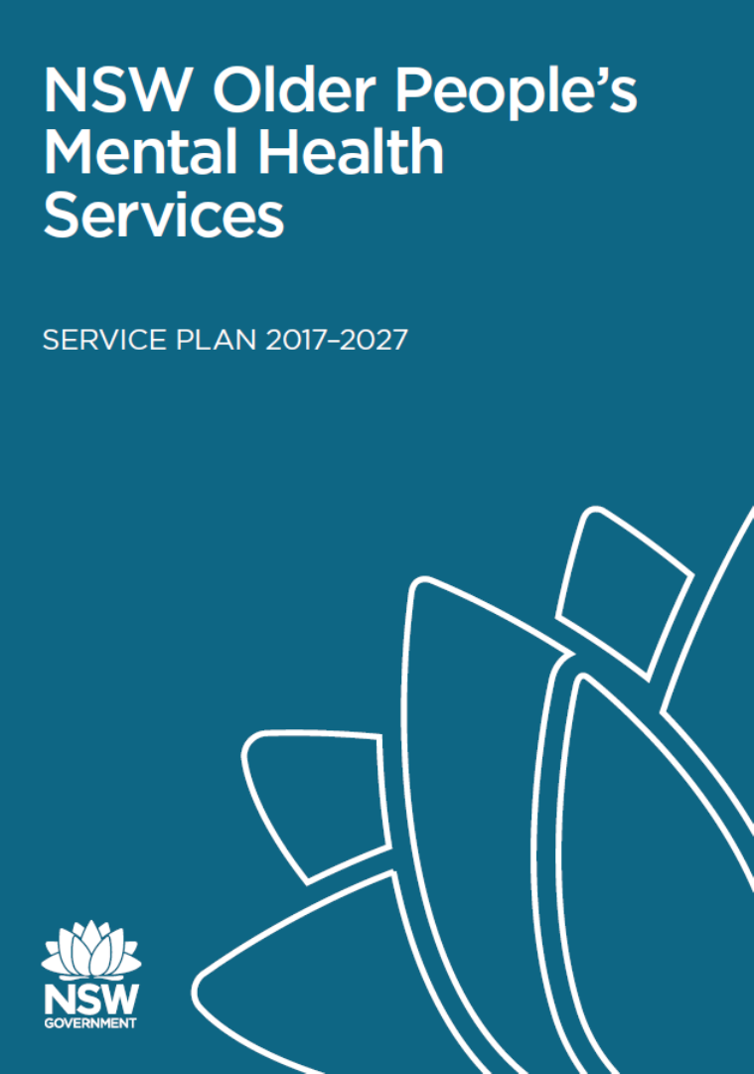
Approach: what we did
10-year statewide OPMH Service Plan – leading to sustained policy, and service development focus
Strong statewide consultation and advice mechanisms – ongoing policy and implementation dialogue
Strong local clinical and strategic leadership – driving local consultation, strategy, implementation, innovative service models
Funding commitment – based on key principle of promoting equitable access to OPMH services across NSW
Consistent effort and communication, as people and context change

Slide 15
Outcomes: how it worked
From 2005-2018
  23 new community OPMH teams across the 7 rural health districts of NSW
  3 new/redeveloped OPMH acute inpatient units (+1 under development)
  Redesign of non-acute inpatient units in 3 rural districts
Sustained increased access to OPMH community services in rural areas – 440% increase in access over 2004/05 to 2009/10 (rate per 100,000 people 65+ years)
Innovative rural OPMH service models (eg ‘hub and spoke’ service models, building on existing service infrastructure & linking geographically dispersed populations and services)
Further development of OPMH as a clinical service stream, with local OPMH clinical and strategic leadership largely sustained (including in rural areas)

Slide 16
Leadership and implementation lessons
Authorising environment
Endorsed guiding documents (policy, strategy, service plan, project plan) will help build and sustain support
Statewide/central leadership and support will help build and sustain support
Local executive/management support and local leadership are critical (noting potential challenges re changes in personnel etc)
Capability and capacity
Sustained consultation and advice mechanisms are important
Partnerships, collaboration and capacity building can drive and sustain work
Some consistency of approach (eg statewide OPMH service models) with room for flexibility and innovation in local implementation works
Funding helps, but is not essential to start with
Evaluation helps build on successful approaches/models

Slide 17
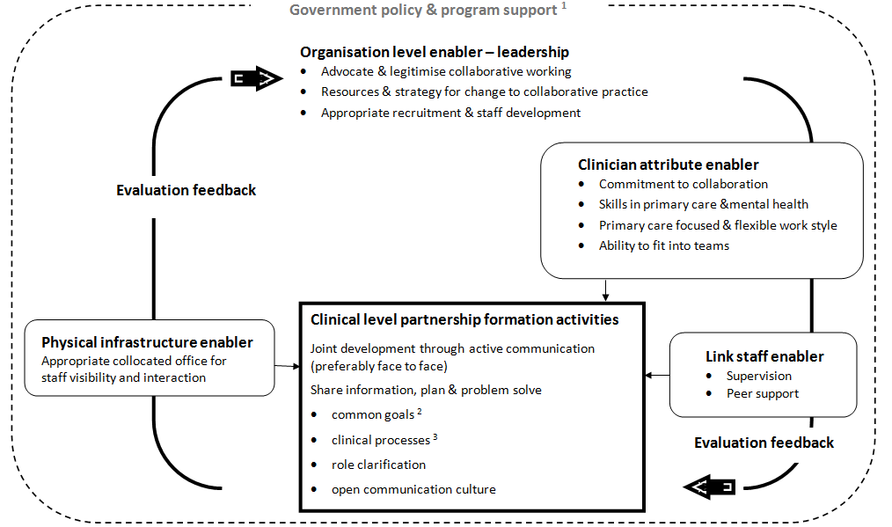
Enabling factors
Organisational
Clinician
Partnership
Infrastructure
Notes:
CLINICAL LEVEL
Partnership formation
Most common factor (22 papers) concerned partnership formation - processes of human organisation central to team building.
Joint development by mental health and primary care agencies – for joint ownership and mutually beneficial outcomes - included formulating a common understanding of the nature of the partnership, how it should function and set of compatible goals. (GENERALISABLE FACTOR)
Role clarity - most common aspect of partnership formation.
Canadian study found clinicians disagreed in 40% of the cases about responsibility for treatment - family physicians expecting the psychiatrist to provide care after referral - psychiatrists considered referrals were for assessment only.
Study of primary mental health workers in UK found some had been expected to design their own roles without guidance. Workers reported feeling like “the meat in the sandwich” between primary care staff, who wanted them to take a direct clinical role, and mental health staff, who wanted them to take a consultation liaison role.
Activities that supported this role clarification were weekly team meetings, regular peer support, a care protocol & expert clinical supervision.
Evaluation feedback
Feedback of evidence about how collaborating and impact on clients “most important factor for sustainability” (Blasinsky IMPACT 2008),
ORGANISATIONAL LEVEL
A supportive institutional environment legitimised a collaborative approach by providing leadership and a change management strategy
Unclear organisational structure & lack of higher system integration = ↓ resources and team conflict.

Slide 18
Authorising Environment | Existing | Next steps
 | 1=None to 10=Strong | Availability (1-10) | Needs action
Evidence base
Policy
Funding/ agreements/KPIs
Executive support
Central office support
Local support
Partner support
Other?

Slide 19
Capability/capacity | Analysis | Comments
 | 1= Nil available to 10 =substantial resources | How to: Secure support. Increase capability. Realise additional capacity. Better utilise existing capacity. Effectively deploy new resources
Funding
Personnel - capacity
Infrastructure
Models of care/protocols
Partnerships
Communications capacity
Support and advice
Other -

Slide 20

We lead by:
To commanding and directing attention
Deciding the holding environment
Providing access to information
Framing issues
Orchestrate conflict – contain disorder
Choose the decision - making process
This Photo by Unknown Author is licensed under CC BY

Slide 21

Stages of implementation
Contemplation
Decision making
Securing commitment
Evaluation and Review
Consolidation
Mobilisation
Planning implementation

Slide 22


Power to set the AGENDA and frame the issue
The question
The cooking method
The information
The pressure
The participants
The duration
The heat
The venue
www.equallywell.org.au

Slide 23
Leadership Strategy
Partnerships planning perseverance
The topic/focus
The participants
The process
The information
The duration
The heat
The venue
Other?
www.equallywell.org.au

Slide 24


The end – Thank you.
www.equallywell.org.au
twitter: equallywell_au

Slide 25


Evidence Informed
Over 20,000 research publications
Te Pou o te Whakaaro Nui
2014 Evidence review
2017 Evidence update
Australian National Mental Health Commission
2018 Narrative literature review
www.equallywell.org.au
Notes:
Te Pou conducted 2x evidence reviews in 2014 and 2017.
The literature review asked:
What is the mortality and morbidity gap?
What’s contributing to it?
What can be done to improve physical health outcomes and reduce the disparity?

Slide 26


The Foundations: National Policy Alignment
Notes:
RUSSELL -

Slide 27

A growing collaborative: 90
www.equallywell.org.au
Notes:
The collaborative is supported by a backbone team within CSU

Slide 28
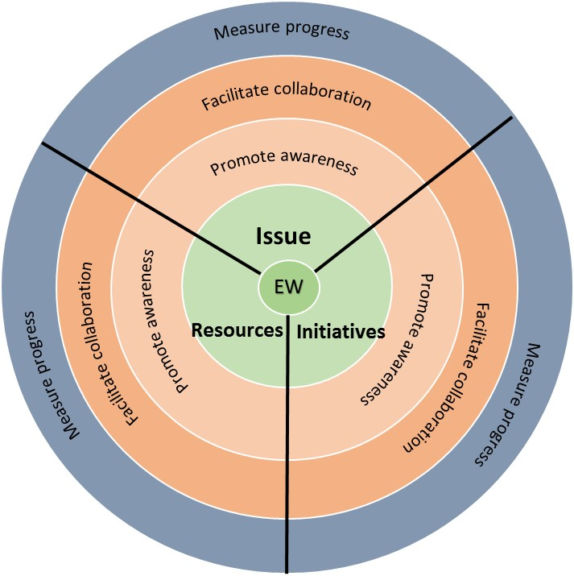

A constellation model of collective impact
Collective impact:
A common agenda
Shared measurement
Mutually reinforcing activities
Continuous communication
Backbone support team
disorder
disorder
www.equallywell.org.au
Notes:
RUSSELL -

Slide 29
Equally Well Ambassadors
www.equallywell.org.au
Notes:
RUSSELL -

Slide 30
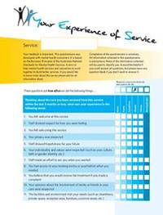
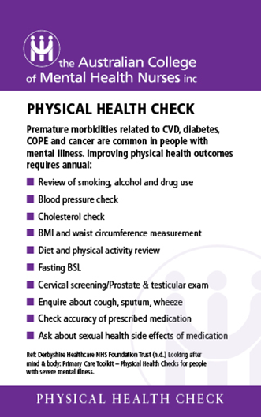
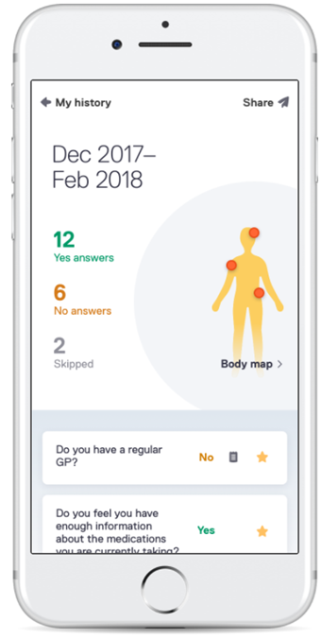
Professional, NGO and local action
487 actions underway across Aust
NEAMI
Health Prompt App
Notes:
RUSSELL -

