Slide 1













Thank you to our Sponsors
#EquallyWellAu22

Slide 2
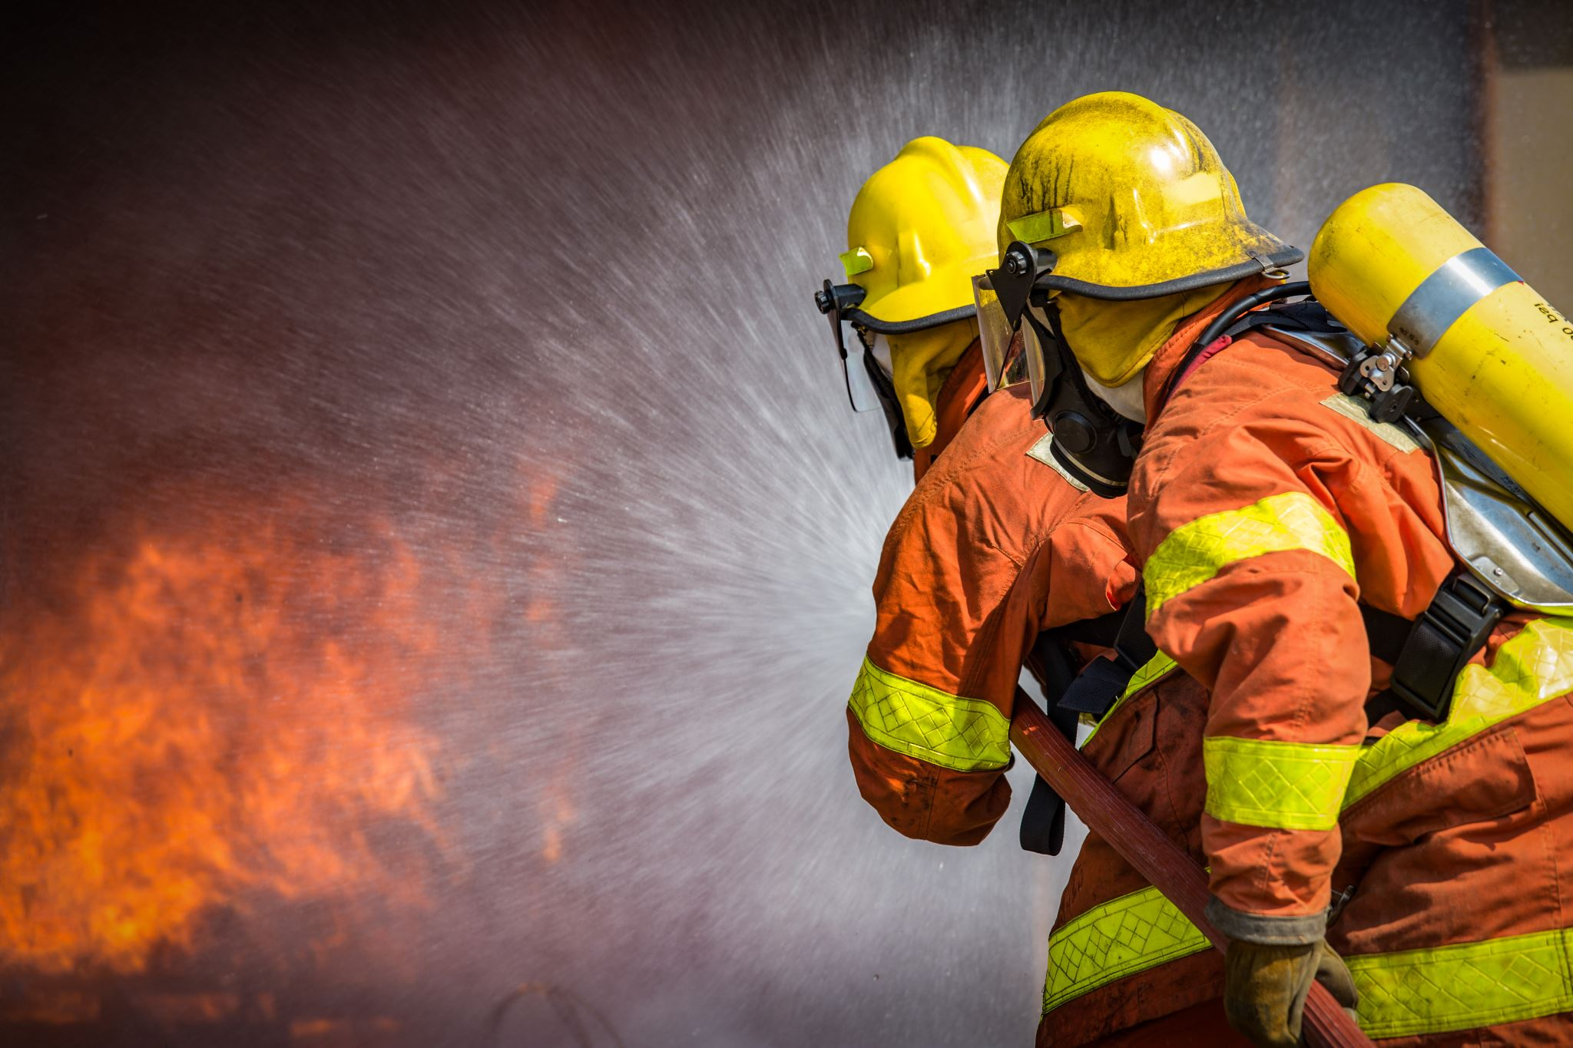

The experiences of peer-facilitators delivering a physical activity intervention for emergency service workers and their families
Dr Grace McKeon
Post-Doctoral Research Fellow, School of Psychiatry, UNSW
@mckeon_grace

Slide 4
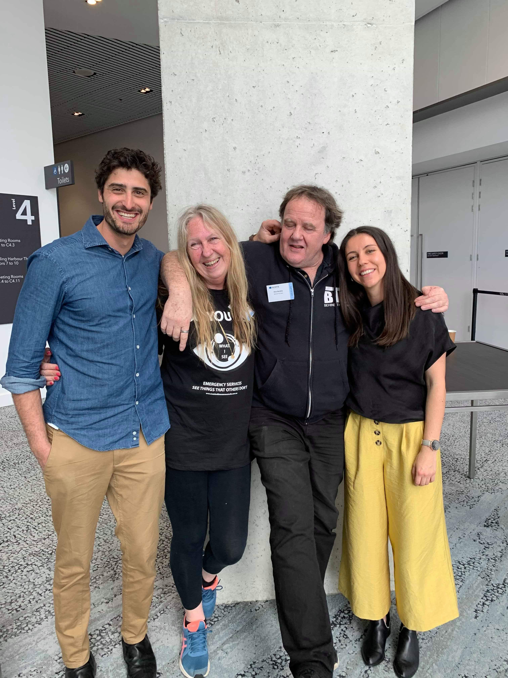


Slide 5
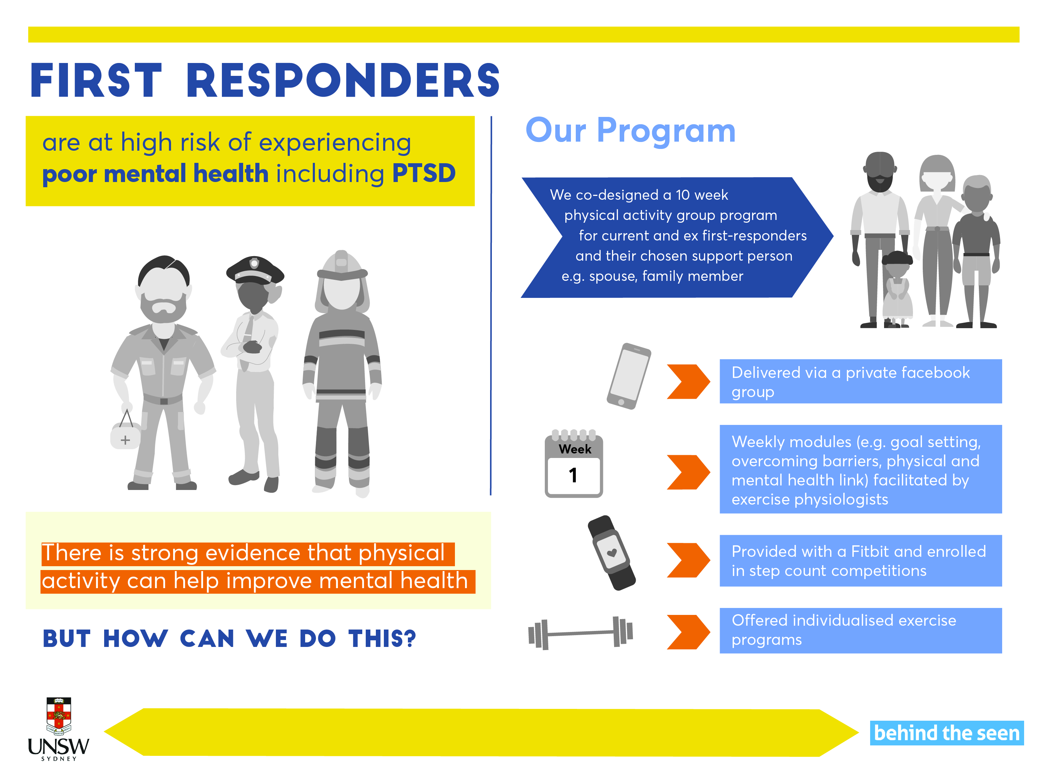
Ashdown-Franks et al 2020, Sports Medicine; Firth et al 2019, Lancet Psychiatry; Schuch et al 2018, American Journal of Psychiatry

Slide 6
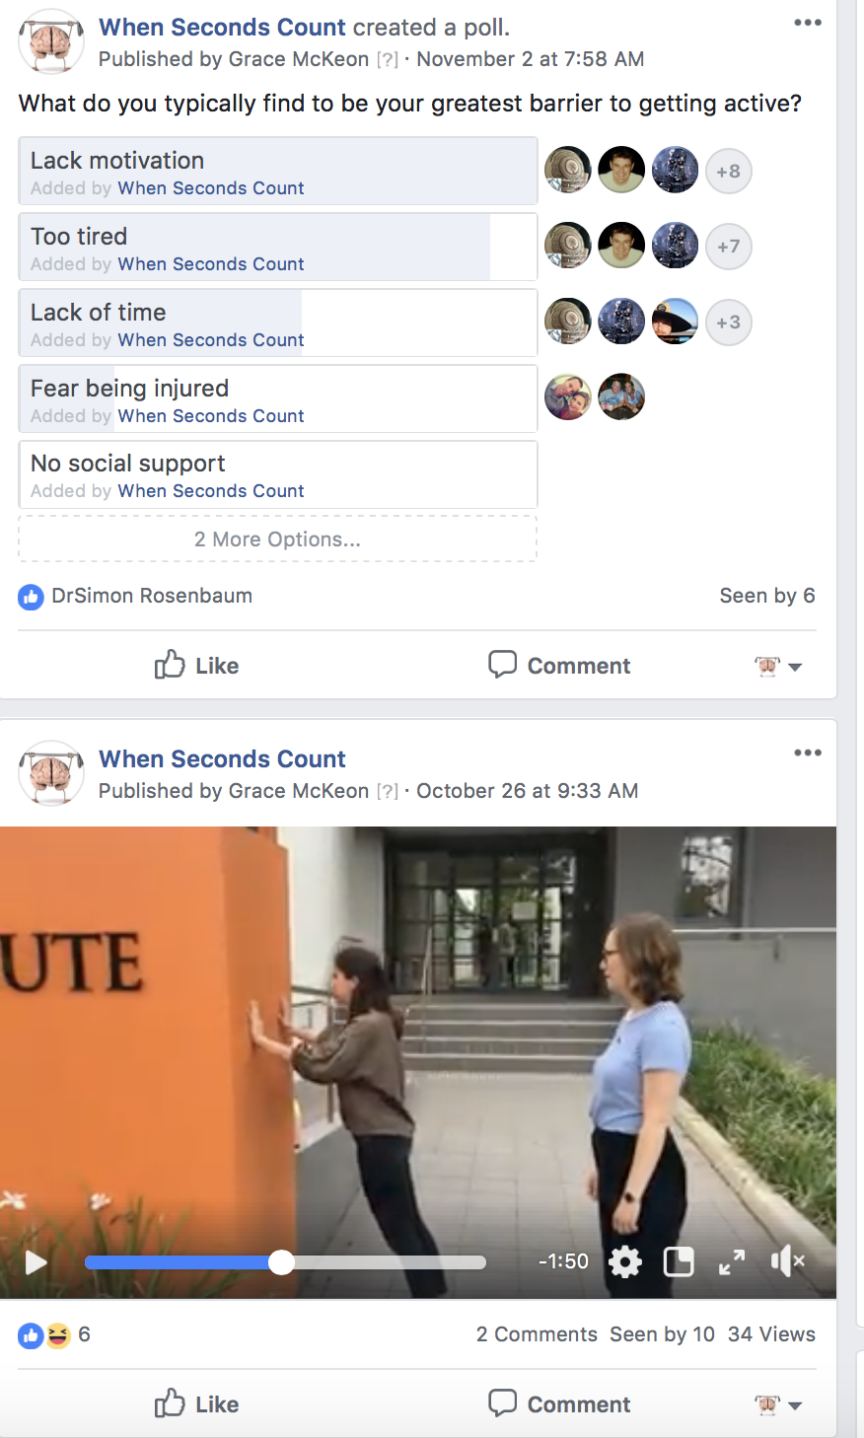
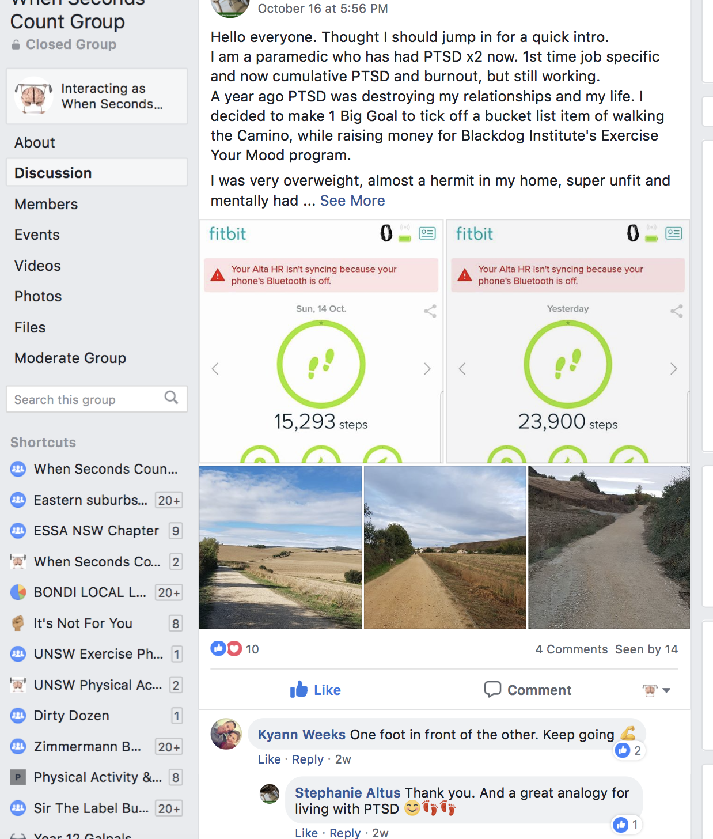
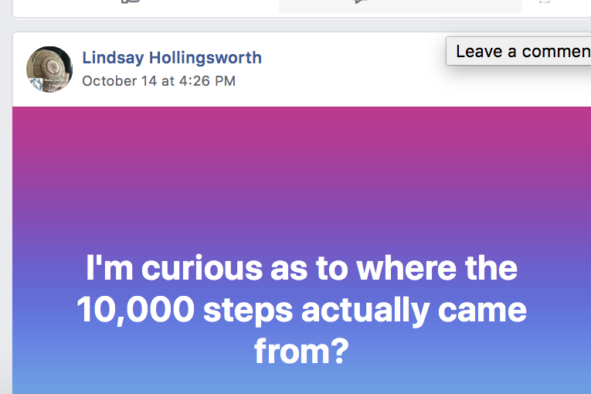

Slide 7
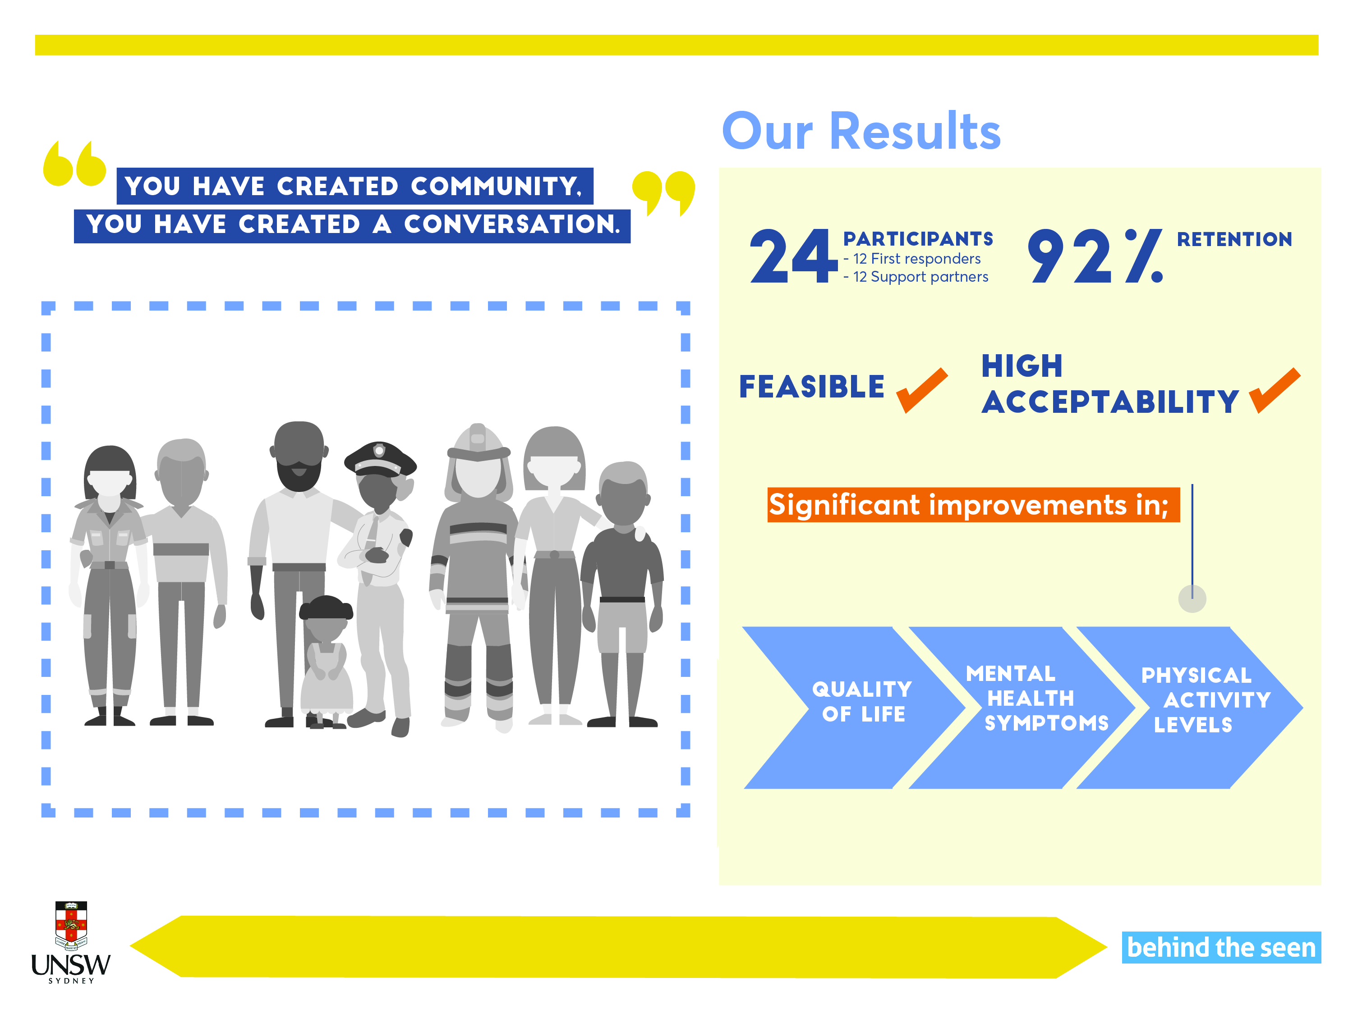
McKeon et al. (2021) JMIR formative research

Slide 8
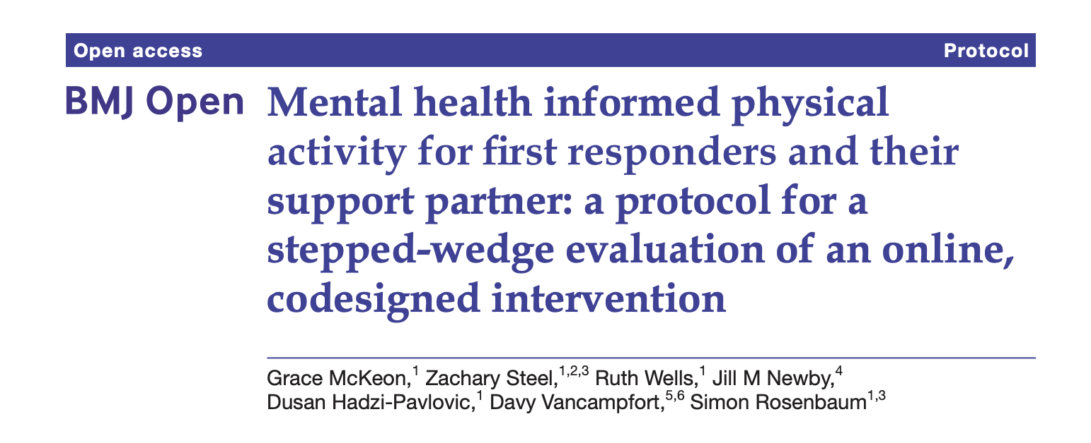

Slide 9



Pilot study
Stepped-wedge trial
Participants to peer-facilitators
Notes:
expressions of interest to act as peer-facilitators for subsequent clusters of the program were sought from all participants. Emergency service workers and their family members in the program who expressed interest were ‘graduated’ into the role of peer-facilitator for the subsequent waves of the program and subsequently co-delivered the succeeding program with exercise physiologists . selected based on their engagement with the program, rather than needing to have met a certain baseline level of activity.

Slide 10

90recruited
Fire Ambo Police Other | 42% 33% 15% 10%
N=47 first-responders
N=43 support partners
42(SD=11.5) years
47% first-responders
60% support partners

Slide 11
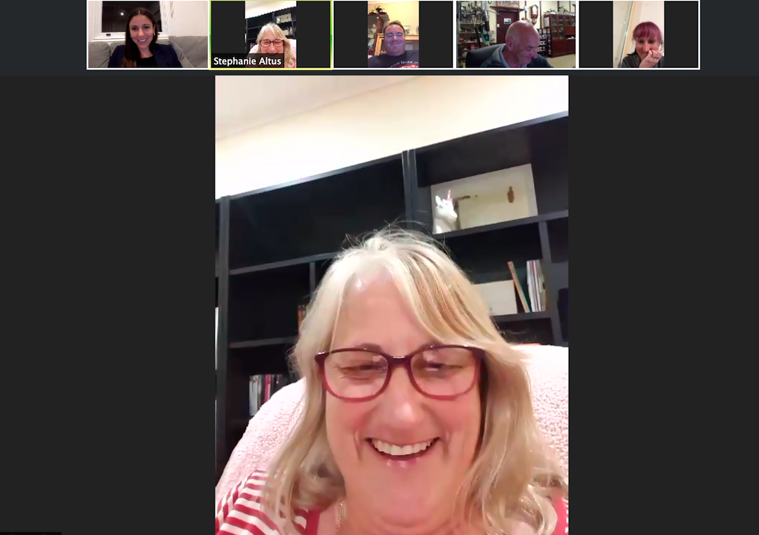


Shared with permission from Steph
Notes:
Post on the Facebook group, participate in weekly group video calls with the facilitators and self-disclose their journey with participants in the group where they were comfortable doing so. It was also suggested that the peer-facilitators help to ‘break the ice’ by initiating posts and social interaction to encourage active participation in the program.
Support the participants in the group e.g., by liking or replying to Facebook posts and therefore validating the experiences of participants.
No formal training was provided, but regular meetings with the peer-facilitators to check in, discuss any concerns and review the progress of the program.

Slide 12
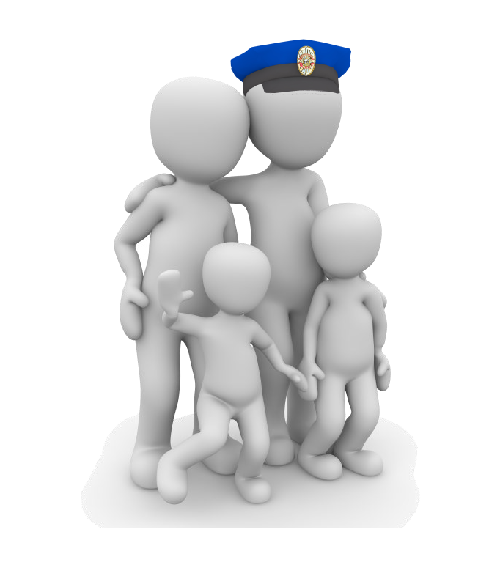

6peer-facilitators
ESW Support partner | 83% 17%
51(SD=9.2) years
50% female
50% active employment 50% retired

Slide 13
What are the experiences of peer-facilitators delivering an online physical activity intervention?
What was your experience being a peer-facilitator?
Why did you decided to volunteer to be a peer-facilitator?
What did you understand your role to be?
What would you like seen differently next time? E.g., training needs
1. The value of lived experience in shaping the peer role
2. Impact on peer supporters
(a) Credibility and relatedness by virtue of experience
(b) Knowledge and confidence by virtue of experience

Slide 14

1. The value of lived experience in shaping the peer role
(a) Credibility and relatedness by virtue of experience
It’s just leading by example and then when other people tell you to do stuff like your psychologist tells you, you have to do this homework, you’re resistant. You’re like, f**k I don’t want to do that.”
I’m not saying that you don’t motivate. You motivate in your own way by your expertise and by showing how to actually do some of the exercises... I think the peer support isn’t so much the technicalities of the exercise, its more about the emotional response.
(b) Knowledge and confidence by virtue of experience
I still remember the day when I got off the couch, I went and picked up some five-pound weights and I started moving. That was the day when things started happening in a better way for me …. .. So coming back around and being on the other end of it and there is a little bit of uncertainty and some people don’t like to talk in front of their phone and share insight because it too personal, it’s too scary …And then they’re like, ‘oh wow he can do it so I guess I can too.’ And then they get to work through those little tiny hurdles and it builds their confidence and they pull strength from other people.

Slide 15

2. Impact on peer supporters
I really think the volunteering piece plays a huge role because it’s filling a piece that we lose when we no longer have the identify of an active first responder. The grief over the loss of your job is really hard for some people to navigate and just knowing that it’s not your identity, it’s just your career.

Slide 16
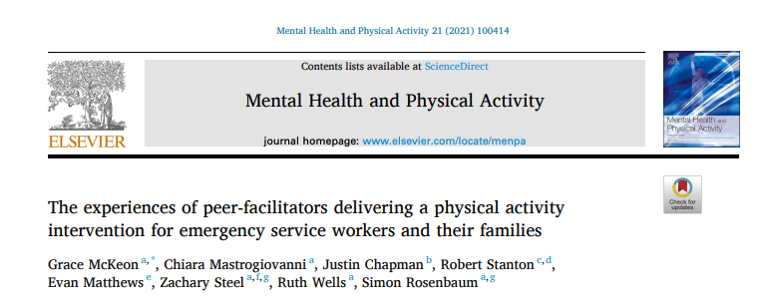

Slide 17
Acknowledgements
A/Prof Simon Rosenbaum, Prof Zachary Steel & Dr Ruth Wells
Chiara Mastrogiovanni, Dr Justin Chapman, Dr Evan Matthews, Dr Robert Stanton
Veronique Moseley and Ross Beckley, Behind The Seen
The Elderslee foundation
Suicide Prevention Australia

