Slide 1




Background
Examining service participation and outcomes from a population-level telephone-coaching service supporting changes to healthy eating, physical activity and weight: A comparison of participants with and without a mental health condition
Tegan Bradley, Kate Bartlem, Kim Colyvas, Paula Wye, Elizabeth Campbell, Kate Reid, Jenny Bowman
Tegan.Bradley@uon.edu.au

Slide 2
Background
Background
Disparity in health burden experienced by people with a mental health condition
Reduced life expectancy
~ median 10 years globally
~ 12 -16 years in Australia
Higher prevalence of chronic disease
Cardiovascular Disease
Diabetes
Notes:
People with a mental health condition experience a significantly reduced life expectancy when compared to the general population.
Life expectancy reduction varies in relation to diagnosis, with some conditions experiencing up to 32 years of life lost, but on average across all mental health conditions this reduction is around 10 years globally, and 12 – 16 years in Australia.
It is important to note that much of this reduced life expectancy is a result of a higher likelihood of experiencing physical health conditions such as cardiovascular disease and diabetes.

Slide 3



Background
Background
Contribution of a number of lifestyle factors
Notes:
The increased prevalence of chronic disease has been attributed to several lifestyle behaviours, which are also experienced at a higher rate amongst people with a mental health condition.
One of the more heavily researched area is smoking. While there has been an overall decrease in the rates of smoking in the last 20 years, people with a mental health condition are twice as likely to be current smokers compared to the general population, and trials continue to explore the best way to support smoking reduction and cessation in this population.
Other behaviours which also contribute to higher prevalence of disease in this group are physical inactivity and poorer nutrition, including reduced fruit and vegetable consumption. These behaviours may also contribute to overweight and obesity, which are also known health risks for cardiovascular disease and diabetes. Importantly, in many instances these factors can be modifiable, making them a target for prevention programs.

Slide 4

Telephone Support for Lifestyle Change
Telephone support
Telephone interventions effective in improving health risk behaviours
Short to medium term
Various populations and settings
Notes:
One approach to support change in lifestyle factors telephone base coaching services.
The evidence base from systematic reviews has suggested that telephone-based interventions are effective in improving health risk behaviours in the short to medium term across different populations, in a range of settings.
Perhaps the most widely recognised telephone based interventions are Quitlines, which provide support for smoking cessation, and are available on an international scale.
Evidence suggests that smokers engaging with Quitlines are 1.5 times more likely to have successfully quit at 1 and 6 months compared to those using self-help material only.
Telephone support for other health behaviours is less widely available. However, in NSW Australia……

Slide 5

Telephone Support for Behaviour Change
Free, confidential telephone-base service to support lifestyle changes
~25,000 coaching participants between 2009-2019
Notes:
The Get Healthy Information & Coaching Service is a free, confidential telephone-based service which helps people to make lifestyle changes regarding healthy eating, being physically active, and achieving and maintaining a health weight. The Service was launched in February 2009, and has provided information and support to approximately 25,000 Australians over the last decade.

Slide 6
Get Healthy Information and Coaching Service®
INFORMATION ONLY
REFERRAL
HEALTH ASSESSMENT
COACHING
Notes:
Individuals may be referred to the Get Healthy Service via a health professional such as their GP, or may self-refer either by registering their details online or calling the service directly. During their first contact with the service, participants complete a health assessment, which asks about their health-related goals, as well as about their current lifestyle factors such as fruit and vegetable consumption, physical activity levels as well as weight and waist circumference. Participants have the option of completing a once-off information only call, during which they receive personalised advice as well as health literature and goal setting materials. Alternatively, participants may choose to enrol in a coaching program, which provides advice, support and goal tracking over the following 6 months.

Slide 7
Get Healthy Information and Coaching Service®
COACHING
10-13 CALLS OVER
6 MONTHS
OPTION TO RE-ENROL AT COMPLETION
Notes:
The contents of the coaching program may differ slightly depending on the needs of the participants. For example, the pregnancy module provides more detailed advice on maintaining a healthy weight during and post pregnancy, while the Aboriginal module includes culturally appropriate and relevant information. All coaches are university qualified with a nutrition or exercise background.
Throughout their coaching program, participants receive up to 13 calls from their assigned coach at the service to discuss their progress, any barriers to creating or sustaining health changes, and provide ongoing support through this process.
At completion, participants have the option to re-enrol in a coaching program and continue to receive support if they choose.

Slide 8
Background
Previous Get Healthy Service® Evaluations
Improves health risk¹
Weight loss - 4kg
Waist circumference - 5cm
Vegetable consumption + 1 serve daily
30mins of walking per week
Reaching target populations²
Socially and geographically disadvantaged
High chronic disease risk profile
People with a mental health condition³
O'Hara, B. J., Phongsavan, P., Venugopal, K., Eakin, E. G., Eggins, D., Caterson, H., ... & Bauman, A. E. (2012). Effectiveness of Australia's Get Healthy Information and Coaching Service®: translational research with population wide impact. Preventive medicine, 55(4), 292-298.
O’hara, B. J., Phongsavan, P., Venugopal, K., & Bauman, A. E. (2011). Characteristics of participants in Australia’s Get Healthy telephone-based lifestyle information and coaching service: reaching disadvantaged communities and those most at need. Health Education Research, 26(6), 1097-1106.
Bradley T., Bartlem, K., Campbell, E., Wye, P., Rissel, C., Reid, K., Regan, T., Bailey, J.,Bowman, J., 2020. Characteristics of participants utilising a telephone-based coaching service for chronic disease health risk behaviours: A retrospective examination comparing those with and without a mental health condition. Prev.Med. Rep. 19, 101123
Notes:
Previous evaluations of the service have found positive results across various measures. Studies conducted in the first few years of service operation indicated that participants who complete a 6 month coaching program have lost on average 4kg, 5cm off their waist circumference, improved their vegetable intake by 1 serve per day, and participated in an extra 30mins of walking per week.
An assessment of those engaging with the service has also determined that the service is reaching those most in need, including socially and geographically disadvantaged populations, and the service is being utilised by those with a high chronic disease risk profile compared to the general population. Earlier research by our team also determined that a quarter of participants who enrolled in a program between 2015-2017 indicated that they had had a mental health condition.
As yet, there has been no assessment of whether coaching participants with a mental health condition are equally as likely to finish a coaching program, and if so, what benefits they might receive from the program.

Slide 9
Background
Research Questions
Are people with a mental health condition completing coaching programs with the GHS?
Are people with a mental health condition who complete a program experiencing the same physical health benefits as those without?
Notes:
We therefore derived two main questions. Firstly, are participants who indicate having a mental health condition completing a coaching program with the Get Healthy Service? And secondly, are those who complete experiencing the same physical health benefits as those who indicate not having a mental health condition at enrolment?

Slide 10
Background
Sample / Methods
5,629 participants enrolled in a coaching program from 2018-2019
Self-identified mental health condition
Comparison of
Completion rates
Withdrawn, completion, early completion
Changes to health measures, including
Weight, waist circumference, BMI, fruit and vegetable consumption, physical activity
Notes:
To answer these questions, we conducted a secondary data analysis on de-identified information collected by the Get Healthy Service for the 5,629 participants who enrolled in a coaching program between January 2018 and October 2019. Participants were grouped as either having or not having a mental health condition based on their response to the question “Have you had a significant mental health condition that required treatment from a health professional?” when enrolling in a coaching program. We then compared these two groups – people with a mental health condition and people without a mental health condition – on their likelihood of completing a program and health changes achieved. For completion, participants were recorded as either withdrawing from the coaching program, completing a program – which involved utilising the full 10-13 calls available from the service, or early completion in which participants indicated that they had met their goals but done so in less than the 10-13 calls available to them through the service.
For health measures, we compared baseline and completion values for participants such as weight, weight circumference, BMI, fruit and vegetable consumption, and three measures of physical activity.

Slide 11
Background
Results - Are people with a mental health condition completing coaching programs with the GHS?
33% of participants indicated having a mental health condition. 63% indicated taking medication for their mental health.
Notes:
Compared to earlier analyses (2015-2017), when only 25% of participants indicating having a mental health condition, from 2018-2019, 33% indicated having a mental health condition. Of this sample, 2/3 indicated that they were taking medication as a part of their mental health care.
After removing participants who were still part way through a program and had not actively withdrawn or completed, we found that 32% of coaching participants with a mental health condition completed a program, compared to 36% of participants who indicated not having a mental health condition. Among participants who did not complete a program, there was no difference in the average number of calls completed prior to withdrawing from the program (4), or the reasons for withdrawing.
Looking at participants who did complete a program, the vast majority of participants with a mental heath condition utilised all 10-13 calls available as a part of the program. Comparatively, almost half of participants without a mental health condition indicated that they achieved their goals in fewer than the 10-13 calls provided, and were recorded as early completers . In both groups, the average # of calls utilised amongst early completers was 6.

Slide 12
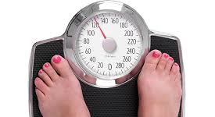
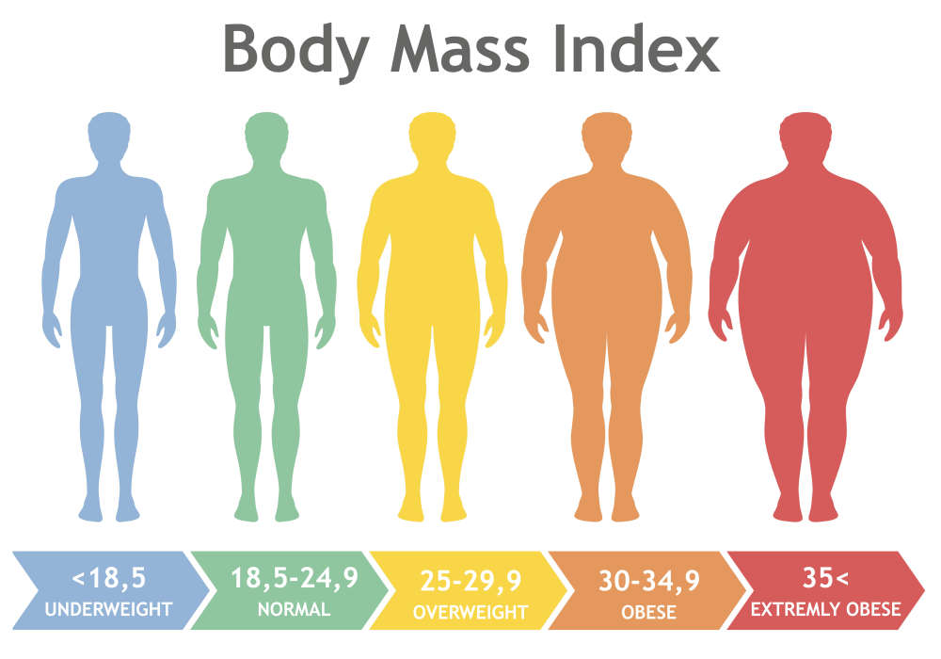

Background
Results – Are people with a mental health condition who complete a program experiencing the same physical health benefits as those without?
BMI Reduction
MHC: 0.63 units
No-MHC: 0.80 units
Waist Circumference Reduction
MHC: 1.01cm
No-MHC: 1.53cm
Weight Reduction*
MHC: 1.46kg
No-MHC: 2.08kg
Proportion with <5% weight loss
MHC: 24.5%
No-MHC: 26.7%
* Indicates significant difference in change between groups
Notes:
For participants who completed a coaching program, changes to health measures were similar, though consistently smaller for participants who indicated having a mental health condition. Participants with a mental health condition experienced an average of 1cm reduction in their waist circumference, 1 and a half kilo weight loss, and a reduction of .63 BMI units. We also found that across both groups, approximately a quarter of participants experienced a 5% weight loss, an amount deemed to be clinically significant for health.

Slide 13

Background
Results – Are people with a mental health condition who complete a program experiencing the same physical health benefits as those without?
Increase in fruit consumption (# of serves per day)
MHC: 0.38
No-MHC: 0.28
Increase in vegetable consumption (# of serves per day)*
MHC: 0.73
No-MHC: 0.92
* Indicates significant difference in change between groups
Notes:
Participants were also asked at intake and program completion about lifestyle factors including fruit and vegetable consumption. Participants with a mental health condition made slightly greater increases to their fruit consumption, and slightly smaller increases to their vegetable consumption compared to participants without a mental health condition.

Slide 14

Background
Results – Are people with a mental health condition who complete a program experiencing the same physical health benefits as those without?
Increase in walking
(# of 30min sessions per week)
MHC: 0.78
No-MHC: 0.87
Increase in moderate physical activity
(# of 30min sessions per week)
MHC: 0.54
No-MHC: 0.64
Increase in vigorous physical activity
(# of 20min sessions per week)
MHC: 0.07
No-MHC: 0.18
Notes:
Physical activity is measured by this service in three different formats – the number of 30min sessions of walking, 30 minute sessions of moderate activity, and 20 minute sessions of vigorous activity. As we can see for both groups, the greatest change was seen in the number of walking sessions and moderate physical activity sessions per week, with little change in the number of vigorous activity session. No statistical difference was found between the two groups in the amount of change to physical activity.

Slide 15
Background
Conclusion
People with a mental health condition comprise ~33% of people engaging with the Get Healthy Service
Equally as likely to complete a coaching program, and do so by utilising all available calls in a program
Experience similar, but smaller, changes to a range of physical health measures collected at the beginning and end of a coaching program
Notes:
Approximately a third of participants engaging in a coaching program with the Get Healthy Service indicate having had a significant mental health condition. These participants are equally as likely to complete a coaching program with the service, and do so by utilising the full number of calls available rather than achieving their goals early. Health benefits experienced between the start and end of a coaching program are similar across the two groups.

Slide 16
Background
Next steps
How might the Get Healthy Service® experience differ for participants with a mental health condition?
Interviews with Get Healthy coaches
Interviews with Get Healthy participants with a mental health condition
Notes:
Following the findings of the current study, a number of logical next steps appeared. We conducted qualitative interviews with the health coaches of the Get Healthy Service to gain further understanding of how the experience of delivering the service to participants both with and without a mental health condition, and their insight and perceptions into how the coaching program might be experienced differently between the two groups. Findings from this study indicated that coaches had a desire for further training, education and resources on mental health and its interplay with physical health in order to provide better support for their coaching participants with a mental health condition. Coaches also perceived a number of other benefits reported by their coaching participants with a mental health condition, including greater confidence in their ability to make changes to their physical health, as well as reported improvements to mental health, factors which are not currently collected as a part of the service evaluation.
My research team is also currently in the process of conducting qualitative interviews with consumers of the get healthy service who have a mental health condition, in order to gain a better understanding of what may be influencing program completion or withdrawal, and what changes could potentially be incorporated into the service in order to better meet the needs of this large group of service users.

Slide 17
Background
Acknowledgements

