Slide 1













Thank you to our Sponsors
#EquallyWellAu22
Notes:
Add your name and introduce yourself
Also let people know about following us on social media – all handles on last slide

Slide 2

An Integrated Metabolic Clinic Embedded in an Outpatient Mental Health Clinic
Dan Siskind MBBS MPH PhD FRANZCP
Clinical Academic Psychiatrist MSAMHS
Professor University of Queensland Faculty of Medicine

Slide 3
Declarations
No conflicts of interest to declare
Supported in part by an NHMRC EL2 (2021-2025) GNT1194635

Slide 4

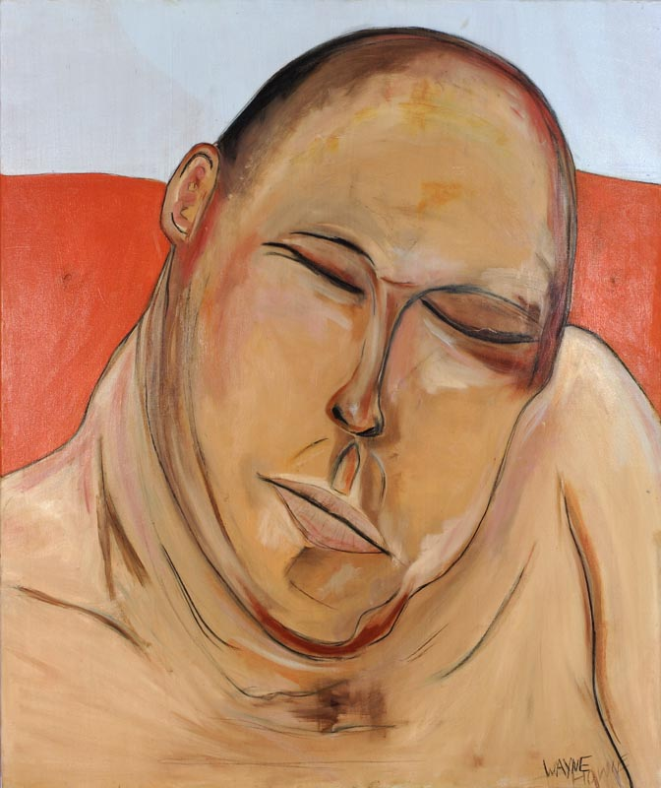
Art from QCMHR Collection

Slide 5
Art from QCMHR Collection

Slide 6




What causes weight gain?
16+ year mortality gap for people with schizophrenia

Slide 7
Antipsychotics and Metabolic Disturbance
Risk of: | weight gain | lipid abnormalities | glucose abnormalities
Clozapine | High | High | High
Olanzapine | High | High | High
Quetiapine | Intermediate | High | Intermediate
Risperidone | Intermediate | Intermediate | Intermediate
Paliperidone | Intermediate | Intermediate | Intermediate
Ziprazidone | Low | Low | Low
Amisulpride | Low | Low | Low
Aripirazole | Low | Low | Low
Firth J, Siddiqi N, Koyanagi AI, Siskind D et al. The Lancet Psychiatry Commission: a blueprint for protecting physical health in people with mental illness. 2019

Slide 8
Art from QCMHR Collection

Slide 9



Slide 10
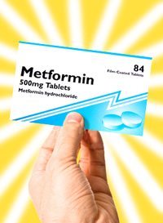

Slide 11
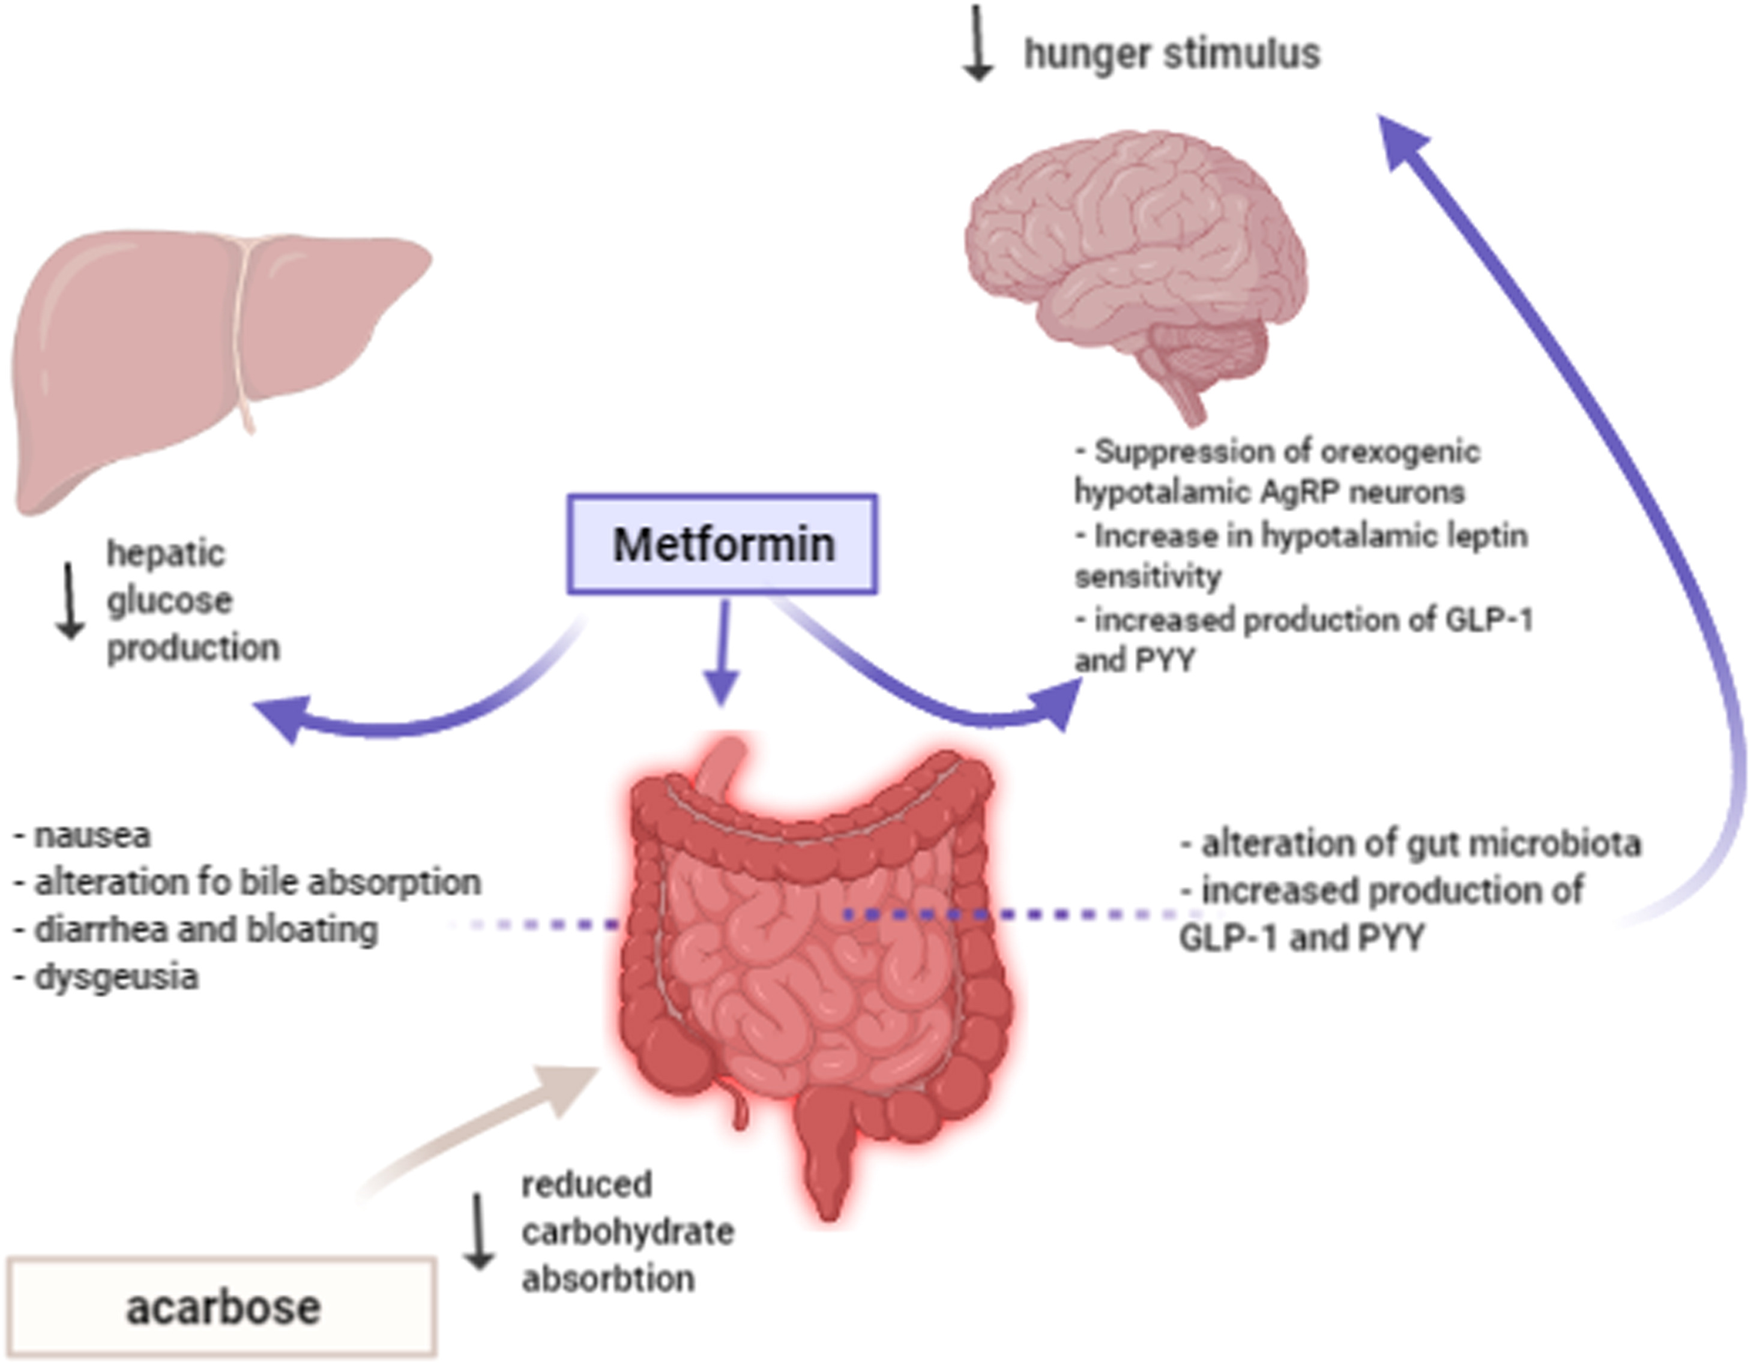

Slide 12
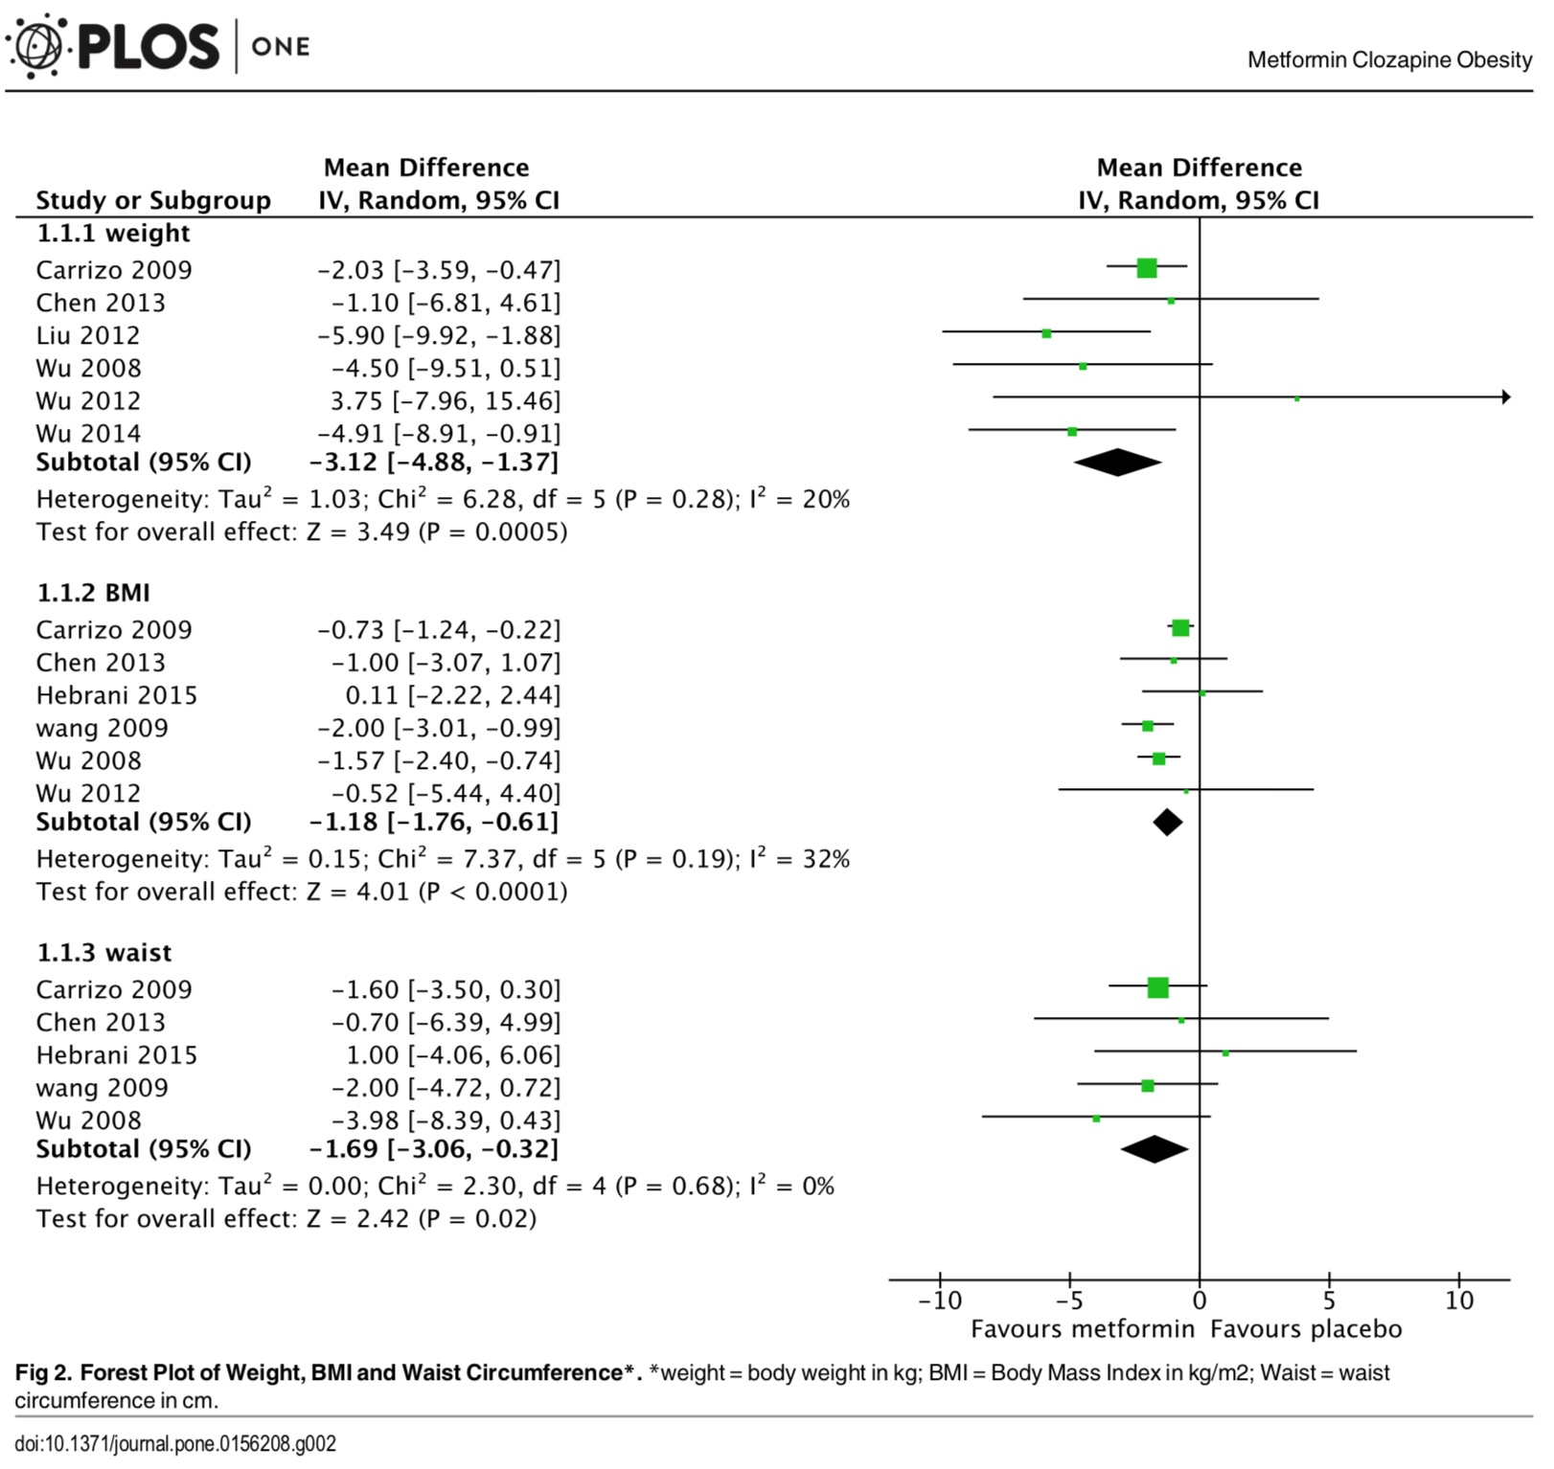
Siskind DJ, Leung J, Russell AW, Wysoczanski D, Kisely S. Metformin for Clozapine Associated Obesity: A Systematic Review and Meta-Analysis. PLoS One. 2016;11:e0156208.

Slide 13
RCT of Metformin vs Placebo at Clozapine Commencement
 | Metformin (n=8) | Placebo (n=5) | P value
Change in weight
Weight Gain | 5 (62.5%) | 5 (100%) | 0.024
Weight Loss | 3 (37.5%) | 0 (0%)
5% Weight gain
≥5% weight gain | 1 (12.5%) | 4 (80%) | 0.015
<5% weight gain | 7 (87.5%) | 1 (20%)
NAFLD Fibrosis Score
Above Threshold | 0 (0%) | 3 (60%) | 0.012
Below Threshold | 8 (100%) | 2 (40%)
Siskind D, Russell A, Suetani S et al. CoMET: A Randomised Controlled Trial of Co-commencement of METformin versus placebo as an adjunctive treatment to attenuate weight gain in patients with schizophrenia newly commenced on clozapine. Therapeutic Advances in Psychopharmacology 2021; 11:1-12.

Slide 14
Retrospective Chart Review of metformin and clozapine
 | Weight gain (%) | N | Mean difference | 95% CI (%) | P
Metformin Use
Yes | 1.32 | 48 | -4.63% | -8.87 to -3.90 | 0.031
No | 5.95 | 42
Gender
Male | 4.37 | 64 | -3.05% | -7.80 to 1.69 | 0.204
Female | 1.31 | 26
Any T2DM Status
Yes | 1.98 | 12 | 0.46% | -7.01 to 7.92 | 0.903
No | 2.44 | 48
Spokes J, Hollingworth S, Winckel K, Kisely S, Baker A, Cosgrove P, Siskind D. Metformin reduces 12-month change in body weight among people newly commenced on clozapine: a retrospective naturalistic cohort study. Therapeutic Advances in Psychopharmacology. 2021;11

Slide 15
GLP-1RA Individual Patient Data Meta-Analysis
Variable | N | Mean Difference GLP-1RA vs control | SE | p-value
Weight (kg) | 168 | -3.71 | 0.65 | <0.001
Waist (cm) | 167 | -3.00 | 0.68 | <0.001
BMI (kg/m²) | 168 | -1.19 | 0.22 | <0.001
HbA1c (IFCC) | 166 | -3.25 | 0.66 | <0.001
FPG (mmol/L) | 166 | -0.45 | 0.09 | <0.001
HDL (mmol/L) | 166 | -0.01 | 0.02 | 0.566
LDL (mmol/L) | 162 | -0.17 | 0.08 | 0.030
TG (mmol/L) | 166 | -0.24 | 0.12 | 0.055
Visceral fat (gm) | 97 | -177.51 | 68.71 | 0.011
Siskind, D, M Hahn, C Correll, A Fink-Jensen, A Russell, N Bak, B Broberg, Larsen J, P Ishoy, T Vilsboell, F Knop, S Kisely, and BH Ebdrup. “Glucagon-Like Peptide-1 Receptor-Agonists for Antipsychotic- Associated Cardio-Metabolic Risk Factors: A Systematic Review and Individual Participant Data Meta-Analysis.” Diabetes Obes Metab in press (2018):

Slide 16
The Problem
Low rates of metabolic testing
Low rates of checking metabolic results
Low rates of acting on these results
Increased morbidity and mortality for the consumers we serve

Slide 17
Rates of Treated Metabolic Syndrome in 2016
 | Monitoring Rates | Criteria Met | Receiving Treatment
Metabolic Syndrome | 43.4% (109/251) | 45.0% (49/109) | 61.2% (30/49)
Central Obesity | 86.1% (216/251) | 72.2% (156/216) | 50.6% (79/156)
Raised FBG / T2DM | 80.1% (201/251) | 47.8% (96/201) | 31.3% (30/96)
Raised BP | 95.6% (240/251) | 56.2% (141/240) | 24.1% (34/141)
Raised TG | 86.1% (216/251) | 69.9% (151/216) | 43.0% (65/151)
Reduced HDL | 65.3% (164/251) | 71.3% (117/164) | 55.6%% (65/117)

Slide 18
Rates of Treated Metabolic Syndrome in 2016
 | Monitoring Rates | Criteria Met | Receiving Treatment
Metabolic Syndrome | 43.4% (109/251) | 45.0% (49/109) | 61.2% (30/49)
Central Obesity | 86.1% (216/251) | 72.2% (156/216) | 50.6% (79/156)
Raised FBG / T2DM | 80.1% (201/251) | 47.8% (96/201) | 31.3% (30/96)
Raised BP | 95.6% (240/251) | 56.2% (141/240) | 24.1% (34/141)
Raised TG | 86.1% (216/251) | 69.9% (151/216) | 43.0% (65/151)
Reduced HDL | 65.3% (164/251) | 71.3% (117/164) | 55.6%% (65/117)

Slide 19
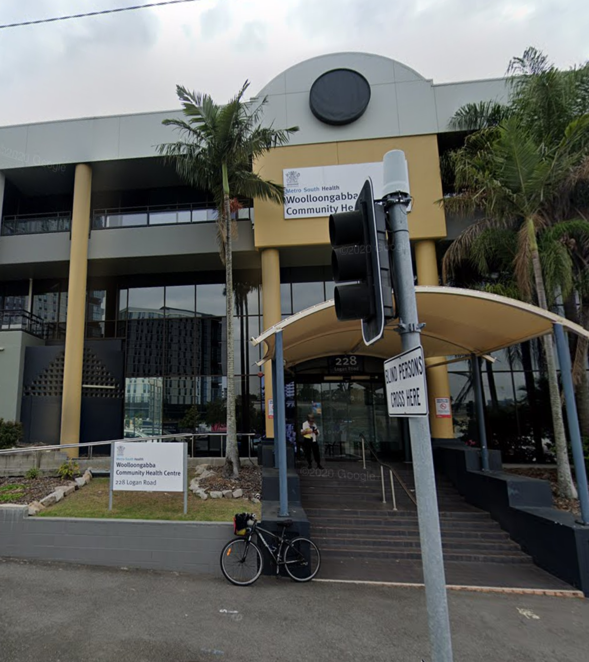
Co-located Endocrine Mental Health Clinic
Established in July 2017
Co-located with mental health clinic
Running in parallel
Endocrinologist – half day a week
Gym in clinic – run by exercise physiology students
Dietician

Slide 20
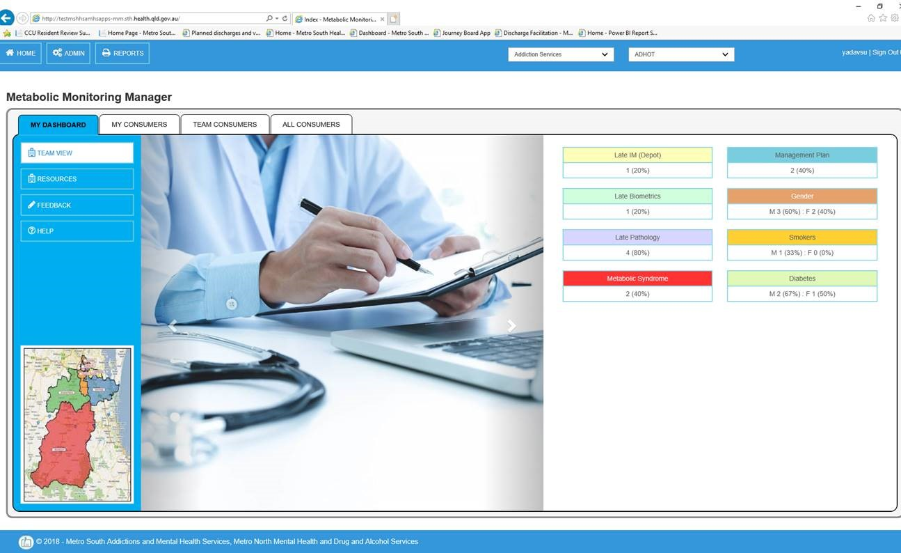
Homepage

Slide 21
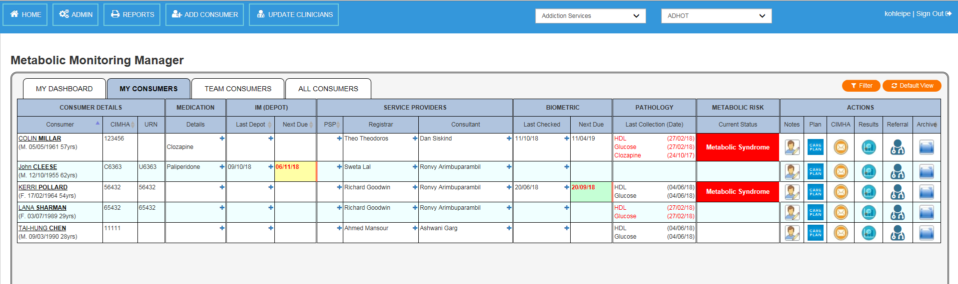
Your Home Screen

Slide 22
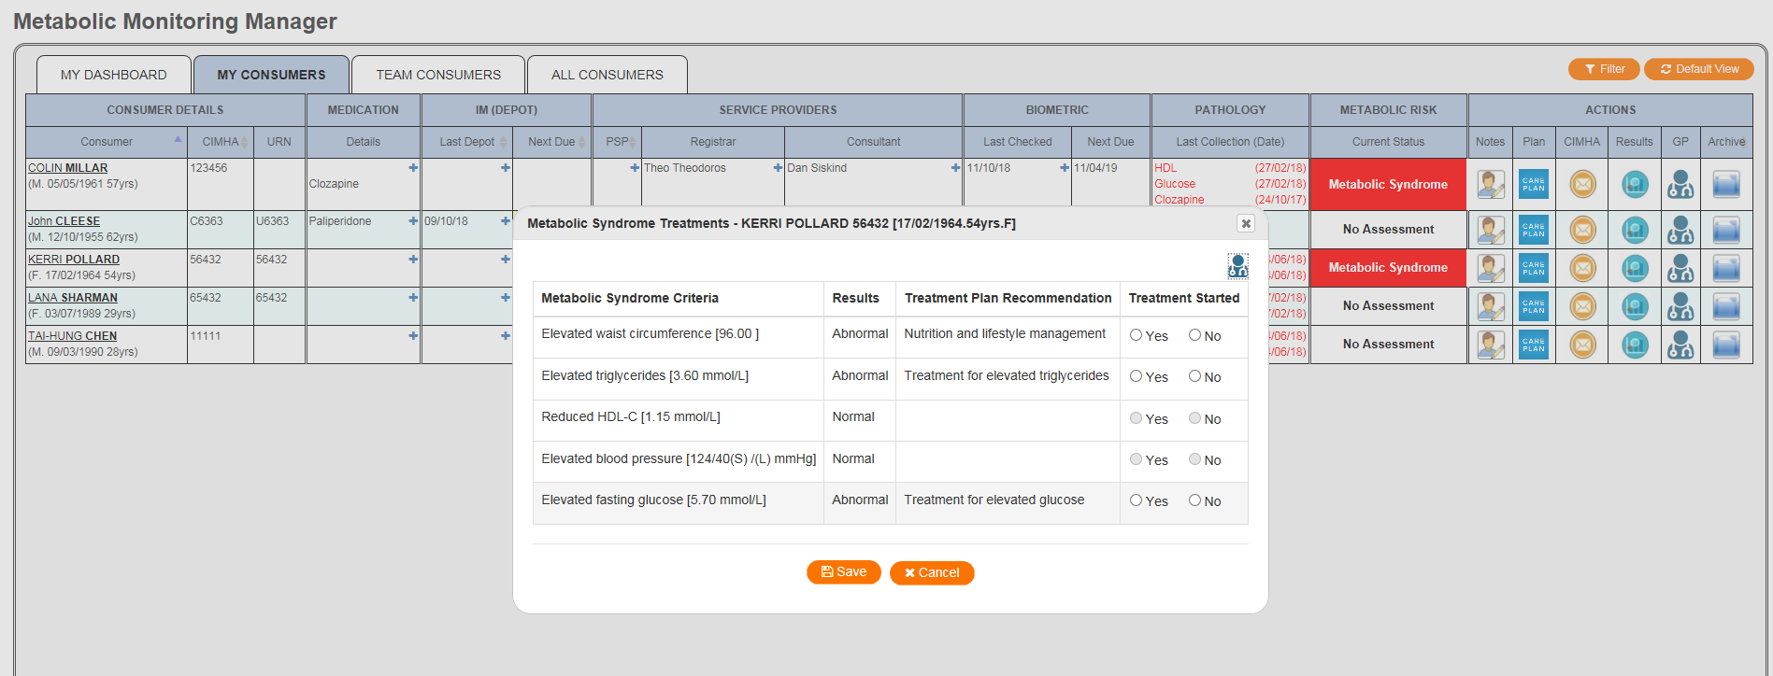
Taking Action

Slide 23
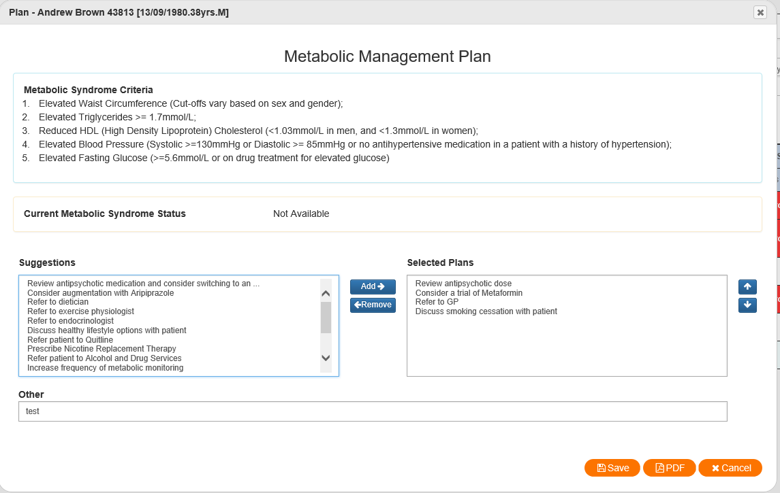
Management Plan

Slide 24
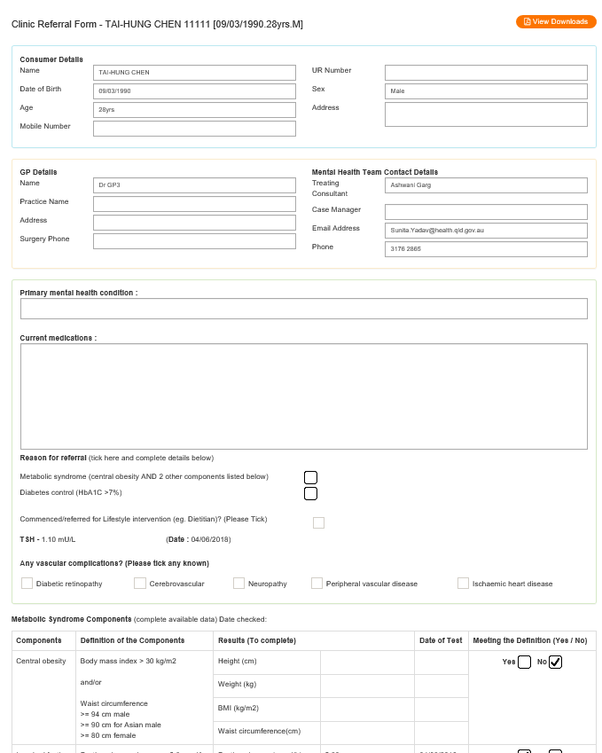

Referral letter to metabolic clinic
Dr Moe Thuzar
Endocrinologist
WCHC Wed pm

Slide 25
Demographics over first year of operation
Total Referrals (n) | 48
Age (years) | 45.5±1.4
Gender n (%) | Male 33 (69%)
Weight (kg) | 112.3±4.1
Body Mass Index (kg/m²) | 36.5±1.3
Waist Circumference (cm) | 125.1±2.5
Antipsychotic Rx | (50% monotherapy)
Clozapine | 27
Other SGA | 42
FGA | 6
Absolute Cardiovascular Risk
Low (<10%) | 32 (67%)
Moderate-High (>10%) | 16 (33%)

Slide 26
Increased prescribing of appropriate Rx
Medication | Patients with eligible condition | Prescribed prior to initial consult | Prescribed following initial consult | P-values
Metformin | 48 | 24 (50%) | 36 (75%) | P=0.001
Other Diabetes Medications | 15 | 9 (60%) | 12 (80%) | P=0.317
Lipid Lowering Medications | 35 | 21 (60%) | 27 (77%) | P=0.007
Antihypertensives | 16 | 9 (56%) | 11 (69%) | P=0.083

Slide 27
Attendance rates higher at co-located clinic

Slide 28
Clinical Practice
High rates of comorbid metabolic disorders
Low rates of evidence-based treatment
Colocation of metabolic and lifestyle interventions can increase uptake among people with severe mental illness

Slide 29
Thanks
MSAMHS (A/Profs Motamarri and Kar Ray)
UQ Faculty of Medicine (Prof Kisely, A/Prof Warren)
CADENCE clinical trials team
  Andrea Baker, Peter Cosgrove
Psychiatry Trainees (Drs Tso, Kumar and Jayasooriya)
Endocrinologists (Prof Russell, Drs Thuzar, Yen, Sly & Jansen)

