Slide 1













Thank you to our Sponsors
#EquallyWellAu22

Slide 2
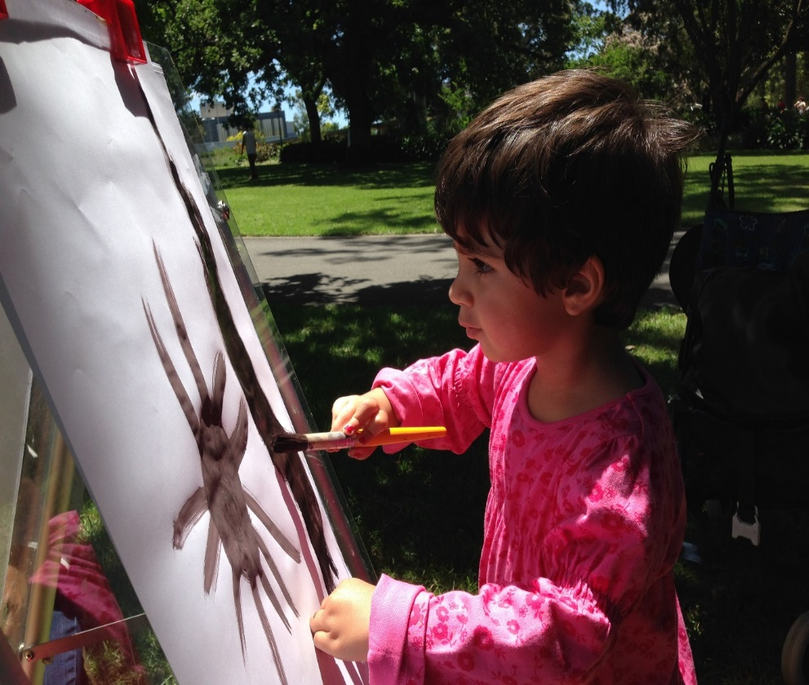
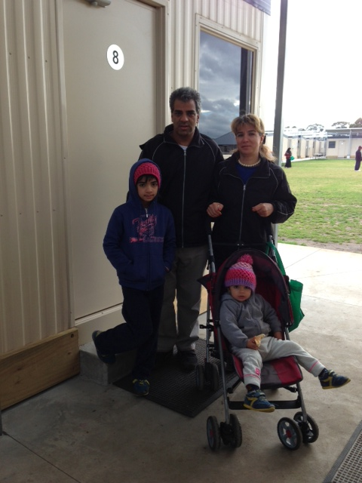
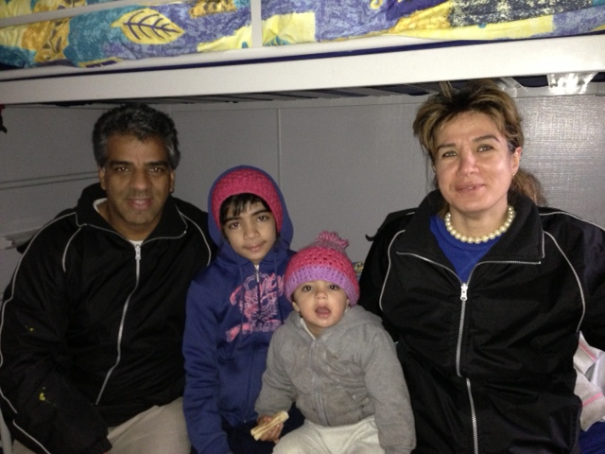
We've boundless plains to share....

Slide 3
557

Slide 4
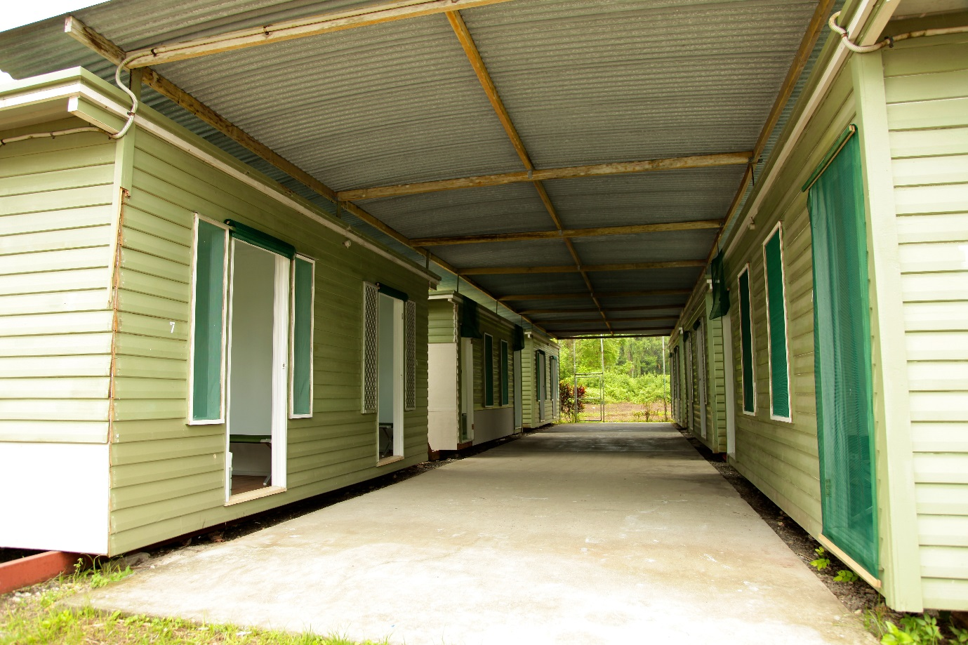

Slide 5
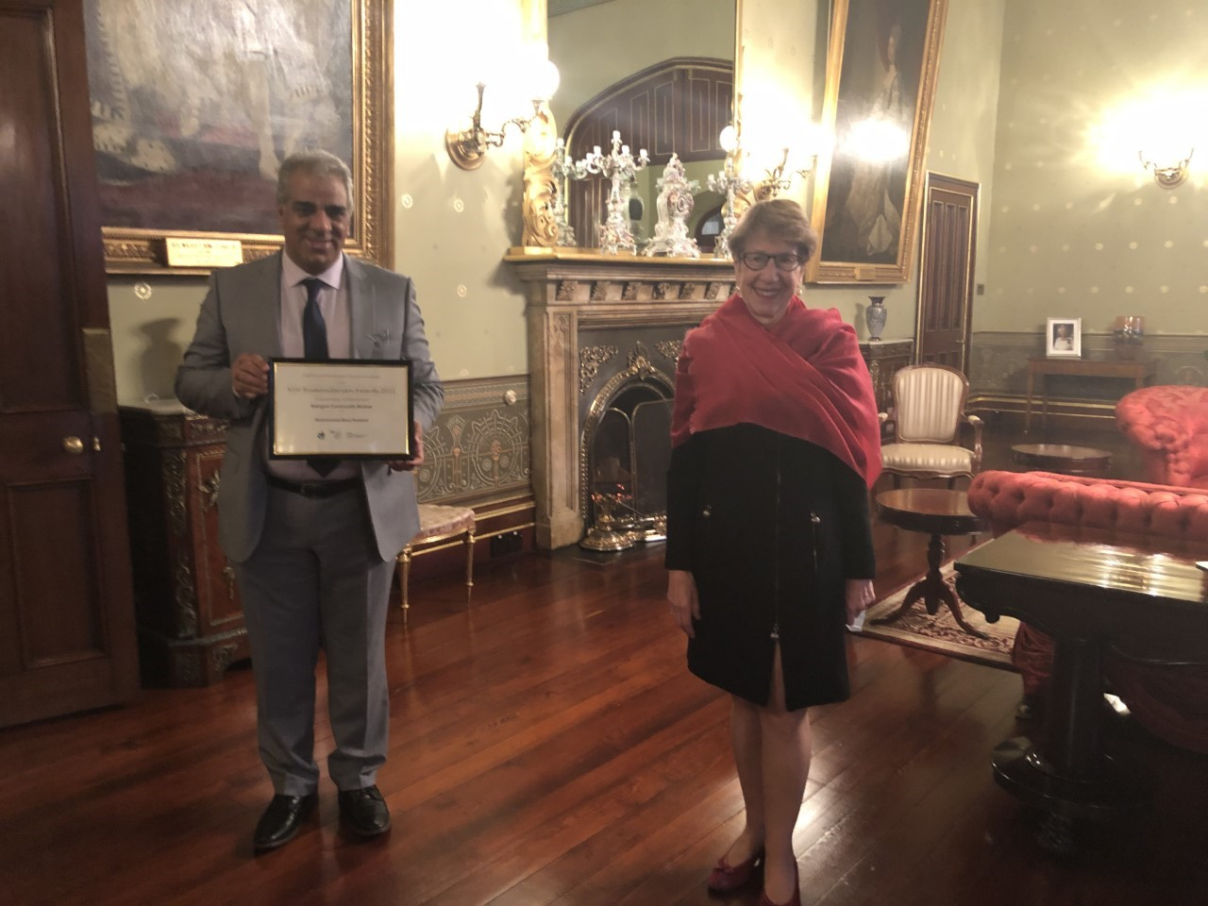

Slide 6

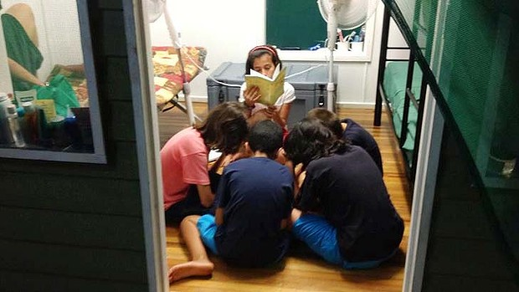

Slide 7
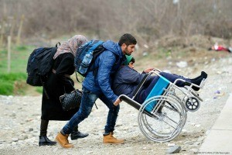

Slide 8
POVERITY
STRESS
BEING ASYLUM
Language
Living LIMBO
MENTAL HEALTH
BARRIERS
Level confidence
CULTURAL AND SOCIAL
MOTIVATION
Lake of time

Slide 9
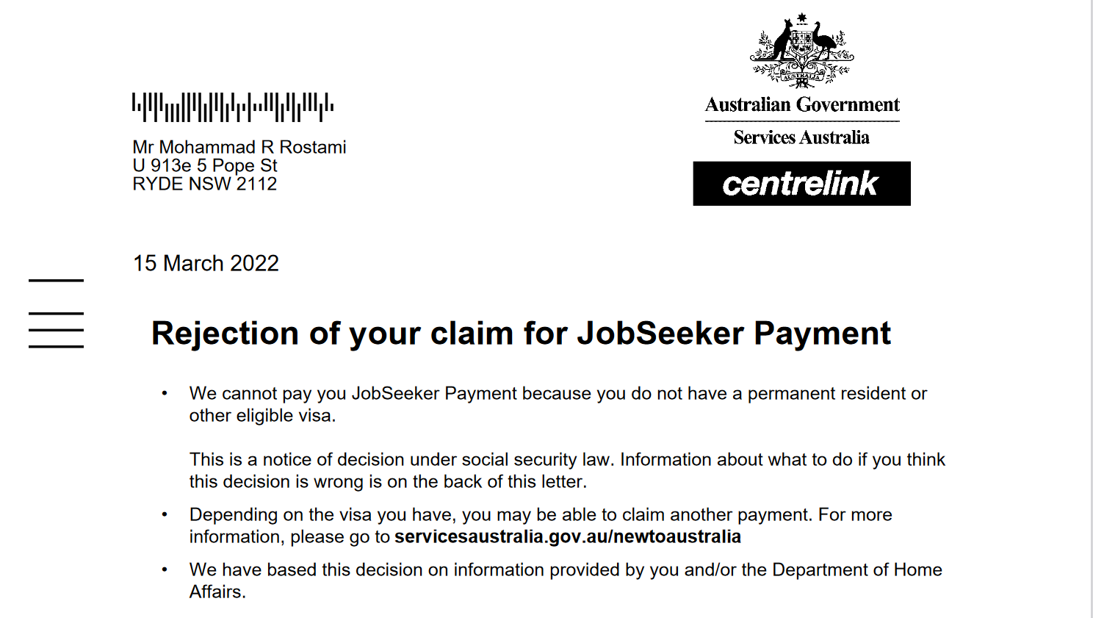

Slide 10


