Slide 1













Thank you to our Sponsors
#EquallyWellAu22
Notes:
Add your name and introduce yourself
Also let people know about following us on social media – all handles on last slide

Slide 2

The Lived Experience ‘Peer’ Workforce – being equally well
Tim Heffernan
Deputy Commissioner
NSW Mental Health Commission
Mental Health Peer Coordinator
COORDINARE, South Eastern NSW PHN

Slide 3



Peer work and climate change
The nation’s mental health system is “fundamentally broken”
Mental Health Council of Australia, 2014
The our current system is deeply flawed and the result is people finding themselves at crisis point
Mental Health Australia, 2015

Slide 4
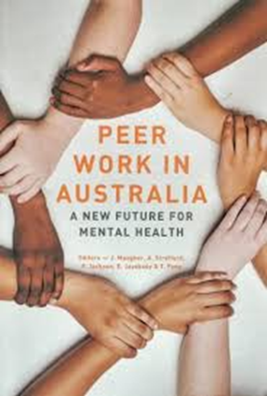
Peer workers – a renewable resource in an ecosystem
‘If we think of workforce as the fuel that feeds the mental health system, then the peer workforce is a lot like alternative fuel sources such as solar and wind power. Peer workers are the renewable resource of the mental health system. The traditional workforces are the fossil fuels that sustain the biomedical model. Things are obviously worsening in this system, but as with climate change, there are significant vested interests whose survival depends on maintaining the status quo, regardless of the damage done.‘
Tim Heffernan, ‘Peer Work and Climate Change’ in Meagher, Stratford, Jackson, Jayakody, Fong (eds) 2018. Peer Work In Australia: A new future for mental health. RichmondPRA and Mind Australia

Slide 5
Recovery group
“My grandmother used to say to me you don’t go to the doctor when you are unwell, you go to someone who has recovered from the sickness.”
Consumer, Wollongong Mental Health Unit. 2009

Slide 6
For every person living with mental illness who dies early of suicide, nine die early due to heart disease, respiratory disease or cancer.
Physical health of people with mental illness
Roberts and Bowman (2019)

Slide 7

Lived Experience (Peer) Work – human rights and social justice
Human rights are indivisible, interdependent and interrelated. Within the unitary system of human rights, the two that figure here are:
The right to health
The right to personal autonomy and agency

Slide 8
Equally Well and Peer Work
Are we keeping people equally well?
Are we keeping ourselves equally well?
Are we treated equally well as other mental health workforces?
Are we equally well represented in mental health services and systems
Are we equally ‘wealthy’ compared to other mental health workforces?

Slide 9


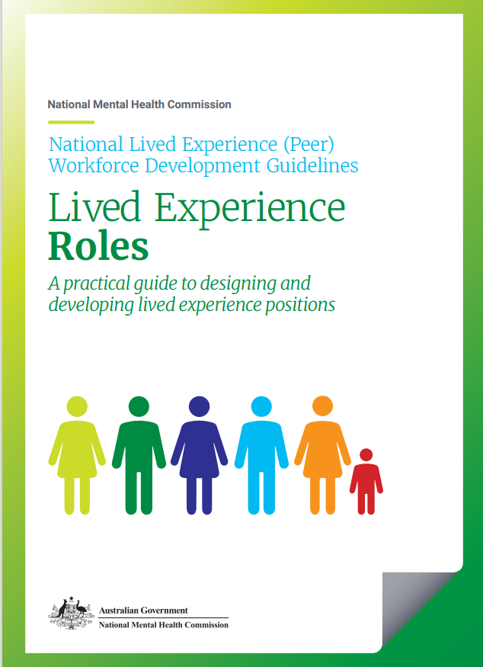

A planning resource for Primary Health Networks
A self-assessment tool for employers.
Planning the Future Mental Health Workforce
Investing in Lived Experience Workforce Development

Slide 10
Who are the Lived Experience (Peer) Workforce?
National Lived Experience Workforce Development Guidelines
Lived Experience workers are ‘change agents’ providing a resource to support personal change for service users and cultural and practice change in the service. This dual focus is a unique characteristic that requires other health professionals and employing organisations to actively partner with the Lived Experience workforce. Understanding the dual focus is the first step towards workforce development.
Members of the Lived Experience workforce in Australia are employed in a range of positions across various settings.
The Lived Experience workforce includes but is not limited to: Consumer Consultants; Carer Consultants; Peer support workers; family/carer peer support workers; specialist peer workers; and various designated Lived Experience roles in executive governance; paid board and committee representation; education; training; research; consultancy; policy design; and systemic advocacy across various service settings.
Designated Lived Experience roles include all positions that require lived experience as key criteria, regardless of position type or setting. Key to qualification for Lived Experience roles, is that the experiences were so significant they caused the individual to reassess and often change their lives, their future plans, and their view of themselves.
Byrne, L., Wang, L., Roennfeldt, H., Chapman, M., Darwin, L., Castles, C., Craze, L., Saunders, M. National Lived Experience Workforce Guidelines. 2021, National Mental Health Commission.

Slide 11
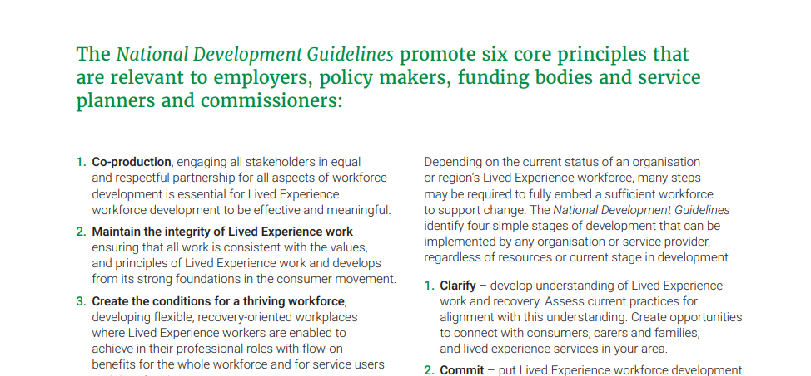
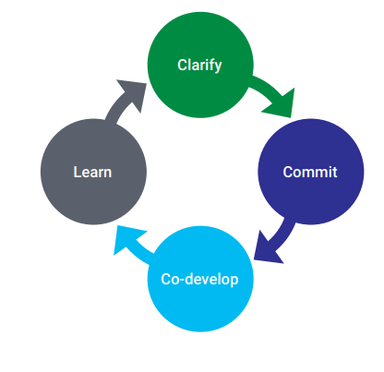
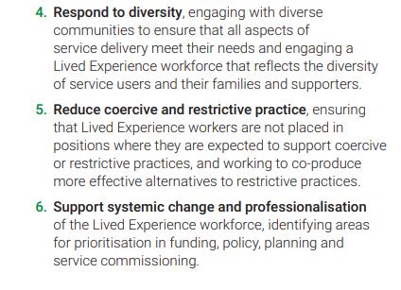
Principles to guide workforce development
Byrne et al. National Lived Experience Workforce Guidelines. 2021, National Mental Health Commission.
#EquallyWellAu22

Slide 12
Lived Experience leadership roles
Lived Experience leadership/senior roles are important to guide and influence change. Lived Experience leadership roles are also invaluable to provide internal Lived Experience-led supervision, protect the authenticity of Lived Experience roles, and guide strategic planning. Lived Experience leadership roles may be developed in parallel with the growth of the workforce or they may be employed during the early preparation stages to embed understanding of lived experience perspectives and guide development of the Lived Experience workforce.
Senior or Lived Experience leadership roles assist to:
• develop a higher-skilled workforce
• develop a workforce that is purposeful and has greater autonomy
• retain experienced and skilled Lived Experience employees
• provide Lived Experience leadership and greater capacity for change
• provide ‘in-house’ Lived Experience-led supervision and training development.
Byrne et al. National Lived Experience Workforce Guidelines. 2021, National Mental Health Commission.

Slide 13
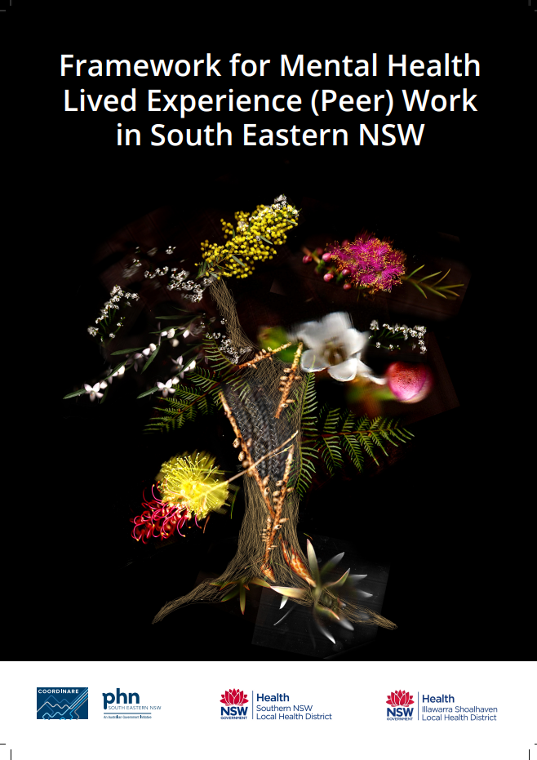
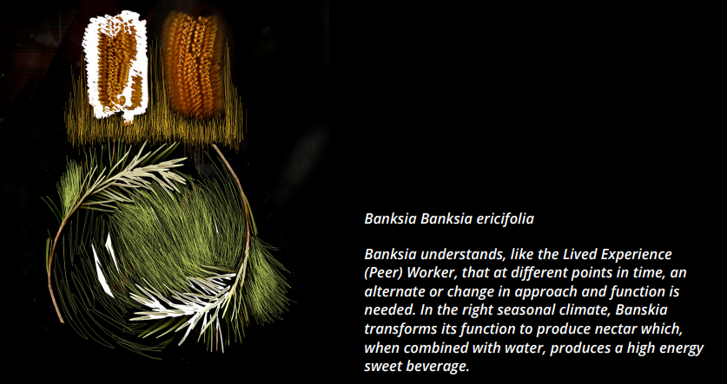
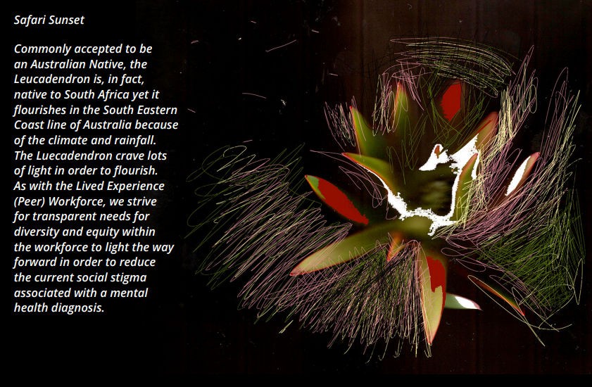

Slide 14
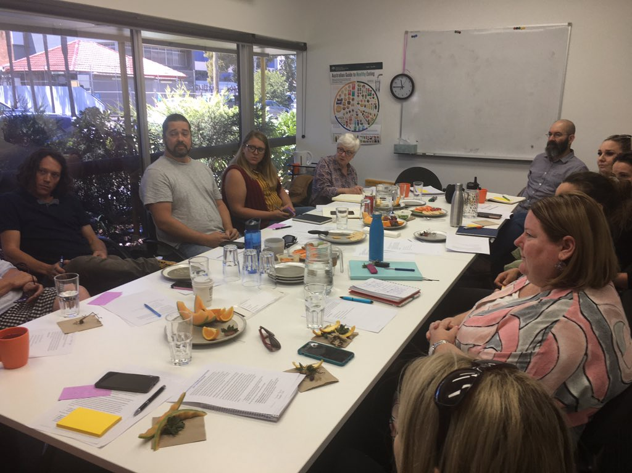
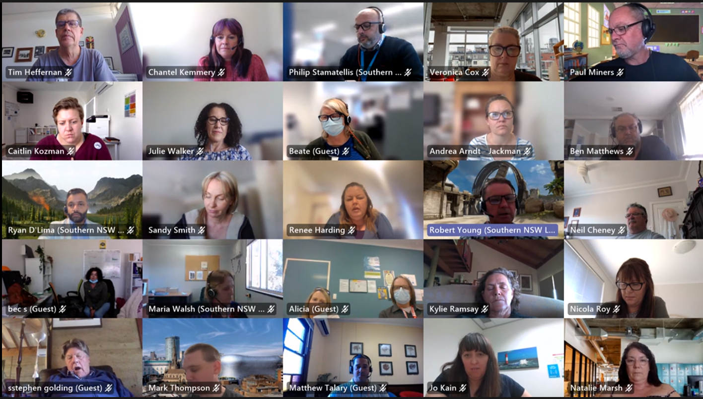



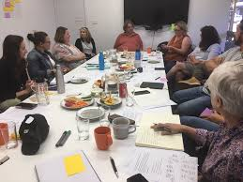
South Eastern NSW Regional Peer Work Framework
Building on the joint commitment of COORDINARE, Southern NSW Local Health District (SNSWLHD) and Illawarra Shoalhaven Local Health District (ISLHD) to make mental health a joint regional priority, implementation of the South Eastern NSW Regional Mental Health and Suicide Prevention Plan has begun.
The first action of this Plan is to develop a regional Peer Workforce Framework and the NSW Ministry of Health has provided funding through SNSWLHD to complete this work.
Dr Leanne Craze AM, is the lead consultant, commissioned by COORDINARE to facilitate this collaborative project developing the regional Framework.
South Eastern NSW Regional Peer Work Framework, 2021

Slide 15

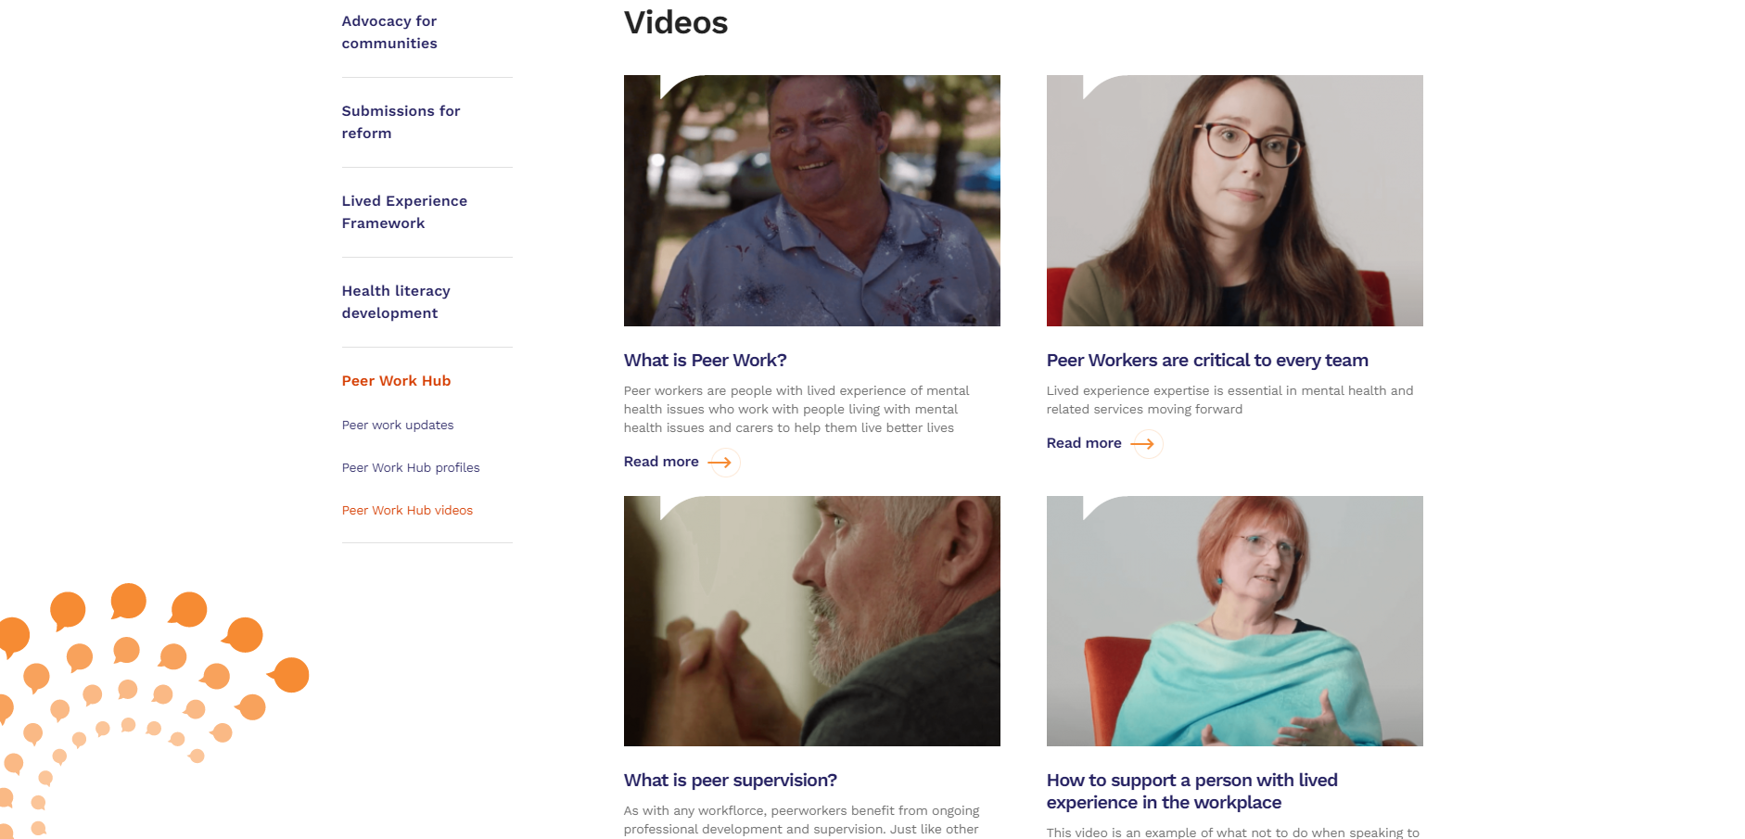

Slide 16
The peer relationship.
Peer work - social justice and human rights
Personal Autonomy and agency
Our lives and our mental and physical health have always been influenced by our relationship, by our community
Equal and reciprocal – people are individuals but also part of families and community
We live and work to keep ourselves and others well
We are a part of ecosystems that can heal or harm
We share and learn from our common experiences
We have done these things for a long time
Lived Experience (peer) workers work from ancient values and principles

Slide 17
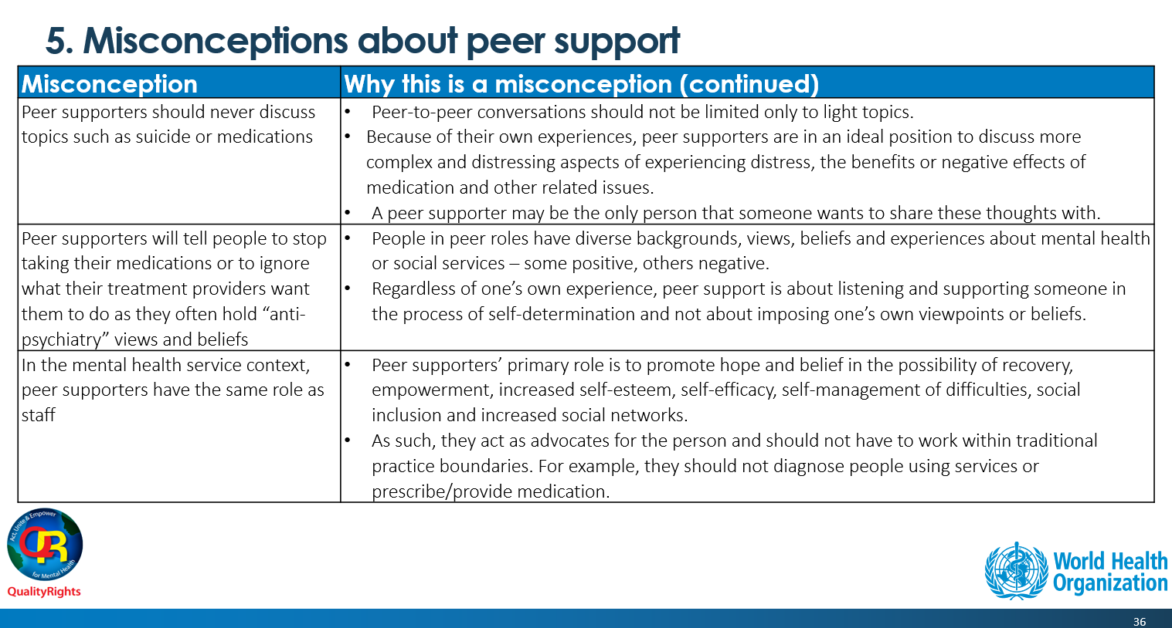
One-to-one peer support by and for people with lived experience: WHO QualityRights guidance module

Slide 18
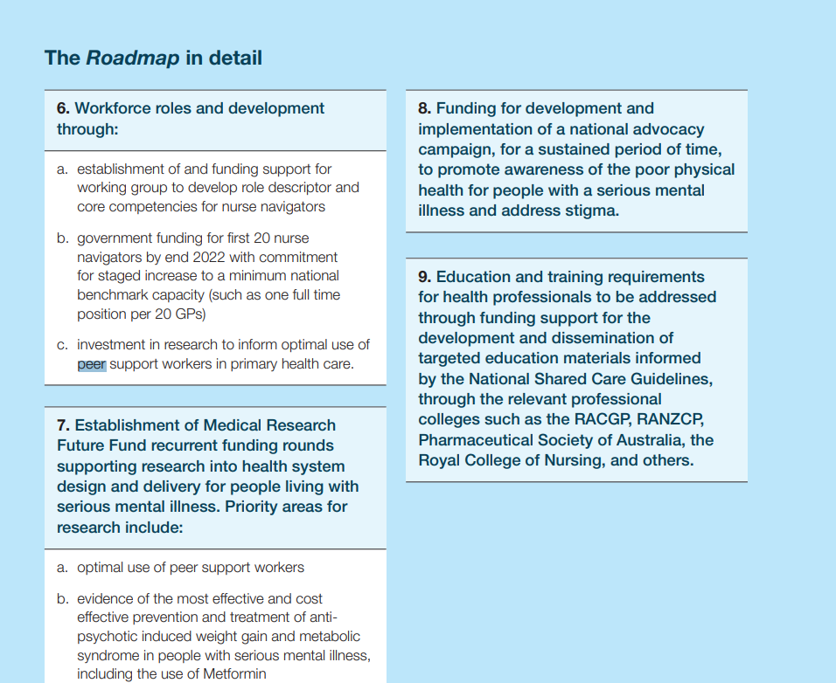
Evidence and scale
BEING EQUALLY WELL A NATIONAL POLICY ROADMAP TO BETTER PHYSICAL HEALTH CARE AND LONGER LIVES FOR PEOPLE LIVING WITH SERIOUS MENTAL ILLNESS AUGUST 2021 Morgan, M; Peters, D; Hopwood, M; Castle D; Moy, C; Fehily, C; Sharma, A; Rocks, T; Mc Namara K; Cobb, L; Duggan, M; Dunbar, JA; Calder, RV.
#EquallyWellAu22

Slide 19
Physical Health
‘‘Here if you need me’’: exploring peer support to enhance access to physical health care.
Julia Bocking, Stephanie B. Ewart, Brenda Happell , Chris Platania-Phung , Robert Stanton and Brett Schol. (2018)
Results:
Three themes pertaining to enhancing physical health care emerged:
(1) the potential of peer workers in mitigating existing barriers,
(2) consumer advocacy organisations expanding their agenda and
(3) benefits of segregated activities as a segue to mainstream options.
Conclusions:
The envisaged forms of peer contribution have far greater scope and depth than is currently considered in policy, the research literature and health practice. Innovative solutions are required for this neglected population. Individual and systemic advocacy led by peer workers can enhance access to physical health care and have the potential to reduce physical health inequalities.

Slide 20
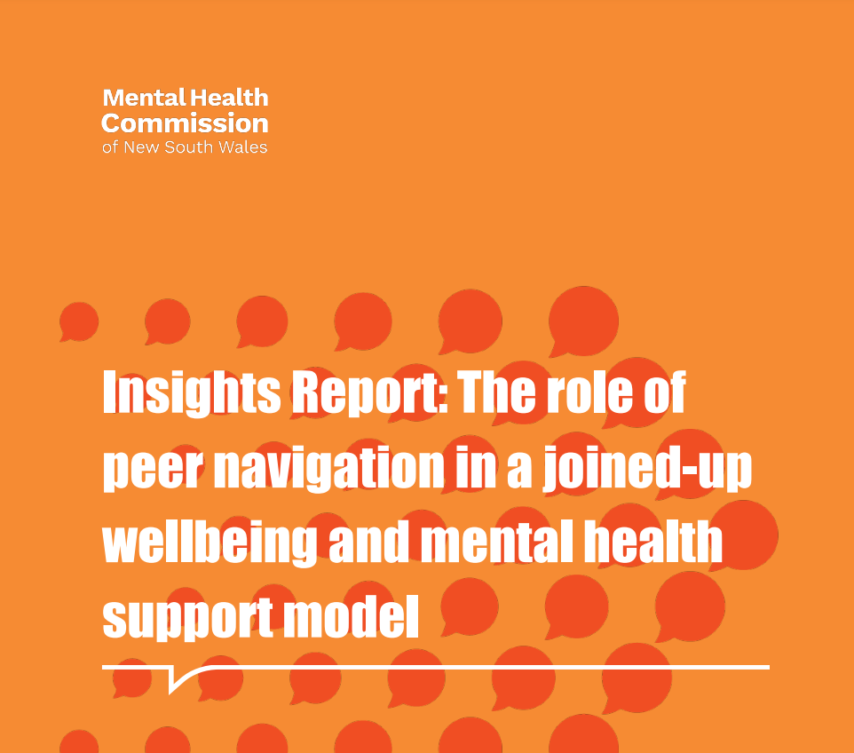
Peer Navigation – Mental Health Commission of NSW
Key insights were gathered and are summarized in the report. These insights are grouped under the following broad service system areas
Describing the role of the peer navigator
Governance and accountability arrangements to support the role
Access to peer navigation support
The role of service providers in developing/embedding peer navigation
The intersection between peer navigation and informal supports
Workforce development
Funding and contracting arrangements
Evaluation and Monitoring
Also – Social Prescribing ‘Linkers’
#EquallyWellAu22

Slide 21
Keeping the Body In Mind
Keeping the Body In Mind (KBIM) is a District wide program of SESLHD Mental Health for consumers of the Service developed to prevent and address cardiometabolic health issues. There are teams based at Bondi, Maroubra, St George and Sutherland. Each team consists of a nurse, exercise physiologist, dietitian and peer support worker.
We work with consumers of the Service to develop health goals and work towards supporting lifestyle changes that are achievable, measurable and sustainable.
A high priority for KBIM is to see young people between the age 15-25 years who have experienced first episode psychosis and are prescribed antipsychotic medications. KBIM uses an evidence based model of care providing a 12-week individualised program to support changes to diet, exercise, smoking, sleep and stress and equip consumers with skills to sustain changes.

Slide 22
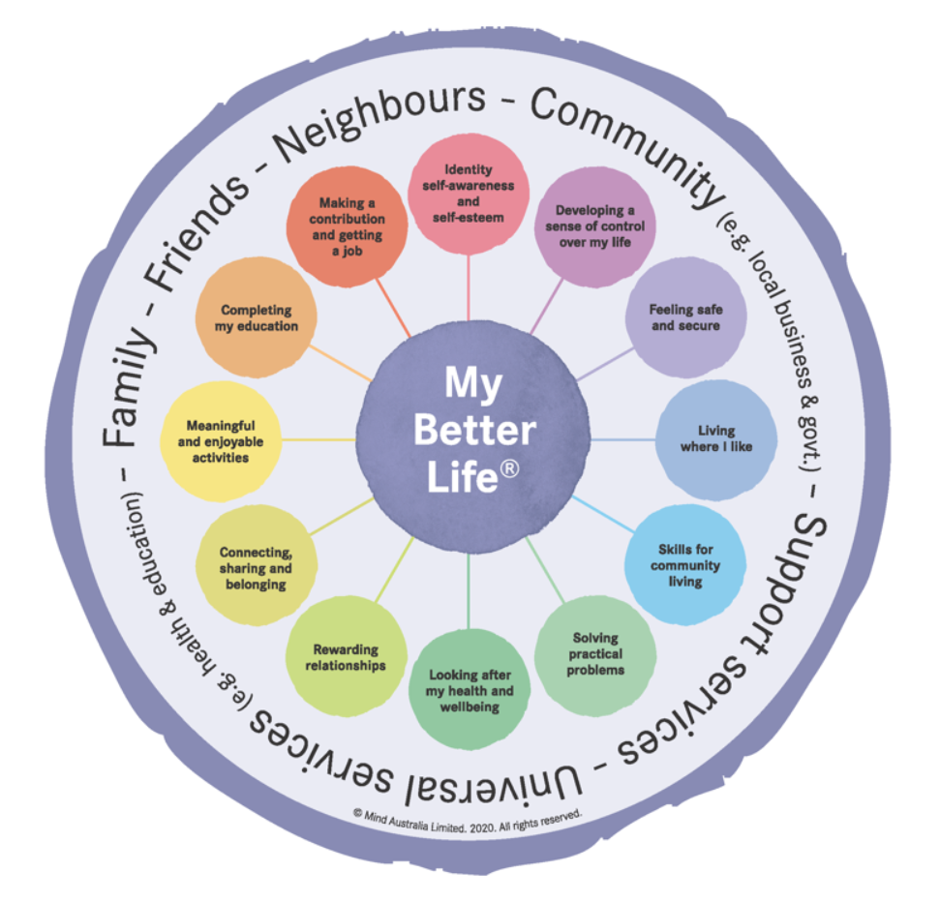
Mind – My Better Life
Mind has developed a model of practice called My Better Life. The model outlines 12 areas of a person’s life that need to be working well for them to be happy, healthy and live a life of meaning.
It is
evidence-informed model a
strengths based, person-centred and recovery-oriented approach.
“My Better Life provides a structure which informs our work, underpins future service delivery and places the unique needs of our clients at the core of our work.”

Slide 23
Living Well, Living Longer – Sydney Local Health District
Drawing on their lived experience of mental health challenges and recovery, peer support workers are integral members of the team. They play a pivotal role in addressing the physical health care requirements of consumers by re-iterating the importance of physical health check-ups.
They play a supporting role by attending medical appointments with the consumer and work within the multidisciplinary team to ensure that recommendations and tests are followed up.
Some peer workers are involved in hosting physical activity groups like walking groups, smoking cessation groups or yoga. Peer support workers assist others to gain their own sense of confidence and hope about their journey of recovery.

Slide 24
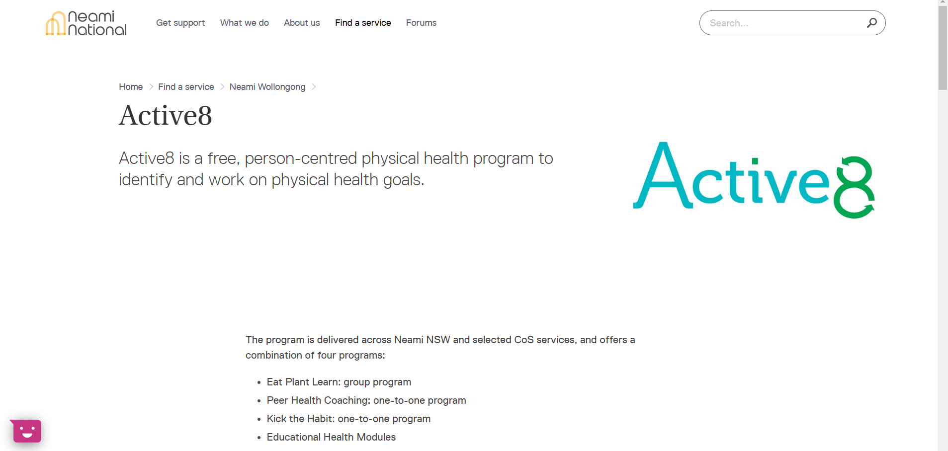
“Peer coaches selectively use self-disclosure to inspire hope, self-determination and reduce stigma. A peer coach’s personal experience of illness and recovery can create a therapeutic relationship with a sense of mutuality in terms of experience and responsibility “

Slide 25
Certificate IV in Mental Health Peer Work
Core units
CHCDIV001 Work with diverse people
CHCMHS007 Work effectively in trauma informed care
CHCMHS008 Promote and facilitate self-advocacy
CHCMHS011 Assess and promote social, emotional and physical wellbeing
CHCPWK001 Apply peer work practices in the mental health sector
CHCPWK002 Contribute to the continuous improvement of mental health services for consumers and carers
CHCPWK003 Apply lived experience in mental health peer work
HLTWHS001 Participate in workplace health and safety
Elective units
CHCCCS023 Support independence and wellbeing
CHCPRP003 Reflect on and improve own professional practice
HLTWHS006 Manage personal stressors in the work environment
CHCLEG001 Work legally and ethically
CHCCCS003 Increase the safety of individuals at risk of suicide
HLTAAP001 Recognise healthy body systems

Slide 26

hydration
sometimes the rain specifies me
asks to see
seeks out my desert place
and turns me into rainforest
theffernan@coordinare.org.au
tim.heffernan@mhc.nsw.gov.au
0419 833 206
@timheffo

