Slide 1













Thank you to our Sponsors
#EquallyWellAu22
Notes:
Add your name and introduce yourself
Also let people know about following us on social media – all handles on last slide

Slide 2



Supporting Healthier Lifestyles: a role for Community Managed Organisations (CMOs)
Jenny Bowman, Kate Bartlem, Tara Clinton-McHarg, Lauren Gibson, Julia Dray, Caitlin Fehily, Magdalena Wilczynska, Olivia Wynne, Joanna Latter

Slide 3
Globally, people living with a mental health condition have a reduced life expectancy of a median of 10 years. In Australia, 12 -16 years. ‘Equally Well’

Slide 4
Chronic physical disease CVD, diabetes, respiratory conditions etc… Modifiable lifestyle behaviours Smoking Nutrition (not enough fruit and veg) Alcohol (harmful levels of consumption) Physical activity (not enough activity) Poor sleep

Slide 5
A need to implement strategies to support ‘preventive care’

Slide 6
Key learnings from our work to date in other settings
People living with a mental health condition
are interested and motivated to improve health lifestyle behaviours^{1,2,3}
want and expect support from mental health services^{2,3,4}
will take up, and accept referrals to behaviour change supports^{5,6}
Simple tools and resources can support health professionals / clinicians to provide preventive care^{7,8,9}

Slide 7
Brief interventions to deliver preventive care – previous trials in clinical settings
Hospital inpatient trials – 3 studies
Support inpatient units to provide nicotine dependence treatment¹⁰
Provide smoking cessation support to inpatients post-discharge^{11, 12}
Community Mental Health Services – 2 studies
All clinicians provide preventive care in routine consultations¹³
A designated ‘healthy lifestyle clinician’ provides preventive care¹⁴
A study underway across 3 NSW LHDs 15

Slide 8
Why CMOs?
Non-government organisations
Work alongside traditional health system
Holistic, person-centred support
Employment, accommodation, daily life assistance, peer support
Organisations such as Flourish Australia, Neami National, Being, One Door, New Horizons ….

Slide 9
Why CMOs?
Important and growing providers of support for people living with a mental health condition¹⁶
‘at least’ 78 providers in NSW
¼ of the entire mental health workforce in NSW
growing by 6.5% per annum
14% are peer workers, an increasing proportion

Slide 10
Aims of the CMO Connect Project
Aim 1 – to explore the potential role that mental health CMOs might play in providing chronic disease preventive care to people with a mental health issue
Aim 2 – identify ways to assist CMOs to adopt and implement evidence-based methods of delivering preventive care to better address the physical health needs of their consumers

Slide 11


Characteristics of the project
Prevention
Organisational change
Codevelopment
Focus on:
Chronic disease preventive care – all SNAP risk factors
Organisational change – focus on the system and the individual
Co-development process – involvement of consumers, staff, organisations

Slide 12
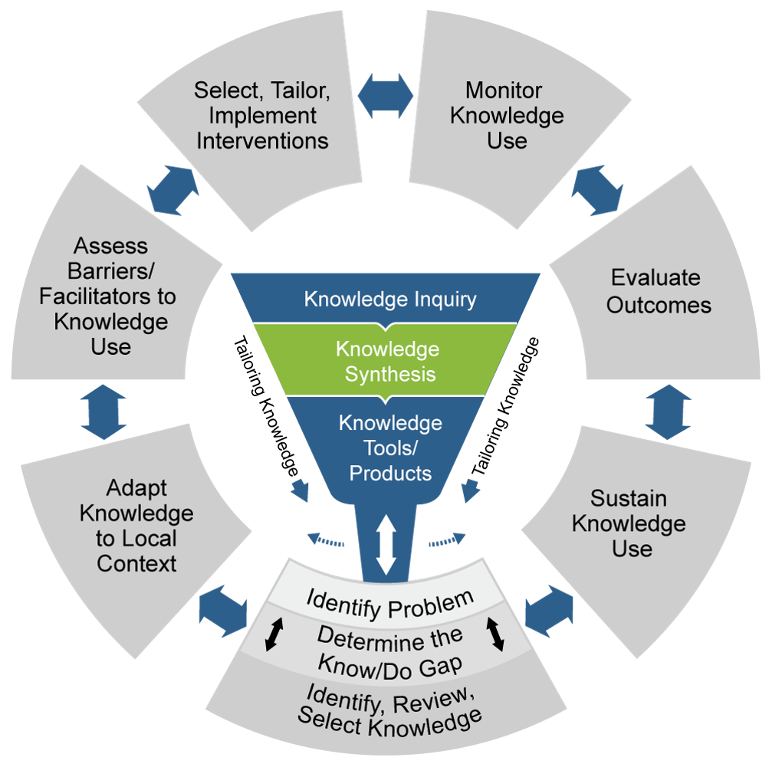
Knowledge to Action Framework
The CMO Connect project focuses on four Action phases
Determine the know-do gap
Adapt knowledge to local context
Assess barriers and facilitators to knowledge use
Select, tailor, implement an intervention

Slide 13
Triangulated data collection
Quantitative and qualitative methods: assessing current provision of preventive care, as well as barriers and enablers.
CMO managers (online survey n=86; interviews n=12),
Staff (online survey n=199)
Consumers (telephone interviews n=150)
Pilot trial of co-developed strategies
To increase the capacity of CMO staff to support healthy lifestyle behaviours for consumers

Slide 14
Some findings to date
Current Provision of Care
happening, but … systematic? Comprehensive ? 17
Fewer than 50% have policies addressing even one risk behaviour
80% of managers reported that their organisation addressed at least one chronic disease risk behaviour
1 in 3 routinely ask most consumers about physical activity
1 in 4 support most consumers to improve physical activity
Less than 1 in 10 support most consumers to reduce or quit smoking
CMO managers reported ‘types of support’ most often provided were :
practical education and life skills; referral and local connections; encouragement
Staff reported that in a usual week, the support provided did include, in some way,
smoking (61%) and physical activity (85%)

Slide 15
Some findings to date
Barriers and Enablers
staff training and guidelines
the availability of funding at a service level
perceived ability to influence behaviours
‘a healthy lifestyle’ embedded within organisational policy and culture
staff awareness of support available within other CMOs and services, to which consumers might be connected

Slide 16
Pilot trial of co-developed strategies
Workshops
Staff and managers from one large CMO
20 participants across two sessions
Strategies being piloted
Training
how to have difficult conversations inclusive of motivational interviewing and practical skills
Step-by-Step ‘how to’ guide
to support Conversation, Advice and Connection, for each behaviour; recovery/strength-based focus
Connections guide
referral services that are affordable, local, accessible

Slide 17
Project Outcomes
Improved understanding of how preventive care might be integrated into CMO practice
Development and piloting of strategies for the provision of preventive care, that could be further developed and tested
The Future?
Large scale rigorous trial
Scale and maintain

Slide 18




Our partners
Funded by
Funding for this research has been provided from the Australian Government’s Medical Research Future Fund (MRFF). MRFF funding has has been provided to The Australian Prevention Partnership Centre.
.
Supported by

Slide 19
References
Stockings et al (2013) 'Readiness to quit smoking and quit attempts among Australian mental health inpatients.', Nicotine Tob Res, 15 942-949
Bartlem et al (2015) 'Acceptability and receipt of preventive care for chronic-disease health risk behaviors reported by clients of community mental health services', Psychiatric Services, 66 857-864
Bartlem et al (2016) 'Effectiveness of an intervention in increasing the provision of preventive care by community mental health services: a non-randomized, multiple baseline implementation trial’, Implementation Science, 11
Fehily et al (2020) 'Effectiveness of embedding a specialist preventive care clinician in a community mental health service in increasing preventive care provision: A randomised controlled trial', Australian and New Zealand Journal of Psychiatry, 54 620-632
Metse et al (2016) 'Uptake of smoking cessation aids by smokers with a mental illness', Journal of Behavioral Medicine, 39 876-886
Fehily et al (2020) 'Uptake of a preventive care consultation offered to clients of a community mental health service', Preventive Medicine Reports, 18
Anderson et al (2013) 'Smoking cessation care provision and support procedures in Australian community mental health centers', Psychiatric Services, 64 707-710
Bartlem et al (2014) 'Care provision to prevent chronic disease by community mental health clinicians', American Journal of Preventive Medicine, 47 762-770
Wye et al (2017) 'Effectiveness of a clinical practice change intervention in increasing the provision of nicotine dependence treatment in inpatient psychiatric facilities: an implementation trial', BMC Psychiatry, 17
Wye et al (2009). Smoking restrictions and treatment for smoking: Policies and procedures in psychiatric inpatient units in Australia. Psychiatric Services, 60(1), 100-107
Stockngs E et al (2014) Impact of a Postdischarge Smoking Cessation Intervention for Smokers Admitted to an Inpatient Psychiatric Facility: A Randomized Controlled Trial. Nicotine & Tobacco Research, Volume 16, Issue 11,,
Metse et al (2014) 'Evaluating the efficacy of an integrated smoking cessation intervention for mental health patients: study protocol for a randomised controlled trial.', Trials, 15 266
Bartlem et al (2013) 'Evaluating the effectiveness of a clinical practice change intervention in increasing clinician provision of preventive care in a network of community-based mental health services: a study protocol of a non-randomized, multiple baseline trial', Implementation Science, 8
Fehily et al (2017) ‘Evaluating the effectiveness of a healthy lifestyle clinician in addressing the chronic disease risk behaviours of community mental health clients: study protocol for a randomised controlled trial’, Trials, 18 276.
Fehily et al (2022) The Effectiveness and Cost of an Intervention to Increase the Provision of Preventive Care in Community Mental Health Services: Protocol for a Cluster-Randomized Controlled Trial. International Journal of Environmental Research and Public Health 19(5) 01 Mar 2022 DOI
Ridoutt et al (2019) ‘The NSW CMO Mental Health Workforce: Findings from the 2019 MHCC Workforce Survey.’ MHCC
Gibson et al (2021) 'Preventive care practices to address health behaviours among people living with mental health conditions:
A survey of Community Managed Organisations', Preventive Medicine Reports, 23

Slide 20
Contact
Thanks to the CMO Connect Investigator team, Project team and Collaborators and all participants
Jenny.Bowman@newcastle.edu.au
Ph: 0412604128

