Slide 1













Thank you to our Sponsors
#EquallyWellAu22
Notes:
Add your name and introduce yourself
Also let people know about following us on social media – all handles on last slide

Slide 2




LET COMMUNITY PHARMACY BECOME YOUR HEALTH PARTNER
To help you bridge the gap between your physical and mental wellbeing by supporting you to better manage your medication
This activity received funding from the Australian Government
Notes:
Welcome everyone

Slide 3


Acknowledgement of Country
We acknowledge the people of the Yugambeh language region, the traditional custodians of the land we meet on today, pay respect to Elders, past, present and emerging, and extend that respect to other Aboriginal and Torres Strait Islander people

Slide 4
Acknowledgement of Lived Experience
We acknowledge all of the lived experience within the symposium today and that we speak honourably and respectfully about ongoing emotional distress, experiences of trauma and mental ill-health and the work of caring, and experiences of care within this context

Slide 5
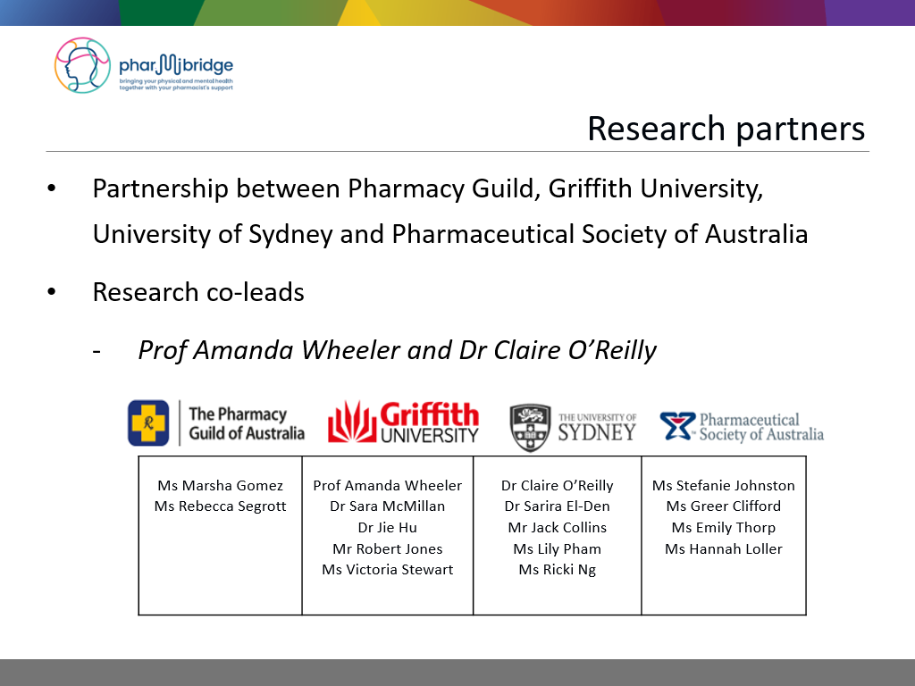
What is the PharMIbridge RCT?
Bridging the Gap between Physical and Mental Illness in Community Pharmacy (PharMIbridge)
Funded under the 6CPA Pharmacy Trial Program
Randomised controlled trial (RCT) of a community pharmacist support service for people living with severe and persistent mental illness (SPMI) such as schizophrenia and bipolar disorder
48 community pharmacies working with 480 consumer participants
Involves 4 regions
ACT, Northern Sydney, Hunter New England and Gippsland
Ms Rebecca Segrott
Ms Erica Vowles
Prof Amanda Wheeler
Dr Sara McMillan
Dr Jie Hu
Ms Helena Roennfeldt
Ms Victoria Stewart
Ms Fleur Webb
Dr Claire O’Reilly
Dr Sarira El-Den
Dr Jack Collins
Ms Lily Pham
Ms Ricki Ng
Ms Hannah Loller
Ms Stefanie Johnston
Ms Greer Clifford
Ms Emily Thorp

Slide 6
What is the PharMIbridge RCT?
Bridging the Gap between Physical and Mental Illness in Community Pharmacy (PharMIbridge)
Funded under the 6CPA Pharmacy Trial Program
Randomised controlled trial (RCT) of a community pharmacist support service for people living with severe and persistent mental illness (SPMI) such as schizophrenia and bipolar disorder
51 community pharmacies randomised & recruited consumer participants (25 Intervention arm: 26 Usual care arm)
Involved 4 regions
ACT, Northern Sydney, Hunter New England and Regional Victoria

Slide 7
Why is the PharMIbridge RCT important?
There is a significant life expectancy gap attributable to physical comorbidities for people living with SPMI ⁽¹⁾
Urgent attention is needed to address the physical health and medication-related needs for this vulnerable population ⁽²⁻³⁾
Medications are a major treatment option for the management of many mental and physical illnesses, and community pharmacists are well-positioned to support physical and mental health care
Limited research on the impact of a community pharmacist-delivered health service for people living with SPMI
¹Lawrence D, Hancock KJ, Kisely S. BMJ 2013;346:f2539. ² Wade M, Tai S, Awenat Y, et al. Clin Psychol Rev 2017;51:75-95. ³ Roughead L, Procter N, Westaway K, et al. Australian Commission on Safety and Quality in Health Care, 2017

Slide 8
Basis for PharMIbridge RCT
Builds on the 5CPA Mental Health Project which piloted a person-centred, goal-oriented medication support service delivered in Australian community pharmacies for >400 people living with depression and anxiety
significant improvements observed for all outcome measures, (e.g. medication adherence, treatment satisfaction) except physical health ⁽⁴⁾
Stigma, lack of mental health training and confidence/skills in communicating with mental health consumers are barriers to care ⁽⁵⁻⁶⁾
training to reduce stigma and improve confidence and skills are crucial to implement a new service for consumers living with SPMI
⁴ McMillan SS, Kelly F, Hattingh HL et al. J Ment Health 2018;27(2):164-173 ⁵ O'Reilly C, Bell S, Kelly P, et al. Res Social Adm Pharm 2015;11(3):e101-e09. ⁶ Wheeler A, Mey A, Kelly F, et al. J Mental Health Training Educ Pract 2014;9(3)

Slide 9
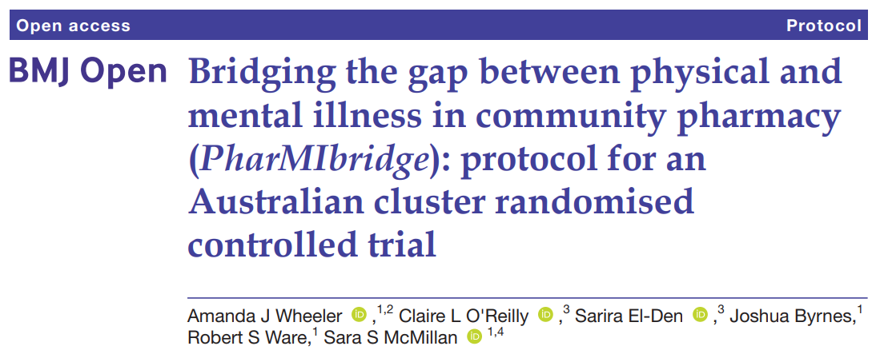
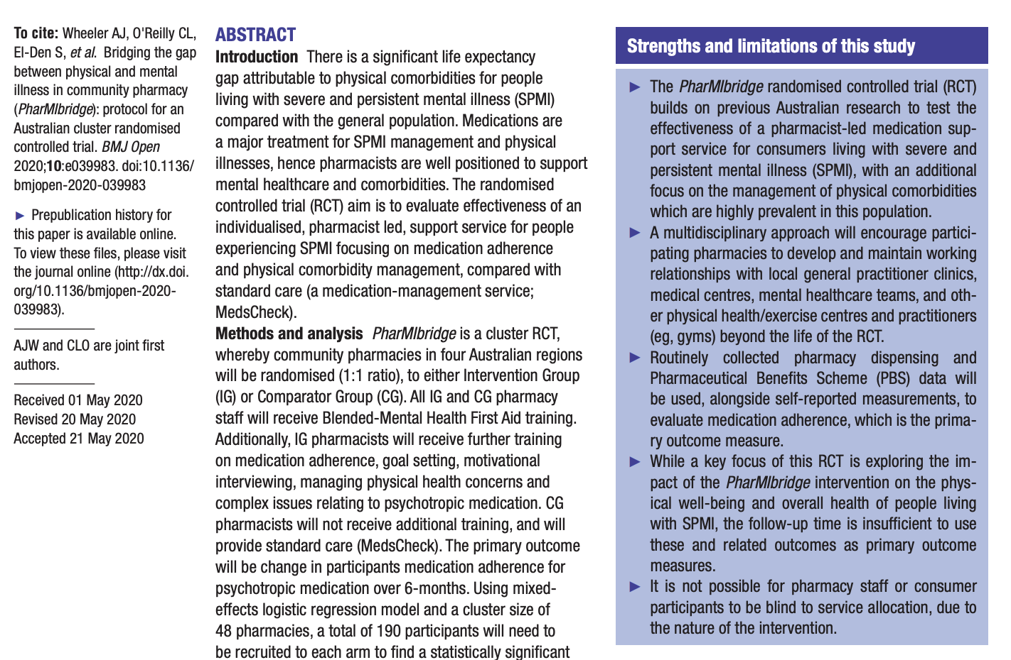
Notes:
Resources provided to pharmacies include:
Postcards (male/female)
Consumer flyers (A4 male/female)
Consumer information sheets
Appointment cards
Polo shirts
Tablet for data collection
Consent forms (MBS/PBS and back up study consent forms)
Back up hard copies of all study materials

Slide 10
What does PharMIbridge aim to achieve?
Evaluating the effectiveness and cost-effectiveness of the PharMIbridge intervention, an individualised pharmacist-led support service for consumers living with SPMI, compared to usual care involving a medication management service (MedsCheck)
Assessing changes in
psychotropic medication adherence (primary outcome)
health outcomes including quality of life, physical health, psychological wellbeing, and medication adherence
community pharmacists’ confidence, knowledge and ability to address medication-related and physical health care needs of people living with SPMI
health care service acceptability, utilisation and cost-effectiveness
Notes:
RCT pharmacies have been randomised to either the Intervention Group (PharMIbridge service) or the Comparator Group (study-funded MedsCheck service)
IG pharmacists will work with participants over a 6-month period CG pharmacists will follow-up with participants at 6-months
Service delivery supported by GuildCare NGTM

Slide 11
RCT overview
Recruitment and baseline measures
Initial Health Review
Structured follow-up & support
6-month Final Health Review
Flexibility required tailored approach for each participant
Intervention Group
Recruitment and baseline measures
Ongoing usual care
6-month follow-up
MedsCheck
Comparator Group
Notes:
Resources provided to pharmacies include:
Postcards (male/female)
Consumer flyers (A4 male/female)
Consumer information sheets
Appointment cards
Polo shirts
Tablet for data collection
Consent forms (MBS/PBS and back up study consent forms)
Back up hard copies of all study materials

Slide 12

“Mental health
friendly pharmacies”
Notes:
Image Source: https://www.pexels.com/search/support/?
Opportunity to share what pharmacists have done / currently do to support mental health consumers? Work in health promotion?

Slide 13
Pharmacy staff training
Pharmacists & support staff in both Intervention Group and Comparator Group completed Blended Mental Health First Aid
Intervention Group completed further face-to-face training (1.5 days)
role plays implementing MHFA with simulated patients
interactive modules delivered by experts (psychiatrist, consumer consultant, psychologist, mental health pharmacist)
social determinants of health, complexities of psychotropic medication, communication, motivational interviewing, supporting physical wellbeing & adherence
Pharmacists in each region supported by a mentor pair (pharmacist with community pharmacy experience & consumer educator with lived experience)
Notes:
that the provision of the PharMIbridge intervention will be cost-effective compared to standard care from a health care sector perspective with regard to RCT-based costs and outcomes

Slide 14
Mentor pairs
Mentors share different but complementary perspectives & experiences
pharmacy mentors support pharmacists to deliver the service, managing complexities of medication & communication with health professionals
consumer mentors support pharmacists to understand the lived experience of medication use
consumer mentors assist in understanding barriers & challenges effecting physical health, including side effects & discrimination in accessing services
at the same time consumer mentors demonstrate hope and encourage pharmacists to see & hear the ‘story behind the script’
Notes:
that the provision of the PharMIbridge intervention will be cost-effective compared to standard care from a health care sector perspective with regard to RCT-based costs and outcomes

Slide 15
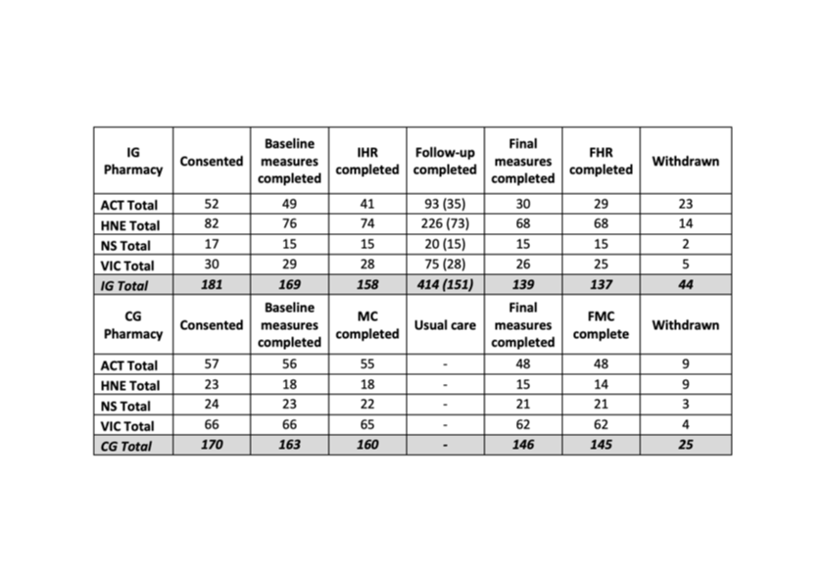




Consumer participant progress
Consumer participant progress in RCT

Slide 16



Thank you
ANZCTR Trial Registration Number: ACTRN12620000577910
www.griffith.edu.au/pharmibridge
Twitter: @AmandaJWheeler
@HelenaRoennfel2
Any questions?

