Slide 1













Thank you to our Sponsors
#EquallyWellAu22

Slide 2
Acknowledgement of Country
We acknowledge the Traditional Custodians of the land on which we meet and pay respect to Elders, past, present and emerging, and extend that respect to all Aboriginal and Torres Strait Islander peoples here today

Slide 3

i
Co-development of strategies with CMO staff to deliver support for lifestyle behaviours
Casey Regan
with
Dr Kate Bartlem
Prof Jenny Bowman
Dr Libby Campbell
Dr Caitlin Fehily
Dr Julia Dray

Slide 4



Casey Regan
with
Dr Kate Bartlem
Prof Jenny Bowman
Dr Libby Campbell
Dr Caitlin Fehily
Dr Julia Dray

Slide 5
Overview
Background
CMO Connect Project
Aims
Co-development Workshop & Outcomes
Learnings

Slide 6
Overview
Background
CMO Connect Project
Aims
Co-development Workshop & Outcomes
Learnings

Slide 7



Background
People living with a mental health condition experience poor physical health
Lifestyle behaviours
Chronic diseases
Reduced life expectancy

Slide 8
Background
People living with a mental health condition experience poor physical health
What can be done?
Lifestyle behaviours
Chronic diseases
Reduced life expectancy

Slide 9
Background
People living with a mental health condition experience poor physical health
What can be done?
Prevent chronic diseases by supporting people to achieve lifestyle behaviour change goals
Lifestyle behaviours
Chronic diseases
Reduced life expectancy

Slide 10

In what ways can people be supported to achieve lifestyle behaviour change goals?

Slide 11
Conversations
In what ways can people be supported to achieve lifestyle behaviour change goals?

Slide 12
Conversations
In what ways can people be supported to achieve lifestyle behaviour change goals?
Education

Slide 13

Conversations
In what ways can people be supported to achieve lifestyle behaviour change goals?
Education
Connecting
Notes:
Change education icon

Slide 14




Community Managed Organisations (CMOs)

Slide 15
Community Managed Organisations (CMOs)
Why are CMO’s a good setting to support people living with a mental health condition to make healthy lifestyle changes?

Slide 16
Community Managed Organisations (CMOs)
People
Why are CMO’s a good setting to support people living with a mental health condition to make healthy lifestyle changes?
Many people living with a mental health condition access such services

Slide 17
Community Managed Organisations (CMOs)
People
Why are CMO’s a good setting to support people living with a mental health condition to make healthy lifestyle changes?
Many people living with a mental health condition access such services
Contact
Routine / frequent nature of contact

Slide 18
Community Managed Organisations (CMOs)
People
Why are CMO’s a good setting to support people living with a mental health condition to make healthy lifestyle changes?
Many people living with a mental health condition access such services
Contact
Routine / frequent nature of contact
Rapport
Established rapport with case manager / support worker

Slide 19
Community Managed Organisations (CMOs)
People
Why are CMO’s a good setting to support people living with a mental health condition to make healthy lifestyle changes?
Many people living with a mental health condition access such services
Contact
Routine / frequent nature of contact
Rapport
Established rapport with case manager / support worker
Services
Person centred and holistic approach to overall wellbeing, recovery-oriented services

Slide 20
How can we help CMOs to support people make lifetsyle behaviour change goals?

Slide 21
Co-development

Slide 22
CMO Connect Project
02
04
Staff Survey
Key Informant Interviews
Online survey with staff of NSW CMO’s
Qualitative telephone interviews with CMO leaders
01
03
05
Consumer Survey
Scoping Survey
Pilot Intervention
CATI with consumers of NSW CMOs
Online survey with leaders of CMO’s
Controlled trial with one CMO to test strategies

Slide 23
CMO Connect Project
05
Pilot Intervention
Controlled trial with one CMO to test strategies

Slide 24
CMO Connect Project
CO-DEVELOP
IMPLEMENT
05
Pilot Intervention
Controlled trial with one CMO to test strategies
TEST

Slide 25
CMO Connect Project
CO-DEVELOP
Co-develop strategies
IMPLEMENT
With CMO staff
05
Pilot Intervention
Controlled trial with one CMO to test strategies
TEST
Via a workshop

Slide 26
Overview
Background
CMO Connect Project
Aim
Co-development Workshop & Outcomes
Learnings

Slide 27
Co-develop strategies to assist staff in supporting people improve lifestyle behaviours

Slide 28
Overview
Background
CMO Connect Project
Aims
Co-Development Workshop & Outcomes
Learnings

Slide 29
Co-Development Workshop
Design
Three hour workshop with staff of a local CMO facilitated by researchers
Setting
CMO delivers programs and services to support people living in the community with a mental health condition
Participants & Recruitment
Participants were staff (n=12,8) in a variety of roles and were invited to take part in the workshop via email sent by manager

Slide 30
Co-Development Workshop
Design
Three hour workshop with staff of a local CMO facilitated by researchers
Setting
CMO delivers programs and services to support people living in the community with a mental health condition
Participants & Recruitment
Participants were staff (n=12,8) in a variety of roles and were invited to take part in the workshop via email sent by manager

Slide 31
Co-Development Workshop
Design
Three hour workshop with staff of a local CMO facilitated by researchers
Setting
CMO delivers programs and services to support people living in the community with a mental health condition
Participants & Recruitment
Participants were staff (n=12,8) in a variety of roles and were invited to take part in the workshop via email sent by manager

Slide 32
What happened during the workshops?

Slide 33
Part 1: Project overview & ways to support
1. Facilitators presented project overview and proposed ways to support
3. Facilitators proposed evidence-based strategies
2. Group discussion about ways to support
4. Group discussion about potential strategies
5. Facilitators documented strategies and input into survey
6. Strategy ranking activity and results presented
7. Group discussion about strategy implementation

Slide 34
Part 2: Group discussion about ways to support
1. Facilitators presented project overview and proposed ways to support
3. Facilitators proposed evidence-based strategies
2. Group discussion about ways to support
4. Group discussion about potential strategies
5. Facilitators documented strategies and input into survey
6. Strategy ranking activity and results presented
7. Group discussion about strategy implementation

Slide 35
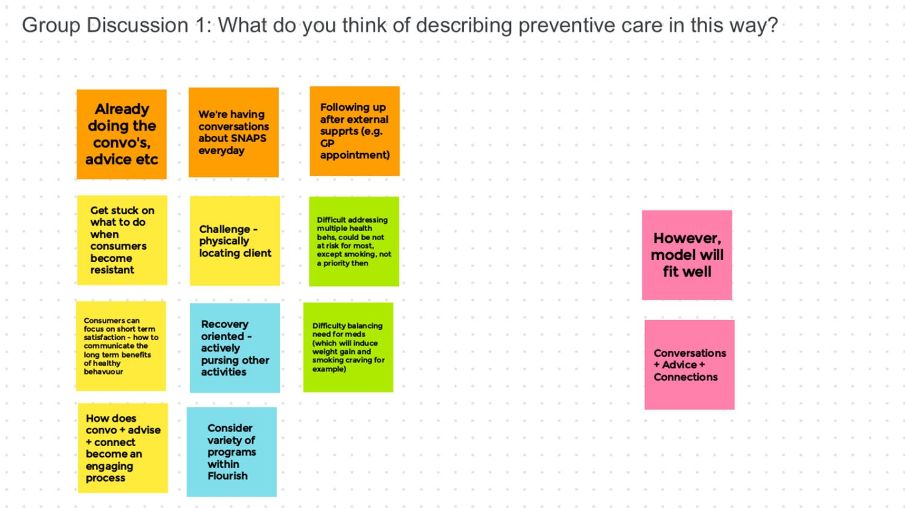
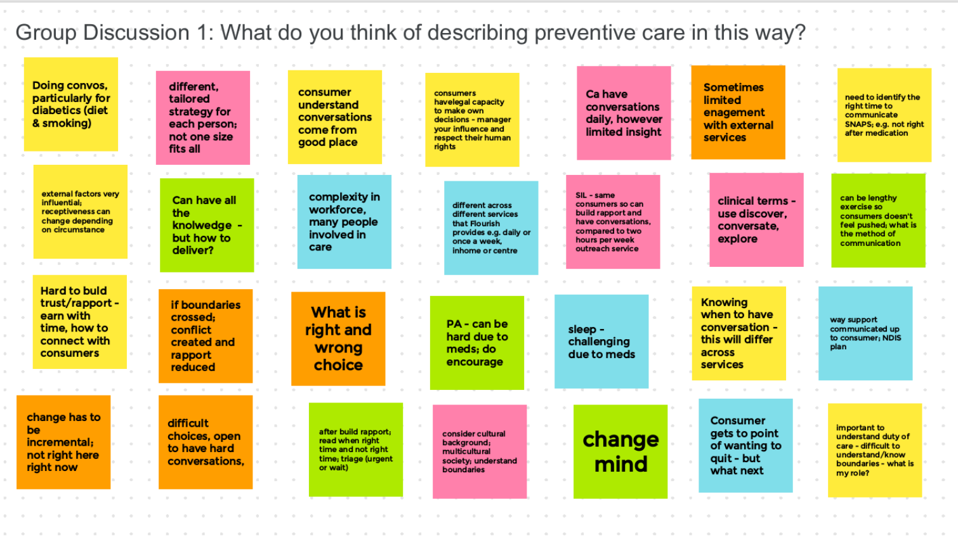
What do you think of describing support in this way?
What are you currently doing?
What aren’t you currently doing?
Workshop 1
Workshop 2

Slide 36
What do you think of describing support in this way?
What are you currently doing?
What aren’t you currently doing?
Workshop 1
Conversations daily, resistance
Workshop 2

Slide 37
What do you think of describing support in this way?
What are you currently doing?
What aren’t you currently doing?
Workshop 1
Conversations daily, resistance
Advice long term benefits
Workshop 2

Slide 38
What do you think of describing support in this way?
What are you currently doing?
What aren’t you currently doing?
Workshop 1
Conversations daily, resistance
Advice long term benefits
Connections can be limited
Workshop 2

Slide 39
Part 3: Evidence-based strategies proposed
1. Facilitators presented project overview and proposed ways to support
3. Facilitators proposed evidence-based strategies
2. Group discussion about ways to support
4. Group discussion about potential strategies
5. Facilitators documented strategies and input into survey
6. Strategy ranking activity and results presented
7. Group discussion about strategy implementation

Slide 40
Evidence-Based Practice Change Strategies
Staff Training
Educational Materials
Guidelines
Monitoring & feedback
Point of care prompts
Consumer Activation

Slide 41
Part 4: Group discussion about strategies
1. Facilitators presented project overview and proposed ways to support
3. Facilitators proposed evidence-based strategies
2. Group discussion about ways to support
4. Group discussion about potential strategies
5. Facilitators documented strategies and input into survey
6. Strategy ranking activity and results presented
7. Group discussion about strategy implementation

Slide 42
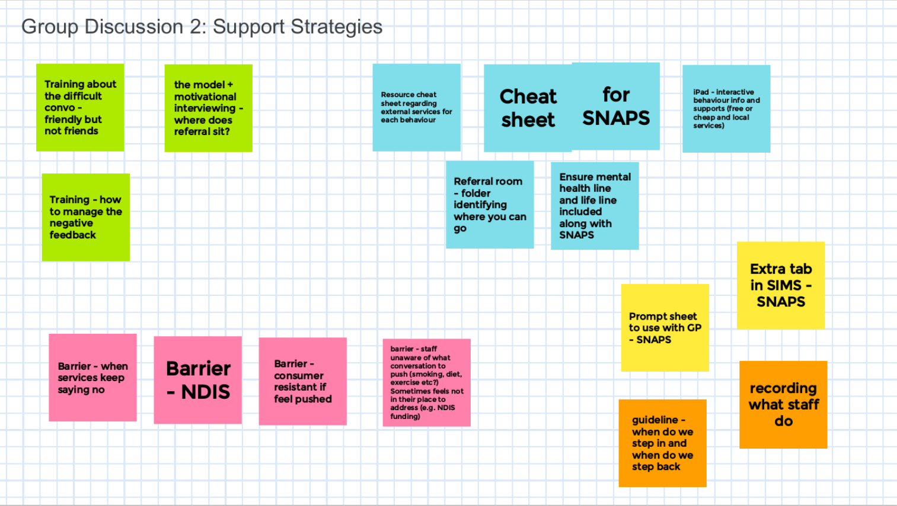
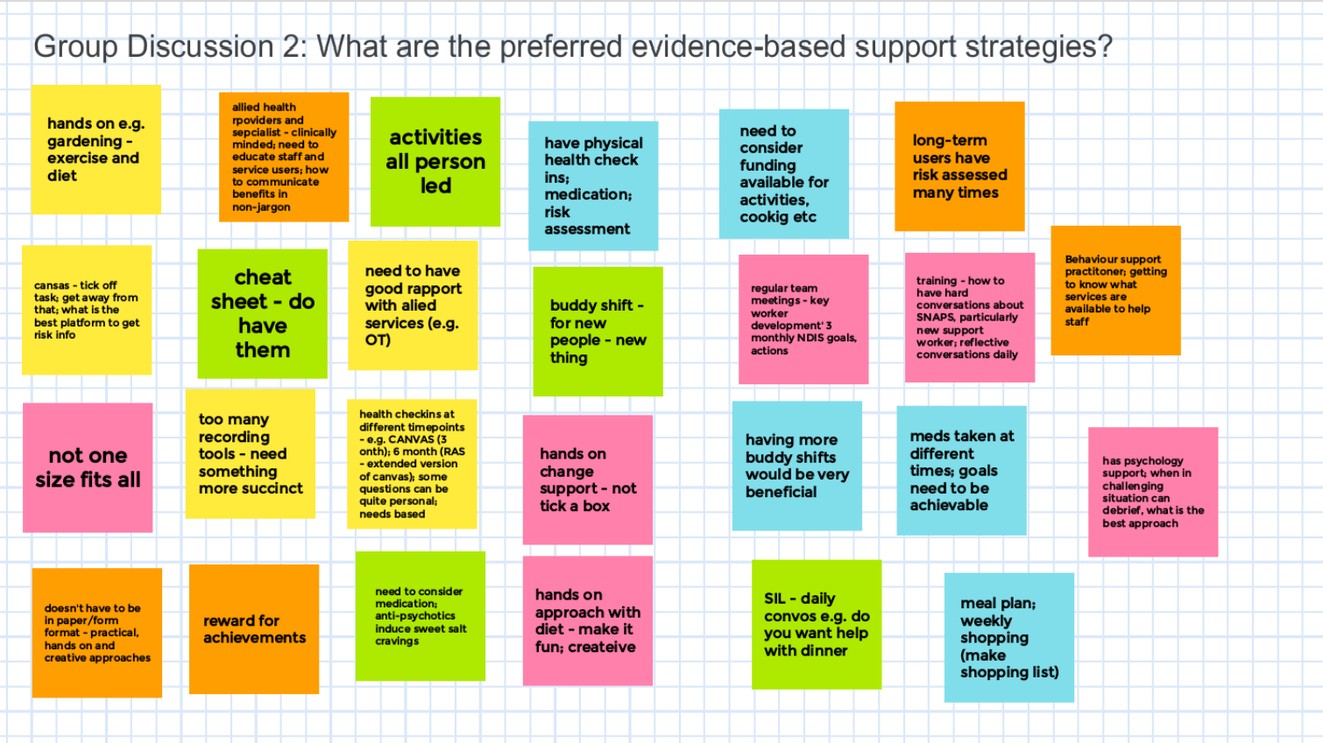
What do you need?
What don’t you need?
What has or hasn’t worked in the past?
Might this differ by behaviour?
Workshop 1
Workshop 2

Slide 43
Part 5: Strategies documented
1. Facilitators presented project overview and proposed ways to support
3. Facilitators proposed evidence-based strategies
2. Group discussion about ways to support
4. Group discussion about potential strategies
5. Facilitators documented strategies and input into survey
6. Strategy ranking activity and results presented
7. Group discussion about strategy implementation

Slide 44
Strategies
Both
Both
W1
W1
Training for all staff (difficult conversations, motivational interviewing)
Local support services guide (who/where/how to refer)
Guidelines around my role –is this my job?
Consumer prompt sheet e.g. to take to GP
Both
W2
W2
Staff ‘point of care’ prompt sheet
Training for new staff (what is my role, creative approaches & activities)
Reflective process time (allocating staff time/funds for regular meetings)
Notes:
CHANGE ICONS so they are relevant

Slide 45

Online Survey
Workshop 1
Workshop 2
………………………….
…………………….…….
…………………………..
..............................
………………………..…
………….………….....
………………………….
………………..………..
………………………....
……………..…………..
Notes:
CHANGE ICONS so they are relevant

Slide 46
Online Survey
Workshop 1
Workshop 2
Training………….....
Services Guide…….
POC Prompt………..
Guidelines…………..
Consumer Prompt…
Training………….....
Services Guide…….
POC Prompt………..
Training (new)..…..
Reflection…………..

Slide 47
Part 6: Strategy Ranking
1. Facilitators presented project overview and proposed ways to support
3. Facilitators proposed evidence-based strategies
2. Group discussion about ways to support
4. Group discussion about potential strategies
5. Facilitators documented strategies and input into survey
6. Strategy ranking activity and results presented
7. Group discussion about strategy implementation

Slide 48
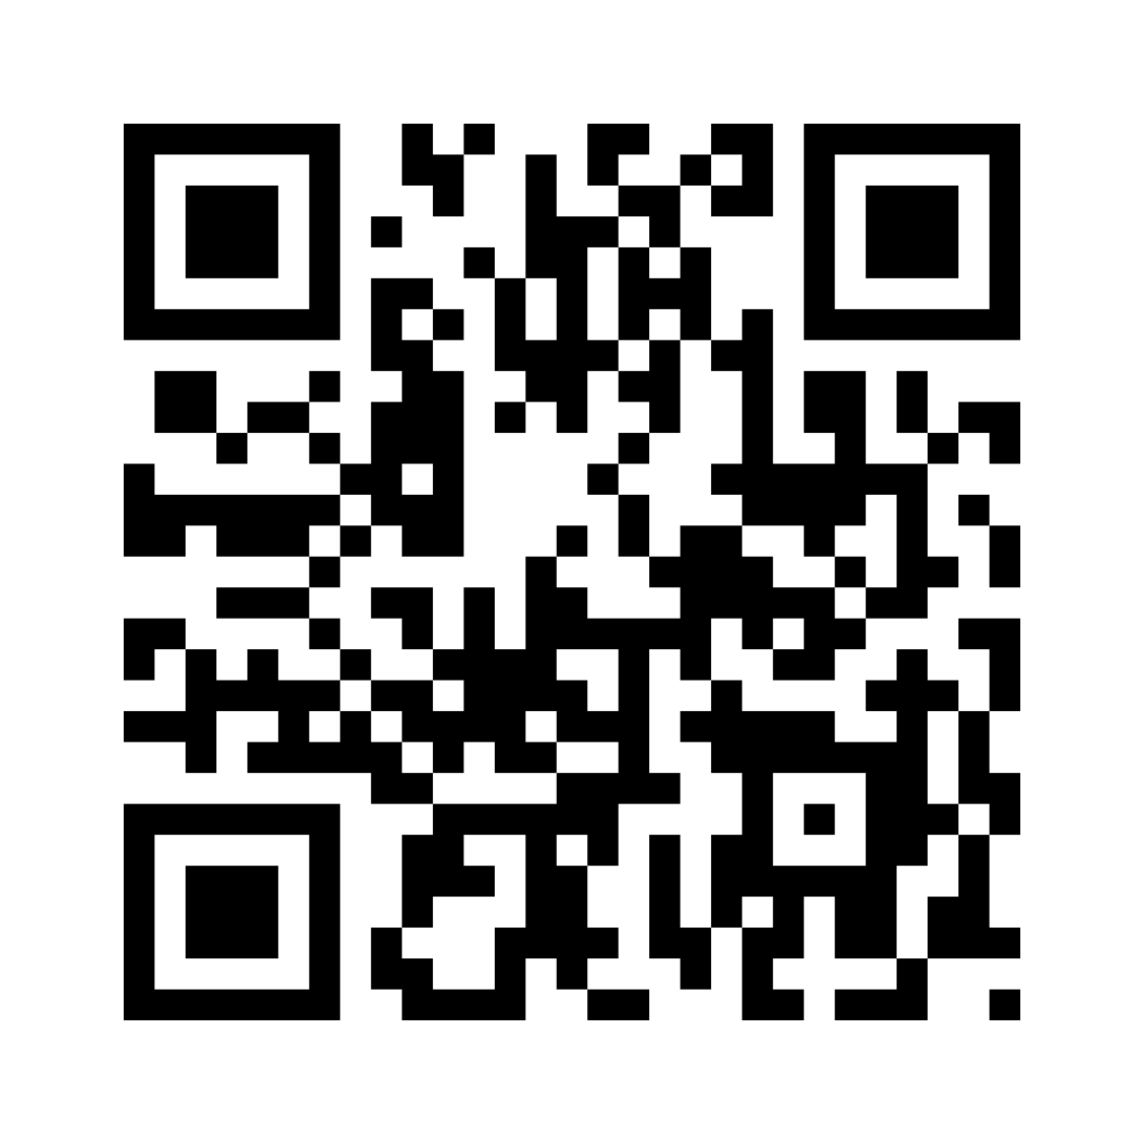
Online Survey
Workshop 1
Workshop 2
Training………….....
Services Guide…….
POC Prompt………..
Guidelines…………..
Consumer Prompt…
Training………….....
Services Guide…….
POC Prompt………..
Training (new)..…..
Reflection…………..

Slide 49
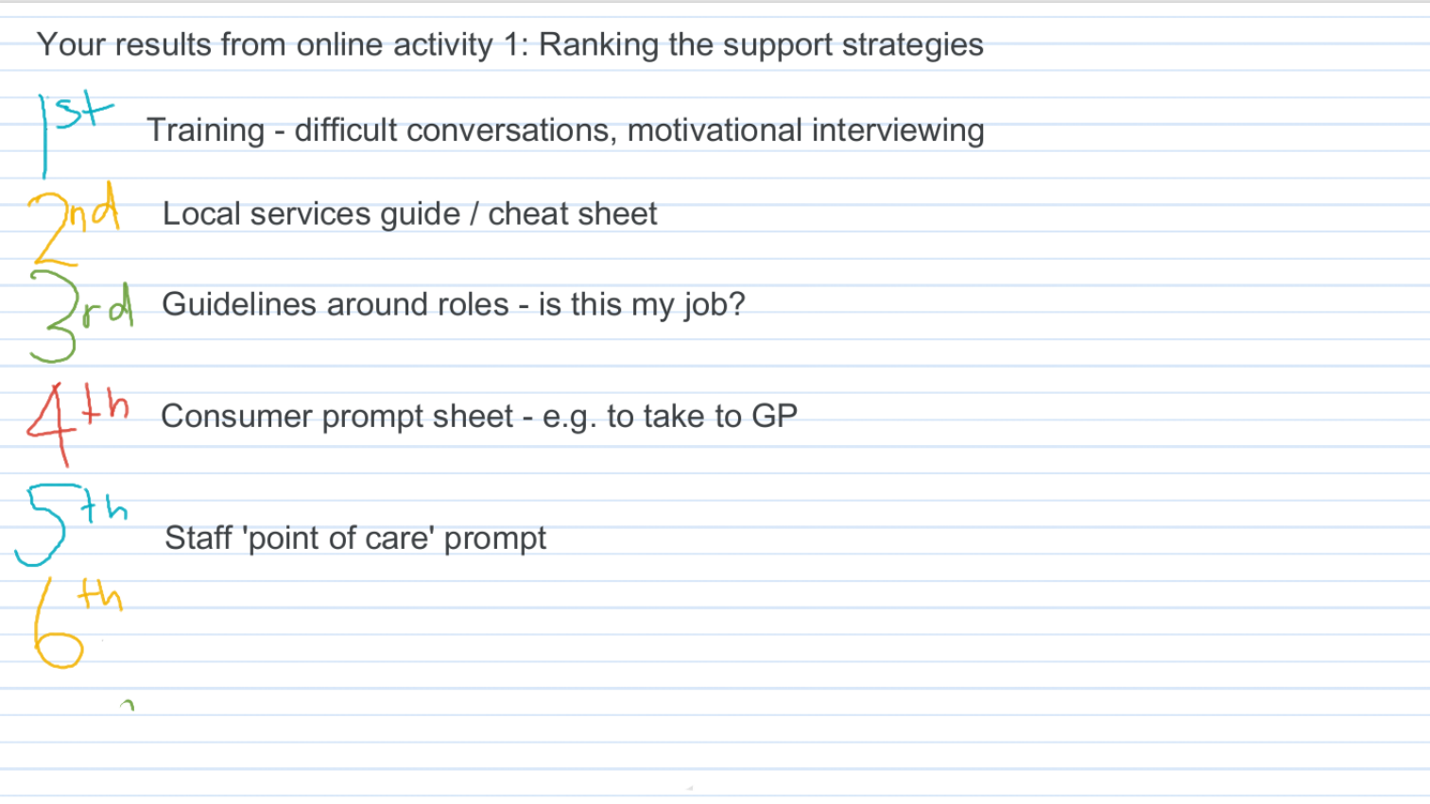
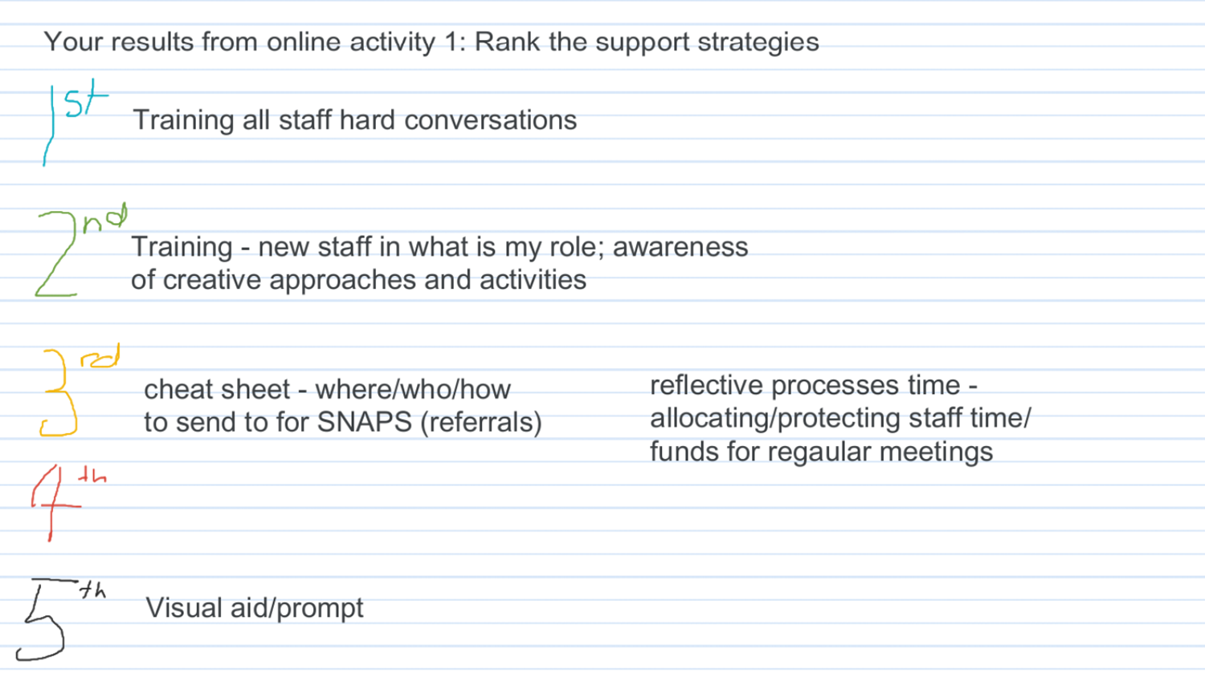
Workshop 1
Workshop 2

Slide 50
Part 7: Group discussion about implementation
1. Facilitators presented project overview and proposed ways to support
3. Facilitators proposed evidence-based strategies
2. Group discussion about ways to support
4. Group discussion about potential strategies
5. Facilitators documented strategies and input into survey
6. Strategy ranking activity and results presented
7. Group discussion about strategy implementation

Slide 51
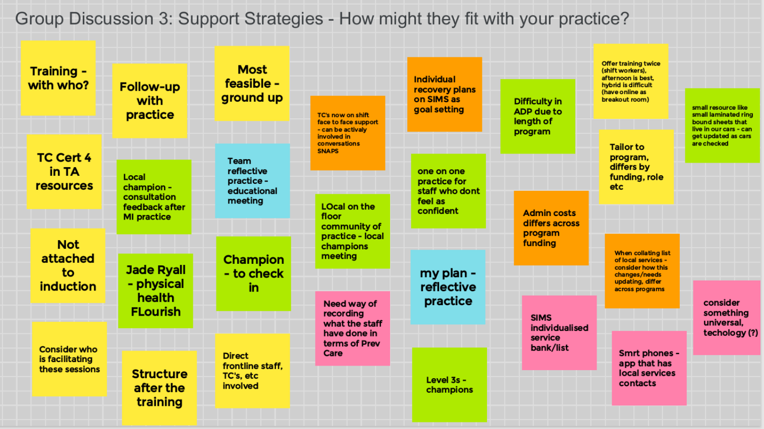
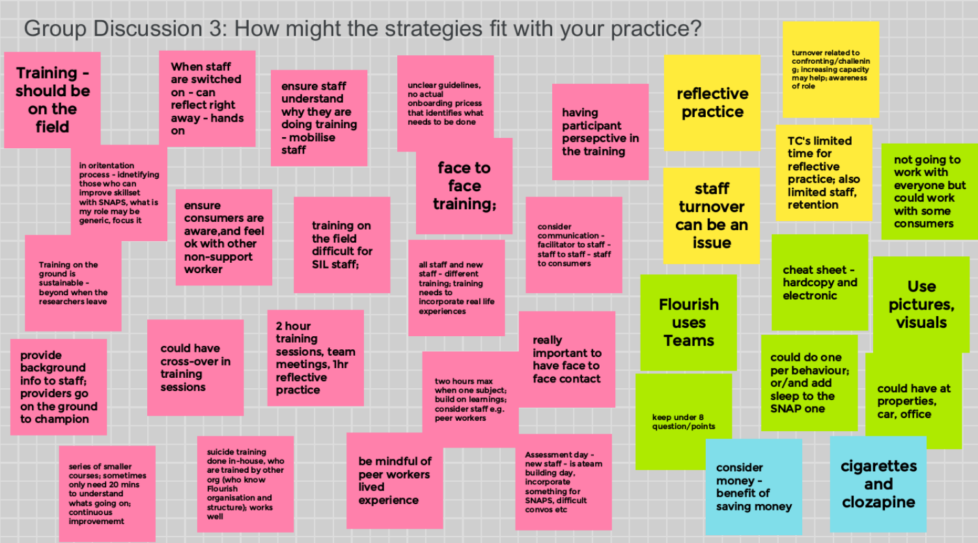
Workshop 1
Workshop 2

Slide 52
Workshop 1
When during team meetings
Time 2hr session or shorter
Form face to face
Who peer, lived experience of MHC, behaviour change
Workshop 2

Slide 53
Overview
Background
CMO Connect Project
Aims
Co-Development Workshop & Outcomes
Learnings

Slide 54
Workshop Learnings
01
Efficiency
Structured method, Jamboard and REDCap

Slide 55
Workshop Learnings
01
02
Efficiency
Barriers
Structured method, Jamboard and REDCap
Consider perceived barriers experienced by staff when delivering support

Slide 56
Workshop Learnings
01
02
03
Efficiency
Barriers
Tailoring
Structured method, Jamboard and REDCap
Consider perceived barriers experienced by staff when delivering support
Tailored strategies to better address contextual factors of CMO

Slide 57
Workshop Learnings
01
02
03
04
Efficiency
Barriers
Tailoring
Inform Intervention
Structured method, Jamboard and REDCap
Consider perceived barriers experienced by staff when delivering support
Tailored strategies to better address contextual factors of CMO
Fit to practice, feasible, acceptable & appropriate to end-users

Slide 58
Thank You

Slide 59
Questions?
Casey.P.Regan@uon.edu.au

Slide 60
Thanks!
Slidesgo
info@slidesgo.com
Please keep this slide for attribution

