Slide 1













Thank you to our Sponsors
#EquallyWellAu22

Slide 2

Physical Movement Challenging the medical model of exercise
Bonnie Ratcliff Master of Social Work (Qualifying)

Slide 3
physical
health
mental
health

Slide 4
1.
2.
3.
4.
needs analysis
development
pilot
evaluation

Slide 5
1.
needs analysis
literature review
consumer and peer worker focus groups
stakeholder consultation

Slide 6
how have we
come to understand
what ‘works well’?

Slide 7
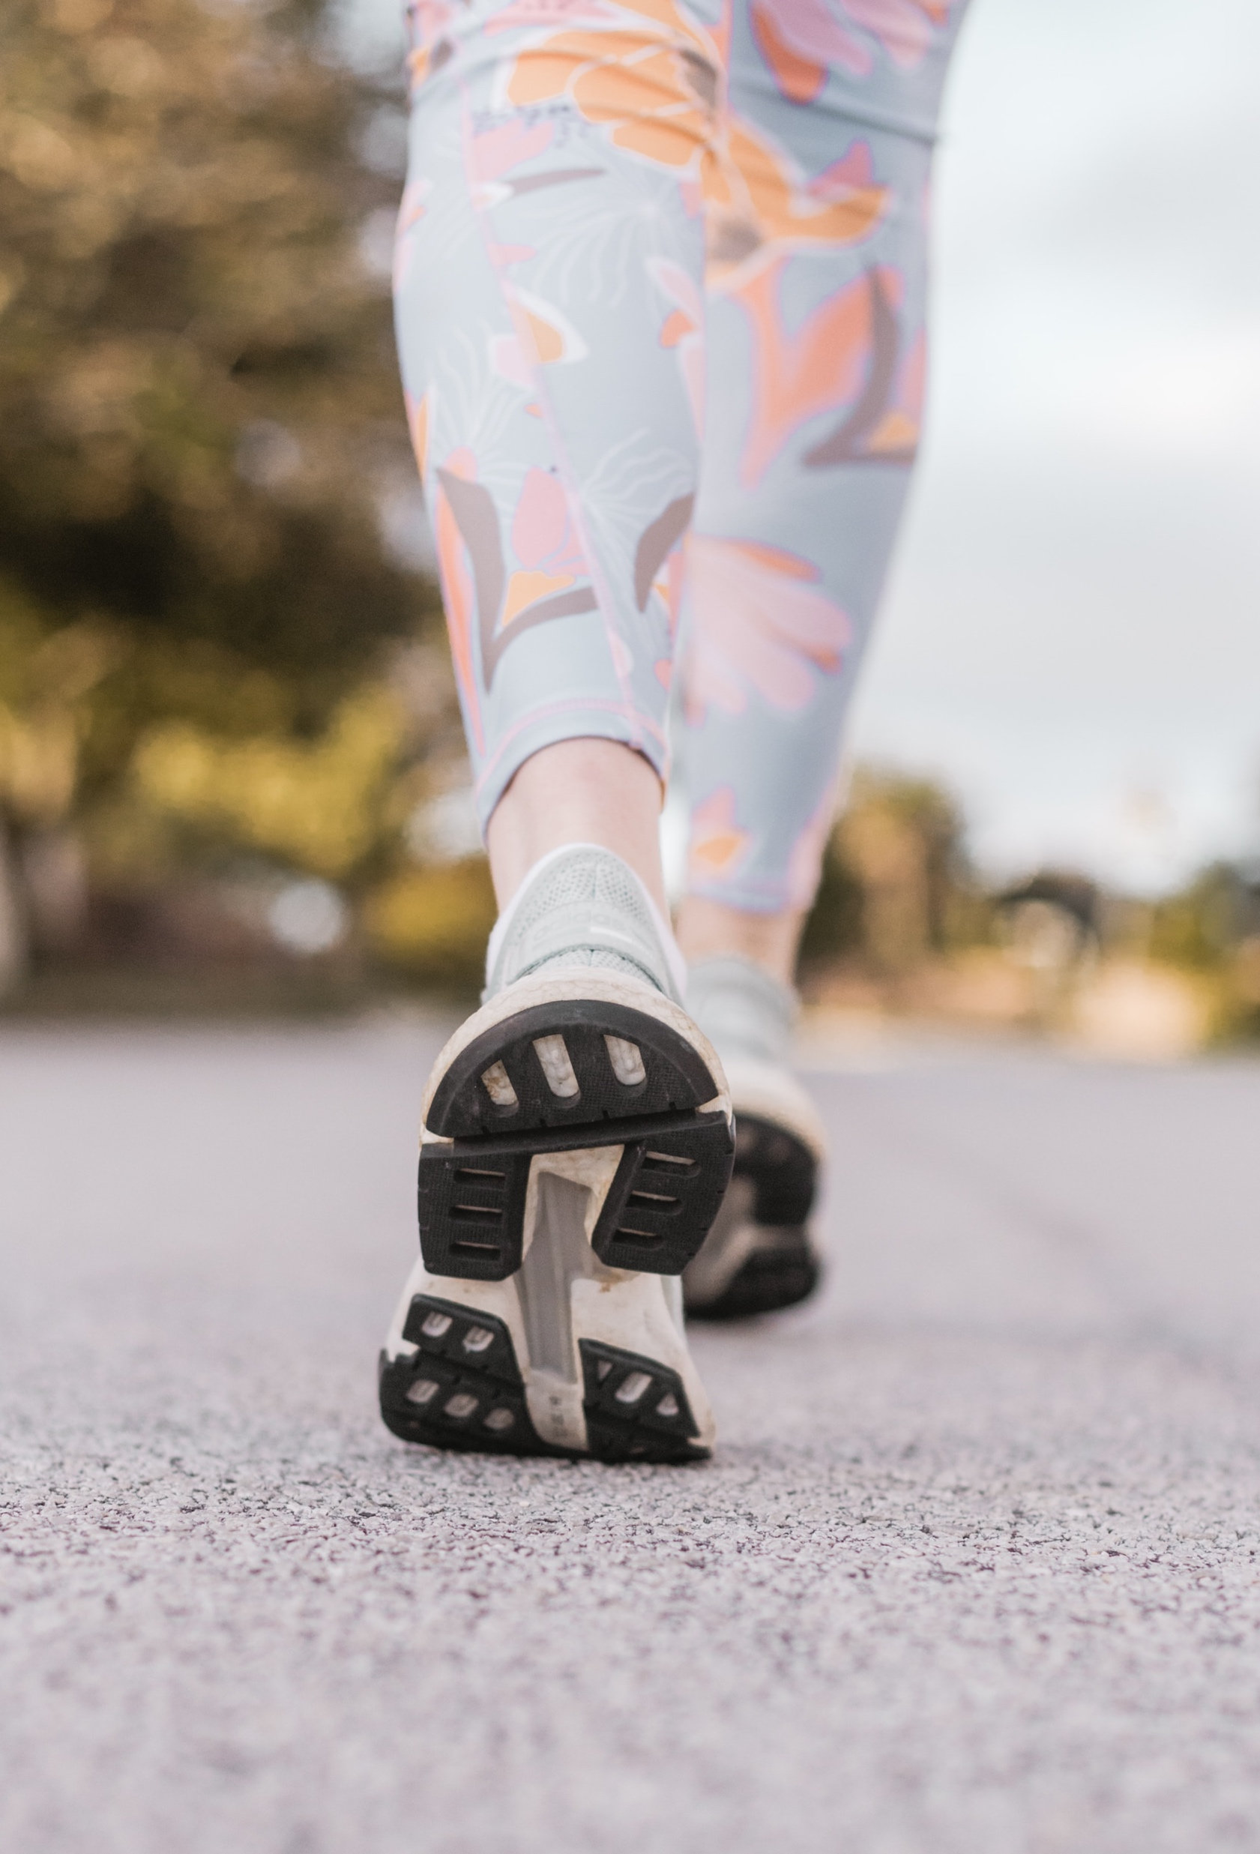
“
Physical activity is any bodily movement produced by skeletal muscles that results in energy expenditure
”
Caspersen et al., 1985, p.126

Slide 8



exercise is medicine
move more and sit less
behavioural lifestyle change

Slide 9
Investigation into the specific dimension of lifestyle reveals a number of unhealthy habits, attitudes and behaviours leading to chronic disease and mortality. A lack of exercise, poor diet, smoking tobacco, high cholesterol levels and little if any, dental care appear to be dominant contributors to poor physical health.
Stanley & Laugharne, 2014, p. 275
“
”

Slide 10
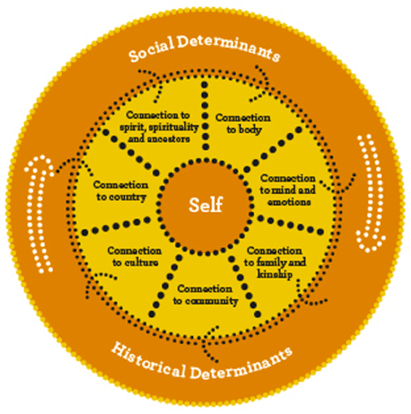
rethinking the problem
Image source: Dudgeon & Walker, 2015

Slide 11
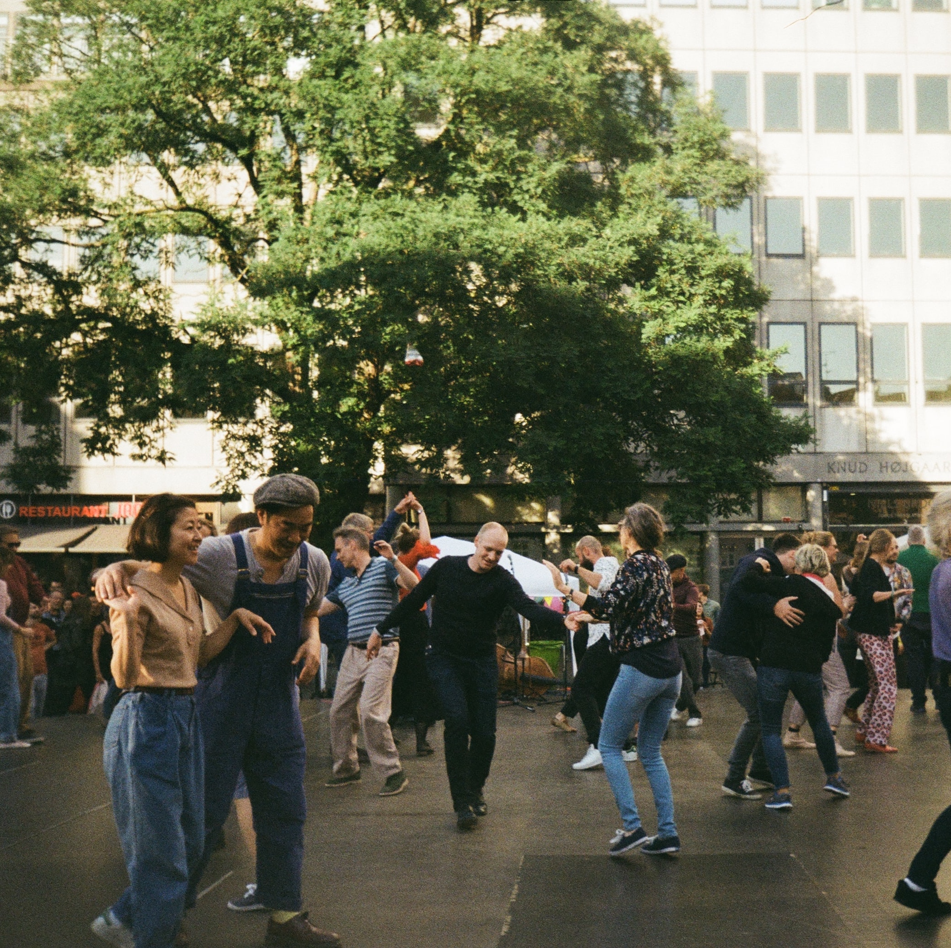
“
Physical activity involves people moving, acting and performing within culturally specific spaces and contexts, and influenced by a unique array of interests, emotions, ideas, instructions and relationships.
”
Piggin, 2020, p.5

Slide 12
rethinking the solution
nested approach not individual lifestyle programs
diverse meanings not prescriptive models
decolonise practice not uphold Western systems

Slide 13
I felt that the music motivates me to go and do things. There is a link between music and physical activity for me. The fact that I listen to, if I listen to nice active music, it gets me in the mood to get active and do active things in the house and outside.
Consumer, Physical Movement Project Focus Group
“
”

Slide 14
movement
introducing
“
”

Slide 15

movement
joyful

Slide 16

Personal reflection

Slide 18
References
Atkinson. (2013). Beyond Components of Wellbeing: The Effects of Relational and Situated Assemblage. Topoi, 32(2), 137–144. https://doi.org/10.1007/s11245-013-9164-0.
Caspersen, C. J., Powell, K. E., and Christenson, G. M. (1985). Physical activity, exercise, and physical fitness: definitions and distinctions for health-related research. Public Health Rep. 100, 126–131
Darroch, Roett, C., Varcoe, C., Oliffe, J. ., & Gonzalez Montaner, G. (2020). Trauma-informed approaches to physical activity: A scoping study. Complementary Therapies in Clinical Practice, 41, 101224–101224. https://doi.org/10.1016/j.ctcp.2020.101224.
Dudgeon, & Walker, R. (2015). Decolonising Australian Psychology: Discourses, Strategies, and Practice. Journal of Social and Political Psychology, 3(1), 276–297. https://doi.org/10.5964/jspp.v3i1.126
Macdonald, D., Abbott, R., & Jenkins, D. (2012). Physical Activity of Remote Indigenous Australian Women: A Postcolonial Analysis of Lifestyle. Leisure Sciences, 34(1), 39–54. https://doi.org/10.1080/01490400.2012.633854.
McGonigal, K. & Chatterjee, R. (2020, April 22). Discover the Joy of Movement with Dr Kelly McGonigal [Audio Podcast]. Retrieved from https://drchatterjee.com/discover-the-joy-of-movement-with-dr-kelly-mcgonigal/
Phoenix, C., & Bell, S. L. (2019). Beyond “Move More”: Feeling the Rhythms of physical activity in mid and later-life. Social Science & Medicine (1982), 231, 47–54. https://doi.org/10.1016/j.socscimed.2018.05.006.
Piggin, J. (2020). What is Physical Activity? A Holistic Definition for Teachers, Researchers and Policy Makers. Frontiers in Sports and Active Living. 2(72).
Stanley, S., & Laugharne, J. (2014). The Impact of Lifestyle Factors on the Physical Health of People with a Mental Illness: a Brief Review. International Journal of Behavioral Medicine, 21(2), 275–281. https://doi.org/10.1007/s12529-013-9298-x.
Shakespeare, Fisher, M., Mackean, T., & Wilson, R. (2021). Theories of Indigenous and non-Indigenous wellbeing in Australian health policies. Health Promotion International, 36(3), 669–679. https://doi.org/10.1093/heapro/daaa097
Terare, & Rawsthorne, M. (2020). Country Is Yarning to Me: Worldview, Health and Well-Being Amongst Australian First Nations People. The British Journal of Social Work, 50(3), 944–960. https://doi.org/10.1093/bjsw/bcz072
Wellard, I. (2012). Body-reflexive pleasures: exploring bodily experiences within the context of sport and physical activity. Journal of Sport, Education and Society, 17(10), pp. 21-33.
Williams, T. L., Hunt, E. R., Papathomas, A., & Smith, B. (2018). Exercise is medicine? Most of the time for most; but not always for all. Qualitative Research in Sport, Exercise and Health, 10(4), 441–456. https://doi.org/10.1080/2159676X.2017.1405363.

