Slide 1
Unintentional Drug-related Deaths for people with mental illness in NSW Australia, 2012-2016
Authors Jennifer Smith-Merry, Kenji Fujita, Tim Chen
Presented by
Professor Jennifer Smith-Merry
Director, Centre for Disability Research and Policy
Sydney School of Health Sciences, The University of Sydney

Slide 2
Warning: this presentation focuses on the circumstances of deaths in people with mental illness.
This project
Funded by the NSW Mental Health Commission
Aims: to use the National Coronial Information System to understand the circumstances of unexpected deaths in people with serious mental illness.
Focuses on New South Wales
This paper
Focuses on drug-related deaths only as part of this broader data set.
Forthcoming publication in Social Psychiatry and Psychiatric Epidemiology

Slide 3
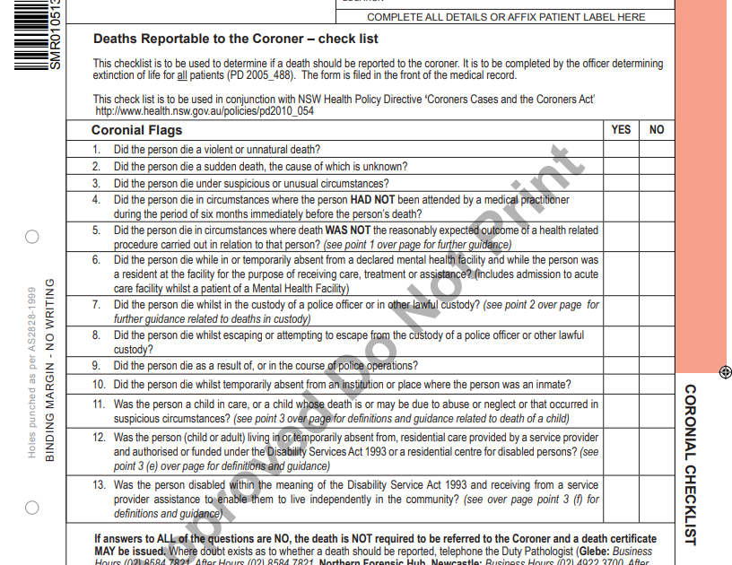
Coroner data
‘Reportable’ deaths:
include MH facility (but not mandatory inquest)
Violent, unnatural, unexpected.
National Coronial Information System
Finding the relevant deaths:
Text based search for relevant ‘cases’
Altogether identified: 1456 deaths over 2012-2016 which were ‘unintentional’

Slide 5
Key findings
There were 495 drug-related deaths identified (19% of all drug related deaths in NSW).
Coroner found individuals died from 1 drug alone (n=97) or between 2 and 16 drugs (n = 398)
Young men aged 25-44 were most likely to die from just one drug.
The most common drugs involved in deaths were diazepam (43% of deaths), temazepam (27%), codeine (26%) and morphine (25%).
Alcohol was included as a cause in 32% of deaths.

Slide 6
Individual drugs involved in deaths
Substance | ATC code | Total (n=495) |  |  | Fold increase (2012 VS 2016) |  | Male (n=319) |  |  | Female (n=176) |  |  | Male versus female^{b} χ²
 |  | Number of casesª | % |  |  |  | Number of casesª | % |  | Number of casesª | %
Diazepam | N05BA01 | 211 | 42.6 |  | 1.5 |  | 135 | 42.3 |  | 76 | 43.2 |  | 0.008
Alcohol | N/A | 159 | 32.1 |  | 1.9 |  | 113 | 35.4 |  | 46 | 26.1 |  | 4.1*
Temazepam | N05CD07 | 132 | 26.7 |  | 1.5 |  | 86 | 27.0 |  | 46 | 26.1 |  | 0.01
Codeine | R05DA04 | 130 | 26.3 |  | 2.5 |  | 79 | 24.8 |  | 51 | 29.0 |  | 0.8
Morphine | N02AA01 | 124 | 25.1 |  | 2.2 |  | 83 | 26.0 |  | 41 | 23.3 |  | 0.3
Oxazepam | N05BA04 | 112 | 22.6 |  | 1.9 |  | 73 | 22.9 |  | 39 | 22.2 |  | 0.01
Oxycodone | N02AA05 | 108 | 21.8 |  | 1.0 |  | 62 | 19.4 |  | 46 | 26.1 |  | 2.6
Paracetamol | N02BE01 | 103 | 20.8 |  | 1.7 |  | 51 | 16.0 |  | 52 | 29.5 |  | 11.8***
Alprazolam | N05BA12 | 93 | 18.8 |  | 1.6 |  | 63 | 19.7 |  | 30 | 17.0 |  | 0.4
Methadone | N07BC02 | 92 | 18.6 |  | 1.2 |  | 64 | 20.1 |  | 28 | 15.9 |  | 1.0
Quetiapine | N05AH04 | 91 | 18.4 |  | 2.5 |  | 51 | 16.0 |  | 40 | 22.7 |  | 3.0
Amphetamine | N06BA01 | 61 | 12.3 |  | 3.2 |  | 46 | 14.4 |  | 15 | 8.5 |  | 3.1
Heroin | N02AA09 | 50 | 10.1 |  | 2.0 |  | 40 | 12.5 |  | 10 | 5.7 |  | 5.1*
Amitriptyline | N06AA09 | 49 | 9.9 |  | 1.3 |  | 18 | 5.6 |  | 31 | 17.6 |  | 16.9***
Olanzapine | N05AH03 | 47 | 9.5 |  | 1.9 |  | 30 | 9.4 |  | 17 | 9.7 |  | 0.0
a. a total of 2323 substances were identified amongst 495 deceased. Because more than 1 substance could be involved par case, frequencies for substances total >100%. b. *p < 0.05, **p < 0.01, ***p < 0.001

Slide 7
Drugs involved in a death from only a single drug.
Name | ATC code | Number (%)
Heroin | N02AA09 | 21 (22)
Methadone | N07BC02 | 10 (10)
Morphine | N02AA01 | 7 (7)
Oxycodone | N02AA05 | 7 (7)
Amphetamine | N06BA01 | 7 (7)
Fentanyl | N02AB03 | 7 (7)
Clozapine | N05AH02 | 7 (7)
Quetiapine | N05AH04 | 3 (3)
Olanzapine | N05AH03 | 2 (2)
Citalopram | N06AB04 | 2 (2)
Others |  | 24 (25)
Total |  | 97 (100)

Slide 8
Demographic findings
 | 2012ª | 2013 ª | 2014 ª | 2015 ª | 2016 ª | Total ª | Fold increase (2012 VS 2016) | Trend^{b} χ² | Rate ratio (CI) | p-value
Gender
Male | 50 (1.7) | 55 (1.9) | 61 (2.0) | 72 (2.4) | 81 (2.6) | 319 (2.1) | 1.5 | 7.7** | 1.81 (1.48-2.22) | <.001
Female | 34 (1.1) | 26 (0.9) | 30 (1.0) | 40 (1.3) | 46 (1.4) | 176 (1.1) | 1.3 | 3.1 | 1*
Age (years)
15-24 | 2 (0.2) | 3 (0.3) | 1 (0.1) | 6 (0.6) | 9 (0.9) | 21 (0.4) | 4.4 | 6.6* | 0.16 (0.01-0.26) | <.001
25-34 | 17 (1.6) | 26 (2.4) | 23 (2.1) | 27 (2.4) | 23 (2.0) | 116 (2.1) | 1.2 | 0.2 | 1*
35-44 | 25 (2.5) | 20 (2.0) | 30 (2.9) | 42 (4.1) | 35 (3.4) | 152 (3.0) | 1.4 | 5.4* | 1.71 (1.31-2.24) | <.001
45-54 | 24 (2.4) | 18 (1.8) | 28 (2.8) | 19 (1.9) | 39 (3.9) | 128 (2.6) | 1.6 | 3.6 | 1.29 (0.96-1.73) | 0.09
55-64 | 10 (1.2) | 10 (1.2) | 5 (0.6) | 14 (1.6) | 20 (2.2) | 59 (1.4) | 1.9 | 4.1* | 0.73 (0.50-1.05) | 0.09
≥65 | 6 (0.6) | 4 (0.4) | 4 (0.3) | 4 (0.3) | 1 (0.1) | 19 (0.3) | 0.1 | 3.2 | 0.17 (0.09-0.30) | <.001
Marital status
Married / De facto | 23 (0.8) | 17 (0.6) | 22 (0.7) | 21 (0.7) | 33 (1.1) | 116 (0.8) | 1.4 | 1.8 | 1*
Never married | 32 (1.5) | 36 (1.7) | 36 (1.7) | 52 (2.4) | 51 (2.3) | 207 (1.9) | 1.5 | 5.7* | 3.25 (2.54-4.16) | <.001
Divorced | 12 (2.5) | 11 (2.2) | 11 (2.2) | 9 (1.8) | 14 (2.7) | 57 (2.3) | 1.1 | 0.0 | 3.36 (2.41-4.62) | <.001
Separated | 4 (2.2) | 4 (2.1) | 8 (4.2) | 10 (5.2) | 7 (3.6) | 33 (3.5) | 1.7 | 1.9 | 4.32 (2.88-6.29) | <.001
Widowed | 4 (1.3) | 2 (0.7) | 2 (0.6) | 5 (1.5) | 1 (0.3) | 14 (0.9) | 0.2 | 0.5 | 4.29 (2.24-7.65) | <.001
Unlikely to be known | 9 (N/A) | 11 (N/A) | 12 (N/A) | 15 (N/A) | 21 (N/A) | 68 (N/A) | N/A | NA | NA^{c} | NA^{c}
Total | 84 (1.4) | 81 (1.3) | 91 (1.5) | 112 (1.8) | 127 (2.0) | 495 (1.6) | 1.4 | 10.7**
a. Number of deaths (Mortality rate per 100,000); b. *p < 0.05, **p < 0.01, ***p < 0.001; c 68 cases (Unlikely to be known) excluded

Slide 9
Text analysis findings
Multi-drug toxicity. No overall toxic level of one drug.
Many were getting different medications from different doctors or specialists (e.g. Oxycodone overdose via dentist)
Some people dying of toxicity while receiving only their injected medications (but with background cardio-metabolic disease)
Behaviours related to drug misuse of OTC and prescription drugs:
purchasing prescription drugs illegally from acquaintances or drug dealers
using the prescription medication of partners or friends
purchasing prescription drugs on the internet including the ‘dark web’
doctor and chemist shopping
Use of prescription medication all on day of prescribing (e.g. misusing Fentanyl patches).

Slide 10
Policy implications
Tier | Policy/ guidelines/ legislation name and date
4 | Physical Health Care of Mental Health Consumers (2017)
4 | Physical Health Care within Mental Health Services (2017)
4 | Transfer of care from mental health inpatient services (2016)
4 | Metabolic Monitoring, New Mental Health Clinical Documentation Module (2012)
4 | Clozapine-induced Myocarditis - Monitoring Protocol (2012)
4 | Adult Mental Health Intensive Care Unit Networks (2019)
3 | Living Well: A strategic plan for mental health in New South Wales 2014-2024 (2014)
3 | NSW Strategic Framework and Workforce Plan for Mental Health 2018–2022 (2018)
2 | 5th National Mental Health and Suicide Prevention Plan (2017)
2 | 5th National Mental Health and Suicide Prevention Implementation Plan (2017)
2 | National Drug Strategy 2017-2026
1 | Mental Health Commission Act 2012 (NSW)
1 | Mental Health Act (2007)
1 | Mental Health (Forensic Provisions) Act (1990)
We cannot keep having systems that do not bring together drug and alcohol and mental health needs.
Care for physical health and drug use are not mentioned in the NSW Mental Health Act (2007)
No actions tied to mental health and drug and alcohol use in either national or state-based mental health policy
No actions tied to mental health in the national drug and alcohol strategy (we don’t have an up to date policy in NSW)
Clinical guidelines for transfer, monitoring do not adequately deal with drug and alcohol problems.
We cannot rely just on mental health specific approaches or drug and alcohol specific approaches. Need to go beyond these two systems (or even these systems combined).

Slide 11
Thank you
Questions?
Follow up: jennifer.smith-merry@sydney.edu.au
Twitter: @USydCDRP

Slide 12
Searching for the right data
Test searches of different word combinations.
“mental illness” 15/22 unintentional relevant
‘Depressed’ search irrelevancy rate: 72%
Removing depressed we missed 8 that would not have been picked up elsewhere (out of 261 results): 3%
Anorexi* search irrelevancy rate: 73% but only small number of hits (e.g. only 61 in total for 6 years and missing those results would mean they were not picked up elsewhere).
In addition to anorexi* and “mental illness” irrelevancy most irrelevant results came from ‘anxiety’
Irrelevancy rate final selection 2012 test data: 31 out of 917 (3.4%)

