Slide 1


Making an Impact on Smoking
for Consumers of Queensland Public Mental Health Services
Sally PLEVER, Irene MCCARTHY, Melissa ANZOLIN
(Qld Mental Health Clinical Collaborative, Metro North Mental Health, Brisbane, Australia)
& Assoc Prof John ALLAN
(Mental Health Alcohol and Other Drugs (MHAOD) Branch, Queensland Health, Brisbane, Australia.
Qld Mental Health Clinical Collaborative
Statewide clinical practice improvement for Mental Health, Alcohol and Other Drug services

Slide 2

We would like to acknowledge the Traditional Owners of the lands on which this meeting takes place and pay respect to Elders past, present and future.
We also recognise the lived experience of people living with mental illness, problematic alcohol and other drug use, as well as those impacted by suicide and trauma, their families, carers and support people. We respect and value their opinions and their input into service delivery and change.
Artwork: A BETTER LIFESTYLE THROUGH OUR HEALTH CARERS
BY ELAINE CHAMBERS-HEGARTY

Slide 3
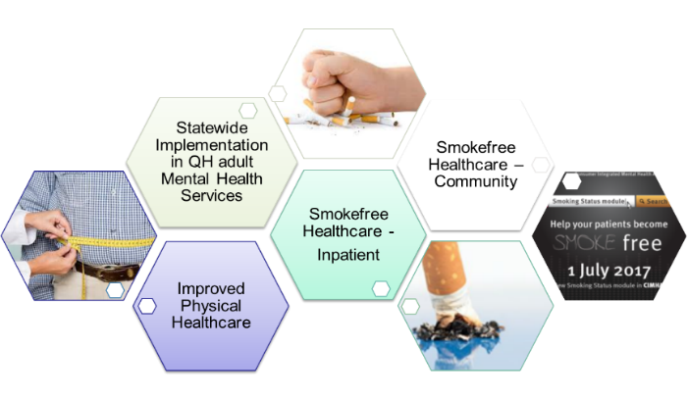
Acknowledgements:
Queensland Health MHAOD services & staff
Queensland MHAOD Clinical Network
Quitline Queensland
Qld Mental Health Clinical Collaborative
Statewide clinical practice improvement for mental health services

Slide 4
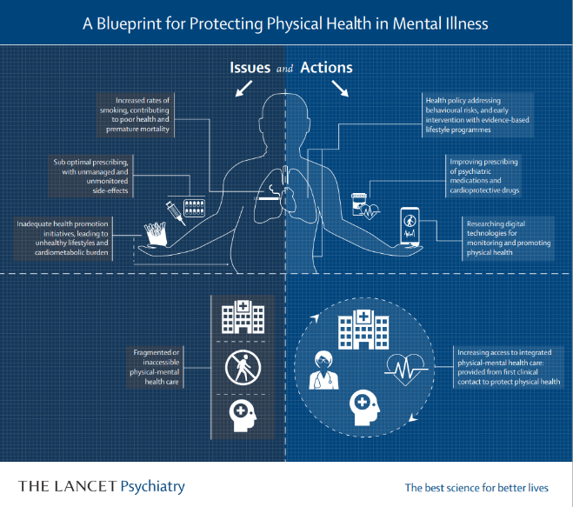
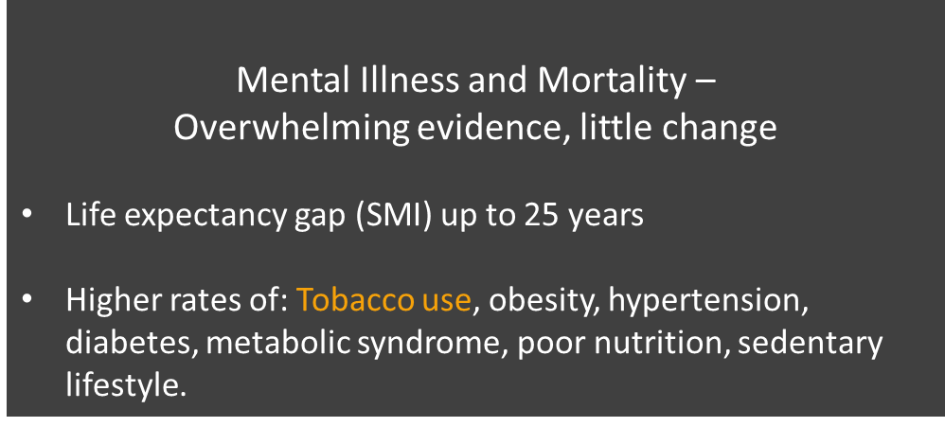
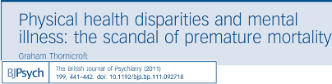
What is the Issue?

Slide 5
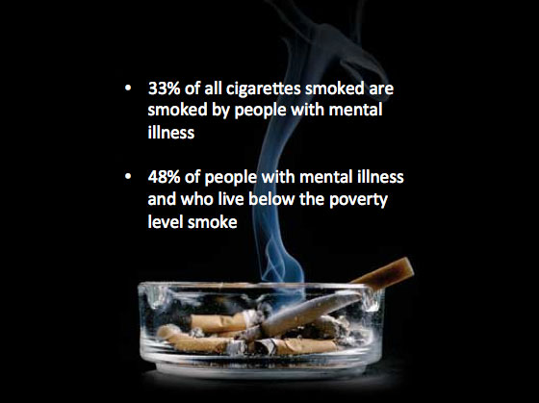
Smoking and mental illness
  Smoking is the leading cause of preventable death in people with mental illness and substance use disorders (Tam et al., 2016)
  Smoking is significantly associated with suicide (Evins, 2017)
  Smoking in Mental Health & AOD population is higher than in the general population and not showing the same declines (Dickerson et al., 2018)
  People with a serious mental illness spend about 1/3rd of their income on smoking.
  We know that people with mental illness & substance use disorders want to quit – they lack appropriate support
  Smoking cessation has not been a priority in mental health and AOD services – myths and ambivalence
Click here
Mental health stats
Missed opportunities to encourage and support smoking cessation
Empower consumers to make informed choices

Slide 6
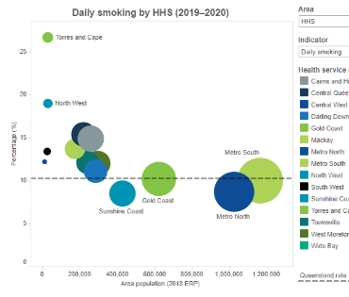

Queensland Adults – Smoking
Chief Health Officer Queensland Report 2020
Queensland adult daily smoking 10%
Prevalence of daily smoking in Qld adults was nearly DOUBLE in those reporting mental illness (2016)
Smoking leading contributor to health inequalities based on SES, geographic location & ATSI
MHCC QH Adult Mental Health Inpatient – Smoking
Data source: Queensland Health Admitted Patient Data Collection Jul – Dec 2021
of adults admitted to a
mental health inpatient unit
smoked within the last 30 days
83% of Aboriginal and Torres Strait Islander peoples admitted to an inpatient unit smoked within the last 30 days

Slide 7
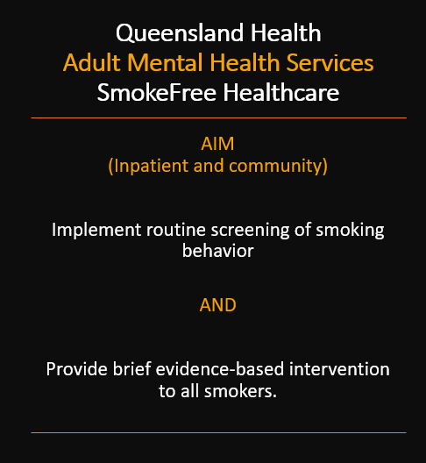

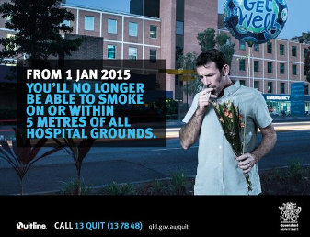
An opportunity for mental health services…
Providing smoking care as routine practice

Slide 8
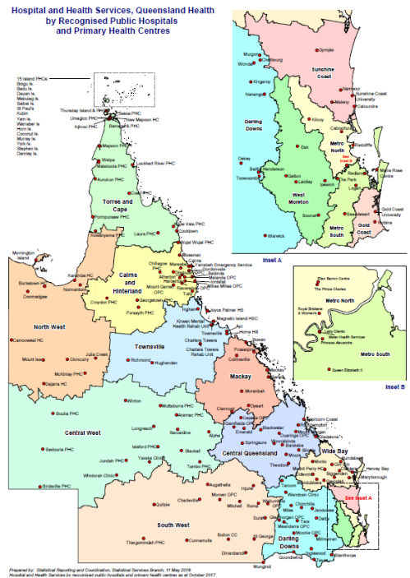
Queensland Health Mental Health Services & Alcohol and Other Drug (Inpatient Units)
Cairns & Hinterland
Central Queensland
Darling Downs
Gold Coast
Mackay
Metro North: RBWH, TPCH & Redcliffe-Caboolture
Metro South: PAH, Logan-Beaudesert & Bayside
Sunshine Coast
Townsville
West Moreton
Wide Bay: Bundaberg & Fraser Coast
Queensland Health Mental Health Services (Community only)
North West
South West
Central West
Torres and Cape

Slide 9
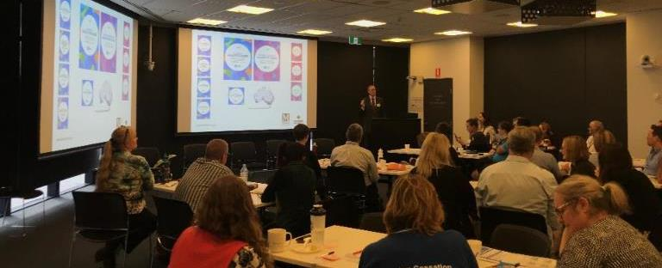
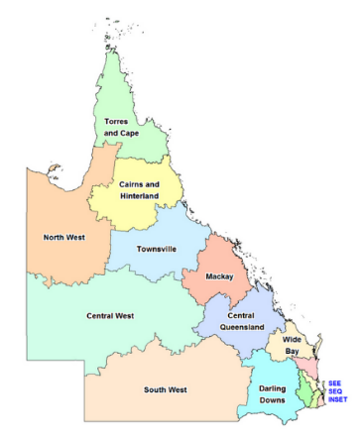
Queensland
Mental Health Clinical Collaborative
(Qld MHCC)
Statewide MH clinicians/managers working together to improve service delivery
Based on IHI Breakthrough series methodology
Adult mental health focus
Chaired by lead clinician
Statewide steering committee
Sponsored via Mental Health Alcohol & Other Drugs Branch

Slide 10

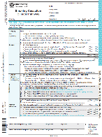

Qld Mental Health Clinical Collaborative
Smokefree MH and AOD Services
Smoking Status Tab
(Community MHS 2017)
QH Quality Improvement Payment
$4million
Community MHS
2017-2021
Quitline Queensland disadvantaged program
expanded to
Community MHS Consumers
Nov 2017
Additional NRT products added (2019)
Physical Health
2012
&
Smoking Cessation
2015
Qld Health
Smoking Cessation Clinical Pathway (SCCP)
(Inpatient MHS 2015)
2021
QH
Alcohol & Other Drugs Services

Slide 11
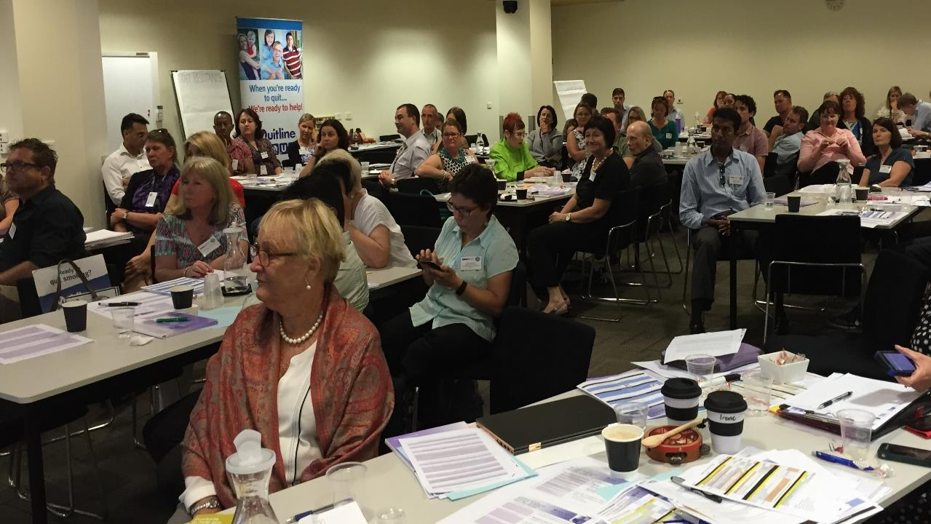
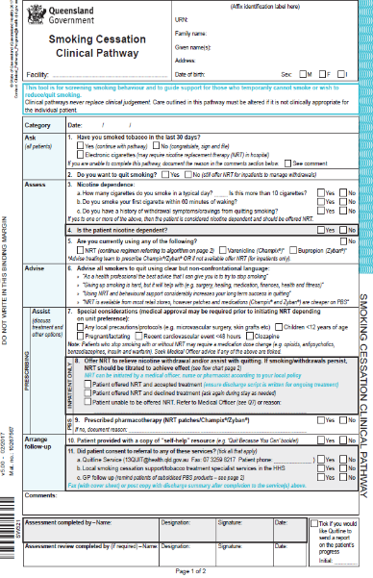
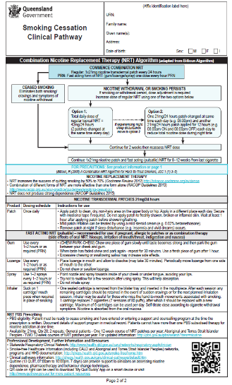
Evidence Based Brief Intervention =
Smoking Cessation Clinical Pathway
(SCCP)
AIM
ASK ALL consumers/clients about smoking at least 6-monthly
(≥18yrs)
(Smoking Tab)
DELIVER
Brief smoking cessation intervention
to identified smokers
at least 6-monthly
(SCCP)
SCCP
Evidence based
Program/service nonspecific
Guided brief intervention
Enables clients to make choices about their smoking

Slide 12
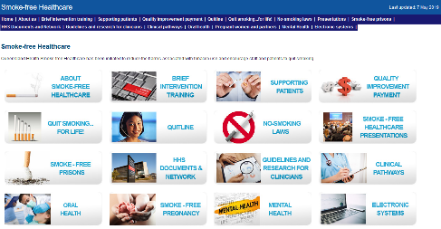
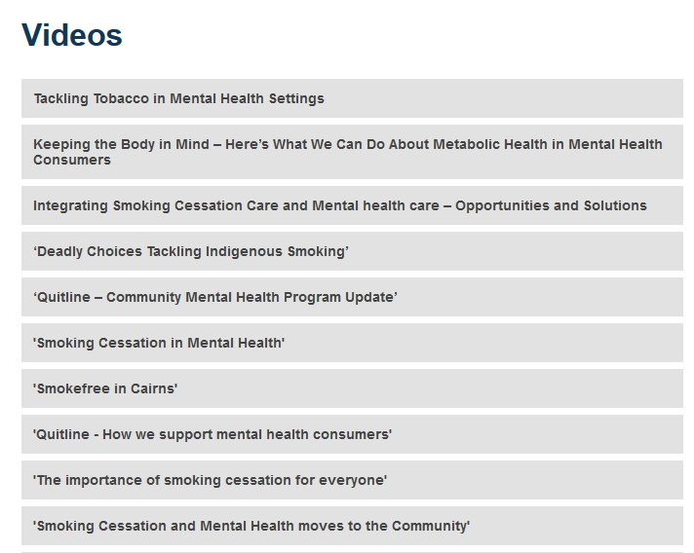

Six Monthly Statewide Forums
Intensive training delivered to over
70 clinicians statewide

Slide 13
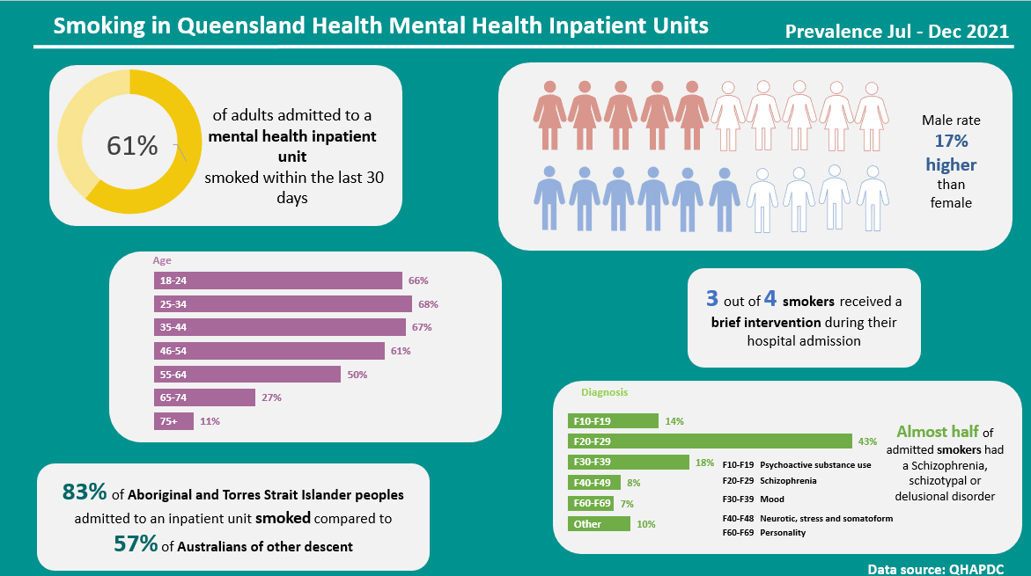

Slide 14
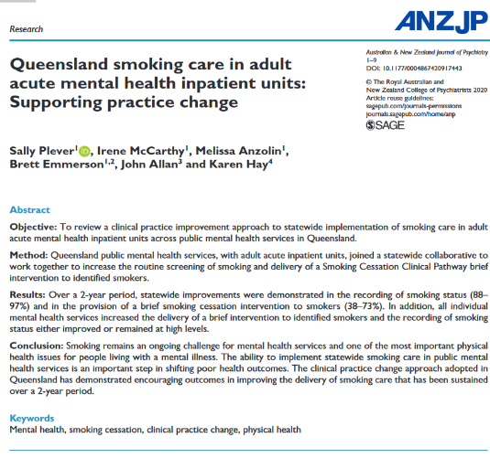
Qld MHCC Smoke-free Indicators - INPATIENT
Statistically Significant Improvement

Slide 15
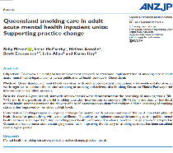

MHCC Smoke-free Indicators - INPATIENT
Community MH services commence July 2017
Statistically Significant Improvement
Under review – has improvement been sustained?
41,500+
Smoking Cessation Clinical Pathways completed
in Qld adult acute inpatient mental health services since October 15

Slide 16
Qld Mental Health Clinical Collaborative
Smokefree MH and AOD Services
Smoking Status Tab
(Community MHS 2017)
QH Quality Improvement Payment
$4million
Community MHS
2017-2021
Quitline Queensland disadvantaged program
expanded to
Community MHS Consumers
Nov 2017
Additional NRT products added (2019)
Physical Health
2012
&
Smoking Cessation
2015
Qld Health
Smoking Cessation Clinical Pathway (SCCP)
(Inpatient MHS 2015)
2021
QH
Alcohol & Other Drugs Services

Slide 17

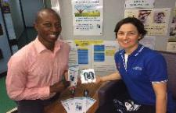
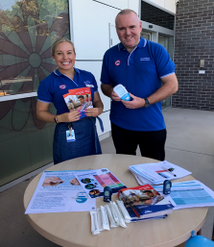
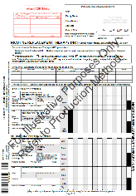
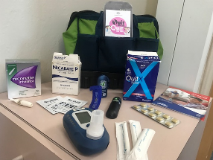
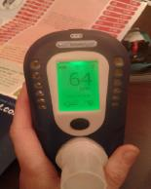
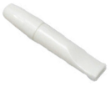
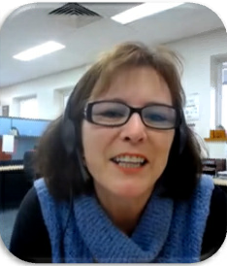
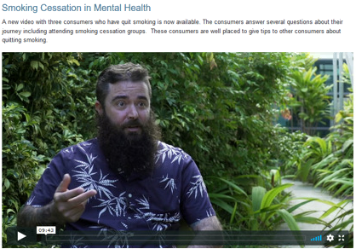
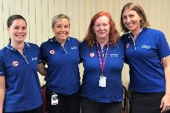
Local MH Service Activities
Ensuring staff have the resources to offer smoking care
NRT ready
Lived experience video’s
Smoking Cessation Champions
Sharing ideas online

Slide 18
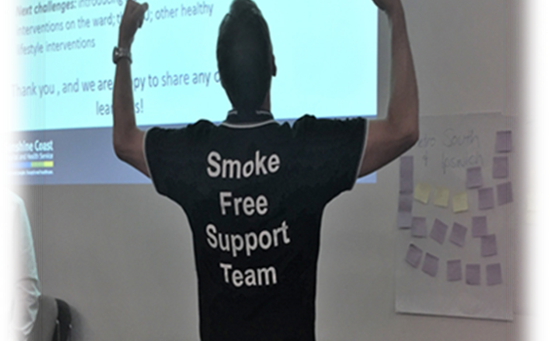
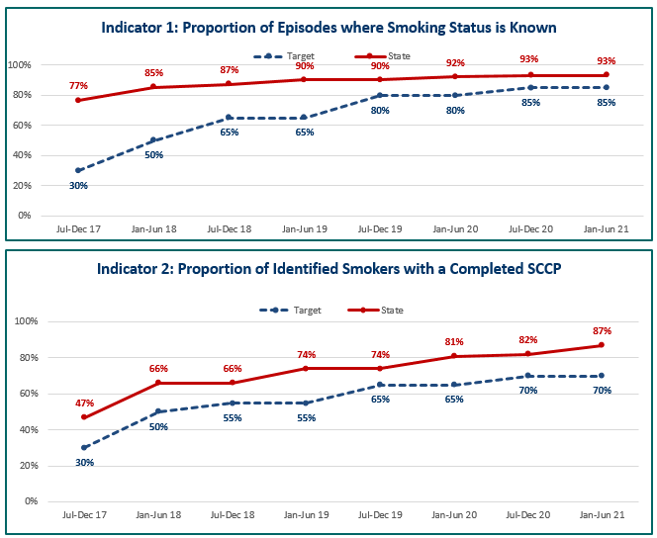
MHCC Smoke-free Indicators – COMMUNITY MHS

Slide 19
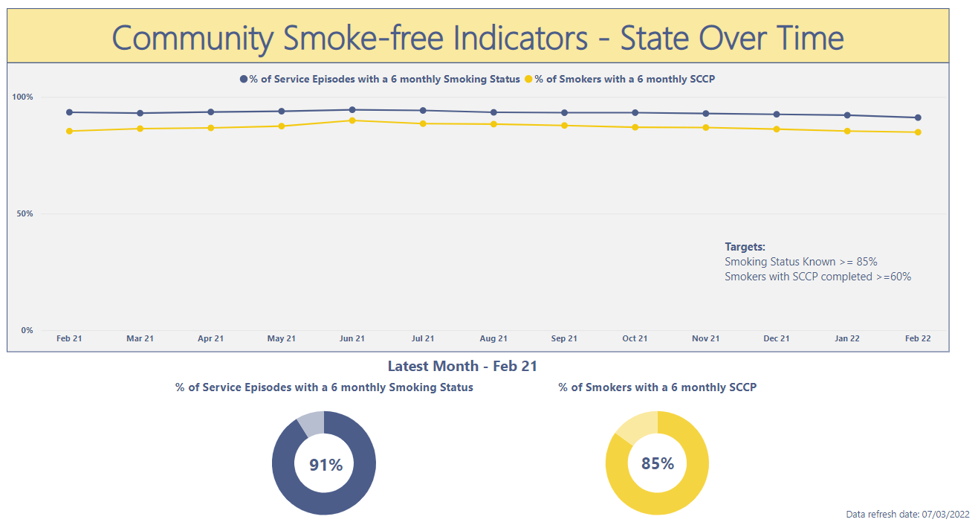
QIPC ended
Notes:
Since the incentive payment stopped in July 2021 services have continued to show good levels of reporting status and SCCP.
Currently evaluating this!

Slide 20
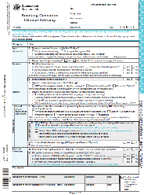
Qld Mental Health Clinical Collaborative
Smokefree Mental Health & AOD Services
Smoking Status Tab
(Community MHS 2017)
QH Quality Improvement Payment
$4million
Community MHS
2017-2021
Quitline Queensland disadvantaged program
expanded to
Community MHS Consumers
Nov 2017
Additional NRT products added (2019)
Physical Health
2012
&
Smoking Cessation
2015
Qld Health
Smoking Cessation Clinical Pathway (SCCP)
(Inpatient MHS 2015)

Slide 21
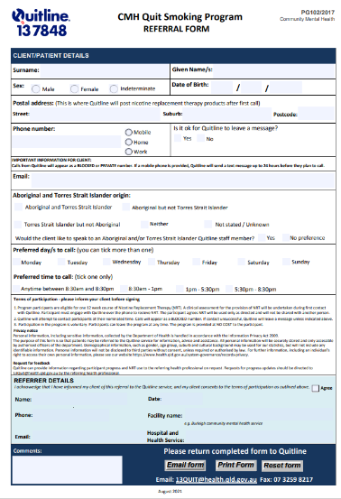
Queensland Quitline
Ready To Quit Smoking Program
Consumers of Queensland Health
Community Mental Health Services
Consumers receive:
  4 telephone support calls
  12 weeks of nicotine replacement therapy
    Patches, gum, MIST
  3 brief evaluation calls following the completion of the program

Slide 22
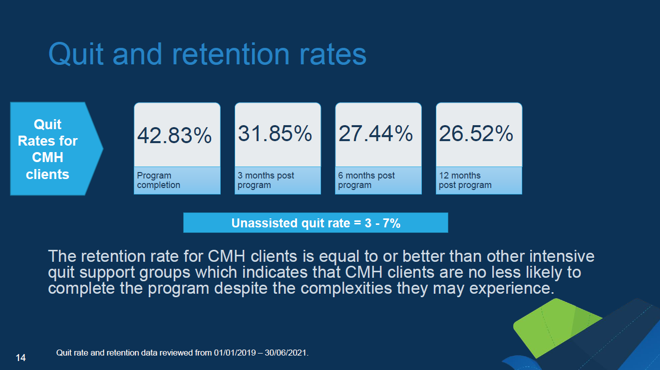
Slide used with permission from Qld Quitline

Slide 23


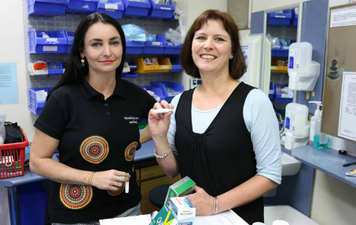
Qld Mental Health Smoking Rate
2021
2020
2019
2018
50.2%
51.5%
51.1%
51.6%
Qld public mental health community consumers
Consumers aged 18 years and over
Smoking status sourced from clinical record
Excludes consumers with unknown smoking status

Slide 24
Qld Mental Health Clinical Collaborative
Smokefree MH and AOD Services
Smoking Status Tab
(Community MHS 2017)
QH Quality Improvement Payment
$4million
Community MHS
2017-2021
Quitline Queensland disadvantaged program
expanded to
Community MHS Consumers
Nov 2017
Additional NRT products added (2019)
Physical Health
2012
&
Smoking Cessation
2015
Qld Health
Smoking Cessation Clinical Pathway (SCCP)
(Inpatient MHS 2015)
2021
QH
Alcohol & Other Drugs Services

Slide 25
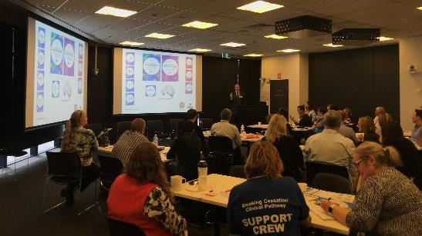
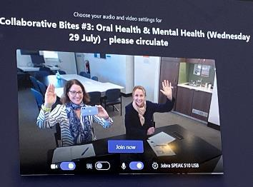
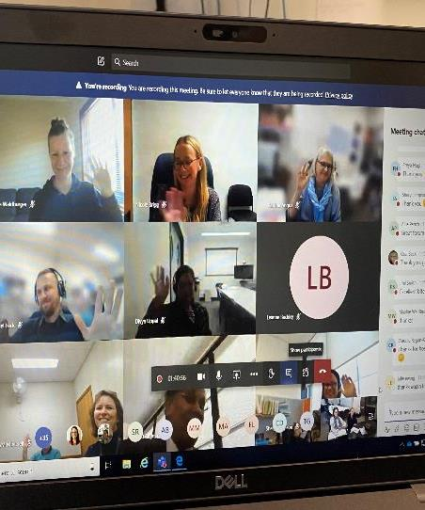
Queensland Mental Health Clinical Collaborative
(Qld MHCC)
Qld MHCC Team
Irene McCarthy (Co-manager)
Melissa Anzolin (Data Analyst)
Sally Plever (Co-manager)
Sally.plever@health.qld.gov.au

