Slide 1









Thank you to our wonderful sponsors.
www.equallywell.org.au

Slide 2
Cervical cancer screening participation in women using NSW mental health services
Michael Impelido, Kate Brewer, Philip Burgess, Jackie Curtis, David Currow, Grant Sara
Equally Well July 2023

Slide 3


Acknowledgements
The traditional owners of the lands on which we meet, work and live
People who have used NSW hospital or community mental health services, whose data we use with gratitude and respect

Slide 4

Cervical cancer is a largely preventable cancer
4th most common cancer in Australian women
1.8 deaths per 100,000 Australian women
Advances in prevention, screening and care have reduced mortality
National Cervical Cancer Screening Program offers free screening for women aged 25-74
Screening halves mortality in participants
Only 55% of eligible women have had recent screening

Slide 5
National Cervical Cancer Screening Program
1991: National screening program introduced
2007: HPV vaccine introduced in National Immunisation Program
2017: Change from
2-yearly cytology (Pap Test)
to 5 yearly HPV testing
2022: Self-collection test option added

Slide 6
What is the current evidence ?
Women with a mental illness are less likely to participate in cervical screening (Solmi et al 2020).
Australian women living with severe mental illness have 27% higher mortality from cervical, uterine or ovarian cancer , despite similar incidence rates (Kisely et al 2016)
One previous Australian study of cervical screening (Tuesley et al 2019).
Serious mental illness defined by antipsychotic prescriptions (PBS)
17% gap in screening rates
This study
Add to Australian evidence
Control for disadvantage and rural location
Compare rates for different age groups
Develop detailed regional data to support change efforts

Slide 7

Mental Health Living Longer data linkage project
Linking NSW Health data to understand and reduce premature mortality in NSW mental health service users
Community Mental Health
Mental Health
Living Longer
Policy
Ambulance
Emergency Department
Planning
Public and Private Hospital
9.7 m people
164 m records
Research
Renal Dialysis and Transplant
Cancer notifications
Change
Cancer screening (Breast, Cervix, Bowel)
All causes
Vaccination and notifiable conditions
Suicide
Medical
Cancer
Translation
Deaths
2001………………………………….………current ( 6m updates)
Collections
Themes
Goals

Slide 8
Method
NSW Cervical Cancer Screening data
NSW MH service data
NSW women 20-69 with cervical cancer screening
Jul 2015 – Jun 2017.
n = 2,224,149
Women 20-69 with mental health service contact
Public or private hospital, public community mental health.
Jul 2013 – Jun 2017.
n = 114,022
Split by mental health service user status
MH service users who had cervical cancer screening
n = 45,930
Other NSW residents n = 1,145,582
Population denominators were corrected for the proportion of women in each age group estimated to have an intact cervix (“hysterectomy fractions”)

Slide 9
NSW 2 year cervical screening participation rate
Mental health service users
Incidence Rate Ratio (IRR) 0.74
Women aged 20-69 who have recently used NSW mental health services were 74% as likely to have had cervical cancer screening compared to other NSW women of the same age.
Approx 16,000 more MH service users would have been screened over 2 years if rates matched other NSW women

Slide 10
Differences in age, disadvantage or region do not explain the gap
Rate | MH service users (%) | Other NSW residents (%) | Rate ratio IRR (95% CI)
Unadjusted rate | 40.3 | 54.3 | 0.74 (0.74-0.75)
+ Age | 40.2 | 54.2 | 0.74 (0.73-0.75)
+ Age, disadvantage | 40.3 | 54.7 | 0.74 (0.73-0.74)
+ Age, remoteness | 40.2 | 54.8 | 0.73 (0.73-0.74)

Slide 11
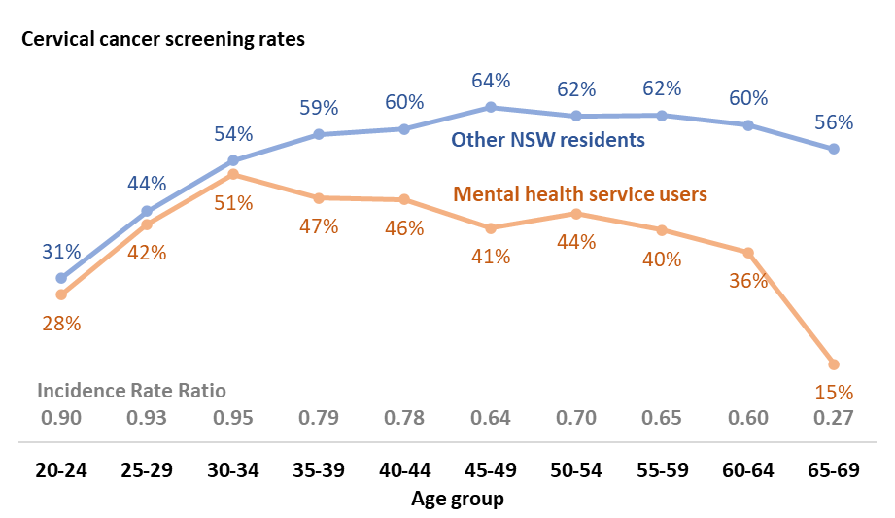
The screening gap is largest for older women

Slide 12
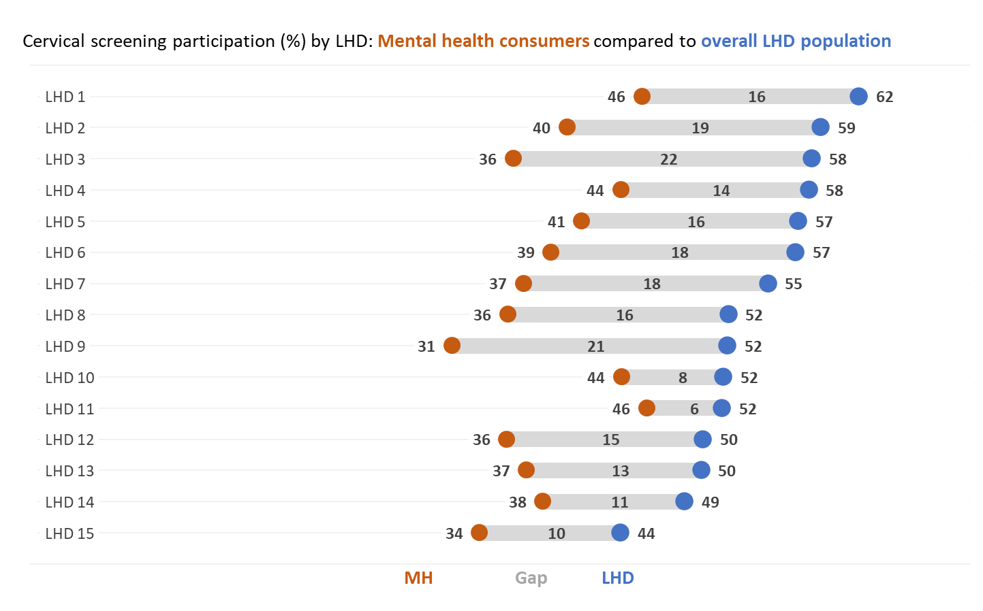
Screening rates vary between health districts
Gap for MH service users largest where population rates are highest
Higher rates in eastern Sydney and coastal NSW
Lower rates in western Sydney and inland NSW

Slide 13

How can health systems support better screening participation?
Work in partnership
Service users, MH services, cancer services, primary care
Understand barriers
Develop and share information
Accessible information for consumers, providers
Data to prompt services and support change efforts
Develop suitable approaches
Integrated physical health / mental health
Culturally safe and trauma-aware approaches
Role of new self-screening method ?

Slide 14
Limitations and next steps
Current NSW data only to 2017 (Pap Test)
Awaiting updated data to 2022
Planning more analysis to understand age-related and subgroup differences
Have gaps changed over time ?
Impacts of COVID on screening and prevention services
Working with Cancer NSW and LHDs
Include data in regular cancer reporting

Slide 15
Thankyou
Mental Health Living Longer project team and collaborators
Steering Committee (Chair: Sharon Smith)
Aboriginal Sovereign Steering Committee (Co-chairs: Ashley Brown, Pauline Ferkula)
Academic Advisory Group and collaborating researchers: Matthew Large, Jackie Curtis (UNSW), Faye McMillan (UTS), Tracey O’Brien, Richard Walton, David Currow (Cancer Institute NSW), Angela Webster, Nicole de la Mata, Nick Glozier (USyd), Philip Burgess (UQ), Parashar Ramanuj (National Orthopaedic Hospital, London), Niels Mulder (Erasmus, Netherlands)
InforMH: Jenn Humphrey, Wendy Chen, Fred Wu, Patrick Gould
Grant.Sara@health.nsw.gov.au

