Slide 1













Thank you to our Sponsors
#EquallyWellAu22
Notes:
Add your name and introduce yourself
Also let people know about following us on social media – all handles on last slide

Slide 2

Dietitians in Mental Health, what does the evidence say?
Presented by: Dr Scott Teasdale
On behalf of the Mental Health Working Group
Professor Tracy Burrows, Janice Plain, Deanne Harris, A/Prof Adrienne Forsyth, Georgina Latimer. Michelle Roberton, Tetyana Rocks, Megan Whatnall, Julia Schindlmayr
Acknowledgement: Dietitians Australia
Contact: tracy.burrows@newcastle.edu.au

Slide 3
Background
Poor diet is one of the leading causes of premature mortality globally
Major contributor to the burden of disease, including non-communicable diseases such as diabetes, cardiovascular diseases and cancers
Poor mental health
Poor Diet

Slide 4

Background
Accredited Practising Dietitians (APDs) are health professionals
APDs are registered by Dietitians Australia (over 8,000 members)
APDs are skilled to provide effective, evidence-based dietary management of mental and/or associated physical illness
Notes:
APDs are registered by Dietitians Australia (over 8,000 members) – not all of them APDs, of course
Dietitians:
Undertake dietary assessment
Identify & prioritise nutritional issues
Create goals & plans
Monitor & manage

Slide 5
Committed to improving the physical health of people living with a mental health condition
Dietitians Australia is a signatory to the Equally Well Consensus Statement.
Having a focus on mental health as one of the association's core policy and advocacy priorities
Establishing an expert advisory group (2020-2021) to make recommendations for advocacy in mental health
Developing an evidence brief to show the importance of nutrition in mental health
Supporting research that stemmed from the expert advisory group's recommendations
Actively pursuing national policy and health system reform impacting on the physical health of people living with mental health condition

Slide 6

Aims
Project 1: Do dietary interventions improve dietary intake, mental health symptomology and/or physical health outcomes in people with mental health conditions?
Project 2: Are dietary interventions delivered to individuals with mental health conditions cost-effective?
Notes:
Each of these was conducted as a separate systematic review and will be presented separately
Reviews synthesise what is out there
Can include individual studies or other reviews that have been undertaken.
Reviews can provide high level evidence and highlight research gaps.

Slide 7
Project 1: Rapid reviews
People with an eating disorder
4 rapid reviews
Included systematic reviews of intervention studies
Mental or physical health outcomes
Standardised screening and data extraction was undertaken by research team
People with a substance use disorder
People with a depressive &/or anxiety disorder
People with a severe mental illness
Notes:
Systematic reviews were undertaken for each aim through searching a range of online databases to identify published research studies.
Categories covered some of the most prevalent mental disorders globally, in the major practice areas in which dietitians are currently involved, and/or dietitian involvement is recommended and DA role statements available
For each review standardised screening and data extraction was undertaken using recognised international methodology.

Slide 8
People experiencing a Severe Mental Illness
Interventions:
Majority (n= 25) were in populations of those living with schizophrenia and related psychoses
Predominantly diet modification only or multi behavioural interventions targeting physical health
Supplementation (predominantly omega-3) focussed on mental health
Effectiveness:
Mixed but generally modest favourable effect on weight, BMI and waist circumference
Mixed results for nutritional supplementation
No effect of probiotics on symptoms of schizophrenia (only 1 study found)

Slide 9
People experiencing a Depressive &/or Anxiety Disorder
Included reviews:
Number of studies included in the reviews ranged from 1 study to 40 studies.
Most reviews focused on individuals with depression and use of supplements
Effectiveness:
Small/modest effect of dietary improvement on symptoms of depression (larger effect in people experiencing a Depressive disorder)
Probiotics and symbiotics had favourable impacts on symptoms of depression and anxiety
Mixed results for omega-3 on depression symptoms of depression
Notes:
Five of the reviews included studies of individuals with depression, while the other four reviews included studies of individuals with depression and/or other disorders including anxiety, bipolar disorder, and post-traumatic stress disorder.
In eight of the reviews the included dietary interventions within studies were supplementation interventions, including six reviews with omega-3 supplementation interventions,^{72-76, 79} one review with pre- and probiotic supplementation interventions,⁷⁷ and one review with any dietary supplementation intervention (with most studies including folic acid, omega-3 or tryptophan supplementation).⁷

Slide 10
People living with an Eating Disorder
Included reviews:
People with any eating disorder
Nutrition education/behaviour change: 1 review (9 studies)
Omega-3 supplementation: 1 review (4 studies)
People with an avoidant/restrictive intake disorder
Multi-behaviour interventions specified: 1 review (11 studies)
Effectiveness:
Mixed and non-significant findings
Favourable findings for avoidant/restrictive intake disorder

Slide 11
People with a Substance Use Disorder
Included reviews:
People with an alcohol use disorder: 2 reviews
Review 1 (1 study) using omega-3
Review 2 (14 studies) using diet only –supplementation/nutrition education
People with a substance use disorder: 1 review (5 studies)
Multi behavioural and diet only
Effectiveness:
Small significant effects
No effect of omega-3

Slide 12
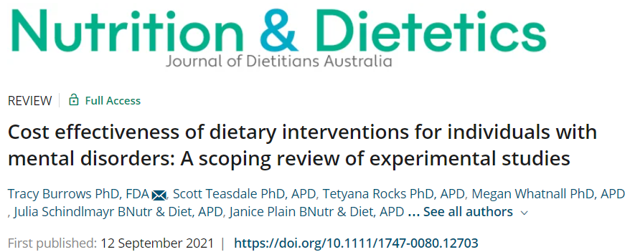
Project 2

Slide 13
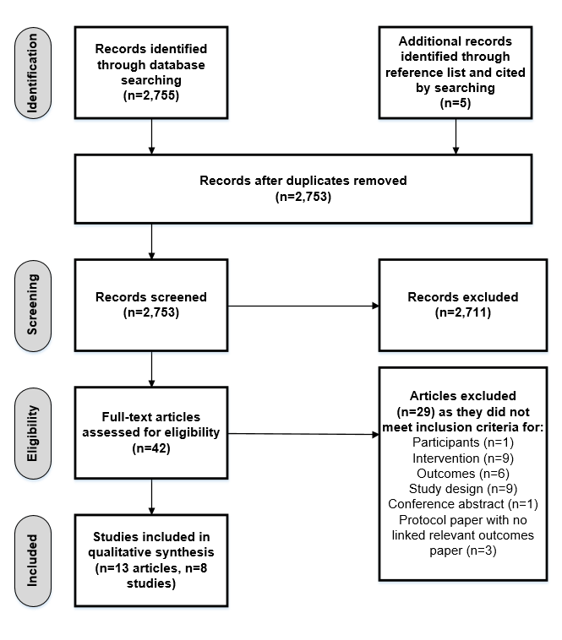
Included studies:
Participants of any age with a mental health condition
Interventions which aimed to improve dietary intake
prescribed diet or supplementation interventions
behaviour change
education
environmental change interventions
Any or no comparator
A cost analysis of the intervention and cost-related outcomes

Slide 14
Results
Outcomes
Targeting physical health: 5 studies
Targeting mental health: 3 studies
Type of Interventions:
Multi-behaviour: 5 studies
(Diet only: 2 studies, ED treatment 1 study)
Cost analyses:
Cost-utility: 3 studies
Cost-effectiveness: 1 study
Cost-utility and cost-effectiveness: 3 studies
Costing study: 1 study
Four studies (50%) reported a mix of positive and neutral results
Two studies (25%) reported positive results in favour of cost effectiveness

Slide 15
Limitations
Both reviews are SCOPING where the aim is broad to synthesise and map research rather than individual specific details of studies
Does not cover all mental health conditions
Discussion
Can be effective for improving aspects of physical health
Can be effective for adjunctive support for symptoms of depression
Preliminary evidence to support the cost effectiveness of dietary interventions in the treatment of individuals with a mental health condition.
Future studies should build assessment of cost-effectiveness into the study design from the outset.

Slide 16
Discussion:
Dietitians Australia:
Defined role statement for working with people with mental health conditions & eating disorders
Position paper for mental health
Continuing professional development
Suite of resources
Conference workshops/webinar series
Find an APD
https://member.dietitiansaustralia.org.au/faapd
Dietitians Role Statements:
Eating Disorders
https://dietitiansaustralia.org.au/working-dietetics/standards-and-scope/role-statements/eating-disorders-role-statement
Mental Health
https://dietitiansaustralia.org.au/working-dietetics/standards-and-scope/role-statements/mental-health-role-statement

