Slide 1













Thank you to our Sponsors
#EquallyWellAu22
Notes:
Add your name and introduce yourself
Also let people know about following us on social media – all handles on last slide

Slide 2



Lifestyle Medicine in Mental Health
Dr Sam Manger MBBS BSc FRACGP FASLM
GP, Senior Lecturer in General Practice and Lifestyle Medicine, JCU
President Australasian Society of Lifestyle Medicine, Podcast The GP Show
Notes:
All images copyright free – Pexels/unsplash
Thank you – organisers and acknowledge of country
2 parts = L a M, and L in M

Slide 3

Acknowledgement of Country
We respectfully acknowledge the Traditional Custodians of the Country on which this event is taking place, and all indigenous Elders past, present and emerging

Slide 4
Declarations
No financial COI
Not being paid or incentivized in this talk (Equally Well paid for accommodation – thank you)
Pro-bono President of ASLM

Slide 5
Thank you

Slide 6
Pillars of Lifestyle Medicine
Mind-Body practices (e.g. meditation, breath work)
Nutrition and Diet
Physical Activity and Movement
Sleep Quality and Quantity
Reducing harmful substances
Connection = Social and Nature
Drivers of Lifestyle Medicine
Behaviour Change Approaches e.g. health coaching, behavioural science
Models of Care e.g. group, peer, coaches, links, digital, proactive
Technology
Research
Personalised and/or Culturally adapted
:
Notes:
Slide
Lots I cannot cover due to time and I didn’t include as covered in other talks I suspect

Slide 7
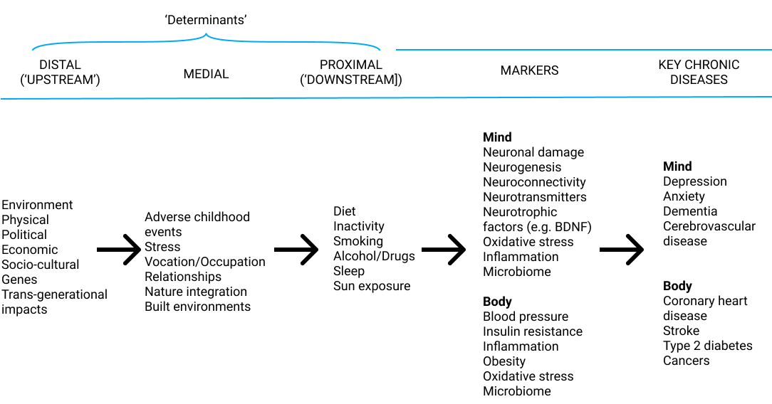
Lifestyle Medicine Model of Disease
Demand and drive change from here (or go direct = politics, lobby etc)
Effect positive and healing
change here
Dr Sam Manger 2019, Adapted from Egger, G., Binns, A., Rossner, S., & Sagner, M. (Eds.). (2017). Lifestyle medicine: Lifestyle, the environment and preventive medicine in health and disease. Academic Press.
Notes:
Cauase of markers = LM
SM = obesity class analogy – saturated in sugar and every turn in our society is truly awful
3. Heritability of your age at death is only ~25%, ~50% of the aging of your brain due to your genes, rest environmental factors,
The more we learn about epigenetics the more these numbers shift

Slide 8
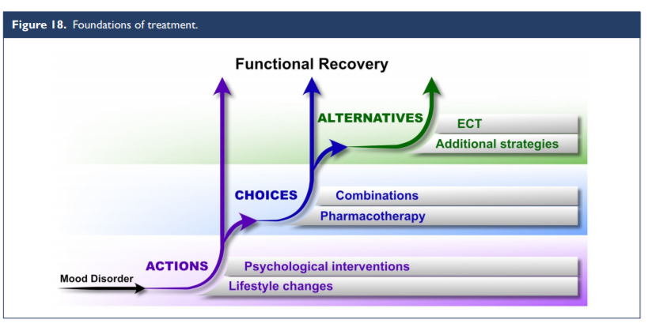
“lifestyle changes and psychological interventions are foundational in the treatment of mood disorders. These are both recommended Actions – essentially non-negotiable and to be discussed with all patients”
Malhi GS, Bell E, Bassett D, et al. The 2020 Royal Australian and New Zealand College of Psychiatrists clinical practice guidelines for mood disorders. Australian & New Zealand Journal of Psychiatry. 2021;55(1):7-117. doi:10.1177/0004867420979353

Slide 9
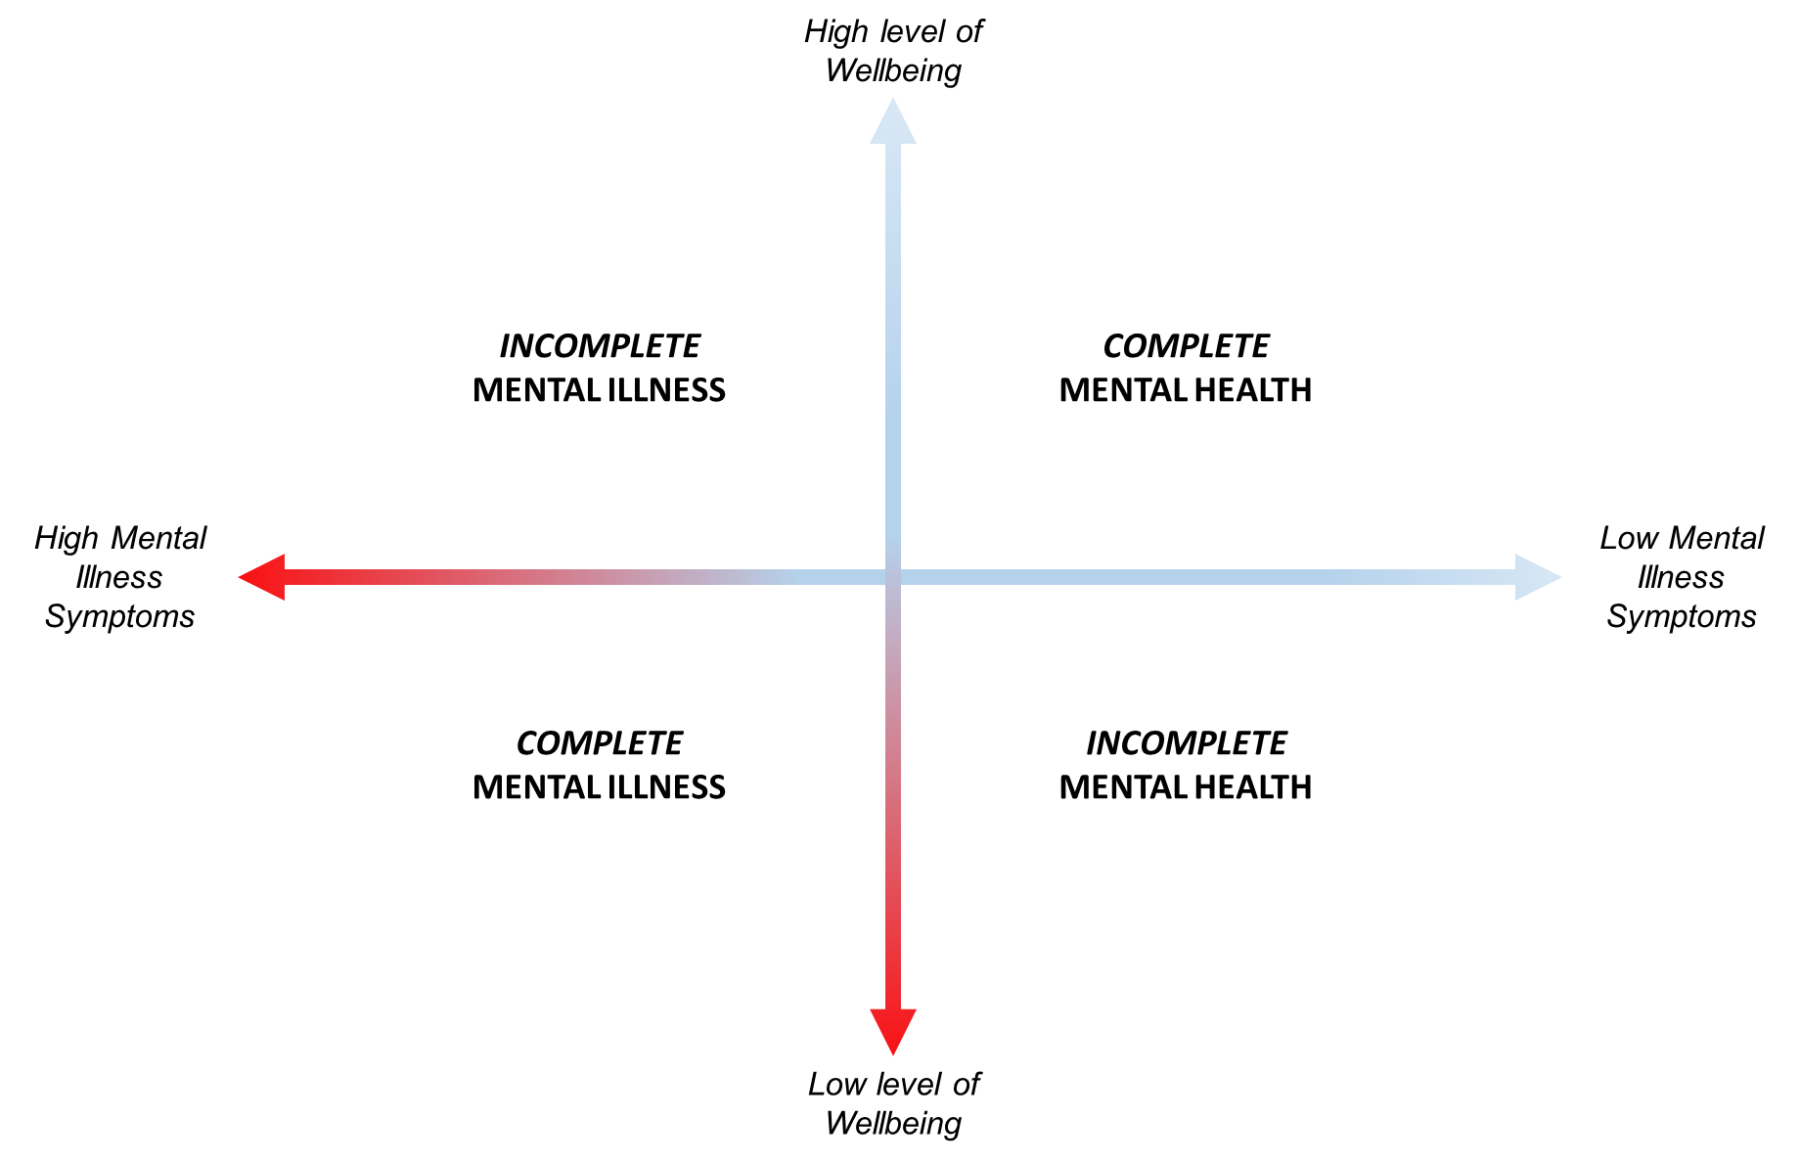
The Dual Continua Model of Mental Health
(Keyes 2005)

Slide 10
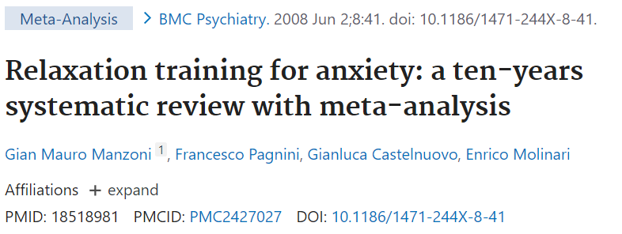
“Relaxation response” practice effect size
Relaxation training showed a medium-large effect size in the treatment of anxiety. Cohen's d was .57
Efficacy was higher for meditation, among volunteers and for longer treatments

Slide 11
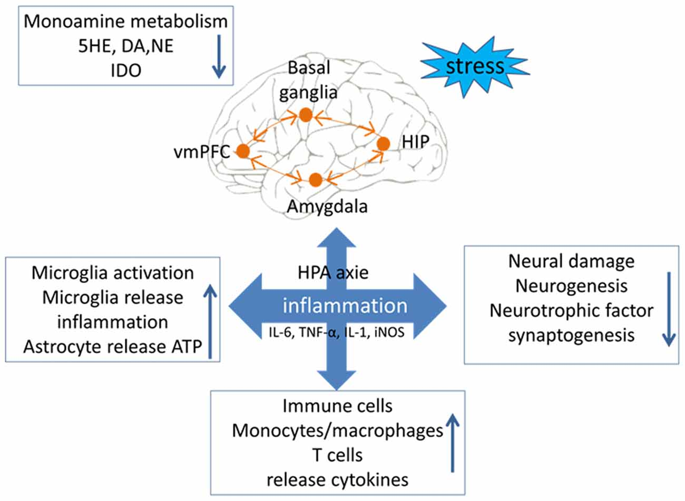
Dysfunctional Stress – Neurological system
Varying impacts:
Cognition, learning and memory
Fatigue
Pain sensitivity / central sensitisation
Stress tolerance
Mood changes
In the hippocampus, stress and glucocorticoids cause dendritic shrinkage and loss of spines
“Neuroinflammation”
Calcia MA, Bonsall DR, Bloomfield PS, Selvaraj S, Barichello T, Howes OD. Stress and neuroinflammation: a systematic review of the effects of stress on microglia and the implications for mental illness. Psychopharmacology (Berl). 2016
Yaribeygi H, Panahi Y, Sahraei H, Johnston TP, Sahebkar A. The impact of stress on body function: A review. EXCLI J. 2017
Munk A, Reme SE, Jacobsen HB. What Does CATS Have to Do With Cancer? The Cognitive Activation Theory of Stress (CATS) Forms the SURGE Model of Chronic Post-surgical Pain in Women With Breast Cancer. Front Psychol. 2021
Zhang L, Zhang J, You Z. Switching of the Microglial Activation Phenotype Is a Possible Treatment for Depression Disorder. Front Cell Neurosci. 2018
Notes:
https://pubmed.ncbi.nlm.nih.gov/30459555/
stress could lead to disorderly release of neurotransmitters, and then cause an imbalance in the level of neuroinflammatory factors; (2) stress could lead to abnormal intestinal flora and increase the levels of inflammatory factors from the peripheral nervous system and the central nervous system (CNS); (3) stress could lead to excessive activation of microglial cells, causing them to release toxic substances to disrupt the balance of inflammation and anti-inflammation; and (4) stress could lead the immune macrophage to release inflammatory cytokines, which indirectly cause neurological circuit disorders.
Stress and Sensitization
A line of experimental studies have demonstrated the link between a sustained stress response and the process of sensitization, which is suggested as a psychobiological mechanism in the transition from acute to chronic pain (Ursin, 2014). On the cellular level, sensitization is defined as an increased efficiency in a neural circuit, due to a change in synapses from repeated use (Collingridge et al., 2004). Sensitization of pain pathways in the central nervous system is widely accepted as a theory of neural mechanisms enhancing pain transmission (Ikeda et al., 2009). This central sensitization progressively amplifies the responses to pain stimuli. It manifests as pain hypersensitivity both as a reduction in pain threshold and an increase in pain responsiveness as well prolonged after sensations and an expansion of the receptive field (Woolf, 2011).
A large body of evidence showing central sensitization in chronic pain syndromes originates from research on patients with fibromyalgia, a condition with widespread pain in the body. Research has demonstrated widespread reductions in pain thresholds as well as an increased temporal summation and a spatial area of pain in this patient group (Gibson et al., 1994; Lorenz et al., 1996; Graven-Nielsen et al., 2000).

Slide 12
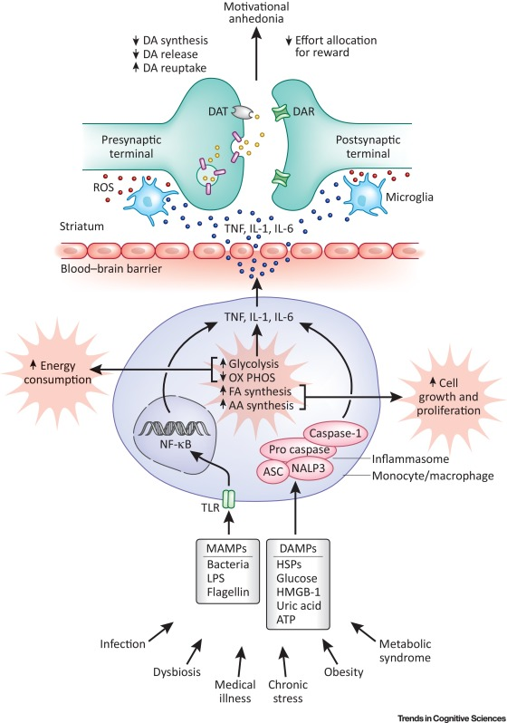
Stress (BPS)
Chronic low-grade inflammation
Reduction of dopamine (DA)
Reduced willingness to expend effort for reward
“I can’t”
Treadway MT, Cooper JA, Miller AH. Can't or Won't? Immunometabolic Constraints on Dopaminergic Drive. Trends Cogn Sci. 2019

Slide 13
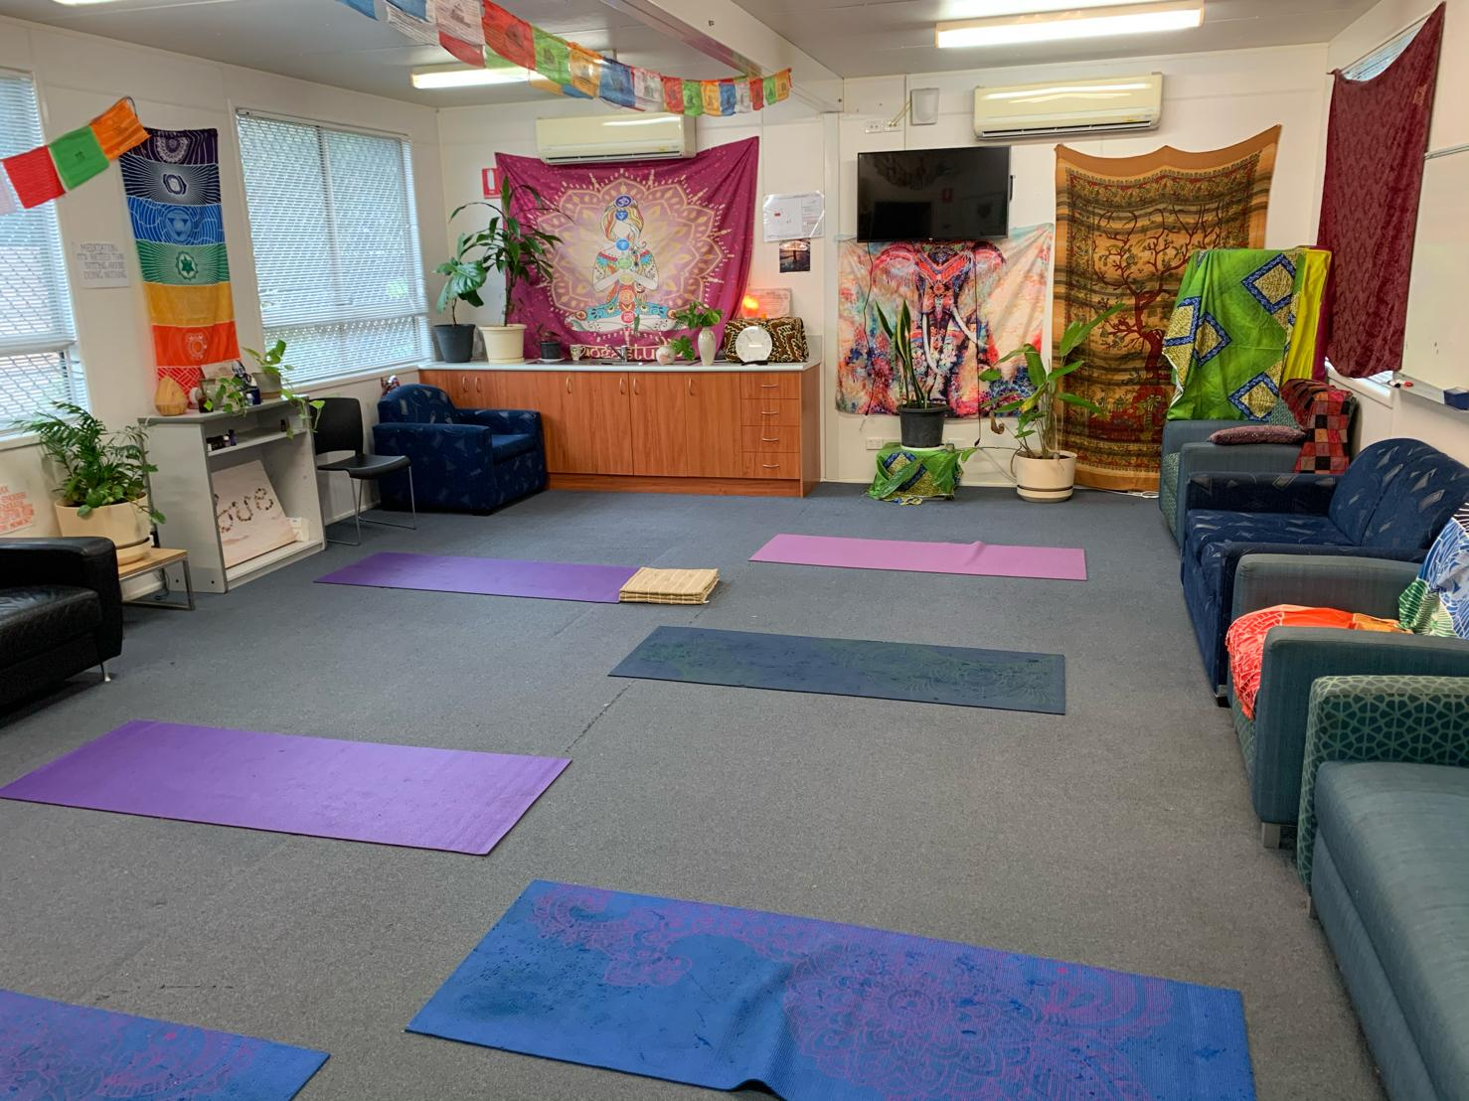
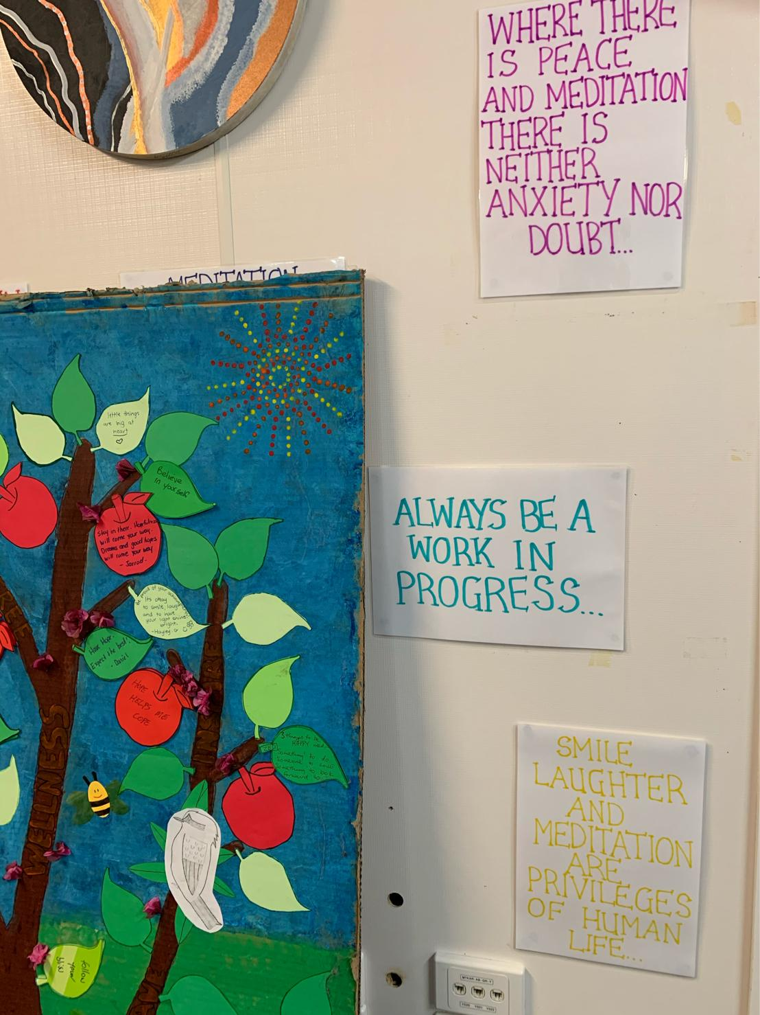
Create space, time, culture

Slide 14
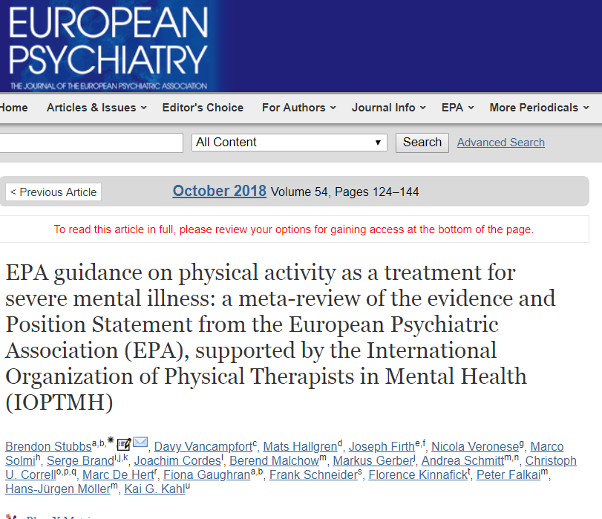
Movement and mood
For Major Depression Disorder; movement can improve depressive symptoms, with effects comparable to those of antidepressants and psychotherapy.
Improve quality of life
For schizophrenia-spectrum disorders; evidence indicates that aerobic PA can reduce psychiatric symptoms and improves cognition

Slide 15
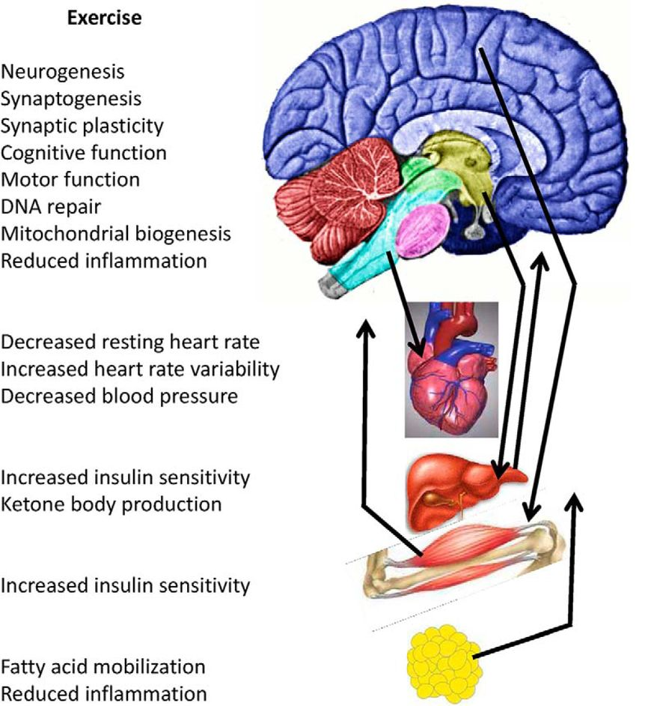
Movement and health
Exercise exert complex integrated adaptive responses:
Systemic repair mechanisms
Endorphin release
Endocannabinoid system
Neurotransmitters production
Brain Derived Neurotrophic Factor
Lower SNS + HPA axis reactivity
Lower visceral fat mass
van Praag H, Fleshner M, Schwartz MW, Mattson MP. Exercise, energy intake, glucose homeostasis, and the brain. J Neurosci. 2014;34(46):15139-15149. doi:10.1523/JNEUROSCI.2814-14.2014

Slide 16
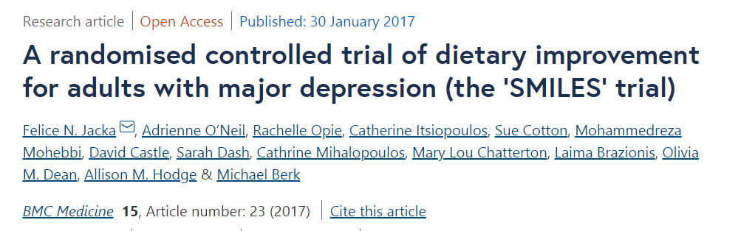
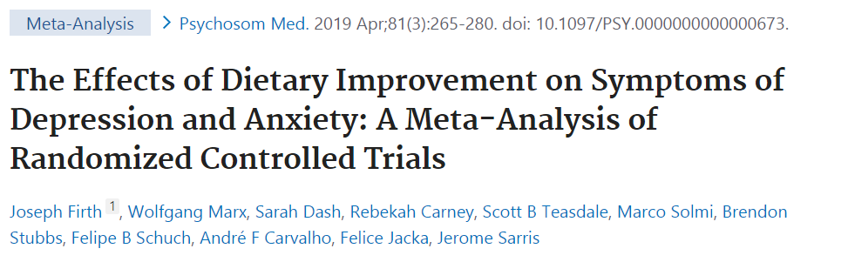
Food and Mood
32% of patients with moderate-to-severe major depression disorder remit with Mod-Mediterranean diet (vs 8% of control)
>45,000 participants; the results showed that dietary interventions significantly reduced depression and anxiety symptoms, particularly in women
Jacka FN, et al. BMC Med 2017 Dec; 15(1):1-3
Firth J, et al. Psychosom Med 2019 Apr; 81(3):265
Notes:
Benefits multiple areas, MH

Slide 17
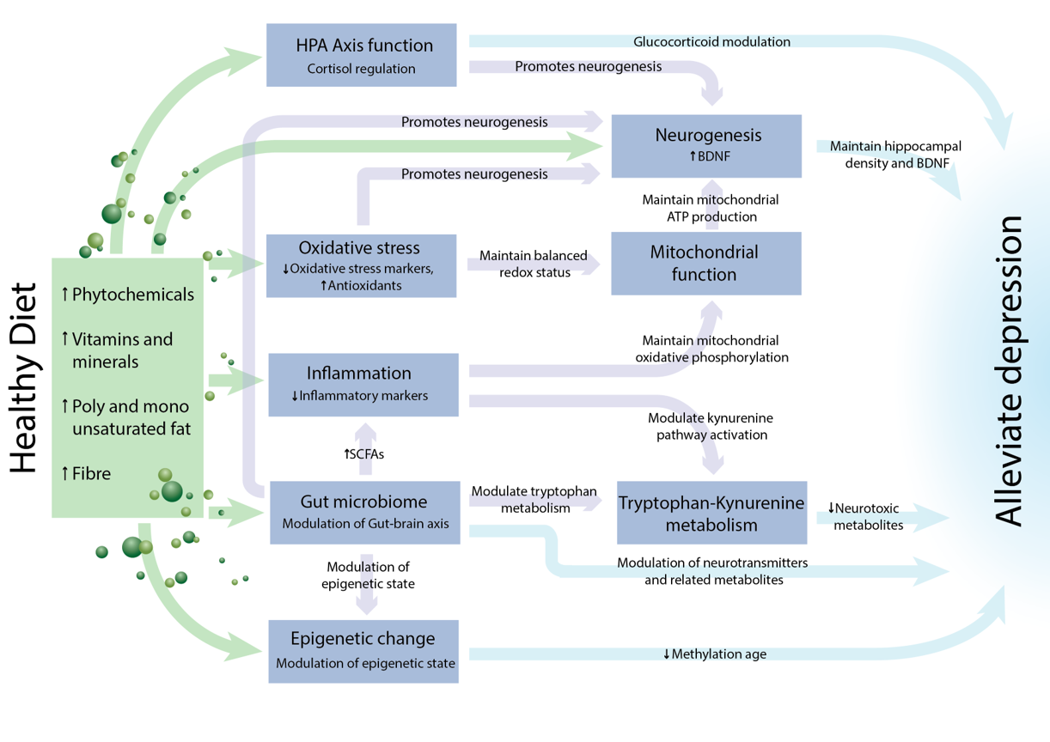
Marx W, Lane M, Hockey M, Aslam H, Berk M, Walder K, Borsini A, Firth J, Pariante CM, Berding K, Cryan JF, Clarke G, Craig JM, Su KP, Mischoulon D, Gomez-Pinilla F, Foster JA, Cani PD, Thuret S, Staudacher HM, Sánchez-Villegas A, Arshad H, Akbaraly T, O'Neil A, Segasby T, Jacka FN. Diet and depression: exploring the biological mechanisms of action. Mol Psychiatry. 2021

Slide 18
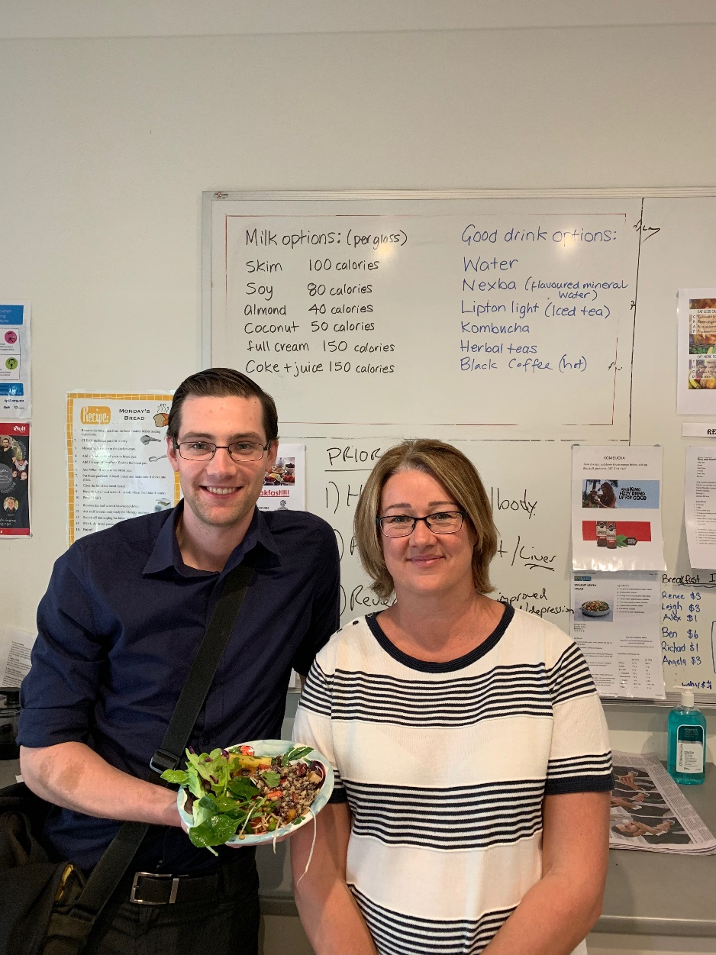

Dr Linda Barron, Consultant Psychiatrist, CCU, Mountain Creek, Sunshine Coast, QLD Health

Slide 19
Sleep in mental illness
Prevalence of sleep disorders in patients with a psychiatric illness is 40%, with obstructive sleep apnoea, insomnia and restless leg syndrome being the most common
Severity of sleep disorder associated withhigher levels of symptom severity
A risk factor for new-onset and recurrent depression in children, adolescents and adults, affecting severity, duration and relapse rates
Manger S. Lifestyle interventions for mental health. Aust J Gen Pract. 2019 Oct;48(10):670-673. doi: 10.31128/AJGP-06-19-4964. PMID: 31569326.
Notes:
Image from: https://www.health.harvard.edu/blog/strategies-to-promote-better-sleep-in-these-uncertain-times-2020032719333
Hombali A, Seow E, Yuan Q, et al. Prevalence and correlates of sleep disorder symptoms in psychiatric disorders. Psychiatry Res 2018;pii: S0165-1781(18)30268–23. doi: 10.1016/j.psychres.2018.07.009.
Franzen PL, Buysse DJ. Sleep disturbances and depression: Risk relationships for subsequent depression and therapeutic implications. Dialogues Clin Neurosci 2008;10(4):473–81.
Kaskie RE, Graziano B, Ferrarelli F. Schizophrenia and sleep disorders: Links, risks, and management challenges. Nat Sci Sleep 2017;9:227–39. doi: 10.2147/NSS.S121076.

Slide 20
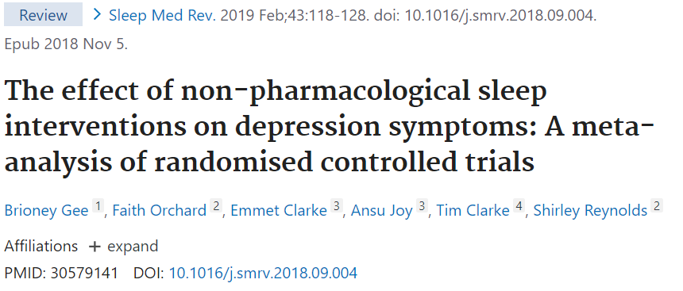
“In studies of participants with mental health problems, sleep interventions had a large effect on depression symptoms ([cohen’s] d = -0.81, 95% CI: -1.13,-0.49)”

Slide 21
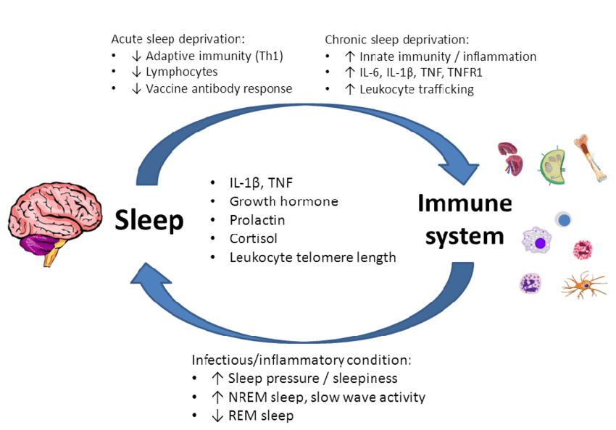
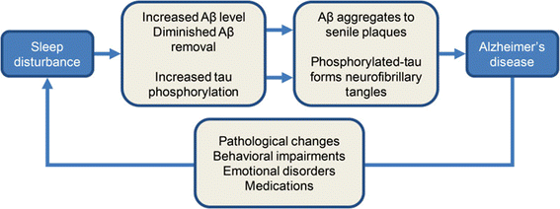
Sleep-Health impacts are bidirectional
Zhang F, Zhong R, Li S, Chang RC, Le W. The missing link between sleep disorders and age-related dementia: recent evidence and plausible mechanisms. J Neural Transm (Vienna). 2017
In book: Synopsis of Sleep Medicine pp.45-64, Chapter 3 Neuroimmune Aspects of Sleep and Wakefulness, August 2016 DOI:10.1201/9781315366340-4

Slide 22

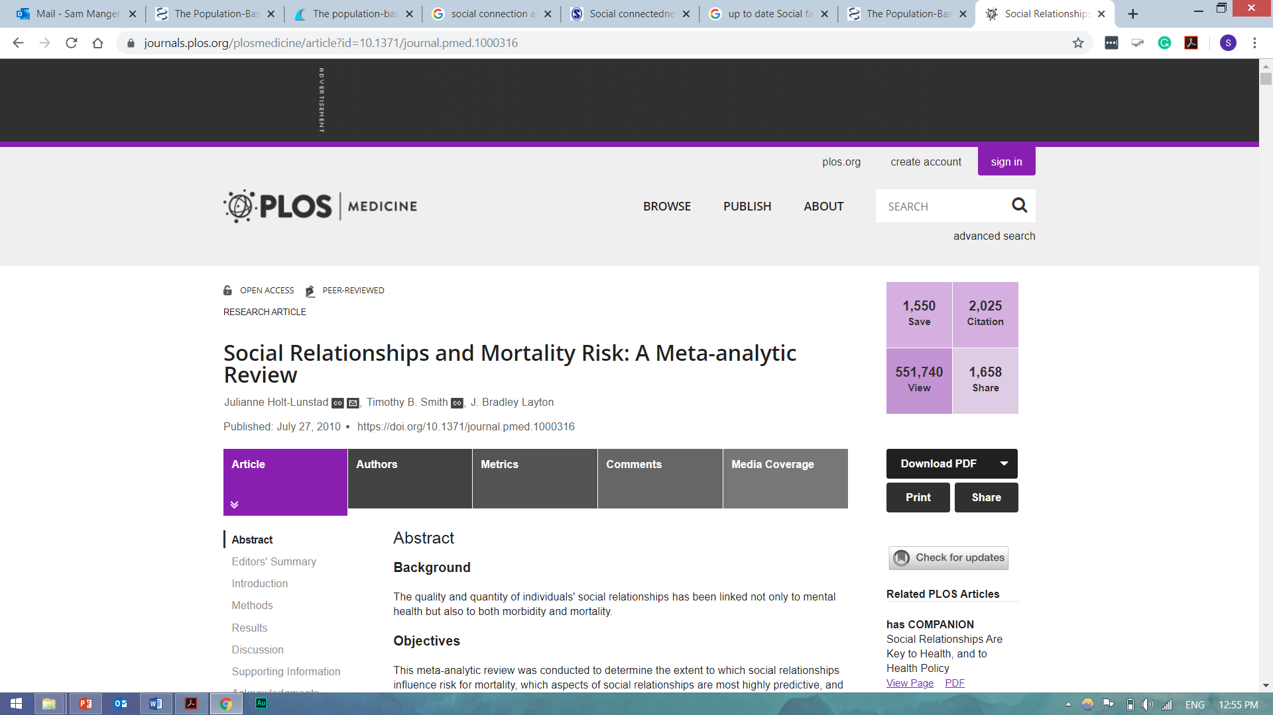
Image source: Pexels, August de Richelieu
A 2010 meta-analysis of 140 studies, ~300,000 participants indicated:
50% increased likelihood of survival for participants with stronger social relationships
Similar negative impact on life expectancy as smoking 15 cigarettes/day
Notes:
https://systematicreviewsjournal.biomedcentral.com/articles/10.1186/s13643-019-0968-x
2010 meta, 300k, 50% inc
SI and MDD connection - but is it MDD leads to social isolation or Si that leads to MDD? 2017 NZ study – both true but SI predicted MDD more strongly
Heartmath eg - EXPERIMENT
MOA – same MOAs, around ppl you love = NTs, connecitivity but inflammation
one-third of Australian adults are not involved in any social or community groups.
2010 meta-analysis of 300,000 participants indicated a 50% increased likelihood of survival for participants with stronger social relationships - This finding remained consistent across age, sex, initial health status, cause of death, and follow-up period.
https://journals.plos.org/plosmedicine/article?id=10.1371/journal.pmed.1000316
If you are isolated – you are at higher risk of every disease and illness there is.
Specifically for MH =
People with limited social connectedness have poorer mental and physical health, including increased depression (Cruwys et al., 2014a), and die earlier than those with strong social connectedness (for a meta-analysis, see Holt-Lunstad et al., 2010).
Though some have appropriately sad – which comes first – MH lead to social isolation or SI lead to MH? This 2017 study in NZ adressed exactly this – both are true, and that social connectedness predicted subsequent mental health more strongly than mental health predicted subsequent social connectedness.
MOA: MANY, hormones, neuroconnectivity, but if we look at the immune system for a moment:
Lonely ppl trust others less n immune system is pro inflammation n less immune fighting active, reverse true for sociable ppl - Cole et al in chicago study - > inflammation may have a role in depression https://www.ncbi.nlm.nih.gov/pmc/articles/PMC6135246/
Being socially rejected or social loss stimulates the same region of the brain as physical pain. Which then causes fear and threat -deep primordial origins driving us to reach out to others and connect, we are safer in numbers physically and mentally
How isolated or connected you feel is more important than objective network

Slide 23
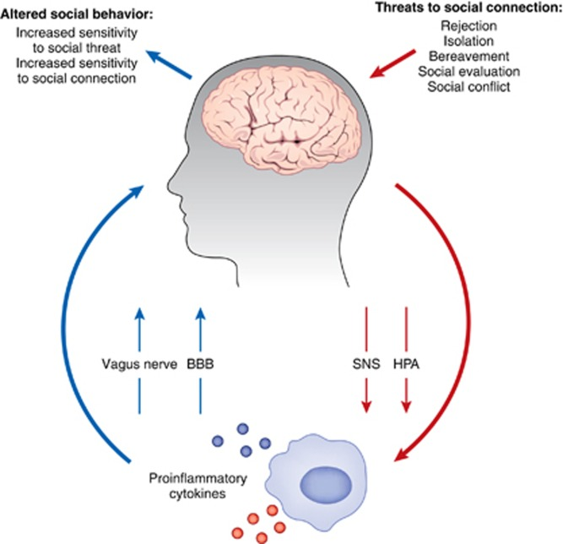
Bidirectional
Inflammation -> isolation
Isolation -> inflammation
Eisenberger NI, Moieni M, Inagaki TK, Muscatell KA, Irwin MR. In Sickness and in Health: The Co-Regulation of Inflammation and Social Behavior. Neuropsychopharmacology. 2017

Slide 24
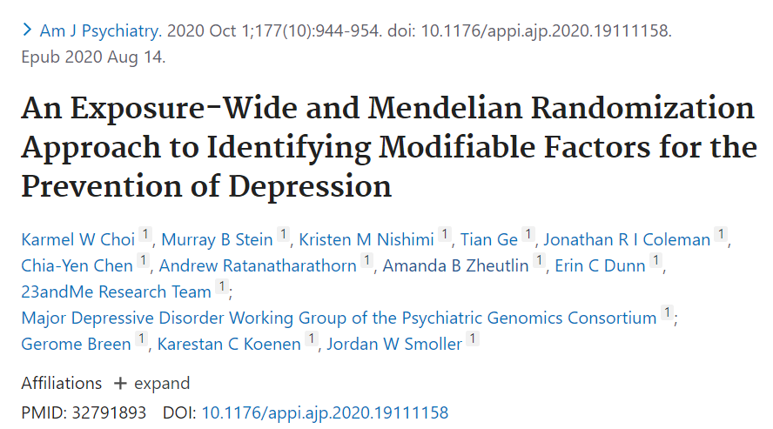
Mental health
“The impact of trusted social connections as causally protective for depression”
“confiding in others showed the strongest phenotypic associations”
= trusted social connection was the strongest protective factor for depression
Notes:
https://www.sciencedaily.com/releases/2020/08/200814131007.htm

Slide 25
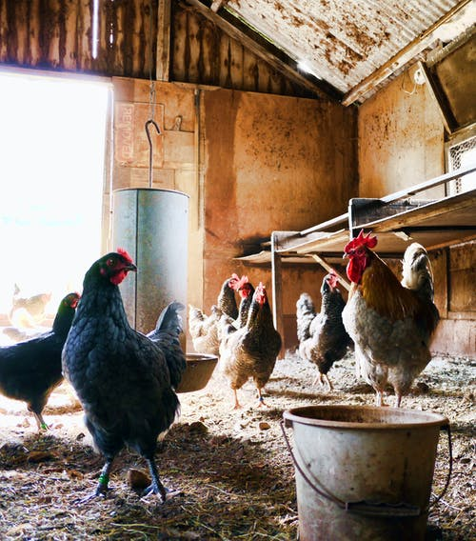
Chicken or egg?
Does depression lead to social isolation or reverse?
Answer = bidirectional, but …
“Social connectedness was found to be a stronger and more consistent predictor of mental health year-on-year than mental health was of social connectedness.”
Image source: pexels
Saeri AK, Cruwys T, Barlow FK, Stronge S, Sibley CG. Social connectedness improves public mental health: Investigating bidirectional relationships in the New Zealand attitudes and values survey. Australian & New Zealand Journal of Psychiatry. 2018

Slide 26
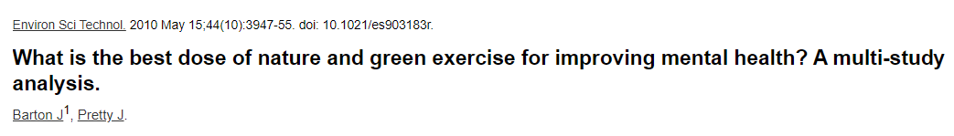
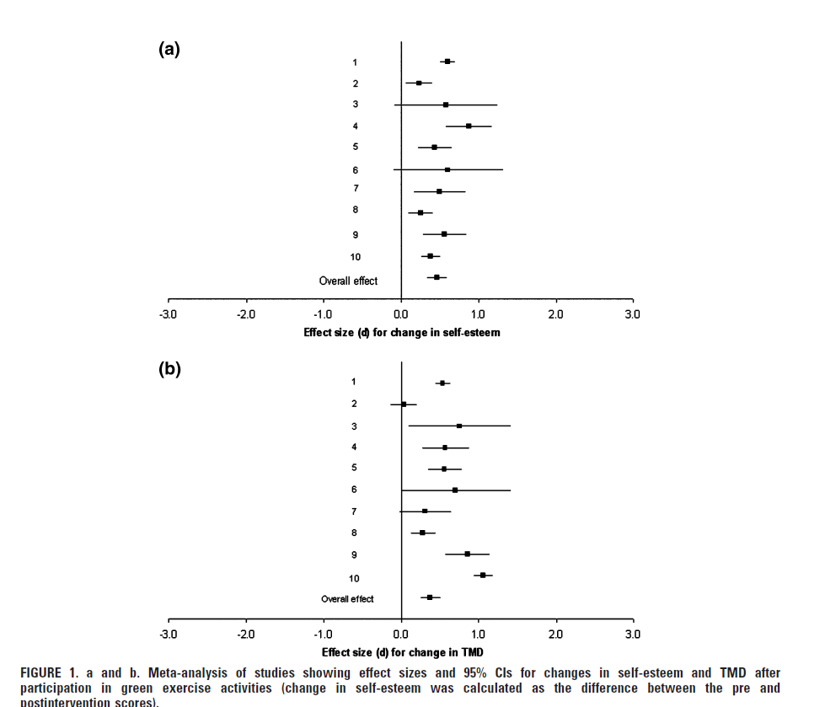
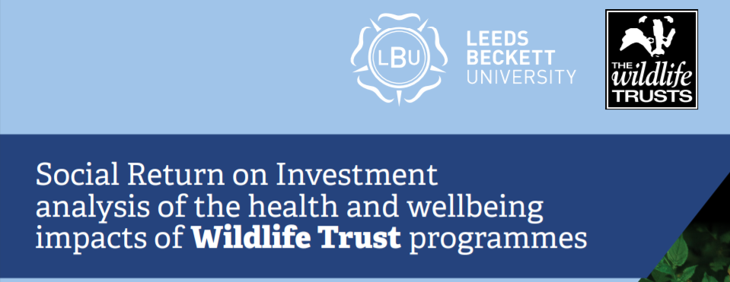
The overall effect size for improved self-esteem was d = 0.46 and for mood d = 0.54
A SROI value of £6.88 for every £1 invested, for people with low wellbeing at baseline, who were part of a targeted programme
Notes:
1. in a study from UK = those low mental well-being improved in six weeks after working in nature for five to six hours each week = 95% improvement (ranging from mild to significant, average moderate), both emotionally and physically
$ benefits = fewer GP visits, return to work, $ 1:8.5 return
Explain forest plot = x,y axis, Cohens 0.2/0.50.8 Small effect = 0.2 Medium Effect = 0.5 Large Effect = 0.8
2. Anti Ds - MA of 522 RCts, 21 antids. Better than placebo, 0.19 – 0.62, two thirds had an effect size <0.34. 60%of people respond (50% sx improvement) by 8 weeks.
3. Nature = TMD – total mood disturbance 0.54
Cohen suggested that d=0.2 be considered a 'small' effect size, 0.5 represents a 'medium' effect size and 0.8 a 'large' effect size.
t is a convention that a Cohen's d of 0.5 or larger is a standard threshold for clinically meaningful benefit
Compared to antidepressants = this huge 2018 study in the lancet =
The authors looked at 522 randomized clinical trials of 21 antidepressants versus placebo in MDD in over 100,000 patients. Overall, all antidepressants were more effective than placebo. reboxetine (odds ratio [OR], 1.36) and the highest efficacy (OR, 2.13) for the tricyclic antidepressant amitriptyline. Looking at all of the agents, 10 drugs have Cohen's d values less than 0.30, which is very small and clinically meaningless, whereas four have effect sizes from 0.30 to 0.34. T
Here we see that the Cohen's d standardized mean difference effect sizes range from a low of 0.19 to a high of 0.62 with amitriptyline. Thus, amitriptyline exceeds the clinically meaningful threshold of 0.50, with a traditional meta-analytic method. No other drug does so, with the closest second place being fluvoxamine, with a Cohen's d value of 0.44.
https://www.medscape.com/viewarticle/897878#vp_2
So to repeat = antiDs do have arole, they can work, and dow ork especially for those with mod-severe D. Uwhat I am saying is simple – if we, te health system are so willing to be

Slide 27
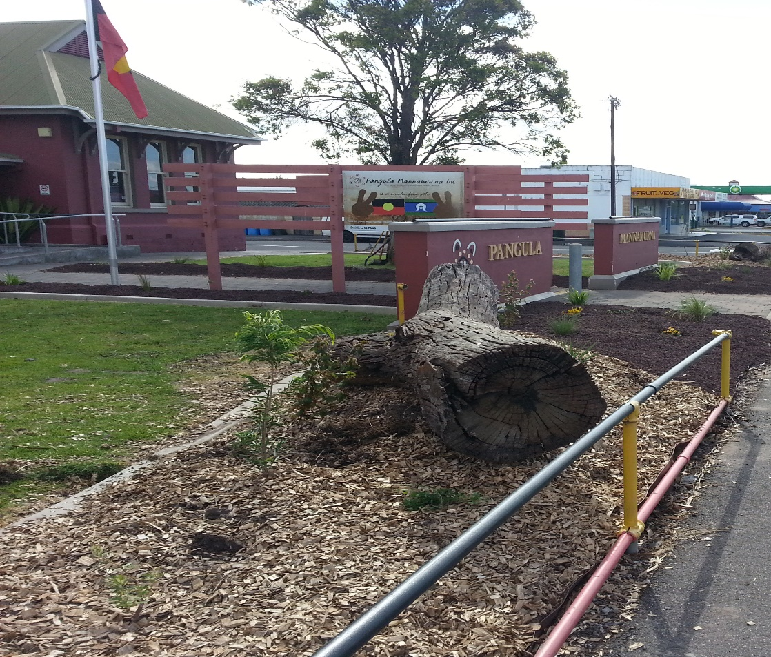
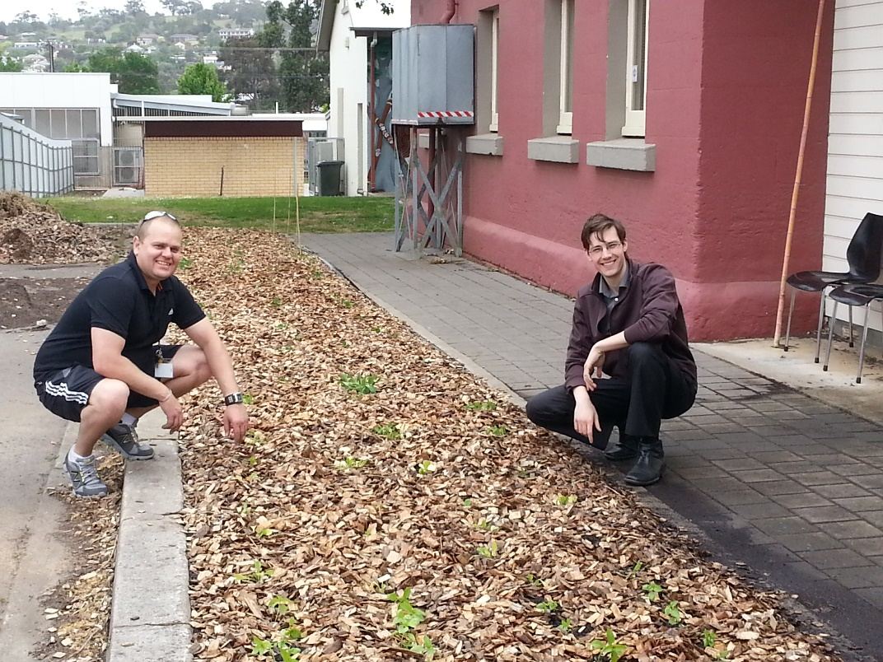
Notes:
TIES in/RECONNECT,
Accept and learn ATSI
All ties in
Faith in doctors and a lot we can learn frm our ATSI
Example slide and other pics gardens, not for self promotion
But to give you hope again, I know people are losing faith in the medical system and doctors, I know that. But I want to help change that picture, so many in the healthcare system care deeply, we are just humans. We want change.
All ties in – reconnecting w land, moving, eating well, reconnecting w each other
This is a way of life and it is not just an answer, it is as far as I can tell – our only solution.
And when it comes to ATSI – we have so much to learn from their culture. It is not they who have to change to be more like us, but us who have to be more like them.. And that facts again support this = Greg Phillips
.

Slide 28

Smoking and mental illness
2014 Systematic review = people who give up smoking have a reduction in depressive and anxiety symptom severity and an improvement in mental health and quality of life
→ with the effect being equal to antidepressant therapy
On top of everything else…
Risk factor for suicide
Cytochrome P450 metabolism of certain medications
Image source: pexels
Taylor G, McNeill A, Girling A, Farley A, Lindson-Hawley N, Aveyard P. Change in mental health after smoking cessation: Systematic review and meta-analysis. BMJ 2014;348:g1151. doi: 10.1136/bmj.g1151
Notes:
Image: unsplash, Dylan Fout
References:
Mendelsohn CP, Kirby DP, Castle DJ. Smoking and mental illness. An update for psychiatrists. Australas Psychiatry 2015;23(1):37–43. doi: 10.1177/1039856214562076
Prochaska JJ, Das S, Young-Wolff KC. Smoking, mental illness, and public health. Annu Rev Public Health 2017;38:165–85. doi: 10.1146/annurev-publhealth-031816-044618
Tsuda Y, Saruwatari J, Yasui-Furukori N. Meta-analysis: The effects of smoking on the disposition of two commonly used antipsychotic agents, olanzapine and clozapine. BMJ Open 2014;4(3):e004216. doi: 10.1136/bmjopen-2013-004216.
Taylor G, McNeill A, Girling A, Farley A, Lindson-Hawley N, Aveyard P. Change in mental health after smoking cessation: Systematic review and meta-analysis. BMJ 2014;348:g1151. doi: 10.1136/bmj.g1151

Slide 29
Consider the physical health benefits!
In people with Severe Mental Illness
Reduction in life expectancy of around 15-20 years – mostly due to CVD/DM/COPD
→ 2-to-3 times more likely to have cardiovascular disease, respiratory illness, metabolic syndrome, diabetes and osteoporosis
67% of those with BPAD and schizoaffective d/o have metabolic syndrome (vs 16% general population)
John, A.P., Koloth, R., Dragovic, M. and Lim, S.C.B. (2009), Prevalence of metabolic syndrome among Australians with severe mental illness. Medical Journal of Australia, 190: 176-179. https://doi.org/10.5694/j.1326-5377.2009.tb02342.x
Lawrence D, Hancock K, Kisely S. The gap in life expectancy from preventable physical illness in psychiatric patients in Western Australia: Retrospective analysis of population based registers. BMJ 2013;346:f2539. doi: 10.1136/bmj.f2539

Slide 30
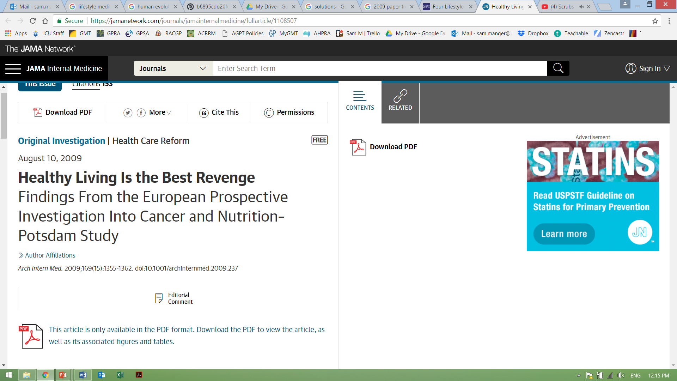
4 lifestyle choices = ~80% reduced risk of major chronic illness including:
a 93% lower risk of diabetes
81% lower risk of heart disease
Over 35% of cancer
Not smoking
BMI <30
3.5 hours physical activity/ week = 30 mins/day
Healthy diet

Slide 31
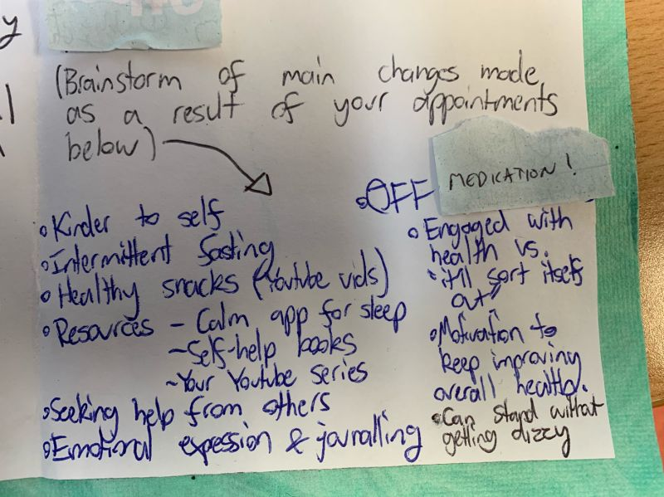
All this adds up
Effective
Acceptable (and desired)
Safe
Identifiable mechanisms of action

Slide 32

How do we connect the patient to these?
The model of care
Image source: pexels

Slide 33
Whether its primary, tertiary, public → it is hard!
>63% of mental health encounters end with a script for psychotropic medication
>80% of those with mental illness want LM vs 19% medication
4% of GP consults include detailed diet/PA advice, 0.91/1000 include exercise physiologist referral
Can it be done?
  Average GP consult includes managing 2.5 problems, (2 mins per additional problem) with 40% having >3 problems
  >41% of GPs are burntout or have a mental health condition
  Frequently cited barriers = time/funding/support/training/skills/knowledge
Australian Institute of Health and Welfare. Mental health services in Australia. Bruce, ACT: AIHW, 2020.Britt et al, General practice activity in Australia 2015–16, Bettering the Evaluation and Care of Health (BEACH)
Stuart B, Leydon G, Woods C, Gennery E, Elsey C, Summers R, Stevenson F, Chew-Graham C, Barnes R, Drew P, Moore M, Little P. The elicitation and management of multiple health concerns in GP consultations. Patient Educ Couns. 2019
Notes:
Current MOC is old, out of date, doesn’t match the current need.
Its reactive, silo’d, incomplete

Slide 34
Pockets of innovation, not scaled or supported
“Australia’s messy suite of payments [and many parts of the system] are largely accomplices of illness rather than wellness, only countered by the ingenuity and ethical beliefs of providers to swim against the current”
- Productivity Commission 2017
Yay us!

Slide 35
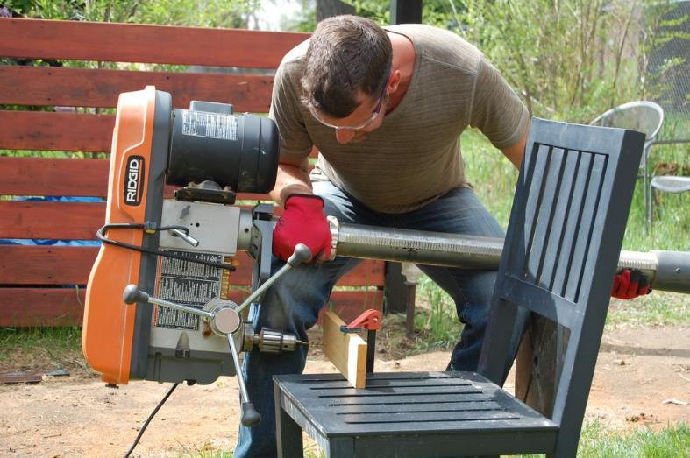
Image source: pexels

Slide 36
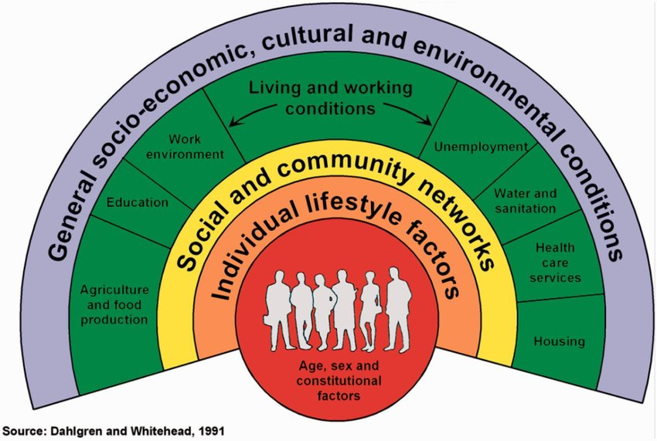
Options for implementation at each level
Socio-Environmental
Modification
Clinical and community models
of care
Individual/group
health coaching/
behaviour change
Dahlgren G, Whitehead M, 1991.

Slide 37
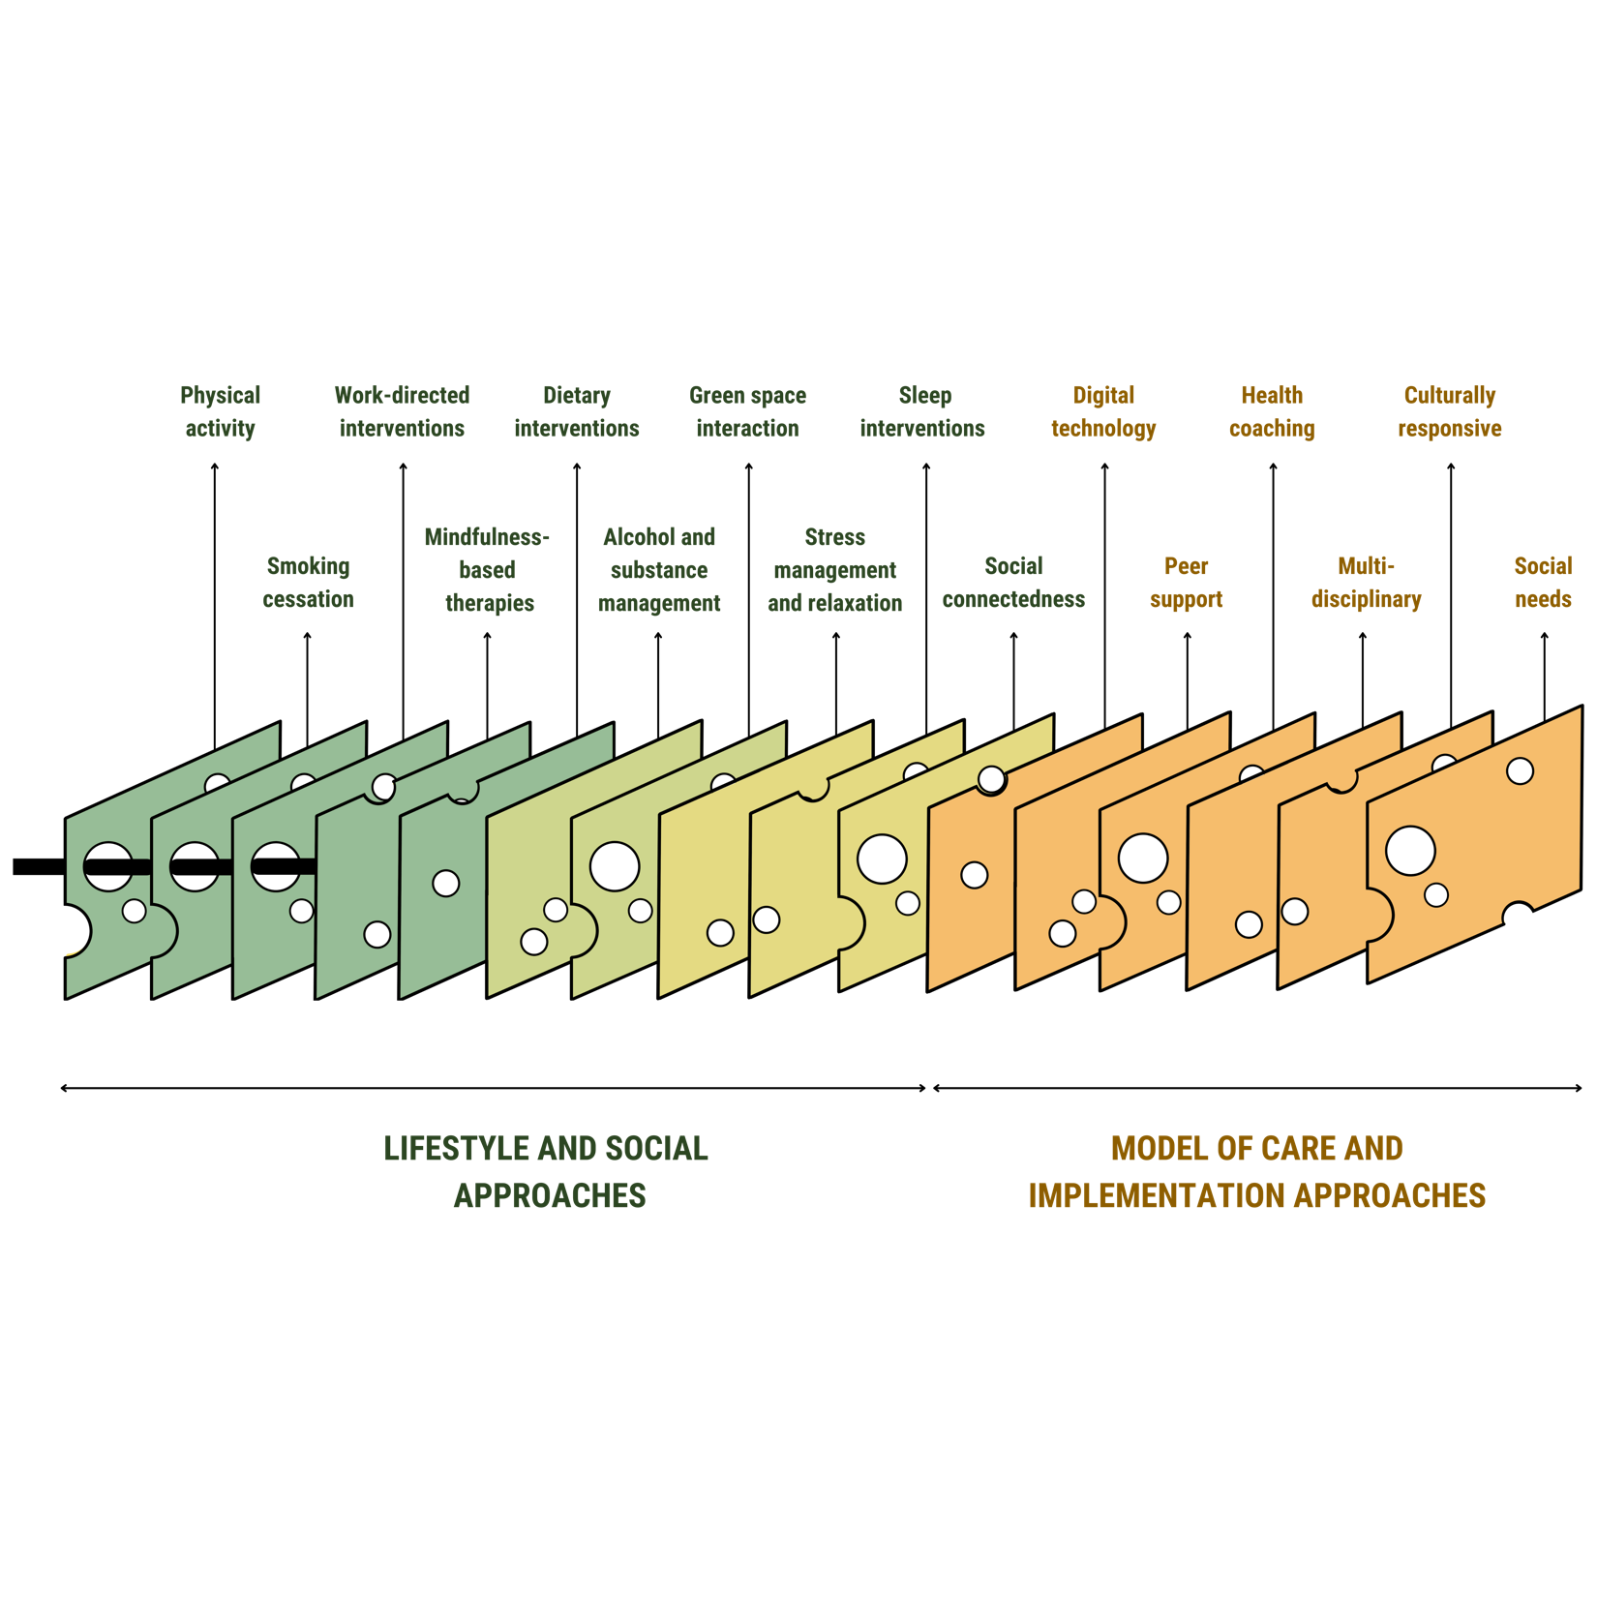
Many layers of LM that can make it effective
Marx W, Manger S, O’Neill A, et al, Clinical Guidelines for the Use of Lifestyle-based Mental Health Care in Major Depressive Disorder: The World Federation of Societies for Biological Psychiatry (WFSBP) and Australasian Society of Lifestyle Medicine (ASLM) Taskforce, 2022 (pre-print, not to be shared)

Slide 38
And more…
Health support and Peer led services e.g. PSWs, health coaching, link workers, community wellbeing officers, digital assistants
Group and shared medical appointments
Stepped Care/Staged Care/Segmented Care models
Integrated care
Proactive health initiatives e.g. school, work, civic community
Digital technology
Built environments

Slide 39

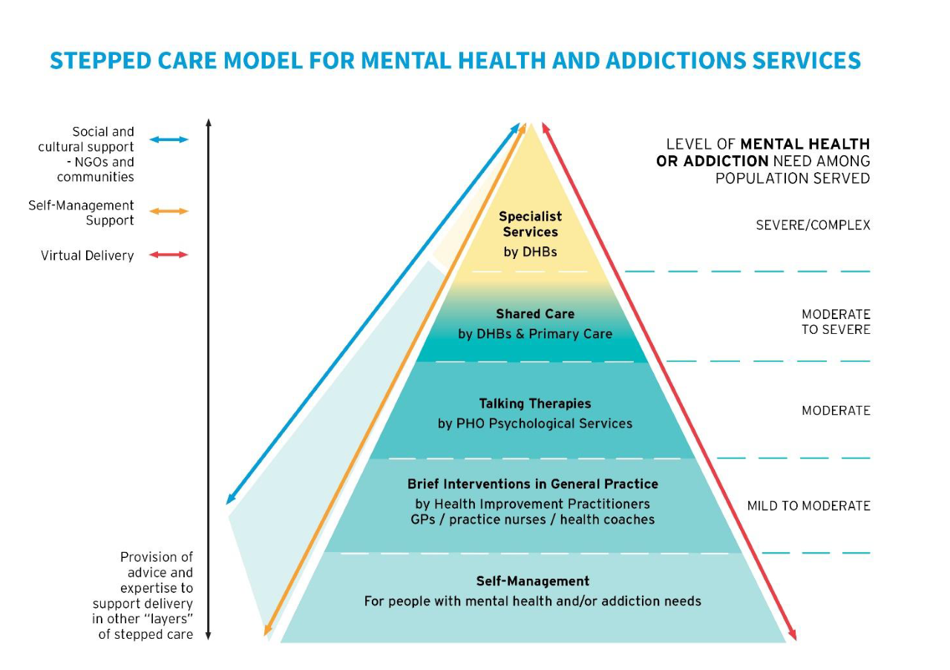
2017 cited as “paradigm shift” in MH care
40 sites across 11 districts
Health coach, HIP and GP are working in sync
Significant reduction symptom scores (PH/MH) ; greatest improvement in Maori
Increased access; reaching more than 3 times as many people as existing referral-based therapy services. 75% were seen within five days
Reduced prescribing of psychotropic medications
High level satisfaction levels with service for both users and therapist's average score of 9/10

Slide 40
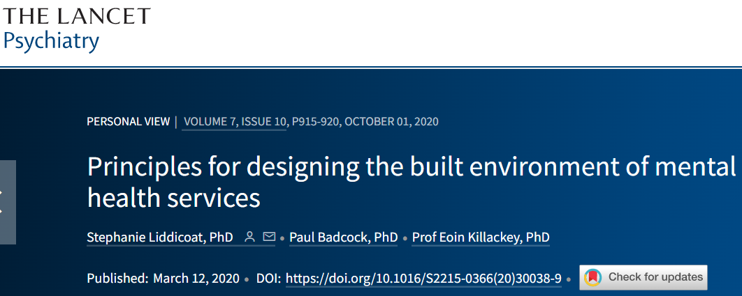
Health service design
“The contribution of the built environment to outcomes for the service user is a largely neglected area…
[Yet] Evaluations of specific design interventions show that good design of the built environment in a clinical service leads to better clinical outcomes and lowers stress for both service users and staff…
given that the built environment represents a modifiable feature…it is surprising how little the design of mental health service facilities has been considered”
Health and design working together

Slide 41
Onion model of health & wellbeing services?
Environmental factors are conducive to health or disease
What aspects of
each level are
modifiable?
Macro-environments:
Harder and slower to influence
Economics
Politics
School
Home
SELF
Culture
Ecological
Community
Work
Micro-environments:
Potentially more opportunity to influence
Health service
Public health
Technological

Slide 42
FAQ: “So…how do I do this where I work?”
TIME
SELF
TEAM
And if you are a “decision maker” or “executive”
YOU NEED TO PROTECT PAID STAFF TIME FOR INNOVATION and SELF-CARE
(like many businesses do)

Slide 43
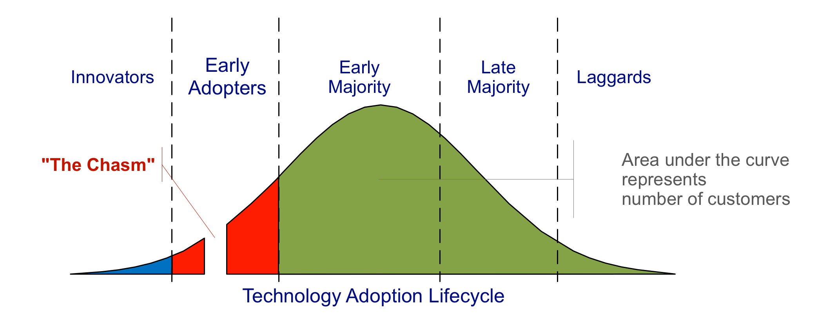
Rogers’ Diffusion of Innovations curve
Identify these!
Craig Chelius, as described in Geoffrey Moore's book Crossing the Chasm, 2009
Rogers E. Diffusion of innovations. 5. New York: The Free Press; 2003

Slide 44
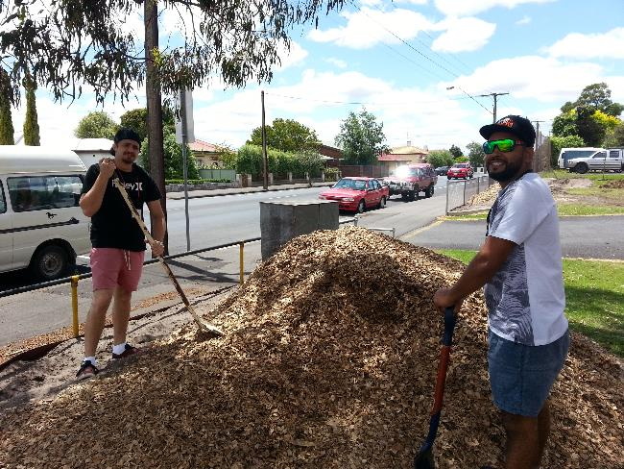
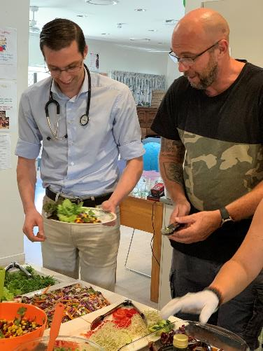
Find the innovators/champions
Notes:
Draws people out of the woodwork who are keen
BARRIERS – food literacy and skills = RAWSOME, PSYCH and EASY
NO ONE SIZE FITS ALL
ADD DAN AND PANGUAL photos – REMEMBER for next presentation = for ATSI = learn, just start, people will join if it is worth. The fish will bite if the bait is worth it

Slide 45
