Slide 1



Aotearoa NZ Experiences
A/Professor Susanna Every-Palmer

Slide 2


The beginnings
A meeting of leaders from the non-government mental health and addiction sector were discussing the number of untimely and unexpected deaths of people in contact with services
This is not acceptable

Slide 3
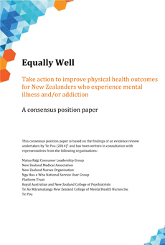
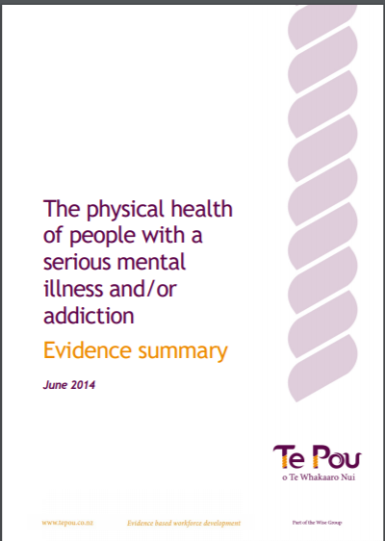
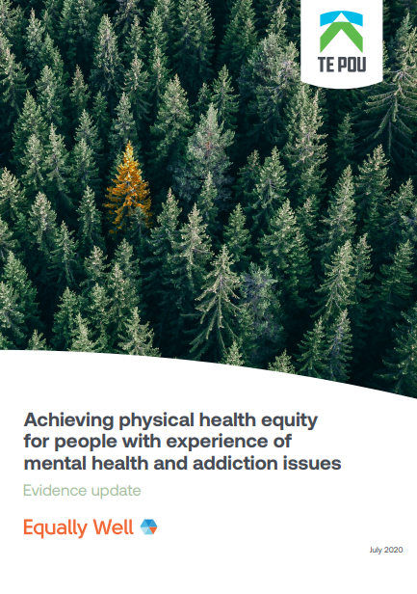
2014 - Evidence-informed call to action
Using evidence to informing both:
What we need to do and
How we work together

Slide 4





























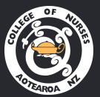



























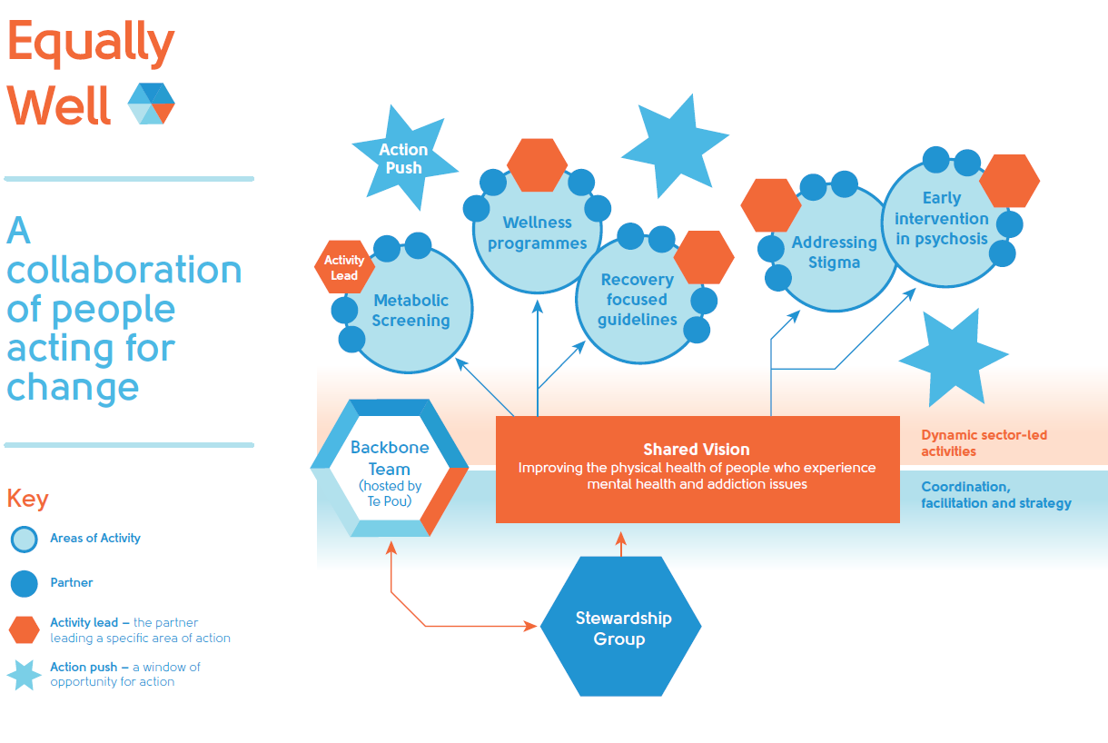


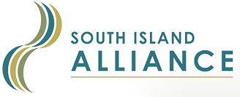






























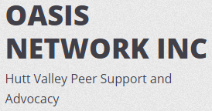



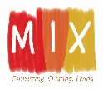


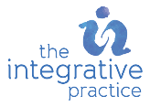





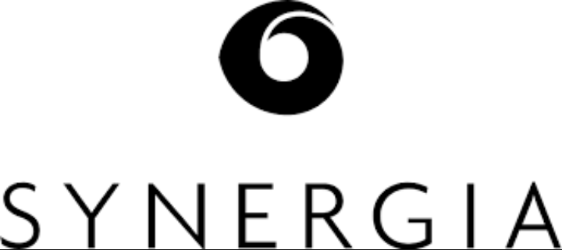

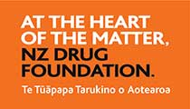













Slide 5
Building and sustaining the Equally Well movement
Population health Changes
2023 and beyond
Systems Changes
Tupuānuku research
Policy – antivirals, influenza
2021
COVID-19 vaccination
Global Call to Action
2020
3rd evidence update
Early Changes laying the foundations
2019
Lived experience strategic leadership
2018
Equally Well UK, CVDRA guidance
2017
2nd Evidence review, Equally Well Australia
2016
Reach 100 endorsements
2015
Framework for Collaborative Action, organisations sign up
2014
Call for urgent action, 1st evidence review

Slide 6
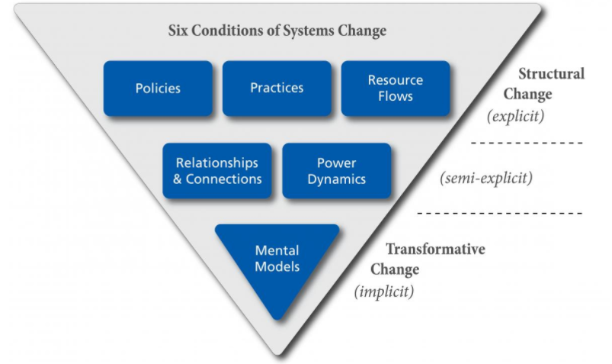
Achieving physical health equity
The six conditions in the Water of Systems Change framework (Tamarack)

Slide 7
Where we want to get to:
Physical health equity for people with mental health and addiction issues
Community change doesn’t just happen. Change occurs when a leader invites others to join them or a group of leaders come together because they want to build something new or are dissatisfied and want to shift the status quo
(Liz Weaver, 2019).

Slide 8
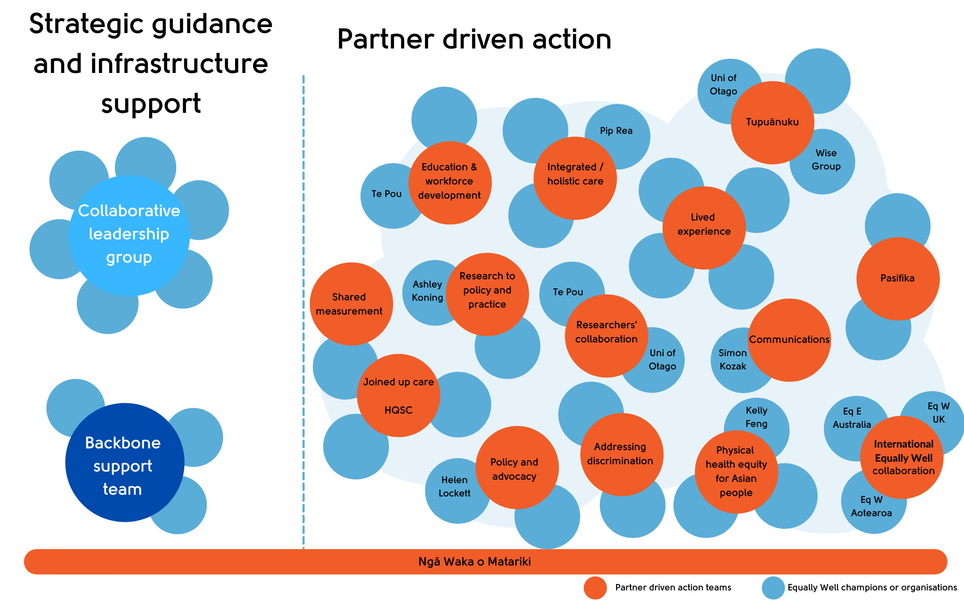
A visual for the Equally Well eco-system

Slide 9
Conditions for collective impact
Common agenda
Shared measurement
Mutually reinforcing activities
Continuous communication
Backbone support
Notes:
Shared measurement – COVID-19 vaccination

Slide 10
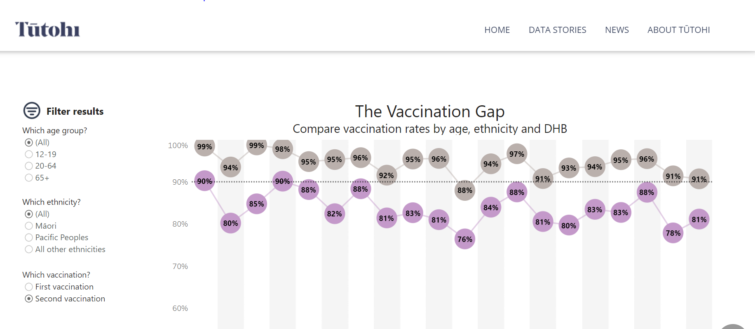
Shared measurement - Tūtohi
Notes:
Tracking vaccination rates

Slide 11
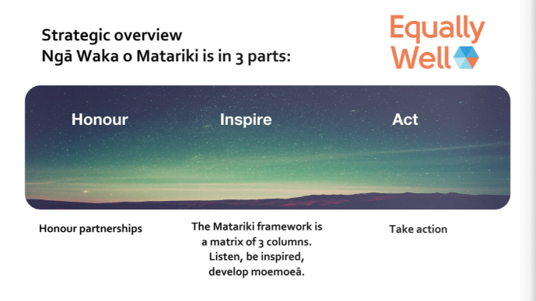
Ngā Waka o Matariki - Māori health strategy
Notes:
Ngā Waka o Matariki has been creative over the last 18 months by a small rōpū (group) of Māori (Tui, Reema, Kahurangi) and Helen. Its focus is on Honouring Te Tiriti and the Declaration of Independence and raising physcial health equity for Māori with MH&A issues. ALL champions to listen, be inspired, take action (moemoeā)... About th run a series of workshops with champions, to help people understand and use the framework

