Slide 1
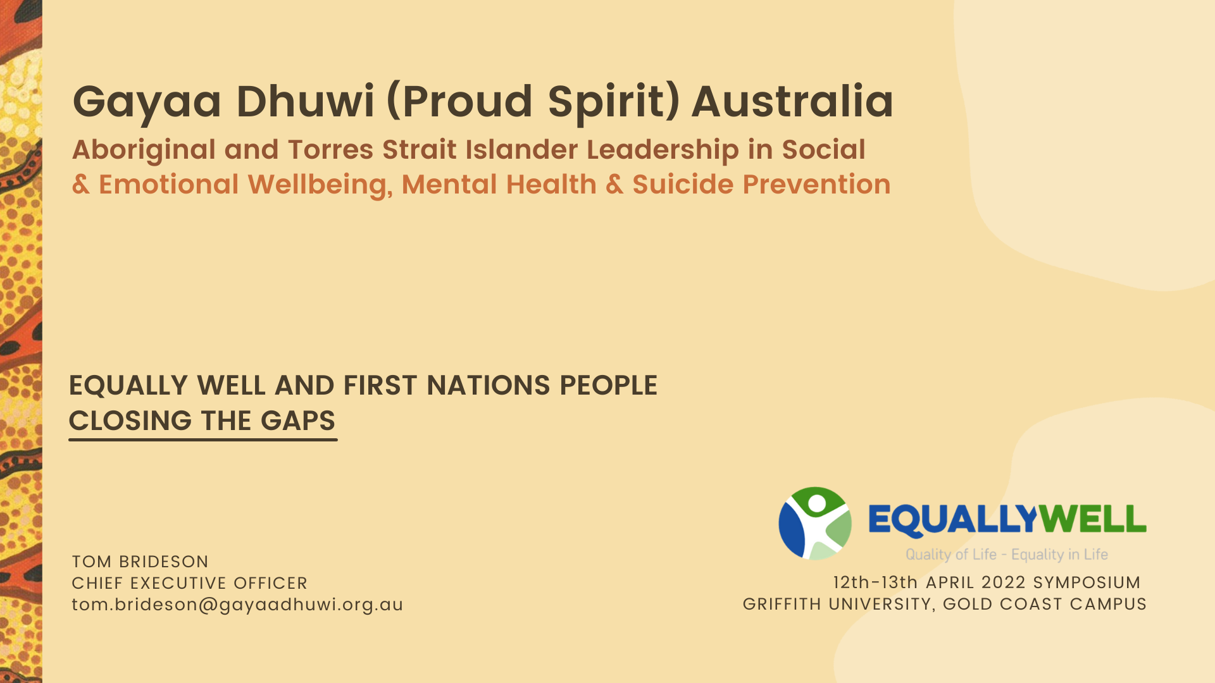

Slide 2
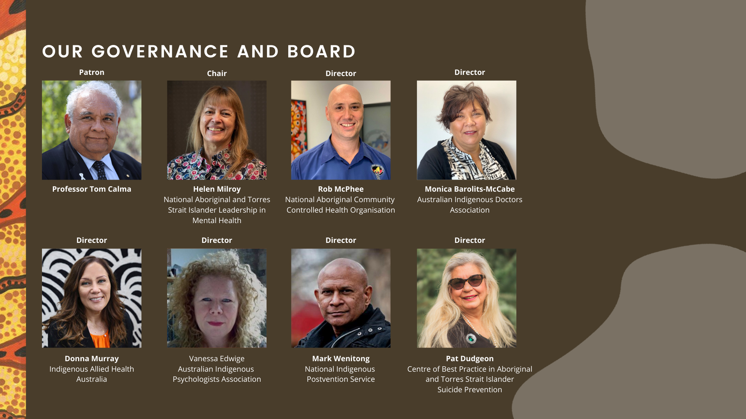

Slide 3
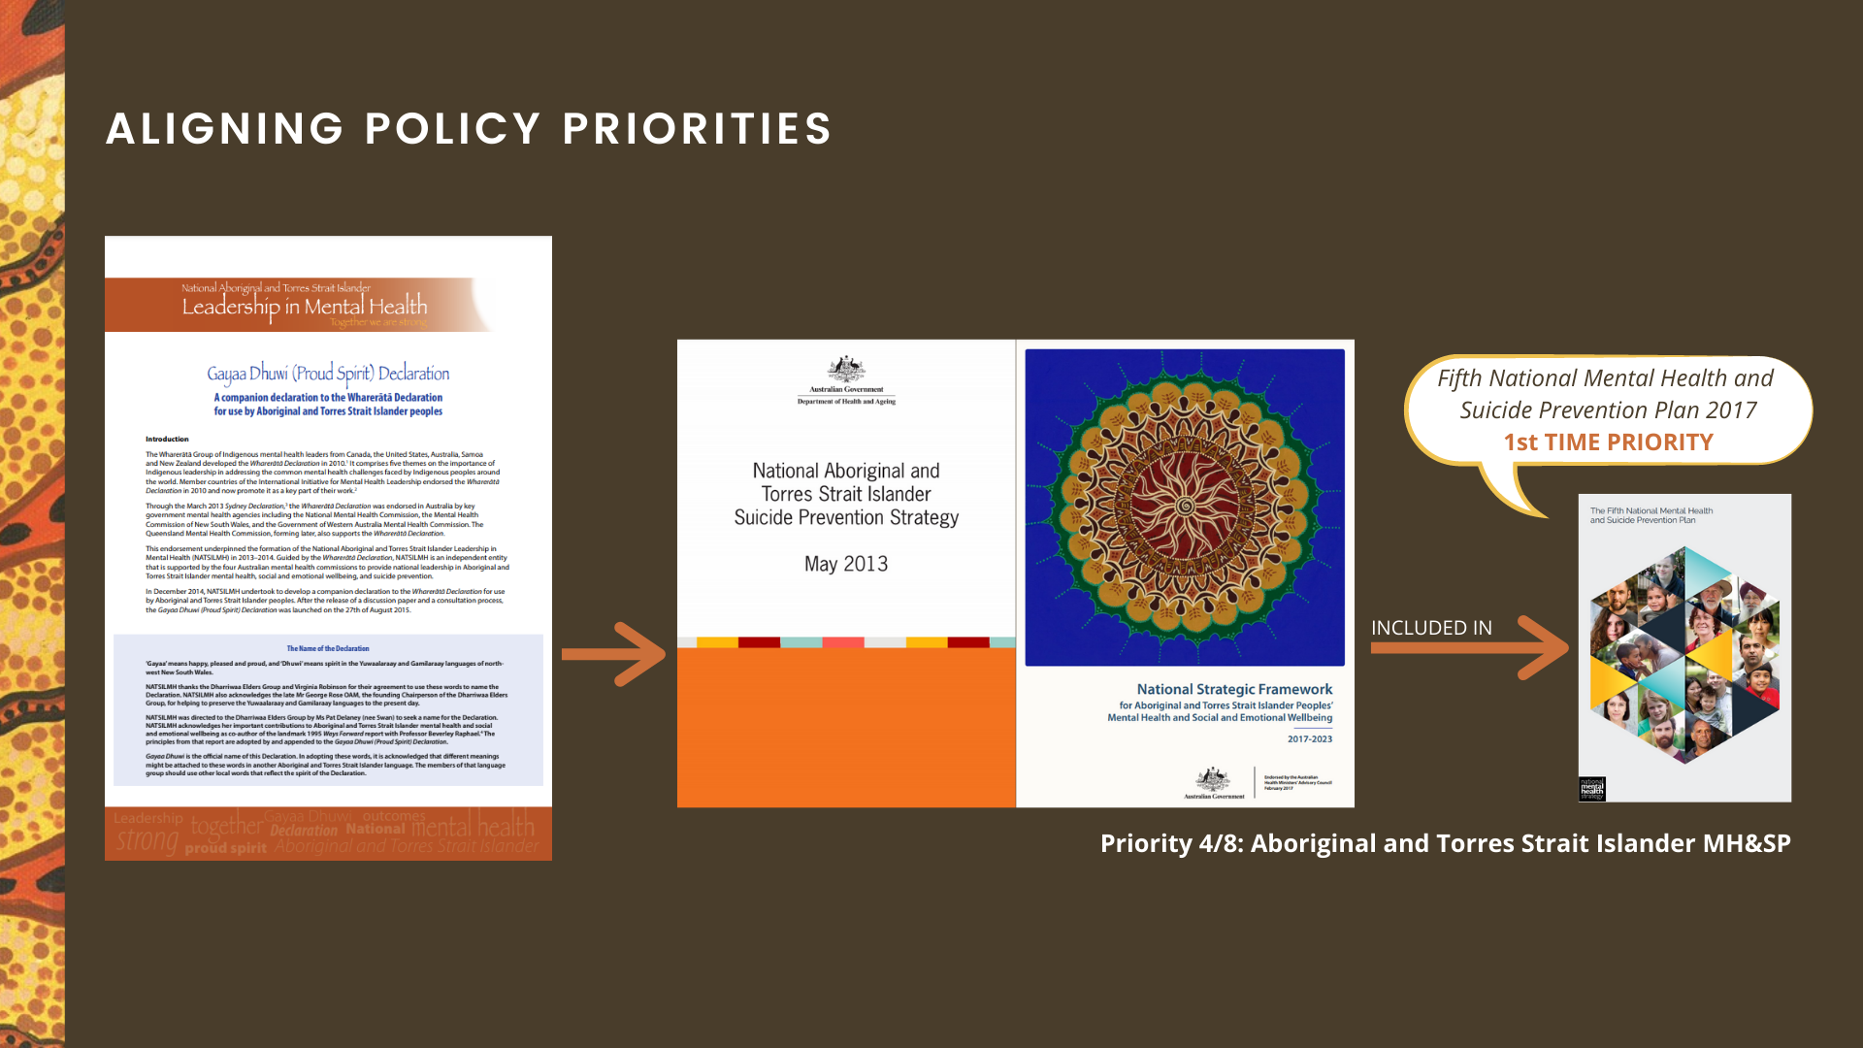

Slide 4
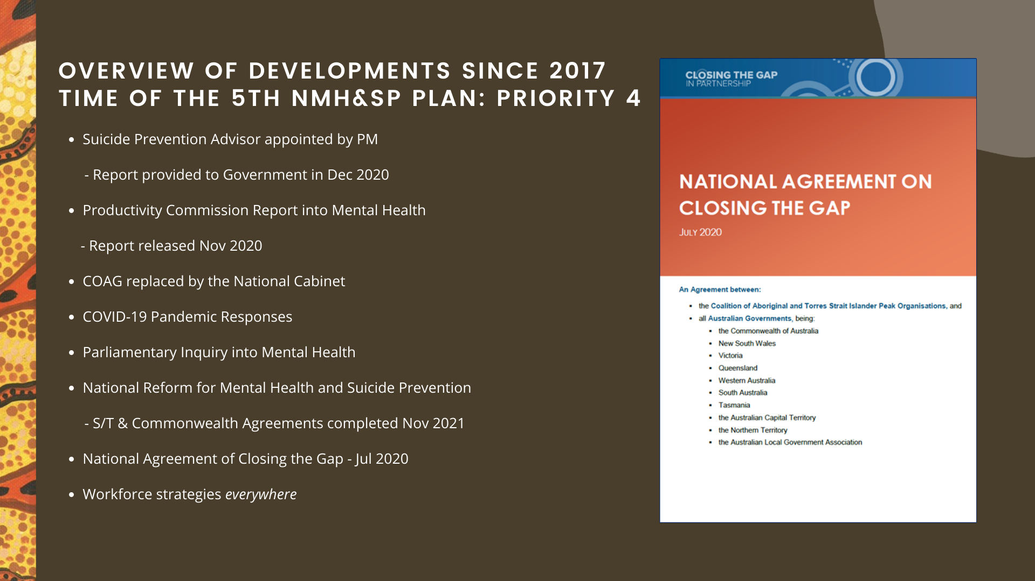

Slide 5
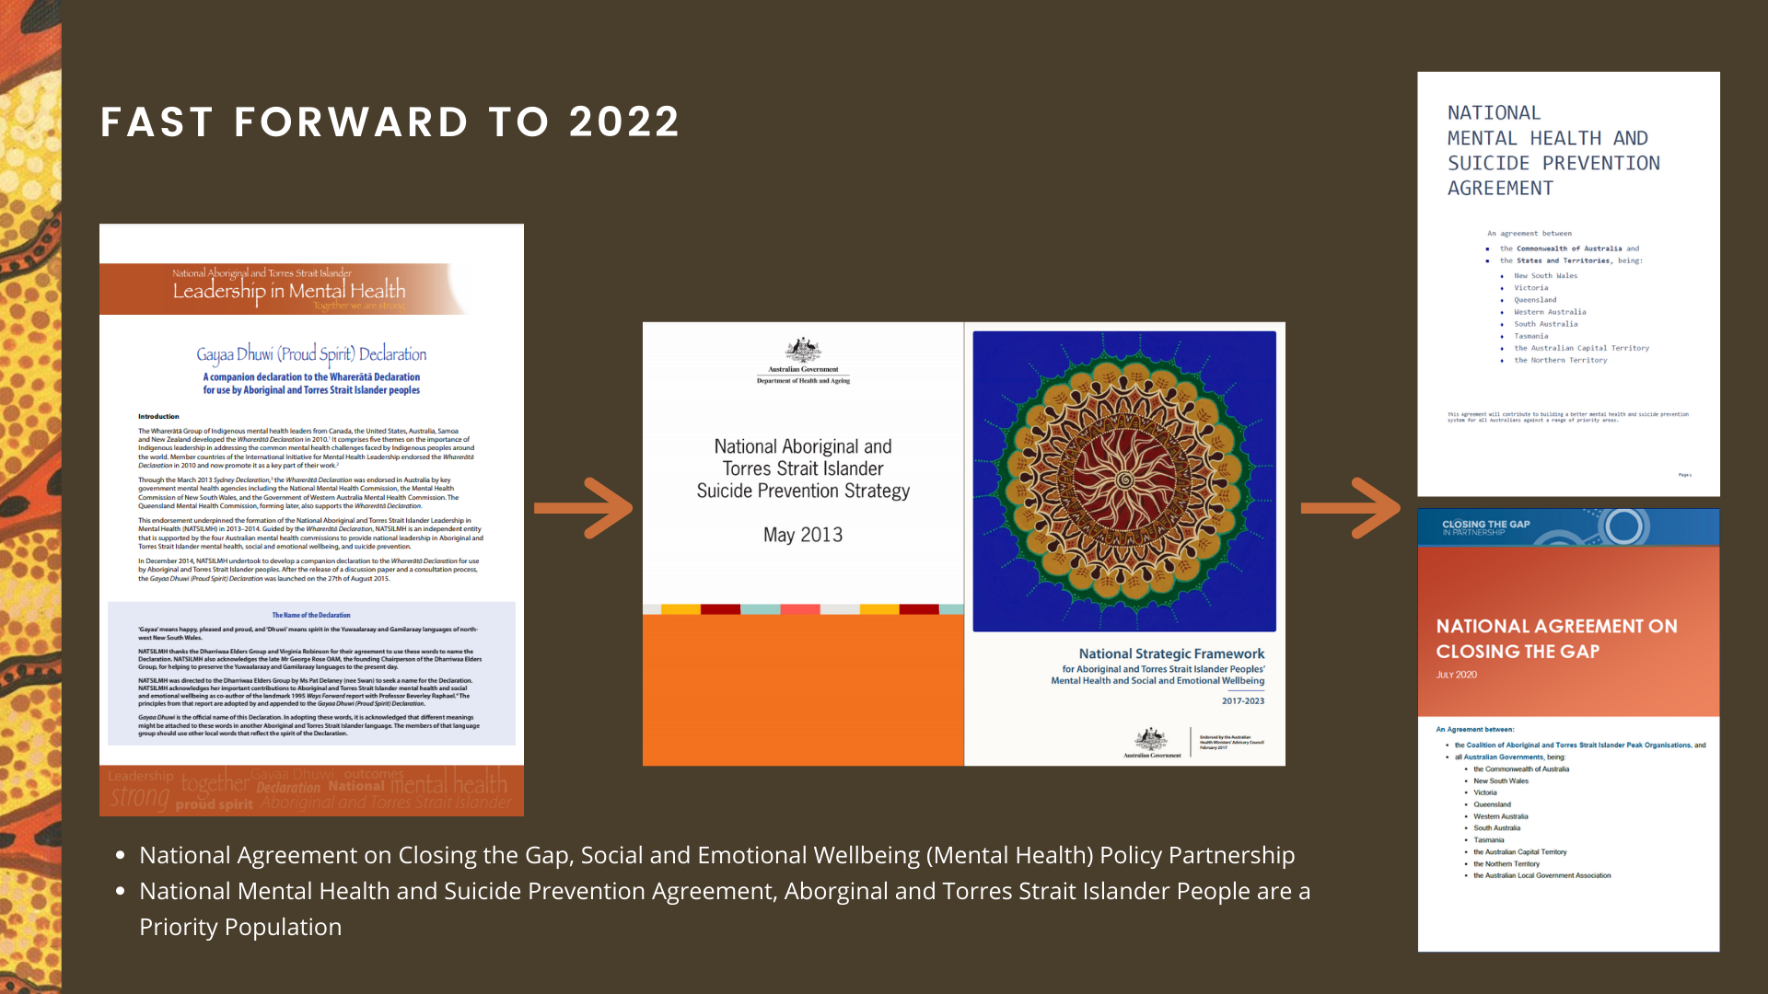

Slide 6

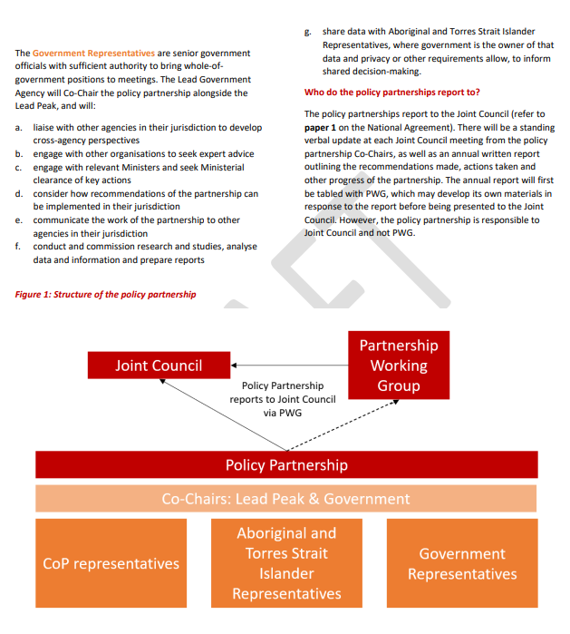
GDPSA WILL LEAD THE COALITION OF PEAKS AND CO-CHAIR WITH GOVERNMENT IN THE SOCIAL AND EMOTIONAL WELLBEING (MENTAL HEALTH) POLICY PARTNERSHIP
Under Priority Reform One, the National Agreement on Closing the Gap commits governments to building and strengthening structures that empower Aboriginal and Torres Strait Islander people to share decision-making authority with governments to accelerate policy and place-based progress on Closing the Gap.
The Social and Emotional Wellbeing (Mental Health) Policy Partnership addresses target 14, a significant and sustained reduction in suicide of Aboriginal and Torres Strait Islander people towards zero.

Slide 7
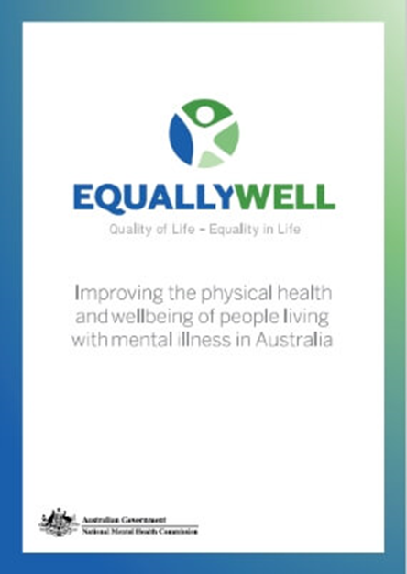
EQUALLY WELL CONSENSUS STATEMENT
A holistic person-centered approach to physical and mental health and wellbeing
Effective promotion, prevention and early intervention
Equity of access to all services
Improving quality of health care
Care coordination and regional integration across health, mental health and other services and sectors which enable a contributing life
Monitoring of progress towards improved physical health and wellbeing

Slide 8
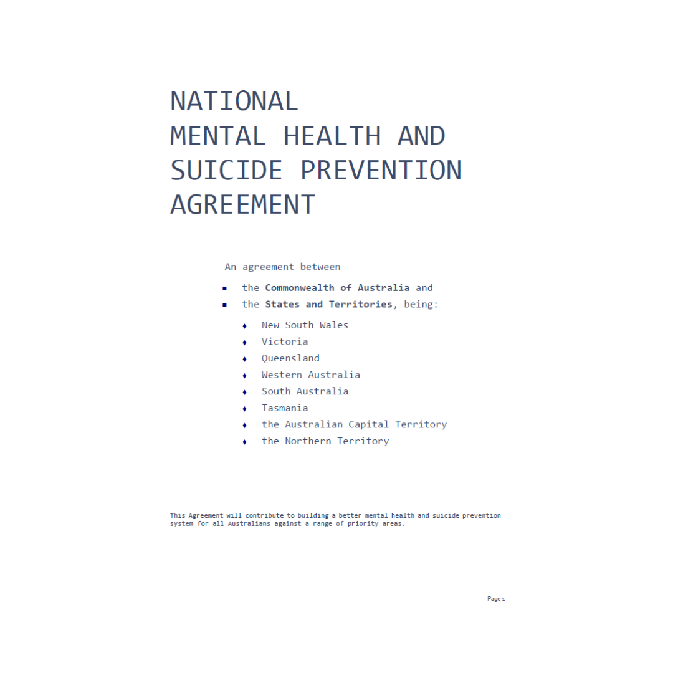
NATIONAL MENTAL HEALTH AND SUICIDE PREVENTION AGREEMENT
The Commonwealth and the States will work in partnership to implement arrangements for a unified and integrated mental health and suicide prevention system which will seek to:
Improve the mental health and wellbeing of the Australian population, with a focus on improving outcomes for priority populations
Reduce suicide, suicidal distress and self-harm through a whole-of-government approach to coordinated prevention, early intervention, treatment, aftercare and postvention supports
Provide a balanced and integrated mental health and suicide prevention system for all communities and groups
Improve physical health and life expectancy for people living with mental health conditions and for those experiencing suicidal distress
Improve quality, safety and capacity in the Australian mental health and suicide prevention system

Slide 9
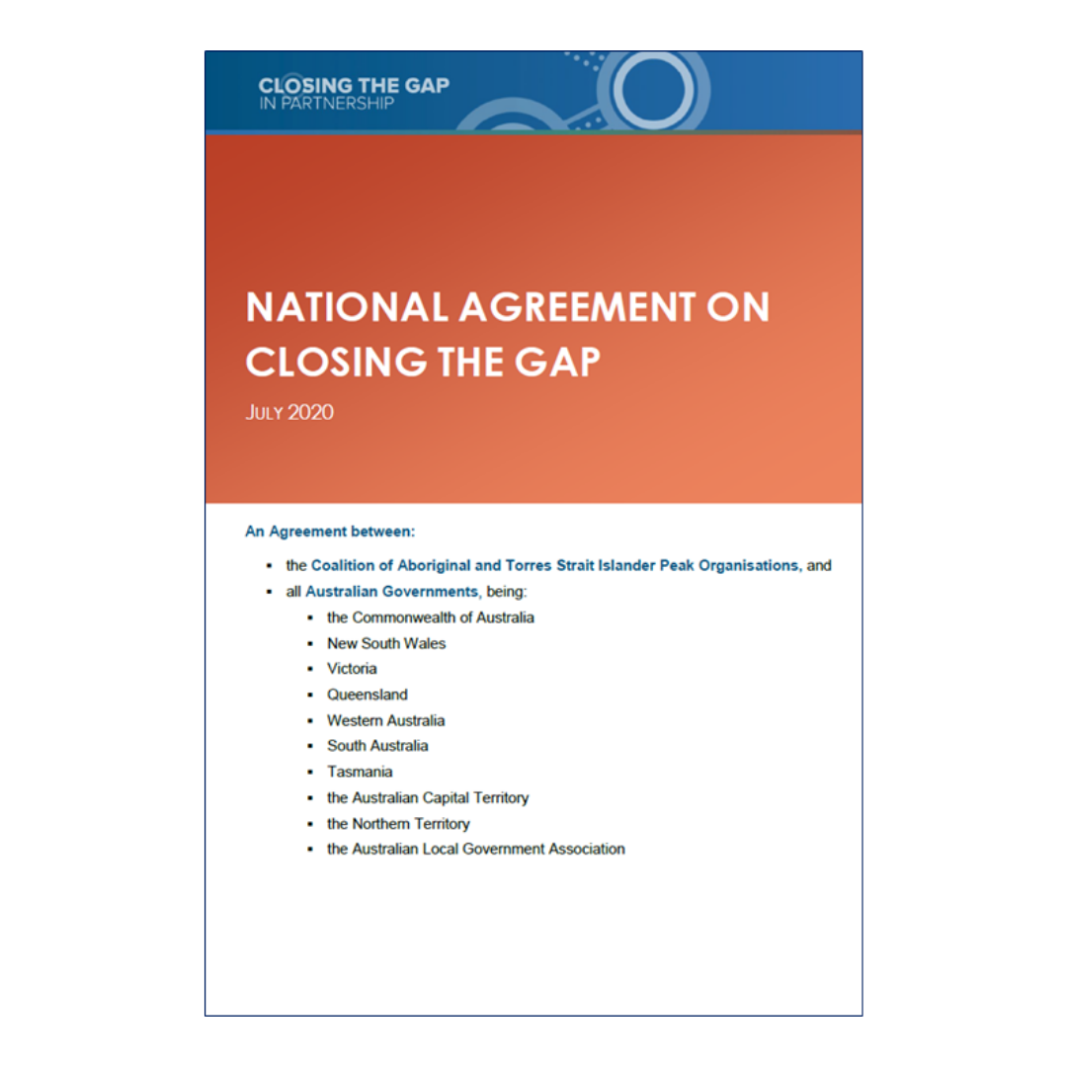
NATIONAL AGREEMENT ON CLOSING THE GAP
The outcomes of this Agreement are:
Shared decision-making: Aboriginal and Torres Strait Islander people are empowered to share decision-making authority with governments to accelerate policy and place-based progress on Closing the Gap through formal partnership arrangements.
Building the community-controlled sector: There is a strong and sustainable Aboriginal and Torres Strait Islander community-controlled sector delivering high quality services to meet the needs of Aboriginal and Torres Strait Islander people across the country.
Improving mainstream institutions: Governments, their organisations and their institutions are accountable for Closing the Gap and are culturally safe and responsive to the needs of Aboriginal and Torres Strait Islander people, including through the services they fund.
Aboriginal and Torres Strait Islander-led data: Aboriginal and Torres Strait Islander people have access to, and the capability to use, locally-relevant data and information to set and monitor the implementation of efforts to close the gap, their priorities and drive their own development.
The socio-economic outcomes (16 targets to achieve these outcomes)
Notes:
Outcome 1: Aboriginal and Torres Strait Islander people enjoy long and healthy lives
Outcome 2: Aboriginal and Torres Strait Islander children are born healthy and strong
Outcome 3: Aboriginal and Torres Strait Islander children are engaged in high quality, culturally appropriate early childhood education in their early years
Outcome 4: Aboriginal and Torres Strait Islander children thrive in their early years
Outcome 5: Aboriginal and Torres Strait Islander students achieve their full learning potential
Outcome 6: Aboriginal and Torres Strait Islander students reach their full potential through further education pathways
Outcome 7: Aboriginal and Torres Strait Islander youth are engaged in employment or education
Outcome 8: Strong economic participation and development of Aboriginal and Torres Strait Islander people and communities
Outcome 9: Aboriginal and Torres Strait Islander people secure appropriate, affordable housing that is aligned with their priorities and need
Outcome 10: Aboriginal and Torres Strait Islander people are not overrepresented in the criminal justice system
Outcome 11: Aboriginal and Torres Strait Islander young people are not overrepresented in the criminal justice system
Outcome 12: Aboriginal and Torres Strait Islander children are not overrepresented in the child protection system
Outcome 13: Aboriginal and Torres Strait Islander families and households are safe
Outcome 14: Aboriginal and Torres Strait Islander people enjoy high levels of social and emotional wellbeing
Outcome 15: Aboriginal and Torres Strait Islander people maintain a distinctive cultural, spiritual, physical and economic relationship with their land and waters
Outcome 16: Aboriginal and Torres Strait Islander cultures and languages are strong, supported and flourishing

Slide 10
WHAT ARE WE WORKING WITH?

Slide 11
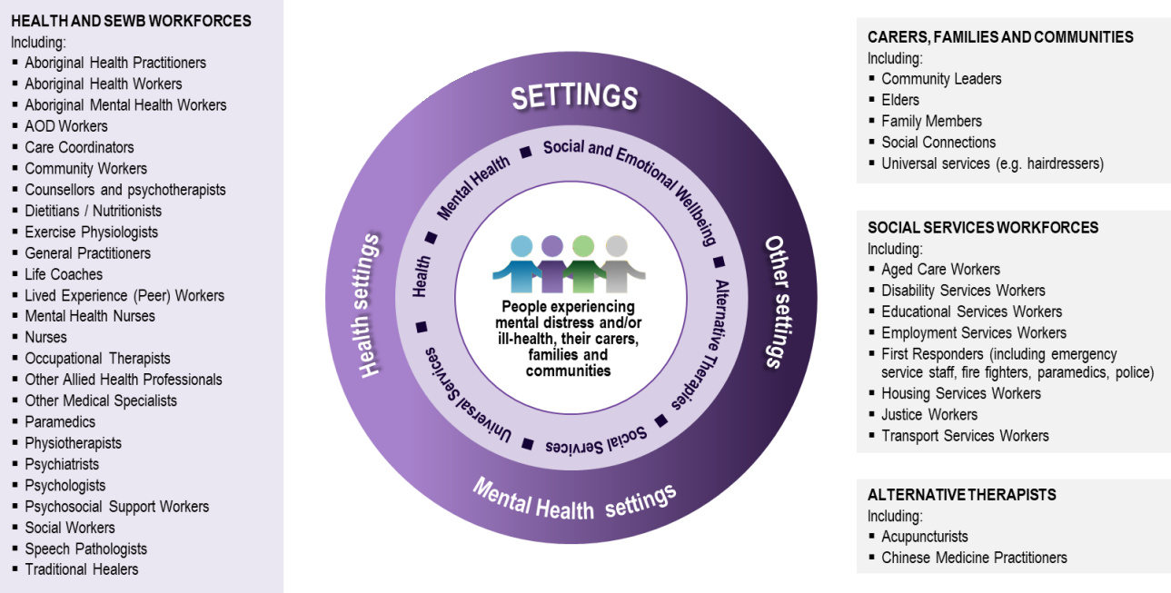
DEFINITION USED FROM MENTAL HEALTH &
SOCIAL AND EMOTIONAL WELLBEING FRAMEWORK
This Strategy views mental health through a social and emotional wellbeing lens.
This approach draws heavily on the National Strategic Framework for Aboriginal and Torres Strait Islander Peoples’ Mental Health and Social and Emotional Wellbeing 2017-2023.
The mental health workforce is therefore defined broadly.
The mental health workforce work across a wide range of settings.

Slide 12
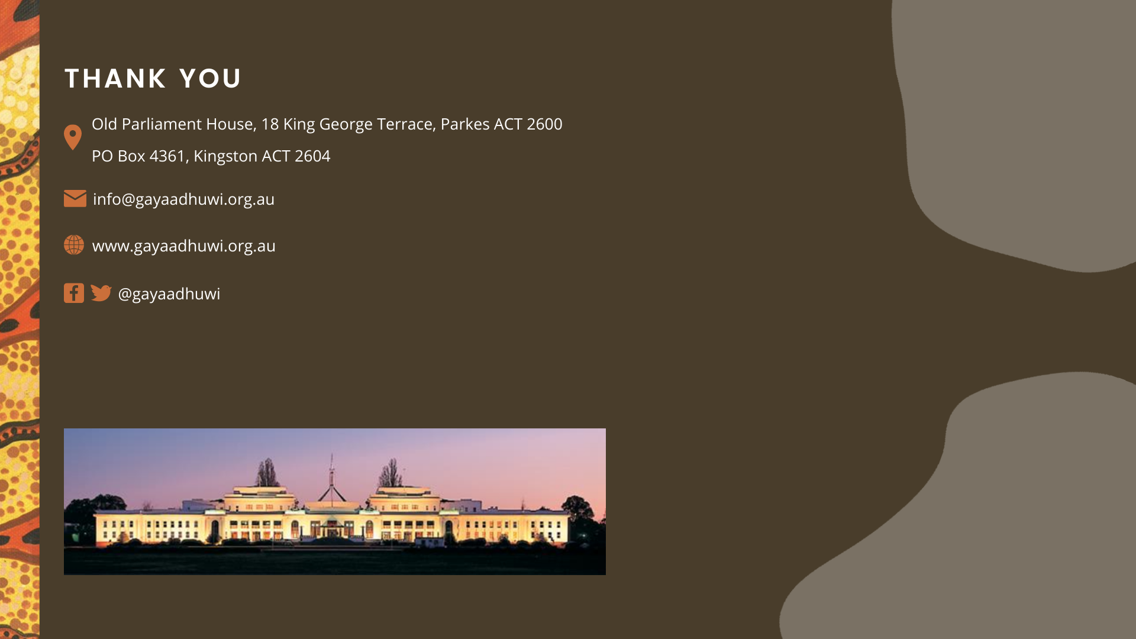

Slide 13
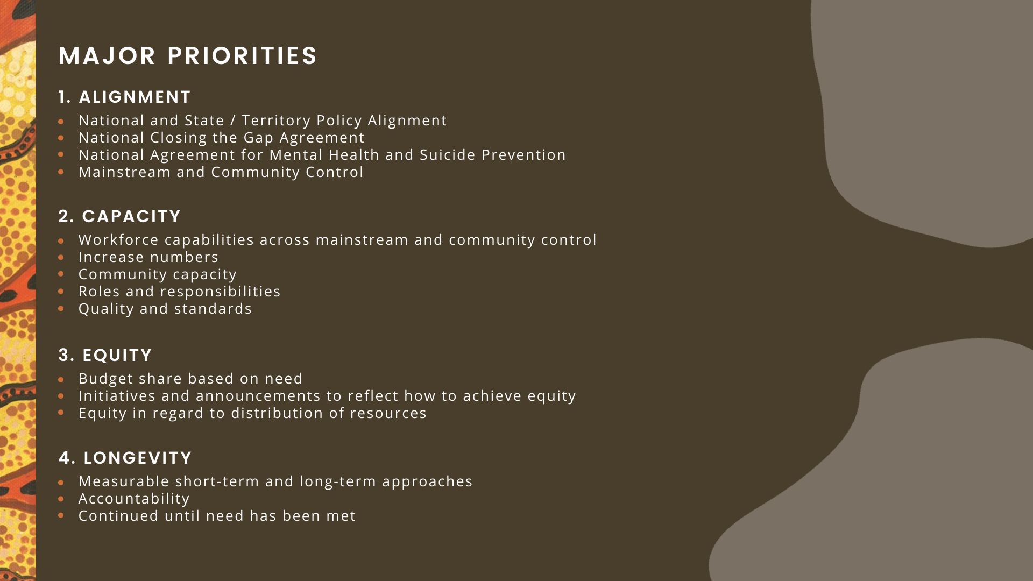

Slide 14
