Slide 1
Addressing the physical health needs of people living with mental illness The Brisbane North PHN Experience
Equally Well Symposium
March 2019

Slide 2
Background
quality of life: people with mental illness have poorer physical health
four out of every five people living with mental illness have a co-existing physical illness
people with co-existing mental and physical illness are twice as likely as people with only one physical or mental illness, and eight times more likely than people with no physical or mental illness, to struggle with regular functional activities.

Slide 3
Background
Compared to the general population, people living with mental illness are:
two times more likely to have cardiovascular disease
two times more likely to have respiratory disease
two times more likely to have metabolic syndrome
two times more likely to have diabetes
two times more likely to have osteoporosis
65% more likely to smoke
six times more likely to have dental problems
comprise around one third of all avoidable deaths.

Slide 4
Equally Well consensus statement
a holistic, person centred approach to physical and mental health and well being
effective promotion, prevention and early intervention
equity of access to all services
improving quality of health care
care coordination and regional integration across health, mental health and other services and sectors which enable a contributing life
monitoring of progress towards improved physical health and well being
Notes:
Over 80 organisations have signed up to and committed to Equally Well and to make physical health of people living with mental illness a priority

Slide 5
Today’s presentation
Who is the Brisbane North PHN?
Regional Plan
Embedding in our commissioned services
Other key PHN led initiatives
Opportunities and Challenges
Notes:
How the Brisbane North PHN is supporting initiatives to address the physical health needs of people living with mental illness

Slide 6
Who is the Brisbane North PHN?
our vision is a community where good health is available to everyone.
one of 31 Primary Health Networks across Australia.
work with local communities, consumers, carers, health professionals, hospitals and community providers to understand our community and their needs.
engage stakeholders to design and commission programs and services to met those needs.

Slide 7
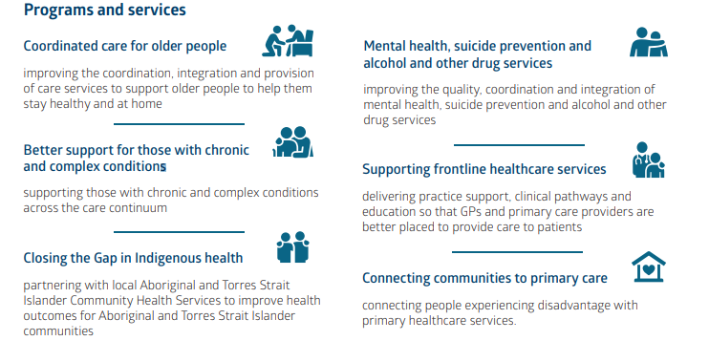
Who is Brisbane North PHN?

Slide 8

Regional Plan
Action 1 Governments will support integrated planning and service delivery at the regional level by:
1.1. requiring development and public release of joint regional mental health and suicide prevention plans.
Action 2 Governments will work with PHNs and LHNs to implement integrated planning and service delivery at the regional level. This will include:
2.5. developing joint regional mental health and suicide prevention plans and commissioning services according to those plans.
Notes:
Regional plans are a key action of 5th National Plan
Jointly developed with LHN/HHS and regional stakeholders
Whole of region plan (not just the PHN’s plan)
Due by June 2020

Slide 9

Vision:
A fair and inclusive Queensland where all people can achieve positive mental health and wellbeing and live lives with meaning and purpose.
Outcomes for people:
healthy, meaningful lives
free from stigma and discrimination
in charge of own recovery
achieve desired outcomes
connect to the right services
seamlessly access different services
address social determinants
lived experience involvement at all levels
innovation and quality improvement
resourced and skilled workforce.
Notes:
Planning for Wellbeing launched in October 2018

Slide 10
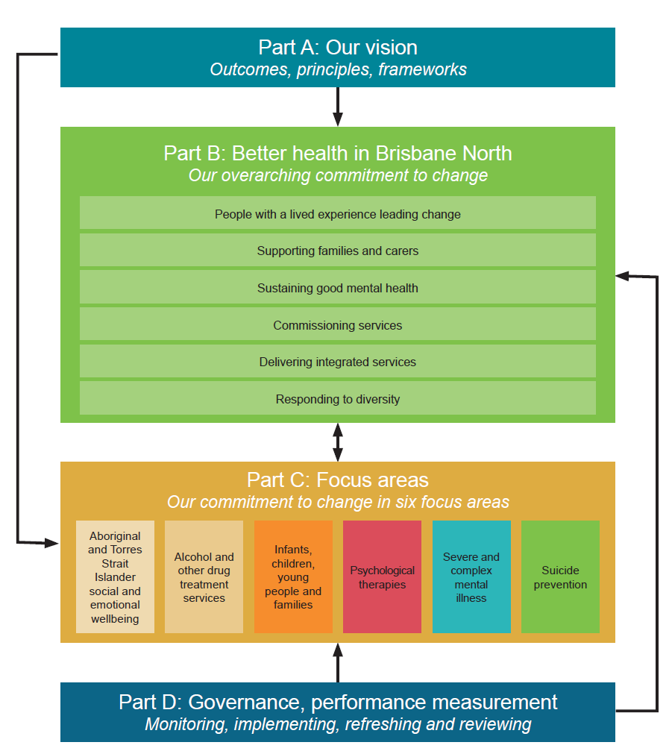
Notes:
Structure of plan

Slide 11

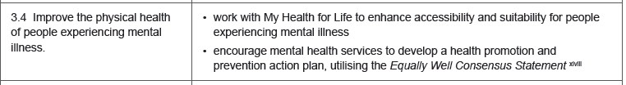

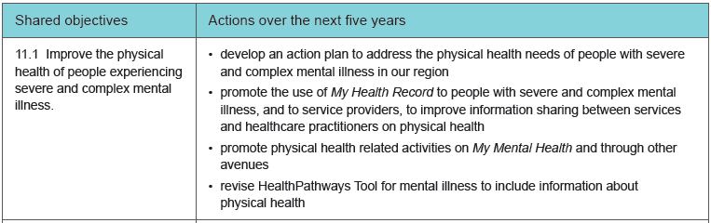
Notes:
Sections that specifically relate to physical health

Slide 12
Our commissioned services
commissioned an expanded range of mental health, suicide prevention and alcohol and other drug treatment services in the North Brisbane and Moreton Bay region.
many of which incorporate an element of addressing physical health needs
delivering on principles of the Equally Well consensus statement.

Slide 13
Mental Health Nurse in Brisbane Program
3 commissioned providers: Morayfield Psychology Centre, Footprints Inc and Toowong Private Hospital
Mental health nurse core activities:
conduct comprehensive intake assessment to determine needs and goals​
​develop care plan addressing needs and goals​
support access to services and supports​
coordinate the range of services and supports and act as a liaison ​
provide mental, physical and psychosocial health information​
monitor mental and physical health and provide interventions as appropriate ​
monitor persons progress toward goals​.
Notes:
To improve outcomes (people with severe and persistent and complex mental illness need more support that one professional alone can provide)​
​
Mental Health Nurses are highly skilled professionals and use evidence based practice​
​
The program is free and the MHNs provide outreach​
​
Eligible participants can remain with the program for as long as they remain eligible​.
People must have, or be identified of being at risk of developing a physical health problem. Aim is to elevate the attention of the need to address peoples physical health
In the minimum data set – this has been modified locally – they have to collect information about the physical health condition of the client
One of the KPIs for the commissioned service is that this is being undertaken
​
Adjunct to other services​
Embed in reporting

Slide 14
Mental Health Nurse in Brisbane Program
Delivers on:
a holistic, person centred approach to physical and mental health and well being
improving quality of health care
care coordination and regional integration across health, mental health and other services and sectors which enable a contributing life
monitoring of progress towards improved physical health and well being

Slide 15
Optimal Health Program
commissioned Neami National
focus on well being for people with mental health conditions
self management program (self development to build self efficacy)
8 week face to face program – trained facilitators
considers the balance mental, emotional social, occupational, physical and spiritual needs

Slide 16
Optimal Health Program (continued)
Delivers on:
a holistic, person centred approach to physical and mental health and well being
effective promotion, prevention and early intervention
monitoring of progress towards improved physical health and well being.

Slide 17
Our other priorities
Team Care Coordination
to improve the self-management and quality of life that supports the ability to live well at home for people with chronic health conditions
assessment of patient physical, psychosocial, environmental and educational support and care needs
provision of health education and system navigation
provision of community support service information
engagement with health and community service providers to coordinate patient care
brokerage funds whilst awaiting system organised services
provision of a written care coordination assessments, action plans and summaries to referrers
referral back to GP or health care team for clinical review and treatment if needed
Notes:
Often link with MNIB
for people with complex chronic health conditions that aims to improve their self- management and quality of life that supports them to remain living well as home through:
provision of disease, health and comunity information/education
completion a comprehensive assessment and coordination of health, community and social support services
ensuring appropriate and timely delivery of patient care and health services that meets individual need by actively supporting the facilitation communication between service providers and health professionals. ensure the patient stays at the centre of their own care
improve coordination and activation of health, community and social support services
increase understanding of available support services
increase health literacy and self-management
identify and address the support needs of vulnerable patients who are at risk of falling through the gaps
reduce unnecessary hospitalisations
improve the integration of care for patients between health care providers and health care services.

Slide 18
Team Care Coordination (Continued)
Delivers on
a holistic, person centred approach to physical and mental health and well being
effective promotion, prevention and early intervention
improving quality of health care
care coordination and regional integration across health, mental health and other services and sectors which enable a contributing life
monitoring of progress towards improved physical health and well being.

Slide 19
Opportunities and Challenges
time limitations for GPs, uptake from GPs, referrals
communication and coordination of care
mismatch between what's being seen in general practice and what's being referred to available services
addressing physical health issues has a marked effect on their mental health.

Slide 20
Opportunities and Challenges
Opportunity for PHNs
how we embed in our commissioned services
understanding service profile, gaps and opportunities and how to integrate not complicate
build on work focused on quality improvement program for GPs
support GPs to see the value of available services and refer – working more broadly with the practice team?

Slide 21
For more information
Libby Dunstan
Deputy CEO
Brisbane North PHN
Libby.Dunstan@brisbanenorthphn.org.au
Ph: 3630 7356

