Slide 1

An opportunistic mental health intervention
Equally Well Symposium 28-29 March 19
Fiona Glover – LICBT Program Coordinator, Flinders University Nicci Tepper – Remedy Healthcare, MindStep Services Manager

Slide 2

Agenda
Remedy Healthcare – a brief overview
Why mental health coaching and why an IAPT model
MindStep program
Chronic disease management health coaching programs
Integration of services
Demographics
Outcomes
Questions

Slide 3
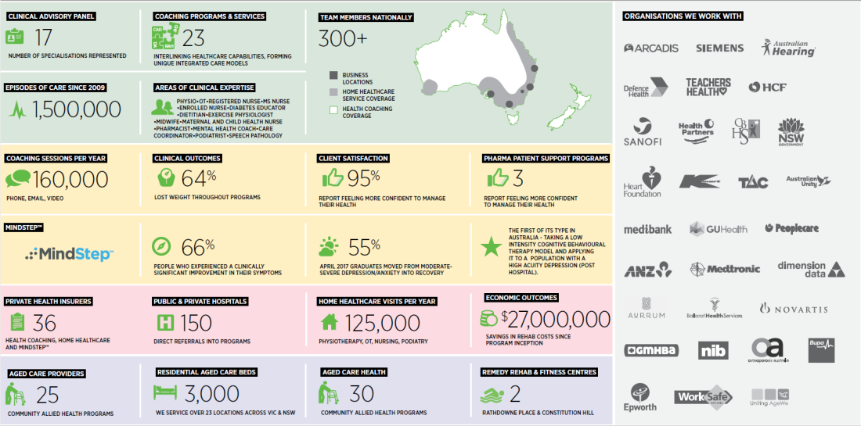
Remedy Healthcare

Slide 4
The case for action is strong and building
“The status quo is unsustainable”
Burden
Person centric
Stepped care models
Growing burden of chronic physical and mental health burden on the community.
Fragmentation and complexity of current health systems that were provider centric, rather than, person-centred are now widely recognised.
Shift towards community / home based and stepped care models underpin all recent health reform platforms.
Innovation
Evidence
Healthcare innovation requires an ability to act and transcend barriers, to disrupt current structures and enable adaptation and emergence to occur within the complex system.
We have the evidence for action, but we don’t always have the policies, structures or systems to translate this into practice.

Slide 5
The search for a mental health intervention
Our journey to find a solution
Our primary customers, private health insurers, spoke to us about their pain points
We searched the world for the right program, the UK IAPT program stands out because:
Clear evidence of effectiveness – proven recovery rates ~50%
Implemented across Britain, with greater than 1 million patients participating
45,000 people came off government benefits and returned to work
Estimated >£300 million saving through return to work and reduced health service use
Ongoing partnership with Flinders University, a recognized leader of low intensity CBT in Australia
High degree of synergy with current Remedy model
Transparency and outcome measurement at every episode of care
Standardised care which can be delivered with high fidelity

Slide 6

Low intensity adaption
Knowledge Translation and Implementation
Adaptation of UK IAPT LiCBT Model for specific context
Provision of ongoing supervision and training to ensure treatment integrity and fidelity to LiCBT model
Expansion of LiCBT offerings into Chronic Conditions
Now Remedy outcomes are informing Flinders research
Return to Work
Chronic Conditions
Perinatal Mental Health
Knowledge translation of EBT to practice
Flinders University
Remedy Healthcare
Practice informing research

Slide 7

MindStep ® program
Weekly phone calls for up to seven appointments
Identify and replace unhelpful behaviours
Validated measurement tools at every appointment
Confidential
Strategies for today, resilience for the future
Practical techniques – using evidence based CBT
Identify and adjust unhelpful thoughts
It works!
Self-referral or other identification methods
Contact and offer MindStep
Attend clinical assessment
Enter program treatment
Complete program treatment
Recover

Slide 8

Remedy Health Coaching
8
Chronic Disease prevention and management
Perinatal Support
Risk Factor Management
Healthy Heart
Diabetes Action
Bone Health
Integrated Care
Pre and post natal support for mothers + partners
Inc. COPD, PVD & CHF. Frequent hospitalisations & Service navigation
At increased risk of developing Diabetes/CAD
Osteoporosis prevention and management
Coronary Artery Disease
Type 2 Diabetes

Slide 9

Health Coaching Programs
Features
Chronic Disease Management and Prevention Programs
~6 months in duration
Via your choice of Phone, Email, Skype, and/or SMS messaging
Individualised contact frequency and duration (e.g. 5 min calls each week, or 25 min calls each month)
Maternity Support programs
~4-6 Outbound consultations
Unlimited inbound email
Unlimited inbound Calls
Linkage to support services and ongoing support

Slide 10

Integrating mental and physical health
Chronic disease management program
Remedy health coach identifies a person who may be eligible
Apply PHQ2
If ‘yes’ to any of the 2 questions – Offer MindStep
If clients consent
– warm transfer to co-located MindStep coach
Formal enrolment into MindStep
Apply clinical assessment and exclude any unsuitable clients
Apply usual program workbooks and guidance
Formal handover back to health coach on completion of program
Implemented since April 2016
Now constitutes about 25% of MindStep population

Slide 11
Why does MindStep help with physical health management?
Client-centred and collaborative
Supportive
Based on client values
Shared decision-making
Problem solving
Goal setting
Behavioural activation
Graded exposure
Relapse prevention
Goal-directed
Practical
Accountable

Slide 12
Case Study
‘Mary’ a 49y/o female cross-referred from Remedy Healthy Heart Program (CAD)
Presented with overwhelm, guilt and anger relating to her work, family situation and health management
Highly irritable, snappy, often teary, “not taking care of herself”
Engaged in a course of behavioural activation focussing on realistic goal setting and practical problem solving
Achieved end of coaching goals of exercising most days and socialising weekly
Additional achievements
Improved sleep
Reported improved optimistic outlook
By two month follow-up has lost 8kg
Reported is now enjoying getting up early once a week with hubby to watch the sunrise ♥

Slide 13
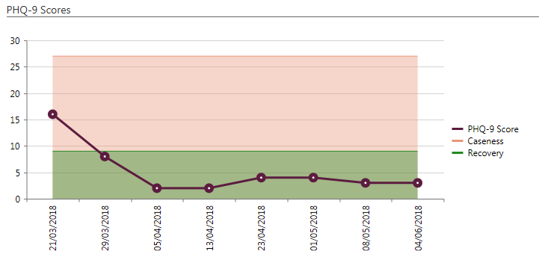
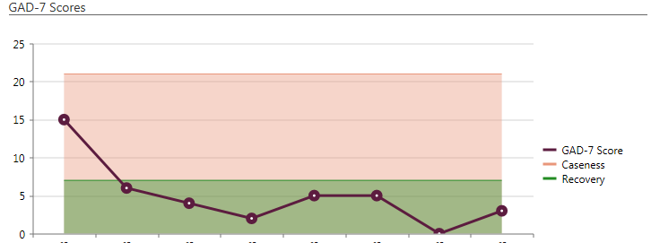
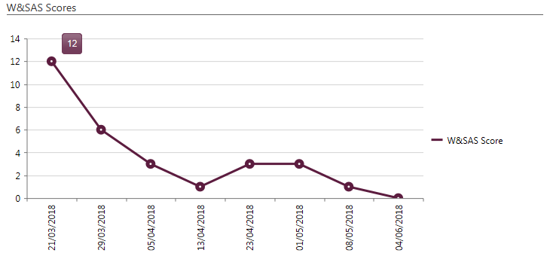
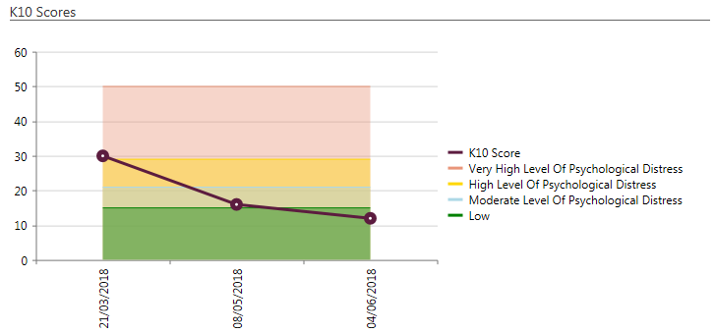
Case Study - continued
Outcome measures

Slide 14
Comparison of total cohort vs cross referred
Symptom severity at first and last measure
Demographics
 | Total | Cross-referred
Average age | 55 | 56
Gender | 74% female | 72% female
Overall, MindStep achieved recovery rate >55% (over 18 months, for ~1000 clients); ranging month to month from 31% to 67%
Cross referred cohort – averaged 71%
Reliable improvement – averaged 66%
Relapse rate at 1, 3 and 6 months between 6-9%.

Slide 15
Evaluation to date
Two external commissioned evaluation studies by Flinders University
Overall, MindStep achieved recovery rate >55% (over 18 months); ranging month to month from 31% to 67%
Relapse rate at 1, 3 and 6 months between 6-9%

Slide 16
Next Steps
Ongoing research partnership
Balanced, prospective comparative study to evaluate physical health, self-management and health literacy outcomes of traditional Health coaching cohort vs Health coaching + MindStep cohort
Cross referring clients from MindStep to coaching
Chronic pain intervention using physical and CBT strategies including psychoeducation, pain catastrophizing, cognitive restructuring, pacing
Return to work intervention including problem solving, worry management and goal setting principles

Slide 17
Questions?
We invite any questions for the group this afternoon
Alternatively, feel free to be in touch:
fiona.glover@flinders.edu.au | https://www.linkedin.com/in/fiona-glover-6a8530aa/
ntepper@remedyhealthcare.com.au | https://www.linkedin.com/in/nicci-tepper/

Slide 18


