Slide 1


Changing the System: Do we have what it takes?
Jenny Bowman
Tara Clinton-Mcharg
jenny.bowman@newcastle.edu.au
tara.clinton-mcharg@newcastle.edu.au

Slide 2

A complex system: more than individual behaviour
Social
Environmental
Socio-economic
Policy
Individual behaviour
Biology
Notes:
From Mitchell Institute report, page 10: http://www.vu.edu.au/sites/default/files/AHPC/pdfs/Chronic-diseases-in-Australia-the-case-for-changing-course-sharon-willcox.pdf

Slide 3
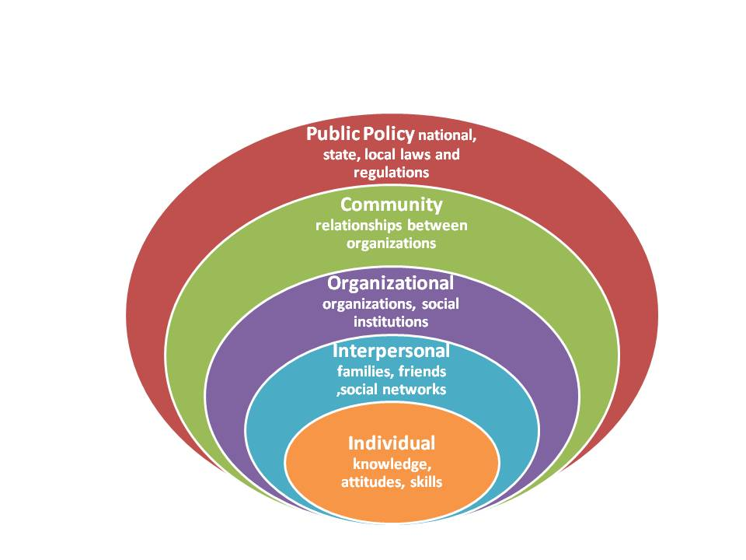

Slide 4
A Complex System
Is more than the sum of its parts
A product of their interaction (tightly linked)
Constantly changing (always evolving; often unpredictable)
Non-linear (not a single input and output line)
History dependent (time delays; short and long term effects)
Counter-intuitive (setting differences; unintended consequences)
Resistant to change (culture; different goals)
Pick up sticks

Slide 5
Systems thinking…
Views "problems" as part of a wider, dynamic system. Identify ways to shift or recombine the parts in the system to offer an improved outcome, and develop tools and methods to help us.
Especially useful when:
We’re dealing with a stubborn long-term problem – not a one-off event – that has a known history
There are multiple actors (organisations and people) and multiple causes that interact and influence each other
There are competing or conflicting interests – or different views of the situation or problem
There’s no single explanation for what is causing the problem and no single solution that fits all situations.
Essential to tackle ‘our’ wicked problem

Slide 6
Systems Change.. How does it happen?
Most commonly, through smaller scale, continuous and evolving changes …that may enable cumulative and emergent larger scale change
We must shift the system from ‘our place of agency’ - what we are able to directly shift and change….
Everyone is a part of the system and needs to engage in change
We don’t shift a whole system, we gently nudge parts in sub-systems, which in turn has a cascading influence across other sub-systems
This re-orientation is critical to setting reasonable expectations about systems change processes

Slide 7
A Systems Change Framework, which aims to support people to engage with the complexity of systems and work towards systems change. It has two key aspects:
1. An iterative inquiry process outlined in the centre of the diagram
2. The learning context within which the process should be carried out. This is denoted by the three nested systems on the outside of the inquiry process.
This framework was developed in partnership by The Australian Prevention Partnership Centre and the Tasmanian Department of Health, June 2018 https://preventioncentre.org.au/resources/learn-about-systems/

Slide 8
Systems practices we can do everyday
See the bigger picture
Be aware of your mental model, beliefs and values
See yourself in the system
Engage diverse perspectives
Listen deeply
Question assumptions
Uncover unintended consequences
Use visual modelling
Look for connections and relationships
Reflect regularly
Davidson S and Morgan M. Systems Change Framework. Sax Institute, September 2018.

Slide 9
Systems Change.. How does it happen?
More rarely, there is potential for systems change that can take place on a larger scale, be transformative and shift the system significantly.
Can we identify critical enablers of, and barriers to, successful, sustainable large-scale system change?
….implementation science ….

Slide 11
Consolidated Framework for Implementation Research (CFIR)
An example of a determinant framework that can help understand what explains or influences implementation outcomes.
Five major domains:
1. intervention characteristics eg , evidence strength and quality
2. outer setting eg , patient needs and resources
3. inner setting eg, culture, leadership engagement
4. characteristics of the individuals involved eg, mindsets, norms, affiliations
5. and the process of implementation eg, plan, evaluate, and reflect
Damschroder LJ et al. Fostering implementation of health services research findings into practice: a consolidated framework for advancing implementation science. Implementation Science 2009, 4:50 doi:10.1186/1748-5908-4-50

Slide 12
eg., How might ‘outer setting’ constructs help identify what needs to be addressed to allow systematic change in the way care is provided…?
Patient-centred organisations are more likely to implement change effectively.
Organizations that support and promote external boundary-spanning roles of their staff (networking) are more likely to implement new practices quickly.
Organisations may feel a competitive pressure to implement because peers have.. or to gain a competitive edge.
…. including policy and regulations (governmental or other central entity), external mandates, recommendations and guidelines, pay-for-performance, collaboratives, and public or benchmark reporting.

Slide 13
Attempting to shift the system… from our own ‘place of agency’….
Identifying strategies which are effective in re-orienting mental health service delivery and changing clinical practice to incorporate preventive care for modifiable chronic disease risk behaviours….
In working with Community Managed Organisations (ie, NGOs), a number of Implementation Science models or theories have been helpful:
… the Knowledge to Action Cycle has assisted in framing the project,
… and the Theoretical Domains Framework has enabled a comprehensive assessment of staff perceptions of barriers and facilitators to preventive care.

Slide 14
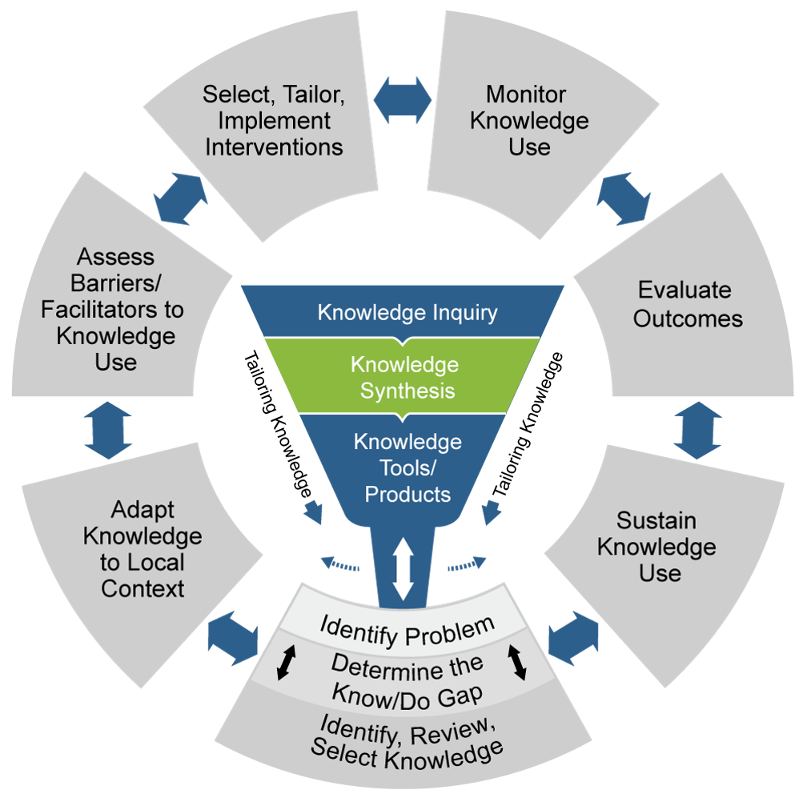
Phases of the KTA
- 3 Tailoring Knowledge
- 7 Action Phases
The CMO Connect project has a focus on four Action phases.
Determine the know-do gap
Adapt knowledge to local context
Assess barriers and facilitators to knowledge use
Select, tailor, implement an intervention

Slide 15
Changing the System: a National Perspective?
Equally Well… facilitating systems change at local, state, national levels…
bringing together individuals, organisations and key stakeholders to create and strengthen a shared vision …
we are all playing a part in national-level systems change
some of the speakers in this session and many others participating in the symposium ‘do’ have the potential to effect large –scale transformative change
we can all contribute to shifting the system from our own ‘place of agency’…

