Slide 1
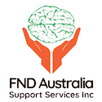
Consumer and Carer Experiences of FND: The Abyss between Brain, Mind and Body
Dr. Katherine gill
President
FND Australia Support services inc
www.fndaus.org.au
Notes:
Introduce Self

Slide 2
What is Functional Neurological Disorder [FND]?
FND results from dysfunction of the nervous system, without damage to the nervous system.
Involves a variety of disabling motor, sensory and cognitive neurological symptoms.
Symptoms include paralysis, abnormal movements, gait disorder, balance problems, tremors, weakness, fatigue, chronic pain, black-outs, seizure-like episodes, and vision disturbances/blindness
Notes:
FND can co-exist with other neurological conditions such as MS, epilepsy

Slide 3
What is Functional Neurological Disorder [FND]?
Functional disorders are one of the most common diagnoses in neurologic practice.
It is the second most common reason for a neurological consultation, after headache.
People with functional seizures make up one quarter of those referred to specialist epilepsy clinics.
Notes:
Common – yet health professional and community awareness does not match the prevalence of the disorder

Slide 4
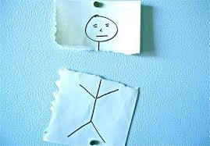
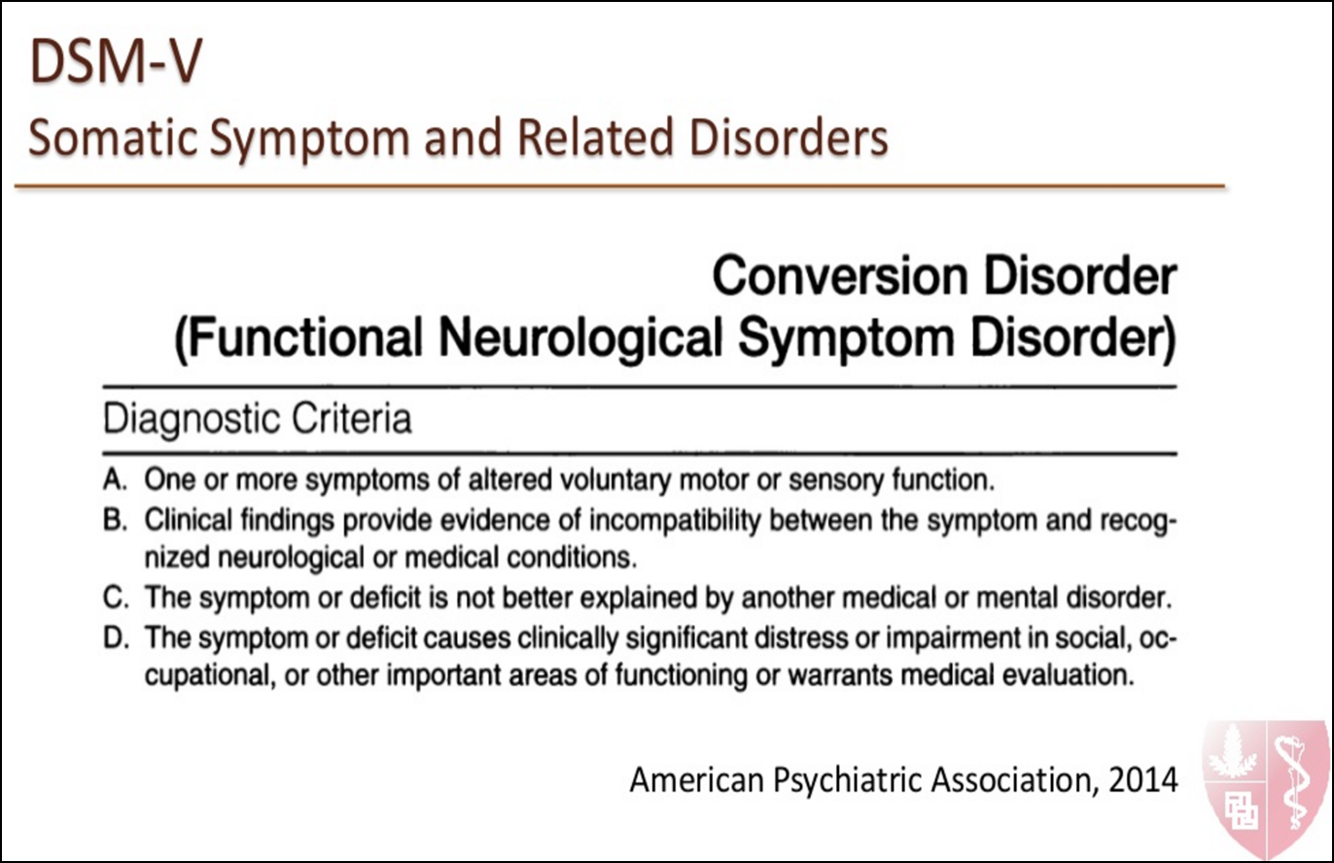
What is Functional Neurological Disorder [FND]?
Notes:
Criterion A gives a basic descriptor of what category the possible symptoms fall under; that of altered voluntary motor or sensory function. What this includes is clarified under the specified symptom type. Examples of altered voluntary motor function include muscle weakness or paralysis, abnormal movements, abnormal walking style, and abnormal limb posturing
Criterion B specifies that the symptoms, though seemingly neurological in nature, are not actually caused by a neurological disease or damage to the nervous system.
In DSM V the need for a psychological trigger or stressor has been removed

Slide 5
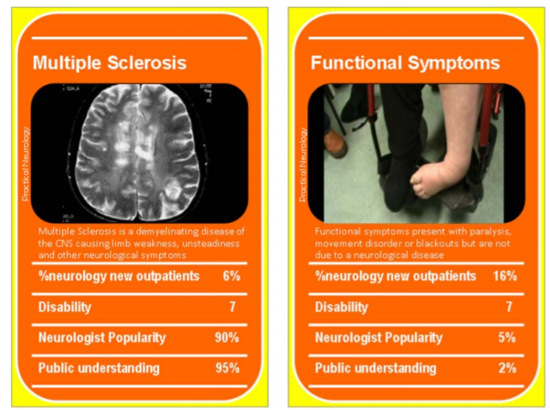
What is Functional Neurological Disorder [FND]?
Stone, J., Reuber, M., & Carson, A. (2013). Functional symptoms in neurology: mimics and chameleons. Practical neurology, 13(2), 104-113.

Slide 6
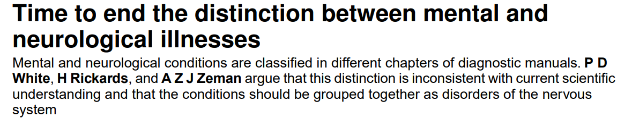
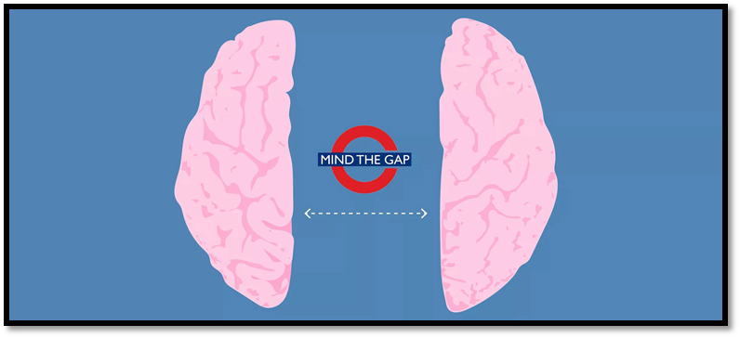
What is Functional Neurological Disorder [FND]?
mind
body
FND
FND lacks ownership; an orphan to a disciplinary home in medicine, falling in the netherworld of the neurology-psychiatry abyss [Rommelfanger, et. Al. 2017]

Slide 7
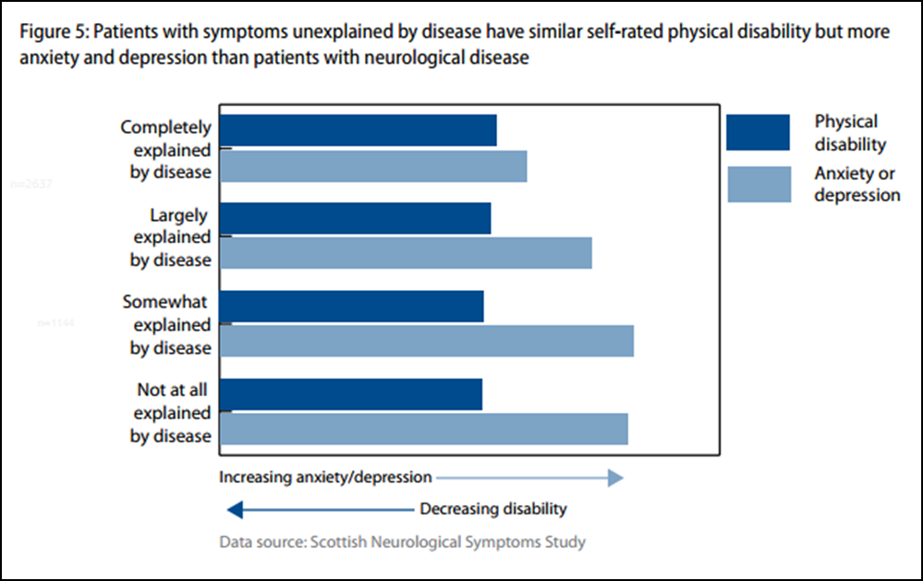
FND/CD Disability and Distress
Notes:
If you don’t have a mental illness at the time of diagnosis, living with the debilitating symptoms, navigating life barriers and attitudes to the illness in health and society, is enough to give you a mental illness

Slide 8
FND/CD Language and Terminology
LANGUAGE
Non Organic
Medically unexplained
Psychogenic
Pseudo
Conversion
Dissociative
Functional
Somatic / Somatisation
Non … e.g. non-epileptic
“……terms that refer to the mind are formulated in an ambiguous manner and seem to refer to physical disturbances with no organic causes and thus of a psychological origin, causing them to be mistaken for “psychogenic” disorders or even “imaginary” and this is not just in the mass media but by neurologists, psychiatrists and psychologists as well” - Dallocchio et. al. 2015
Notes:
If you don’t have a mental illness at the time of diagnosis, living with the debilitating symptoms, navigating life barriers and attitudes to the illness in health and society, is enough to give you a mental illness

Slide 9
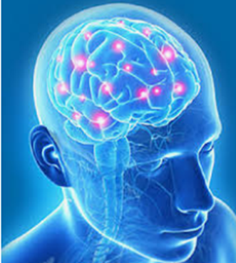
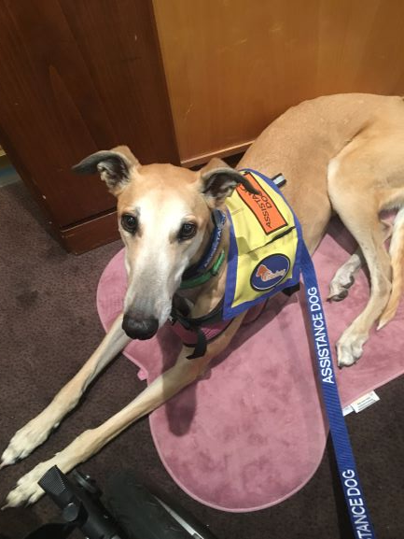
FND/CD – What is the evidence?
Scientific literature focuses on:
Neurobiology
Psychiatric co-morbidity
How to diagnose FND
Description of symptoms, comparison to organic diseases
Describing the cohort of people with FND compared or controls or organic disease
LACKING
Treatment / outcome
How to recover?
What does recovery looks like?
How to live with FND
Clinical Perspective
How to help people with FND recover?
Notes:
How to distinguish FND from organic disorders and malingers/factitious disorders

Slide 10
FND/CD – Attitudes reflected in the literature
Some scientific literature and text books portray negative attitudes about people with FND/CD.
“pathologically manipulative”
“Symptoms occur in the presence of emotionally significant others”
“reinforcement of behaviours by reward, behaviours that obtain a reward are those that are expressed”
References to primary and secondary gain, continue to be promoted, in stark contrast to the reality of the illness.
“secondary gain consists of manipulative control over emotional responses, attention, actions of other persons and relief from responsibilities”
Notes:
Insulting to read literature
Attend training / cpd
Read text books
Imagery portrayed

Slide 11
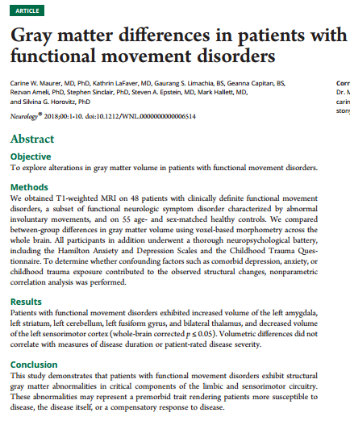
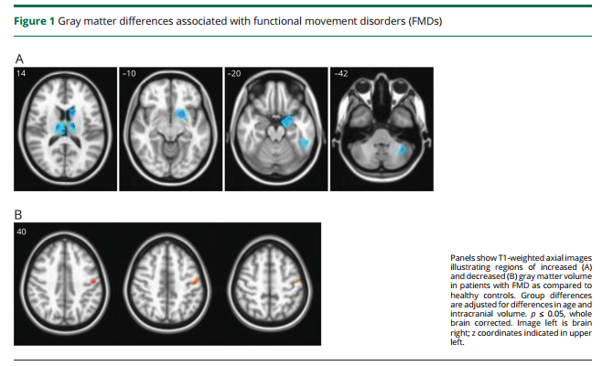
FND/CD – Brain Studies
BRAIN ABNORMALITIES: Results demonstrate abnormalities in Grey Matter Volume in critical components of the limbic and motor circuitry in patients with FMD.

Slide 12
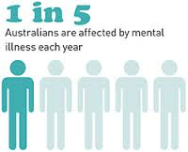
FND/CD and Mental Health
Psychiatric 1 in 4 patients with functional symptoms do think that psychological factors are relevant
Stress 1 in 3 patients have no evidence of recent stress
People with FND/CD have higher levels of mental health co-morbidity than the general population.
Around 30% of people have no mental health history or trauma.
FND patients had significantly more severe life events and ‘escape’ events than controls [n=28]
Notes:
If you don’t have a mental illness at the time of diagnosis, living with the debilitating symptoms, navigating life barriers and attitudes to the illness in health and society, is enough to give you a mental illness

Slide 13
FND/CD – How? Why?
The Perfect Storm
Many different causes/
perpetuating factors
Many different symptoms
Need for holistic and individual care
Biological
Psychological
Social / Environmental
There are many ways to break a bone but the outcome is a broken bone. Similarly there are many reasons, people may develop FND and the outcome is a dysregulated nervous system with motor, sensory and other neurological symptoms.
Notes:
Symptoms fluctuate

Slide 14
FND/CD – The Clinicians
“The nature of the crisis is that there are many patients, we don’t understand the pathophysiology, we often don’t know how to make the diagnosis, we don’t know how to treat the patients, the patients don’t want to hear that they have a psychiatric disorder and they go from doctor to doctor, psychiatrists don’t seem interested anyway, and the prognosis is terrible.” [1]
Notes:
If you don’t have a mental illness at the time of diagnosis, living with the debilitating symptoms, navigating life barriers and attitudes to the illness in health and society, is enough to give you a mental illness

Slide 15
FND/CD – The Economic Costs
Compared to organic disorders, FND patients had more primary care visits, more specialty visits, more emergency department visits, more hospital admissions, and higher inpatient as well as outpatient costs. They estimated that annual direct medical costs attributable to FNDs alone [in excess of other physical and mental health comorbidities] for the USA were $256 billion a year [in 2005].
In England, the costs of somatisation disorders for people of working age estimated to be £18 billion pounds in the financial year 2008 to 2009 [31]
“Because of the enormous healthcare and welfare costs associated with functional symptoms, health professionals and medical scientists need to take an active interest in keeping up to date with best practice in diagnosis and management of FND” [2].

Slide 16
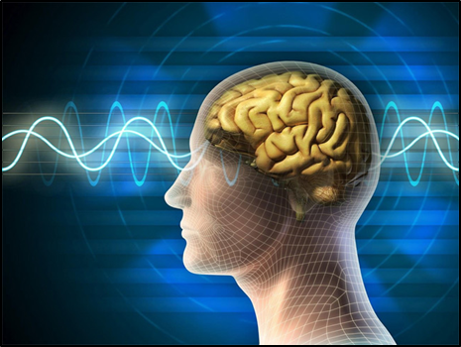
FND/CD –Is Recovery Possible?
“FND represents a unique opportunity for physical and mental health care to collaborate in the treatment of a potentially curable but significantly disabling disorder” [3].
“Functional Neurological Disorders are a neglected but potentially reversible source of disability” [4]
Notes:
Temporary
Spontaneous recovery

Slide 17
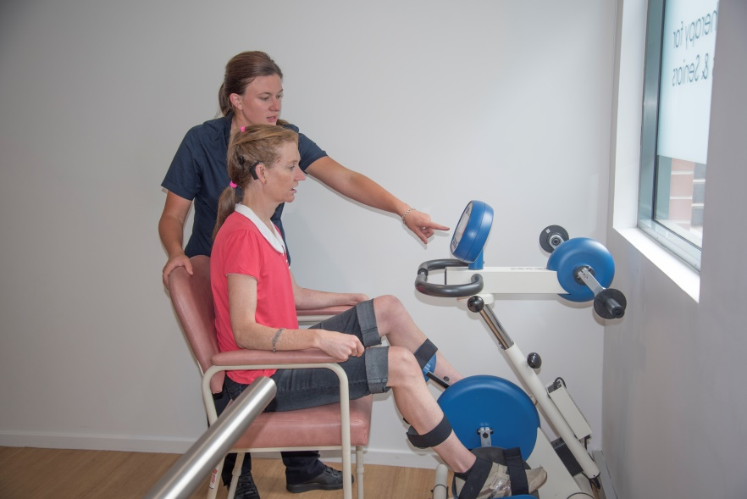
FND/CD Knowledge Exchange
Motor / brain retraining -> some recovery
Physical therapy can help functional decline
CBT used to support management of functional seizures
Prognosis is poor, 50–90% of people with FND experience ongoing symptoms [1], many of which become worse, especially when treatment begins later than 6–12 months from symptom onset [1].
Studies have found that at the 12 year follow-up, the majority of patients [83%] remain symptomatic, distressed and disabled [6-7].
Long term disability is similar to that seen in cohorts of people with multiple sclerosis [MS]
Notes:
Temporary
Spontaneous recovery

Slide 18
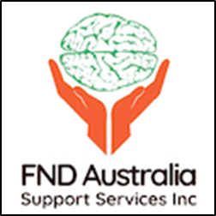
Consumer and Carer Experiences
National Mental Health Commission – Sponsored Study
Notes:
To capture the evidence of experiences

Slide 19
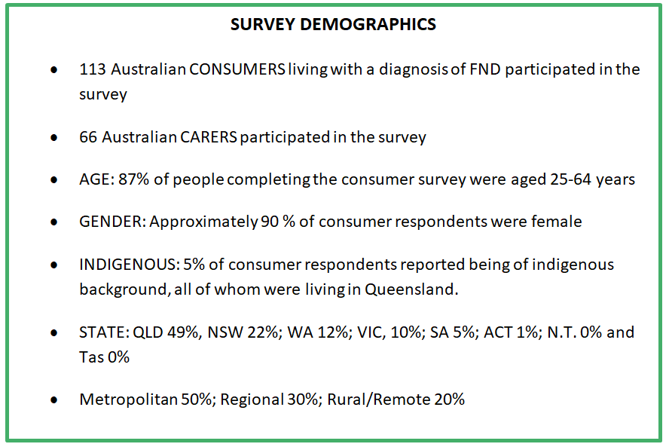
FND/CD Knowledge Exchange

Slide 20
FND/CD Consumer and Carer Experiences
THEMES
Significant Impact on Life / Life Changing
Confusion
Unheard, Voiceless
Exclusion – slipping through system gaps – treatment, diagnosis
Lack of trust, disbelief and feeling judged, stigma and discrimination
Lack of awareness / knowledge – health + community
Major Losses
Pain

Slide 21
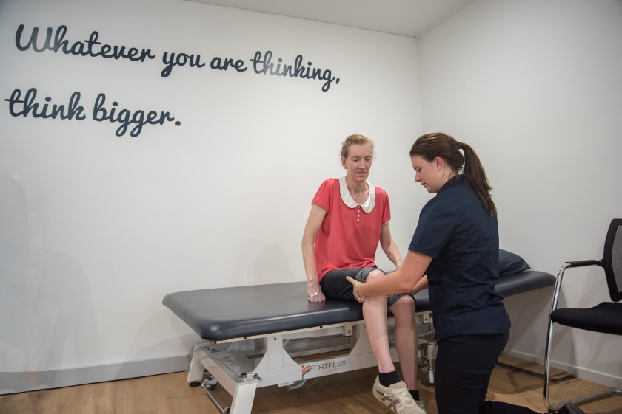
FND/CD Consumer and Carer Experiences
“My experience was 14.5 years of the medical world not knowing about FND, could have saved a lot of money spent on medical professional not knowing what I had.”
< 3 Months = 16%
4-11 Months = 18%
1 - 10 Years = 54%
> 10 Years = 12 %
Poor prognosis is associated with longer delay to diagnosis {Selkirk, 2008 #95}

Slide 22
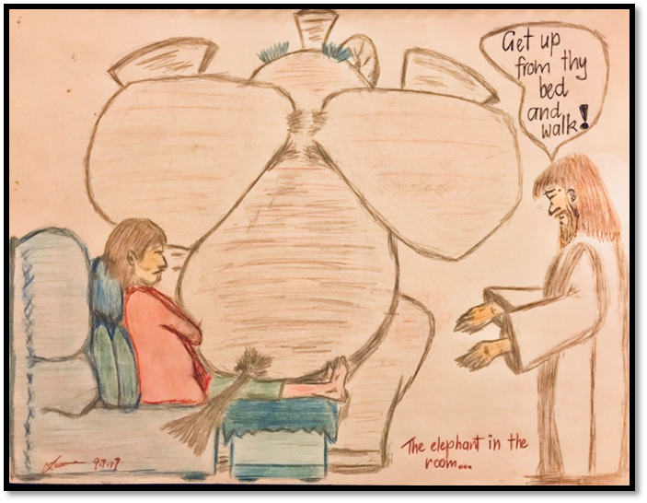
FND/CD Consumer and Carer Experiences
Diagnosis
“[I needed to be] given more information and support. I was referred back to GP”
“Quicker diagnosis, medical professionals not disregarding my symptoms, not being discharged from hospital with no understanding of what was going on, even though I couldn't walk unassisted, not being told 'you just need to try harder' by a neurologist even though he couldn't tell me what was going on.”

Slide 23

FND/CD Consumer and Carer Experiences
“Doctors nurses and other staff need to be aware of the condition and to give me information and referrals so I didn't have to source myself. Like many I was told I was faking it and I chose to be this way. It was all in my head etc.”
I was “told to not come back to the hospital because there is nothing they can do. More info would have been nice too”
“GP’s generally have no understanding of FND. I was humiliated and made to feel like I was a whinger and had no reason to be having symptoms. It was very distressing

Slide 24
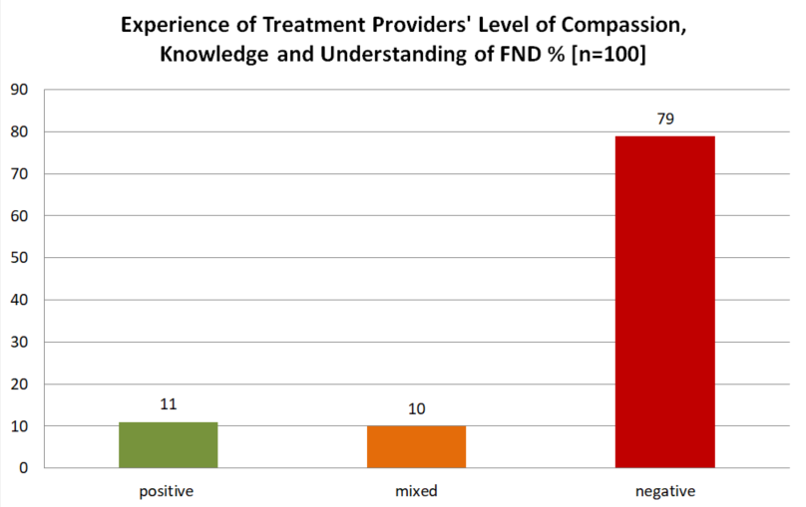
FND/CD Consumer and Carer Experiences
MIXED Experiences: I have not had that many good experiences with Drs, Specialists & even some nurses over the years. They didn’t have the knowledge, understanding & thought I was attention seeking. Made me feel like making it up, crazy & stop wasting there time when nothing wrong with me because tests came back fine. Bad bedside manners. It wasn’t until I saw Dr XX and Professor XX that things began to change last year. They have been helpful, understanding & have good way of communicating things.

Slide 25
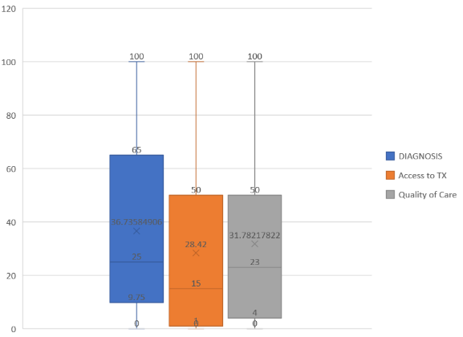
FND/CD Consumer and Carer Experiences
On a scale of 0 to 100, where 0 is least satisfied and 100 is most satisfied, how satisfied were you with:
1. DIAGNOSIS: The experience of being diagnosed with FND, the explanation provided about the condition, and the treatment plan recommended on diagnosis?
2. ACCESS TO TREATMENT: The ability to access the right treatment, at the right time, at a place that was accessible to you?
3. QUALITY OF CARE : The quality of care and treatment that you have received for FND

Slide 26
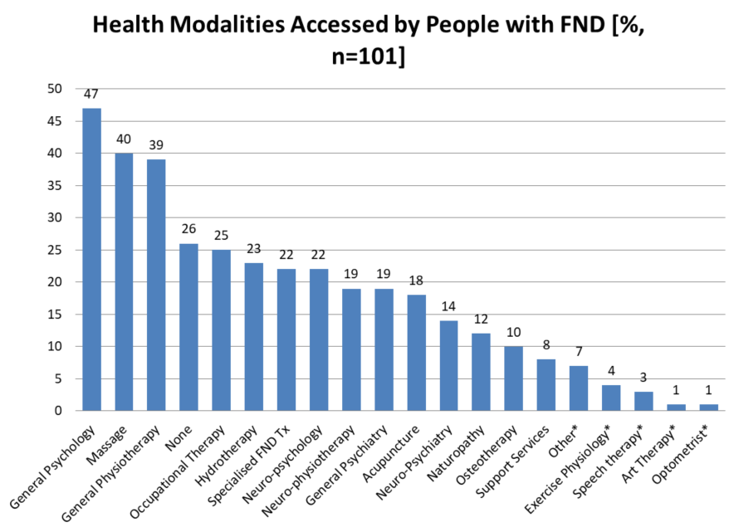
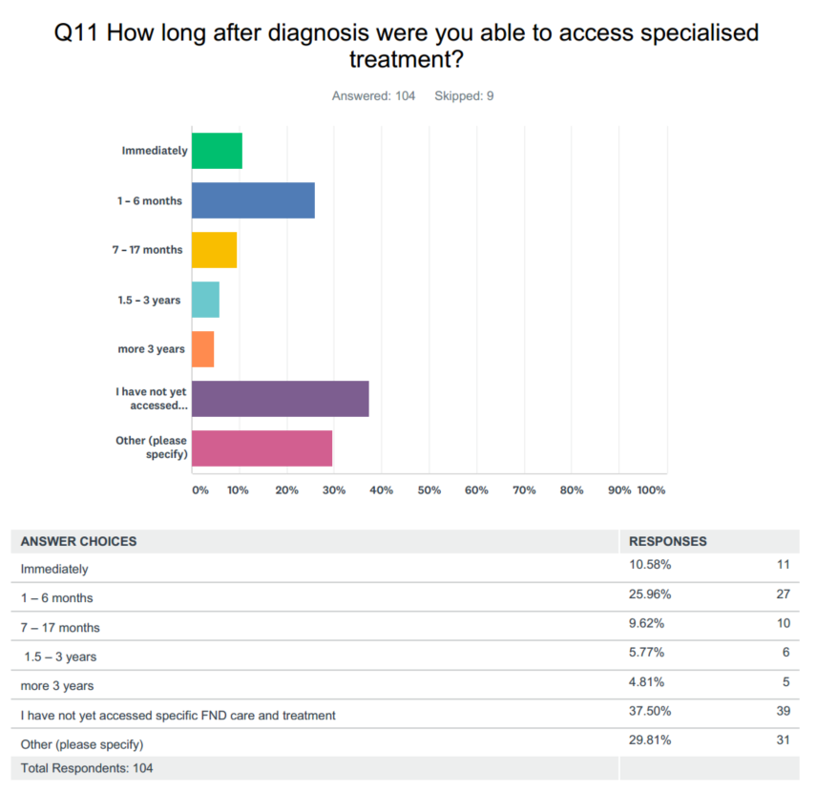
What happens after diagnosis?
Immediately | 10 %
1-6 months | 26 %
7-17 months | 10 %
1.5 - 3 years | 6 %
> 3 years | 5 %
I have not accessed TX | 38 %
Other | 5 %

Slide 27

What happens after diagnosis?
“Everyone just says I don't know anything about that and passes you on.”
“So far my experience is the medical profession seems to be very much in the dark about FND”
“Most of the Medical Profession has no idea or understanding of FND!!!”
“No one knows how to treat the condition. I feel like a practice mannequin where people try anything and everything with no real thought.”
“Once diagnosed with FND no one wants to do much to help”

Slide 28
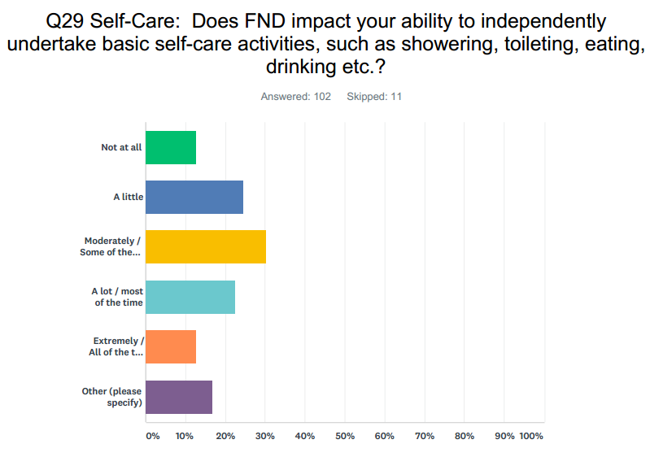
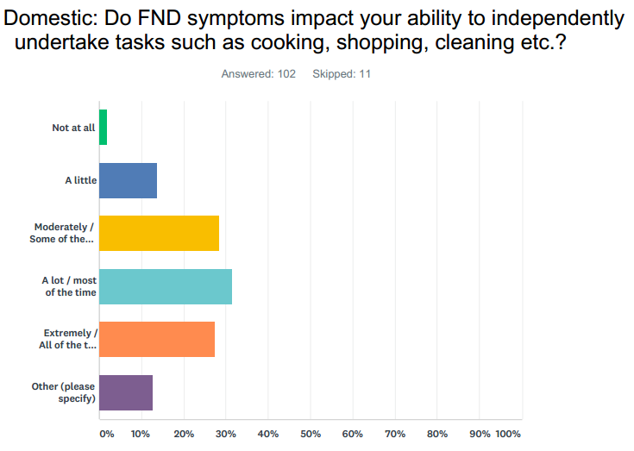
HOW DOES FND IMPACT DAILY LIFE?
Impacts independent self care [87%]
Impacts ability to perform domestic tasks [98%]
I cannot prepare my own food, I only shower once every 10 days, I require assistance to toilet. I cannot do anything for myself. I am 100% reliant on others.
I can't cook, I can't shop, I can't clean. I'm 100% reliant on others to do everything for me.
I live in assisted living. Meals are bought to my bed as I can't sit at table. Cleaning my room is done for me
“I can no longer cook, do basic housework, or do the grocery shopping, occasionally need assistance with basic personal care.”

Slide 29
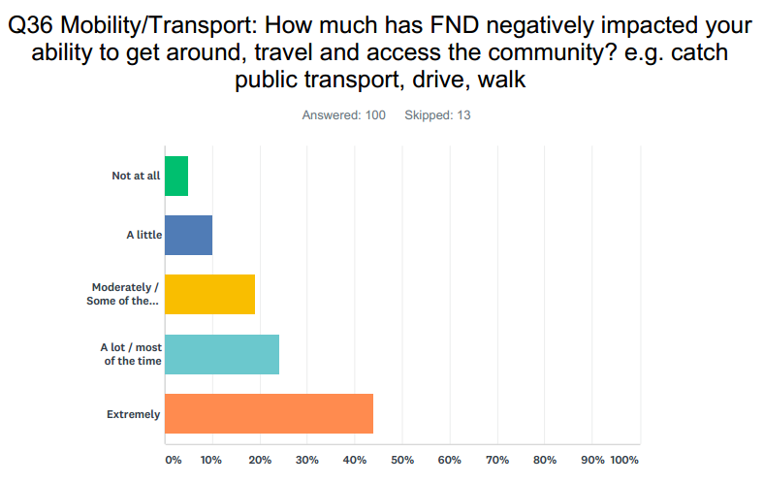
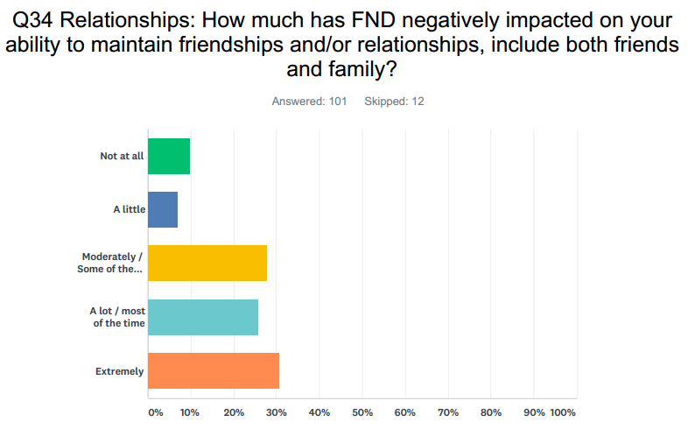
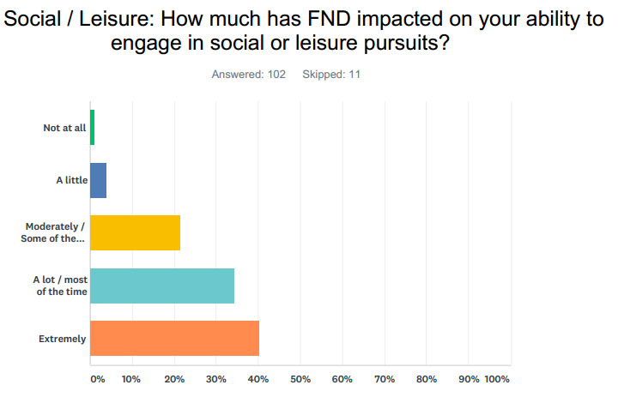
HOW DOES FND IMPACT DAILY LIFE?
Impacts community access –mobility/transport [95%]
Impacts ability to maintain friendships / relationships [90%]
Impacts social and leisure activities [99%]

Slide 30
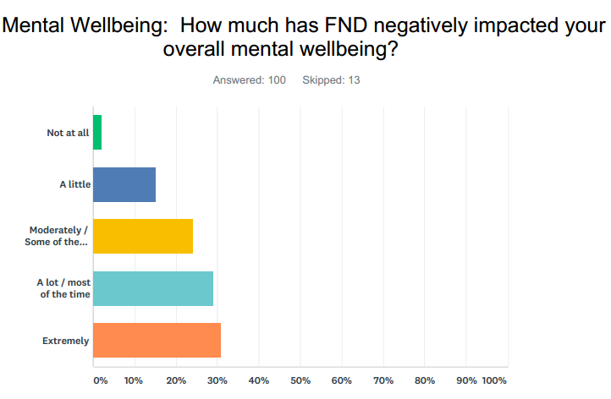
HOW DOES FND IMPACT DAILY LIFE?
“Deep depression BECAUSE of losing my life and abilities to this condition. Suicidal”
“I go through depressive episodes, hopelessness, anxiety, etc.”
“I am so depressed. I am lonely. Lost. Scared. Have bleak outlook of future.”
“It is hard enough adapting to such a disabling illness but having to deal with the discriminating and harmful attitudes in society, in the health profession and in the workplace is what does even more damage. It is a very distressing and debilitating illness”
Impacts Mental Well-being - [98%]

Slide 31
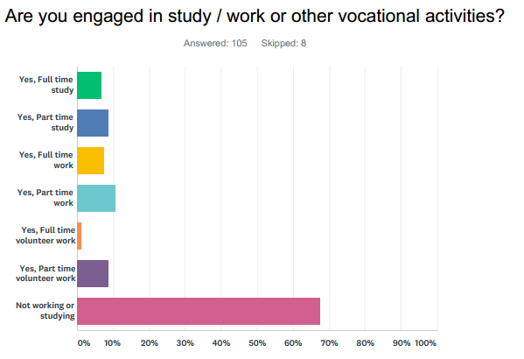
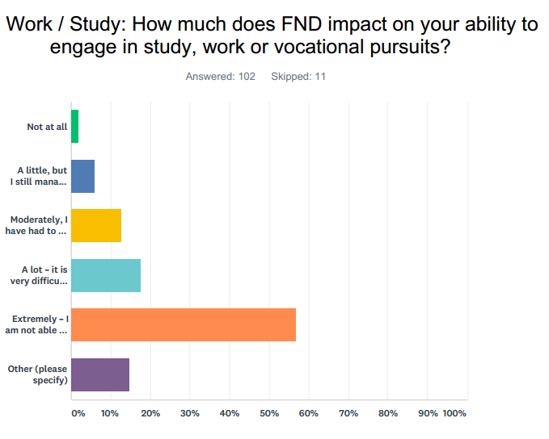
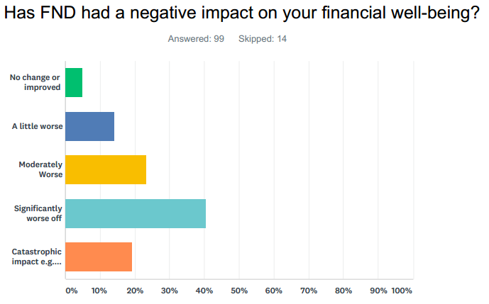
HOW DOES FND IMPACT DAILY LIFE?
Yes FT Study | 6.5%
Yes PT Study | 8.5%
Yes FT Work | 7.5%
Yes PT Work | 10.5%
Yes FT Volunteer Work | 1.0%
Yes PT Volunteer Work | 8.5%
Not Working or Studying | 67.5%
Not at all | 2%
A little | 6%
Moderately - cut back work /study | 13%
A lot - very difficult to work /study | 18%
Extremely - not able to work /study at all | 57%
Other | 4%
No Change | 5%
A little Worse | 14%
Moderately worse | 23%
Significantly Worse | 40%
Catastrophic Impact | 19%
“Potentially on the verge of losing house as I have not been able to work since I ended up in a wheelchair”
“Lost everything both my and my hubby’s incomes. We were about to buy a home and we lost my husband’s business.”
“Having to sell our farm - which is our home and livelihood....loss of home and employment.”

Slide 32

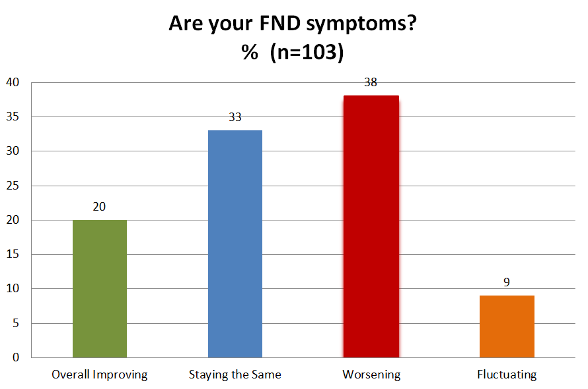
Recovery
Up and down on any given day or month. Very gradually improving in some areas.
Occupational therapists and psychologists taught me how to manage my symptoms. Any improvement is mostly because I have learnt to manage and pace myself.
Wax and wane you do your best to get as strong as you can till you go backwards again but never coming back to what you were, as we say a new kind of normal

Slide 33
FND/CD – Impact on Carers
Carer’s Mental Wellbeing
95% of carers reported that caring for a loved one with FND negatively impacted their own mental well-being to some extent. 33% of carers reported mental wellbeing was extremely affected or affected most of the time.
Carer’s Physical Wellbeing
85% of carers reported that caring for a person with FND has impacted on their physical wellbeing, to some extent, often due to manual handling e.g. pushing a wheelchair, lifting an adult person and lifting a wheelchair.
Carer’s Financial Wellbeing
87% of carers reported that caring for a person with FND affected their ability to work.
89% of carers reported that caring for a person with FND had a negative impact on their financial well-being. 7% reported catastrophic impacts including having to liquidate their business and sell their home.

Slide 34
FND/CD - Needs – Consumers and Carers
People reported:
Needing access to care and treatments, with professionals who know what the condition is and how to manage and treat the symptoms.
Wanting information about the condition and treatment options.
Wanting professionals to know and understand the condition instead of having to inform practitioners
Needing access to services and disability aids to manage around the house and the community.
Needing help dealing with Centrelink and NDIS.
Notes:
Cannot solve service provision but we can address the knowledge translation aspects. Information needs came up repeatedly

Slide 35

Connect With Us
Facebook
Peers – FND Australia Support Services
Carers – FND Australia Support Services Caregivers/Support Advocates
Clinicians – FND Australia Support Services/Health Practitioners
Public Page - https://www.facebook.com/FNDAus/
Twitter - https://twitter.com/FNDAus
E: kate@fndaus.org.au
W: www.fndaus.org.au

Slide 36
References
1- Hallett, M., Psychogenic movement disorders: a crisis for neurology. Current neurology and neuroscience reports, 2006. 6(4): p. 269-271
2 -Stone, J., et al., Functional disorders in the Neurology section of ICD-11: A landmark opportunity. Neurology, 2014. 83(24): p. 2299-2301.
3 Szaflarski, J.P., et al., Four-year incidence of psychogenic nonepileptic seizures in adults in Hamilton County, OH. Neurology, 2000. 55(10): p. 1561-1563
4 Rommelfanger, K.S., et al., Disentangling stigma from Functional Neurological Disorders: conference report and roadmap for the Future. Frontiers in neurology, 2017. 8: p. 106.
5 Dallocchio, C., A. Marangi, and M. Tinazzi, Functional or psychogenic movement disorders: an endless enigmatic tale. Frontiers in neurology, 2015. 6: p. 37.
6 Carson, A., et al., Disability, distress and unemployment in neurology outpatients with symptoms ‘unexplained by organic disease’. Journal of Neurology, Neurosurgery & Psychiatry, 2011. 82(7): p. 810-813
7 Stone, J., et al., The 12 year prognosis of unilateral functional weakness and sensory disturbance. Journal of Neurology, Neurosurgery & Psychiatry, 2003. 74(5): p. 591-596

