Slide 1



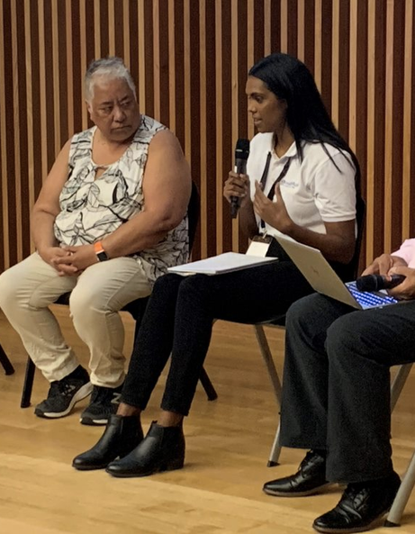


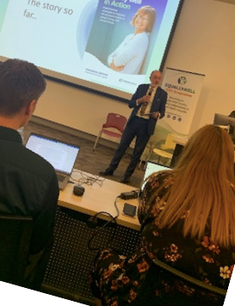

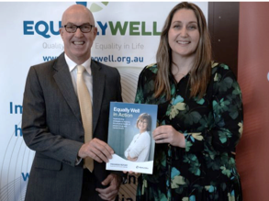

Quality of Life - Equality in Life
Presentation Title
EQUALLY WELL EQUALLY WELL EQUALLY WELL EQUALLY WELL
EQUALLY WELL EQUALLY WELL EQUALLY WELL EQUALLY WELL
Presenter Name

Slide 2






aims to improve the quality of life of people living with mental illness.
Notes:
https://www.youtube.com/watch?v=GanP6RozyWI&t=1s

Slide 3
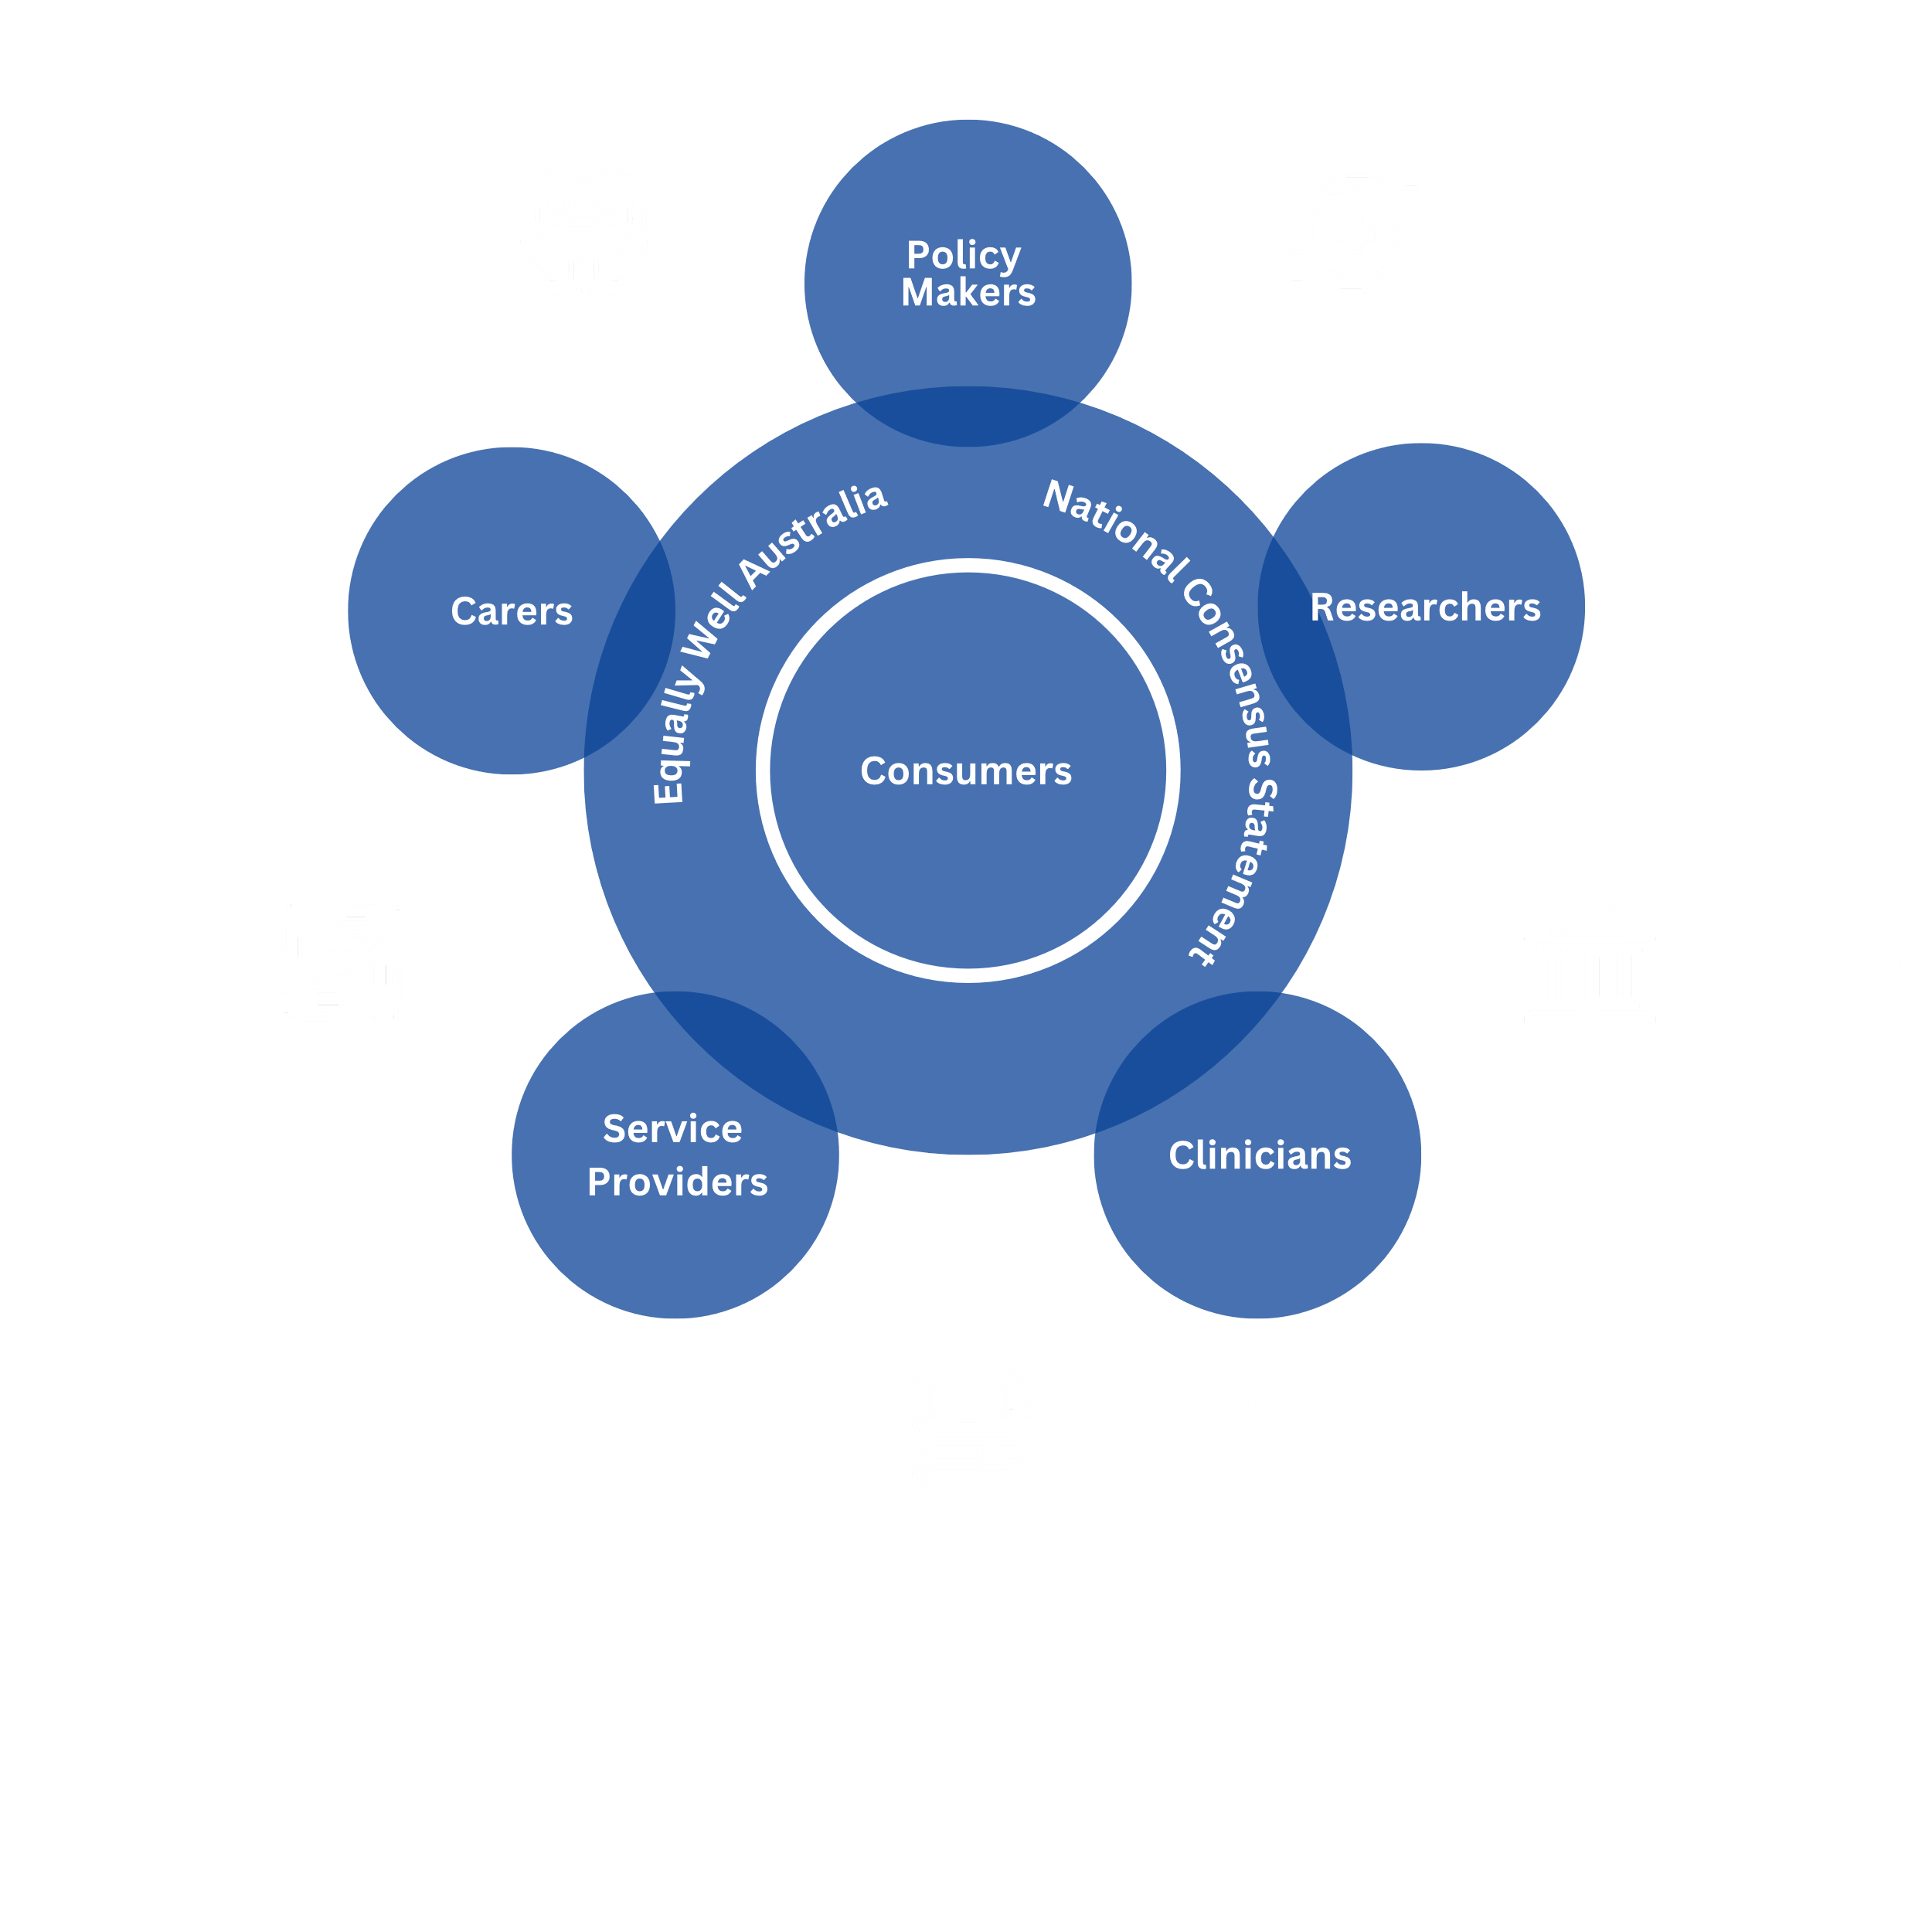
Who is
?
Equally Well is a movement around the shared goal of improving the physical health and wellbeing of people with a lived experience of mental health issues and promoting equity of access to physical health care as a basic human right.
Equally Well is anyone who works together to improve physical health for people living with mental illness.
EQUALLY WELL IS ALL OF US!

Slide 4



Did you know...
Compared to the general population, people living with mental illness are:
2X
6X
more likely to have cardiovascular disease
more likely to have dental problems
Four out of every five people living with mental illness have a co-existing physical illness.
2X
2X
more likely to
have respiratory disease
more likely to
have osteoporosis
1/3
One third of all avoidable deaths are made up of those living with severe mental illness
2X
65%
more likely to smoke
more likely to
have diabetes
Notes:
National Mental Health Commission. Equally Well Consensus Statement. Improving the physical health and wellbeing of people living with mental illness in Australia. https://www.equallywell.org.au/wp-content/uploads/2018/12/Equally-Well-National-Consensus-Booklet-47537.pdf Sydney: NMHC;
2016

Slide 5





Intergenerational trauma
Many factors contribute to people’s poorer physical health outcomes.
Poor quality care
Stigma and discrimination
Lack of physical health
Food insecurity
Lack of education
Exposure to violence and abuse
Smoking
Substance misuse
Mental health and physical wellbeing
Mental health services should include physical health care checks as part of routine care, and emphasise healthy lifestyle choices.
Social exclusion
Unemployment
Lifestyle choices
Lack of supportive relationships
Harmful eﬀects of medicine
Lack of whole-of-person care
Low income
Inadequate housing
BE A PART OF THE CHANGE
Poverty
Poor access to services
Figure: Nursing, Midwifery and Allied Health Professions Policy Unit, Improving the physical health of people with mental health problems:
Actions for mental health nurses. Dept. of Health, Public Health England 2016.

Slide 6





20%
Physical Health
is a vital piece of the mental health puzzle
Only 1 in 5 consumers reported their mental health professional asking about their physical health.
25%
Only 1 in 4 carers reported mental health professionals asking about the physical health of the person they support.
Notes:
Kaine, C., Lawn, S., Roberts, R., Cobb, L., & Erskine, V. (2022) Review of Physical and Mental Health Care in Australia, Lived Experience Australia Ltd: Marden, South Australia, Australia
https://www.equallywell.org.au/wp-content/uploads/2022/07/Review-into-Mental-and-Physical-Health-in-Australia.pdf

Slide 7


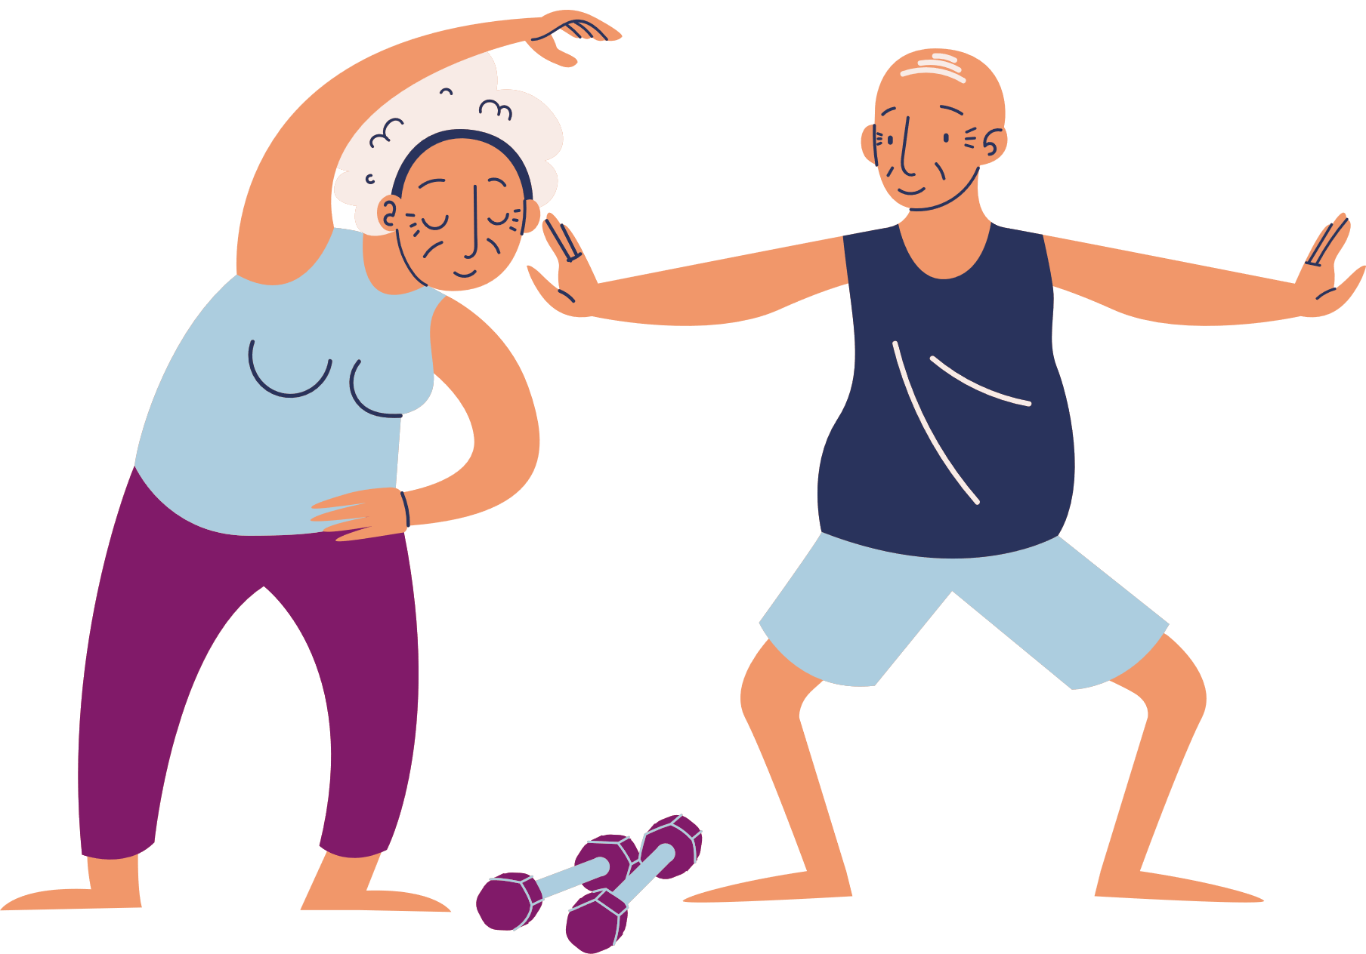


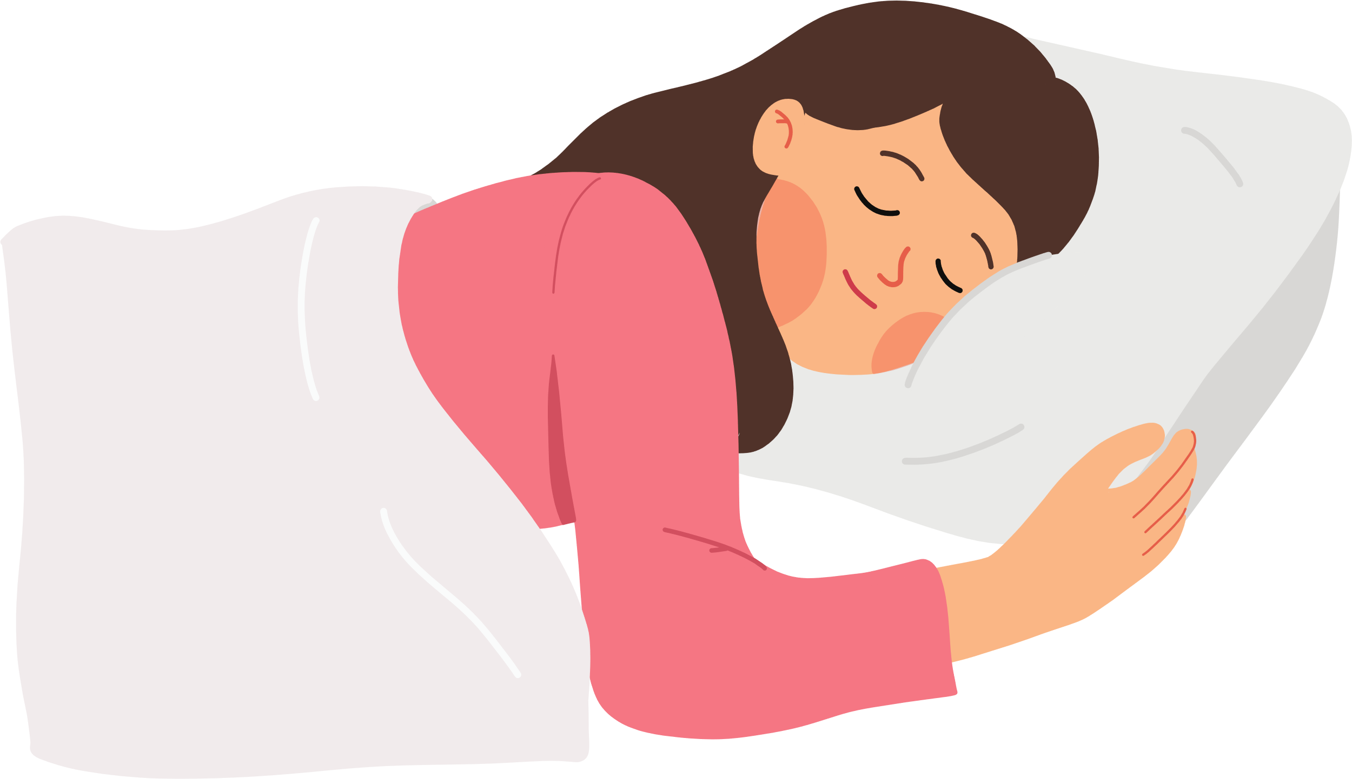



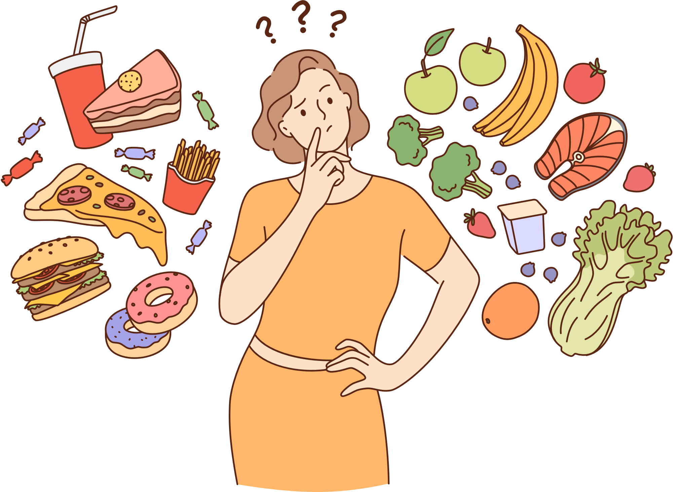
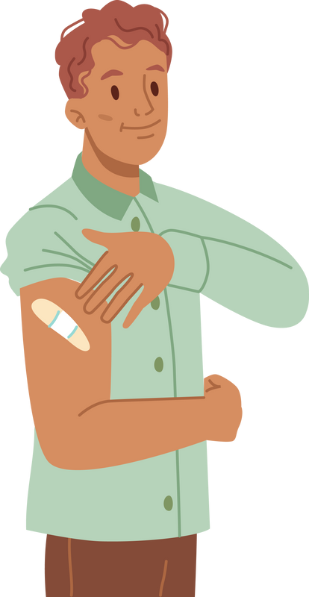

Smoking &
Vaping Habits
Physical Activity
Why should health professionals worry about the physical health of people living with mental illness?
Sleep & Rest
Oral Health
Holistic care is our job
Equity of access to health care and optimal health is a fundamental human right
Poor physical health is associated with a 4 times increase in the incidence of psychological distress
And associated with 47% of completed suicides
Improved physical health results in far fewer hospitalisations, reducing pressure and costs to medical staff, services and facilities.
Alcohol
consumption
Social
Participation
Nutrition
Vaccination

Slide 8







“ Do what you can, where you can,
when you can. ”
Equally Well Au
@EquallyWell_Au
@EquallyWellAu
@equally_well_au
equallywell.org.au
Stay connected and join the Equally Well movement.

Slide 9
References:
National Mental Health Commission. Equally Well Consensus Statement. Improving the physical health and wellbeing of people living with mental illness in Australia. https://www.equallywell.org.au/wp-content/uploads/2018/12/Equally-Well-National-Consensus-Booklet-47537.pdf Sydney: NMHC;
2016.
Australian Bureau of Statistics. National Health Survey: Mental Health and co‑existing physical health conditions, Australia, 2014‑15. Dec (2015).
Nursing, Midwifery and Allied Health Professions Policy Unit, Improving the physical health of people with mental health problems: Actions for mental health nurses. Dept. of Health, Public Health England 2016.
Australian Institute of Health and Welfare. Comorbidity of mental disorders and physical conditions 2007. Cat. no. PHE 155. Canberra: AIHW: 2012
Roberts R. Equally Well. Physical health and mental illness. A narrative literature review. National Mental Health Commission: Charles Sturt University; 2019.
Kaine C, Lawn S, Roberts R, Cobb L, Erskine V. Review of Physical and Mental Health Care in Australia. Marden, South Australia: Lived Experience Australia Ltd; 2022.

