Slide 1
Improving the physical health of people living with mental illness and reducing early mortality - Progress on implementing the Fifth Plan
Dr Marcus Nicol, Director , Monitoring and Reporting, National Mental Health Commission

Slide 2
Overview
The National Mental Health Commission’s role
Overview of the evidence
Development of the Equally Well national consensus statement
Progress on implementing priority area 5: Improving the physical health of people living with mental illness and reducing early mortality in the Fifth National Mental Health and Suicide Prevention Plan
  Barriers
  Enablers
  Achievements

Slide 3
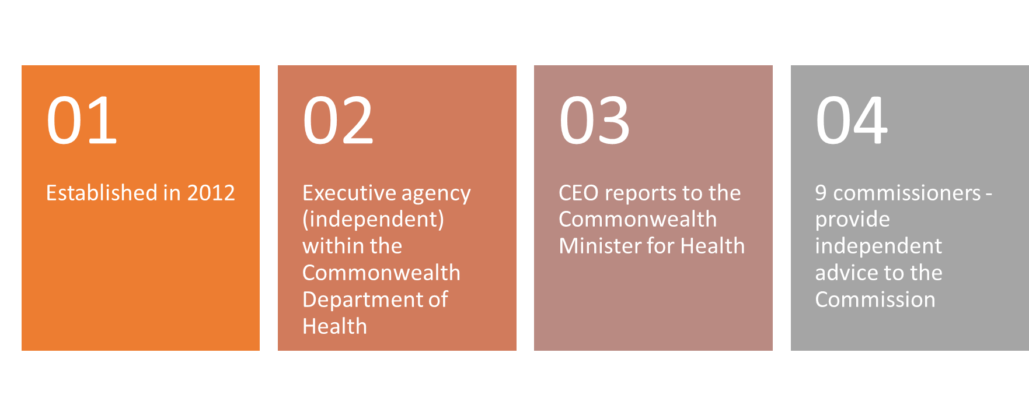
About the National Mental Health Commission

Slide 4
The Commission’s role
That all Australians achieve the best possible mental health and wellbeing.
  Monitor and report on mental health and suicide prevention systems
  Provide advice to Government and the community
  Act as a catalyst for change
Notes:
Monitor and report on mental health and suicide prevention systems
We aim to hold the government and system accountable for its performance
Provide advice to Government and the community
We deliver insight into ways to continuously improve Australia’s mental health and suicide prevention systems
Act as a catalyst for change
By engaging, collaborating, facilitating, influencing, leading, researching and seeding initiatives

Slide 5
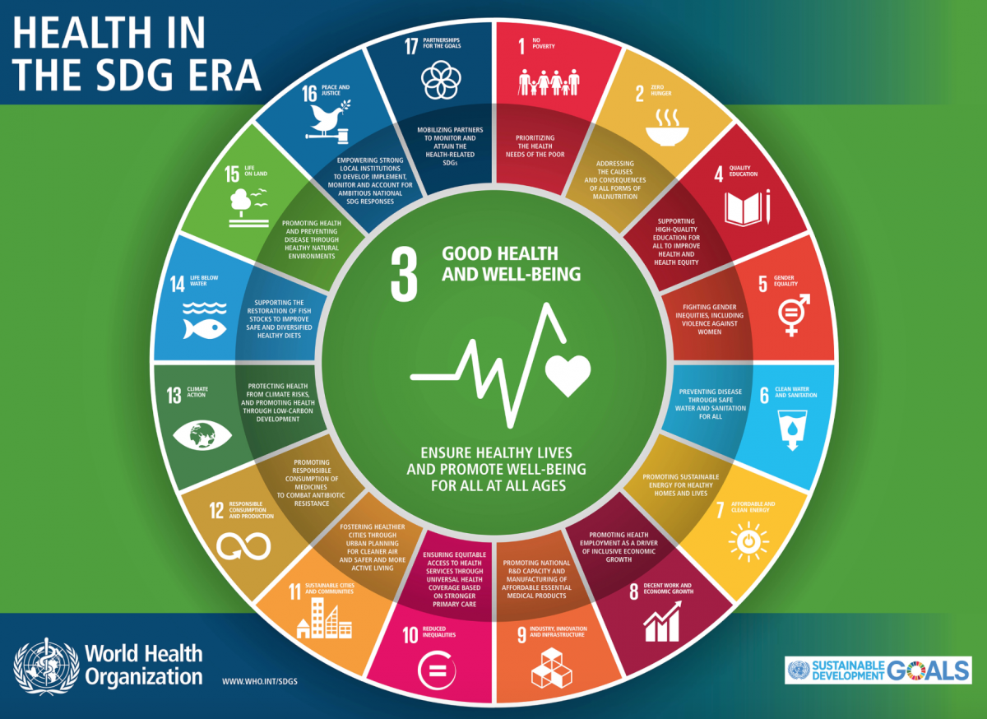
An overview of the evidence
Health and wellbeing is a basic human right and it is being denied to many in our community because they have a mental illness.
On average, people with a serious mental illness die younger – between 14 and 23 years earlier – than the general population.
For Aboriginal and Torres Strait Islander people the gap worsens due to their existing life expectancy gap.
The life expectancy gap for those with serious mental illness seems to be widening over the past three decades.
Four out of every five people living with a mental illness have a co-existing physical illness. They comprise around one third of all avoidable deaths.
Notes:
National and international evidence that people with mental illness will have poor physical health.
Yet we know that much of the link between mental illness and poor physical health is preventable. We just need to do more to prevent it!
The disparities in health outcomes for people living with mental illness– with lower life expectancy and higher rates of physical ill-health – are unacceptable.
Literature review detailing the evidence will be released on Commission’s website shortly.
Commission was well-placed to lead this work with partners to develop a national consensus statement on how to improve physical health.

Slide 6


Equally Well:
Launched in July 2017 by inaugural National Mental Health Commission Chair, Allan Fels.
Committed to putting health care for people living with mental illness on an equal footing.
We will improve the physical health of people living with mental illness by acting to deliver:
  a holistic, person centred approach to physical and mental health and wellbeing
  effective promotion, prevention and early intervention
  equity of access to all services
  improved quality of health care
  care coordination and regional integration across health, mental health and other services and sectors which enable a contributing life
  the monitoring of progress towards improved physical health and wellbeing.
Notes:
To achieve improved health outcomes for people living with mental illness, it clearly will require a change in how the system works.
To achieve this the Commission worked with key partners across the mental health sector to consult widely and develop an agreed approach with best practice actions.
Inspiration from colleagues in NZ who formed Equally Well Coalition.
One of the core reforms we have called for is person-centred care rather than provider-centred care as this approach makes it easier to combine physical health care as well as mental health care.
The Equally Well Statement challenges the low expectations that pervade the health system in terms of health outcomes for people with serious mental illness. Not only can people with mental illnesses benefit from evidence-based interventions, just like everyone else, but more fundamentally, they have the same right to high-quality appropriate health care as everyone else.

Slide 7

Fifth National Mental Health and Suicide Prevention Plan
FIFTH PLAN PRIORITY AREAS
1: Achieving integrated regional planning and service delivery
2: Suicide prevention
3: Coordinating treatment and supports for people with severe and complex mental illness
4: Improving Aboriginal and Torres Strait Islander mental health and suicide prevention
5: Improving the physical health of people living with mental illness and reducing early mortality
6: Reducing stigma and discrimination
7: Making safety and quality central to mental health service delivery
8: Ensuring that the enablers of effective system performance and system improvement are in place
Notes:
Fifth Plan was endorsed by COAG Health Council on 4 August 2017
A Fifth Plan Implementation Plan has also been developed and contains details of each action from Fifth Plan – provides details of action, identifies roles and responsible parties and co-ordination point (usually an AHMAC committee)
The Commission was given role to monitor and report on progress of on the implementation of the Fifth Plan

Slide 8
Fifth National Mental Health and Suicide Prevention Plan
Priority Area 5: Improving physical health and reducing early mortality
Actions - Governments will:
14: Commit to the principles of Equally Well
15: Develop/update guidelines and resources for use by health services and professionals
16: Work with PHNs and LHNs to ensure physical illness is part of local treatment planning and clinical governance for MH
17: Commence regular national reporting on physical health of people with a mental illness
Notes:
Improving physical health and reducing early mortality was targeted as a priority area in the Fifth Plan.
The Fifth Plan actions align with the Equally Well principles that sets out practical approaches to addressing the problem of poor physical health of the mentally ill including better prevention services, early treatment, better equity of access, improved quality of health care, care coordination and better integration across physical health, mental health and other services.

Slide 9
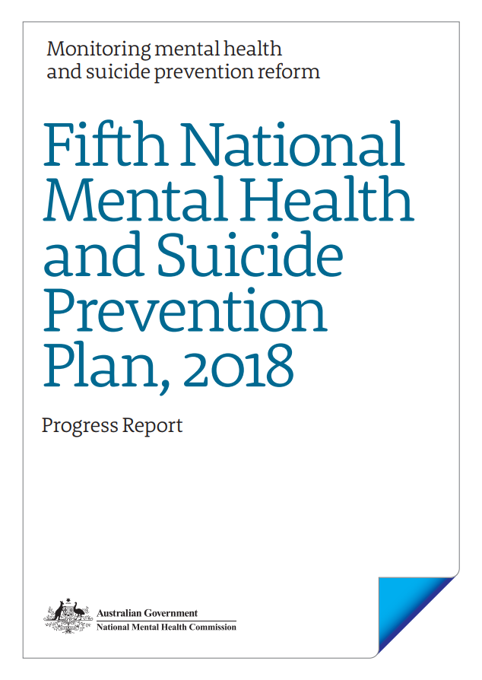
Fifth Plan Progress Report 2018
The Commission is responsible for delivering an annual report, for presentation to Health Ministers, on (1) the implementation progress of the Fifth Plan actions and (2) performance against the identified indicators.
To achieve this we surveyed the coordination points for each relevant Fifth Plan action identified in the Fifth Plan Implementation Plan.
Respondents were asked to:
  categorise their progress against each action
  provide free text descriptions of their key achievements, barriers, and enablers relating to their contribution to the Fifth Plan actions
  categorise their level of consumer and carer involvement in progressing their contribution to each action
Notes:
In October 2018, the Commission released its first Progress Report on the Fifth Plan
There are two parts to the report – the first is the results of a survey to 51 relevant stakeholders on the progress against Fifth Plan actions – stakeholders were Commonwealth Department of Health, state and territory health departments, PHNs, state and territory mental health commissions (or equivalent) and relevant AHMAC committees
Each respondent provided feedback on THEIR CONTRIBUTION to Fifth Plan progress (note that no-one responded as to overall progress for each priority area – this has changed for 2019 survey and we will ask co-ordination points as identified in the Fifth Plan – this is mostly the relevant AHMAC committee)
The second part of the progress report was data on the 24 performance indicators identified in Fifth Plan – we reported data on 13 of those – others did not have specifications finalised at the time. In 2019, we hope to report on 16 indicators

Slide 10
Fifth Plan Progress Report 2018
The NMHC surveyed 51 relevant stakeholders, including PHNs, Australian Government and state and territory departments of health, state mental health commissions, and relevant AHMAC sub-committees.
Survey respondents were asked to self-report the progress of their contribution to each action, as at 30 June 2018.
For Priority Area 5, we surveyed PHNs, state/territory health departments and mental health commissions as they are named as having a role in progressing the relevant actions in in Fifth Plan
Notes:
Note that Priority Area 5 only sought responses from PHNs, state and territory health depts and state and territory commissions
Important note – we surveyed 51 respondents in total, and PHNs were 29 of the 51 and therefore much of the data comes from PHN responses

Slide 11
Priority Area 5: Improving physical health and reducing early mortality
Barriers
Responses by PHNs and Commissions
Lack of a clear funding mechanism to address physical health issues and segmented funding arrangements
GPs need to be empowered to provide support to patients living with mental illness through education and training
A need for improved transition mechanisms between primary and secondary care
Limited formal arrangements to support the integration of community mental health and primary health care services

Slide 12
Priority Area 5: Improving physical health and reducing early mortality
Enablers
Responses by PHNs and Commissions
My Health Record is an enabler to improving communication and transition between services for people living with complex health needs
Involving GPs in model design, and working closely with medical practices to improve relationships was crucial to improving physical health
Willingness and ability to develop more integrated services such as Collaborative Care Plans for patients engaged with multiple service providers
Service providers in some regions were collaborating and consulting with consumers to develop, deliver, and review numerous health promotion, prevention and early intervention programs.

Slide 13
Priority Area 5: Improving physical health and reducing early mortality
Select achievements
Education and training to GPs about the management of physical health issues for people living with mental illness - PHNs from Northern Sydney, Central &Eastern Sydney, Perth South, Perth North and Country WA
Provision of physical health training and education events for clinicians – Queensland Health
Implementation of primary mental health clinical care coordinators to support improved access to metabolic monitoring in primary care for individuals living with mental illness - Adelaide PHN
Peer-led initiative aimed at improving the physical health of people living with mental illness - South Eastern NSW PHN
Smoking cessation program for people living with mental illness - Gippsland PHN
Launch of My Medicines and Me – a collaborative tool for consumers – WA Health
Notes:
Note – we also released a separate case study report that included 3 case studies relating to physical health

Slide 14
Fifth Plan Performance Indicators
Fifth Plan identifies four indicators that are relevant to physical health:
  PI2: Rate of long-term health conditions in people with mental illness
  PI3: Rate of drug use in people with mental illness
  PI4: Avoidable hospitalisations for physical illness in people with mental illness
  PI5: Mortality gap for people with mental illness
In 2018, the Commission reported on PI2 and PI3 as these had data available
Notes:
4 relevant performance indicators (including 2 that are still under development, so you could talk a little about the difficulties in measuring/monitoring progress. You could mine the Excel workbook for interesting data for the two available indicators)
Note PI2 and PI3 were reported in 2018, PI 4 and PI5 currently do not have an agreed data methodology and source – this under development with MHISSC
Note that the full set of available data for the 13 indicators is available on Commission website

Slide 15
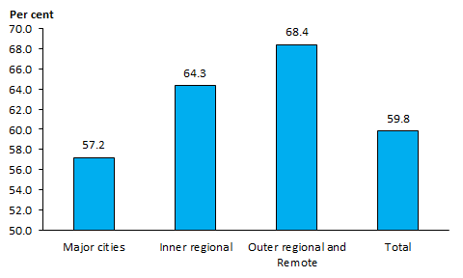
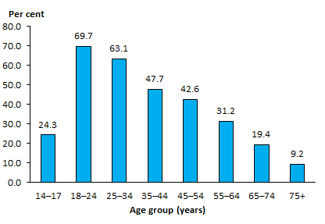
Performance Indicators
PI2: Long term health conditions in people with mental illness
PI3: Tobacco and other drug use in people with mental illness
Notes:
PI2: In 2014–15 59.8% of people with a mental illness also had a long-term physical health condition. The proportion of people with a mental illness who also reported having a long-term physical health condition increased as remoteness increased
PI3: The rate at which adolescents and adults with a mental illness consumed five or more standard alcoholic drinks on a single occasion varied by age group, ranging from 69.7% in 18-24 year olds, to 9.2% in people aged 75 and over
NOTE: these figures represent a part of a larger dataset that has many more data elements available eg state and territory breakdown, Indigenous status, sex etc – these data are available on the Commission website as an excel file

Slide 16
Thank you
E: marcus.nicol@mentalhealthcommission.gov.au
W: www.mentalhealthcommission.gov.au

