Slide 1

Identifying and treating mental illness alongside physical illness in general practice
Associate professor Mark Morgan
Bond University
Chair of RACGP Expert Committee for Quality Care

Slide 2


Slide 3
Depression
Heart Disease or Diabetes
1.5 – 2 times more
About 30% of patients
30% more
41% more
Mortality increased up to x 3

Slide 4
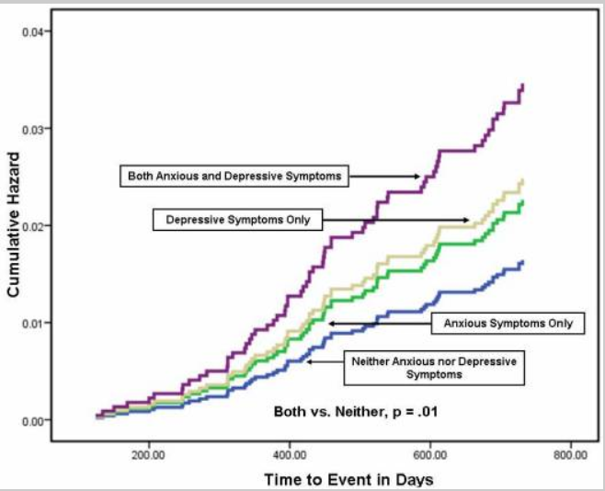
Mortality Rates in people with heart disease
Doering et al. 2010

Slide 5

Neuroendocrine
Inflammatory and endothelial
Coping and adherence
Appetite
Increased cardiovascular risk
Fatigue
Daily stress of managing diabetes
Neuroendocrine
Inflammatory and endothelial
Increased cardiovascular risk
Notes:
Rationale for TrueBlue Study – randomised trial of collaborative care for the management of depression alongside the management of diabetes (and coronary heart disease)
Bidirectional relationship between diabetes and depression
Overlap of some symptoms and biophysical focus of medical consults leads to missing diagnosis of co-morbid depression
Poorer outcomes in co-morbid disease

Slide 6

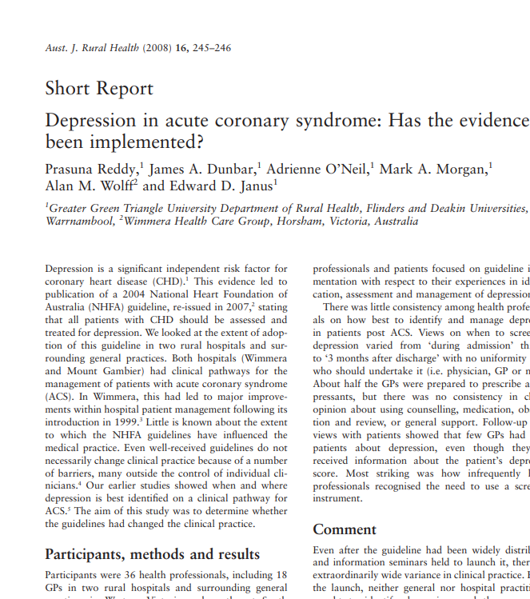
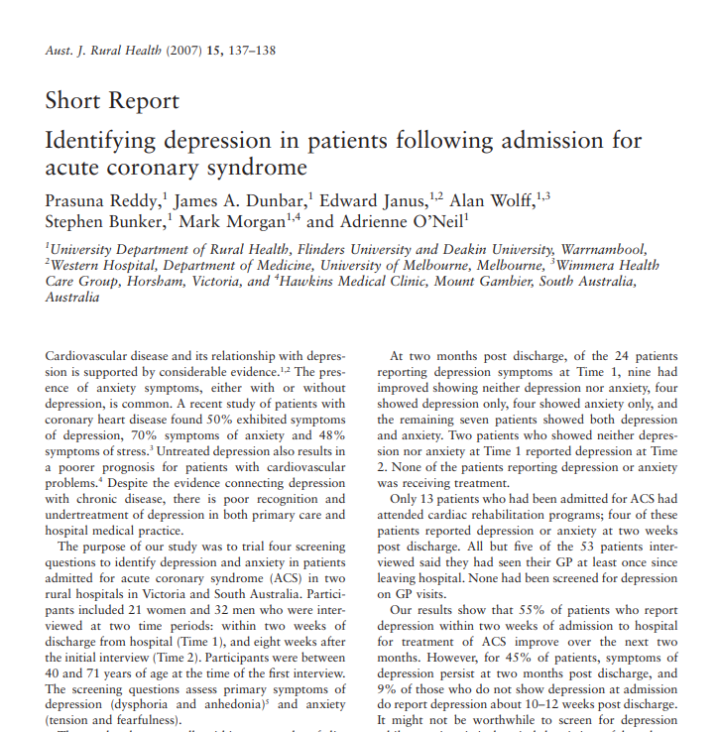
Why?

Slide 7

Smoking
Influenza injection
HbA1c
erections
Prescriptions
Blood sugar levels
Renal function
Cholesterol
Blood pressure
toe nails
Goals
Driving licence
Hypos
Fine Touch Sensation
Waist
Blood tests
Team Care Arrangements
Retinopathy
Item numbers
Triglycerides
depression
walk more, eat less
Allied Health Referrals
GP Management Plans
Notes:
7
7
These are just some of what goes through my mind when I see a diabetic patient so it is no wonder some of these things get missed.
Certainly in Australia the minority of patients receive optimal care
Bear in mind that the average over 65yr old patient with diabetes will have more than 6 co-morbidities
Clearly there is a need for timetabled, protocol driven care, with tasks shared between the team and tools for communicating between members of the team.
For there to be a nominated case-manager. These are the features of collaborative care.

Slide 8

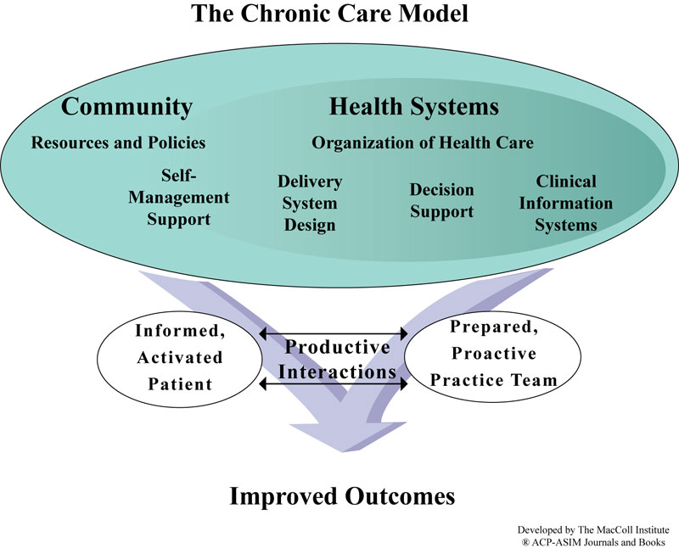
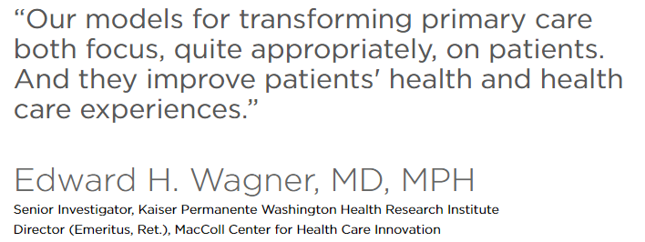

Slide 9

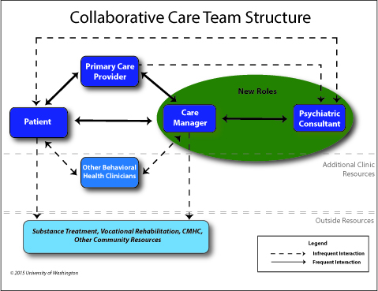
Wayne Katon

Slide 10
Pilot Project: D_TECT
GP
Practice
Nurse
Research GP psychologist
Private psychologist
Community Exercise programs
Allied Health providers

Slide 11
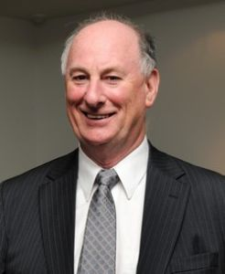
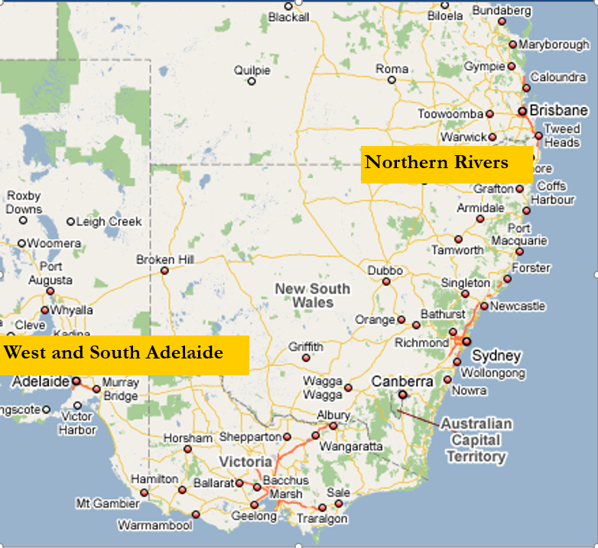
James Dunbar
D_TECT and TrueBlue trials

Slide 12

TrueBlue randomised trial
Does collaborative care improve outcomes for multimorbidity?
Subjects Diabetes/Coronary Heart Disease + Depression (n=400)
Intervention Each 3 months: practice nurse and then GP
Control Usual Care
Notes:
12
12
TrueBlue was designed after a search for the most successful models of care worldwide- [we settled on University of Washington IMPACT model]
Our pilot study demonstrated the feasibility of practice nurses screening for and monitoring depression
while helping GPs carry out routine monitoring of patients with diabetes and heart disease.
400 patients with depression, diabetes or heart disease were recruited using the Patient Health Questionnaire – the PHQ9 – to identify depression.
11 GP practices were randomised to deliver TrueBlue care or usual care.
In the intervention group patients attended every three months to see the practice nurse followed by their usual GP

Slide 13
Patient Pathway
Waiting room survey
Depression score (PHQ-9 questionnaire)
Over the counter medication list
45-minute nurse consult
Physical measures and review of pathology results
Review of psycho-social risks using PHQ-9 responses, etc.
Review of lifestyle factors
Discuss and develop up to three personal goals based on findings
Case-management tasks, such as referrals, recall date
15-minute GP consult
Clinical management
Completion of GP management plan, mental health plan
Recall at 3 months – update plan, re-negotiate goals

Slide 14





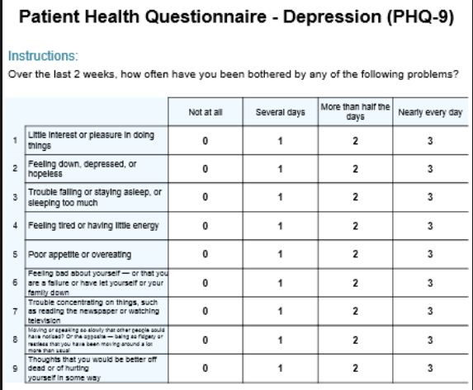
Collaborative Care Ingredients
Care Manager (practice nurse)
Informed and engaged and patients
With an informative care plan.
GP – clinical decisions
IT systems –recall and tracking
Training and consultation-liaison
Measurement for stepped care
Notes:
New roles for team members. The care manager tracks recovery, assists with adherence to treatments such as behavioural activation
Measurement and tracking
Consultation-liaison with specialist services such as psychologists
Primary care physician receives curated information from the care manager.

Slide 15
Outcomes of TrueBlue
Depression reduced (from 10.7 to 7.1 on PHQ9)
Cardiovascular risk reduced (from 27.4% to 24.8%)
Exercising (from 41% to 60%)
Goal setting and case-management activities increased (81% goals achieved, 14% re-negotiated)
Adherence to “best practice” guidelines

Slide 16
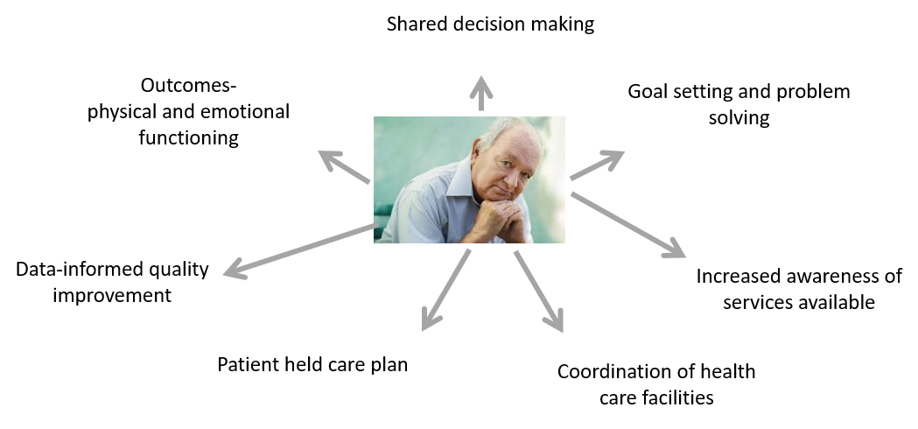
Collaborative Care for identifying and treating mental illness alongside physical illness

Slide 17
Policy that supports team-based longitudinal care in Australia
Health Care Homes
MBS Review
GP committee
Allied health committee
Mental health committee
Guidelines
RACGP and Diabetes Australia
National Heart Foundation

Slide 18

My thoughts
Remove the separation of MBS rebates for mental and physical illness
Voluntary enrolment
Blended payments
New role for psychiatrists
Allied health generalist training
Needs based funding
Move pharmacists from their shops
Support for behavioural activation
Symptom tracking apps
Routine telehealth

