Slide 1

Improving physical health care in mental health services for older people: reflections on a decade of local and state-wide initiatives.
Prepared by
Dr Rod McKay
Clinical Advisor:
Older People’s Mental Health Policy Unit Mental Health Branch, NSW Ministry of Health
March 2019

Slide 2
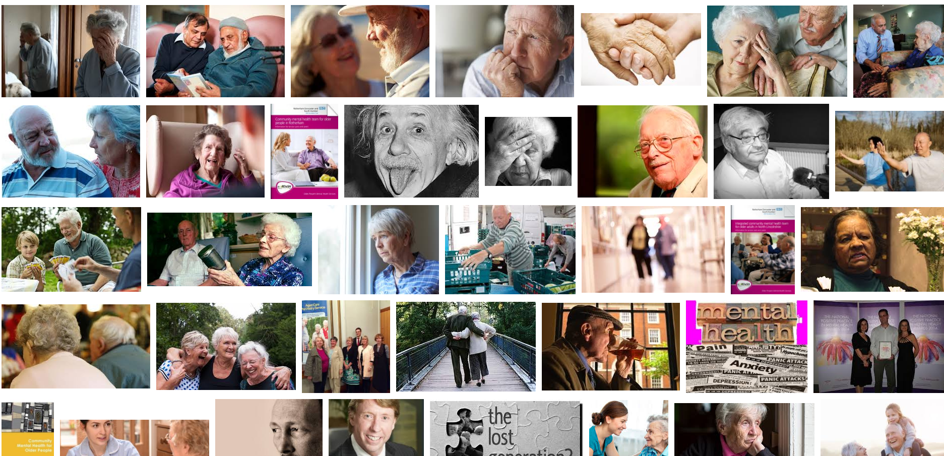
Why are we discussing this?
https://www.google.com.au/search?q=older+people+mental&tbm=isch&source=lnt&tbs=itp:photo&sa=X&ved=0ahUKEwjKw8qZ5qXVAhULurwKHVOvBgYQpwUIHA&biw=1920&bih=974&dpr=1

Slide 3
Roles that will influence my reflections
Clinical Advisor since 2006
Psychiatrist focused on working with older people
Past clinical director
Educator
Director Psychiatry and Mental Health Programs:, Health Education and Training Institute
Past binational chair, RANZCP Faculty of Psychiatry of Old Age
Past binational chair, RANZCP Community Collaboration Committee
Chair, National Mental Health Information Development Expert Advisory Panel
Community member

Slide 4
Key messages
Systematic improvement of the physical healthcare of older people with mental illness accessing mental health services is difficult
Systematic action to improve the physical healthcare of older people with mental illness accessing mental health services is difficult, but possible
There are factors that appear likely to increase the probability that action will lead to improved health outcomes, but evidence for this is weak
We need to
Have specific actions to improve the physical health outcomes of older people with mental illness
Improve the evidence base regarding what works to improve the physical health outcomes of older people with mental illness
Work collaboratively and continually work to build trust between partners
NSW is starting a project based on these lessons

Slide 5


National perspective: Variation is large

Slide 6
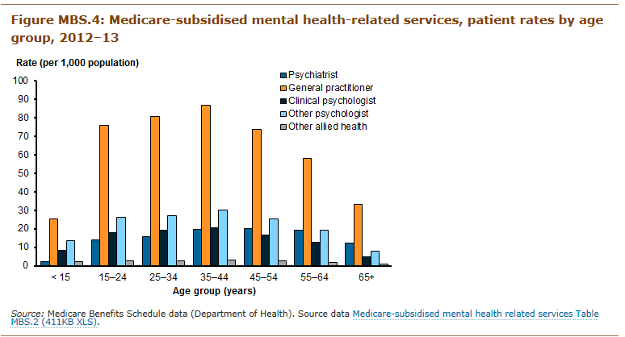
Medicare funded MH services

Slide 7
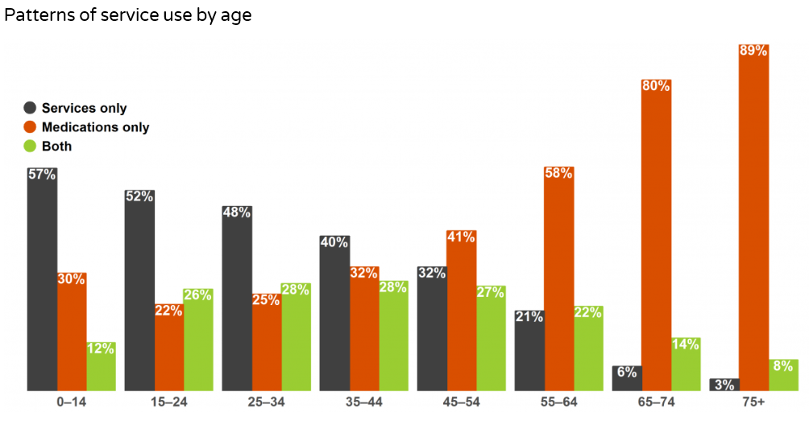
Effect of age

Slide 8
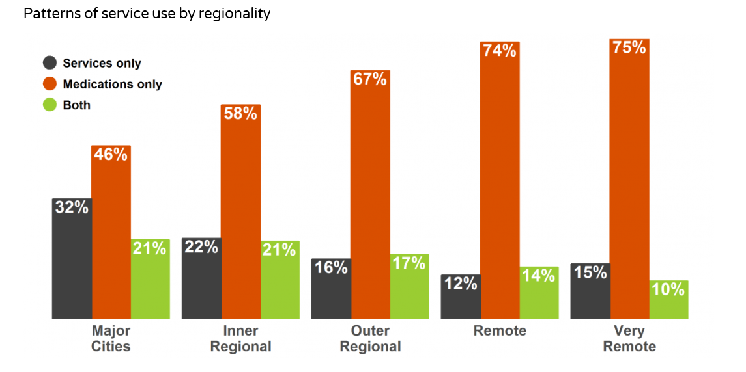
Effect of region

Slide 9
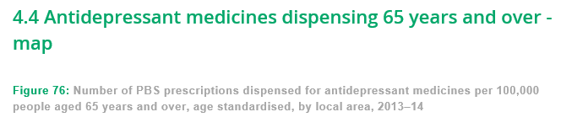
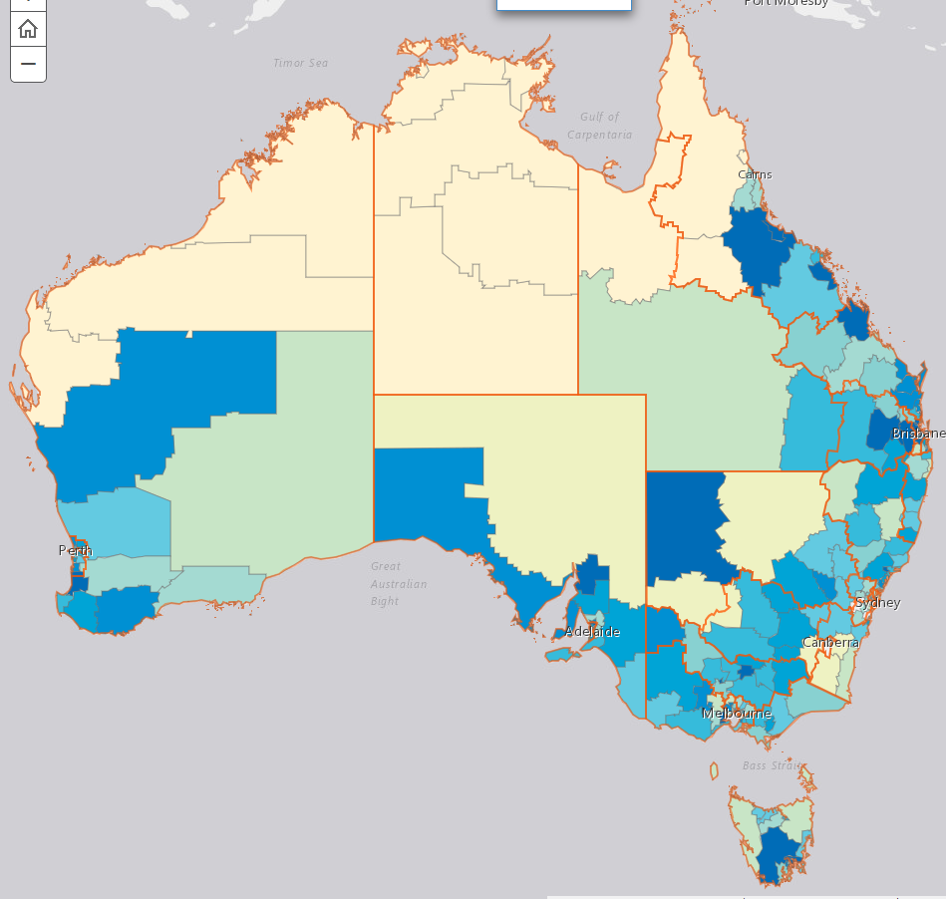
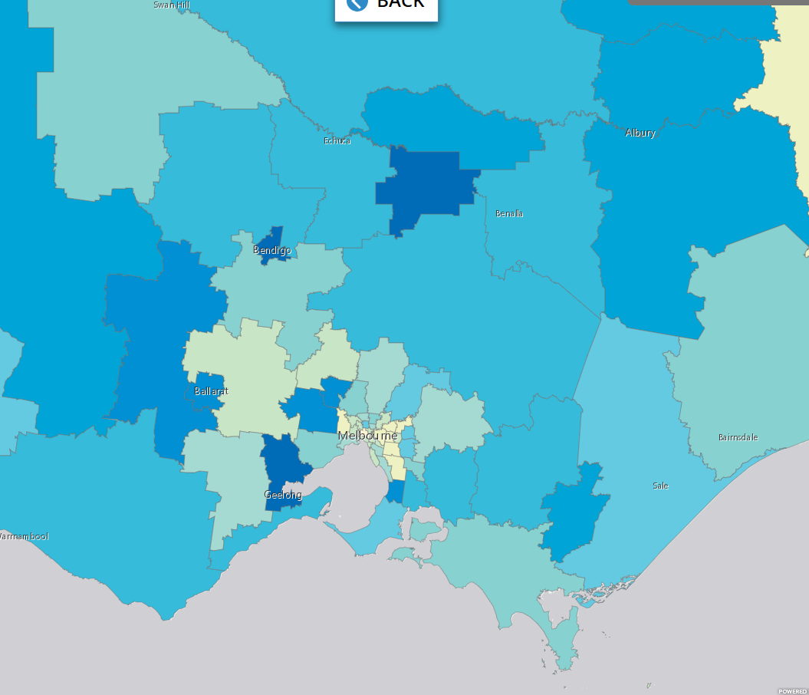
Antidepressant prescription

Slide 10
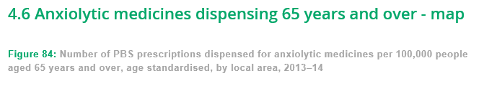
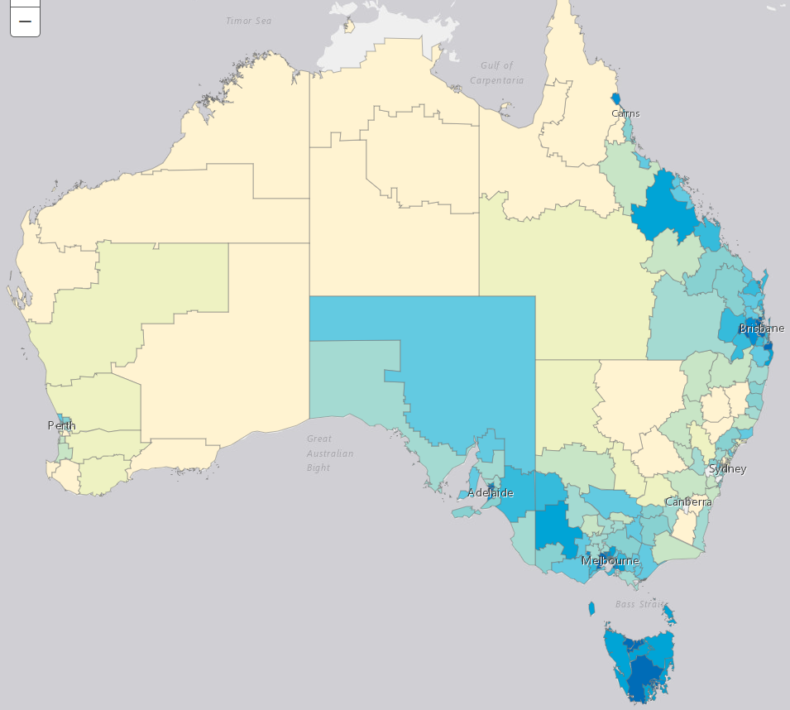
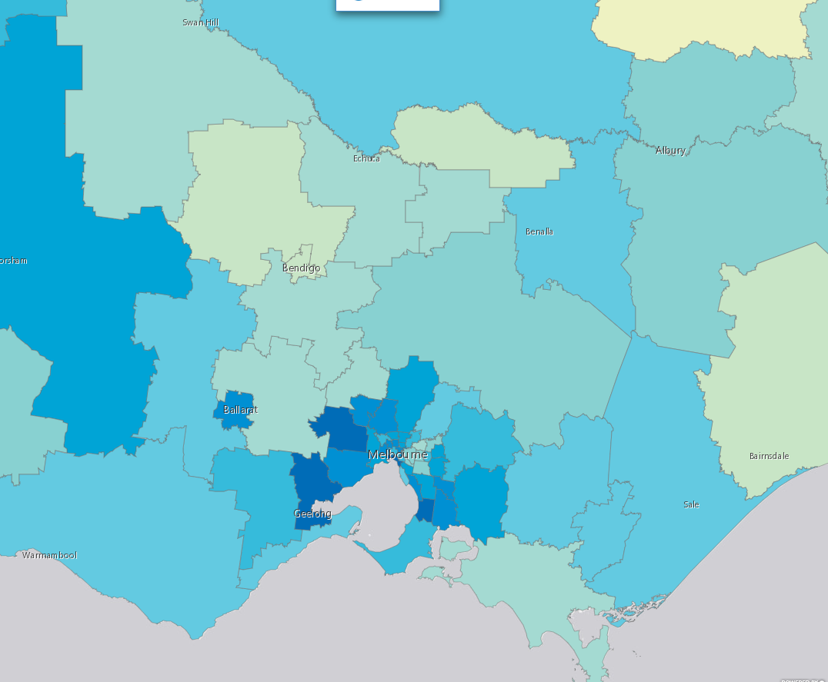
Anxiolytic prescription

Slide 11
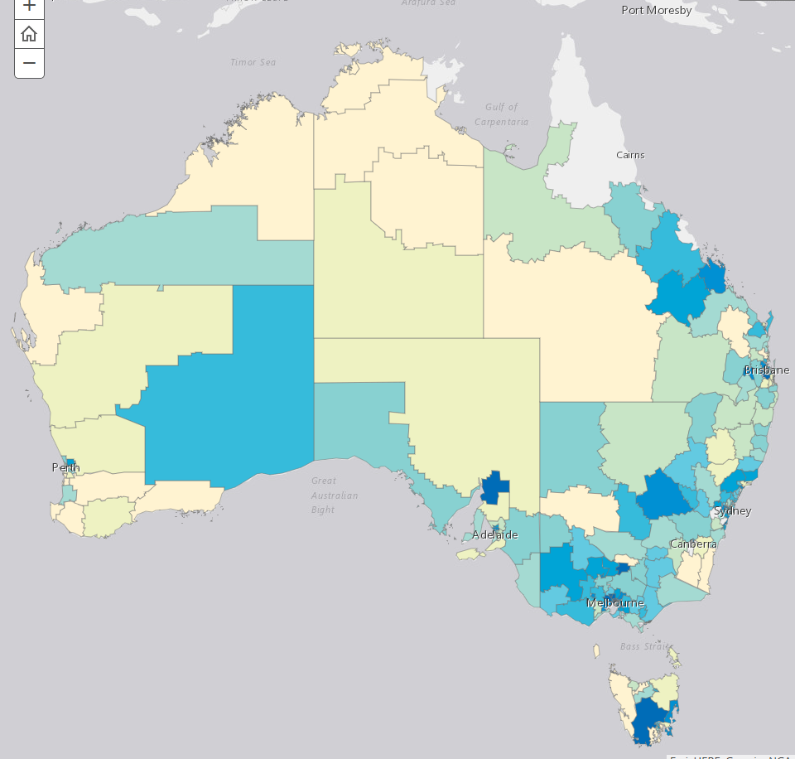
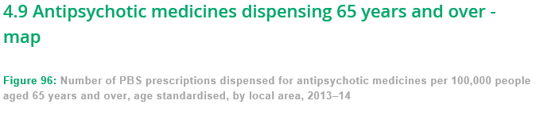
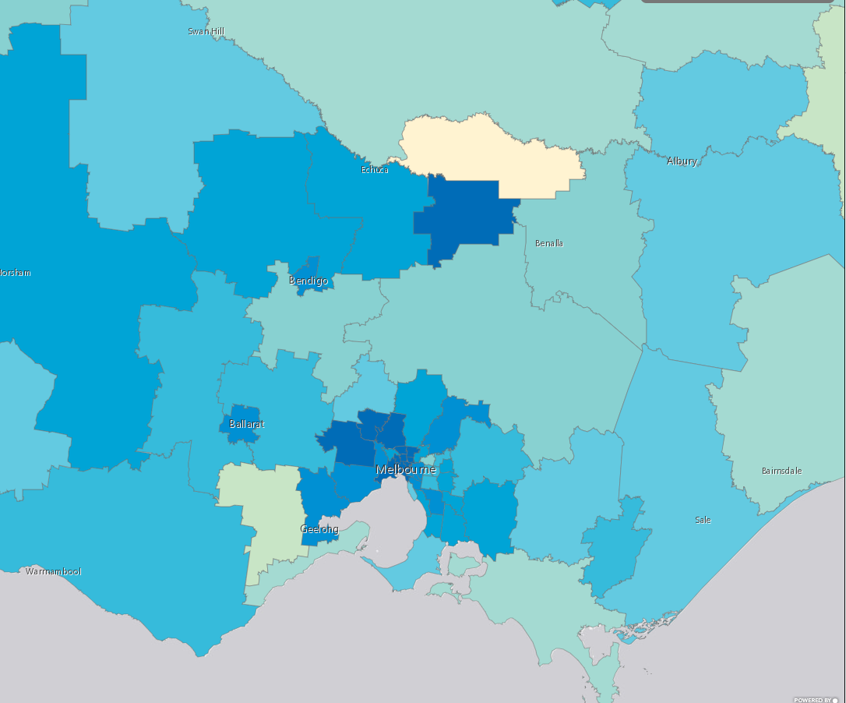
Antipsychotic prescription

Slide 12
National perspective: Older People are not all the same

Slide 13
National perspective: Older People are not all the same.... RUG-ADL : need for assistance with Activities of Daily Living

Slide 14
National perspective: Older People are not all the same.... Functional or symptom problems measured on HoNOS65+

Slide 15
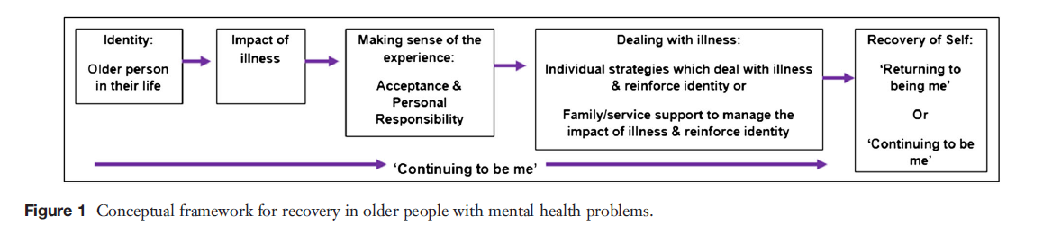
What does recovery mean to older people?
(Daley, 2012)
“Continuing to be me”

Slide 16
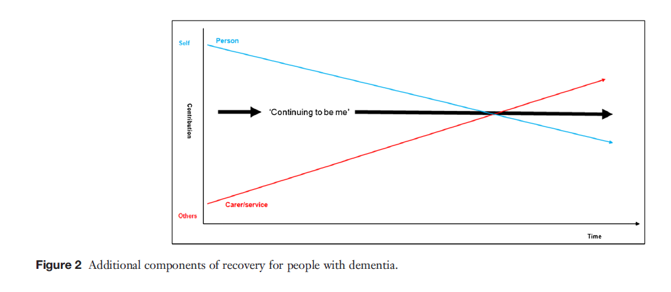
What does recovery mean to older people?
(Daley, 2012).

Slide 17
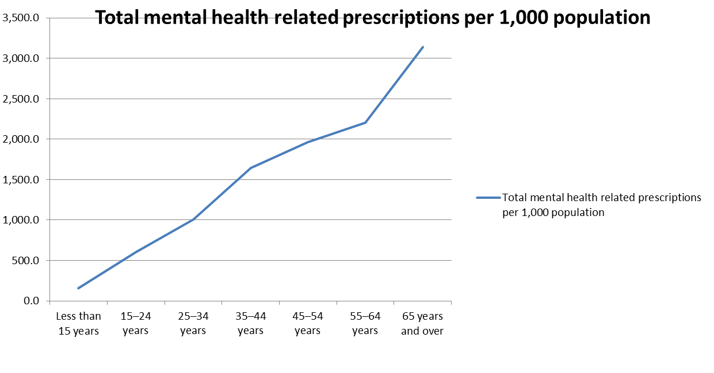
National perspective: Mental Health related prescriptions
Mental health services in Australia
Mental health-related prescriptions
Table PBS.6: Patients dispensed with mental health-related prescriptions(a), by patient demographic characteristics and services received, 2013–14

Slide 18
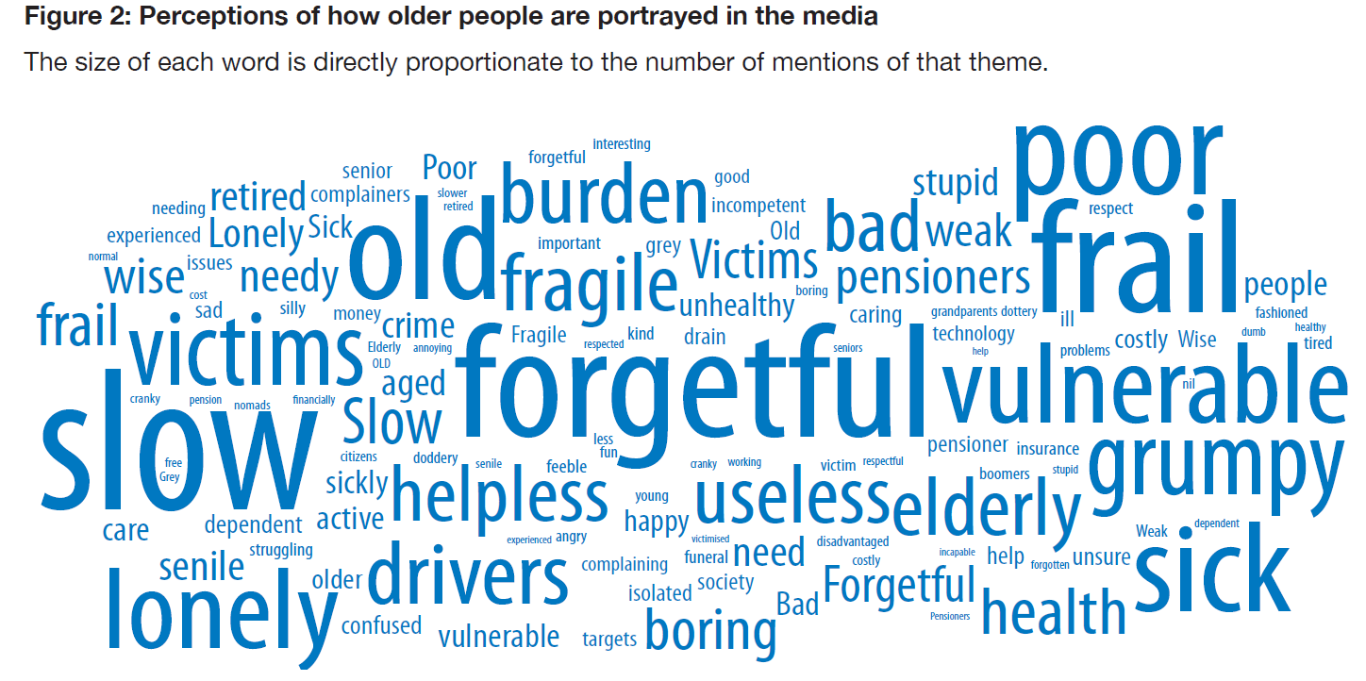
National Perspective: ageism is real emerges in media portrayals of older people: and influences us
Fact or fiction? Stereotypes of older Australians • Research report • 2013. Australian Human Rights Commission

Slide 19
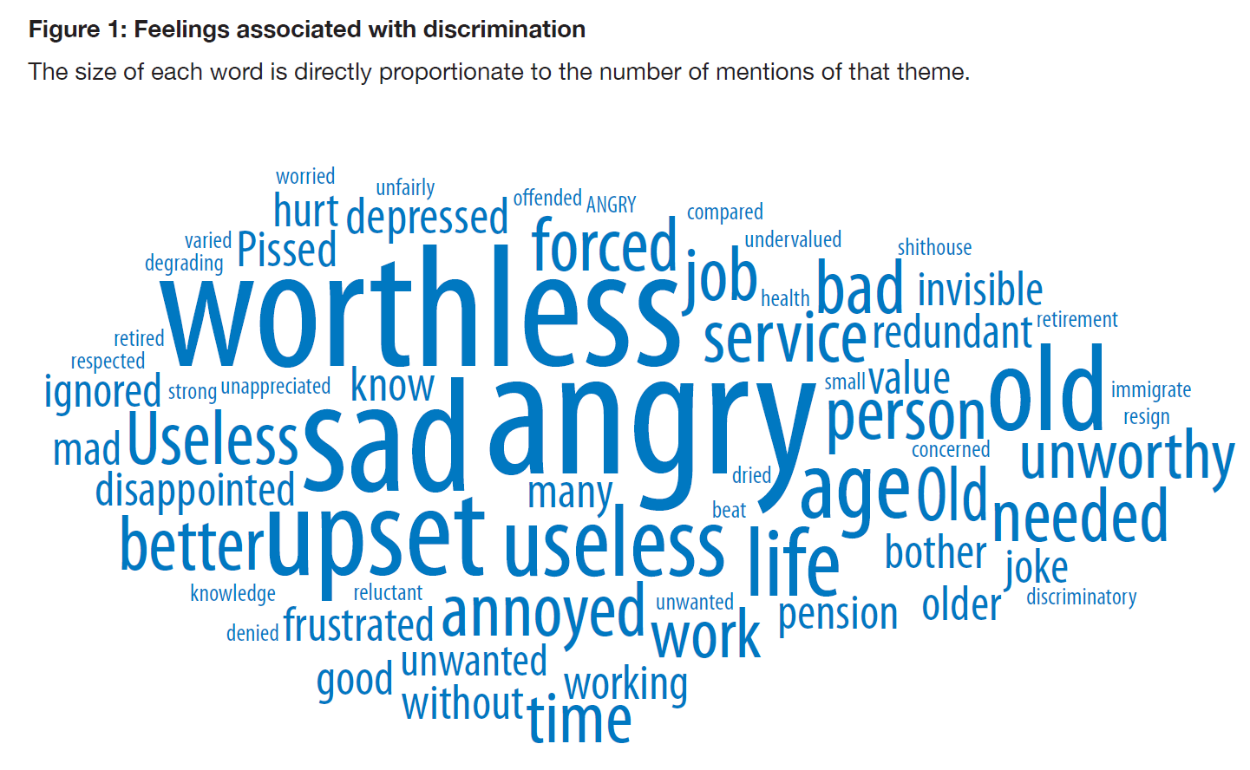
And influences how older people feel and advocate (or don’t)
Fact or fiction? Stereotypes of older Australians • Research report • 2013. Australian Human Rights Commission

Slide 20

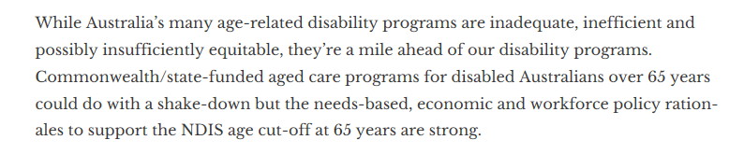

Slide 21
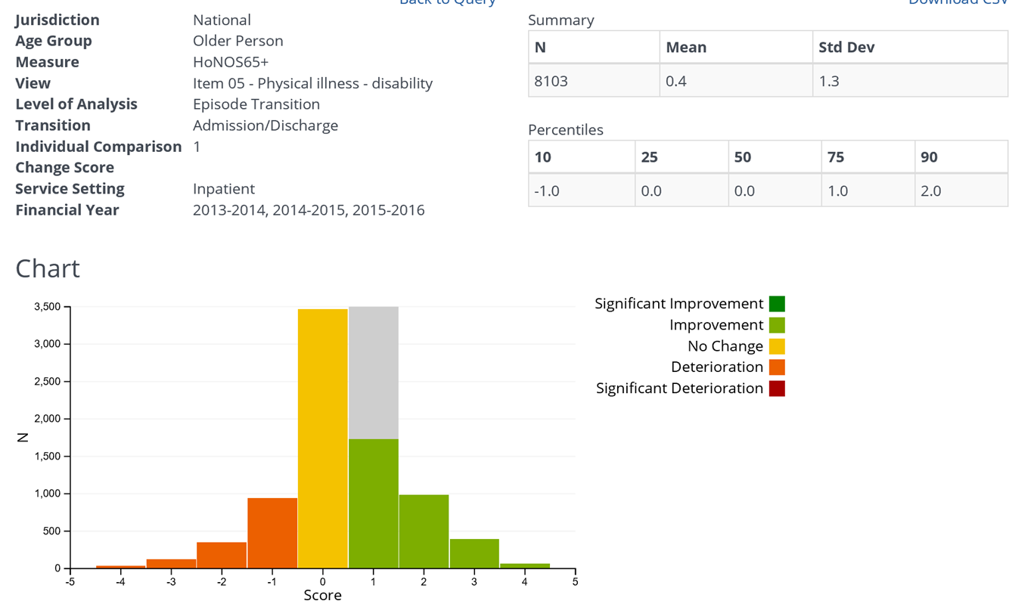
OPMH services responding to physical health needs?

Slide 22
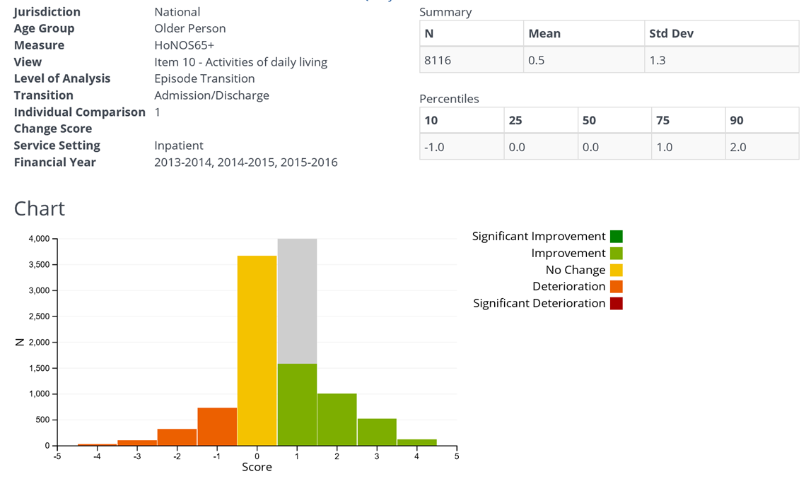
How are OPMH services responding to physical health needs? (cont.)

Slide 23

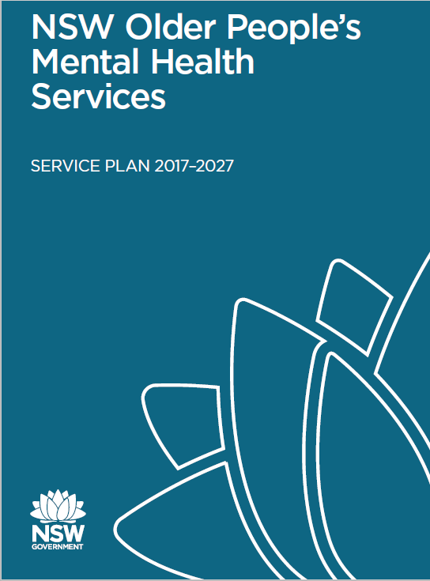
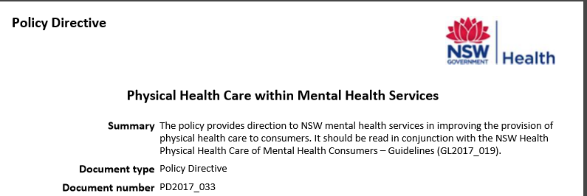
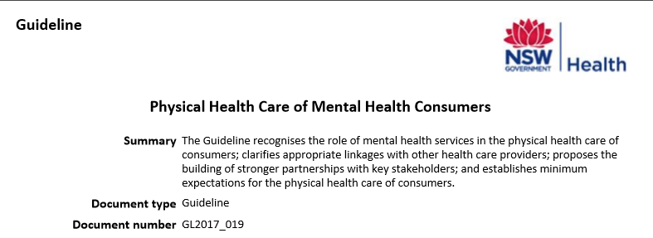
NSW Context

Slide 24
SMHSOP workforce initiatives
Orientation and induction guide
SMHSOP workforce surveys (2007, 2013)
SMHSOP core competencies
OPMH scholarships and training programs
Training initiatives (especially BPSD)
SMHSOP Recovery Project

Slide 25
SMHSOP Benchmarking
“Using data to reflect on practice… understand variation between services … explore areas for best practice … foster a sense of respectful enquiry and collaboration”
Feeding back and examining data about current practice
Using data to understand similarities and differences in care
Prompting and supporting service improvement
Forums every 6 months supported by
on request site visits
Annual self audit
28 Day Readmission
7 Day Follow Up
Performance Indicator
Seclusion & Restraint
YES
Processes of Care
Structures and Resources
Consumer
Data Quality

Slide 26
Relevant benchmarking self audit findings
Recovery orientation
Involvement of GPs
Physical examination in community and inpatient settings
Action about falls
Physical healthcare capacity within inpatient units

Slide 27

Recovery-Oriented Practice Improvement Project
1. Project planning and initiation, confirming project goals and deliverables
2. Establish SMHSOP Recovery Project Steering Group
3. Literature and policy scan
.
4. Develop SMHSOP recovery toolkit document to complement NHS online training
5. Recruit LHD ‘recovery champions’ and workshop toolkit package
6. Support champions in establishing local recovery practice improvement projects
7. Evaluation and showcasing of LHD projects
8. Sustaining improvement and focus

Slide 28
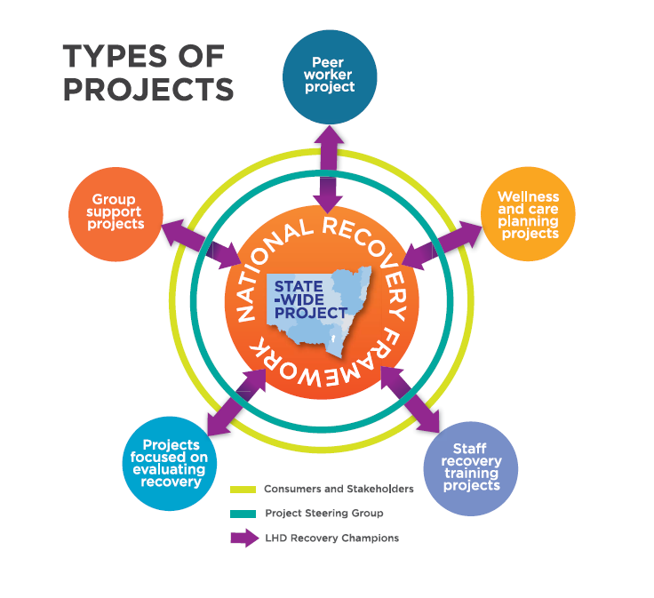

Slide 29
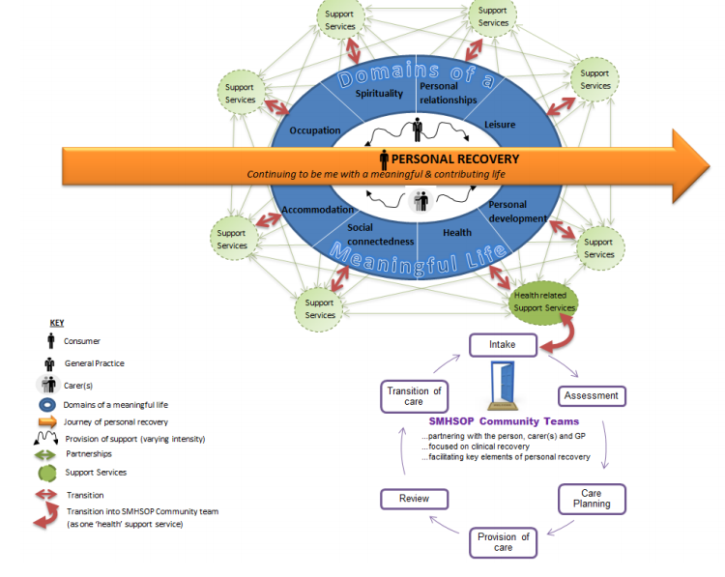
Driving models of care

Slide 30
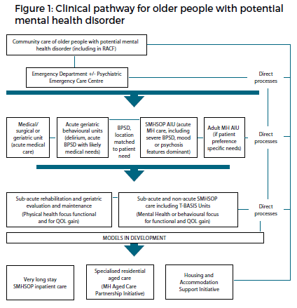
Inpatient Model of Care

Slide 31
A journey in NSW
Word Count (PDF fount) | 2005-15 Service Plan (2006) | Inpatient Model of Care (2016) |  | Community Model of Care (2017) | 2017-27 Service Plan
Recovery | 9 | 29 |  | 207 | 123
Connectedness | 1 | 1 |  | 6 | 8
Hope | 0 | 2 |  | 11 | 0
Identity | 0 | 1 |  | 2 | 1
Meaningful | 1 | 1 |  | 3 | 7
Empower | 1 | 1 |  | 10 | 0
Dignity | 2 | 2 |  | 9 | 2
Choice | 3 | 5 |  | 19 | 8

Slide 32
Strategies and practice ideas
Explicit focus on physical health care in policies and models of care
NSW Health Policy Directive (Physical Health Care within Mental Health Services) and Guideline (Physical Health Care of Mental Health Consumers)
NSW OPMH community and inpatient models of care
Explicit practice focus in statewide OPMH benchmarking and annual self-audit process to support reflect practice and quality improvement
Self-audit standards and collaborative data and practice discussions
Measuring and monitoring practice, including through consumer feedback (YES consumer questionnaire)
Mental health-residential aged care partnership models for people with early ageing issues, frailty associated with severe and persistent mental illness
Notes:
Overall experience of OPMH services in 2017 – 75% very good/excellent for inpatient; 86% very good/excellent for community

Slide 33
Strategies and practice ideas (cont.)
Strategies/programs to promote integrated care for mental and physical health problems in primary care settings (in this case through primary care nurses, collaborating with consumers, GPs and mental health services)
Bartels et al, ‘Integrated IMR for Psychiatric and General Medical Illness for Adults Aged 50 or Older with Severe Mental Illness’ (Psychiatric Services, 2014)
OPMH service physical health screen and ‘wellness on wheels’ home-based nurse-conducted physical health assessment (post-initial MH assessment) including metabolic measurements to identify physical health issues for GP advice
Consumer-held ‘physical health care card’ to guide consumer questions to GP
Empowering people with mental illness around their physical health care
Notes:
One LHD, that identified physical health as an area where it wasn’t achieving the standard, developed a physical health screening tool to identify physical health issues that a consumer’s GP should be informed about.
A novel approach to physical assessment implemented in one service is ‘Wellness on wheels’. After a consumer has been assessed, two nurses visit the consumer and conduct a physical assessment, including metabolic measurements, with the information being fed back to the consumer’s GP. One LHD developed a physical health card, which the consumer can take to appointments with their GP to guide questions they might ask. The LHD reported positive feedback about the card.
LHDs also reported examples of improving falls risk screening. One LHD developed a roadshow where it visited all community services in its LHD and gave presentations on the need for screening for falls. Services also reported that the transfer of the annual falls audit (April falls audit) to an electronic format made it easier to implement. Nevertheless, this was an area that the self-audit suggests needs improvement: only 40% of community teams said that their initial community assessment includes a screening assessment for falls risk (Table 7). Following that, 47% said that care planning includes relevant actions if a community consumer is identified as being at high risk of falls (Table 7).

Slide 34
Lessons
What is required to make change (and recovery) real for older people?
A willingness to undertake a journey
Understanding older people
Understanding relevant mental illness and services
Understanding what recovery means to older people
Access to services with the aptitude and skills to provide recovery oriented care to older people with mental health needs
Daily practice
Leadership
Shared language, mutual respect, and hope

Slide 35
Encouraging thinking outside the square: now for physical health care
1. Project planning and initiation, confirming project goals and deliverables
2. Establish SMHSOP Recovery Project Steering Group
3. Literature and policy scan
.
4. Develop SMHSOP recovery toolkit document to complement NHS online training
5. Recruit LHD ‘recovery champions’ and workshop toolkit package
6. Support champions in establishing local recovery practice improvement projects
7. Evaluation and showcasing of LHD projects
8. Sustaining improvement and focus

Slide 36
References and useful resources: articles
Coates D, Livermore P, Green R. The development and implementation of a peer support model for a specialist mental health service for older people: Lessons learned. Mental Health Review Journal. 2018 Jun 11;23(2):73-85.
Coates D, Livermore P, Green R. The unique contribution of older people with a lived experience of mental illness to the peer workforce: observations from older peer workers. European Journal for Person Centered Healthcare. 2018 Apr 30;6(1):78-87.
Hill, Laura, et al. "Recovery and person-centred care in dementia: common purpose, common practice?." Advances in psychiatric treatment 16.4 (2010): 288-298.
Daley, Stephanie, et al. "Development of a framework for recovery in older people with mental disorder." International journal of geriatric psychiatry (2012).
Leamy. et al (2011) Conceptual framework for personal recovery in mental health: systematic review and narrative synthesis. British Journal of Psychiatry 199, 445–452.
McKay, Roderick, et al. "Reclaiming the best of the biopsychosocial model of mental health care and ‘recovery’for older people through a ‘person-centred’approach." Australasian Psychiatry 20.6 (2012): 492-495.

Slide 37
References and useful resources
NSW Health
Specialist Mental Health Services for Older People (SMHSOP) Community Model of Care Guideline https://www1.health.nsw.gov.au/pds/ActivePDSDocuments/GL2017_003.pdf
Community Older Peoples’ Mental Health Services http://www.health.nsw.gov.au/mentalhealth/opmh/Pages/copmh-services.aspx
NSW Older People’s Mental Health Services SERVICE PLAN 2017-2027 https://www1.health.nsw.gov.au/pds/ActivePDSDocuments/GL2017_022.pdf
NSW Older People's Mental Health Recovery-oriented Practice Improvement Project - Statewide Project Report http://www.health.nsw.gov.au/mentalhealth/opmh/Pages/opmh-recovery-project-report.aspx
GL2017_019 Physical Health Care of Mental Health Consumers https://www1.health.nsw.gov.au/pds/ActivePDSDocuments/GL2017_019.pdf
RANZCP
Physical health and mental health https://www.ranzcp.org/news-policy/policy-submissions-reports/physical-health-and-mental-illness

Slide 38
References and useful resources
Beyond Blue
What works to promote emotional wellbeing in older people A guide for aged care staff working in community or residential care setting http://resources.beyondblue.org.au/prism/file?token=BL/1263A
Australian Commission on Safety and Quality in Healthcare
Australian Atlas of Healthcare Variation https://www.safetyandquality.gov.au/atlas/
NSW Mental Health Commission
Data and Analysis https://nswmentalhealthcommission.com.au/resources/data
Living Well in Later Life. The case for change https://nswmentalhealthcommission.com.au/resources/living-well-in-later-life-the-case-for-change
UK
National Institute for Clinical Excellence Mental wellbeing of older people in care homes Quality standard [QS50) https://www.nice.org.uk/guidance/QS50
Joint Commissioning Panel for Mental Health. Guidance for commissioners of older people’s mental health services https://www.jcpmh.info/good-services/older-peoples-services/

Slide 39
How did we get there?
Strategic direction
Benchmarking NSW older persons style
Specific project
Recovery project
Partnership

Slide 40

Questions? Dr Rod McKay Clinical Advisor, Older People’s Mental Health Policy Unit Mental Health Branch, NSW Ministry of Health Email: Roderick.mckay@health.nsw.gov.au

