Slide 1
Intersections of mental and physical health: Healthtalk Australia and the value of online health and illness experiences
Kate Johnston-Ataata, Dave Peters, Nicholas Hill, Jacinthe Flore & Renata Kokanović
Equally Well conference 2019
28-29 March
RMIT University, Melbourne

Slide 2

Online health and illness experiences: Why do they matter?
1. Information, support, reassurance for:
other people with the same health condition
family and friends
2. Information and support for person-centred care for:
health & allied health practitioners
3. Evidence about what is and isn’t working in our healthcare system for:
health service providers
policymakers
Photo by Tinh Khuong on Unsplash

Slide 3
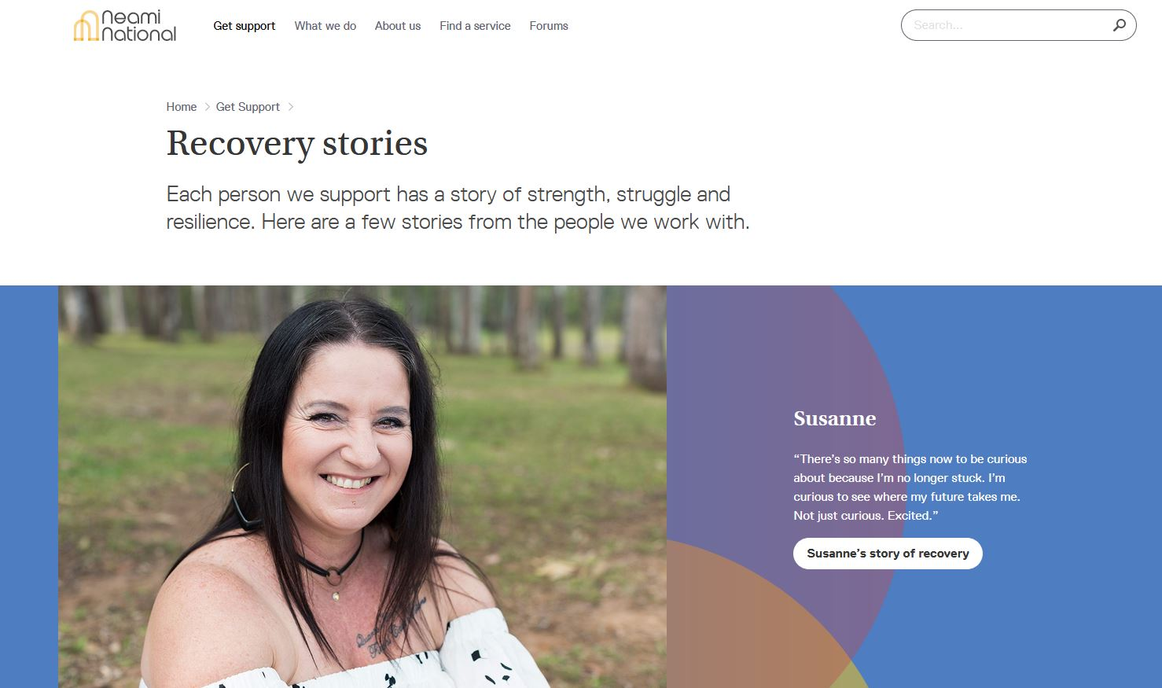
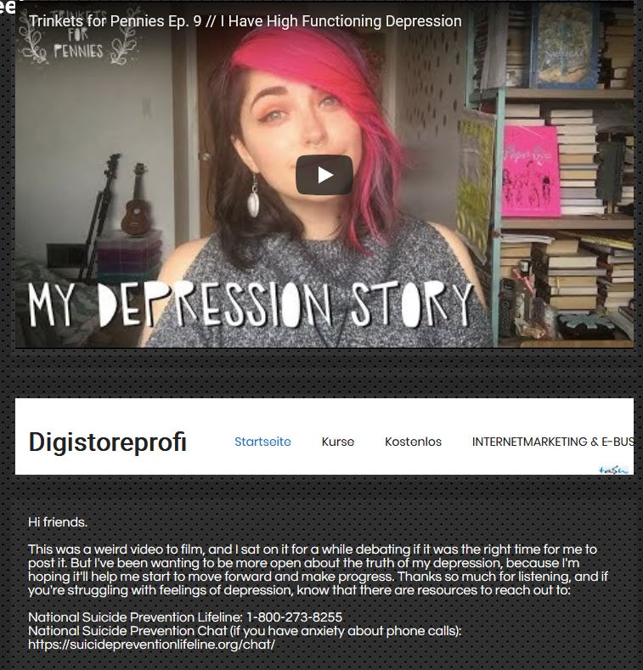
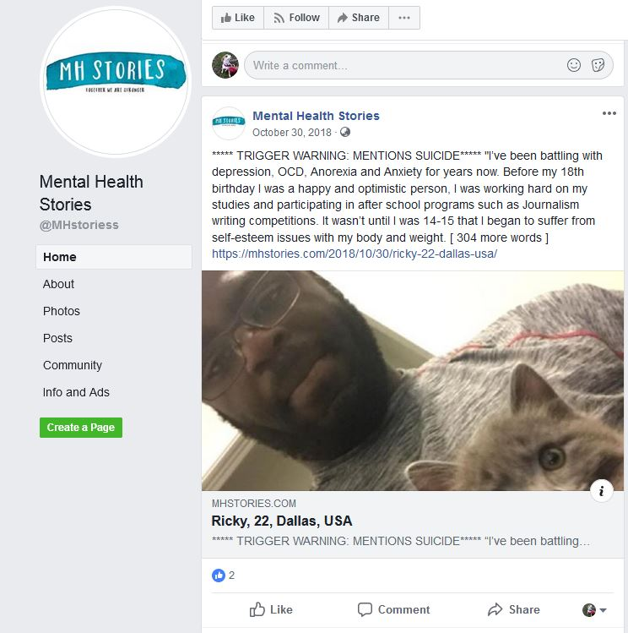
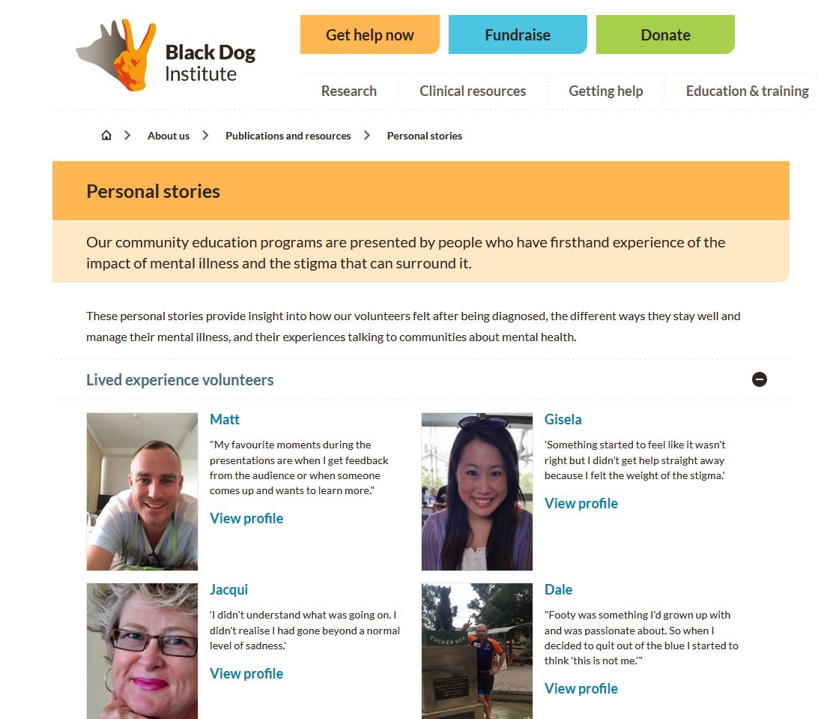
Online health and illness experiences: Where are they?

Slide 4
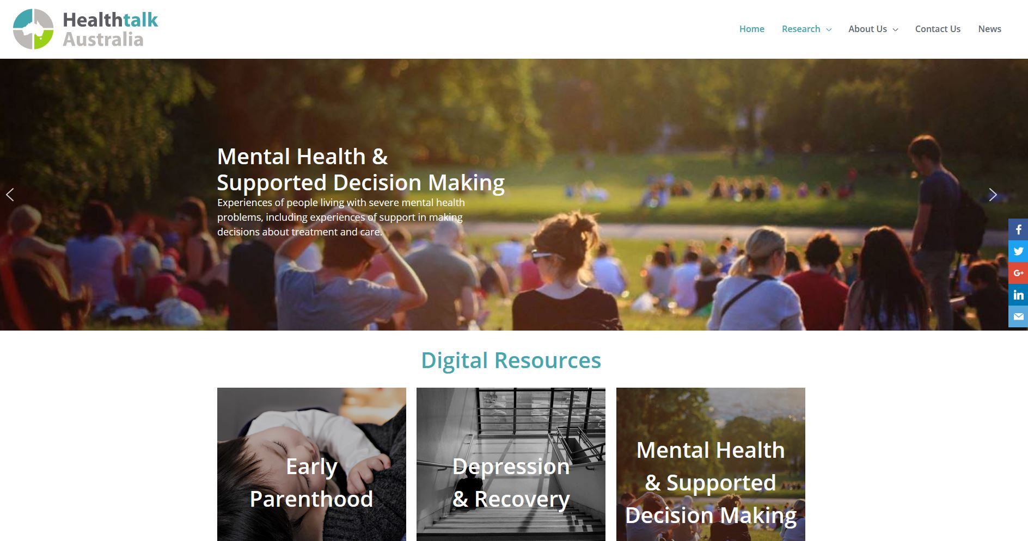
Introducing Healthtalk Australia

Slide 5

Who are we?
- A research consortium established 2012 between RMIT, USyd, Monash, UNSW
- Member of an international network of universities / organisations conducting similar research in 13 countries and 9 languages (DIPEx International)
Mission
To use the power of individual stories to understand and improve healthcare for all Australians, placing the person at the centre stage of healthcare improvement and reform.
What do we do?
- conduct qualitative research on experiences of health and illness (narrative interviews on film, audio or text)
- use interview data to build online resources to support and inform people with lived experience, their families and friends, and inform HPs / service providers / policymakers

Slide 6
Australia: 8 HTA online resources developed so far (348 stories)
Four mental health online resources:
- Depression & Recovery
- Mental Health and Supported Decision Making: Lived Experience perspectives
- Mental Health: Carers’ Experiences
- Emotional Experiences of Early Parenthood (section on PND)
Internationally: 14 Healthtalk online resources on mental health (of 156 total) across 6 countries
Depression, psychosis, eating disorders, mental health among immigrant communities, experiences of taking antidepressants

Slide 7
\
Methodology and research approach
Detailed, rigorous, proven
Narrative interviews recorded on film / audio with ~ 30 participants
  recruited to achieve widest range of illness experience & demographic / sociocultural background
Collaborative approach
  Advisory Group
  Industry partnerships

Slide 8
Industry partners & collaborators
Government bodies:
Healthdirect Australia
National Mental Health Commission
Victorian Department of Health & Human Services (DHHS)
NGOs: beyondblue
Mental Health Victoria
Mind Australia
Neami National
Private Mental Health Consumer Carer Network (Australia)
SANE Australia
Spectrum
Tandem Carers
Victorian Mental Illness Awareness Council
Wellways
Australasian Menopause Society
Breast Cancer Network Australia
Endocrine Society of Australia
National Breast Cancer Foundation
Women’s Health Victoria
Health services:
Hunter New England Area Health Service
Monash Health
Orygen Youth Health

Slide 9
Knowledge translation:
- Co-design of health information / education resources
- Endorsement by relevant professional bodies / government agencies
- Used for training by other organisations
- Testimonials:
I wish to express my appreciation of your website.... the personal stories are more powerful than even the best research. Increases our understanding and therefore better informs how we engage with others, particularly when coming from a service provider position.
L Walker, Helping Minds, February 2017

Slide 10
What makes Healthtalk Australia’s online resources unique?
1. Extensive Advisory Group & industry partner input and involvement
2. Breadth of experiences solicited
3. Attention to protection of privacy of participants
4. Stories of health and illness experiences told in the context of people’s overall lives
5. Experiences analysed and presented by both theme and by individual story
6. Interviewees presented naturalistically
7. Experiential and clinical information combined (‘one-stop-shop’)
8. All health-related experiential information checked by clinicians
9. Stories / information presented in a non-judgemental manner
10. No commercial funding

Slide 11
Stories of intersections of mental health and physical health

Slide 12
Mental Health and Supported Decision-Making project
(ARC LP 2014-2018)
CIs:
Renata Kokanović
Bernadette McSherry
Lisa Brophy
Helen Herrman
Partners: DHHS, Mind Australia, Neami National, Wellways, VMIAC, Tandem
Depression & Recovery project
(ARC LP 2010-2012)
CIs:
Renata Kokanović
Jane Gunn
Sue Ziebland
Partner: beyondblue

Slide 13
Ralph (Depression & Recovery project)
A bad day would be just miserable, going to bed crying for no reason at all, with the light on, because I didn't want the light off. Not wanting to go out, not wanting to have friends around. Not going to play tennis.
In fact even at one stage I couldn't bring myself around to plan a holiday. It just felt too daunting to have a holiday. This is in America – due to come up to summer vacation and I wanted to go on holidays – or sorry the family did – because that was what we were there for, besides work - but I thought, ‘I don't know how am I going to this, I don’t know how I’m going to do it. Strange country, driving, other side of the road, new places, I can't do it.’
Well there's depression of course, and there's anxiety; panic attacks. There's the crying spells. There was the tingling in the hands or the arms. Numbness in my back; numbness in my back; numbness in the legs; difficulty in walking - feeling that my gait's not quite right; not sleeping of course; feeling angry; uncoordinated sometimes.

Slide 14
Kate (Emotional Experiences of Early Parenthood study)
I think one of the things that came out of my first period of depression was just how important exercise was to me, although one of the signs that I was becoming depressed would was that I was exercising frantically and I was really, I lost a whole lot of weight and my periods stopped and I got way too thin but I was, you know, swimming 1500 metres and running about six k’s every day.
So it became clear that I was using the endorphins from that to cope, which was just too much, I was just doing way too much and not, and not eating, just drinking instead, it was just an awful kind of cocktail.
But I did, when I toned that all down it became clear that exercise was something that I needed to schedule in and, although it’s terribly hard when you’re tired, that’s the one thing that I will, you know – there’s a crèche at our pool and though it’s not a particularly state-of-the-art arrangement, they’re safe, it’s only 20 minutes I’m going to be in the pool, maximum half an hour, just to get that headspace.
Sometimes when my husband gets home, even if it’s 7.30 at night I’ll go for a run, just to get out and sometimes I don’t run, sometimes I walk. But I have found that for me that’s really important for levelling my mood and for cleansing stuff out.
Notes:
RALPH

Slide 15
Luana – Mental Health and Supported Decision-Making project
Yeah, I spoke to a staff member from [mental health organisation] who was really good and helped me in what to say to the psychiatrist. Because even though you know I’m an articulate person and I’ve studied a university degree and worked in the public service, it’s very hard to know what to say to the psychiatrist. Because they’ll use any bit of emotion in some instances against you.
When I was trying to get off my CTO the previous time I’d been to see them, I’d been quite argumentative about lactating. So I’d been saying that I wanted my medication reduced to stop the lactating. But there was an argument, so they used that against me and said, “Oh, last time you came here you were angry.” So – as trying to sort of justify the CTO, and I thought - I wasn’t just lactating a small amount, it was quite a large amount and it was an embarrassing side effect.
So that’s why I came across as angry. But yeah, to use that emotion against me was really – I thought that was quite unfair. So luckily I was told what to say to [mental health organisation] to appear like I was calm and in control.

Slide 16
The Mental Health and Supported Decision-Making Project: An Advisory Group member and research participant’s perspective

Slide 17
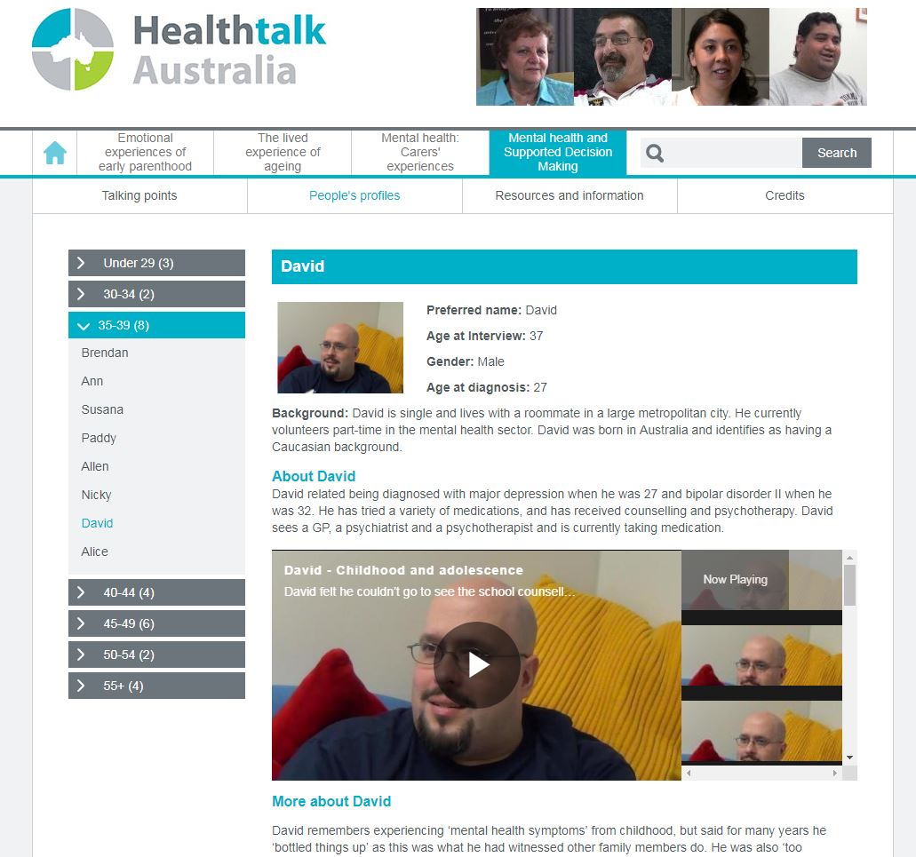

Slide 18

Interested in collaborating? Chat to us at morning tea or send us an email!
Healthtalk Australia – Key People
Director Renata Kokanović
Coordinator Kate Johnston-Ataata (kate.johnston-ataata@rmit.edu.au) http://healthtalkaustralia.org/
@healthtalkaus

