Slide 1




Mental health and smoking cessation– resetting policy levers and targets to achieve parity
by John Allan
Executive Director MHAODB Queensland
President Elect RANZCP
www.equallywell.org.au

Slide 2
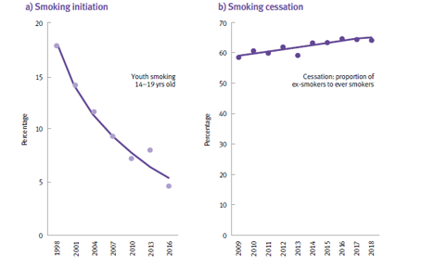
Trends in smoking initiation and cessation Queensland (CHO Report 2018
www.equallywell.org.au
Notes:
CHO report 2018

Slide 3
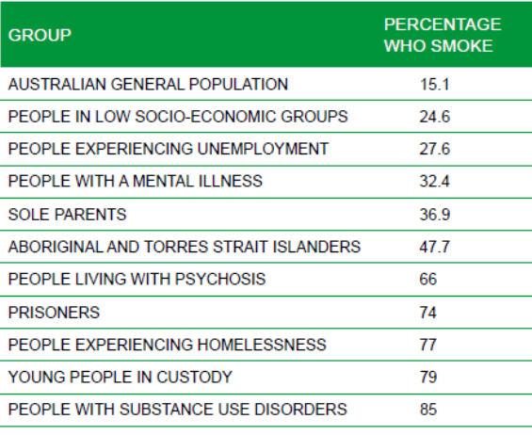
Smoking and disadvantage
(Australian National Health Prevention Agency 2013)
www.equallywell.org.au

Slide 4
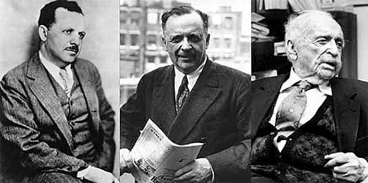
Who Was Edward Bernays?
1891-1995 (104 yrs)
Uncle = Sigmund Freud
www.equallywell.org.au

Slide 5
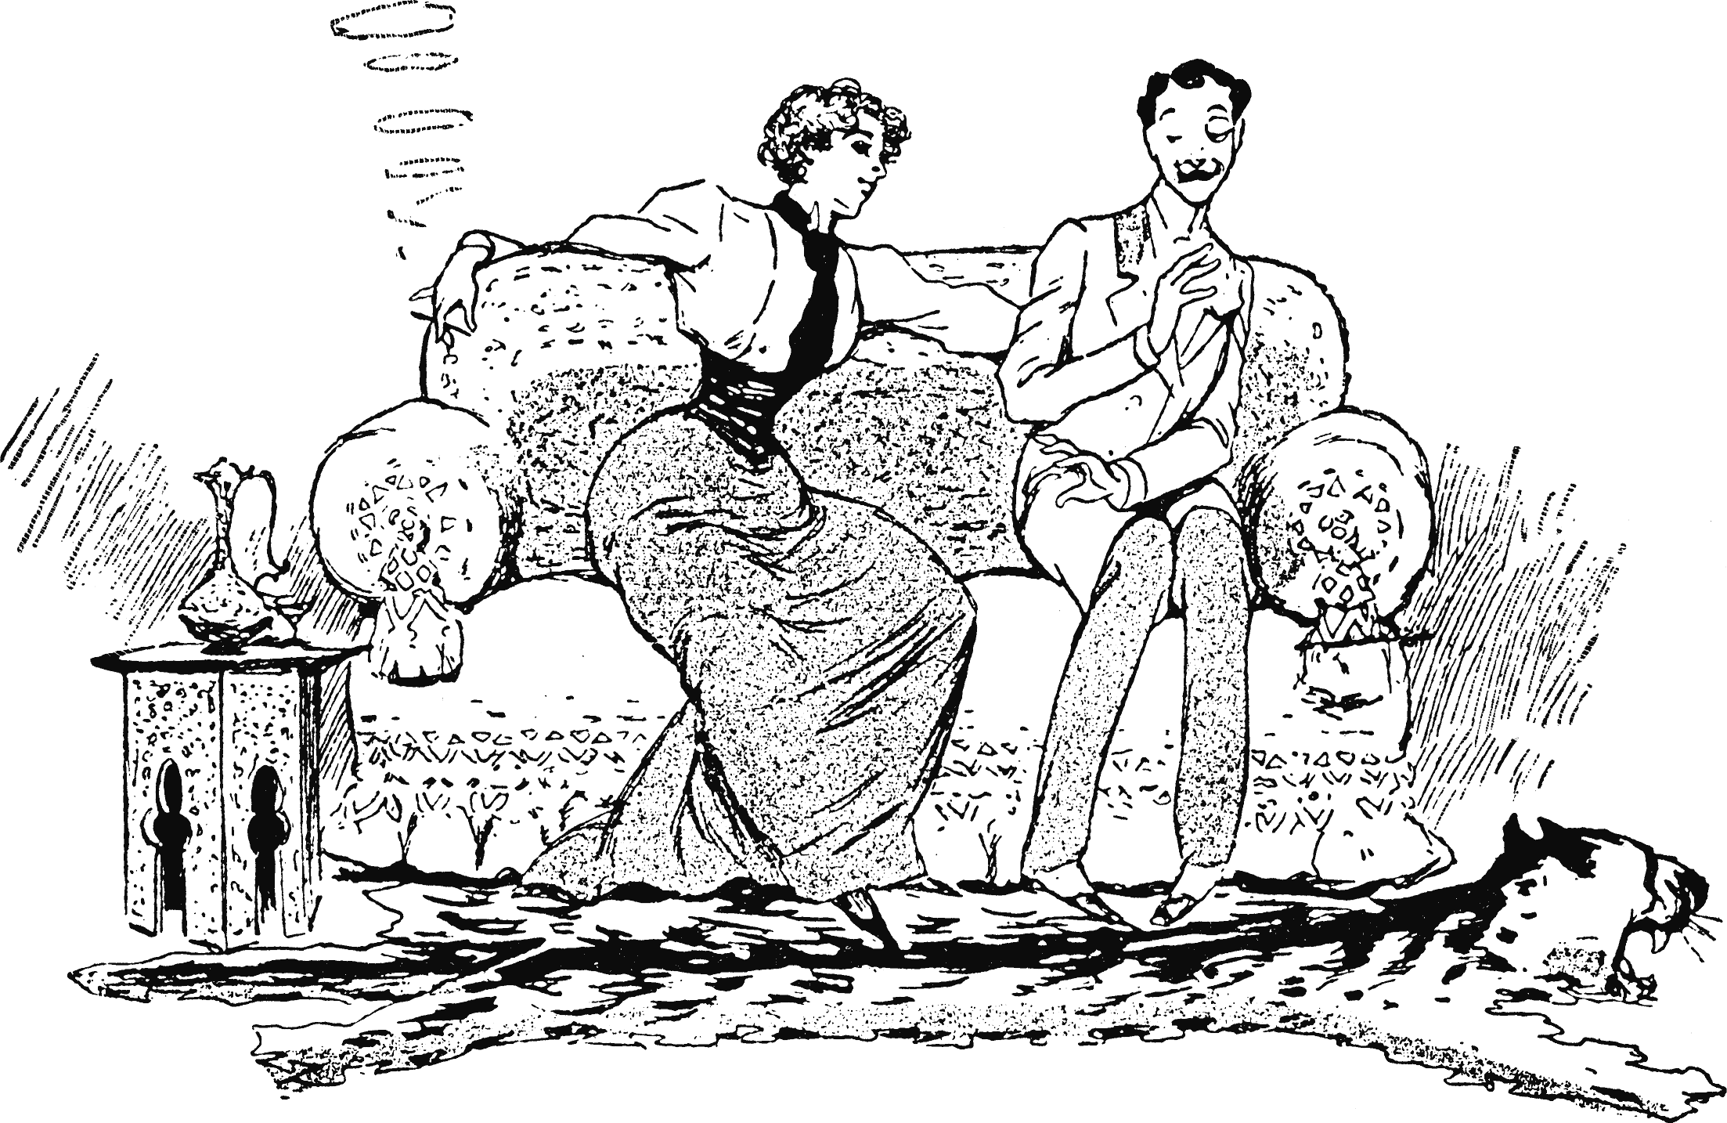
Client: American Tobacco Company
www.equallywell.org.au

Slide 6
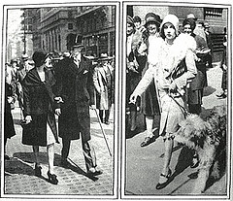


Torches of Freedom
www.equallywell.org.au

Slide 7


Progress
www.equallywell.org.au

Slide 8
‘What do 1,000 smokers with mental illness say about their tobacco use?’
Ashton, Rigby and Galletly – ANZ Journal of Psychiatry 2013
Reasons for wanting to address tobacco (N=820) % of responses
Adapted From Mental Illness Fellowship of Australia
www.equallywell.org.au

Slide 9
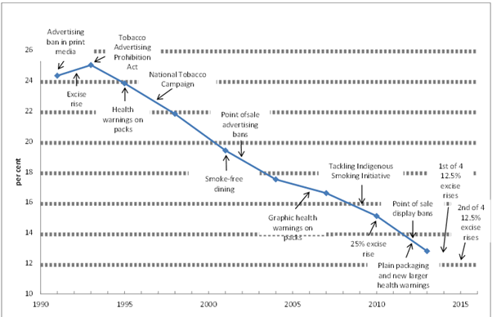
Figure 1: Smoking prevalence rates for 14 years or older and key tobacco control measures implemented in Australia since 1990 (Australia the Healthiest Country: Report 2009).
www.equallywell.org.au

Slide 10
Anti-smoking messaging
“If the campaign is strategically planned and based on carefully conducted market research, the executions are creatively developed, and the campaign messages are delivered repeatedly and consistently over a long time period, then the chances of a successful campaign are maximized.”
(Siegel, M. 2002. Anti-smoking advertising: Figuring out what works.
Journal of Health Communication, Vol 7, p.159).
Why is it then that the incidence of smoking is high amongst marginalised communities?
www.equallywell.org.au

Slide 11


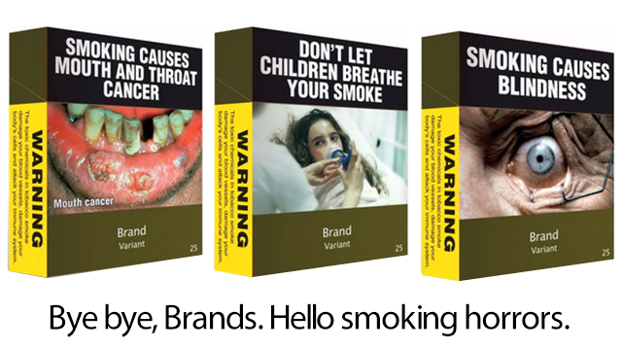
stimuli:
www.equallywell.org.au

Slide 12


Period Drama – Product Placement – Mad Men 2015
Smoking on TV is the new cool!

Slide 13
Ambivalence and myths I inherited
Not interested in giving up
Is a form of treatment
Symptoms will get worse if stop smoking and the illness will recur
Smoking relieves stress
Only vice left as so much taken away & may decrease friendships or opportunities to recover
Smoking restrictions are ineffectual
Smoking is a lifestyle choice and even a right –not an addiction
www.equallywell.org.au

Slide 14
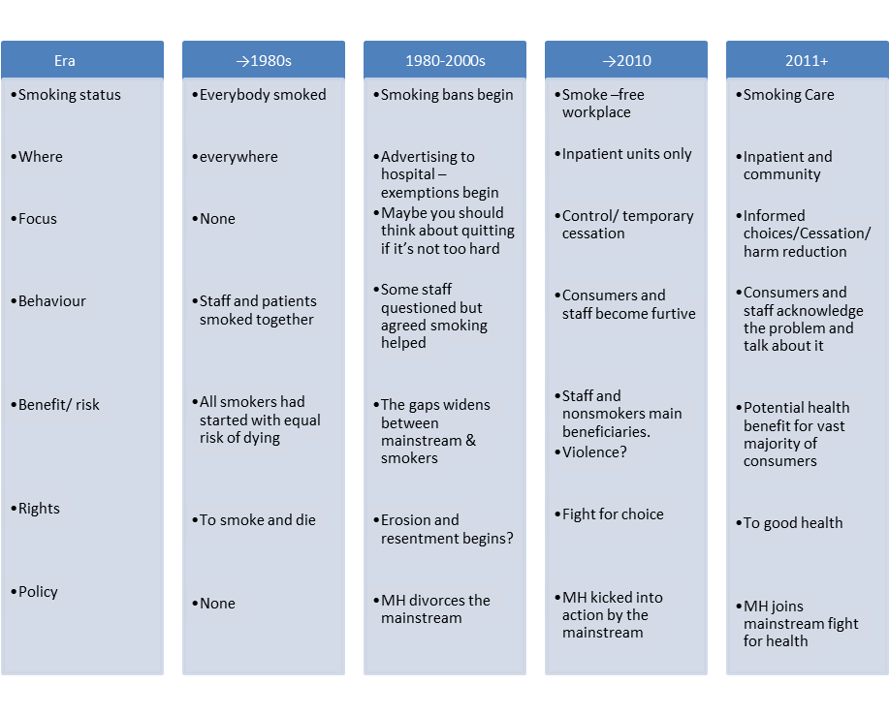
My History of Mental Health Services and Smoking
www.equallywell.org.au

Slide 15
Health system responsibilities
To provide a healthy environment that promotes wellness
To not support addiction by condoning smoking
To support health, wellness and recovery
To be assertive in protecting all consumers entrusted to our care from the harmful effects of tobacco including second-hand smoke
To act on what we know- to educate all consumers and families about the devastating effects of tobacco and to facilitate and support their ability to manage their own physical wellness
Smoking staff, transparent about own values
www.equallywell.org.au

Slide 16
Policy tips for the Smoking in mental health initiative
Work out who is addicted to what
Join with an accepted program e.g. physical health care
Respect your partner’s capacity to bring a fresh set of ideas which may challenge you
Endlessly talk to your critics – they might change
Get noticed by others- they may want to give you money
Identify your leaders who may not always be obvious
Introduce evidence but be patient
www.equallywell.org.au

Slide 17
Policy Levers
Tackle institutionalised ambivalence | Provide advice and support to mental health professionals, carers and consumers Improve education and awareness Engage and support research
Exploring harm reduction approach rather than just a quit approach | Undertake and support research that explores harm reduction Support and work with stakeholders to develop and implement strategies that incorporate a range of techniques that minimise harms
Address smoking cessation from a physical healthcare perspective | Work with stakeholders to broaden focus of smoking cessation to include physical healthcare Incorporate smoking cessation into new and current physical healthcare initiatives
Ensure uniformity of effort | Develop agreed priorities, commitments and strategies to address smoking for people with mental health issues Encourage and support stakeholders to work in partnership and share resources around smoking cessation for people with mental health issues
www.equallywell.org.au

Slide 18
What polices and targets could we set?
People with serious mental illness and poor health become a special target group for all governments and we set hard indicators
  Population: Reduce smoking rates for people with mental illness to general population levels or lower given the other risks to physical health
  MH Services: achieve 100% smoke-free including staff
  Everyone who enters a mental health service has smoking status checked and is offered treatment
  Education and awareness: All mental health staff can and do provide smoking cessation advice and treatments as indicated
  Free NRT as a therapeutic product
www.equallywell.org.au

Slide 19
E-Cigarettes: Panacea or Pandemic?
Early evidence that using nicotine-containing e-cigarettes may reduce the post-cessation weight
Reduction in the dose of some antipsychotic medications
Reduce financial stress and social inequities
Reduced exposure for patients, staff and visitors to secondhand smoke.
Improve anxiety and mood, alleviate boredom and can facilitate socialising.
www.equallywell.org.au

Slide 20
PHE Independent Review e-cigarette
Public Health England (PHE) 2018 e-cigarette evidence review, undertaken by leading independent tobacco experts, provides an update on PHE’s 2015 review
switching completely from smoking to e-cigarette has substantial health benefits
e-cigarettes could be contributing to at least 20,000 successful new quits per year in the UK
that regular use of e-cigarettes among young people who have never smoked remains negligible
www.equallywell.org.au
Notes:
Public Health England maintain that e-cigarettes are “at least 95 per cent” less harmful than cigarettes and there are “substantial health benefits” for those who quit smoking to vape.
The main findings of PHE’s evidence review are that:
- vaping poses only a small fraction of the risks of smoking and switching completely from smoking to vaping conveys substantial health benefits
- e-cigarettes could be contributing to at least 20,000 successful new quits per year and possibly many more
e-cigarette use is associated with improved quit success rates over the last year and an accelerated drop in smoking rates across the country
many thousands of smokers incorrectly believe that vaping is as harmful as smoking; around 40% of smokers have not even tried an e-cigarette
there is much public misunderstanding about nicotine (less than 10% of adults understand that most of the harms to health from smoking are not caused by nicotine)
the use of e-cigarettes in the UK has plateaued over the last few years at just under 3 million
the evidence does not support the concern that e-cigarettes are a route into smoking among young people (youth smoking rates in the UK continue to decline, regular use is rare and is almost entirely confined to those who have smoked)
Concern has been expressed that e-cigarette use will lead young people into smoking. But in the UK, research clearly shows that regular use of e-cigarettes among young people who have never smoked remains negligible, less than 1%, and youth smoking continues to decline at an encouraging rate. We need to keep closely monitoring these trends, but so far the data suggest that e-cigarettes are not acting as a route into regular smoking amongst young people

Slide 21
Safety of E-Cigarettes
Significantly more likely to have a heart attack, develop coronary artery disease and suffer depression
56 percent more likely to have a heart attack
30 percent more likely to suffer a stroke
twice as likely to suffer from depression, anxiety and other emotional problems.
www.equallywell.org.au
Notes:
We know that nicotine is addictive. We know that cigarette smoking is a major cause of multiple health issues. We do not know what liquid nicotine, the flavours and other additives that are in these vaping products do to the human body and immune system.
Since introduction of e-cigarettes sales have increased 14 fold in the US over the last decade.
March 2019 University of Kansas School of Medicine
This study found that compared with nonusers, e-cigarette users were 56 percent more likely to have a heart attack and 30 percent more likely to suffer a stroke. Coronary artery disease and circulatory problems, including blood clots, were also much higher among those who vape -- 10 percent and 44 percent higher, respectively. This group was also twice as likely to suffer from depression, anxiety and other emotional problems.
Most, but not all, of these associations held true when controlling for other known cardiovascular risk factors, such as age, sex, body mass index, high cholesterol, high blood pressure and smoking. After adjusting for these variables, e-cigarette users were 34 percent more likely to have a heart attack, 25 percent more likely to have coronary artery disease and 55 percent more likely to suffer from depression or anxiety.
However the researchers indicated they were also unable to determine whether the damage had occurred prior to using e-cigarettes, or was caused by vaping
Study, used data from a total of 96,467 respondents from the National Health Interview Survey, a Centre for Disease Control and Prevention survey of Americans, from 2014, 2016 and 2017.
Cigarette smoking carries a much higher probability of heart attack and stroke than e-cigarettes, but that doesn’t mean that vaping is safe
Furthermore, the evidence is building on the influence of e-cigarettes which may serve as a gateway to future smoking.
Tobacco industry determined to secure future markets and potentially position themselves as a part of the solution, may promote the use of these
devices as ‘reduced risk’ products.
Use of e-cigarettes in Queensland doubled between 2013 and 2016. (CHO Report 2018)

Slide 22
Rising usage of e cigarettes by young people
teens using e-cigarettes in US surges 1.5 million in 2018 to 5 million
San Francisco lawmakers will consider a ban on e-cigarette sales to curb a rising usage by young people.
www.equallywell.org.au
Notes:
Experimentation with e-cigarettes by young people has the potential to increase uptake and nicotine dependence.
San Francisco are considering banning the sale of e-cigarettes until the FDA carries out an investigation on their effects on health
The proposed law would be the first of its kind in the US, and aims to crack down on what activists call an "epidemic" of youth e-cigarette use.
According to the US centre for Disease Control and prevention the number of US teenagers who admitted using tobacco products "within the last 30 days" rose 36% between 2017 and 2018 - from 3.6m to 4.9m. It attributes this to a growth in e-cigarette use. March 2019
Monitoring the Future study, based on interviews with 45,000 students across the country, said this was the largest single-year increase in its 44-year history, surpassing a surge in marijuana smoking in the 1970s. University of Michigan 2018
The US Food and Drug Administration (FDA) said in September 2018 there was an "epidemic" of use of flavoured e-cigarettes among teens.

Slide 23
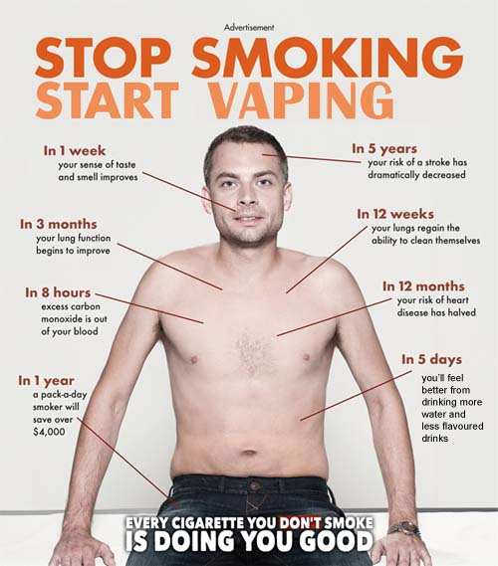
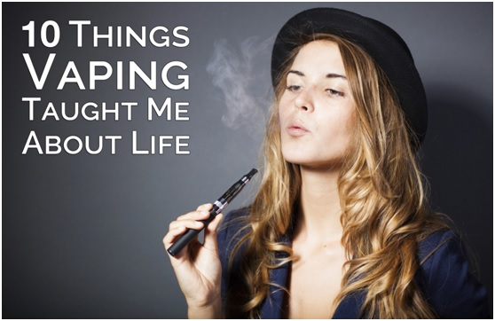

Anti-smoking stimuli:
Non-smoker
smokers
www.equallywell.org.au

Slide 24
Generational phase-out of smoking - Tobacco-free generation
Initiatives
TFG legislation
Anyone born after a defined date would not be able to purchase any tobacco product and legislation may included vaping products
Goal a to be smoke-free society at a set date
Increase Smoking Age
lift the smoking age incrementally to reduce smoking over time
Goal a to be smoke-free society at future time with incremental reduction
www.equallywell.org.au
Notes:
Norway has reduced smoking prevalence by more than half since 1980 and has exhibited a remarkable performance with annual rates of decline greater than 2% from 1980 to 2012

Slide 25
My right to smoke! Is it?
Tobacco company strategy - worker messages expounding the right to smoke -This view further entrenched by the culture in mental health facilities
Public health/ human rights framework seeks to respect, protect and fulfill right to health
The UN article on the right to health states: The right to the enjoyment of the highest attainable standard of physical and mental health, including, the right to prevention, treatment and control of diseases
The addiction model- it is not a choice when addicted
The legal position
www.equallywell.org.au

Slide 26
What should we be doing?
Young people are the new targets of big tobacco and we must respond & be wary of false claims
Organise our experience into universal coverage
Make up our mind about vaping
Not just about hospitals but all places
Involve families – smoking is environmentally triggered
If we can’t achieve reasonable change, change direction
www.equallywell.org.au

