Slide 1
Navigating mental health in a digital world: how safe is it?

Slide 2
The Future is Now!
We live in the digital age
Technologies are emerging and affecting our lives in ways that indicate we are at the beginning of a 4th industrial revolution
Digital disruption has transformed many industries e.g. banking
Digital services also offer the potential to drive much needed changes in health services – indeed they are doing it now!
Digital services can also play a role in helping to achieve all of the essential elements of Equally Well

Slide 3
6 Essential Elements of Equally Well
A holistic, person centred approach to physical, mental health and wellbeing
Effective promotion, prevention and early intervention
Equity of access to all services
Improved quality of health care
Care coordination and regional integration across health, mental health and other services and sectors which enable a contributing life
Monitoring of progress towards improved physical health and wellbeing

Slide 4
Digital health
Electronic health records
  allow health professionals to see patients’ complete health information, saving time, reducing duplicate tests, reducing adverse drug events and leading to better patient care decisions
Patient portals
  provide patients with a convenient way to access their personal health information
    -> patients feeling more involved in their care and having more informed discussions with their health care provider

Slide 5
Digital health
Telehealth (Videoconferencing)
  provide patients with the ability and convenience of connecting with their health care provider through secure, two-way digital communications without the need to travel
Telemonitoring (Telehomecare)
  allows patients and clinicians to collaborate in monitoring health conditions, which can reduce the need for emergency visits and hospitalization

Slide 6
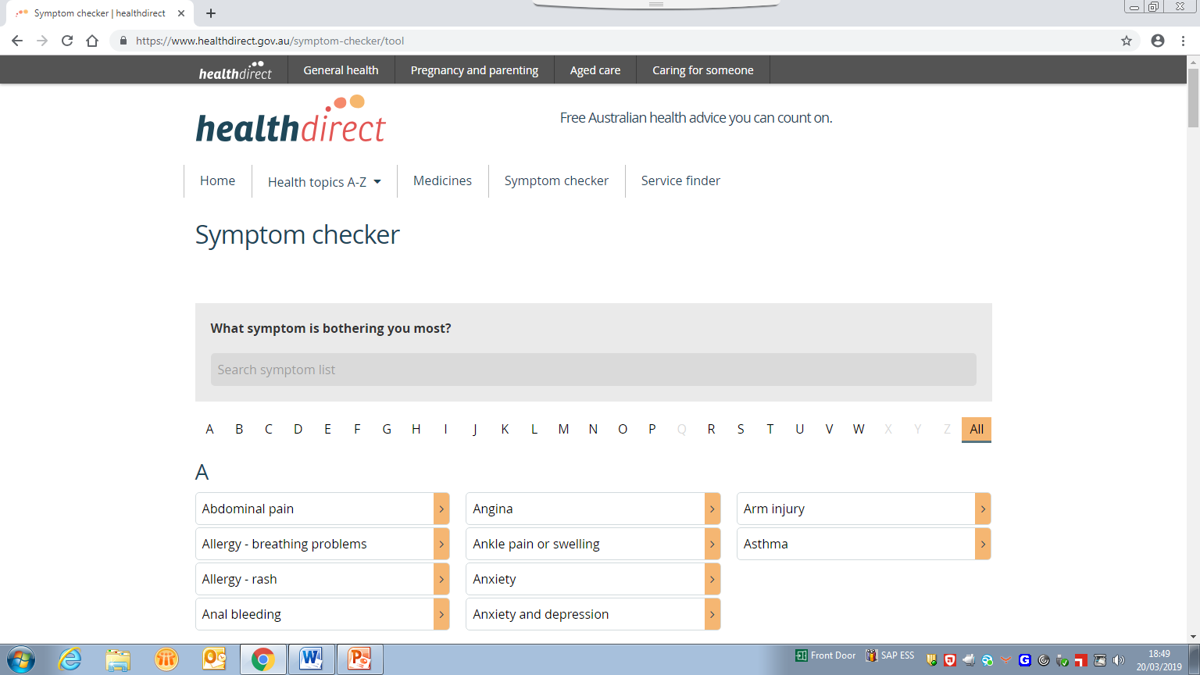

Slide 7


Slide 8
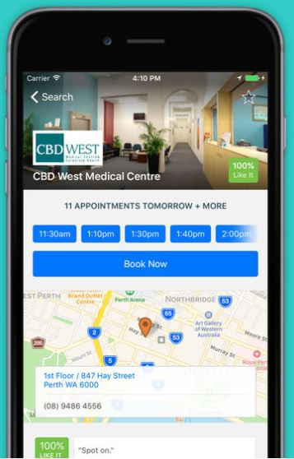
Health Engine
Free app allows you to book with doctors, dentists, physiotherapists, chiropractors and more in your local area
Can even connect HealthEngine app to your electronic My Health Record
  ->quick access to all your health information in one place
Can read patient reviews about their experience and pricing
Can view a picture of practitioners when choosing which doc you’d like to see
Get sent reminders on the day of your appointment

Slide 9
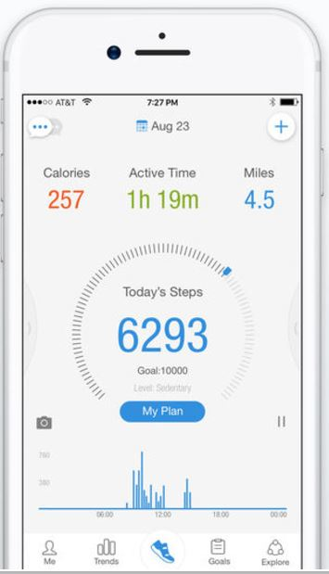
Pacer
Free app
Tracks and records your daily steps or sport or gym exercises
Can track your blood pressure, physical activity, BMI and weight
Can compare individual performance against other team members within a group
Doesn’t require the additional purchase of a smartwatch, Fitbit or other hardware
Can sync steps and calories with the MyFitnessPal app
If you have an Apple device, the Pacer data syncs to the Health App

Slide 10
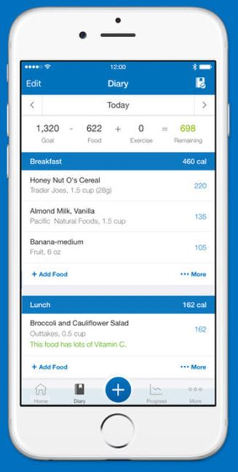
My Fitness Pal
Free app
Offers a suite of tools to track your daily food intake, calories, exercises and steps
Enter your food consumption to keep track of calories going in and log your calories burned for the day
Contains a food database where you can select meals and see the calorie count
Also has a barcode scanner that allows you to scan purchased food items and log them in the app
Can track all the major nutrients including: calories, fat, protein, carbs, sugar, fibre, cholesterol and more
Can connect with other apps e.g. Pacer, Fitbit, MapMyFitness, Runkeeper

Slide 11

Lumen
Breath-analysis device and app
Monitors your metabolism on the phone
Measures the ratio of carbon dioxide to oxygen in your breath
Reveals whether the body is producing energy from fat or carbohydrate
Uses machine learning
Gives you actionable insights on food choices for fitness or weight loss

Slide 12

Diabetes app: smartphone scan set to replace finger-prick test
Free app
Small water-resistant sensor worn on the back of the upper arm
“Game-changer" - does away with the routine finger-prick test
Wave the phone over the sensor to get a real-time glucose level reading
Sensor needs to be replaced after 14 days and costs $92.50

Slide 13
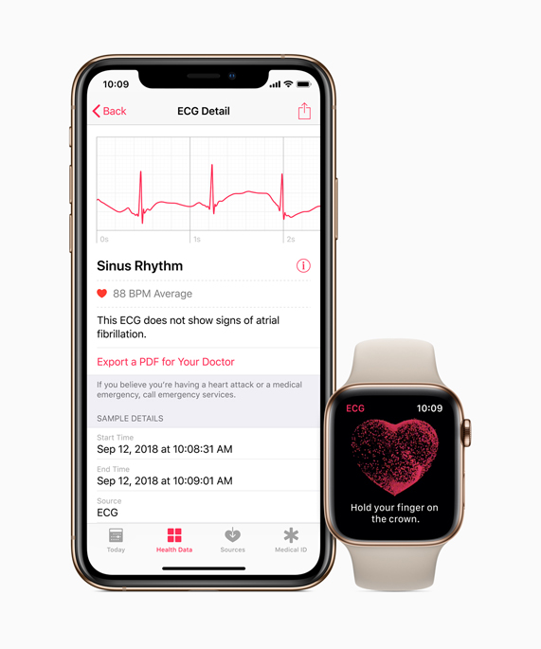
ECG app and irregular heart rhythm notification available today on Apple Watch

Slide 14
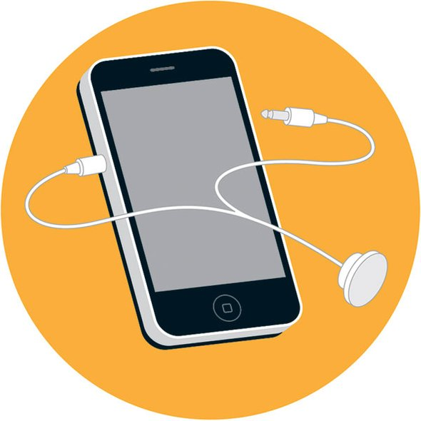
RESAPP
Determines the cause of a cough
How it works:Because respiratory diseases, such as pneumonia, alter the structure of the respiratory tract, each one creates a unique sound signature in a patient's cough
Based on four to five coughs, signal-processing algorithms in this app can detect those patterns, identifying both the type and severity of an ailment

Slide 15
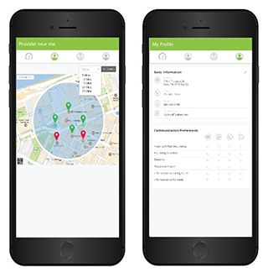
In360
AI powered, patient-facing healthcare decision app
Offers users real-time access to streamlined data collection and personal decision-making tools
Incorporates users’ behavioral trends to make predictive recommendations and gauge care options
Presents the information in a straightforward way

Slide 16
And on and on…..
Well over 1000 apps on the Apple App Store and Google Play specifically targeted at individuals with diabetes
A 2015 review of apps for calculating insulin doses concluded that they mostly provided “no protection against, and may actively contribute to, incorrect or inappropriate dose recommendations that put current users at risk of both catastrophic overdose and more subtle harms”
81% of 211 diabetes apps examined in one study had no privacy policy and even among those that did, few had stipulations explicitly protecting consumer’s privacy

Slide 17
And on and on…..
Health Engine routinely shared users’ private medical information to personal injury law firms as part of a referral partnership contract (not in the privacy policy but a separate ‘collection notice’ with no opt out provision)
Grundy et al (2019): “Health app developers routinely and legally share consumer data with 3rd parties in exchange for services that enhance the user’s experience (e.g. connecting to social media) or to monetise the app (e.g. hosted advertisements)”
“Little transparency exists around third party data sharing, and health apps routinely fail to provide privacy assurances, despite collecting and transmitting multiple forms of personal and identifying information”

Slide 18
Safe, high-quality digital health services
  How does the consumer know that digital health services are safe?
  How do they know they are effective?
  How do they choose between the many options?
  How does a clinician decide which digital health service to recommend?

Slide 19
Current safeguards
Face-to-face health services
Registration of health practitioners –with AHPRA
Accreditation of institutions that educate and train health practitioners
Accreditation of hospitals and general practices
Regulation of medical devices and medicines
Codes of conduct and guidelines
Digital health services
TGA regulates digital medical devices, including software that meets the definition of a medical device (SaMD)
Privacy legislation
Consumer legislation (competition and fair trading)
App store?? Internet??

Slide 20
Supporting safe, high-quality digital mental health services
Australian Commission on Safety and Quality in Health Care has been contracted to develop a Certification Framework for Digital Mental Health Services, including National Standards for Digital Mental Health Services
Project Phases
  Consultation
    Report to the Department of Health by 30 June 2019
  Design and Development
  __________________________________________________________
  3. Establishment and Operations

Slide 21
Methodology
Established a Digital Mental Health Advisory Group
Literature search
Consultation with stakeholders including:
  targeted background briefings, including with national and international leaders in DMHS and mobile health apps
  broad public consultation with a diverse group of stakeholders
    6 face-to-face workshops
    4 on-line workshops
    on-line survey

Slide 22
Spectrum of options
Unregulated
‘Wild West’
Limited guidance
Tools and resources
Assists potential users to make their own choices
Has inherent limitations
Guidelines/ Standards
Available to assist development and implementation of DMHS
Basis for assessment or certification
Assessment
Self-assessed
Independent
assessment
User reviews
Against specified criteria
Program or provider
Provides information to potential user
Point in time
Limited level of warranty
Use to create a register or curated library
Certification
Statement of conformance to standards or guidelines at a pre-determined threshold
Implies a higher level of warranty
Regulation
Mandated requirement for compliance with standards

Slide 23
Digital mental health services
Defined as: a service that uses digital technology to facilitate engagement and the delivery of care
Includes mental health, suicide prevention and alcohol and other drugs
4 service categories: information and education; digital counselling; treatment services; peer to peer services
5 major media/channels: telephone; videoconferencing; internet; SMS; apps
Excludes electronic medical records and decision support tools
Not covering physical health
BUT…. we are something of a pioneer – our work will likely inform how other sectors might also tackle the issue

Slide 24
Digital mental health services
Complex task
Many issues to be considered
We’d like your help!

Slide 25
Group exercise 1
Thinking about the range of DMHS across all sectors/service categories/media channels, do they all need to be certified?
If not, are there some types of DMHS that are a higher priority for certification than others?

Slide 26
Preliminary thoughts about safety and quality domains
  Clinical
    Clinical governance
    Safety and effectiveness
    Co-design with consumers
    Continuity and transitions of care
    Identification and procedure matching
    Clinical handover and documentation
    Recognising and responding to acute deterioration
Notes:
Develop a Certification Framework that establishes:
Aim and principles
What is certification and what does it mean, including the level of warranty implied by holding certification status
What is required for a DMHS to be certified e.g. in addition to demonstrating that they meet the standards, evidencing a commitment to ethical and safe practice and maintaining quality improvement processes for the duration of a certification period
The process by which DMHS will be assessed as to whether they conform with the National DMHS Standards
The duration of certification and clear rules in relation to the applicability of certification status to updates and iterations of DMHS
Rules and procedures in relation to the administration of the Certification Framework (including the scope of the Certification Framework and the jurisdiction of any entities authorised within the CF, as well as complaints handling and appeals mechanisms)
Fees and charges for certification
Rules and procedures in relation to governance of the National DMHS Standards and the Certification Framework

Slide 27
Preliminary thoughts about safety and quality domains
  Technical
    Privacy and confidentiality
    Data security
    Usability and accessibility
    Interoperability
    IT infrastructure stability
    Change management
Notes:
Develop a Certification Framework that establishes:
Aim and principles
What is certification and what does it mean, including the level of warranty implied by holding certification status
What is required for a DMHS to be certified e.g. in addition to demonstrating that they meet the standards, evidencing a commitment to ethical and safe practice and maintaining quality improvement processes for the duration of a certification period
The process by which DMHS will be assessed as to whether they conform with the National DMHS Standards
The duration of certification and clear rules in relation to the applicability of certification status to updates and iterations of DMHS
Rules and procedures in relation to the administration of the Certification Framework (including the scope of the Certification Framework and the jurisdiction of any entities authorised within the CF, as well as complaints handling and appeals mechanisms)
Fees and charges for certification
Rules and procedures in relation to governance of the National DMHS Standards and the Certification Framework

Slide 28
Preliminary thoughts about safety and quality domains
  End-user facing
    Description of purpose and audience
    Development and production
    Evidence base
    Endorsements
    User satisfaction and engagement – including reviews
Notes:
Develop a Certification Framework that establishes:
Aim and principles
What is certification and what does it mean, including the level of warranty implied by holding certification status
What is required for a DMHS to be certified e.g. in addition to demonstrating that they meet the standards, evidencing a commitment to ethical and safe practice and maintaining quality improvement processes for the duration of a certification period
The process by which DMHS will be assessed as to whether they conform with the National DMHS Standards
The duration of certification and clear rules in relation to the applicability of certification status to updates and iterations of DMHS
Rules and procedures in relation to the administration of the Certification Framework (including the scope of the Certification Framework and the jurisdiction of any entities authorised within the CF, as well as complaints handling and appeals mechanisms)
Fees and charges for certification
Rules and procedures in relation to governance of the National DMHS Standards and the Certification Framework

Slide 29
Group Exercise 2
What does the certification process need to cover to meet the needs and expectations of consumers, carers and clinicians and build trust in the certification process?
What is most important to get right?

Slide 30
Spectrum of options
Unregulated
‘Wild West’
Limited guidance
Tools and resources
Assists potential users to make their own choices
Has inherent limitations
Guidelines/ Standards
Available to assist development and implementation of DMHS
Basis for assessment or certification
Assessment
Self-assessed
Independent
assessment
User reviews
Against specified criteria
Program or provider
Provides information to potential user
Point in time
Limited level of warranty
Use to create a register or curated library
Certification
Statement of conformance to standards or guidelines at a pre-determined threshold
Implies a higher level of warranty
Regulation
Mandated requirement for compliance with standards

Slide 31
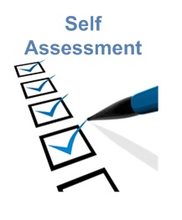

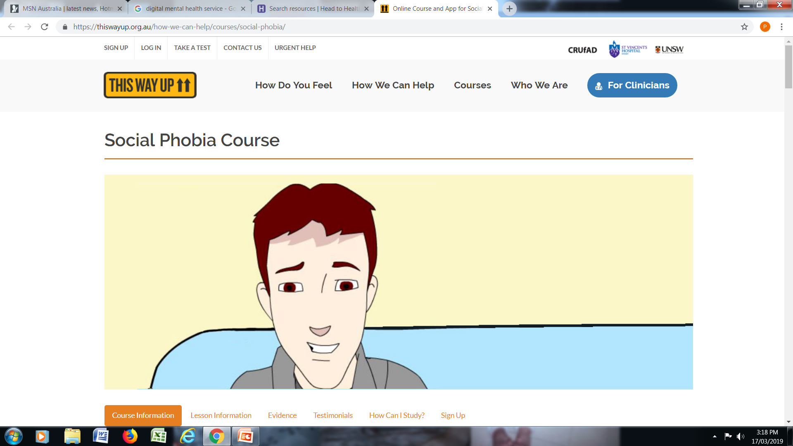

Possible Components
Assessment
  1. Assessment method
    Self-assessment
    Independent assessment
    User reviews
  2. Level of assessment
    DMHS
    Service provider (CQOE)
    Blended assessment

Slide 32
Group Exercise 3
What are the most important components for the certification framework?
What is your preferred method of assessment and why?

Slide 33
More information
More information (including a discussion paper) is available on our website: https://safetyandquality.gov.au/dmhs
Face-to-face and on-line workshops
On line survey available until 26 April 2019
Please consider completing the survey and circulate to your friends and colleagues as well
We want as much feedback as possible to inform our report to the Department of Health on the options for a Certification Framework

Slide 34


