Slide 1



Physical health and mental illness: giving a voice to consumers
Dr Katherine Moss
Advanced Trainee in Forensic Psychiatry, The Park Centre for Mental Health
Researcher, Queensland Centre for Mental Health Research
B.Phty (Hons) MBBS (Hons)
Notes:
Good afternoon everyone – by way of introduction my name is Katherine Moss. I am in my final year of psychiatry training, specialising in forensic psychiatry. I have been working in the field of psychiatry for the past 7 years. I currently work part time in a clinical role in the high secure unit of The Park, Centre for Mental Health and part-time as a researcher at the Queensland Centre for Mental Health Research under Assoc Prof Ed Heffernan and the team there.
This afternoon I will present this talk entitled Physical health and mental illness: giving a voice to consumers.
What you will hear this afternoon is really a work in progress as my colleagues as I are currently investigating physical health and mental illness within a high secure psychiatric setting. So I’ll talk a little about the background to the research we are doing and present some preliminary findings.

Slide 2
"I get unfit when I go to hospital"
Notes:
What a poignant statement
And this is from one of my own patients in the high secure unit
What a sad state of affairs for our forensic psychiatric patients – detained in a government run facility only to have their physical health deteriorate....

Slide 3
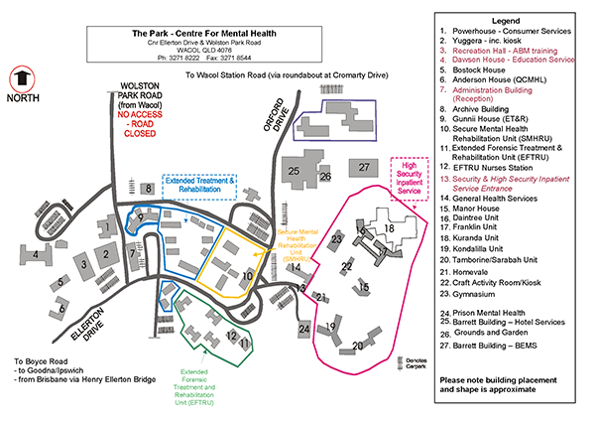
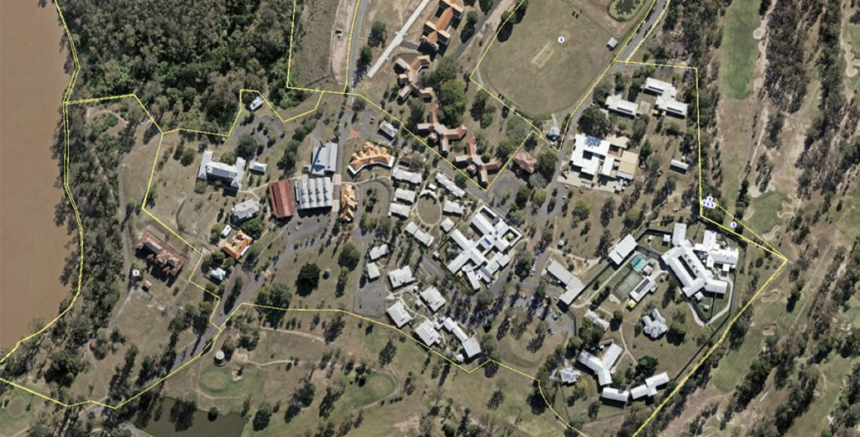
The Park, Centre for Mental Health
Notes:
Very briefly to set the scene for you - The Park Centre for Mental Health is located in the Brisbane western suburb of Wacol
It has 70 high secure inpatient beds, 34 medium secure beds and 20 rehabilitation beds
Pink- high secure unit, 5 wards
Yellow – medium secure unit, 3 wards
Green – rehabilitation unit
Pool
Tennis court
Gym
Canteen – operates in the high secure unit weekly
Physical health has been a concern there for some time
Noted that patients have high BMIs and put on weight during admissions
Clinical need that we need to do more to address the issue of overweight/obesity and weight gain
Changes to canteen/hospital menu etc etc
Regular metabolic monitoring has been implemented
Physical activity – remains a significant challenge.
- some exercise equipment on the wards (never seen anyone use)
- lovely outdoor exercise equipment (but only seen one person use)
- gym
- PT/rec officer/physio

Slide 4

Background
National Mental Health Commission has identified co-design of mental health services as an important area of mental health reform
Physical health of patients with severe mental illness has been highlighted as a key work area
Poor physical health of forensic psychiatric patients has been established in the literature
No co-designed physical activity interventions in a forensic setting
Notes:
In terms of why we are doing this research:-
The National Mental Health Commission has identified co-design of mental health services as an important area of mental health reform. Additionally, the physical health of patients with severe mental illness has been highlighted as a key work area. It is well established that there is a significant gap between the physical health of patients with severe mental illness and that of the general population. Patients with severe mental illness are reported to die 10-20 years earlier and have significantly more health issues. The physical health of patients in high security hospitals is often compromised by the requirements of long hospital inpatient stays, limited access to physical activity and the high prevalence of psychotic illness and anti-psychotic treatment. To date there have been relatively few studies that have investigated physical activity interventions for forensic patients. Additionally, there have been no co-
designed studies performed in a forensic setting.

Slide 5
Background: Co-design
Co-design provides the opportunity for patients and staff to help identify current needs and expectations, inform design and influence how care and services are provided
Through questionnaires and interviews, patients and staff experiences can form a valuable part of design and improvement
Co-design recognises that lived-experience is equal to other forms of knowledge, evidence and expertise

Slide 6
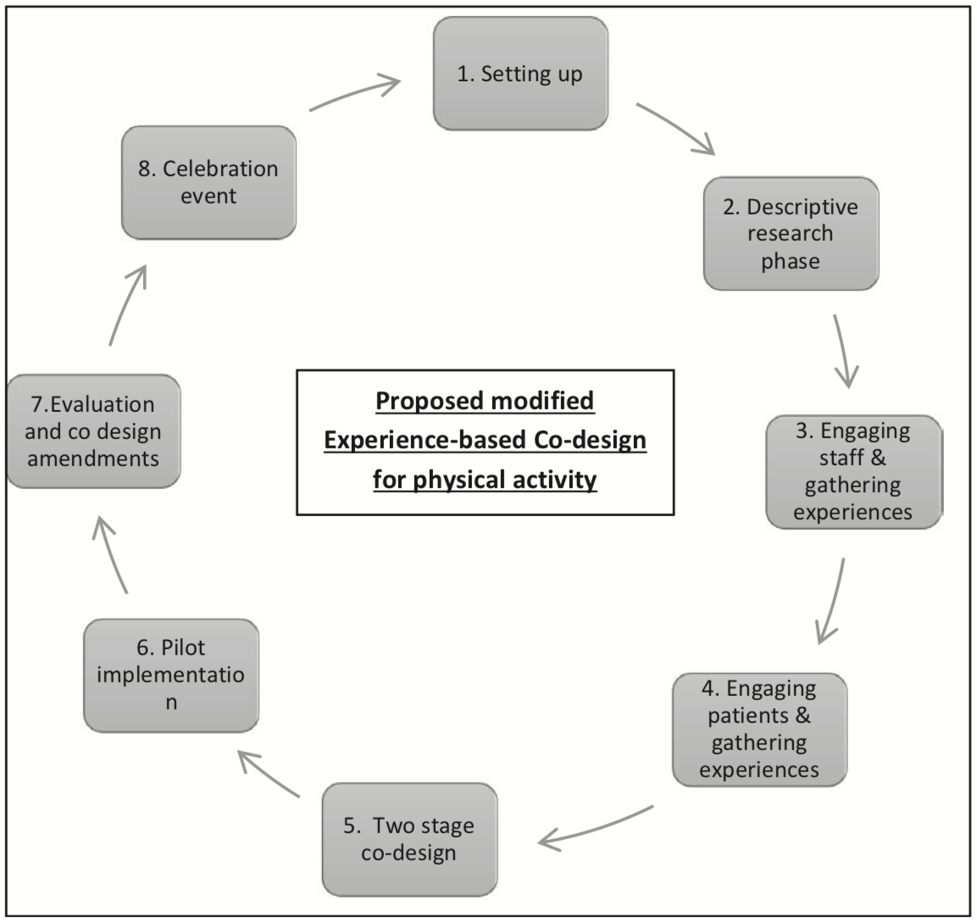
Co-design for physical activity
Matthews et al. Psychiatr Ment Health Nurs. 2017;24:545–552.

Slide 7
Background: Implementation Science
Implementation science developed out of the finding that evidence based practices take, on average, 17 years to be incorporated into routine general practice in health care and that only about half of evidence based practices ever reach widespread clinical usage
Uses a systematic and scientific approach to identify the range of factors likely to facilitate an intervention's success
Fundamental to the design of successful interventions
An intervention and its implementation need to be evaluated to fully understand outcomes and impacts
Notes:
Implementation science attempts to address the significant knowledge gap between interventions that research has shown to be effective and their delivery to communities and translation into practice. It is needed to address the complexities of the systems in which interventions are implemented.
Implementation science developed out of the finding that evidence-based practices take, on average, seventeen years to be incorporated into routine practice in health. There is now widespread evidence documenting the benefits of physical activity for patients with severe mental illness.
A forensic setting poses unique challenges with regards to implementing physical activity interventions for patients. Despite this, incorporating physical activity into treatment programs for patients who reside in government run secure settings can be regarded as an important component of recovery and care.
What we don't want to do is to run an exercise intervention that only really works as part of a research study and is not later implemented and is not sustainable.

Slide 8
Theoretical Domains Framework (TDF)
Developed by a collaboration of behavioural scientists and implementation researchers
Aimed to provide a comprehensive theory-informed approach to identify determinants of behaviour
Synthesis of 33 theories of behaviour and behaviour change clustered into 14 domains
Framework rather than theory alone
Provides a lens to view the cognitive, affective, social and environmental influences on behaviour
Used to understand health professional behaviour and to consider what may be important in changing patient behaviours
Atkins et al. Implementation Science (2017) 12:77
Notes:
Implementing new practices requires changes in individual and collective behaviour. Changing behaviour requires an understanding of the influences on behaviour in the context in which they occur. The Theoretical Domains Framework was initially developed for implementation research to identify influences on health professional behaviour related to implementation but this was extended to be relevant to other areas in which changing behaviour is important such as changing patient behaviours.

Slide 9
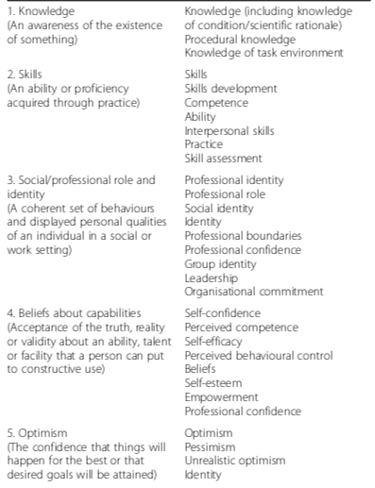
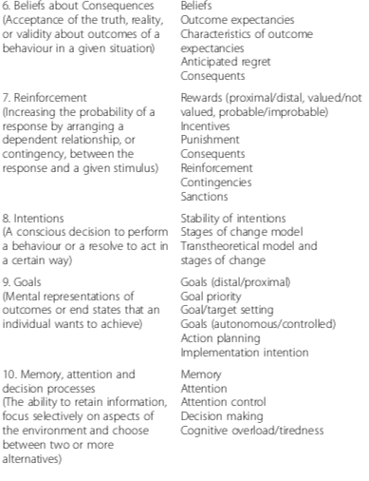
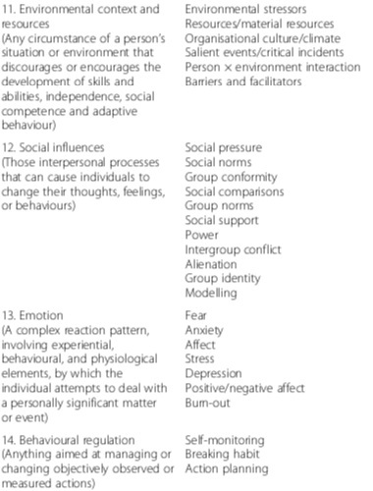
Definitions and component constructs of TDF
Atkins et al. Implementation Science (2017) 12:77

Slide 10
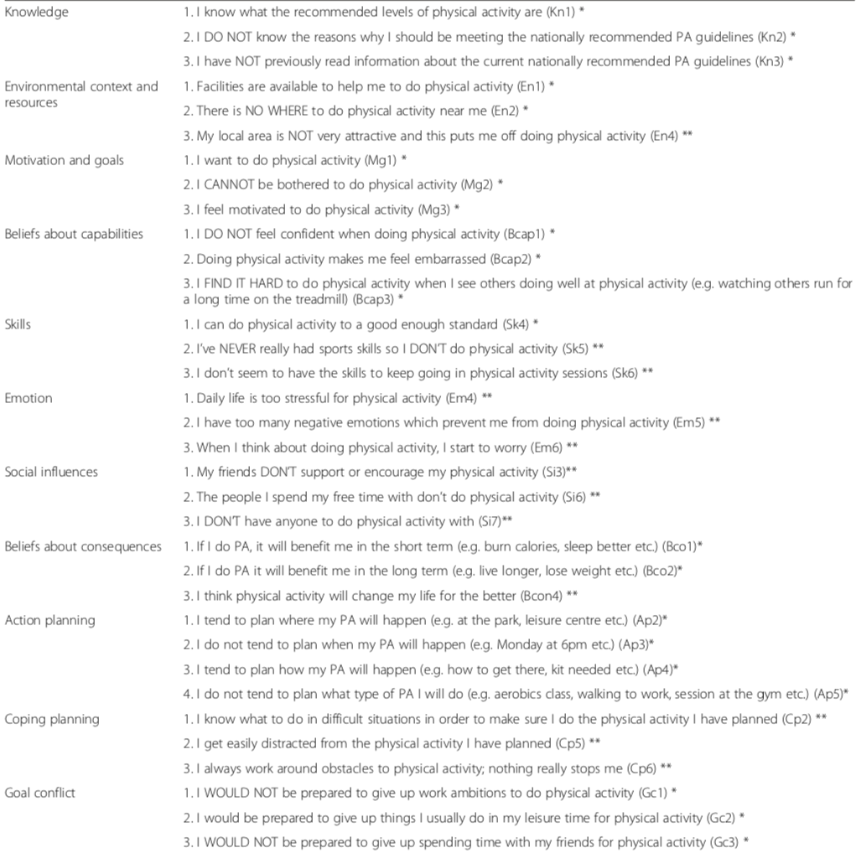
Physical activity questionnaire using TDF
Taylor et al. International Journal of Behavioural Nutrition and Physical Activity (2013) 10:74.
Notes:
There is evidence to support the success of tailored interventions to increase physical activity, especially when these interventions are tailored on the basis of theoretical constructs such as attitudes, self-efficacy or social support.
Taylor and colleagues sought to develop a physical activity questionnaire that would help to identify the important determinants of behaviour change in relation to physical activity.
Determinant areas that did not fit with physical activity behaviour – such as social/professional role/identity and memory, attention and decision processes were omitted.
The researchers reported good discriminant validity and test-retest reliability and good internal consistency for the majority of determinant areas
Most of these factors were able to differentiate between high and low exercisers, indicating that individuals undertaking no or minimal physical activity report stronger barriers in these areas than those who exercise over the recommended levels.

Slide 11

Research Project
Phase 1 – collection of data to inform the current health status and current physical activity levels of patients
Phase 2 – collection of data to inform physical activity intervention (physical activity questionnaire, semi-structured interview)
Phase 3 – co-design and implementation of a physical activity intervention and evaluation (this will include a wait list control design)
Longer term plan – ongoing assessment of physical activity levels, physical health outcomes and implementation strategies over time

Slide 12
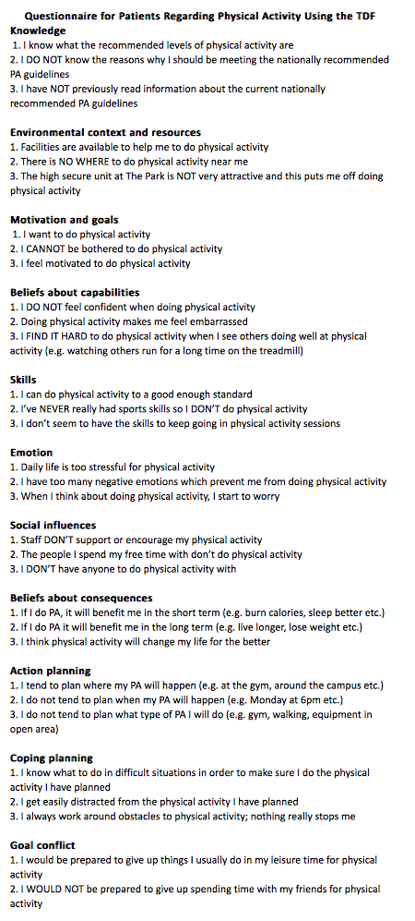
Physical Activity Questionnaire
Based on the Theoretical Domains Framework
Knowledge
Environmental context and resources
Motivation and goals
Beliefs and capabilities
Skills
Emotion
Social Influences
Beliefs about consequences
Action planning
Coping planning
Goal conflict
Notes:
This is the current working questionnaire for our forensic population.
We made a number of small changes that we wrote to the authors about.
For example some activities given as examples were not offered in out setting such as aerobics so we just omitted them.

Slide 13
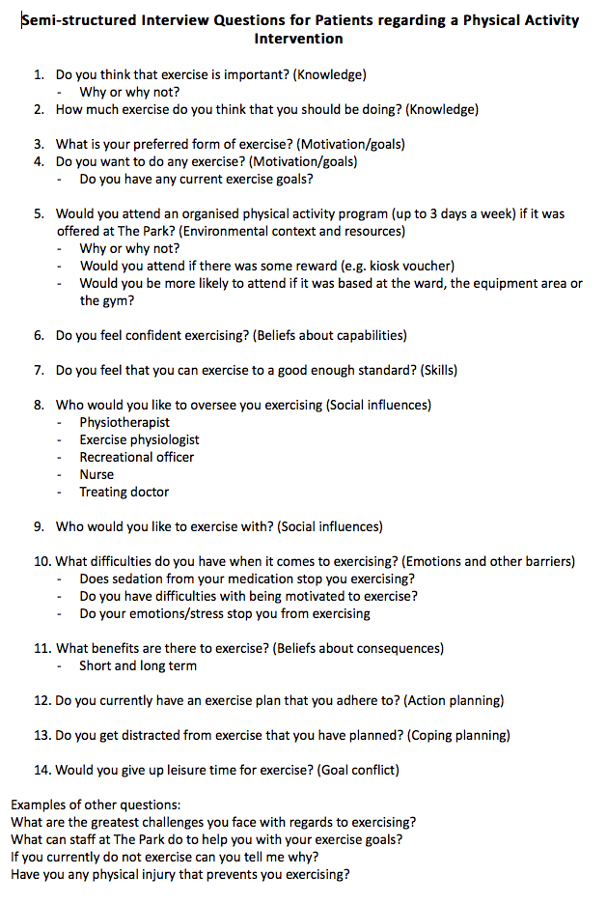
Interview Questions
To provide further information
15-20 minutes

Slide 14
Preliminary findings
Notes:
Now I am going to just run through some of the preliminary findings from our study – which is really attempting to give consumers a voice in the design and implementation of a future physical activity intervention.

Slide 15
Knowledge
90% of patients believed that exercise was important, one was unsure
"exercise...keeps your body and mind in sync with each other"
"helps overall to keep you healthy mentally and physically...reduce waist line...reduce heart disease"
70% of patients thought they should be exercising around 30-60 minutes per day
Notes:
Their understanding of the importance of exercise was really based on their own personal experience of exercise rather than any education.
2 patients indicated that they knew the recommended levels of physical activity – on further questioning one said 30-60 minutes per day and the other said 60 minutes per day. 4 other patients indicated that they thought 30 minutes a day was probably enough. One person made mention of different intensity of exercise.
When Taylor and colleagues assessed these determinants "Knowledge" did not distinguish between high and low exercises – may be that possessing such information may not be enough to induce activity in low exercisers especially if they perceive other predominant barriers.

Slide 16
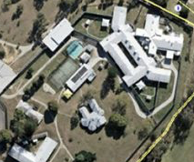
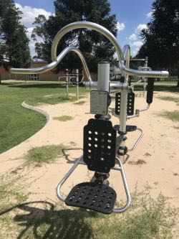
Environmental context and resources
8/10 acknowledged that there were facilities available to help them do physical activity
2/10 reported that there was no where for them to do physical activity
Both these patients were not restricted with regards to ground leave
3/10 reported that the high secure unit was not very attractive and said that it puts them off doing physical activity

Slide 17
Motivation
5/10 reported feeling motivated to exercise and 7/10 reported that they wanted to do some physical activity
2/10 reported that they "couldn't be bothered to do physical activity"
Of these – one cited issues with sedation relating to medication and one had physical injuries

Slide 18
Exercise preference/goals
60% of patients reported that their preferred form of exercise was walking
Other forms of exercise – jogging, swimming, yoga, exercise bike, gym work, sports (soccer, volleyball)
70% wanted to do exercise
2/10 had current goals (get back into golf and walk at least 9/18 holes, continue daily regime of yoga and swimming)
80% indicated that they would attend a formal exercise group if it was offered
Monetary incentive would help influence decision in ~50%
Notes:
This is really important when we start to try to devise an exercise intervention. Need to consider the type of exercise that people want to do.

Slide 19
Beliefs about capabilities/skills
8/10 reported feeling confident with regards to physical activity
"Yes I feel confident…it gives me a sense of satisfaction…accomplishment…makes me feel better…definitely releases stress"
2/10 reported not feeling confident about exercising
9/10 felt that they could exercise to a good enough standard on questionnaire

Slide 20
Emotion
7/10 reported that they had no issue with emotions in regard to physical activity
1/10 reported that when they thought about physical activity they began to worry
2/10 reported having negative emotions that prevented them from doing more physical activity
1/10 found daily life "too stressful" to participate in physical activity
Walking 90 mins 3 x per week

Slide 21

Social influences
1/10 felt staff did not support or encourage physical activity
3/10 reported that the people they spend time with on the unit don't do physical activity
3/10 reported not having anyone to do physical activity with
5/10 - recreational officer
2/10 - physiotherapist
1/10 - personal trainer
1/10 - unsure
1/10 - self

Slide 22
Beliefs about consequences
Short term:
"reduce weight, to increase muscle, tone up"
"improve your health...mood...sleep...skill"
Long term:
"maintain a healthy lifestyle"
"live a longer life...healthier life"
Notes:
All patients reported that doing physical activity would benefit them in some way
Short term 7/10
Long term 9/10
Change life for the better 7/10

Slide 23
Action planning and coping planning
5/10 reported planning where their physical activity would happen
1/10 reported not planning when their physical activity would happen
1/10 reported not planning what exercise they would do
5/10 reported that they knew what to do in difficult situations in order to do the physical activity they had planned
3/10 reported being easily distracted from physical activity
1/10 reported working around obstacles to physical activity
Notes:
Planning is regarded as highly valuable in the process of health behaviour change. It bridges the gap between behavioural intentions and health behaviour. To further develop this concept, a distinction is made between action planning and coping planning. The coping planning refers to the mental simulation of overcoming anticipated barriers to action.
Planning is something that we work on in our rehabilitation wards and encourage patient to take responsibility for their activities.

Slide 24
Goal conflict
7/10 reported that they would be prepared to give up leisure time for physical activity
? Lots of leisure time in a forensic psychiatric facility
Notes:
In Taylor’s study "Goal conflict" was not able to distinguish between high and low exercisers – and this may be because this is a perceived barrier for most individuals as people regularly pursue multiple goals simultaneously
This may actually not hold in a forensic setting – with patients who have few goals and are restricted in what they are able to do or pursue

Slide 25
Facilitators and barriers
Accessing regular times for gym
Cancellation of activities due to lack of staff or training of staff
Not enough equipment
Heat
Physical health issues (e.g. back, shoulder and knee pain; being overweight)
Motivation (50%)
Sedation (50%)
Emotions/stress (20%)
Facilitators/Opportunities | Barriers
Importance of physical activity recognised by staff and patients for improving physical health, providing occupation and diversion and improving mental health Staff members who help to motivate patients to exercise Having opportunities to exercise and equipment in ward Facilitators and Barriers compiled by research findings by Dominic Beer in his thesis "Physical Exercise for Inpatients Within a High Secure Forensic Mental Health Facility: Barriers and Opportunities", 2016. | Mental illness related factors – low mood, current psychosis Medication side effects Previous injury Low motivation Poor baseline physical health status Insufficient staff numbers Insufficient expertise/training for facilitators and staff Priority on mental illness and risk management Reduced opportunity to access equipment of facilities Lack of resources/equipment
Notes:
We can’t talk about using implementation science to inform our study and not discuss facilitators and barriers for physical activity within a forensic setting. On the screen are the barriers that have been reported in this current study and the table shows some barriers and facilitators that were examined in previous but fairly recent study at The Park. Addressing the barriers and utilizing the facilitators will be imperative if we want to design a sustainable physical activity programme for forensic psychiatric patients.

Slide 26
What the consumers say...
Exercise is important (90%)
Walking is a preferred form of exercise (60%)
We want to exercise (70%)
We would attend an exercise intervention (80%) if it was offered
Our preference is to exercise in a group setting (60%) - overseen by someone we know and trust
The main barriers are our current physical health issues (70%), the weather, access issues
We would give up leisure time to exercise (50%)

Slide 27
So if this is what they are saying what are we doing about it?
Aiming to recruit ~40 patients
Utilise principles of co-design (includes interviews with staff and consumers)
Consideration of implementation factors to design a physical activity intervention
Evaluate not only the effectiveness of the intervention but the implementation strategies utilised

Slide 28
In conclusion
"All the endorphins affect your mental health...you sleep better if you exercise...function better...it gives you a feeling of wellbeing... works out your emotions"
"As far as my mental health goes I can’t put it into words…I just feel so much saner when I exercise…I’m more positive and smile more"
Notes:
I would like to end this talk with 2 quotes from patients because they really highlight to me the importance of striving to improve the physical health of patients with serious mental illness…even in a very difficult setting like a high secure forensic unit.

Slide 29
References
Matthews et al. (2017) Using experience-based co-design for the development of physical activity provision in rehabilitation and recovery mental health care. Psychiatric and Mental Health Nursing, 24:545–552.
Atkins et al. (2017) A guide to using the Theoretical Domains Framework of behaviour change to investigate implementation problems. Implementation Science, 12:77
Taylor et al. (2013) Development and initial validation of the determinants of physical activity questionnaire. International Journal of Behavioural Nutrition and Physical Activity, 10:74.
Beer, D. "Physical Exercise for Inpatients Within a High Secure Forensic Mental Health Facility: Barriers and Opportunities", 2016.

