Slide 1


PHYSICAL HEALTH A Human Rights Issue
Equally Well National Symposium
March 2019
Indigo Daya
Dr Chris Maylea
#EquallyWellAust @ChrisMaylea @VMIAC @indigodaya

Slide 2

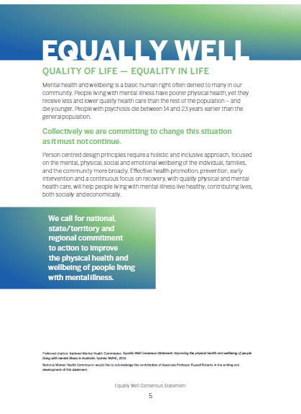
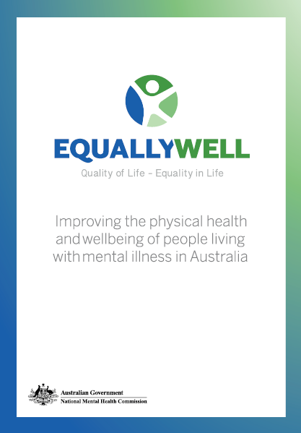
Equally Well Consensus Statement p.5
“Mental health and wellbeing is
a basic human right often denied
to many in our community”

Slide 3
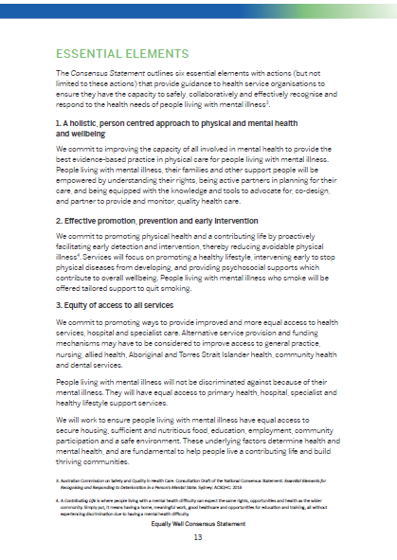
Equally Well Consensus Statement p.13
“People living with mental illness, their families and other support people will be empowered by understanding their rights, being active partners in planning for their care, and being equipped with knowledge and tools to advocate for, co-design, and partner to provide and monitor, quality health care.”

Slide 4
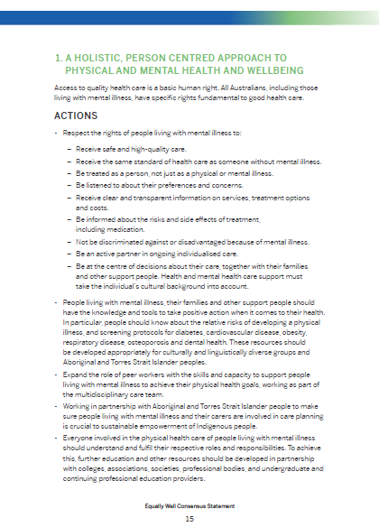
Equally Well Action No.1 p.15
1. Respect the rights of people living with mental illness

Slide 5
Right to Health
International Covenant on
Economic, Social & Cultural Rights
(ICESCR)
Convention on the Rights of
Persons with Disability
(CRPD)

Slide 6
Right to Health (CRPD)
Require health professionals to provide care of the same quality to persons with disabilities as to others,
Notes:
Chris

Slide 7

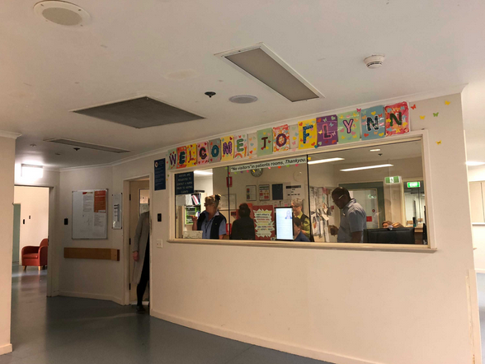
Same quality
?

Slide 8
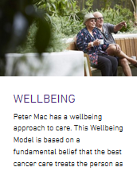
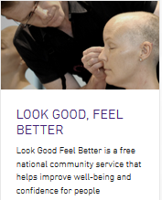
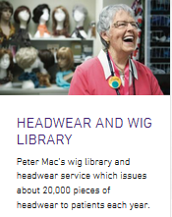

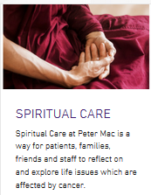





Physiotherapy
Nutrition & dietetics
Music therapy
Treatment related side effects
Pain management
Quitting smoking

Slide 9
Right to Health (CRPD)
Require health professionals to provide care of the same quality to persons with disabilities as to others,
including on the basis of
free and informed consent
Notes:
Chris

Slide 10

Consent
Free
Informed
Notes:
I thought a flying owl might help convey the message you spoke about, i.e., you need both elements or you don’t have consent (you can’t fly…). Plus, owls are cool.

Slide 11
Consent
Free
No pressure or undue influence. No ‘threats’ of compulsory treatment.
Notes:
I thought a flying owl might help convey the message you spoke about, i.e., you need both elements or you don’t have consent (you can’t fly…). Plus, owls are cool.

Slide 12
Consent
Informed
Explain the implications of the decision, including pros and cons.
Notes:
I thought a flying owl might help convey the message you spoke about, i.e., you need both elements or you don’t have consent (you can’t fly…). Plus, owls are cool.

Slide 13
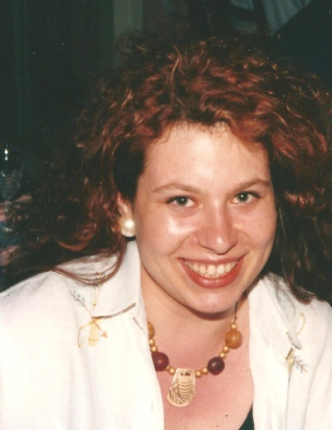
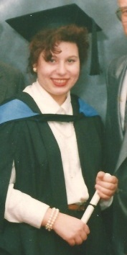
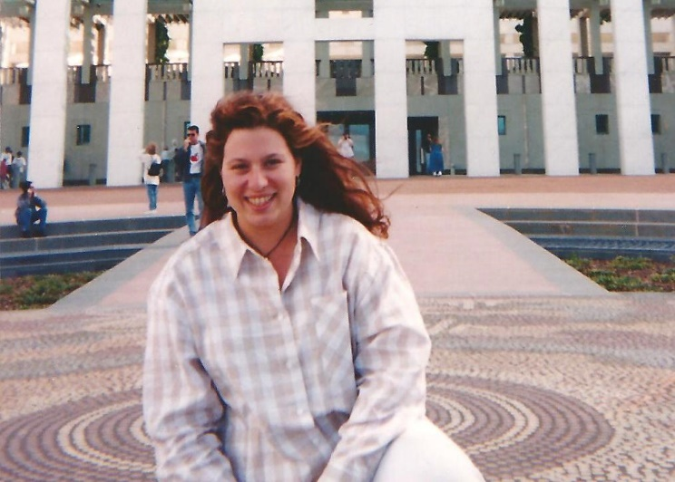
Before I was mad, I was a size 14.

Slide 14

You might gain a bit of weight.
Notes:
Indigo – how dare they

Slide 15
You decide to put our lives at risk with meds.

Slide 16

Sometimes, you don’t even tell us the risks.

Slide 17
Right to Health (CRPD)
Require health professionals to provide care of the same quality to persons with disabilities as to others, including on the basis of free and informed consent
by, inter alia, raising awareness of the human rights, dignity, autonomy and needs of persons with disabilities through training and the promulgation of ethical standards for public and private health care (a25)
Notes:
Chris

Slide 18
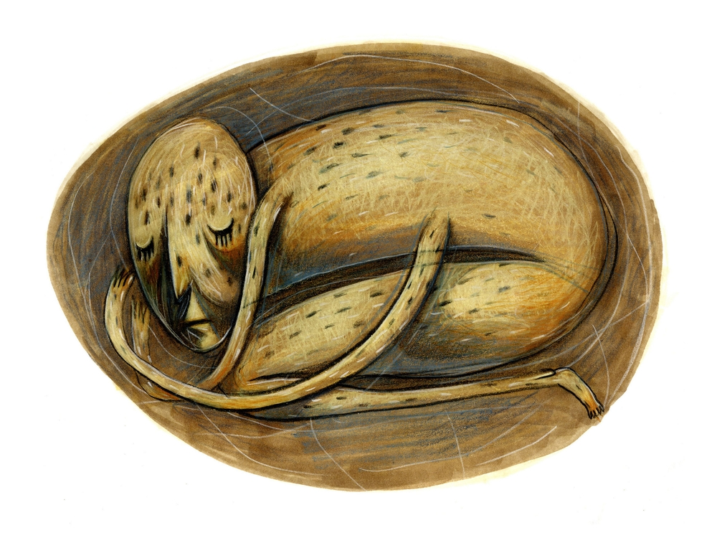

Raising awareness of…
Human rights
Dignity
Autonomy
Needs
Notes:
Do you want separate slides or text for these? I thought this image might help represent that Mh legislation holds consumers back from the freedoms everyone else has in healthcare? Tell me if it doesn’t work for you.

Slide 19

We don’t get to think about retirement.

Slide 20
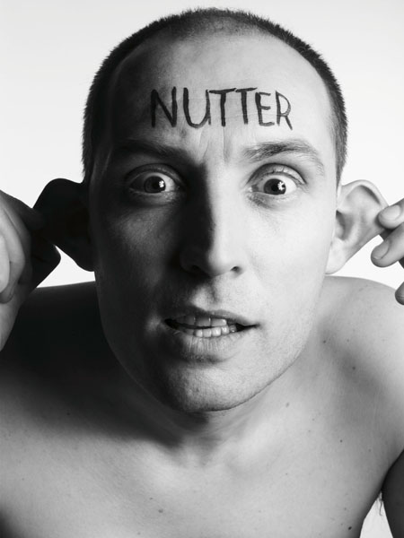
Our psychiatric labels become all you see.

Slide 21
“Best interests”
Will and preferences

Slide 22







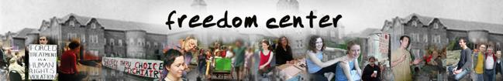





Notes:
No international orthopaedic survivor movement
If this worked there wouldn’t be a consumer movement

Slide 23

Misunderstanding capacity
Supported decision making, not coercion
Notes:
OK I’m not leaving this image in, but it made me laugh so much I had to put it in a draft! ROTFLOL….

Slide 24
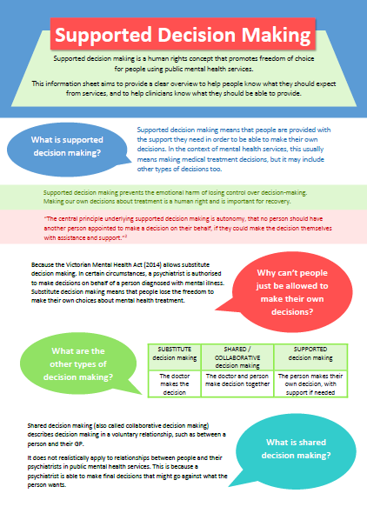
Supported decision making
Reasonable adjustment for psychosocial disability.
Ensuring equitable human rights.

Slide 25
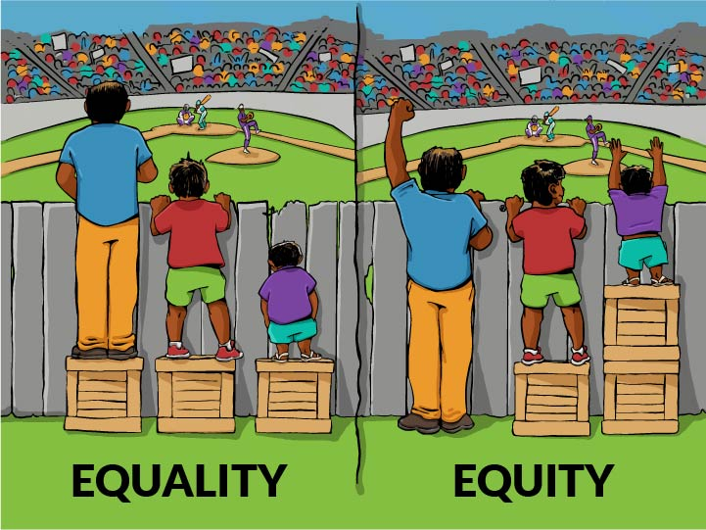
Reasonable adjustment
Image by Craig Froehle
Notes:
Need to add attribution for image

Slide 26
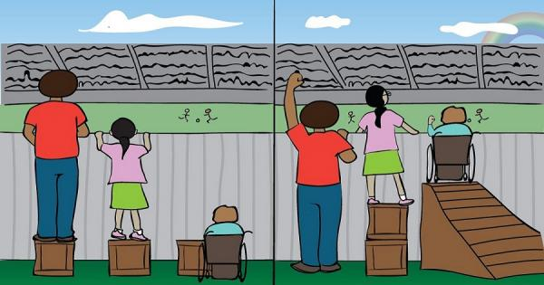
Reasonable adjustment for a physical disability
Image by Maryam Abdul-Kareem, adapted from the original drawing by Craig Froehle

Slide 27
Reasonable adjustment in mental health: Support to make own decisions
SDM

Slide 28
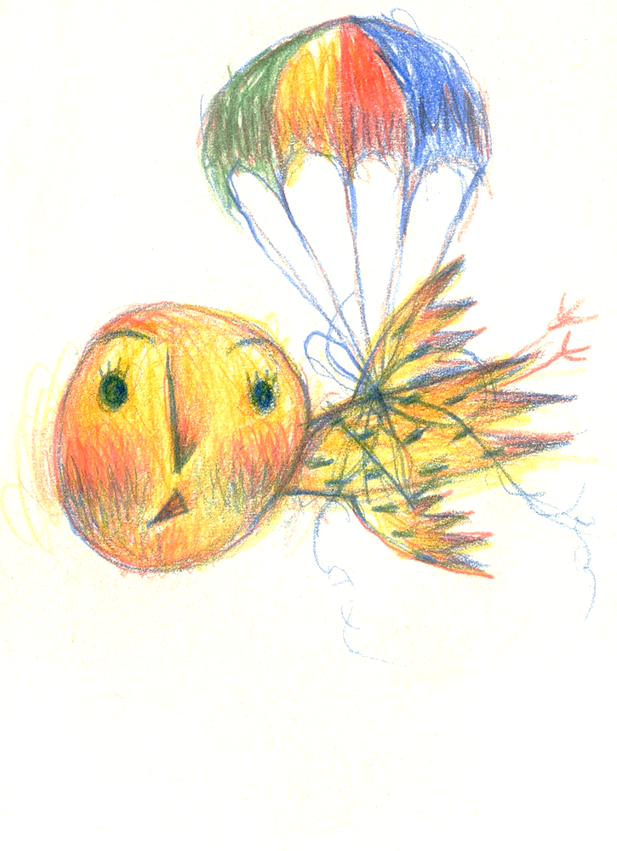
How do we do supported decision making?
Will and preferences NOT best interests
Advance statements
Nominated persons
Legislative change: Advance directives & stop compulsory treatment
Honest information about:
Risks as well as benefits
Likelihood of each
Other options (including do nothing)

Slide 29
Supported decision making is about more than rights.
Losing your rights is harmful.
Supported decision making has therapeutic value.
People are actually the best judge of what’s best for them.

Slide 30
Self-report on antipsychotic impacts
(Abstract only) Read, J. and Williams, J. (2019). Positive and negative effects of antipsychotic medication: an international online survey of 832 recipients. Current Drug Safety. Retrieved from: http://www.currentdrugsafety.com/articles/170386/positive-and-negative-effects-of-antipsychotic-medication-an-international-online-survey-of-832-recipients

Slide 31
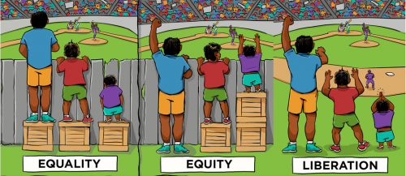
Eventually…

Slide 32

First, do no harm.
Notes:
I think we should finish on this message

