Slide 1


RICHMOND FELLOWSHIP QUEENSLAND
A future recovered for people facing mental health challenges
Promoting health without stigma:
Delivering a weight-neutral health-behaviour change program
Mandy-Lee Noble
Accredited Practising Dietitian
Notes:
Hello everyone,
Thank-you for attending today and bring your knowledge and experience to share with others.
Today I would to share with you my experience of delivering a weight-neutral health-behaviour change and how that has been beneficial to both the participants and and to myself as a health professional.

Slide 2


Healthy Bodies Healthy Minds: Partnership & Collaboration
Notes:
HBHM has been designed specifically with these barriers in mind
HBHM is an 8 week exercise and nutrition program for people with mental illness, delivered by exercise physiologists and dietitians.
The program is held at gym facilities of PCYC Queensland collaboratively with Richmond Fellowship Queensland.
Both the exercise and nutrition components of the program are manualised for consistent implementation across multiple sites.
The exercise component is designed to improve participants’ knowledge of exercise concepts, and confidence in exercising in the gym to achieve goals appropriate to individual’s health and fitness presentations. Participants receive a free gym membership to enable self-initiated exercise and support maintenance of exercise after the program finishes.
The nutrition component is designed to improve the client’s relationship with food and skills in accessing and preparing nourishing meals and snacks themselves while experience mental health challenges.

Slide 3
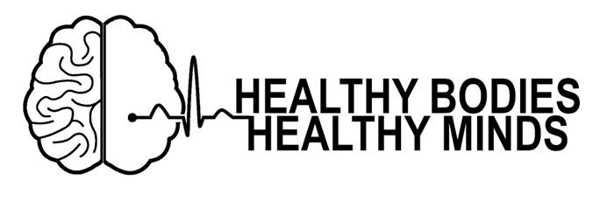
Community implementation
Exercise and nutrition intervention
Delivered by Exercise Physiologists and Dietitians
8 weeks, 2-hr group sessions once/week + gym memberships
Funding from NDIS (Health and Wellbeing line item)
Notes:
In a nut shell the program it is an 8 week 2hour group session program delivered at PCYC gyms that are local to participants. One hour is spent with the dietitian and one hour with the exercise physiologist.

Slide 4
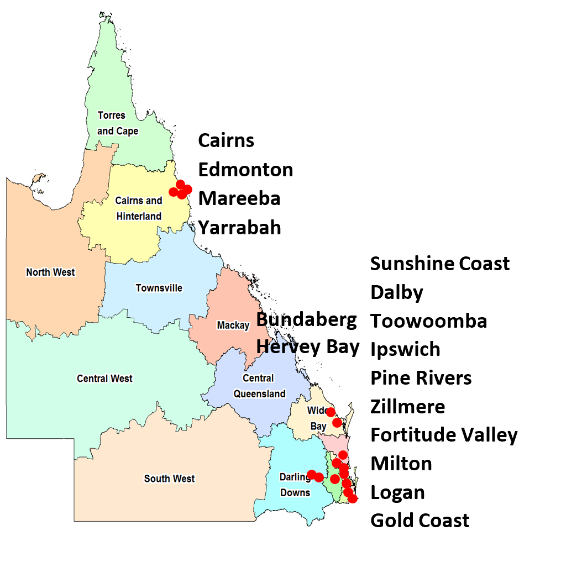
Delivery
Since 2015
37 programs
16 PCYC sites
357 participants
61% attendance
$349,000 state funding
Notes:
This program has attracted $349,000 in government grant funding from Primary Health Networks, Partners in Recovery, and the QLD Mental Health Commission.
Although it is sustainable under NDIS through Improved Health and Wellbeing, the challenge has been making this program accessible to people with mental health issues who haven't qualified for this support.

Slide 5
What is A Weight-neutral Health-Behaviour Program?
Weight-neutral program: The aim of program is to improve health-behaviours. Weight change or weight control is not an intended outcome.
Weight-centric: The aim of program is to change body weight change or control body weight.
Notes:
Weight-centric approach are any approach were weight loss is celebrated or weight gain is cautioned against.
All weight loss programs
But also many public health campaigns
Weight-neutral interventions are sensitive to but do not aim to change body shape or weight.
Similar to a weight-neutral medication like aspirin that has never been intended to effect body weight and does not aim to change weight
What it doesn’t mean is that body weight is ignored or invisible and the experience of those is bigger bodies are ignored
Or that treatments or therapies that is superior more appropriate for people in bigger bodies are ignored
Also weight-neutral is not pretending that weight or weight bias does not exists it is not pathologising it, it is providing tailored care to the individual and it actively pushing back at weight bias.

Slide 6
Future funding may Rely on Addressing Weight Stigma
Obesity epidemic in Australia (5 December 2018)
Recommendation 1
Commonwealth funding be contingent on the appropriate use of language to avoid stigma and blame in all aspects of public health campaigns, program design and delivery.
Recommendation 2
Organisations responsible for training medical and allied health professionals to incorporate understanding and awareness of stigma and blame in medical, psychological and public health interventions of overweight and obesity.
Notes:
So I know that some of the other wonderful presenters have already spoken about the likelihood of achieve long-term weight loss and impact of weight stigma on people with mental illness.
I also image many of you are familiar with the burden of ﻿double stigma experienced by that many individuals with higher BMIs and a mental illness experience.
So beyond lack of efficacy and the potential of harm another good reason for considering the implementation of of a weight-nuetral program health is that:
Future funding for health programs may be contingent on the program demonstrating the use non-stigmatizing language language and avoidance of blame as well as understanding and awareness of stigma and blame in health interventions for those with higher BMIs.
However there are barriers to delivering a weight neutral health behaviour change program. These include the delivering the program in the context of a weight-centric healthcare system and a weight biased society, the internalised and externalised weight bias of our clients and finally our own weight biases.
So as a health professional can be very daunting to push back against weight bias in your work and in fact many of my clients who practice weight normative care often confide in me that they totally don’t believe in weight loss but they feel compelled to continue because that is what their workplace or the client base wants.

Slide 7
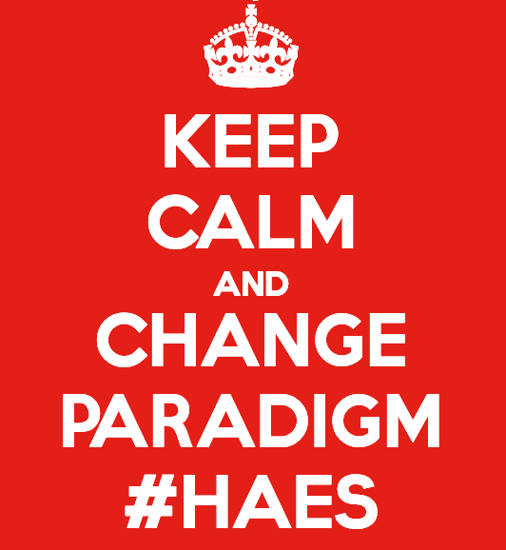
Notes:
However for those of you who do have the courage to step into the space of weight neutral care there is an evidence-based alternative and that is Health at Every Size of HAES practice.
And the Healthy Bodies Healthy Minds program is an example of a health program for people with serious mental health challenges that fits beautifully within that HAES paradigm

Slide 8
Health At Every Size®
Weight Inclusivity: Accept and respect body size and shape diversity
Health Enhancement: Support policies that improve and equalize access to health.
Respectful Care: Acknowledge our biases, work to end weight discrimination, weight stigma, and weight bias.
Eating for Well-being: Promote flexible, individualized eating based on hunger, satiety, nutritional needs, and pleasure.
Life-Enhancing Movement: Support physical activities that allow people of all sizes, to engage in enjoyable movement, to the degree that they choose.
Notes:
Weight Inclusivity: Accept and respect the inherent diversity of body shapes and sizes and reject the idealizing or pathologizing of specific weights.
Health Enhancement: Support health policies that improve and equalize access to information and services, and personal practices that improve human well-being, including attention to individual physical, economic, social, spiritual, emotional, and other needs.
Respectful Care: Acknowledge our biases, and work to end weight discrimination, weight stigma, and weight bias. Provide information and services from an understanding that socio-economic status, race, gender, sexual orientation, age, and other identities impact weight stigma, and support environments that address these inequities.
Eating for Well-being: Promote flexible, individualized eating based on hunger, satiety, nutritional needs, and pleasure, rather than any externally regulated eating plan focused on weight control. Life-Enhancing Movement: Support physical activities that allow people of all sizes, abilities, and interests to engage in enjoyable movement, to the degree that they choose.

Slide 9
Non-Diet Approach (Willer, 2013)
Notes:
This is the Non-Diet Approach it is the clinical application of the Health at Every Size (R) values and the framework that we have followed for the delivering the HBHMs program.
Weight-neutral approaches such as the Non-Diet Approach have resulted in decreased body dissatisfaction, decreased disordered eating and decreased depression and lead to increased sustainable, enjoyable self-care behaviours such as eating and moving well in the long term.
A 2015 systematic review in the ﻿Journal of Nutrition Education and Behaviour found non-diet approaches to ﻿statistically significant improve in disordered eating patterns, self-esteem, and depression without resulting in significant weight gain or worsening of blood pressure, blood glucose, or cholesterol. And is two studies biochemical measures improved significantly compared with the control

Slide 10
Appetite
Accept and Embrace Body Cues:
Encouragement to honour hungry and fullness
Mindful eating discussions:
What does hunger feel like to you?
What foods satisfy your hunger and make you feel good?
Eating with others and eating without distractions
Practical mindful eating exercises
“It has it changed my relationship with chocolate and I don’t eat it the same way I used to. I don’t buy a block of chocolate and sit down and eat the whole block. I would rather eat something better for me.” Belinda (HBHM participant)
Notes:
In the non-diet approach we focus on supporting people to rediscover their internal cues for eating through rediscovering their hunger and fullness signals and establishing mindfully eating habits to build body trust and address superfluous eating.
We know the effect of medication on appetite is major concern for our participants particularly those on Antipsychotics. We also know that it is food restriction and restraint that drives disordered eating patterns like binge eating.
However in the populations researched the non-diet approach has been found to have significant effects on eating-behaviours and appetite.

Slide 11
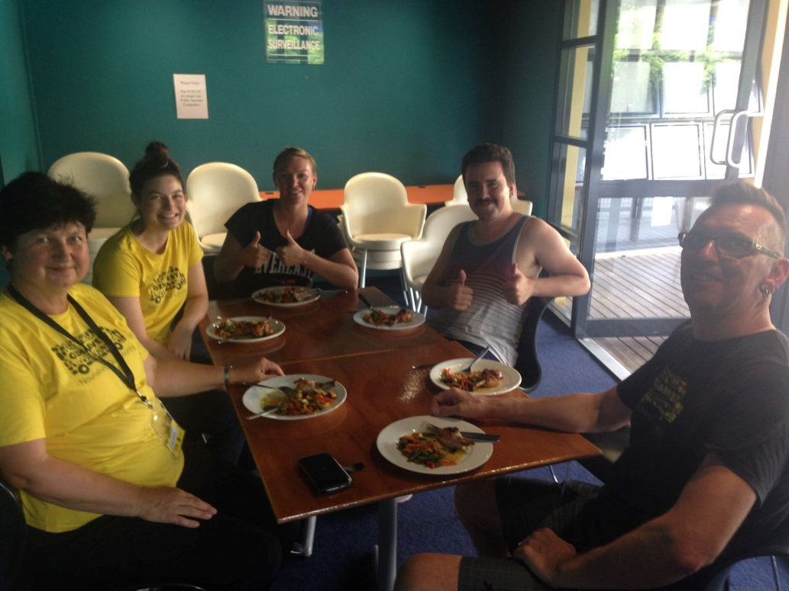
Eating
Acceptance of all foods:
Eat with participants
Prepare food together
Discuss all food equally
Consider the cultural and social aspects
Acknowledge food security
Notes:
Food provides more than just fuel and maintenance materials for body physiology. Food and eating is a highly enjoyable, socialised, culturally embedded activity, and we have the ability to experience pleasure from eating through all of our senses – sight, smell, touch, sound and taste. When we diet we deny ourselves parts of all three of these important dimensions: physiological, cultural and sensory.

Slide 12


Body Image
Accept and Embrace Body Shape:
Moderate diet talk
Moderate internal and external weight stigma
Use of non-stigmatizing language
Promotional material
Resources
Notes:
The program does not promote weight loss or achieving particular weight range, BMI, adiposity or body composition
Materials promoting the program do not contain stigmatizing images or promote any particular body type
Everyone is equally accepted in there ability to have health-behaviours and to ability to contribute knowledge and experience in establishing and maintaining health behaviours to the group discussions

Slide 13
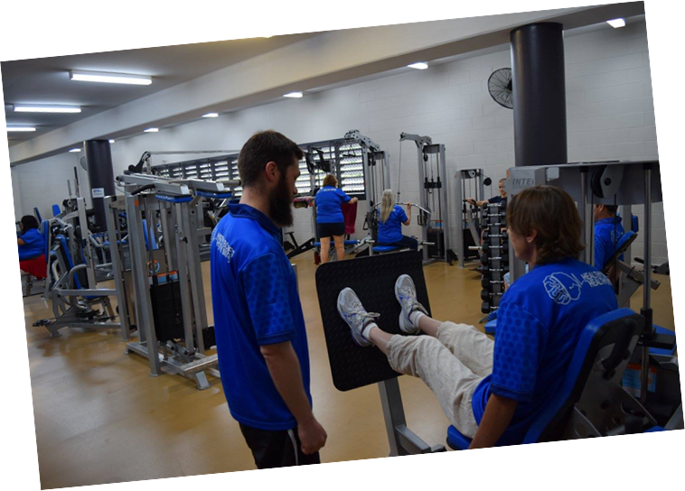
Fitness
Accept and embrace Joyful Movement:
Notes:
Exercise concepts
Confidence in use of equipment
Individualised health and fitness goal
The exercise component is designed to improve participants’ knowledge of exercise concepts, and confidence in exercising in the gym to achieve goals appropriate individual health and fitness and health presentations. Participants will meet with the Ex Phys for an individual assessment session prior to commencing the program. Participants work closely with each other throughout the program by incorporating a ‘buddy system’ which improves social interaction, and they receive a free gym membership to enable self-initiated exercise and support maintenance of exercise after the program finishes.

Slide 14

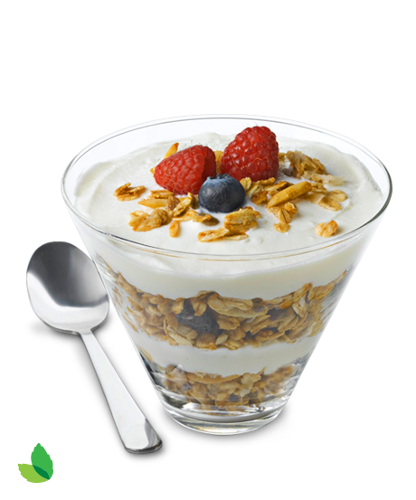
FOOd
Accept and embrace Non-Diet Nutrition:
Australian Guide to Healthy Eating
Diet myths
Label reading
Health Star Rating
Budgets
Goals setting
Recipes
Notes:
So weight-neutral nutrition is where it will really get tricky for some because the notion that we need to police the diets of people with high BMIs due to the false assumption that people with higher BMIs have poorer diets is deeply entrenched.
However the trick to make it simple is to ask yourself would I give the same advice to a person with the same health conditions who was BMI 22 and the answer is yes than that is weight-neutral.
All of the interventions listed above can be weight neutral and this way we are including the needs of participants at higher and lower BMI.

Slide 15
Outcomes and evaluation
Outcomes:
> 60% completion
Reduced psychological distress and symptoms of depression
Improved self-worth, relationships, coping and general mental health and hope
Evaluation:
Multi-site RCT with PCYC Qld, QIMR Berghofer Medical Research Institute, Metro North Mental Health Services (MNMHS) and Metro South Addiction and Mental Health Symposium (MSAMHS)
Pre and post evaluation of motivation and attitudes towards nutrition.
Notes:
We evaluated the 2015/2016 programs using measures of quality of life and recovery. In the 2015/2016 evaluation with 58 participants, 66% of those who began completed the program, and those who completed did so with high attendance (Median=75%). Participants experienced statistically significant reductions in psychological distress (assessed using the K6 scale), and symptoms of depression (assessed using DASS scale). Mental health related quality of life significantly improved, along with self-worth, relationships, coping and general mental health (assessed using AQoL-8D), and hope assessed using the Recovery Assessment Scale.
Attendance for the 2017/2018 programs has been a median of 62.5%; we are building in pre/post evaluation of the current programs to assess how the programs impact motivation and attitudes towards nutrition.
Intuitive Eating Scale, Nutrition Self-Efficacy and Australian Food Score.
Feasibility and acceptability of the program is measured through attendance and satisfaction survey.

Slide 16
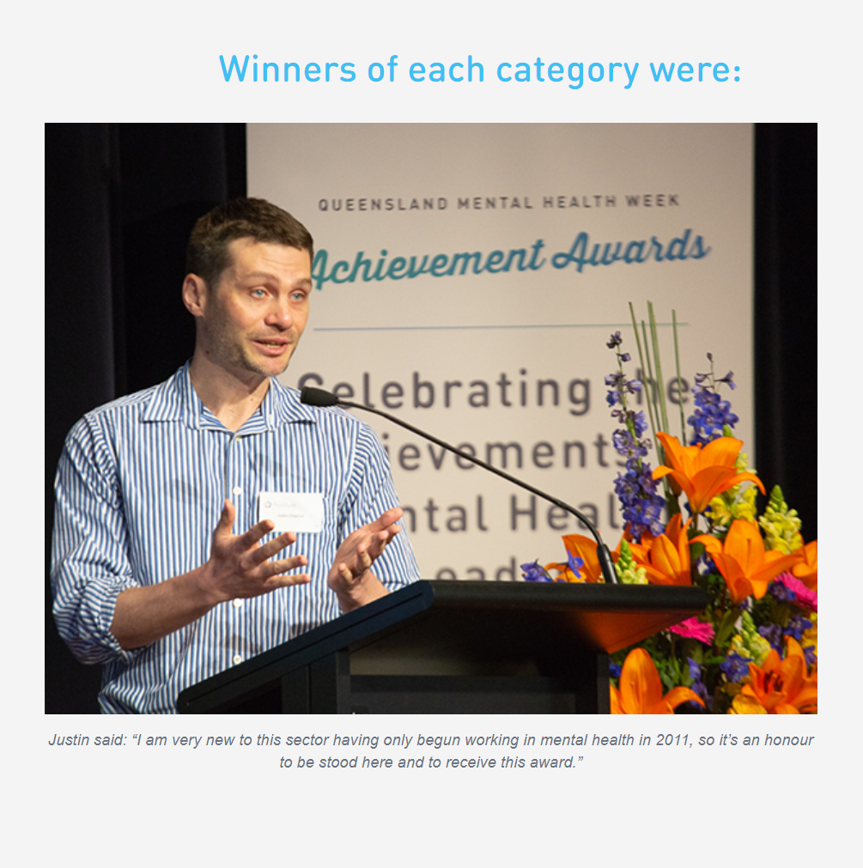
Queensland Mental Health Week Awards 2018
Notes:
Healthy Bodies Healthy Minds program was recognised at the Queensland Mental Health Week Awards last year. Dr Justin Chapman won the Individual Award for his work and PCYC Qld were recognized with the non-for-profit award

Slide 17
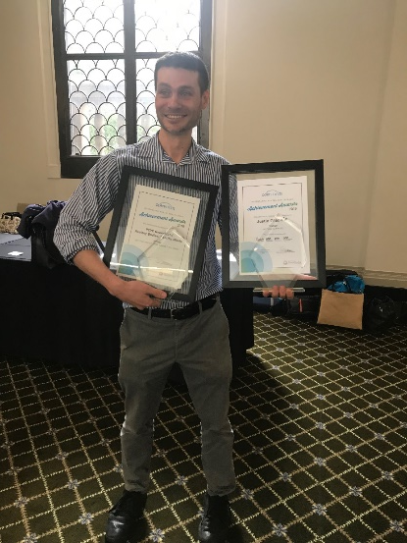
Acknowledgement
Dr Justin Chapman
Healthy Bodies, Healthy Minds
Program Manager
E: Justin.Chapman@pcyc.org.au
M: 0432 299 240
Notes:
So, I would like to acknowledge HBHM Program founder and manager Justin Chapman and these are his contact details.

Slide 18

Contact
Mandy-Lee Noble Accredited Practising Dietitian Verified HAES® Provider E: mandy-lee.noble@rfq.com.au M: 0434 217 647
Notes:
Finally I would like thank-you for your attention today and the Equally Well Symposium co-ordinators for inviting me to speak today. I would love to answer your questions or hear you comments about practical application of HAES practice and how a non-diet approach could be incorporated into health programs for people with mental health challenges.

