Slide 1
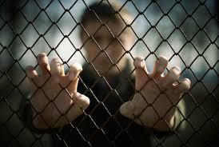
The Physical Health and Activity of Forensic Mental Health Patients
Dr Katherine Moss
Advanced Trainee in Forensic Psychiatry, The Park Centre for Mental Health
Researcher, Queensland Centre for Mental Health Research
B.Phty (Hons) MBBS (Hons)
Notes:
Good morning. I am really excited to be able to present in this session Supporting Healthy lifestyles – diet and exercise.
By way of introduction my name is Katherine Moss and I am in my final year of training in forensic psychiatry in Brisbane. Before I became a doctor I worked as a physiotherapist for a couple of years.
My interest in physical health for patients with severe mental illness started when I had a rehabilitation term under Dr Nicole Korman (who is a consultant psychiatrist with a particular research interest in physical health). At the time we were running an exercise intervention study – the results of which have now been published.
At the moment I am fortunate to be able to combine a clinical job (which currently is at the high secure unit of The Park, Centre for Mental Health) with a research job under the direction of Assoc Prof Ed Heffernan at the Queensland Centre for Mental Health Research.

Slide 2
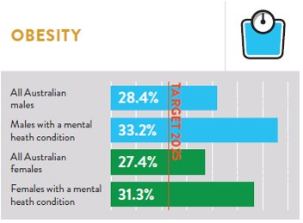
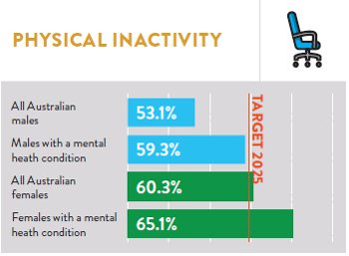
Background
We know people with severe mental illness have high rates of obesity
We know that people with severe mental illness have low rates of physical activity
What is happening in forensic psychiatric facilities?
Australian Health Policy Collaboration (2018) Australia’s Mental and Physical Health Tracker 2018
Notes:
In terms of the background to this talk I've just put up in pictorial form the latest findings from the Australian Health Policy Collaboration 2018.
Really it confirms what the literature has been saying for years now – that people with severe mental illness have high rates of obesity and low rates of physical activity.
Postulated that this has to do with a combination of factors – medication, poor diet, alcohol misuse, less active lifestyles, illness-related factors including negative symptoms of schizophrenia and motivation issues
The question for me, in my current working environment is "what is happening in our forensic psychiatric facilities?"

Slide 3
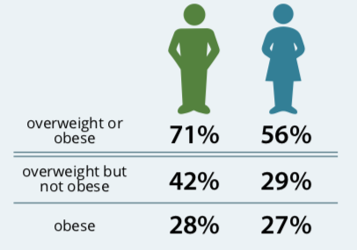
What is the prevalence of obesity and overweight in forensic psychiatric units?
Australian Institute of Health and Welfare (2017) A picture of obesity in Australia
Cormac et al 2005 – 36% men and 75% women were obese (N=248, Rampton Hospital, UK)
Ojala et al (2008) – >33% were obese and metabolic syndrome was found in 33% of the sample (N=221, Forensic psychiatric unit, Finland)
Haw and Rowell (2011) – 47% men and 63% women were obese (N=234, secure forensic unit, UK)
Hilton et al (2015) – 33% were obese (N=291, Ontario Maximum Secure Psychiatric Hospital, Canada)
Every-Palmer et al (2018) – 94% of patients were overweight/obese (N= 51, forensic and rehabilitation inpatients, NZ)
Notes:
This slide really outlines the current literature in the area. There are another 5 or so studies but I have tried to put up data that is more comparable – looking at percentages of obesity and overweight.

Slide 4
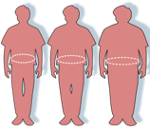
What about weight gain in forensic psychiatric units?
Cormac et al (2005) – mean increase in weight during admission 10.62kg in men and 12.7kg in women
Haw and Rowell (2011) – 103/234 patients had gained weight (median 2.9kg)
Hilton et al (2015) – average gain of 12% of body weight, 40% increased by at least 1 BMI category, average gain of 3.67kg/month
Huthwaite et al (2017) - 47.2% of their sample of (N=36) gained weight
Every-Palmer et al (2018) – 75% attempting to lose weight

Slide 5
So what?
Notes:
The physical health of patients in high security hospitals is often compromised by the requirements of long hospital inpatient stays,
limited access to physical activity and the high prevalence of psychotic illness and anti-psychotic treatment. To date there have been
relatively few studies that have investigated physical activity interventions for forensic patients.
The long term plan is to implement a co-designed physical activity intervention for patients. But there are a few steps we need to take along way.

Slide 6
Research project plan
The development and implementation of a physical activity intervention for patients with serious mental illness residing in a high secure forensic setting
Phase 1 – collection of data to inform the current health status and current physical activity levels of patients
Phase 2 – collection of data to inform physical activity intervention (physical activity questionnaire, semi-structured interview)
Phase 3 – design and implementation of a physical activity intervention and evaluation (this will include a wait list control design)
Longer term plan – ongoing assessment of physical activity levels, physical health outcomes and implementation strategies over time

Slide 7
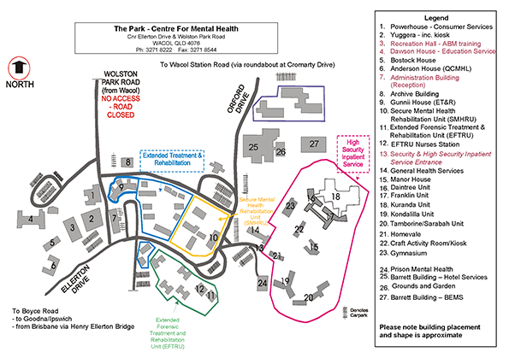
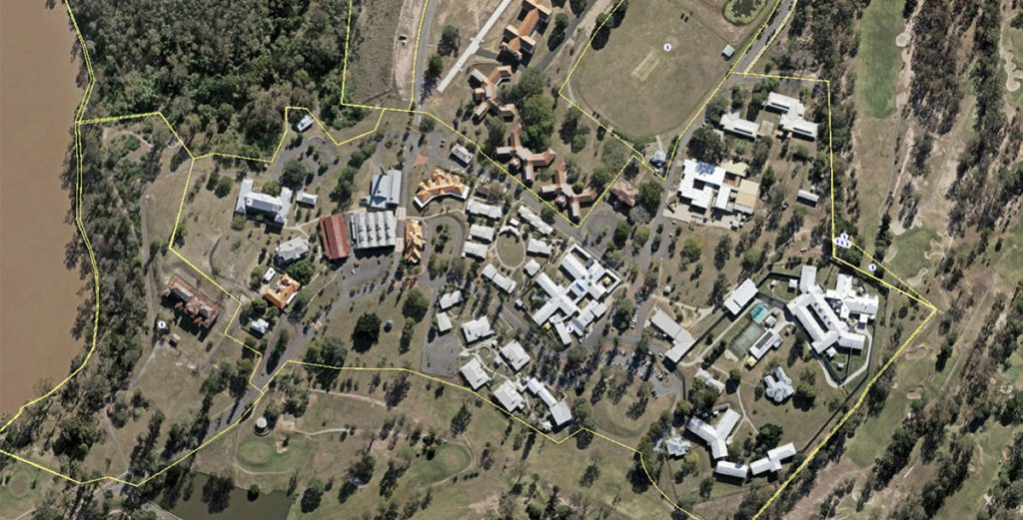
The Park, Centre for Mental Health
Notes:
Very briefly to set the scene for you - The Park Centre for Mental Health is located in the Brisbane western suburb of Waco . It has 70 high secure inpatient beds, 34 medium secure beds and 20 rehabilitation beds
Pool
Tennis court
Gym
Canteen – operates in the high secure unit weekly

Slide 8
What can patients expect when they go to a forensic psychiatric facility?
Meet Peter…
Notes:
Peter –
27yr male, single male with a strong family history of mental illness (paternal aunt and cousin also dx with schizophrenia), father had a criminal history and was a professional boxer
Polysubstance abuse history – using cannabis from the age of 14, alcohol use disorder by 15 and later experimented with amphetamines, heroin and morphine all prior to his first presentation with psychosis
Diagnosis of paranoid schizophrenia and obsessive compulsive disorder
5 admissions to hospital for psychosis
Assaulted staff member
Admitted to The Park 2011 initially to the medium secure unit
During admission to the medium secure unit he repeated used substances, touched female staff inappropriately and in 2013 seriously assaulted a co-patient
He was then transferred to the high secure unit 24.9.2013
IQ testing – 7th percentile (78), verbal IQ 83
What can he expect when he is admitted to the high secure unit?
In ideal world:-
Access to recommended physical activity facilities and support
Staff that can act as positive role models and champions
Doctors to consider weight management alongside medication management
Access to nutritious food, health education (diet and exercise) and health promotion
Specialist health care input form GP, Dietician, Physiotherapist/Exercise Physiologist/Personal Trainger
Policies that support best practice

Slide 9
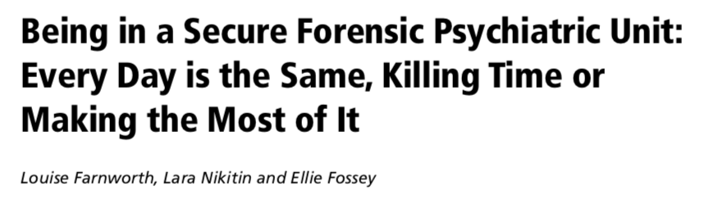
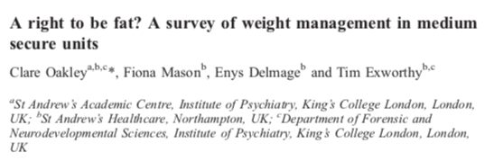
What can patients expect when they go to a forensic psychiatric facility?
Notes:
Old study (2004) – naturalistic study - conducted in 2 wards of a specialist forensic psychiatric inpatient unit in Victoria
– described their current lives as “nothingness” in comparison to their past lives, other descriptors were “bland”, “boring”, “inactive”, “fill in time the best way you can” and “doing things that killed time until you could get out”
Quantitative time use data showed a pattern of time use dominated by passive leisure and sleep. Time diaries which were broken down into 5 minute intervals were collected over 2 days for each of the participants.
What about physical health in a forensic setting?
Obesity and overweight are more prevalent in forensic inpatients
At risk of weight gain when detained
What about the recovery model? Does this work in a restrictive forensic setting?

Slide 10
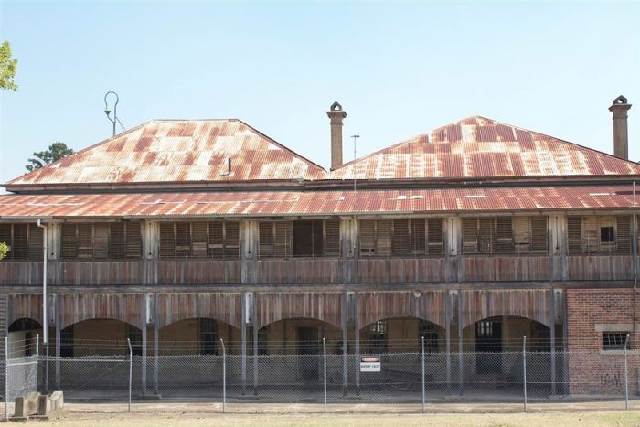
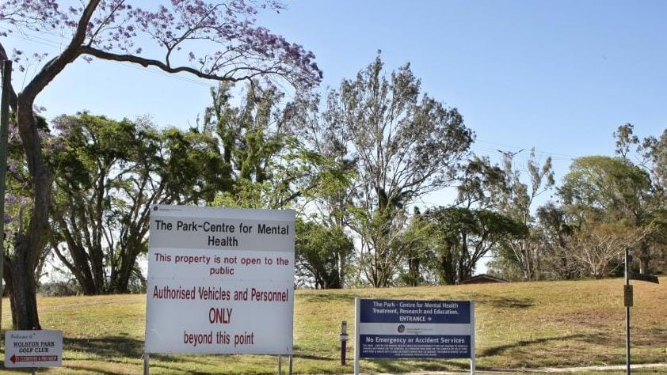
Physical health at The Park, Centre for Mental Health (2010)
In High Secure Unit: 58/60 were assessed
BMI: 30.4 + 5.7 kg/m²
Waist Circumference (Males): 107.6 + 14.2 cm
Waist Circumference (Females): 105.2 + 27.3 cm
HDL: 0.84 + 0.24 mmol/L
Triglycerides: 2.06 + 1.34 mmol/L
% with Metabolic Syndrome: 56%
Notes:
Overweight BMI 25-30
Obese BMI >30
WC – 94cm men, 80cm women (Caucasian)
HDL (high density lipoprotein) – cholesterol that helps protect against build up of fatty blockages in arterial walls (<1.0 in men and <1.3 in women)
Trigl <1.7 mmol/L
Metabolic Syndrome is important because it identifies patients at increased risk of cardiovascular disease (CVD), diabetes and chronic kidney disease (CKD). The risk of having CVD, diabetes and CKD among people with the MetSy is 2–3 times that of people without the condition. It also increases the risk of complications in those with CVD and diabetes. Overall meta-analysis of studies suggests that there is a 1.6–fold increase in mortality in patients with the Metabolic Syndrome compared to those without it.
Estimates of metabolic syndrome in the general Australian community – 20-30%

Slide 11
Physical health at The Park, Centre for Mental Health (2019)
10 consumers at The Park, Centre for Mental Health
Av BMI 30.4 +/- 7.1kg/m² (50% obese)
Av waist circumference 110.8 +/- 18.5cm
Metabolic Syndrome 30%
Weight change 3.74kg +/- 7.70kg
Triglycerides 1.6 +/- 0.86

Slide 12
Physical health data comparison from The Park: 2010 vs 2019
 | 2010 | 2019
Body Mass Index: kg/m² | 30.4 + 5.7 | 30.4 + 7.1
% Overweight | 26 | 40
% Obese | 52 | 50
Waist Circumference (Males): cm | 107.6 + 14.2 | 111.3 + 19.6
Waist Circumference (Females): cm | 105 + 27.3 | 106
Metabolic Syndrome | 56 | 30
Weight gain from admission: kg | -1.12 + 7.71 | 3.74 + 7.70
Notes:
Overweight BMI 25-30
Obese BMI >30
WC – 94cm men, 80cm women (Caucasian)
HDL (high density lipoprotein) – cholesterol that helps protect against build up of fatty blockages in arterial walls (<1.0 in men and <1.3 in women)
Trigl >1.7 mmol/L

Slide 13
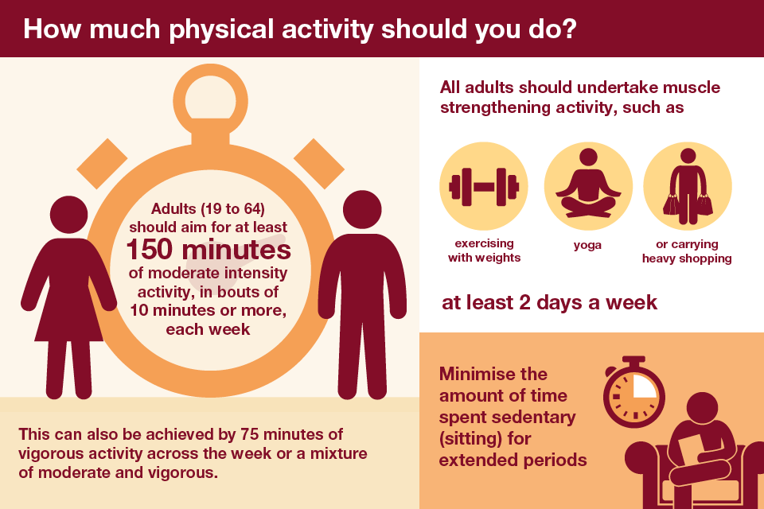
Physical activity of patients with serious mental illness
Vancampfort et al (2017) – Meta-analysis investigating sedentary behaviour and physical activity levels and their correlates in people with severe mental illness
Mean amount of moderate or vigorous activity was 38.4min per day (268min/week) - significantly lower than healthy controls
Significantly less likely than matched healthy controls to meet physical activity guidelines
Bergman et al (2018)
Mean physical activity was 268 min/week, 1181 MET-minutes per week
9/25 patients did not meet the international recommendations
Notes:
Vancampfort
People with severe mental illness spent on average 476.0 min per day (95% CI: 407.3-545.4) being sedentary during waking hours, and were significantly more sedentary than age- and gender-matched healthy controls (p=0.003). Their mean amount of moderate or vigorous physical activity was 38.4 min per day (95% CI: 32.0-44.8), being significantly lower than that of healthy controls (p=0.002 for moderate activity, p<0.001 for vigorous activity). People with severe mental illness were significantly less likely than matched healthy controls to meet physical activity guidelines (odds ratio = 1.5; 95% CI: 1.1-2.0, p<0.001, I2 =95.8). Lower physical activity levels and non-compliance with physical activity guidelines were associated with male gender, being single, unemployment, fewer years of education, higher body mass index, longer illness duration, antidepressant and antipsychotic medication use, lower cardiorespiratory fitness and a diagnosis of schizophrenia.
Bergman
Setting – Swedish forensic psychiatric clinic
Mean age 33.6
N=28
9/25 did not meet the international recommendations for physical activity
VO2 max
A metabolic equivalent, or MET, is a unit useful for describing the energy expenditure of a specific activity. A MET is the ratio of the rate of energy expended during an activity to the rate of energy expended at rest. For example, 1 MET is the rate of energy expenditure while at rest. A 4 MET activity expends 4 times the energy used by the body at rest. If a person does a 4 MET activity for 30 minutes, he or she has done 4 x 30 = 120 MET-minutes (or 2.0 MET-hours) of physical activity. A person could also achieve 120 MET-minutes by doing an 8 MET activity for 15 minutes.

Slide 14
Current physical activity levels of patients at The Park
6 patients < 600 MET-minutes per week
1 patient 600-1000 MET-minutes per week
3 patients >1000 MET-minutes per week
Mean 834.7 MET-minutes per week
Participant ID | IPAQ-SF Responses |  |  |  |  |  |  | IPAQ-SF Intermediary Calculations |  |  |  |  |  |  |  | IPAQ-SF Final MET-Minutes and Categorical Scores
 | Vigorous Activity |  | Moderate Activity |  | Walking Activity |  | Sitting | Vigorous (min/d) | Moderate (min/d) | Walking (min/d) | Categorical Score Criteria |  |  |  |  | TOTAL DAYS OF ACTIVITY |  | TOTAL ACTIVITY (min/wk) |  | MET-MINUTES PER WEEK |  |  |  | PHYSICAL ACTIVITY CATEGORY
 |  |  |  |  |  |  |  |  |  |  | High Activity Criteria |  | Moderate Activity Criteria
 |  |  |  |  |  |  |  |  |  |  | ≥3 Days Vig (≥1500 MET-min/wk) | ≥7 Days Any (≥3000 MET-min/wk) | ≥3 Days Vig (≥20 min/d) | ≥5 Days Mod/Walk (≥30 min/d) | ≥5 Days Any (≥600 MET-min/wk)
 | Days | Min | Days | Min | Days | Min | Hours | (Q2 Truncated) | (Q4 Truncated) | (Q6 Truncated) |  |  |  |  |  | Days | Days (Recoded) | (Self-Reported) | (Truncated) | Vigorous | Moderate | Walk | Total | Category | Category (Recoded)
 | Q1 | Q2 | Q3 | Q4 | Q5 | Q6 | Q7
1 | 1 | 30 | 2 | 75 | 7 | 60 | 240 | 30 | 75 | 60 | N | N | N | Y | Y | 10 | 7 | 165 | 165 | 240 | 600 | 1386 | 2226 | Moderate | 2
2 | 0 | 0 | 0 | 0 | 7 | 10 |  | 0 | 0 | 10 | N | N | N | N | N | 7 | 7 | 10 | 10 | 0 | 0 | 231 | 231 | Low | 1
3 | 0 | 0 | 0 | 0 | 6 | 30 | 300 | 0 | 0 | 30 | N | N | N | Y | N | 6 | 6 | 30 | 30 | 0 | 0 | 594 | 594 | Moderate | 2
4 | 0 | 0 | 0 | 0 | 1 | 10 | 360 | 0 | 0 | 10 | N | N | N | N | N | 1 | 1 | 10 | 10 | 0 | 0 | 33 | 33 | Low | 1
5 | 0 | 0 | 5 | 90 | 0 | 0 | 630 | 0 | 90 | 0 | N | N | N | Y | Y | 5 | 5 | 90 | 90 | 0 | 1800 | 0 | 1800 | Moderate | 2
6 | 0 | 0 | 0 | 0 | 3 | 10 | 480 | 0 | 0 | 10 | N | N | N | N | N | 3 | 3 | 10 | 10 | 0 | 0 | 99 | 99 | Low | 1
7 | 0 | 0 | 0 | 0 | 3 | 90 | 630 | 0 | 0 | 90 | N | N | N | N | N | 3 | 3 | 90 | 90 | 0 | 0 | 891 | 891 | Low | 1
8 | 0 | 0 | 0 | 0 | 0 | 0 | 660 | 0 | 0 | 0 | N | N | N | N | N | 0 | 0 | 0 | 0 | 0 | 0 | 0 | 0 | Low | 1
9 | 0 | 0 | 1 | 60 | 7 | 15 | 180 | 0 | 60 | 15 | N | N | N | N | N | 8 | 7 | 75 | 75 | 0 | 240 | 346.5 | 587 | Low | 1
10 | 0 | 0 | 5 | 25 | 7 | 60 | 480 | 0 | 25 | 60 | N | N | N | Y | Y | 12 | 7 | 85 | 85 | 0 | 500 | 1386 | 1886 | Moderate | 2
Notes:
IPAQ – SF
International Physical Activity Questionnaire – Short Form
834.7 compared to 1181
At present, the World Health Organisation recommends that people conduct at least “600 metabolic equivalent minutes (MET minutes)” of physical activity - the equivalent of 150 minutes each week of brisk walking or 75 minutes per week of running.

Slide 15
Interventions in a forensic setting
Study | Setting | Participants | Study Design | Intervention | Findings
Bacon et al 2012 Australia | Secure mental health hospital (116 beds) | 2 | Mixed methods Before-after evaluation (8 weeks) | Group session with training x2 per week; individual sessions | Weight loss for both participants (3.4kg; 1kg)
Cormac et al 2008 UK | High secure psychiatric unit | 95 | Before-after evaluation (10-12 weeks) | 1hr fitness session + weight management education session (+ optional 1hr fitness session) | Mean weight loss 1.3kg, mean waist size reduction was 2cm
Cormac et al 2013 UK | High secure psychiatric unit | 102 | Before-after evaluation (10-12 weeks) - 14 programmes | 1hr fitness session + weight management education session (+ optional 1hr fitness session) | Mean weight loss 1.3kg 63% lost weight 21/76 lost >5kg
Long et al 2015 UK | Low and medium secure psychiatric unit | 32 | Before-after evaluation | Environmental interventions including 30mins of activity on ward per day, flashcards, supervised group exercise, prioritised time-tabling of PA, incentives | No significant changes in weight, BMI, body fat, muscle mass, bone mass, metabolic age or PEF. ~1/3 lost weight
Savage et al 2009 UK | Medium secure forensic unit | 6 | Before-after evaluation (12 weeks) | Personalised training programme, 1:1 basis, one session per week for 12 weeks Combination of aerobic (e.g. cycling and weight-training) | A statistically significant improvement in service users’ self-reported feelings of relaxation, happiness and calmness followed engagement in personal training sessions.
Tetile et al 2008 Norway | Secure forensic mental health hospital | 15 | Before-after evaluation (8-12 weeks) | Exercise 3 x per week (2 indoor and 1 outdoor) | Statistically significant improvements were found in resting heart rate and systolic blood pressure. No significant changes found in weight/BMI.
Wynaden et al 2012 Australia | Secure forensic mental health hospital | 56 | Mixed methods evaluation (6 months) | Education sessions and formal exercise programme Range of individual, group and team exercises 30-60 min/day | 40.6% reported programme was enjoyable 26.4% reported it was useful, 21.7% reported it made them feel better 15.4% thought their fitness was improved and 13% though it helped them cope with stress

Slide 16
What happened to Peter?
Has been inpatient for 5.5 years
Put on 14.7kg
Diagnosed with metabolic syndrome in 2019
Cardiomyopathy from clozapine, on B-blocker
IPAQ-SF – 1888 MET-minutes per week
Awaiting review for consideration of rehabilitation ward
Notes:
Peter has been an inpatient in the high secure unit for 5 and a half years
He has been stabilised on 2 antipsychotic medications
He has put on 14.7kg
His last metabolic monitoring in February showed that he met the criteria for metabolic syndrome – in that he scored 3/5 on the relevant tests (WC 122.5cm, low HDL 0.9 and high trig 3.4)
Peter enjoys doing exercise but is limited in what he can do due to fracturing his foot late last year
He score fairly well on the IPAQ-SF (1888 MET-Minutes per week)
Peter is currently awaiting transfer to a rehabilitation unit
He fractured his foot late last year and has been undergoing rehabilitation for this
He has high trigylcerides (3.4)
Is there more that we can do for Peter?
?not on statin or fish oil
?not on metformin
?doing his own exercise with no specialist input

Slide 17
Things to consider
Where?
Ward, courtyard, gym, outside exercise equipment
When?
Current campus walks 4:30-5:30pm but specialist staff have gone home by then
Consider other rehabilitation needs
What?
Low, moderate, high intensity, what "dose" of exercise
Who?
Group vs Individual vs Choice of either
Supervision
Why?
Increase activity, reduce cardiovascular risk, weight loss, improve psychiatric symptoms, reduce stress, improve sleep

Slide 18

Conclusions
The physical health and health needs of patients at The Park has not really changed over the past 9 years
Patients currently do a variety of different physical activities to meet their needs (campus walks, gym, swimming) but there is no one overseeing this
Addressing the physical health needs of forensic patients is complex
Illness factors, environmental factors, risk factors, motivation factors, movements in/out of facilities
Current studies – small numbers, staff shortages during studies, no control group, recruitment rates 52-70.3%, attrition rates 13-55%
Where to from here
Phase 2 – collection of data to inform physical activity intervention (physical activity questionnaire, semi-structured interview)
Phase 3 – design and implementation of a physical activity intervention and evaluation (this will include a wait list control design)
Notes:
The physical health and health needs of patients at The Park has not really changed over the past 9 years
High rates of obesity, weight gain during admissions, low physical activity levels
Patients currently do a variety of different physical activities to meet their needs (campus walks, gym, swimming) but there is no one overseeing this
RANZCP guidelines highlight the important role of psychiatrists in ensuring treatment plans include the consideration of cardiometabolic risks and physical activity for all patients
Addressing the physical health needs of forensic patients is complex
Illness factors, environmental factors, risk factors, motivation factors, movements in/out of facilities
Current studies – small numbers, staff shortages during studies, no control group, recruitment rates 52-70.3%, attrition rates 13-55%
Where to from here
Phase 2 – collection of data to inform physical activity intervention (physical activity questionnaire, semi-structured interview)
Phase 3 – design and implementation of a physical activity intervention and evaluation (this will include a wait list control design)
Implementation science to help inform us of how to proceed

Slide 19
References
Australian Health Policy Collaboration (2018) Australia’s Mental and Physical Health Tracker 2018 https://www.vu.edu.au/sites/default/files/australias-mental-and-physical-health-tracker-report-card.pdf
Australian Institute of Health and Welfare (2017) A picture of obesity in Australia https://www.aihw.gov.au/getmedia/172fba28-785e-4a08-ab37-2da3bbae40b8/aihw-phe-216.pdf.aspx?inline=true
Bacon, N., Farnworth, L., & Boyd, R. (2012). The use of the Wii-fit in Forensic Mental Health: Exercise for People at Risk of Obesity. British Journal of Occupational Therapy, 75(2): 61-68.
Bergman, H., Nilsson, T., Andine, P., et al. (2018). Physical performance and physical activity of patients under compulsory forensic psychiatric inpatient care. Physiotherapy Theory and Practice, DOI: 10.1080/09593985.2018.1488320
Cormac, I., Ferriter, M., Benning, R. & Saul, C. (2005) Physical health and health risk factors in a population of long-stay psychiatric patients. Psychiatric Bulletin, 29, 18-20.
Every-Palmer, S., Huthwaite, M.A., Elmslie, J.L., Grant, E &Romans, S.E. (2018). Long-term psychiatric inpatients’ perspectives on weight gain, body satisfaction, diet and physical activity: a mixed methods study. BMC Psychiatry, 18, 300.
Farnworth, L., Nikitin, L & Foessey, E. (2004). Being in a Secure Forensic Psychiatric Unit: Every Day is the Same, Killing Time or Making the Most of it. British Journal of Occupational Therapy, 67 (10), 430-438.
Haw, C & Rowell, A. (2011). Obesity and its complications: a survey of inpatients at a secure psychiatric hospital. The British Journal of Forensic Psychiatry, 13, 270-277.
Hilton, N.Z., Ham, E., Lang, C.L., & Harris, G.T. (2015). Weight Gain and Its Correlates Among Forensic Inpatients. The Canadian Journal of Psychiatry, 60, 232-238.
Ojala, K., Niskanen, L., Tiihonen, J., Paavola, P, Putkonen, A & Repo-Tiihonen, E. (2008). Characterisation of metabolic syndrome among forensic psychiatric patients. The Journal of Forensic Psychiatry and Psychology, 19, 33-51.
Vancampfort, D., Firth, J., Schuch, F.B., Rosenbaum, S., Mugisha, J., Hallgren, M., Probst, M., Ward, P.B., Gaughran, F., De Hert, M., Carvalho, A.F & Stubbs, B. (2017). Sedentary behavior and physical activity levels in people with schizophrenia, bipolar disorder and major depressive disorder: a global systematic review and meta-analysis. World Psychiatry, 16, 308-315.
Wynaden, D., Barr, L., Omari, O., & Fulton, A. (2012). Evaluation of service users’ experiences of participating in an exercise programme at the Western Australian State Forensic Mental Health Services. International Journal of Mental Health Nursing, 21, 229–235.

