Slide 1

Wanda Bennetts
Senior Consumer Consultant
Notes:
‘I would like to acknowledge and pay my respects to the traditional custodians of the land we are gathered on today –the Gunditjmara (goon-ditch-mara) People and pay my respects to their Elders past and present. I would also like to acknowledge other Elders and community members present here today.

Slide 2
IMHA: Background
Reforms to the Mental Health Act 2014 (Vic)
Mental Health Principles
Supported decision making mechanisms
Independent, representational advocacy - a key mechanism
Notes:
How did IMHA come about? From Reforms to MH Act in 2014 which include the following:
provide the services to implement supported decision making mechanisms & working with regard to the MH Act principles
ensure people are supported to make, or participate in, decisions about their assessment, treatment and recovery.
working with the mental health sector to improve outcomes for consumers and help realise the objectives of the Act.
Independent- IMHA sits outside mental health services, hospitals and government so that there is no conflict of interest

Slide 3
IMHA: our advocacy model
Representational advocacy
Taking instructions from consumers
Consumer voice - Not best-interests
Supporting self advocacy by consumers
Information provided by clinicians/support people is shared with consumers
Notes:
Not best interest advocacy – take instructions from consumers
Support consumers to self advocate where possible
Provide representational advocacy where needed e.g. represent their views to clinicians
in the community, in-patient facilities and forensic facilities

Slide 4
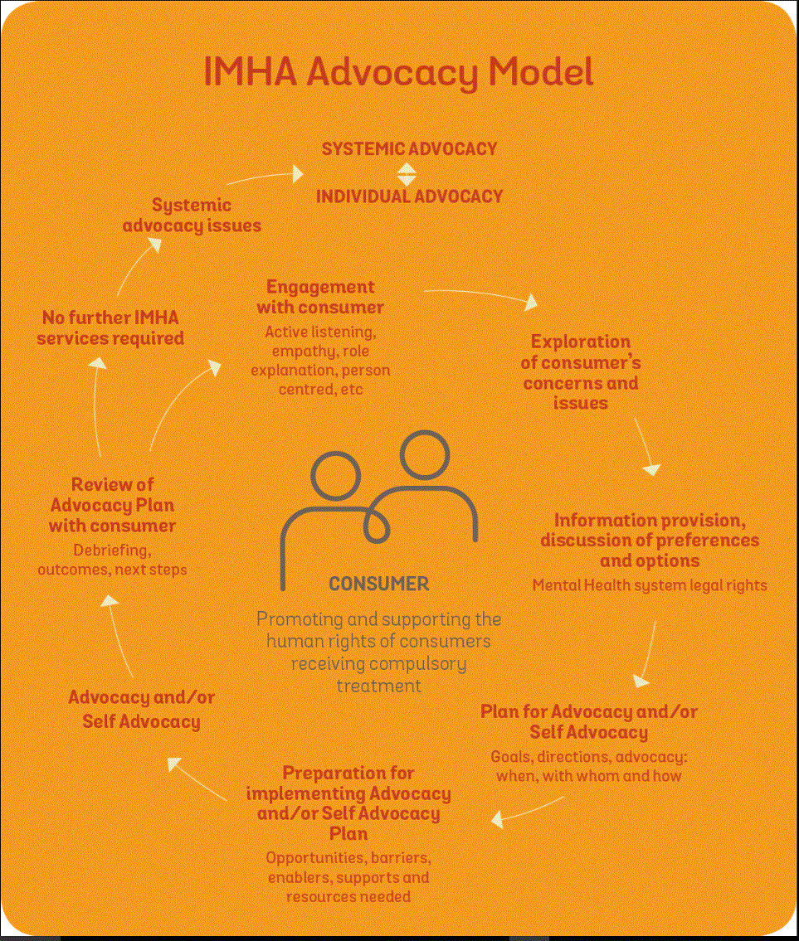

Slide 5
IMHA: What do advocates assist with?
IMHA advocates support and assist people who are receiving compulsory mental health treatment to make decisions and be involved in their mental health assessment, treatment and recovery

Slide 6
IMHA: Advocacy methods
Single issue/ immediate needs – Often over the phone, may not be advocate who attends the inpatient unit in the region.
Ongoing issues – Can be in person, over the phone, through email. (treating team meetings, referrals to other agencies, advocacy and coaching for self-advocacy).

Slide 7
IMHA: What does this look like in practice?
Information about the mental health system & consumers rights
Participation in treatment decisions
Advance Statements & Nominated Persons
Referrals
Coaching for Self Advocacy
Advocacy
Notes:
Mental Health Act, mental health services, treatment orders and the Mental Health Tribunal process (not legal advice)
Assisting a client to self-advocate around the views and preferences regarding treatment e.g. medication, leave entitlements etc, and providing representational advocacy if needed
Explaining the role of advance statements/when they can be overridden and/or assisting someone in the process of preparing an Advance Statement.
Identifying relevant services (e.g. housing, family violence, employment, debt advice) and making referrals
Not an exhaustive list! Support consumers around many different issues related to mental health assessment, treatment and recovery

Slide 8
IMHA advocacy and physical health
Examples of IMHA advocacy around physical health
IMHA
Amplifies the voice of the consumer
Supports people to access services they need
Raises issues at a higher level
Able to raise at DHHS level
Notes:
Here are just a few examples of the need for advocacy around physical health needs for people in mental health systems. Not always able to get outcome for everyone in way would like, but this highlights even more the need for this work when related to physical health needs in mental health.
Example 1. A consumer within an acute unit wanted some further tests completed with regards to ear, nose and throat difficulties they were experiencing. The consumer felt that this impacted on his mental health as he wanted a holistic approach taken to his health concerns and he felt that his physical health needs were being minimalised and not taken seriously. As the consumer didn’t feel he was being supported around his physical health then he harmed himself so that he could receive emergency treatment for his physical health and he verbalised how he thought this would then ensure he received the appropriate treatment and that his treating team would have to listen. I had been advocating to the treating team for referrals and appointments to take place with the ear, nose and throat specialist but unfortunately I wasn’t able to pursue this as the consumer was returned to prison so IMHA had to stop at this stage.
Example 2. A consumer Jane (not their real name) who was taking a combination of clozapine and another zuclopenthixal. She said that this was making her feel very groggy and had been struggling for a number of years with these concerns. When we spoke to the psychiatrist about this, the psychiatrist said that the consumer had a severe long-term mental illness and that would require treatment. We highlighted the importance of Jane being involved in the decisions about her treatment, and that she would like one of the medications lowered to be able to live a meaningful life and work. The psychiatrist said that the mental side-effects were due to the person’s diet, and that until they fixed their diet medications would not be discussed. Both Jane and I highlighted that these two things are not contingent, and continued this discussion over the course of 6 months. After this we made a complaint that the consumer has had no involvement in any of the treatment decisions and that their community life and physical health is deteriorating.
Example 3 - A consumer who was in the HDU area, and had reported to staff over a period of 3 – 4 days that he had intense tooth pain. He wanted to be able to have his tooth checked by a dentist, however had just been given Panadol each day with no further medical attention. I advocated to the Nurse Unit Manager who at first said that this would be dealt with in time as this had only just been reported. I asked that she check his file to see that this had been reported over a number of days, which she then confirmed, and noted that the fellow said he thought the tooth might be broken.
Following my advocacy, he was able to be seen by a dentist at the hospital the next day, who confirmed his tooth was cracked. He then received dental care.
The consumer said that he felt nobody was taking his pain seriously due to him being in the HDU area, prior to engaging with IMHA.
Example 4 Gynaecological health a person was told it was their mental health, not a gynaecological problem so not referred anywhere
Example 5 Rural challenges – wait for weeks as no services in rural areas

Slide 9
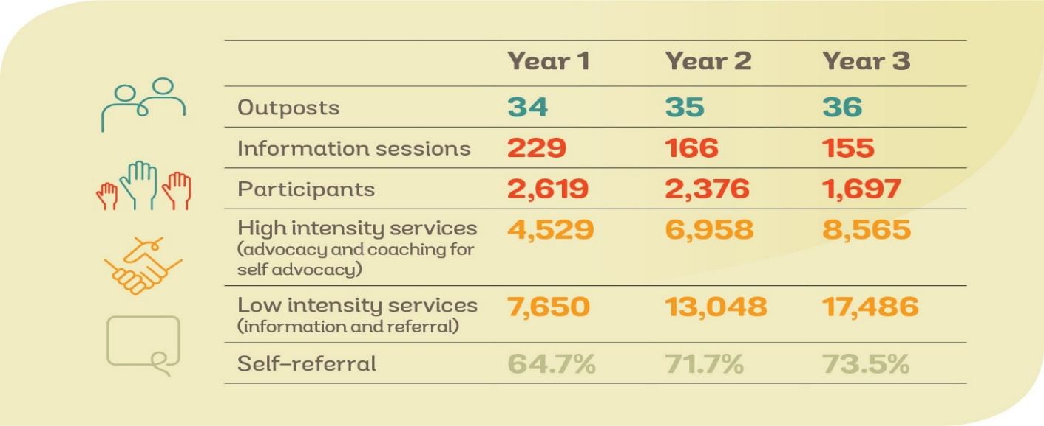
Our First Three Years of Service

Slide 10
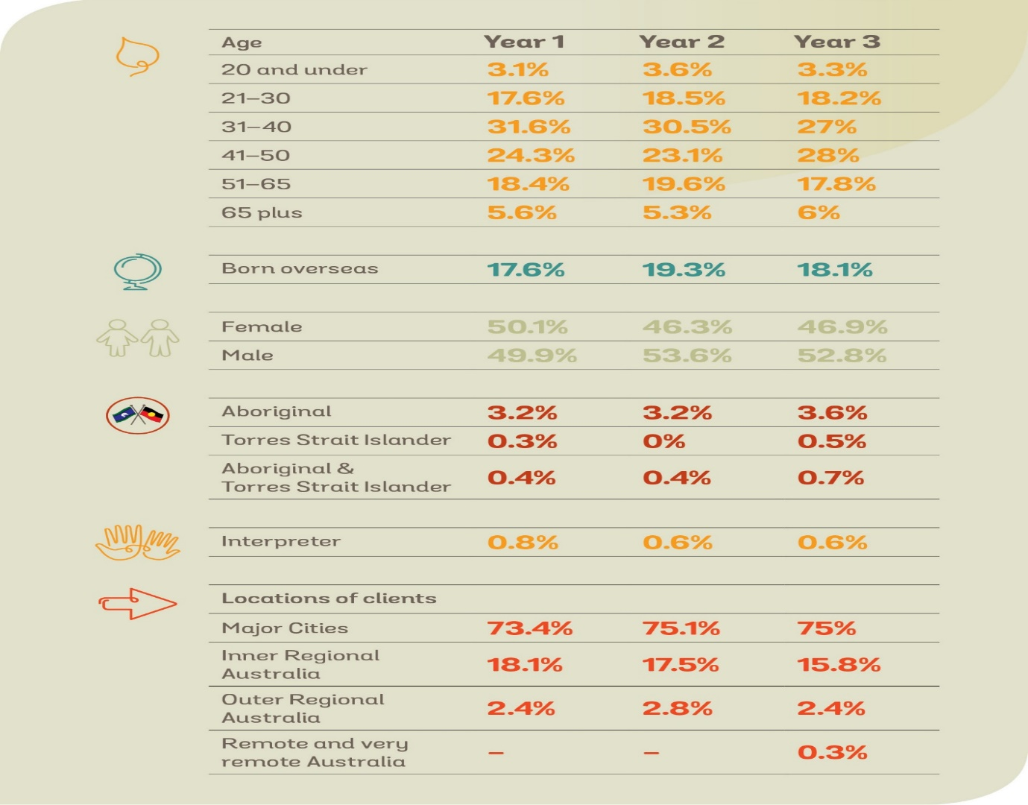
Our First Three Years of Service, cont.

Slide 11
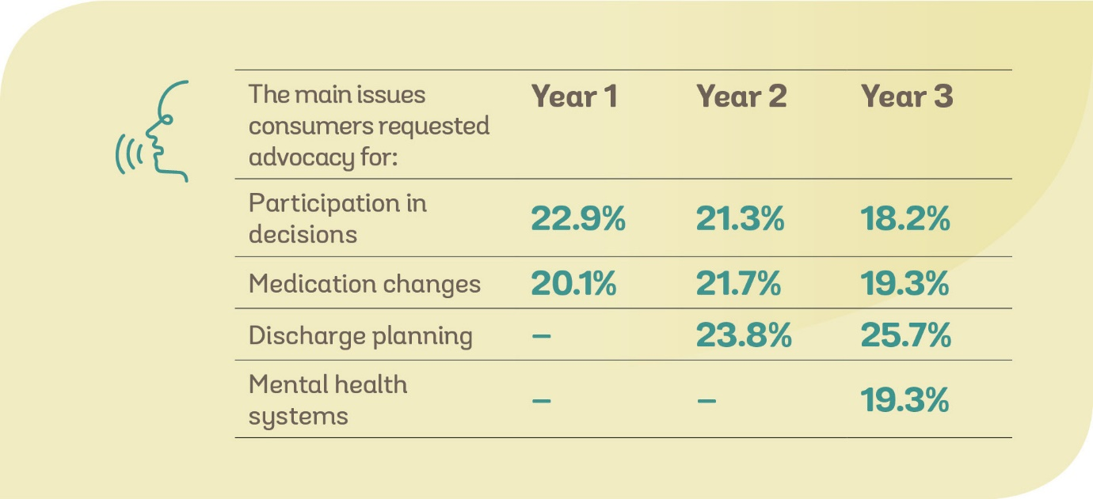
Our First Three Years of Service, cont.

Slide 12
IMHA: Eligibility
Free service
All people on compulsory treatment orders
Graduated levels of service based on priority indicators
Notes:
Priority Clients- A&TSI, CALD, Dual Disability, Assistance with Communication, voluntary inpatients at risk of becoming compulsory, ECT -1st time, subject to restrictive interventions e.g. bodily restraint, seclusion, people in SECU, experiencing homeless
In early phase- significant outreach at inpatient facilities and community settings
Connecting with people who may not feel able/inclined to approach
Providing information via IMHA website and inquiry line to family members & carers – provide information to anyone who contacts IMHA

Slide 13
IMHA :Thinking about making a referral?
Is the person:
on a compulsory treatment order?
needing advocacy around an issue to do with their mental health assessment, treatment and recovery?
needing issue-specific, time limited advocacy – not ongoing support?

Slide 14
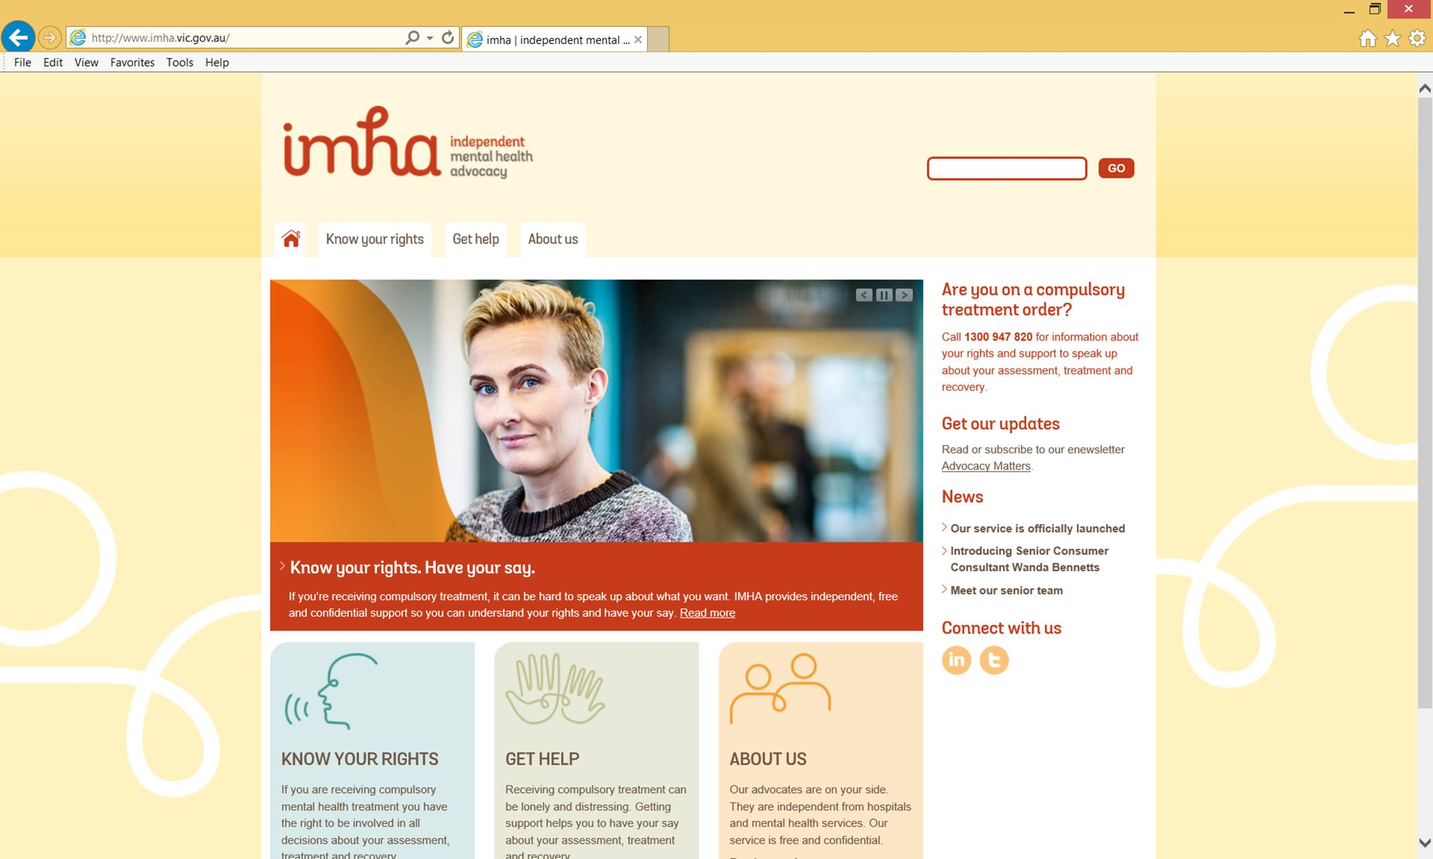
IMHA referrals
IMHA phone line on 1300 947 820
(9.30am - 4.30pm, Monday to Friday)
www.imha.vic.gov.au
contact@imha.vic.gov.au
Notes:
Entry points include a phone line staffed by Advocates, outposts and a website
IMHA inquiry line staffed by an IMHA advocate – information provision open to all, consumers, service providers, carers and support people

