Slide 1













Thank you to our Sponsors
#EquallyWellAu22
Notes:
Add your name and introduce yourself
Also let people know about following us on social media – all handles on last slide

Slide 2

Equally Well: A Family Affair….
Prof Sharon Lawn
Equally Well Symposium
12-13 March 2022

Slide 3
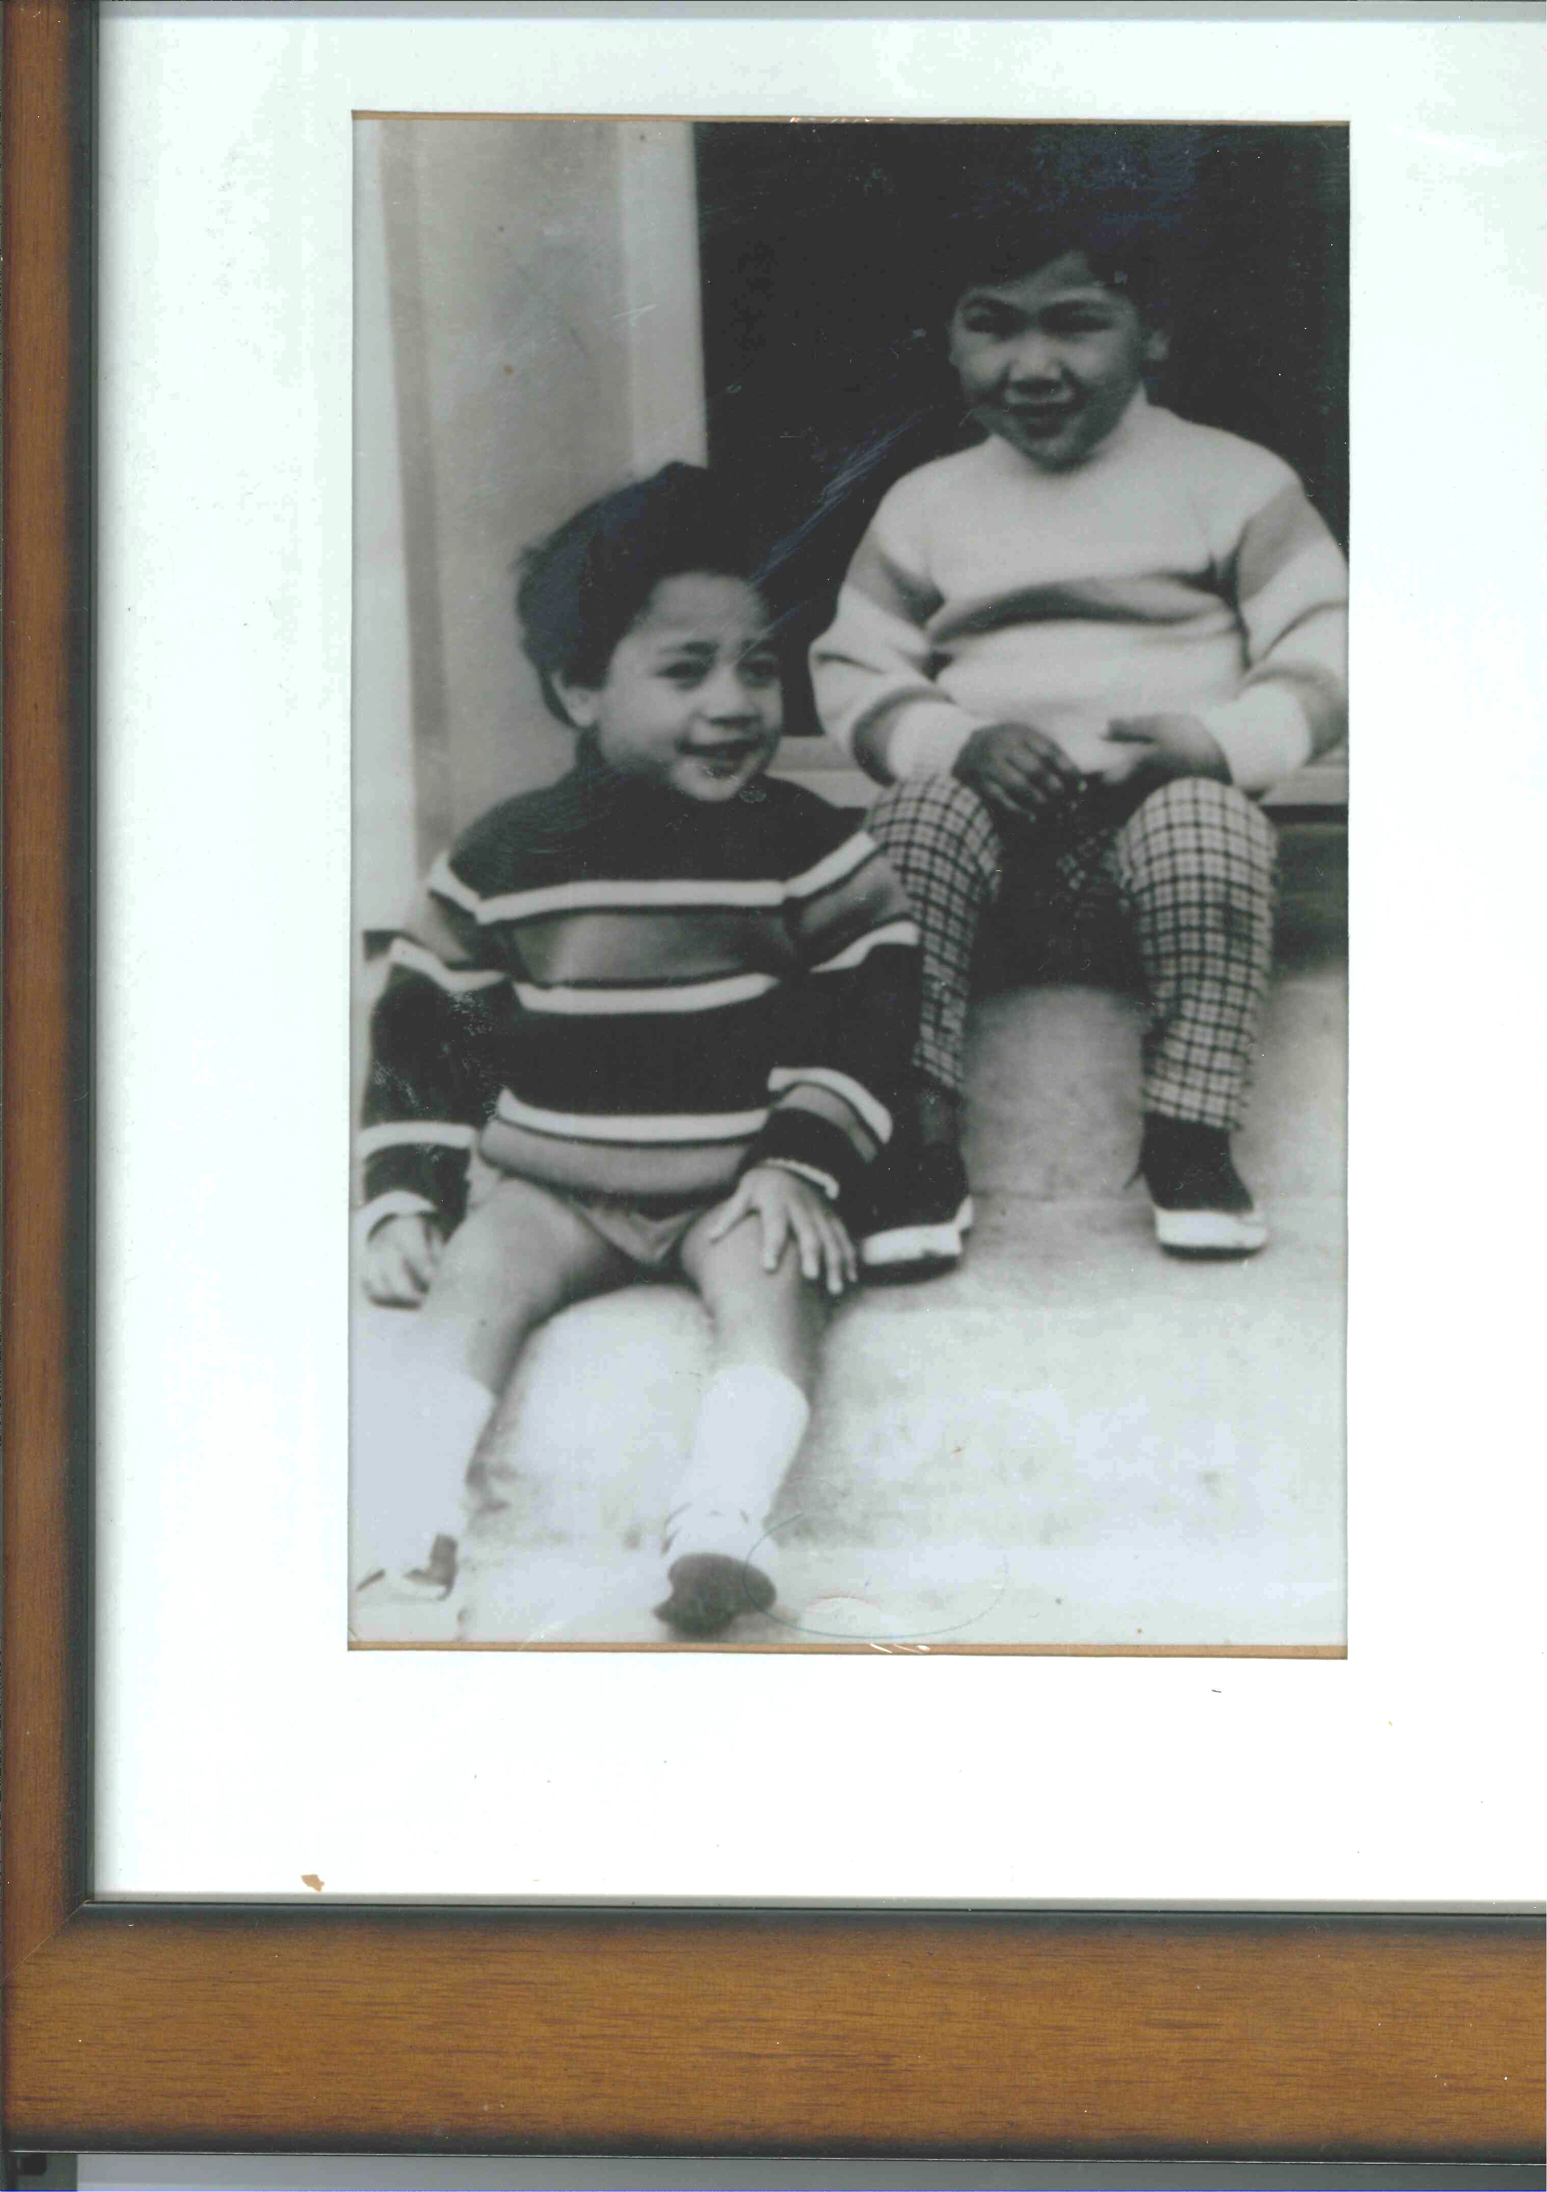

Slide 4
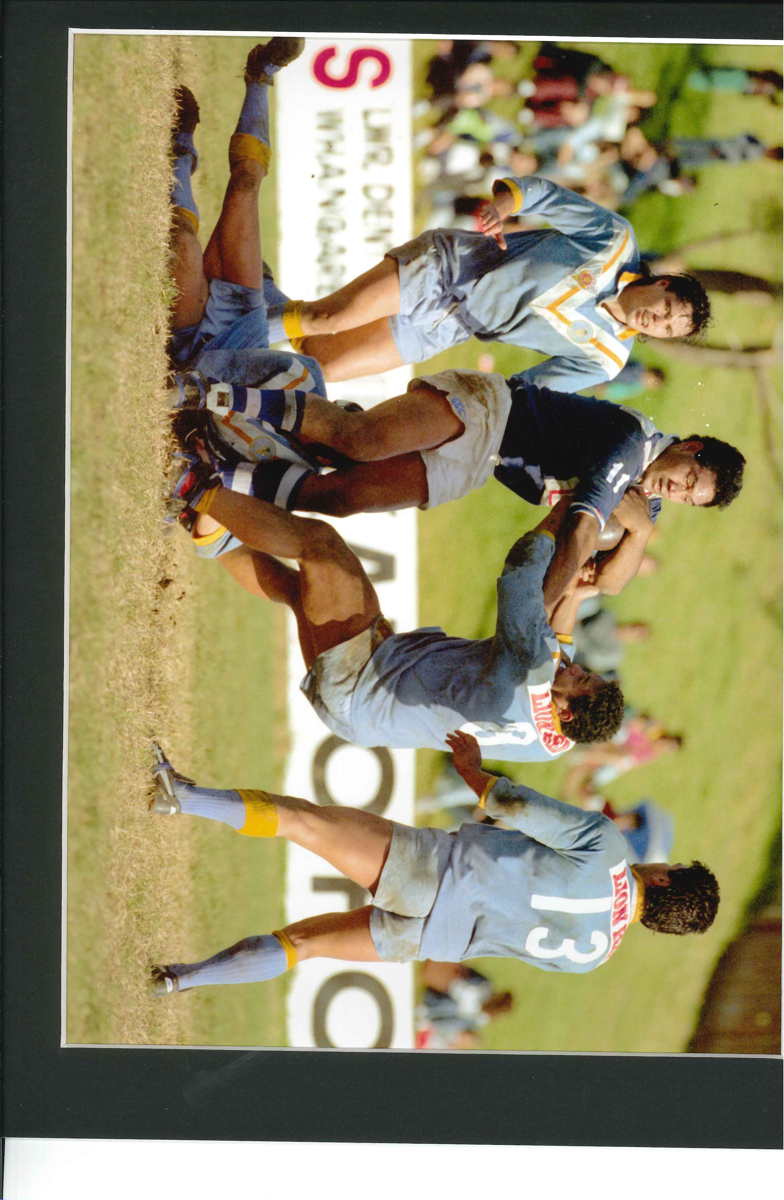


Slide 5
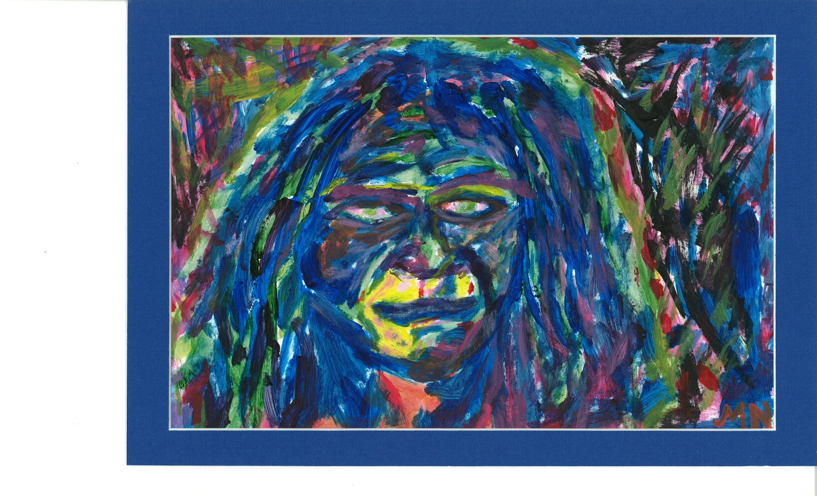

Slide 6
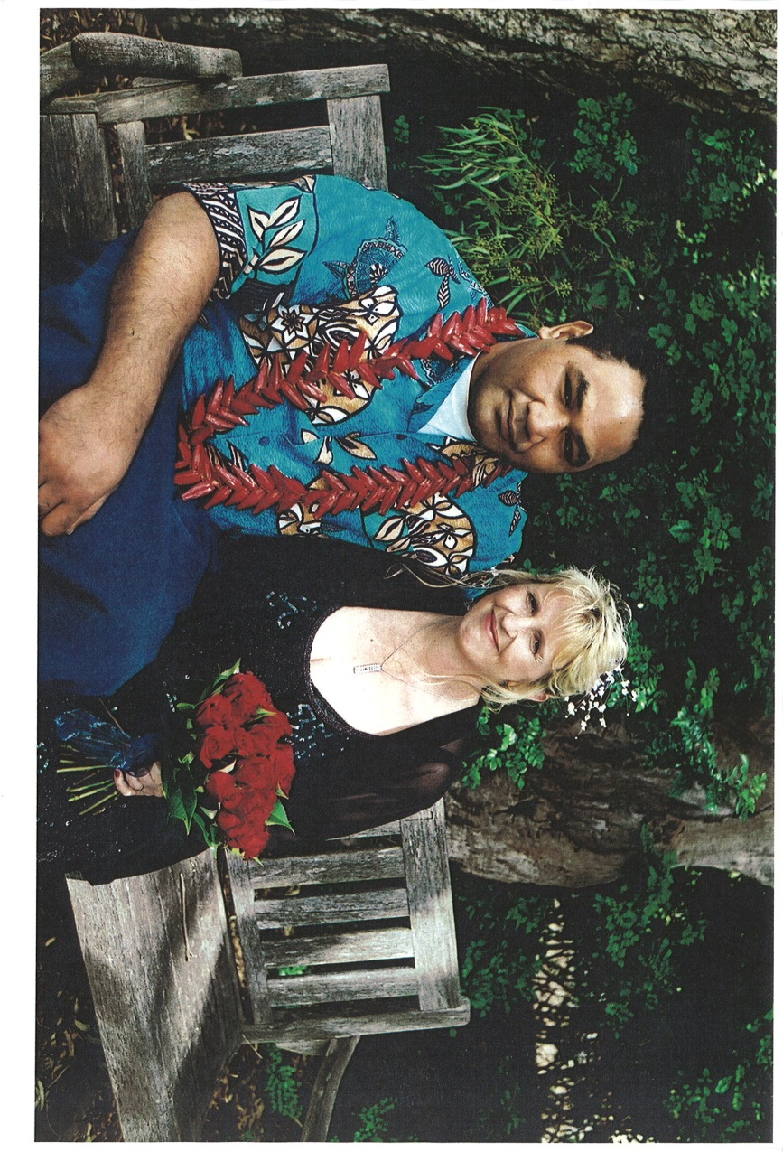
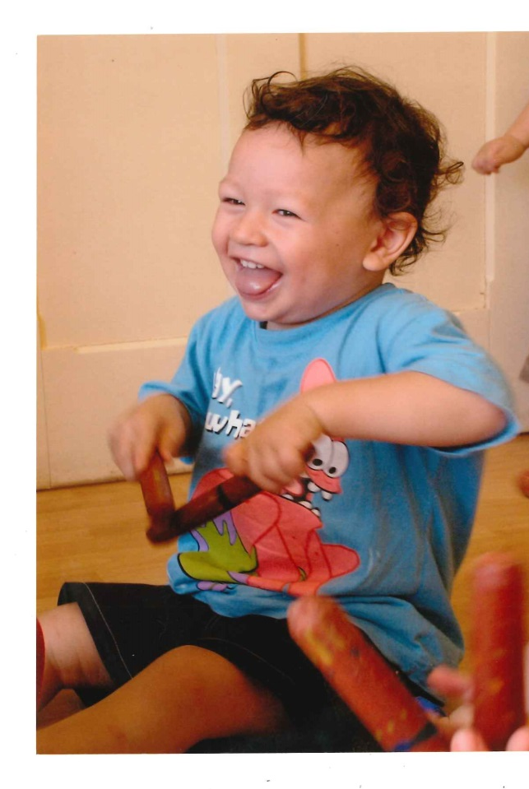
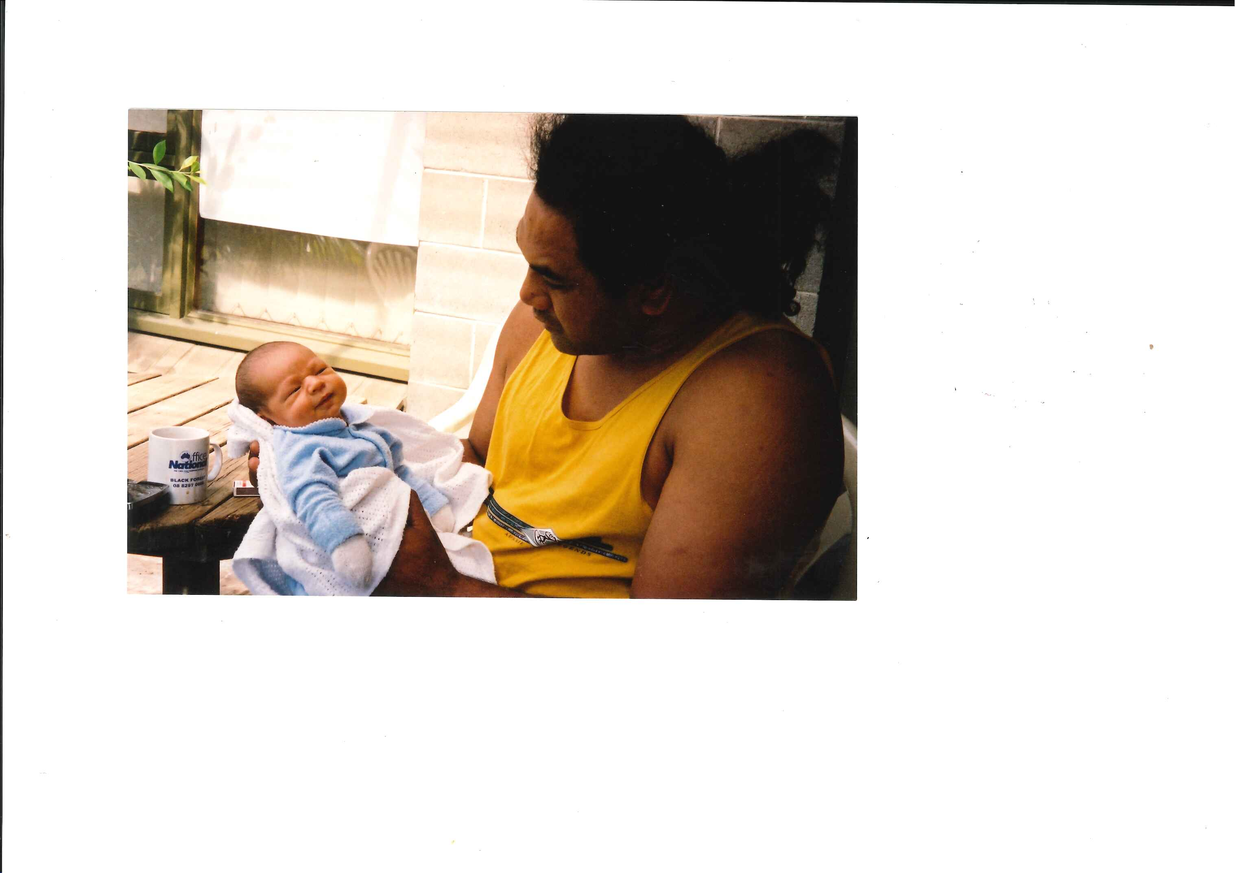

Slide 7
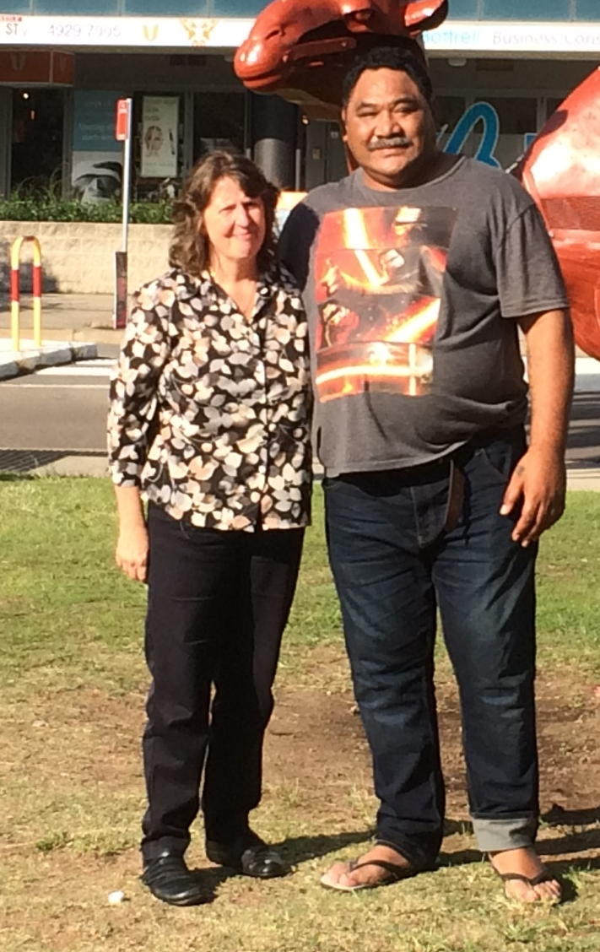
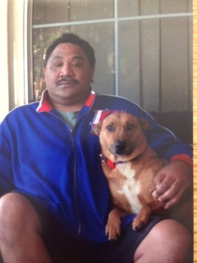
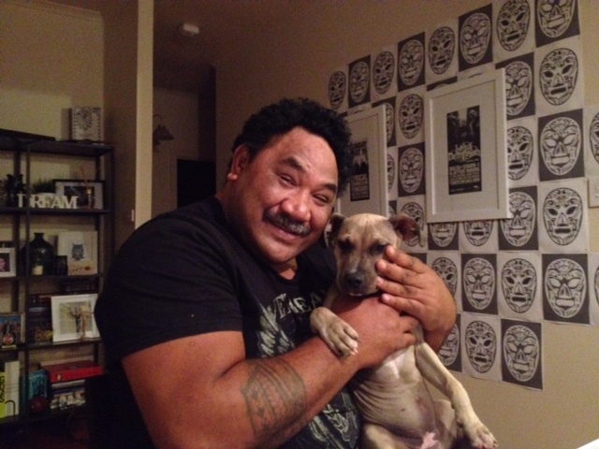

Slide 8
Our family message to you:
Be hopeful and take an interest in more than just the compliance with medications and seeing everything through a diagnostic lens’.
Understand more about what my day is actually like and ask me more about who I am, who I’ve been and help me to draw on that to help me stay motivated, to believe that I can do something about all these problems – Don’t act like you’ve given up, that it’s inevitable and too late.
Walk alongside me. Include my family.
Talk openly with me about my self-esteem and help me grow that. It’s complicated, and the demons from the past are too easily ready to take over my present.
My family help put all these pieces together, when I’m too distressed or just can’t find the words. Listen to them.
Make a ‘living plan’ with me and my family. To measure the small steps and progress, to keep me motivated, and us all accountable. Tell me the outcomes, regularly. Help me feel that I’m taking some control, that it's worth it to keep trying.
Work with me and my family. Don’t keep them sitting in the waiting room or in the car. Help them to remain hopeful, patient, persistent and determined to encourage me with the many small and consistent steps that I need to take every day.
Understand how hard, tiring and anxiety provoking it is to plan ahead, to see beyond that day or that week.
Recognise that people’s physical and mental ill-health does not occur in a vacuum. Families see, feel and experience the consequences every day with the person, often picking up the pieces. Afterall, it’s their life too because it is shared with the person.

Slide 9


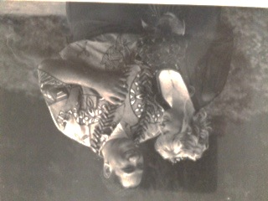





Thank you for Listening
Contacts
LivedExperienceAustralia.com.au
admin@LivedExperienceAustralia.com.au
1300 620 042
Facebook.com/LivedExperienceAustralia
LinkedIn.com/company/LivedExperienceAustralia
Twitter.com/LivedExpAust
Sharon Lawn
Executive Director
slawn@LivedExperienceAustralia.com.au
Mobile: 0459 098 772
Notes:
Sharon

