Slide 1













Thank you to our Sponsors
#EquallyWellAu22
Notes:
Add your name and introduce yourself
Also let people know about following us on social media – all handles on last slide

Slide 2
Leadership and Collaboration: NSW Older People’s Mental Health (OPMH) Physical Health Practice improvement Project
Dr Rod McKay, OPMH Clinical Adviser
Dr Kate Jackson, Director, OPMH Policy
John Stevens, Policy Officer
Mental Health Branch, NSW Ministry of Health
April 2022
Notes:
Note that we have presented on this project at various stages in this journey:
2019 Equally Well Symposium in Melbourne, as we were embarking on the project, with a focus on project context and design
2020 Equally Well webinar series, reflecting on the project approach of ‘building on what we know and what we have’
In this presentation we will focus on the themes of leadership and collaboration, reflecting on:
project design/approach
project implementation
reflections on the journey so far, where we are now and next steps
Note that:
NEAMI and some of our LHD partners are presenting on other aspects of the project today.
Our presentation also includes recorded reflections from Rod McKay (clinical lead), Marcelle Droullers (a CSU project partner) and Michelle XX (an LHD project lead)

Slide 3
Background
Strong evidence to support need to act, but ‘implementation gap’
Building on approach for previous statewide practice improvement project
Policy priority and commitment to Equally Well
Supported by statewide OPMH clinical benchmarking
Strong support from local OPMH service leaders across NSW
“Overall, the number and scope of truly
tested interventions remain limited, and
strategies for implementation and scaling up
of programmes with a strong evidence
base are scarce. ”
Liu et al (2017)
Notes:
2019 reflections at commencement of project were that we need to:
Have specific actions to improve the physical health outcomes of older people with mental illness
Improve the evidence base regarding what works to improve the physical health outcomes of older people with mental illness
Work collaboratively and continually to build trust between partners
Focussed statewide practice improvement work addresses these points
The project recognized that there was strong evidence about the need to improve the physical health of older people with mental illness, but noted the key theme of the 2019 Equally Well symposium about the so-called ‘implementation gap’ in terms of evidence about ‘what works’ to address this (as per quote from Liu)
Other key context was:
Recognition of improving the physical health of people with mental illness as a policy priority (both in NSW and nationally), and NSW Health’s commitment to Equally Well
Identification of physical health assessment and care as a practice improvement priority within statewide OPMH benchmarking processes
Support for a statewide OPMH physical health practice improvement from LHD OPMH service leaders across NSW
Opportunity to build on project approach from a previous statewide OPMH practice improvement project, focused on promoting recovery-oriented practice in NSW OPMH services
There is substantial evidence in Australia and internationally that the risk factors for chronic physical disease are higher among people living with severe and persistent mental illness than in the general population. Older people with mental illness experience disadvantage in accessing appropriate physical health assessment and care, and experience poorer physical health and earlier mortality than the general population. This is particularly so for people who grow older with a continuing experience of severe and persistent mental illness, compared with older people who have developed mental illness in later life and generally have a history of better health care management.
The project supports state and national policy, population health and practice improvement priorities including NSW OPMH Service Plan 2017-2027 , Fifth National Mental Health and Suicide Prevention Plan, the National Mental Health Commission’s Equally Well Consensus Statement, and the NSW Mental Health Strategic Framework and Workforce Plan and the recently published NSW health guideline Physical Health Care for People Living with Mental Health Issues.
The project supports NSW Health's commitment to Equally Well
The OPMH physical health care practice improvement project has developed from OPMH benchmarking discussions and policy work indicating the need for new strategies to improve physical health assessment and care for consumers of OPMH services. NSW OPMH annual benchmarking self-audit findings indicate that OPMH services are challenged by a number of standards relating to physical health care including the involvement of GPs, physical examination of older consumers in the community and action about falls prevention (especially in the community). The NSW OPMH Community Model of Care Evaluation confirms that OPMH community services are experiencing challenges related to physical health assessment and accessing skilled staff for assessment and management (physios, dieticians, GPs).
The project was endorsed by the OPMH Services Advisory Group, which has representation from all LHD OPMH services. There is strong interest in membership of the project steering group. This interest ensured buy in from local health districts before any major planning for the project took place

Slide 4
Project approach – built on leadership and collaboration
Builds on previous work using a similar approach
Aims to promote practice improvement within OPMH services and through OPMH service collaboration with consumers, carers and service partners
Undertaken within existing resources using an opt-in, ‘start where you can’ approach
State-level leadership from project team and steering group to guide and support projects across NSW
Local leadership from project champions and supporting managers, and CMO project leads
Collaboration at state and local levels, leveraging strengths of consumers, carers, key stakeholders and project partners
Encourages consumer consultation and collaboration, and ideally co-design
Encourages evaluation through research collaboration
McKay Roderick, Jackson Kate, Stevens John (2021) Implementing recovery-oriented practice in older people’s mental health services: the NSW experience. Australian Health Review. https://doi.org/10.1071/AH21155
Notes:
The project was build on a previously successful model used to improve recovery oriented care in NSW OPMH services, see McKay Roderick, Jackson Kate, Stevens John (2021) Implementing recovery-oriented practice in older people’s mental health services: the NSW experience. Australian Health Review and the related project report that can be found on the NSW Health website
The project was undertaken with no additional resources, leveraging on the passion and commitment for change by our key stakeholders.
We acknowledged early on that different LHD services were at different stages of readiness, and so a ‘start where you can’ approach was adopted, with the scope and scale of projects being undertaken were dictated by each LHDs readiness and resources to commit to the project
The project brought together partners from the academic, NGO and government sectors, seeking to leverage each's strengths to help drive projects towards success
Following endorsement of the project by both LHD coordinators and with the ministry executive, a recruitment drive took place to recruit LHD project champions to develop and initiate local projects that would bring about practice improvement
To support the LHD champions and their projects a state level project team was formed that was an intermediary between a state level expert reference group and the local projects, bringing a panel of experts together to provide support and advice to each of the LHD projects.

Slide 5
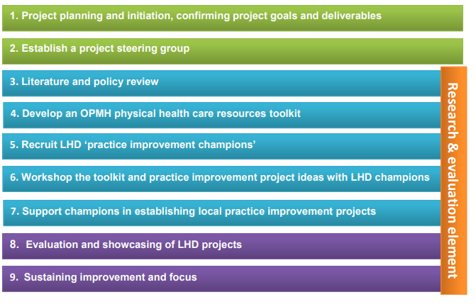
A staged approach to implementation
……
Notes:
Outline the staged approach to implementation, reflecting on how building and sustaining leadership and collaboration was part of project design

Slide 6
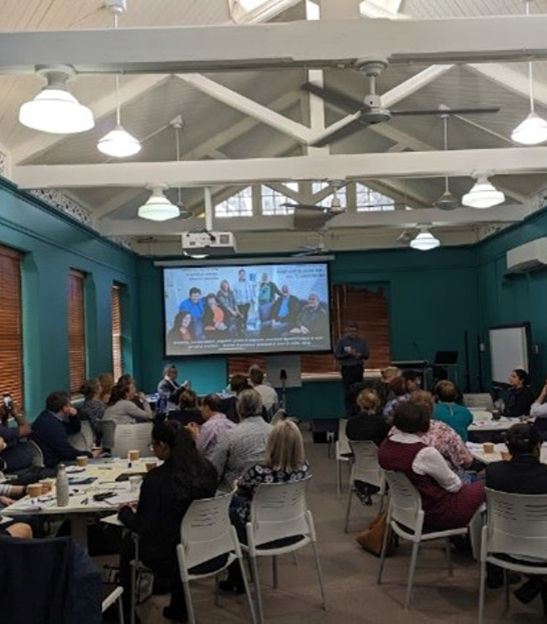
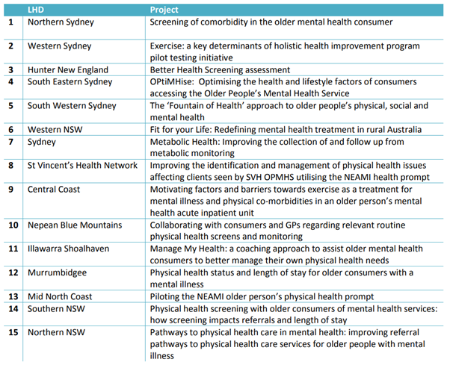
Implementation
Notes:
Following the recruitment of local project champions we:
Ran a workshop to support LHDs in the development of their projects,
Drafted a project tool kit with resources to support this process
Established access to an online data analytics platform for quality improvement for projects to access
Linked LHD teams with academic and NGO partners
Provided 1:1 support as needed from the project team
Facilitated bimonthly project steering group meetings to guide both the statewide and local project leads with expert advice from OPMH clinical services, Equally Well and research/academic partners, General Practice, CMOs, consumer, carer and peer worker representatives
Published regular project communiques to build and sustain support for the project, including from LHD mental health service leaders
Subgroups of projects emerged from the workshops and we facilitated subgroup meetings to help similar LHD projects collaborate, support each other and discuss ideas, challenges and successes
Over a 5 month period, each of the LHDs had committed to this table of projects. As we will see later, not all 15 projects were able to progress, but we had a very strong starting point to progress projects that would improve the physical health outcomes across NSW OPMH services and OPMH service partnerships

Slide 7
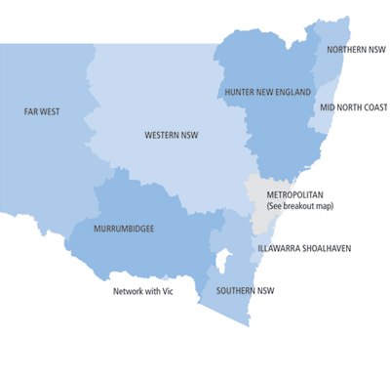
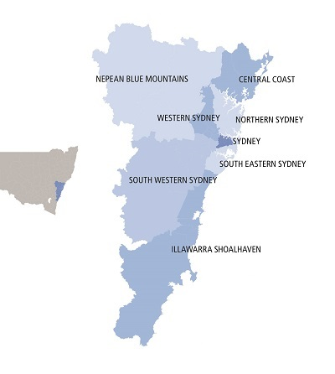
Participating teams across NSW
Notes:
This is truly a statewide project, as you can see, we have engagement from across the state

Slide 8

COVID-19 impacts
Rapid shift in priorities of OPMH services and project partners
Workforce changes and challenges, reducing staff resources
LHD project champions redeployed into new roles, disrupting local leadership and collaboration
Lockdowns and restrictions affected how services/project teams could engage with consumers of services
Timeframes for the project had to be extended
COVID disrupted project processes, increasing the complexity of leadership and collaboration

Slide 9
Where we are now?
SVHN, Murrumbidgee, Mid-North Coast, Northern NSW, South Eastern Sydney, Southern NSW and Sydney LHDs | NEAMI physical health prompt
Nepean Blue Mountains LHD | Flourish physical health prompt
South Western Sydney LHD | The ‘Fountain of Health’ approach to older people’s physical, social and mental health
Western NSW LHD | Fit for your Life: Redefining Mental Health Treatment in rural Australia
Northern Sydney LHD | Screening of comorbidity in the older mental health consumer
Central Coast LHD | Motivating factors and barriers towards exercise as a treatment for mental illness and physical co-morbidities in an older persons mental health acute inpatient unit
Western Sydney LHD | Exercise a key determinants of holistic health improvement program pilot testing initiative
South Eastern Sydney LHD | OPtiMHise: Optimising the health and lifestyle factors of consumers accessing the Older People’s Mental Health Service
Illawarra Shoalhaven LHD | Manage My Health: a coaching approach to assist older mental health consumers to better manage their own physical health needs
Many projects underwent a redesign
Several projects joined the NEAMI multl-site trial due to workforce impacts of COVID
Retained all participating LHDs by shifting from 15 projects to 9 projects that are all on track for completion by mid 2022
Two projects completed
Notes:
Now 9 projects (down from 15), but all participating LHDs and CMOs are still engaged in projects
2 completed (see bolded projects)
4 were redesigned and adapted following COVID; two have been rolled into the larger project (multisite trial)
Of the 14 LHD teams participating, 9 had a change of project champion or supporting manager needing minor adjustments to time frames or approach
All 9 projects are on track for completion by mid-2022, with most looking like they can progress to publication

Slide 10
Project reflections: statewide project manager perspective
2019
2020
2021
Establishing and maintaining collaboration
Different motivators Different pressures and ways of working Accustomed to working under different time frames Drawing on strengths and facilitating communication
Managing different impacts on partners due to COVID
Different impacts on health workforce, education workforce and NGO workforce Staff movements Project champions and priorities shifted rapidly Keeping communication lines open until we could reestablish the work
Adjusting project outcomes and timeframes
Being adaptable to the shift in working arrangements and workforce demands Supporting teams to adapt and adjust with project scope and realistic goals Adjusting time frame of the project rather then letting it fail
Notes:
Use these as speaking points

Slide 11
Project reflections: statewide project manager perspective
Communicating progress and celebrating successes
Having the project being ‘start where you can’ allows it to be adaptive if there is a crisis
You can bring about quality improvement during a pandemic
Team building approach across sectors requires commitment
More complexity results in better work but needs persistence, time and support
Establish and manage timeframes
Sustainable change with long term improvements for OPMH
Governance structures
Design project to operate utilizing existing resources
Maintianing momentum
Establish cross sector partnerships
Notes:
Communicating progress and celebrating successes
Having the project being ‘start where you can’ allows it to be adaptive if there is a crisis
You can bring about quality improvement during a pandemic
Team building approach across sectors requires commitment
More complexity results in better work but needs persistence, time and support

Slide 12

Project reflections: statewide policy lead perspective
Creating the right environment for collaboration
Leadership and collaboration are mutually supportive
Policy commitment helps
A distributive leadership approach can be effective in a complex system
Persistence and adaptability are essential
A ‘start where you can’ approach can be adaptable to change
Building strong collaborative initiatives can help with scaling up to other sites
Research partnerships have added complexity, but should lead to publication and help generate further implementation and action
Notes:
Creating the right environment and processes to support statewide practice improvement - established mechanisms encouraging statewide cooperation between OPMH clinicians, service managers, policy makers and key stakeholders/partners have been significant facilitators of engagement in practice change (as per OPMH recovery project).
Leadership is partly about communicating an aim and vision, and engaging people in working together to achieve that aim and vision. Leadership has can’t achieve anything without collaboration. This project confirms that.
Policy commitment was important in establishing initial support for the project, and in maintaining support amidst many challenges to progressing the project.
A distributive leadership approach, involving both state-level and local level/service partner leadership, has kept the project on track (as per OPMH recovery project) in the context of a complex adaptive system of health and mental health care.
This project is ambitious in the number of leaders it has involved and the extent/scope of collaboration (statewide, LHD and CMO, research partners etc), and the pandemic has added further complexity. Persistence and adaptability have been essential.
The ‘start where you can’ approach meant that local projects were more adaptable to change as the pandemic altered the personnel, workforce and resources to progress the project changed in the context of the pandemic. With staffing changes and limitations and project delays, some projects have had to ‘restart where they could’ at various points in time.
Leveraging the leadership, investment and collaborative design of one project (NEAMI physical health prompt) to offer LHDs with limited local capacity the opportunity to participate in a multi-site trial has helped maintain statewide participation.
Adding the research partnership and collaboration to the project approach (building further on the OPMH recovery project and noting the need to address the gap in the implementation literature) added to the complexity of the project, but should/will ultimately lead to greater publication. This may in turn build further implementation and action.

Slide 13
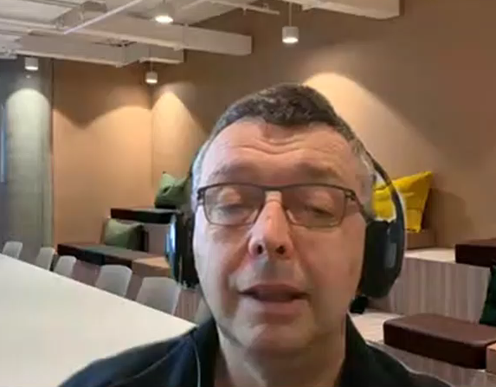
Project reflections: statewide clinical lead perspective Adjunct A/Prof Rod McKay – Clinical Advisor OPMH Policy Unit
Notes:
Rod’s points

Slide 14
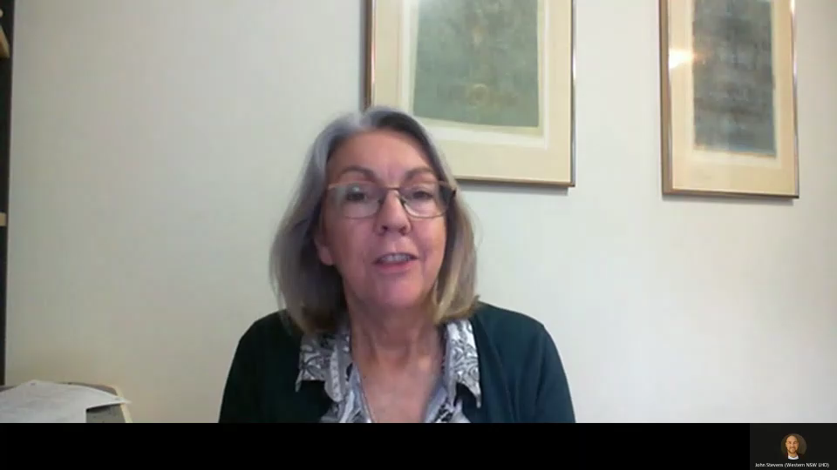
Project reflections: research partner perspective Marcelle Droulers – Charles Sturt University
Notes:
Marcelle’s points

Slide 15
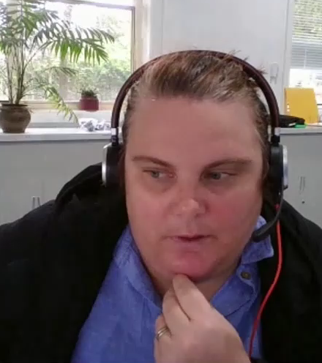
Project reflections: local project lead perspective Michelle Johnson – Nepean Blue Mountains LHD
Notes:
Michelle/Gabe’s points

Slide 16
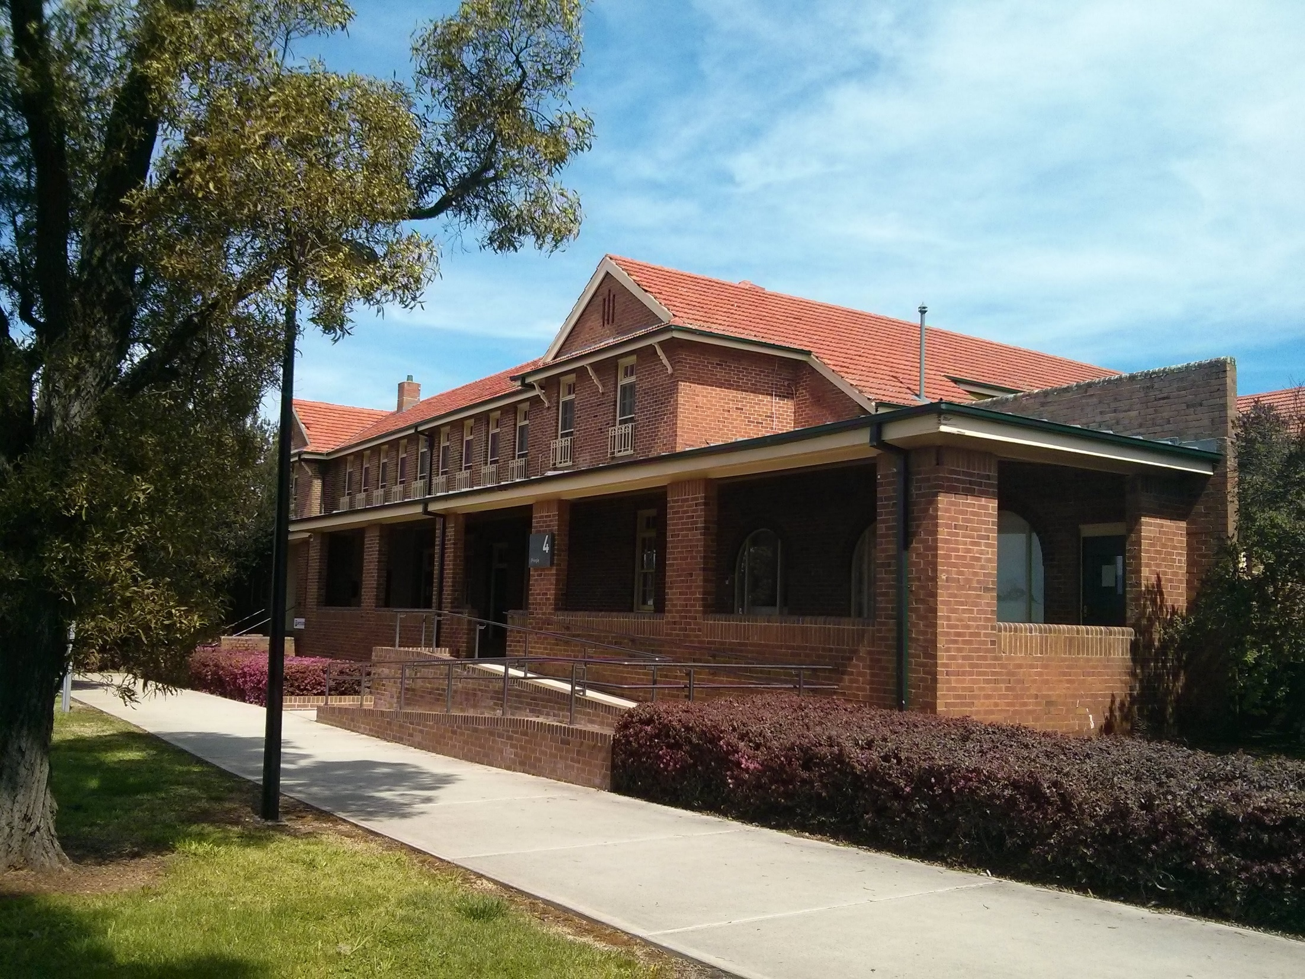
Next steps
Local/collaborative projects cover a range of areas including:
screening and assessment
exercise/physical activity
empowering older people around their physical health
Next steps are to support all projects to complete their projects and publish their project outcomes
Statewide project report (NSW Health) and statewide project evaluation (CSU)
Showcase event/s and communication strategy
Scaling up/promoting successful strategies and sustaining effort
Notes:
At the beginning of this project, and in our 2019 Equally Well symposium presentation, we highlighted a number of areas for potential focus, based on the evidence, our policy and benchmarking work, and our consultation advice:
Improving assessment and treatment in known physical health risk areas (eg cardiovascular conditions, obesity, diabetes)
Looking within OPMH services at attitudes to physical health care and collaborative care, staff skills and staffing profiles, collaboration (esp. with GPs), advice to consumers on physical health issues
Empowering older people with mental illness around their physical health
Across the projects that have been/are being progressed under the statewide practice improvement project, you will see that all of these areas have been taken up. Some of these will be presented at this symposium (eg NSLHD, CCLHD, NEAMI)
Local/collaborative projects cover a range of areas including screening and assessment, exercise/physical activity, and empowering older people around their physical health through physical health prompts
Next steps are to support all projects to complete their projects and publish their project outcomes (local project leads/teams, NSW Health, research partners)
A statewide project report will be prepared to share the project approach and outcomes (NSW Health)
An evaluation of the statewide project is also planned for publication (CSU)
A showcase event and communication strategy are also planned
Ultimately, the focus will be on scaling up/promoting successful strategies and sustaining effort

Slide 17
Questions?
Dr Kate Jackson, Director, OPMH Policy Kate.Jackson@health.nsw.gov.au
John Stevens, Policy Officer
John.Stevens@health.nsw.gov.au
Mental Health Branch, NSW Ministry of Health

